Slide 1
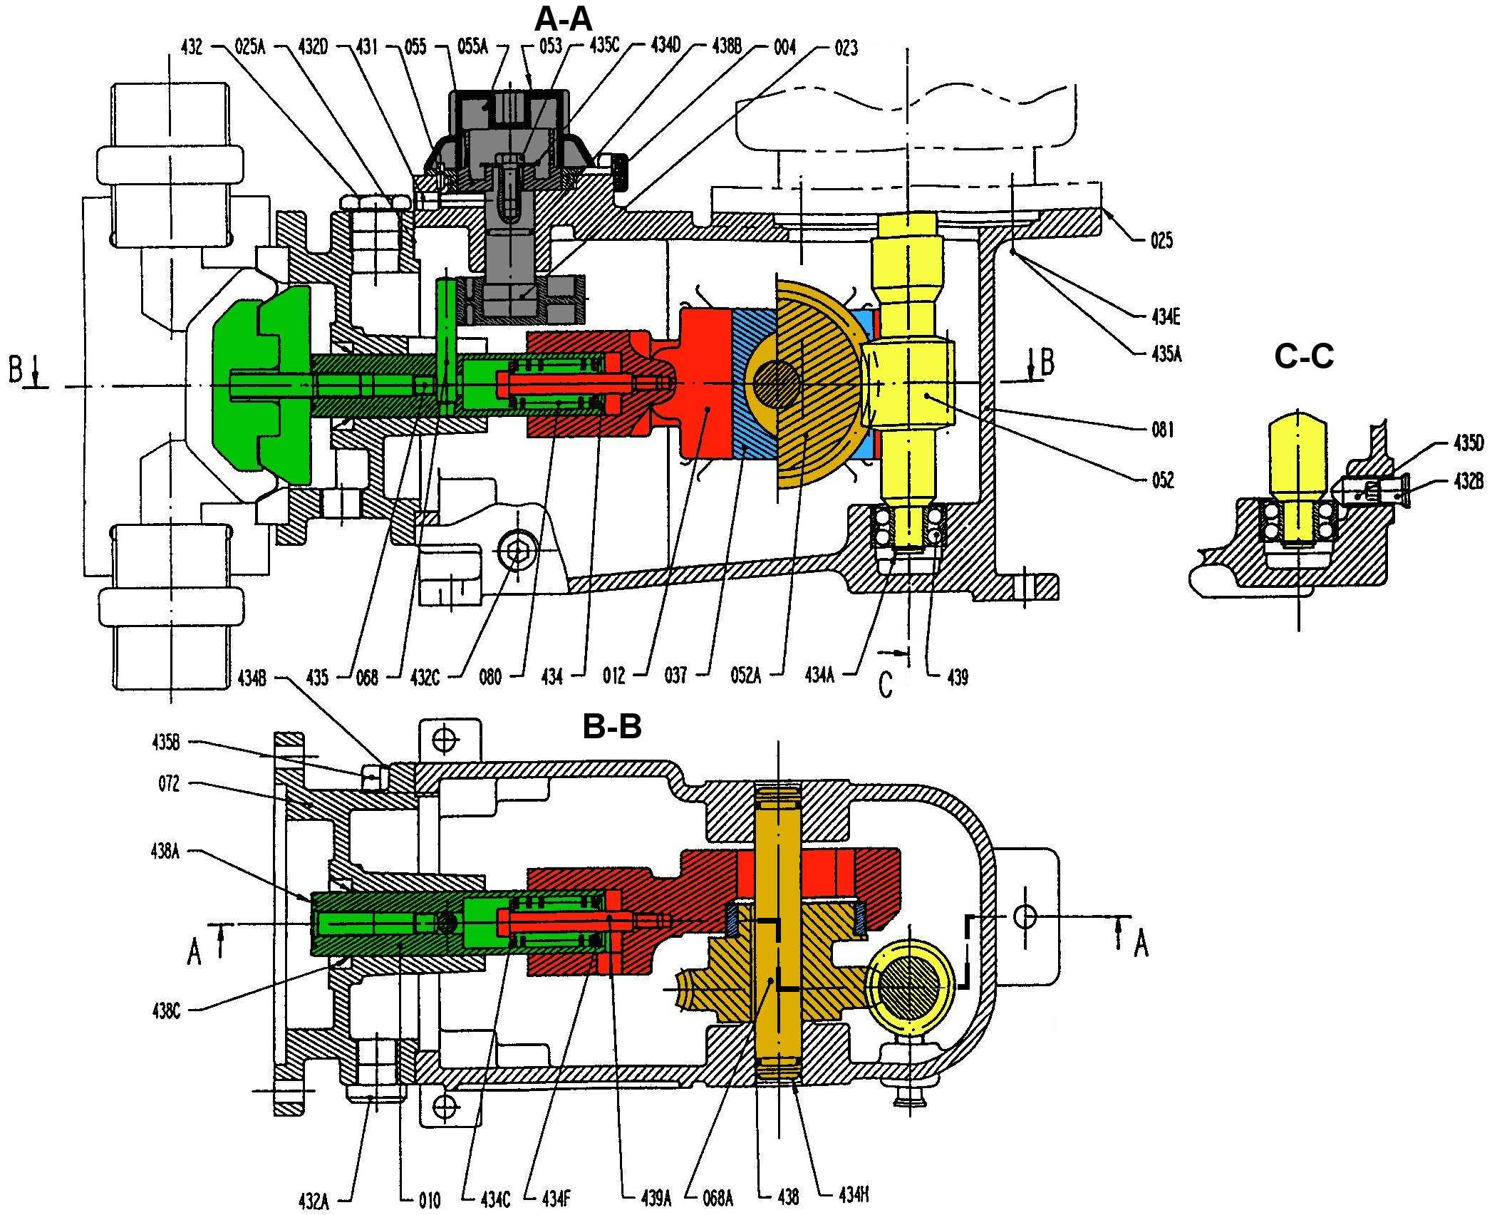

Slide 3



















$$\vec{x_{0}}$$
5
3
1
$$\vec{x_{1}}$$
$$A$$
$$\vec{z_{1}}$$
4
$$θ$$
$$\vec{x_{2}}$$
$$\vec{z_{0}}$$
$$\vec{y_{0}}$$
$$\vec{y_{0}}$$
$$O_{2}$$
$$\vec{y_{0}}$$
5
$$B$$
$$O_{0}$$
$$\vec{y_{2}}$$
$$\vec{x_{2}}$$
0
$$\vec{x_{0}}$$
2
$$φ$$
$$\vec{x_{0}}$$
$$\vec{z_{0}}$$

