Slide 1








$$\vec{z_{0}}$$
$$\vec{y_{2}}$$
1
2
$$B$$
0
$$O$$
$$A$$
$$\vec{x_{1}}$$
$$\vec{x_{0}}$$
$$\vec{y_{0}}$$

Slide 2



$$C$$
$$P$$
$$D$$
$$\vec{z_{0}}$$
$$\vec{y_{2}}$$
1
2
$$B$$
0
$$O$$
$$A$$
$$\vec{x_{1}}$$
$$\vec{x_{0}}$$
$$\vec{y_{0}}$$

Slide 3












$$\vec{y_{1}}$$
$$\vec{y_{0}}$$
$$\vec{z_{2}}$$
$$\vec{z_{1}}$$
$$α$$
$$\vec{x_{1}}$$
$$β$$
$$\vec{y_{2}}$$
$$\vec{z_{0}}=\vec{z_{1}}$$
$$\vec{x_{0}}$$
$$\vec{x_{1}}=\vec{x_{2}}$$
$$\vec{y_{1}}$$

Slide 4








$$\vec{z_{G}}$$
$$\vec{z_{0}}$$
$$φ$$
$$θ$$
$$\vec{y_{T}}$$
$$\vec{x_{G}}$$
$$\vec{x_{T}}$$
$$\vec{y_{G}}$$

Slide 5
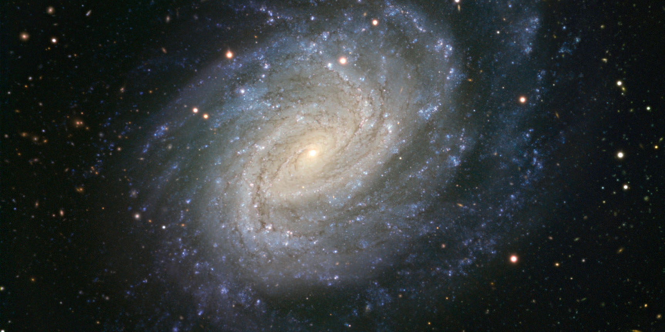
http://www.science-et-vie.com/wp-content/uploads/2012/08/Galaxie_NGC_1187_ESO.jpg

Slide 6
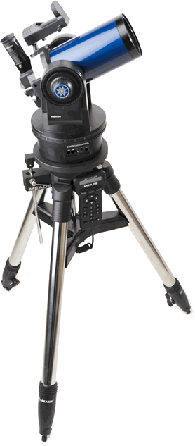
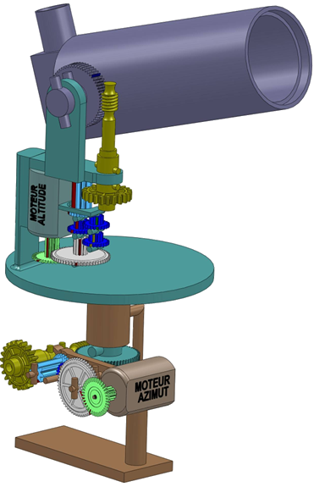

Slide 7
