Slide 1
Introduction to CLIPS
(C Language Integrated Production System)
Prof. Khaled Shaalan
Khaled.shaalan@buid.ac.ae
I-<number>

Slide 2
CLIPS and Knowledge Management
CLIPS is an expert systems building tool
  In development it is used to capture Knowledge
  In usage it is used to apply knowledge
I-<number>

Slide 3
CLIPS: An expert system tool
Tool
  Complete environment for developing expert systems, including integrated editor and debugger
Shell
  Performs inferences and reasoning, i.e. uses the created rule and fact system
freeware expert system tool
The link for the CLIPS web site
  http://clipsrules.sourceforge.net/
Download
  http://sourceforge.net/projects/clipsrules/files/CLIPS/
I-<number>

Slide 4
The CLIPS Programming Tool
History of CLIPS
  Influenced by OPS5 (early OOP language)
  Implemented (source code) in C for efficiency and portability
  Developed by NASA, distributed & supported by COSMIC
  Runs on PC, Mac, also under UNIX and VAX VMS
CLIPS provides mechanisms for expert systems
  A top-level interpreter
  Production rule interpreter
  Object oriented programming language
  LISP-like procedural language
I-<number>

Slide 5
Components of CLIPS
Rule-Based Language
  Can create a fact list
  Can create a rule set
  An inference engine matches facts against rules
Object-Oriented Language
  Can define classes
  Can create different sets of instances
  Special forms allow you to interface rules and objects
I-<number>

Slide 6
Example. Expert system for diagnosing car problems.
Rule 1: IF the engine is getting gas
AND the engine will turn over
THEN the problem is spark plugs
Rule 2: IF the engine does not turn over
AND the lights do not come on
THEN the problem is battery or cables.
Rule 3: IF the engine does not turn over
AND the lights do come on
THEN the problem is the starter motor.
Rule 4: IF there is gas in the fuel tank
AND there is gas in the carburettor
THEN the engine is getting gas
I-<number>

Slide 7
Example. Expert system for diagnosing car problems.
Match
Working space
The engine is getting gas
the engine turns over
Rule 1
Rule 2
Rule 3
Rule 4
Facts
(knowledge we know)
rules
I-<number>

Slide 8
Example. Expert system for diagnosing car problems.
Match
Working space
Rule 1
Rule 2
Rule 3
Rule 4
Agenda
- Rule 1
the engine is getting gas
the engine will turn over
Rule 1
rules
Rule 1: IF the engine is getting gas
AND the engine will turn over
THEN the problem is spark plugs
I-<number>

Slide 9
Example. Expert system for diagnosing car problems.
Act
Working space
Rule 1
Rule 2
Rule 3
Rule 4
Agenda
- Rule 1
the engine is getting gas
the engine will turn over
the problem is spark plugs
Rule 1
rules
facts
Rule 1: IF the engine is getting gas
AND the engine will turn over
THEN the problem is spark plugs
I-<number>

Slide 10
Example. Expert system for diagnosing car problems.
Conflict Resolution
Agenda
- Rule 1
- Rule 4
Working space
The engine is getting gas
There is gas in the fuel tank
There is gas in the carburettor
The engine turns over
Rule 1
Rule 2
Rule 3
Rule 4
facts
rules
Rule 1:
IF the engine is getting gas
AND the engine will turn over
THEN the problem is spark plugs
Rule 4:
IF there is gas in the fuel tank
AND there is gas in the carburettor
THEN the engine is getting gas
I-<number>

Slide 11
CLIPS
(C Language Integrated Production System)
Interpreter uses recognize-act Cycle:
Match - find all rules with matched antecedents
  each combination of facts that satisfies a rule is called an instantiation
  each matching rule is added to the agenda
2. Conflict Resolution - select a rule from the agenda to execute. If none, halt.
3. Act - execute rule performing specified actions
4. Repeat - go back to step 1.
I-<number>

Slide 12
A Production System Cycle
User’s program
Working Memory
(Facts)
Knowledge-Base
(Rules)
Assert/retract/modify
facts
Change rules
1.
Pattern Matching
Agenda
2.
Conflict Resolution
select rule
3.
Fire rule
I-<number>

Slide 13
CLIPS – Programming Systems
CLIPS Editor
  load, save and edit CLIPS program files
CLIPS Interpreter
  enter commands, execute CLIPS programs
Execution-Menu
  set execution parameters (e.g. watch)
Browse-Menu
  manage constructs
I-<number>

Slide 14
CLIPS Data Base
Consists of a list of facts
Each fact:
consists of one or more fields enclosed by parentheses
(x y z)
(> 3 1)
(pen color red)
Three facts with three fields each.
represents a piece of information
used to represent the current state of the problem
is declarative knowledge
First field in a fact should express a relationship
I-<number>

Slide 15
CLIPS Data Base (cont.)
In Clips program:
Initial state of a problem (or the problem domain) is defined by a deffacts
New facts are added by assert
Current facts are displayed by facts
Re-asserted facts are ignored- called Refraction
Old facts are removed by retract
I-<number>

Slide 16
Fields of a Fact
Words (symbols)
A sequence of alphabetic, numeric, underscores, or dash symbols
foo
foo-bar
foo_bar
foo-12
Note that CLIPS is case sensitive
foo is not the same as FOO or Foo
I-<number>

Slide 17
Fields of a Fact (cont.)
Strings
Numbers
A collection of characters within double quotation marks
Strings and words are not equivalent
“cat” is not the same as cat
Are stored in a single precision, floating point representation
237 237.0 2.37E+2
are all the same!
I-<number>

Slide 18
Example Facts
(foo 1286 “this is field 3”)
(this is a fact with 7 fields)
(“This is a facts with 1 field - a string”)
(animal-is walrus)
(animal-is duck)
(animals-are duck horse cow)
(said duck “quack”)
(address 1000 main st)
(address 1000 “main st”)
(address “1000 main st”)
Address with diff. no. of fields
I-<number>

Slide 19
ordered Facts
Use the first field to describe relationship between subsequent fields:
Use object-attribute-value and attribute-value formats:
(<relation> <field-1> <field-2> …)
(person l-name smith
f-name john
ssn 123457689
dept engineering)
Relation
attribute
value
I-<number>

Slide 20
Asserting and Retracting Facts
Actions:
clips>
The data base: use (facts) to show data base)
f-0
f-1
f-2
(reset) ; you may use Ctrl-E
clips>
(assert (plays ivan tennis))
clips>
(assert (plays martina tennis))
clips>
(retract 1)
clips>
(assert (plays martina tennis))
FALSE
clips>
(initial-fact)
(plays ivan tennis)
(plays martina tennis)
No Change!
Refraction
I-<number>

Slide 21
Asserting multipe Facts
Actions:
clips>
The data base: use (facts) to show data base)
f-0
f-1
f-2
f-3
(reset)
clips>
(assert (a) (b) (c))
clips>
(initial-fact)
(a)
(b)
(c)
I-<number>

Slide 22
Linking Facts through Common Fields
Sometimes it is advantageous to create multiple facts logically linked together by a common field:
(person ssn 123456789 l-name smith
f-name john dept engineering)
(personal ssn 123456789 age 31
height 71 weight 175
sex male m-status single)
(financial ssn 123456789 salary 45000
title senior-engineer)
Same Person
I-<number>

Slide 23
Why Link Facts through Common Fields?
(machine id m-1 status idle cur-order none)
(machine id m-2 status idle cur-order none)
…
(machine id m-10 status idle cur-order none)
(order id o-1 status waiting requires m-1)
...
(order id o-9 status waiting requires m-8)
Now envision rules:
IF order waits for a specific machine and
the machine is idle
THEN assign order to machine and
change status of order to assigned and
change status of machine to busy
I-<number>

Slide 24
CLIPS Notation
Symbols other than those delimited by < >, [ ], or { } should be typed exactly as shown.
  E.g degfacts
[ ] mean the contents are optional
  E.g [comment]
and < > mean that a replacement is to be made.
  E.g deffacts <anyname>
I-<number>

Slide 25
CLIPS Notation
A Description followed by * means that the description can be replaced by zero or more occurrences of the specified value.
  E.g. <facts> * zero or more facts
A Description followed by + means that the description can be replaced by one or more occurrences of the specified value.
  E.g <file name>⁺ one or more file name
A vertical bar | indicates a choice among one or more of the items separated by the bars.
  E.g. +|plus indicates plus sign or the word plus
I-<number>

Slide 26
Control of Fact Base: Deffacts Construct
The deffacts construct can be used to assert a group of facts.
(deffacts <deffacts name> [optional comment]
<facts> * )
The reset command is used to assert the facts in a deffacts statement.
I-<number>

Slide 27
Control of Fact Base
Undeffacts
Load
removes specified deffacts statement from memory
(undeffacts <deffacts-name>)
Note that CLIPS provides a special deffacts statement:
(deffacts initial-fact
(initial-fact) )
used to load file containing knowledge base into memory. It does not execute the deffacts statement(s)
(load “myfile-name”)
I-<number>

Slide 28
How Do These Work
Load places information from a file into memory storage
Reset takes information in memory storage and creates material needed for program
Undeffacts removes information from memory storage
memory
(load “file”)
storage
program
(reset)
(undeffacts “X”)
file
facts
file
facts
(reset)
rules
I-<number>

Slide 29
Entering / Exiting CLIPS
The CLIPS prompt is: CLIPS>
This is the top-level mode where commands can be entered.
To exit CLIPS, one types: CLIPS> (exit) 
CLIPS will accept input from the user / evaluate it / return an appropriate response:
CLIPS> (+ 3 4)  → value 7 would be returned.
I-<number>

Slide 30
Example
Assume the following is in the file “mfile”:
(deffacts initial-machine-configs
(machine id m-1 status idle)
(machine id m-2 status idle)
(machine id m-3 status idle))
We now enter the following commands:
clips> (load “mfile”)
clips> (reset)
clips> (facts)
What’s in memory?
f-0 (initial-fact)
f-1 (machine id m-1 status idle)
f-2 (machine id m-2 status idle)
f-3 (machine id m-3 status idle)
I-<number>

Slide 31
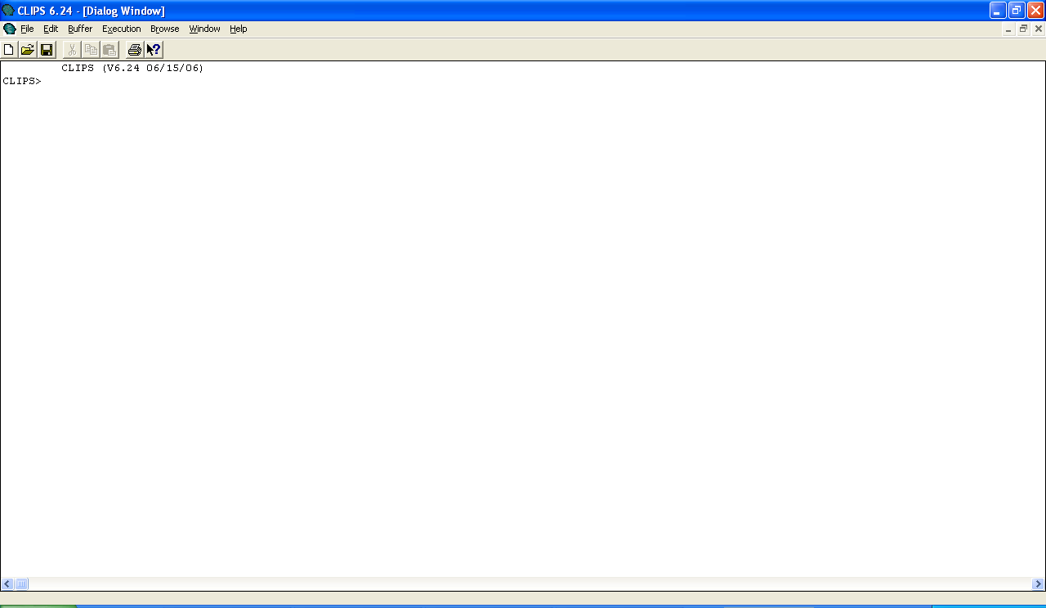
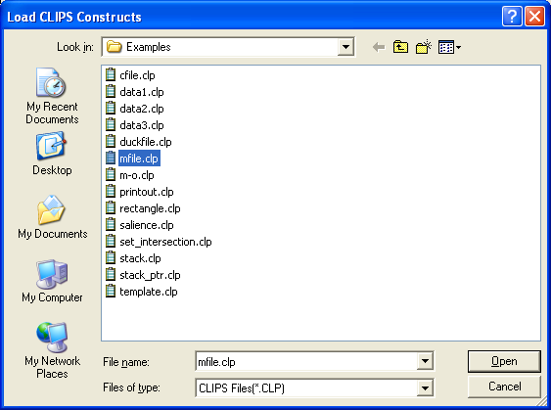
clips> (load “mfile”)
I-<number>

Slide 32
clips> (reset)
I-<number>

Slide 33
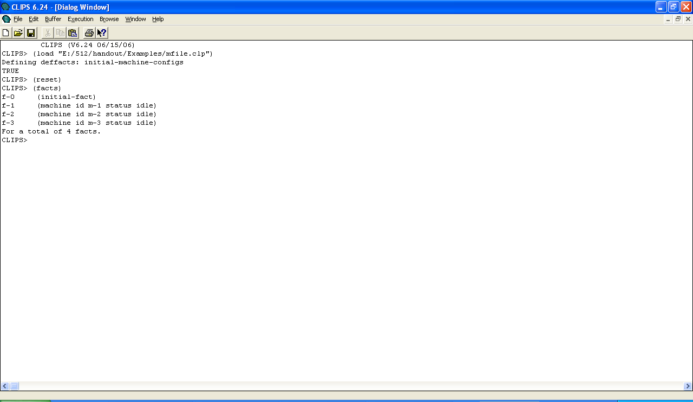
clips> (facts)
I-<number>

Slide 34
Example (cont.)
Now we enter:
clips> (undeffacts initial-machine-configs)
clips> (facts)
What’s in memory?
f-0 (initial-fact)
f-1 (machine id m-1 status idle)
f-2 (machine id m-2 status idle)
f-3 (machine id m-3 status idle)
What about now entering:
clips> (reset)
clips> (facts)
What’s in memory?
f-0 (initial-fact)
f-1
f-2
f-3
I-<number>

Slide 35
Deftemplate
Before facts can be constructed, CLIPS must be informed of the list of valid slots for a given relation name.
A deftemplate is used to describe groups of facts sharing the same relation name and contain common information.
I-<number>

Slide 36


Deftemplate General Format
I-<number>

Slide 37
Deftemplate vs. Ordered Facts
Facts with a relation name defined using deftemplate are called deftemplate facts.
Facts with a relation name that does not have a corresponding deftemplate are called ordered facts – have a single implied multifield slot for storing all the values of the relation name.
I-<number>

Slide 38
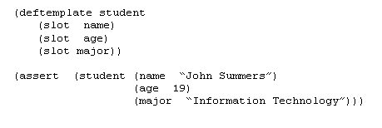
Adding (asserting) Facts
CLIPS store all facts known to it in a fact list.
To add a fact to the list, we use the assert command.
I-<number>

Slide 39
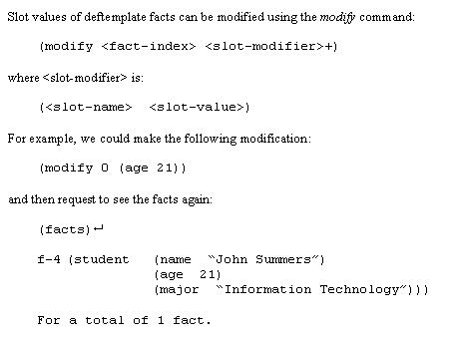
Modifying Facts
Slot values of deftemplate facts can be modified using the modify command:
I-<number>

Slide 40
Results of Modification
A new fact index is generated because when a fact is modified:
  The original fact is retracted
  The modified fact is asserted
The duplicate command is similar to the modify command, except it does not retract the original fact.
I-<number>

Slide 41
Watch Command
The watch command is useful for debugging purposes.
If facts are “watched”, CLIPS will automatically print a message indicating an update has been made to the fact list whenever either of the following has been made:
  Assertion
  Retraction
I-<number>

Slide 42
Watch example (give it a try!)
CLIPS> (watch facts)
CLIPS> (reset)
==> f-0 (initial facts)
CLIPS> (deftemplate student (slot name) (slot age) (slot major))
CLIPS> (assert (student (name "John Summers")
(age 19) (major "Information Technology")))
==> f-1 (student (name "John Summers")
(age 19) (major "Information Technology"))
<Fact-1>
I-<number>

Slide 43
Watch example
CLIPS> (modify 1 (age 21))
<== f-1 (student (name "John Summers")
(age 19) (major "Information Technology"))
==> f-2 (student (name "John Summers")
(age 21) (major "Information Technology"))
<Fact-2>
I-<number>

