Slide 1

Gradient modelling of spatial metabolomics
Methods and Reproduction
BC-515: library calls and implementations from scratch
Yuanhua Huang
2026/9/7
Notes:
We will use one breast cancer section, BC-515, to work through MET-MAP and SIGMA. For each method, we will run the library version and then examine the same calculation written directly in a notebook. The four notebooks already contain their outputs, so we can connect each step of the code to the resulting maps and numerical summaries.
Course files: README.md, 01_METMAP_library.ipynb, 02_SIGMA_library.ipynb, 03_METMAP_from_scratch.ipynb, 04_SIGMA_from_scratch.ipynb.

Slide 2
MET-MAP and SIGMA answer different spatial questions
 | MET-MAP | SIGMA
Question | Which continuous spatial gradients explain MSI variation? | How does MSI vary around a learned pathological interface?
Training information | MSI and spatial coordinates | MSI, coordinates, label anchors and an RNA target in this run
Main output | Three continuous isodepths and MSI reconstruction | Region score, boundary spots and signed distance
The lesson follows each method from input arrays to the saved BC-515 results.
2
Notes:
MET-MAP asks which continuous spatial gradients explain the measured metabolic variation. It learns from MSI intensities and spatial coordinates. SIGMA uses a different reference: a pathological interface learned with Tumor and Stroma labels. In this BC-515 run, it also uses the first 32 Harmony dimensions as an RNA target.
MET-MAP produces learned spatial coordinates. SIGMA produces a region score and distance from its estimated boundary. Each loss measures a different objective, so comparing the two loss values would not tell us which method performs better.
Sources: vendor/MET-MAP/src/multi_gaston/multi_gaston.py, upstream commit 43c9386ffe7d5b2f0f66d64d4820358c3cd8a11c, vendor/SIGMA/src/sigma_spatial/.

Slide 3
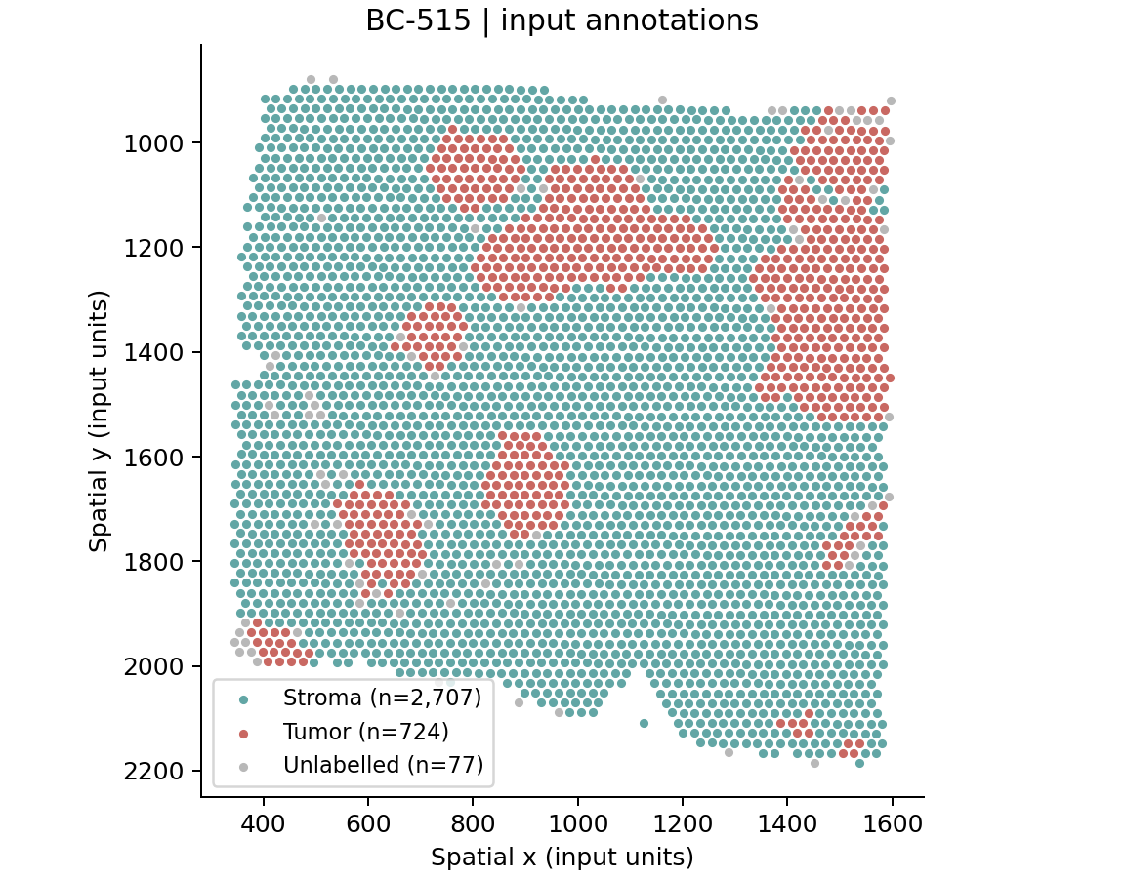
BC-515: one tissue section
3,508 spots
2,086 measured MSI features
15,953 genes in the RNA matrix
Available annotations
Stroma: 2,707
Tumor: 724
Unlabelled: 77
All spots and measured MSI features remain in the analysis.
3
Notes:
This section contains 3,508 spots and 2,086 measured MSI features. Most spots are annotated as Stroma, with 724 Tumor spots and 77 unlabelled spots. We keep all of them in the analysis.
For SIGMA, the unlabelled spots still contribute to the graph and reconstruction terms. Only the labelled spots contribute to the supervised classification loss. For MET-MAP, the annotations enter only the interpretation of the maps after fitting.
Sources: data/BC_515_Section_1.h5ad, 01_METMAP_library.ipynb, 02_SIGMA_library.ipynb.

Slide 4
Four notebooks, two implementation comparisons
Notebook | Implementation | Pair
01_METMAP_library.ipynb | Official multi_gaston source | 01 with 03
03_METMAP_from_scratch.ipynb | Encoder, decoder and training loop in notebook cells
02_SIGMA_library.ipynb | Bundled SIGMA library with the original BC-515 protocol | 02 with 04
04_SIGMA_from_scratch.ipynb | Preprocessing, graph, model and output calculations in notebook cells
Open the notebooks on GitHub or in JupyterLab to inspect their saved results.
Repository: METMAP-SIGMA-Tutorials
4
Notes:
The notebooks form two pairs: 01 and 03 for MET-MAP, and 02 and 04 for SIGMA. Each pair uses the same inputs and settings, with comparison cells at the end to check that the calculations agree.
The MET-MAP library notebook imports a fixed upstream source version. The SIGMA library notebook imports the bundled version that follows the original BC-515 workflow. In the two scratch notebooks, the model and analysis steps are defined in the cells, so we can inspect how the outputs are calculated.
Sources: README.md, vendor/SIGMA/ORIGINAL_COMPATIBILITY.md.

Slide 5
Environment and Jupyter kernel
Python 3.11 and the supplied version snapshot
conda create -n metmap-sigma python=3.11 -y
conda activate metmap-sigma
python -m pip install -r requirements.txt
python check_setup.py
python -m jupyterlab
In Jupyter
Course input
Open a notebook in JupyterLab.
Restart the kernel, then run all cells.
Place the supplied H5AD file in data/.
Keep the bundled libraries in vendor/.
5
Notes:
Run these commands from the downloaded repository folder. Use Python 3.11 and install the versions listed in requirements.txt. Download BC_515_Section_1.h5ad from the repository's bc515-data-v1 release and place it in data/. If you already have a copy elsewhere, BC515_DATA can point to that file.
Run check_setup.py before opening JupyterLab. Then open a notebook, restart its kernel and run all cells in order. The notebooks use the libraries in vendor/ and run on the CPU. No GPU is needed.
Sources: README.md, DATA.md, requirements.txt. Data release: https://github.com/Elsa-bingxue/METMAP-SIGMA-Tutorials/releases/tag/bc515-data-v1.

Slide 6
The input matrices in AnnData
adata = ad.read_h5ad(HERE / "data/BC_515_Section_1.h5ad")
X_raw = np.asarray(adata.uns["msi"])
mz = np.asarray(adata.uns["mz_features"])
coords = np.asarray(adata.obsm["spatial"])
labels = adata.obs["annotation"]
rna_target = np.asarray(adata.obsm["X_harmony"])[:, :32]
Array | Shape | Role
X_raw | 3,508 × 2,086 | Measured MSI intensities
coords | 3,508 × 2 | Spatial positions
rna_target | 3,508 × 32 | SIGMA auxiliary target
adata.X contains RNA expression. MSI is stored in adata.uns["msi"].
6
Notes:
The MSI matrix is stored in adata.uns["msi"]. This matters because adata.X contains RNA expression, and using it would change the analysis entirely. The m/z values, spatial coordinates and annotations must retain the same spot and feature ordering as the intensity matrix.
SIGMA also takes the first 32 columns of X_harmony as its RNA target. That representation is already present in the course file. We do not recompute Harmony here. Run the notebook's setup cells first so that its imports and repository path are defined.
Sources: 01_METMAP_library.ipynb, 02_SIGMA_library.ipynb.

Slide 7
MET-MAP learns a low-dimensional spatial representation
A coordinate encoder and a linear MSI decoder
Stage | Dimensions | Operation
Spatial input | 2 | Standardized x and y
Encoder hidden layers | 120, 120 | Linear layer and ReLU at each stage
Isodepths z | 3 | Linear output of the encoder
MSI reconstruction | 2,086 | Linear decoder: A_hat = Wz + b
The encoder maps location to metabolic depth. The decoder reconstructs each feature.
7
MET-MAP / multi_gaston. Samarah et al., Nature 648, 182–190 (2025).
Notes:
The encoder takes two spatial coordinates through hidden layers of 120 units each and returns three isodepth values. A linear decoder then uses those three values to reconstruct all 2,086 MSI features. This makes the spatial representation small enough to inspect while allowing each feature to have its own decoder weights.
We chose K = 3 for this BC-515 example. The axes can change sign, order and scale, so their biological interpretation requires evidence beyond the fitted maps. The original paper describes the liver and intestine experiments and their parameter searches. Here we apply one fixed configuration to BC-515.
Sources: vendor/MET-MAP/src/multi_gaston/multi_gaston.py, upstream commit 43c9386ffe7d5b2f0f66d64d4820358c3cd8a11c, Samarah et al., Nature 648, 182–190 (2025), https://doi.org/10.1038/s41586-025-09616-5.

Slide 8
MET-MAP preprocessing and objective
Approximate total ion count from measured features
tic = X_raw.sum(axis=1)
X_log = np.log1p(X_raw / tic[:, None] * tic.mean())
S, A = data_processing.tensor_transform_inputs(coords, X_log)
Standardization
Each MSI feature has zero mean and unit variance.
The two coordinate axes are standardized separately.
Loss = mean squared reconstruction error + 0.0001 × sum(abs(W))
Only decoder weights receive the L1 penalty. The decoder bias remains unpenalized.
8
Notes:
We first adjust each spot by the sum of its measured MSI features and then apply log1p. This row sum approximates total ion count. Instrument TIC is not available in the course file. StandardScaler then standardizes each logged feature and each coordinate axis separately, and the arrays become float32 tensors.
The objective combines mean squared reconstruction error with an L1 penalty on the decoder weights. The decoder bias remains unpenalized. Training uses MSI and coordinates, without label, boundary or orthogonality terms. The preprocessing sets the scale of the reconstruction error.
Sources: vendor/MET-MAP/src/multi_gaston/data_processing.py, vendor/MET-MAP/src/multi_gaston/multi_gaston.py, upstream commit 43c9386ffe7d5b2f0f66d64d4820358c3cd8a11c.

Slide 9
MET-MAP library call
Notebook 01 uses the pinned official source
sys.path.insert(0, str(ROOT / "external/MET-MAP/src"))
from multi_gaston import multi_gaston, data_processing
model, total_loss, l1_loss = multi_gaston.train(
S, A, S_hidden_list=[120, 120], A_hidden_list=[],
A_linear=True, lasso_lambda=0.0001, K=3,
epochs=3000, batch_size=None, checkpoint=500, SAVE_PATH=None,
optim="adam", lr=0.001, weight_decay=0, seed=0,
schedule="linear", schedule_para=[0.05, 12000],
loss_threshold=-1.0,
)
Full-batch training, 3,000 epochs, fixed seed 0 and CPU execution.
9
Notes:
For execution, use the source-path cell in Notebook 01, which imports from vendor/MET-MAP/src. The notebook also sets CPU execution and the thread configuration before this training call.
Training uses all spots in each update, with seed 0 and 3,000 epochs. Keep loss_threshold = -1.0: this avoids an early-stopping branch in the pinned source that refers to an undefined corr_loss. The linear scheduler reaches its target factor of 0.05 at 12,000 steps, so this 3,000-epoch run uses only the first part of that schedule.
Sources: 01_METMAP_library.ipynb, vendor/MET-MAP/src/multi_gaston/multi_gaston.py, upstream commit 43c9386ffe7d5b2f0f66d64d4820358c3cd8a11c.

Slide 10
MET-MAP from scratch
Notebook 03 exposes the model and training loop
for epoch in range(settings['epochs']):
optimizer.zero_grad()
mse = nn.functional.mse_loss(
fitted(spatial), abundance, reduction='mean')
l1 = settings['lasso_lambda'] * torch.norm(
fitted.expression_function[0].weight, 1)
objective = mse + l1
total_losses[epoch] = objective.item()
l1_losses[epoch] = l1.item()
objective.backward()
optimizer.step()
scheduler.step()
Matching the library requires the same initialization, layer order and loss reduction.
10
Notes:
Each iteration clears the gradients, reconstructs MSI from the spatial coordinates and adds the decoder's L1 penalty to the mean squared error. Backpropagation computes the gradients, Adam updates the parameters, and the scheduler changes the learning rate for the next step.
Here, expression_function[0] is the linear decoder. Notebook 03 also defines the encoder, decoder and optimizer. Matching the library requires the same layer initialization and order of operations, including when losses are recorded. With those details aligned, the two saved runs give identical numerical outputs in the recorded environment.
Sources: 03_METMAP_from_scratch.ipynb, vendor/MET-MAP/src/multi_gaston/multi_gaston.py, reference/implementation_parity.csv.

Slide 11
MET-MAP training and reconstruction
Final reconstruction
MSE
0.796654
Logged total loss
1.294701 at the start
0.804907 at the final step
The final MSE excludes the L1 term and follows the last parameter update.
11
Notes:
The total training loss falls from 1.294701 to 0.804907 over 3,000 steps. The final reconstruction MSE is 0.796654. The total loss includes the L1 penalty and records the value before the parameter update. The final MSE measures reconstruction after the last update and excludes the penalty.
The trace shows how optimization progressed on the training section. It does not tell us how well the model would reconstruct an independent section, because this run has no held-out evaluation.
Source: 01_METMAP_library.ipynb, saved training and reconstruction outputs.

Slide 12
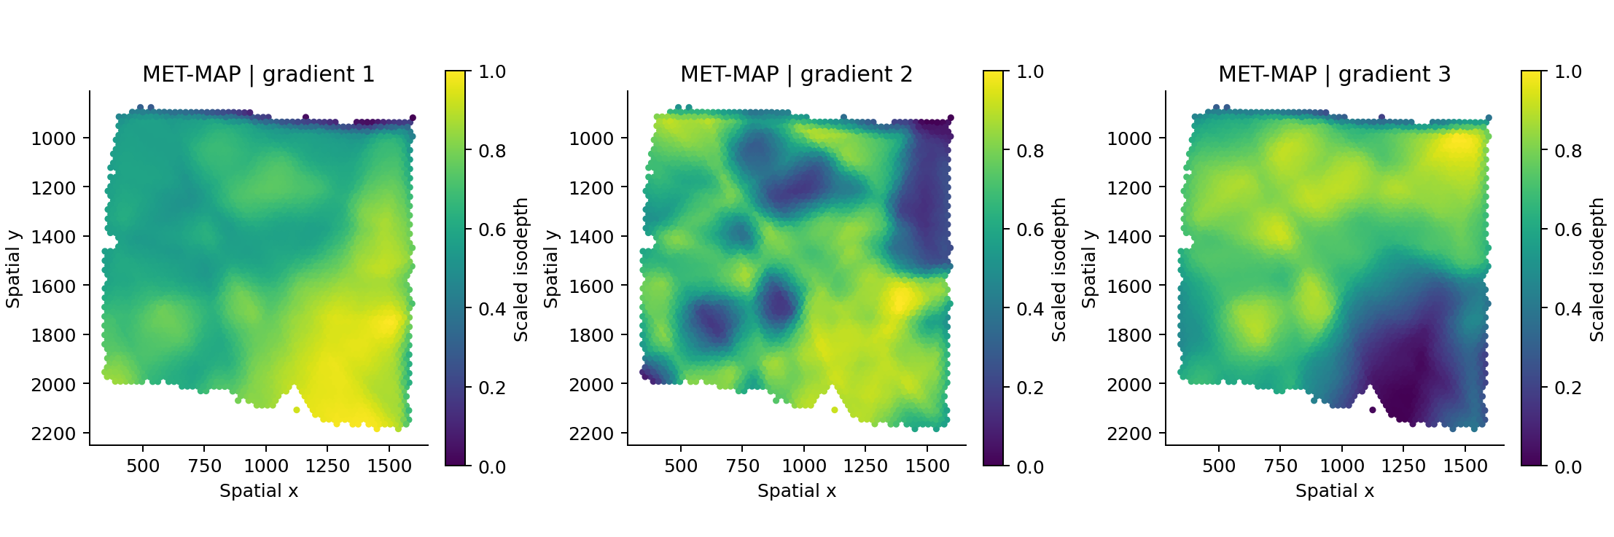
MET-MAP results: three continuous gradients
All 3,508 spots, shown in the original spatial coordinate system
Each axis is scaled to 0–1 for display. Isodepth is a learned coordinate.
12
Notes:
Each map shows one of the three learned isodepths across all 3,508 spots. The colors are scaled from 0 to 1 separately for display, and the spatial y-axis increases downward, as it does in the notebook figures. The library and scratch runs produce identical saved isodepth arrays.
An isodepth locates a spot in the learned representation of MSI variation. We can compare its spatial pattern with tissue annotations. The sign, order and scale of the axes remain arbitrary, and interpreting an axis as distance from the tumor boundary would require a separate calculation.
Sources: 01_METMAP_library.ipynb, reference/implementation_parity.csv.

Slide 13
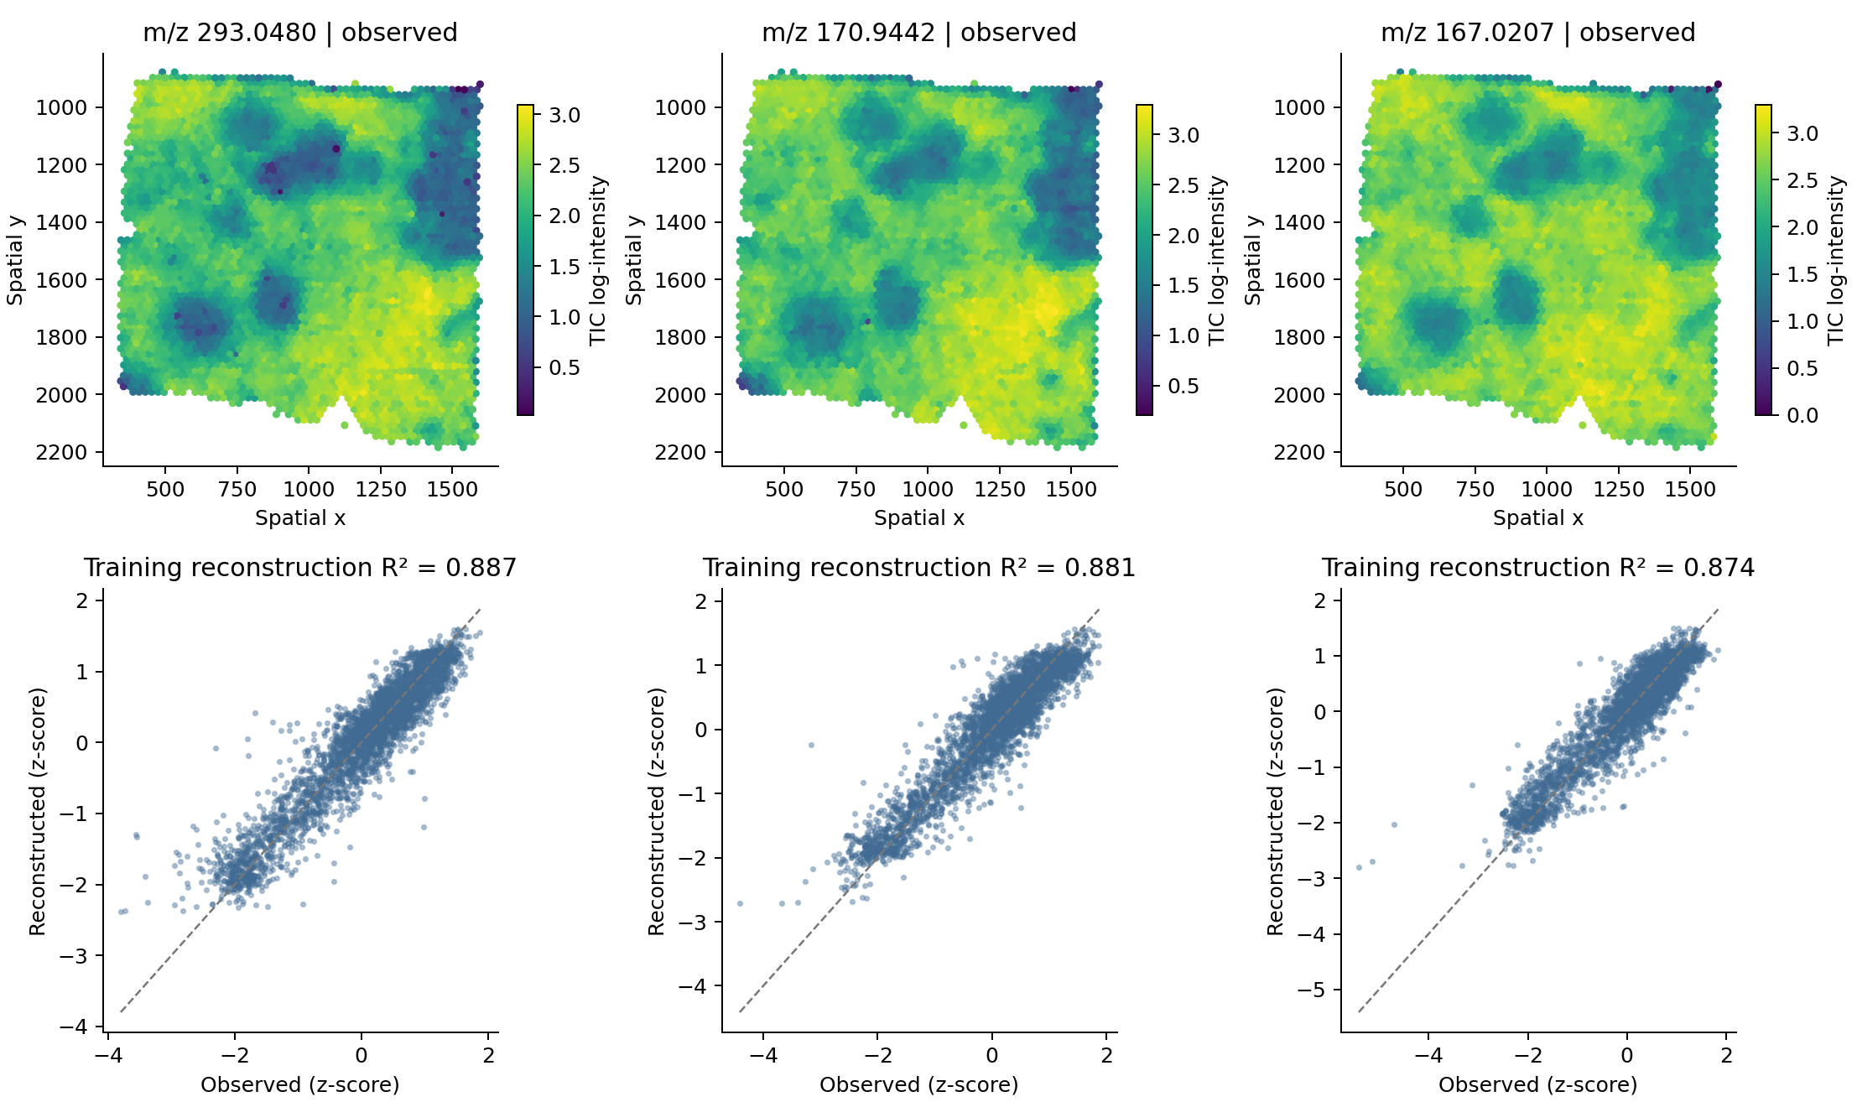
MET-MAP results: reconstructed metabolite patterns
Top feature: m/z 293.0480, training reconstruction R² = 0.887339.
13
Notes:
These features have high reconstruction R² within the training section. For m/z 293.0480, R² is 0.887339, meaning that its spatial variation is well represented by the fitted model. The ranking retains negative R² values for features that are poorly reconstructed.
The ranking also includes each absolute decoder weight multiplied by the standard deviation of its isodepth. This accounts for the scale of the learned axis when describing its contribution to a feature. Chemical identification and biological interpretation require evidence beyond the reconstruction fit.
Source: 01_METMAP_library.ipynb, saved feature ranking and reconstructed metabolite maps.

Slide 14
SIGMA preprocessing
A compact MSI representation and a spatial Gaussian graph
Input or operation | BC-515 setting | Output
MSI transform | log1p, RobustScaler (10–90%) | 3,508 × 2,086
Feature compression | TruncatedSVD, 64 components, then z-score | Embedding E: 3,508 × 64
Spatial graph | 15 nearest neighbors per spot | Directed Gaussian-weighted edges
RNA target | First 32 X_harmony dimensions, z-scored | Z: 3,508 × 32
Supervised anchors | Tumor = 1, Stroma = 0 | 3,431 labelled spots
Unlabelled spots still contribute to the graph and the reconstruction terms.
14
Notes:
SIGMA reads the MSI intensities from adata.uns['msi']. After log1p and robust scaling, it reduces the 2,086 features to 64 SVD components and standardizes them. The spatial graph connects each spot to its 15 nearest neighbors. The median positive neighbor distance sets the Gaussian bandwidth.
The RNA target uses the first 32 Harmony dimensions already stored in the data file. Tumor and Stroma labels provide 3,431 supervised anchors, with a positive-class weight of 2707/724. The 77 unlabelled spots still contribute to graph calculations and reconstruction. The notebooks start from the supplied Harmony representation.
Sources: 02_SIGMA_library.ipynb, vendor/SIGMA/src/sigma_spatial/.

Slide 15
SIGMA separates smooth structure from residual variation
Gaussian diffusion
G starts at the MSI embedding E. At each iteration, each spot combines
its Gaussian-weighted neighbor average with 10% of its original embedding.
G_next = 0.9 × weighted_neighbor_mean(G) + 0.1 × E
After 10 diffusion steps | Training role
Smooth embedding G | Input to the graph network
Residual R = E − G | MSI prediction target
Kernel: exp(−distance² / (2σ²)). σ is the median positive neighbor distance.
15
Notes:
At each diffusion step, a spot takes 90% of its weighted neighbor average and 10% of its original MSI embedding. After ten steps, G contains the smoothed representation. Subtracting G from E gives the residual R that the network will predict.
This averaging step divides by the sum of outgoing edge weights. The network uses a different normalization, which we will examine next. The code also propagates the label anchors through a separate clamped field for 50 steps. It exports that field as a reference. The classification head receives supervision through the anchor loss.
Sources: 04_SIGMA_from_scratch.ipynb, vendor/SIGMA/src/sigma_spatial/graph.py, vendor/SIGMA/src/sigma_spatial/pipeline.py.

Slide 16
SIGMA network and training objective
Network stage | Dimensions | Operation
High-pass block 1 | 64 to 128 | H − GraphLowPass(H), Linear, LayerNorm, ReLU, Dropout
High-pass block 2 | 128 to 64 | Same operation, dropout = 0.1
Output heads | 64, 32, 1 | MSI residual, RNA target, region logit
Loss = SmoothL1(MSI residual) + 0.05 × weighted BCE(anchors)
+ 0.05 × MSE(RNA target)
Adam, learning rate 0.001, weight decay 0.0001, 1,000 epochs.
16
Notes:
The network takes G as input. Each block subtracts a low-pass graph output before applying the linear layer, LayerNorm, ReLU and dropout. The shared representation feeds heads for the MSI residual, RNA target and region logit.
The loss combines residual SmoothL1 with weighted binary cross-entropy on the labelled spots and RNA mean squared error. The last two terms each have weight 0.05. Training uses Adam for 1,000 epochs.
GraphLowPass uses PyTorch Geometric source-to-target propagation. It adds self-loops with weight 1 and uses incoming edge counts in its normalization. Substituting a weighted-degree normalization would change the model's calculations.
Sources: 04_SIGMA_from_scratch.ipynb, vendor/SIGMA/src/sigma_spatial/model.py, vendor/SIGMA/src/sigma_spatial/graph.py.

Slide 17
SIGMA library call
Notebook 02 imports the bundled original-protocol library
SOURCE = HERE / "vendor/SIGMA/src"
sys.path.insert(0, str(SOURCE))
import sigma_spatial as sigma
assert sigma.__version__ == "0.3.1+bc515.original"
estimator = sigma.SIGMA(n_components=64, k=15, seed=0, device="cpu")
estimator.fit(
adata, annotation_key="annotation",
tumor_label="Tumor", stroma_label="Stroma",
rna_key="X_harmony", z_dim=32,
epochs=1000, lr=0.001, lambda_sup=0.05, beta_rna=0.05,
boundary_k=10, boundary_mode="legacy",
)
The bundled compatibility changes preserve the original BC-515 computation.
17
Notes:
The source-path cell loads SIGMA from vendor/SIGMA/src. The version check should return 0.3.1+bc515.original. The fit call then specifies the annotation labels, RNA target and training settings used for BC-515.
Several small implementation choices matter for reproducing this run. The RNA output head initializes first. Diffusion divides before multiplying, the class weight keeps its original dtype, and the output score uses NumPy's sigmoid calculation. The downstream analysis works from raw MSI intensities. Notebook 04 writes these same operations directly in its cells.
Sources: 02_SIGMA_library.ipynb, vendor/SIGMA/ORIGINAL_COMPATIBILITY.md, ORIGINAL_PROTOCOL.md.

Slide 18
SIGMA region score, boundary and signed distance
1. Region score
Apply sigmoid to the region logit, then
rescale the scores to 0–1 within BC-515.
2. Inside and boundary
Inside means score ≥ 0.5. In legacy mode, a boundary spot has
both same-side and opposite-side spots among its 10 neighbors.
3. Signed distance
Distance to the nearest boundary spot is negative inside
and positive outside. Boundary spots have distance zero.
Distances use the input coordinate units. The normalized region score is uncalibrated.
18
Notes:
The sigmoid output is rescaled from 0 to 1 within this section. A score of at least 0.5 assigns a spot to the inside. These scores depend on the section and have no probability calibration.
For the legacy boundary rule, a spot needs both same-side and opposite-side spots among its ten neighbors. We then measure Euclidean distance to the nearest boundary spot, assign a negative sign inside and a positive sign outside, and set boundary spots to zero. The distance uses the input coordinate units. A physical interpretation in micrometres would require a verified coordinate conversion.
Sources: 02_SIGMA_library.ipynb, 04_SIGMA_from_scratch.ipynb.

Slide 19
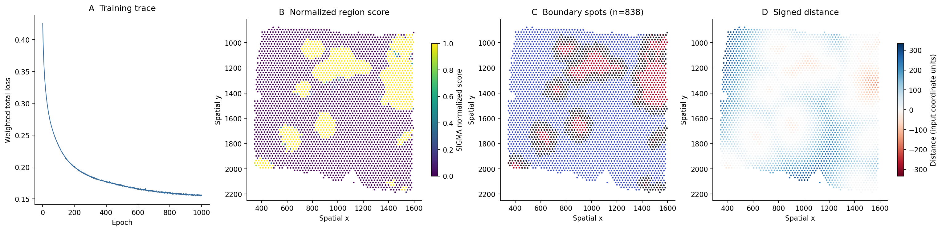
SIGMA results on BC-515
751 inside spots and 838 boundary spots
Training loss decreases from 0.425294 to 0.155556.
19
Notes:
With seed 0 and 1,000 epochs on CPU, this run gives 751 inside spots and 838 boundary spots. The training loss falls from 0.425294 to 0.155556. The maps show where the resulting region split places the interface.
An earlier saved original notebook contains 752 inside spots and 834 boundary spots, without a complete runtime record. For the comparison in this course, both SIGMA implementations agree with the original code when all three run in the same environment.
Sources: 02_SIGMA_library.ipynb, reference/sigma_library_summary.json, reference/original_protocol_comparison.csv.

Slide 20
SIGMA: decay fits and metabolic programs
ranking = sigma.rank_lambda_profiles(
adata, matrix_source="msi_uns", ranking_col="r2_logI"
)
Analysis step | Original BC-515 settings
Exponential decay | log1p(I − min I) = a − |d| / λ; Huber regression
Feature selection | 2,000 variable features; R² ≥ 0.05; enrichment ≥ 1.05
Distance profiles | Top 300 features; 40 bins; raw-intensity profile z-scores
Metabolic programs | Ward clustering, 4 groups; one representative per group
Feature ranking uses fit R² and near-interface enrichment.
20
Notes:
For each of the 2,000 most variable MSI features, fit log1p(I minus its minimum) against absolute distance using Huber regression. A negative slope gives the decay length, lambda = -1/slope. Keep fits with at least 300 observations, R² of at least 0.05 and near-to-far enrichment of at least 1.05. The near and far cutoffs use the 20th and 80th distance percentiles. Remove lambda values above the 99th percentile, then rank by R² and enrichment.
For the leading 300 features, calculate anisotropy across eight sectors and build profiles in 40 signed-distance bins between the 2nd and 98th percentiles. A bin needs five spots, and a profile needs 80% of its bins defined. Interpolate missing bins, z-score each profile and apply Ward clustering with four groups.
Within each group, trim lambda above its 90th percentile when candidates remain, then choose the representative by R² and enrichment.
Sources: 02_SIGMA_library.ipynb, 04_SIGMA_from_scratch.ipynb, ORIGINAL_PROTOCOL.md.

Slide 21
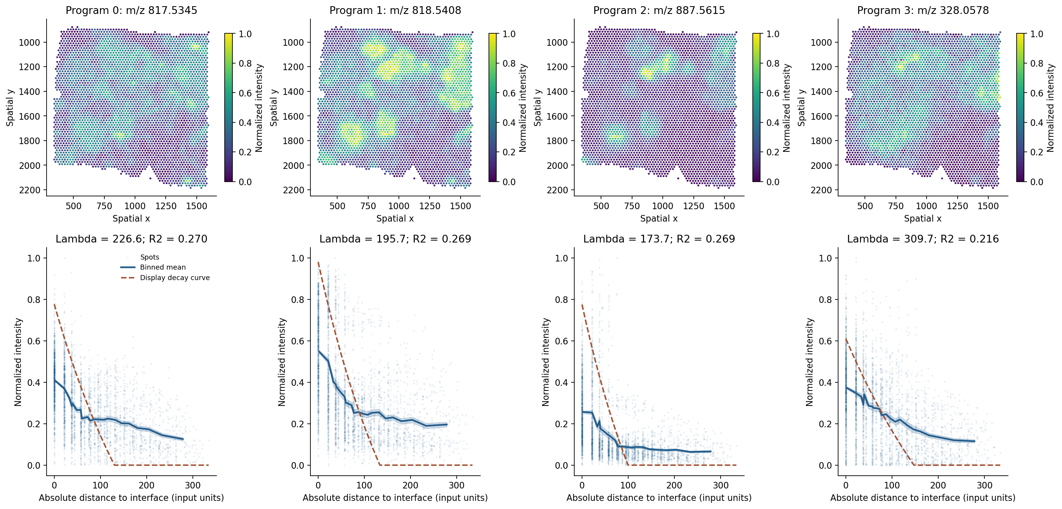
SIGMA: representatives of the four metabolic programs
Absolute distance in input units; 30 quantile bins. λ comes from the raw-intensity fit.
21
Notes:
The four columns show one representative from each metabolic program: m/z 817.534520, 818.540767, 887.561462 and 328.057840. The maps show normalized raw intensity. The profiles below use absolute distance in the input coordinate units, grouped into 30 quantile bins.
Lambda and R² come from the log1p decay fit on raw intensity. To draw the dashed trend, the original plotting code keeps that fitted slope and recalculates the intercept using normalized intensity. This display adjustment leaves the reported decay length unchanged.
The clustering step uses a separate set of 40 signed-distance bins, which preserves the distinction between the two sides of the interface. The absolute-distance plots here summarize how intensity changes with distance from the interface.
Sources: 02_SIGMA_library.ipynb, ORIGINAL_PROTOCOL.md, SLIDE_NOTES.md.

Slide 22
SIGMA from scratch: the high-pass calculation
Notebook 04 follows the graph operators in the source
class SpectralHighPassBlock(nn.Module):
def __init__(self, in_dim, out_dim, dropout=0.1):
super().__init__()
self.lowpass = GraphLowPass()
self.lin = nn.Linear(in_dim, out_dim)
self.norm = nn.LayerNorm(out_dim)
self.dropout = nn.Dropout(dropout)
def forward(self, x, edge_index, edge_weight=None):
highpass = x - self.lowpass(x, edge_index, edge_weight)
return self.dropout(F.relu(self.norm(self.lin(highpass))))
The scratch notebook also defines preprocessing, diffusion, boundary detection and ranking.
Network low-pass: incoming edge-count normalization with weight-1 self-loops.
22
Notes:
The subtraction x - self.lowpass(x, edge_index, edge_weight) is the high-pass calculation. The block then applies a linear layer, LayerNorm, ReLU and dropout. Notebook 04 defines GraphLowPass immediately before this class, so the full graph operation is available to inspect.
When implementing it, keep the two normalizations separate. Preprocessing diffusion divides by weighted outgoing degree. The network layer uses incoming edge counts and adds self-loops with weight 1. Matching these operations is necessary to reproduce the library output.
Sources: 04_SIGMA_from_scratch.ipynb, vendor/SIGMA/src/sigma_spatial/model.py, vendor/SIGMA/src/sigma_spatial/graph.py.

Slide 23
Implementation and original-code comparisons
Comparison | MET-MAP | SIGMA
Input identity and spot order | Matched | Matched
Training loss arrays | Maximum difference 0 | Maximum difference 0
Core model outputs | Maximum difference 0 | Maximum difference 0
Feature ranking / programs | Maximum difference 0 | Maximum difference 0
36 paired checks and 62 original-code checks passed
Checks: reference/verification.json · reference/implementation_parity.csv
23
Notes:
The two MET-MAP notebooks agree in 15 comparisons, and the two SIGMA notebooks agree in 21. Both SIGMA implementations also agree with a separate execution of the original code in 62 comparisons. Every recorded maximum absolute difference is zero.
The checks cover training losses and model outputs, including the boundary masks and signed distances. They also compare the decay rankings, profile matrices, program assignments, module scores and representative features. The agreement applies to the recorded input and runtime. Repeating the comparison on another platform requires checking its results again.
Sources: reference/verification.json, reference/implementation_parity.csv, reference/original_protocol_comparison.csv.

Slide 24
Batch execution and result files
Run from the METMAP-SIGMA-Tutorials folder
python execute_notebook.py 01_METMAP_library.ipynb
python execute_notebook.py 03_METMAP_from_scratch.ipynb
python execute_notebook.py 02_SIGMA_library.ipynb
python execute_notebook.py 04_SIGMA_from_scratch.ipynb
Inspect the run
Check the pair
Open the executed notebooks.
Inspect training, spatial maps and decay fits.
Run both implementations.
Check their final comparison cells.
24
Notes:
Run these commands from the repository folder. The execution script starts each notebook in a fresh kernel and saves the outputs back into the notebook. It also writes results under results/.
Run both notebooks for a method before checking their final comparison cells. Those cells load the paired outputs and report any differences. Keep a copy of the downloaded notebooks if you want to retain the supplied figures alongside your own run.
Sources: execute_notebook.py, README.md.

Slide 25
Common reproduction failures
Symptom | Check or action
Input file not found | Place the course input in data/. See DATA.md for the exact file checksum.
Unexpected SIGMA version | Restart the kernel, rerun the source-path cell, then check __version__ and __file__.
MET-MAP corr_loss error | Keep loss_threshold=-1.0 for the pinned source.
Different paired outputs | Compare the input hash, spot order and package versions. Rerun both implementations with the same settings.
No SIGMA boundary | Inspect the region-score range and side split. A valid boundary is required for signed distance.
25
Notes:
For a missing input, download the H5AD file from the repository's BC-515 data release and place it in data/. Running python check_setup.py checks the file checksum and dependencies.
If SIGMA reports an unexpected version, restart the kernel before rerunning the source-path cell. Python keeps imported modules in memory, so changing the path alone may leave the previous import active. For the pinned MET-MAP source, keep loss_threshold=-1.0 to bypass the branch that references corr_loss.
If paired results differ, compare the input checksum, spot order and package versions, then rerun both notebooks with identical settings. SIGMA also needs a valid split and boundary before it can calculate signed distance. Check the score range if no boundary appears.
Sources: DATA.md, check_setup.py, README.md, 01_METMAP_library.ipynb, 02_SIGMA_library.ipynb.

Slide 26
Interpretation and further reading
What the BC-515 run establishes
The two implementations reproduce each method’s
computation on one section with fixed settings.
Training fit and label agreement do not estimate held-out performance.
Metabolite m/z alone does not establish chemical identity.
Independent sections are needed for biological validation.
MET-MAP
SIGMA
Samarah et al., Nature 648, 182–190 (2025)
doi.org/10.1038/s41586-025-09616-5
github.com/raphael-group/MET-MAP
SIGMA 0.3.1+bc515.original
github.com/Elsa-bingxue/SIGMA
Original BC-515 workflow
26
Notes:
The MET-MAP example applies a fixed model configuration to BC-515. The SIGMA example follows the original BC-515 training, decay-fit and metabolic-program workflow. In each case, the library and notebook implementations agree for this input and environment.
Biological interpretation needs evidence beyond these computational checks. Training fit and agreement with the supplied labels leave performance on independent sections untested. Chemical identification also requires more than an m/z value. The MET-MAP paper and both source repositories provide the background for further work.
References: Samarah et al., Nature 648, 182–190 (2025), https://doi.org/10.1038/s41586-025-09616-5. https://github.com/raphael-group/MET-MAP. https://github.com/Elsa-bingxue/SIGMA.

Slide 27

Questions and discussion
Thank you
Notes:
How does changing K affect the MET-MAP gradients? For SIGMA, what changes when we remove the RNA loss? Both are useful exercises after reproducing the supplied settings.
For a biological follow-up, what evidence would identify a representative MSI feature and show that its spatial pattern recurs in another section?
Sources: 01_METMAP_library.ipynb, 02_SIGMA_library.ipynb.

