Slide 1
论文第一次汇报
企业管理 罗颖
2111601024

Slide 2
目录
现有研究回顾
幸福感
主观幸福感
心理幸福感
消费者幸福感
拟采用理论和测量方法
拟研究框架
框架一
框架二

Slide 3
幸福感
关于幸福的哲学理论可以分为两大派别： 享乐主义（hedonic） 和幸福论（eudaimonia）
享乐主义认为幸福是由高兴和快乐组成
幸福论认为幸福不仅仅包括快乐， 还包括人类潜能的展现
这两个哲学派别衍生出了两种幸福感研究的心理学取向
主观幸福感（ Subjective Well -being， SWB）
心理幸福感（Psychological Well-being， PWB）

Slide 4
幸福感
两种幸福感有着相同的影响因素
Ryff等人的一系列研究表明心理幸福感的各个维度与主观幸福感之间存在着一定程度相关
Waterman实证研究证明了两者之间的相关
两种幸福感之间也存在着差异
两种幸福感的出发点是不同的，SWB 以快乐论为基础，PWB 以实现论为导向；SWB 从实证经验出发，PWB从心理理论着手

Slide 5
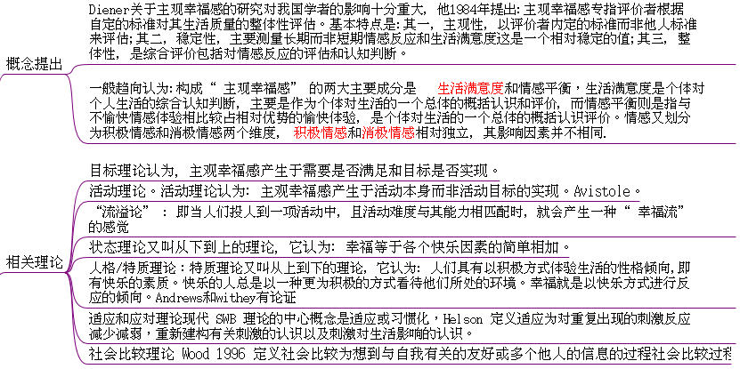
主观幸福感

Slide 6
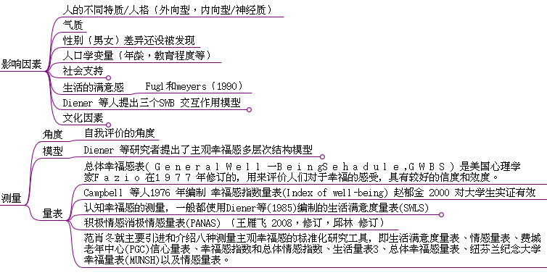
主观幸福感

Slide 7
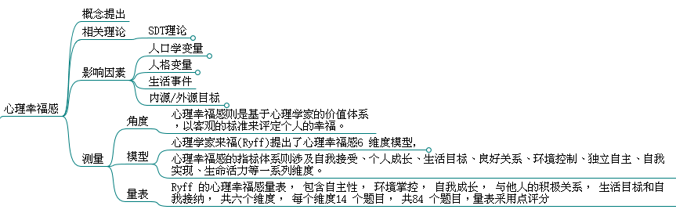
心理幸福感

Slide 8
消费者幸福感--概念提出
借助主观幸福感研究成果的消费者幸福感定义
Desmeules( 2002) 把消费者幸福感定义为消费者对其消费活动的一种总体满意度评价和积极 / 消极的情感反映
以生活满意理论为指导的消费幸福感定义（大多数学者采用）
sirgy等人认为消费幸福感便是人们在消费生活领域的满意状况,消费生活领域的满意源自对消费生活中具体事件和体验的满意
其他观点：
sirgy, Lee, Kressmann( 2006) 认为,特定产品( 品牌、 服务) 会对消费者许多子生活领域( 工作、 休闲、 家庭等)的生活质量( QOL)产生积极影响,消费者幸福感就是消费者对这些积极影响的感知程度

Slide 9
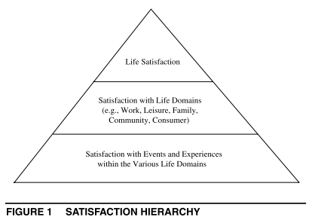
消费者幸福感--相关理论
自下而上生活满意理论
生活满意理论认为,满意是分层级的,生活领域的具体活动可通过自下而上溢出来的形式来影响该领域的生活满意以及整体生活满意
马斯洛的需求层次理论
logic implicit in the satisfac-tion hierarchy and bottom-up spillover theory

Slide 10
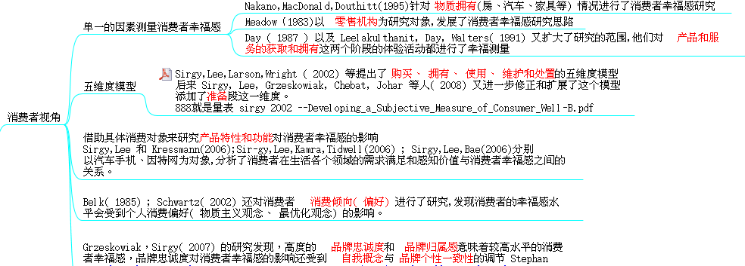
消费者幸福感--现有研究总结

Slide 11
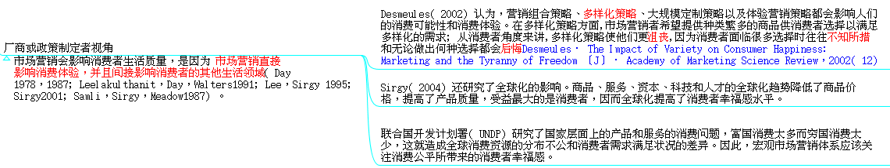
消费者幸福感--现有研究总结

Slide 12
消费者幸福感--测量方法
自我报告法
测量幸福的方法有很多,但大部分文献普遍采用的还是通过自我报告对这一构念进行测量,通过询问快乐感受作为基本方式,这一方法在前人对消费类型与幸福的关系的研究中显示出了较好的信度和效度,也一再被后续研究者采用
其他类型报告法
也有研究将幸福的追溯测量和即时的情绪测量进行配合,或考虑带来幸福感的适应过程从而进行动态性的多次追踪以及预期式自我报告

Slide 13
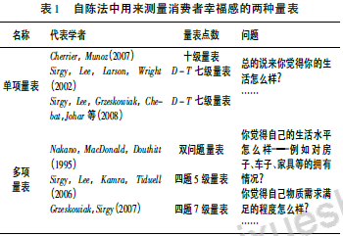
消费者幸福感--测量量表

Slide 14
消费者幸福感--测量量表
生活满意单项量表：
life satisfaction measure we used was a single-item Delighted-Terrible (D-T) scale.
The D-T measure is a well-established measure of subjective well-being (Andrews and Withey 1976).(sirgy,2002.developing a subjective measuer of consumer well-being)
消费者幸福感量表：
carter，gilovich （2012）在验证物质性/体验性购买对幸福感的影响时the tendency to cling more closely to cherished experiential memories is connected to the greater satisfaction people derive from experiences than possessions (Study 5Memory Exchange).使用：Participants were first asked to recall and briefly describe either a significant material or experiential purchase they had made and to indicate its cost and how long ago they had made it.
Delighted-Terrible (D-T) scale
 | terrible 1 | unhappy 2 | mostly dissatisfied 3 | mixed feelings 4 | mostly satisfied5 | pleased 6 | delighted 7
How do you feel about your life as a whole
 | 1 not at all important/satisfied | 2 | 3 | 4 | 5 somewhat important/satisfied | 6 | 7 | 8 | 9very important/satisfied
how important the purchase was to you
your satisfaction with the purchase

Slide 15
消费者幸福感--测量量表
Leaf Van Boven ，Thomas Gilovich(2003)研究物质性/体验性购买时Study 1: Recent Purchases采用的测量消费者幸福感的量表(To Do or to Have? That Is the Question）
 | 1 (not happy) | 2 | 3 | 4 | 5(moderately happy) | 6 | 7 | 8 | 9 (extremely happy)
When you think about this purchase, how happy does it make you
 | 1 (not at all) | 2 | 3 | 4 | 5 (moderately) | 6 | 7 | 8 | 9 (very much)
How much does this purchase contribute to your happiness in life
 | 1 (not well-spent) | 2 | 3 | 4 | 5 (moderately well-spent) | 6 | 7 | 8 | 9 (very well-spent)
To what extent would you say this purchase is money well-spent
 | 1 (not at all) | 2 | 3 | 4 | 5 (moderately) | 6 | 7 | 8 | 9 (very much)
To what extent do you think the money spent on this purchase would have been better spent on something else—some other type of purchase that would have made you happier?

Slide 16
消费者幸福感--测量量表
Nakano, McDonald, and Douthitt (1995) used a two-question measure to capture consumer well-being
 | 1 | 2 | 3 | 4 | 5 | 6 | 7
How do you feel about your standard of living—the things you have like housing, car, furniture, recreation, and the like?
How do you feel about the extent to which your physicalneeds are met?

Slide 17
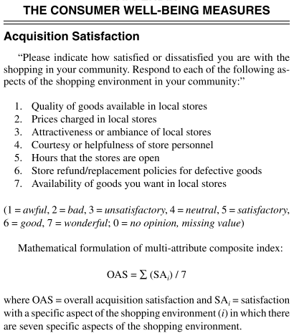
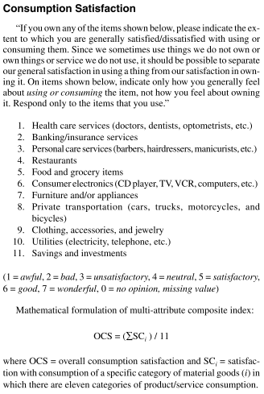
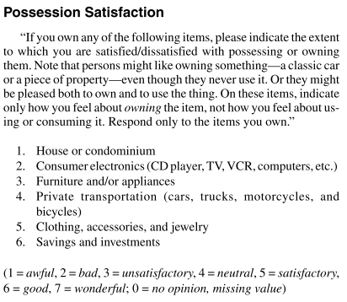
消费者幸福感--测量量表
sirgy等人（2002）提出的五维度模型
Mathematical formulation of multi-attribute composite index:
OPS = ( ∑ SP i ) / 6where OPS = overall possession satisfaction and SP i = satisfaction
with a specific category of material possessions (i) in which there are
six categories of material possessions.

Slide 18
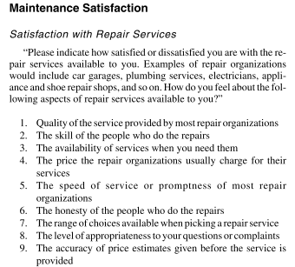
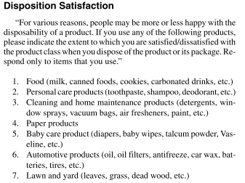
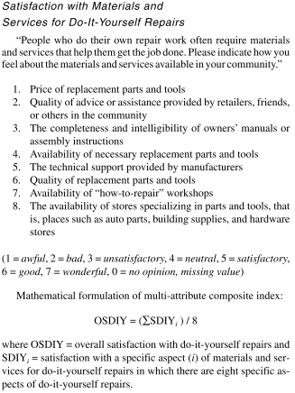
消费者幸福感--测量量表
sirgy等人（2002）提出的五维度模型
(1 = awful, 2 = bad, 3 = unsatisfactory, 4 = neutral, 5 = satisfactory,
6 = good, 7 = wonderful, 0 = no opinion, missing value)
Mathematical formulation of multi-attribute composite index:
ODS = ( ∑ SD i ) / 7
where ODS = overall disposition satisfaction and SD i = satisfaction
with disposition of a specific disposal service (i) in which there are
seven categories of disposed products.
(1 = awful, 2 = bad, 3 = unsatisfactory, 4 = neutral, 5 = satisfactory,
6 = good, 7 = wonderful, 0 = no opinion, missing value)
Mathematical formulation of multi-attribute composite index:
OSRS = ( ∑ SRS i ) / 9
where OSRS = overall satisfaction with repair services and SRS i =
satisfaction with a specific aspect (i) of repair services in the com-
munity in which there are nine specific aspects of repair services.
These are:

Slide 19
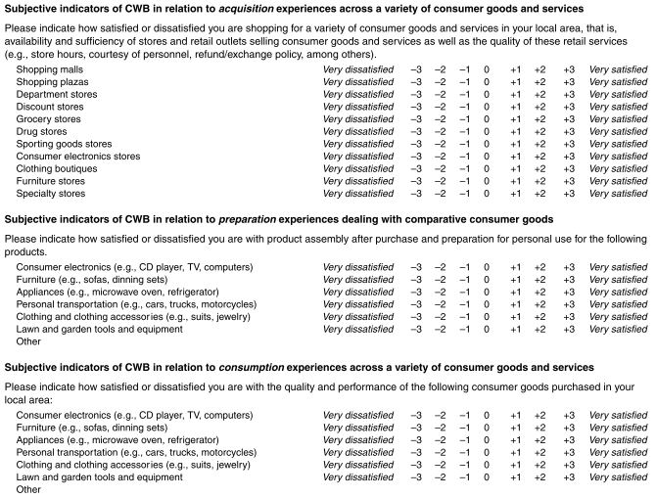
消费者幸福感--测量量表
sirgy等人（2006）提出的五维度改进模型

Slide 20
消费者幸福感--测量量表
关于购买决策的消费者幸福感测量
（Travis J. Carter and Thomas Gilovich2010The Relative Relativity of Material and Experiential Purchases
）
gilovich的购买决策的研究，the relative relativity
 | 1 | 2 | 3 | 4 | 5 | 6 | 7
the difficulty of the decision
how concerned they had been about whether they had made the right choice
how torn they had been between the option they chose and the other options
past difficulty with the decision
 | 1 | 2 | 3 | 4 | 5 | 6 | 7
their concern about whether they had made the right choice
their concern about whether another option might have been better
how often they thought about whether other options might have been better
present concern
 | 1 | 2 | 3 | 4 | 5 | 6 | 7
whether they had thought of the purchase more in absolute terms or more in comparison to other，similar items
 | 1 | 2 | 3 | 4 | 5 | 6 | 7
satisfaction with the purchase

Slide 21
消费者幸福感--测量量表总结
量表分宏观测量量表（sirgy 2002）和微观测量量表（其他研究者）
量表多属单项和双项9点李克特量表
针对不同的研究自变量，量表的使用存在很大程度的不一致性

Slide 22
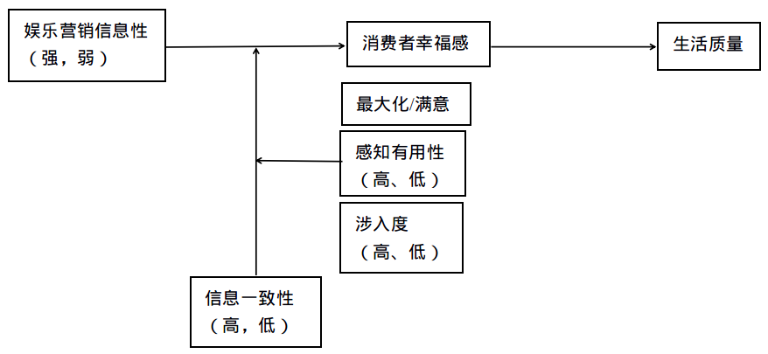
拟研究框架一：娱乐营销信息性对消费者幸福感影响机制研究 --以大众体验营销为例

Slide 23
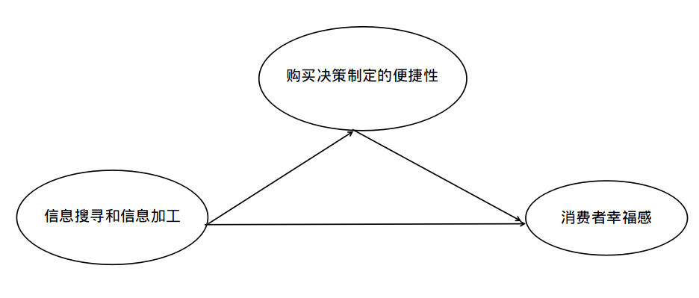
拟路径分析：娱乐营销信息性对消费者幸福感影响机制研究 --以大众体验营销为例

Slide 24
拟采用理论
自下而上生活满意理论
生活满意理论认为,满意是分层级的,生活领域的具体活动可通过自下而上溢出来的形式来影响该领域的生活满意以及整体生活满意
（用于支持自变量对消费者幸福感的影响，以及消费者幸福感对于整体生活质量的影响）

Slide 25
拟采用实验方法
主效应实验：
采用回忆法，让被试回忆制定某种商品购买决策时触到的有关商品的信息渠道，信息类型等，来分析有无娱乐营销的成分。再让被试回忆做决策时的难易程度以及对该决策的感受，评价该决策制定对消费者幸福感的影响和生活满意的影响？（参考Travis J. Carter and Thomas Gilovich2010 The Relative Relativity of Material and Experiential Purchases 实验一）
调节一实验：
采用想象法，想象某种商品的购买决策制定，文本描述某种娱乐营销场景，让被试回答对于商品信息和娱乐营销信息的一致性问题，以及决策制定难易程度，最后测量被试从中体验的消费者幸福感和生活满意程度。

Slide 26
拟采用测量方法
购买决策制定的难易程度及消费者幸福感的测量
gilovich（2010）的购买决策的研究，the relative relativity
 | 1 | 2 | 3 | 4 | 5 | 6 | 7
the difficulty of the decision
how concerned they had been about whether they had made the right choice
how torn they had been between the option they chose and the other options
past difficulty with the decision
 | 1 | 2 | 3 | 4 | 5 | 6 | 7
their concern about whether they had made the right choice
their concern about whether another option might have been better
how often they thought about whether other options might have been better
present concern
 | 1 | 2 | 3 | 4 | 5 | 6 | 7
whether they had thought of the purchase more in absolute terms or more in comparison to other，similar items
 | 1 | 2 | 3 | 4 | 5 | 6 | 7
satisfaction with the purchase

Slide 27
拟采用测量方法
生活满意单项量表
Delighted-Terrible (D-T) scale
 | terrible 1 | unhappy 2 | mostly dissatisfied 3 | mixed feelings 4 | mostly satisfied5 | pleased 6 | delighted 7
How do you feel about your life as a whole

Slide 28
存在疑问
1.信息性，信息一致性欠缺深入了解，量表，理论支持暂未找到。
2.调节变量选择。
3.satisfaction 和happy，是都可以译成幸福感还是有的就是满意度？比如购买满意度，而不是消费者幸福感
在国外学术研究中，学者们经常使用不同的术语来表示消费者幸福这一概念。像消费者幸福( Consumer well － being) 、消费者生活质量( Quality of consumer life) 、消费者生活满意( Consumer life satisfaction) 、消费者快乐( Consumer happiness) 、消费者福利( Consumer welfare) 等都出现在与消费者幸福有关的研究文献中。尽管学者们对这些术语存在着理解上的差异，但是它们在表示消费者幸福这一概念内涵上并没有本质区别。消费者幸福感研究述评 *谢凤华，刘国栋 2012 湘 潭 大 学 学 报 ( 哲 学 社 会 科 学 版 )

Slide 29
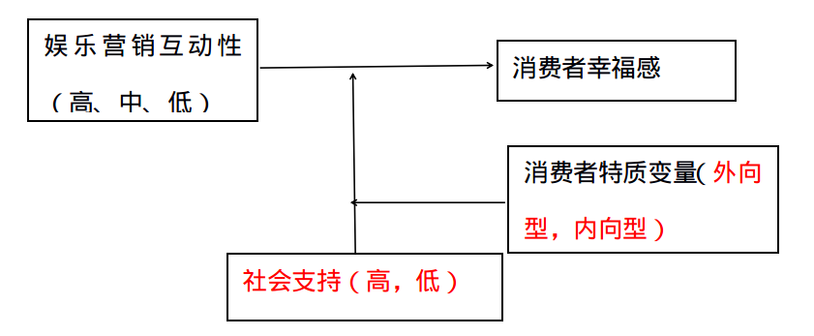
拟研究二：娱乐营销互动性对消费者幸福感影响机制研究 --以大众体验营销为例

Slide 30
存在疑问
1.各变量欠缺深入了解，量表，理论支持暂未找到。
2.调节变量选择。
3.消费者幸福感和幸福感的区分，两者的测量量表除了sirgy的五阶段模型，其他的有点混。参考原文找

Slide 31
谢谢！

