Slide 1


PharmaFriend
Simplify your search.

Slide 2
WHAT?

Slide 3
GIVING SOME CONTEXT...
Health-care has always been the priority.
In recent decades pharmacological advances have enabled medicine to establish better prognoses and save people around the world.
Improvements in this field will directly translate into improved quality of life.
Access to medicines is without a doubt one of the pillars of the health-care system.

Slide 4
WHY?

Slide 5
PROBLEM
When the access to the medicines is denied, the therapeutic success is not certain.
We don’t always have our medicine when we need it the most. Why?
Lower number of pharmacies and distance between them
Production problems by the pharmaceutical industry (Stock rupture)
Pharmacy decided to not buy this product
Logistical problems on the part of the pharmacy or storekeeper;

Slide 6
SOLUTION?

Slide 7
SOLUTION
At PharmaFriend we believe that the injured party should not be the customer especially when we talk about health.
Our mission is to accurately communicate where the client can pick up their medicine.
Facilitating the obtaining of the medicine we improve the chances for the treatment being initiated as soon as possible.
Reducing the time spent and possibly improving the client’s health.

Slide 8
HOW?

Slide 9
SPECIFICATIONS
The combination (Position + Medicine + Radius) will send a request to our database and upon comparison the three closest pharmacies will be given in a map.
User-friendly interface
Highly precise geolocalization (API: OpenStreetMap)
Huge database of pharmacies and medicines (>5000)
Stock precision (>99%)

Slide 10
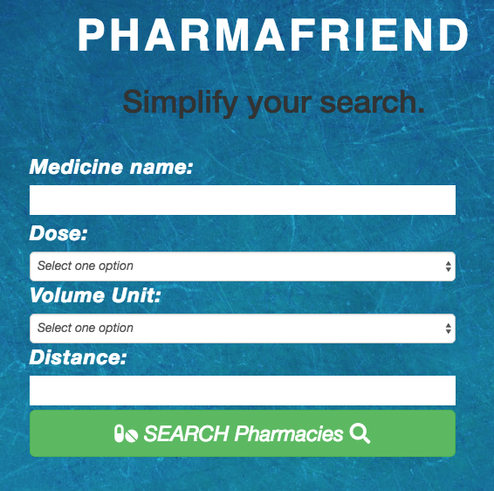
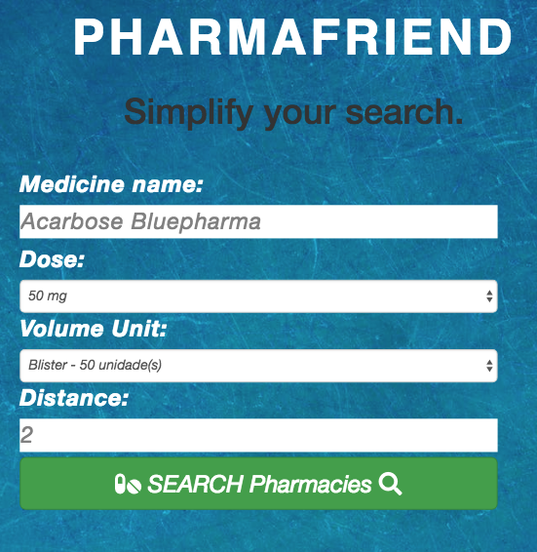
Searching a medicine...

Slide 11
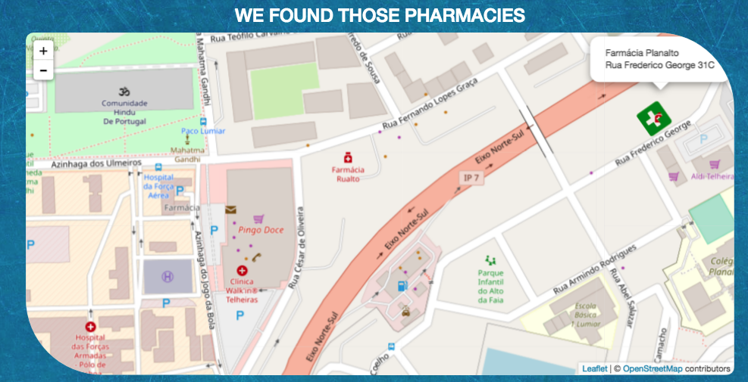
Search Results...

Slide 12







USED SOFTWARE

Slide 13
OUR VISION
PharmaFriend
In health all the details matter, and for us to simplify is to improve.
Simplify your search.

Slide 14
THANK YOU!

