Slide 1


PharmaFriend
Simplify your search.

Slide 2
WHAT?

Slide 3
GIVING SOME CONTEXT...
Health-care has always been the priority.
Improvements in this field will directly translate into improved quality of life.
In recent decades pharmacological advances have enabled medicine to establish better prognoses and save people around the world.
Access to medicines is without a doubt one of the pillars of the health-care system.

Slide 4
WHY?

Slide 5
PROBLEM
When the access to the medicines is denied, the therapeutic success is not certain.
We don’t always have our medicine when we need it the most. Why?
Stock Rupture
Production problems by the pharmaceutical industry
Pharmacy decided to not buy this product
Logistical problems on the part of the pharmacy or storekeeper;

Slide 6
SOLUTION?

Slide 7
SOLUTION
At PharmaFriend we believe that the injured party should not be the customer especially when we talk about health.
Our mission is to accurately communicate where the client can pick up their medicine.
Facilitating the obtaining of the medicine we guarantee the treatment is initiated as soon as possible reducing the time spent and possibly improving the client’s health.

Slide 8
HOW?

Slide 9
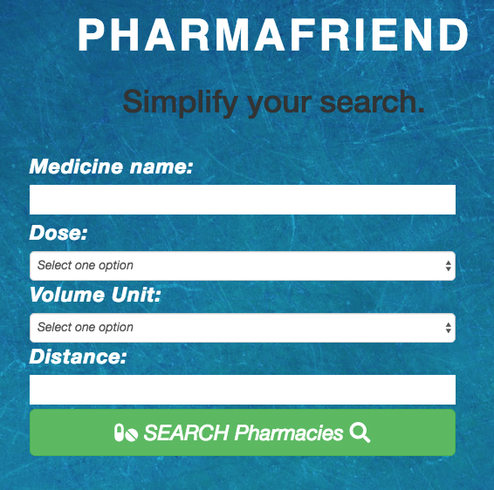
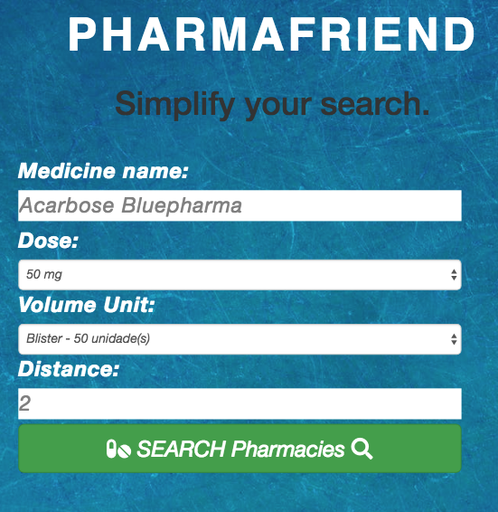
Searching a medicine...

Slide 10
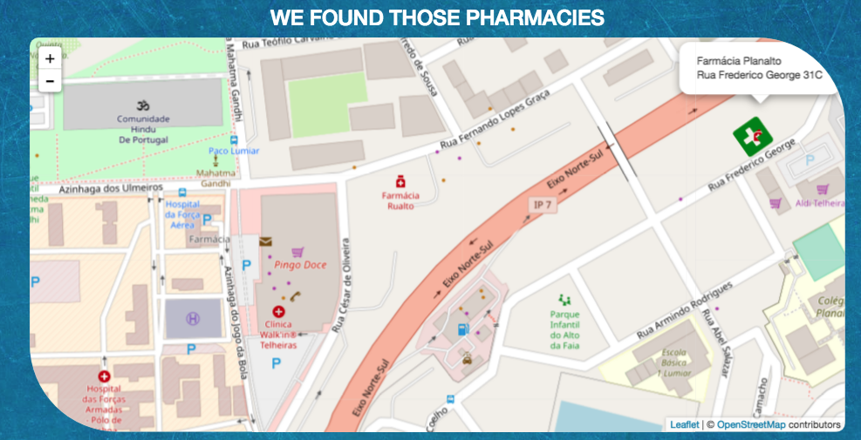
Search Results...

Slide 11
SPECIFICATIONS
User-friendly interface
Login interface
Highly precise geolocalization (API: OpenStreetMap)
Huge database of pharmacies and medicines (>5000)
Stock precision (>99%)

Slide 12







USED SOFTWARE

Slide 14
OUR VISION
PharmaFriend
In health all the details matter, and for us to simplify is to improve.
Simplify your search.

Slide 15
THANK YOU!

