Slide 1

Faculty of Engineering – Ain Shams University (ASU)
Mechatronics Department
Sensors & Measurement Systems
(MCT-334)
(Industrial Sorting Project)
Presented by:
Mohamed Emad Mohamed
Anas Ahmed Talaat
Elsayed Ayman Elsayed Ali
Submitted by:
Dr/Omar M. Shehata
Dr/Mohamed O. Elshalakani

Slide 2
Faculty of Engineering – Ain Shams University (ASU)
Mechatronics Department
Content:
Introduction
Overview of Inductive sensor
Analysis of Reading
Accuracy & precision
Fourier series
Overview of Ultrasonic sensor
Analysis of Reading
Accuracy & precision
Fourier series
Overview of Color sensor
Analysis of Reading
Accuracy & precision
Fourier series
correlation between Sensors
Overview of system sorting
Conclusion
Reference

Slide 3
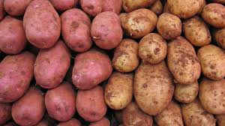
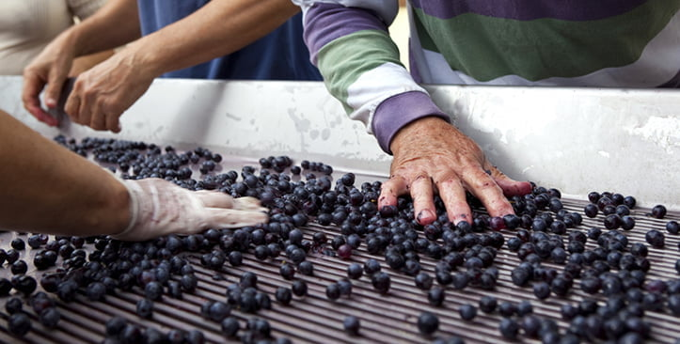
Faculty of Engineering – Ain Shams University (ASU)
Mechatronics Department
Sorting in industry:
Sorting is any process of arranging items systematically, and has two common, yet distinct meanings:
ordering: arranging items in a sequence ordered by some criterion;
categorizing: grouping items with similar properties.
Ordering items is the combination of categorizing them based on equivalent order and ordering the categories themselves.
Introduction
Overview of Inductive sensor
Analysis of Reading
Accuracy & precision
Fourier series
Overview of Ultrasonic sensor
Analysis of Reading
Accuracy & precision
Fourier series
Overview of Color sensor
Analysis of Reading
Accuracy & precision
Fourier series
correlation between Sensors
Overview of system sorting
Conclusion
Reference

Slide 4
Faculty of Engineering – Ain Shams University (ASU)
Mechatronics Department
Common sorting algorithms:
Bubble/Shell sort: Exchange two adjacent elements if they are out of order. Repeat until array is sorted.
Insertion sort: Scan successive elements for an out-of-order item, then insert the item in the proper place.
Selection sort: Find the smallest (or biggest) element in the array, and put it in the proper place. Swap it with the value in the first position. Repeat until array is sorted.
Quick sort: Partition the array into two segments. In the first segment, all elements are less than or equal to the pivot value. In the second segment, all elements are greater than or equal to the pivot value. Finally, sort the two segments recursively.
Merge sort: Divide the list of elements in two parts, sort the two parts individually and then merge it.
Introduction
Overview of Inductive sensor
Analysis of Reading
Accuracy & precision
Fourier series
Overview of Ultrasonic sensor
Analysis of Reading
Accuracy & precision
Fourier series
Overview of Color sensor
Analysis of Reading
Accuracy & precision
Fourier series
correlation between Sensors
Overview of system sorting
Conclusion
Reference

Slide 5
Faculty of Engineering – Ain Shams University (ASU)
Mechatronics Department
Introduction
Overview of Inductive sensor
Analysis of Reading
Accuracy & precision
Fourier series
Overview of Ultrasonic sensor
Analysis of Reading
Accuracy & precision
Fourier series
Overview of Color sensor
Analysis of Reading
Accuracy & precision
Fourier series
correlation between Sensors
Overview of system sorting
Conclusion
Reference
We will present one level of sorting process using some sensors like:
Ultrasonic sensor
Color sensor
Inductive sensor
Picture of project

Slide 6
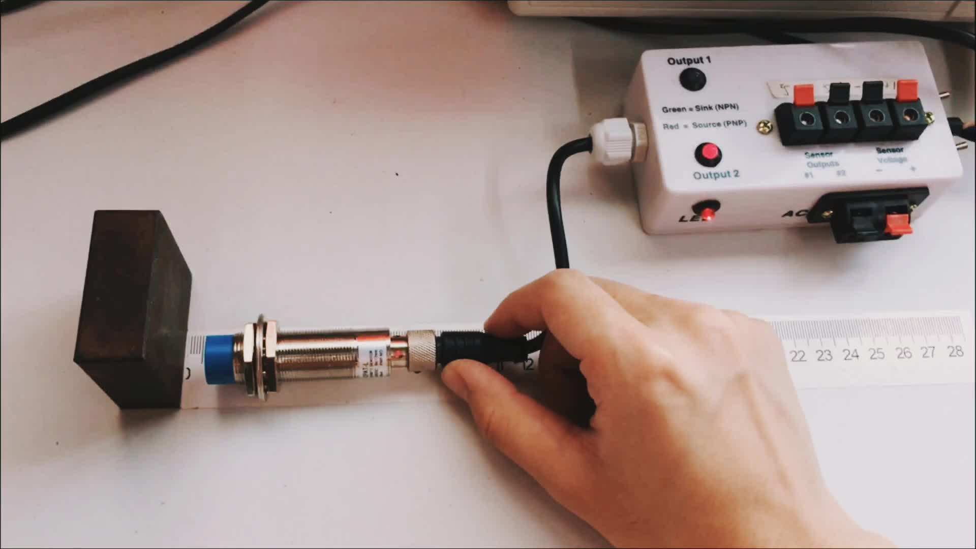
Faculty of Engineering – Ain Shams University (ASU)
Mechatronics Department
Inductive Sensor(LM12-2004A):
Introduction
Overview of Inductive sensor
Analysis of Reading
Accuracy & precision
Fourier series
Overview of Ultrasonic sensor
Analysis of Reading
Accuracy & precision
Fourier series
Overview of Color sensor
Analysis of Reading
Accuracy & precision
Fourier series
correlation between Sensors
Overview of system sorting
Conclusion
Reference
surveillance of metal elements motion. They can also be used in other machine systems applications as no contact control sensors for level of liquids, control sensors for the speed and position of rotating chains, etc. They are developed on the base of PNP and NPN transition. They have small dimensions and feature a cylindrical metal shell resistant to vibrations and a plastic lid which is oil and water resistant.
Electrical Specifications:
Insulating resistance: ≥ 50 M Ω
Gearing distance: from 2 mm to 7 mm
Precision of repetition: 0.01
Ambient temperature: -25˚С to +65˚С
Gearing speed: 5mm/s
Rated voltage: 6~36VDC; 90~230VAC

Slide 7
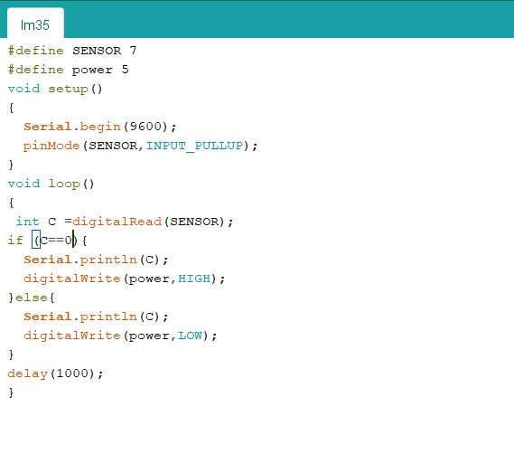
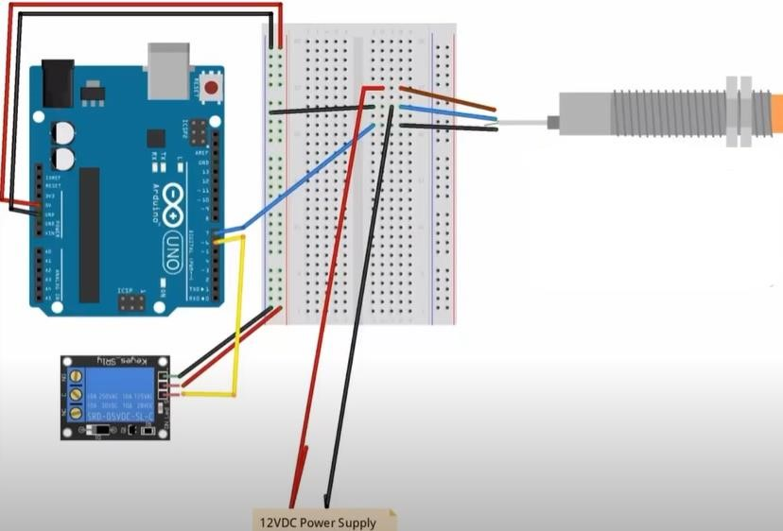
Faculty of Engineering – Ain Shams University (ASU)
Mechatronics Department
we use during calibration & practical working:
Fixation of the target at 4,00mm from the capacitive sensor.
Using relay 5VDC.
Introduction
Overview of Inductive sensor
Analysis of Reading
Accuracy & precision
Fourier series
Overview of Ultrasonic sensor
Analysis of Reading
Accuracy & precision
Fourier series
Overview of Color sensor
Analysis of Reading
Accuracy & precision
Fourier series
correlation between Sensors
Overview of system sorting
Conclusion
Reference
The circuit used in the calibration process:

Slide 8
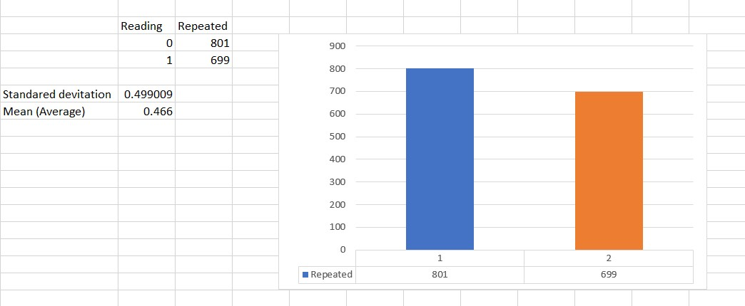
Faculty of Engineering – Ain Shams University (ASU)
Mechatronics Department
Normal Distribution curve:
Introduction
Overview of Inductive sensor
Analysis of Reading
Accuracy & precision
Fourier series
Overview of Ultrasonic sensor
Analysis of Reading
Accuracy & precision
Fourier series
Overview of Color sensor
Analysis of Reading
Accuracy & precision
Fourier series
correlation between Sensors
Overview of system sorting
Conclusion
Reference

Slide 9
Faculty of Engineering – Ain Shams University (ASU)
Mechatronics Department
Introduction
Overview of Inductive sensor
Analysis of Reading
Accuracy & precision
Fourier series
Overview of Ultrasonic sensor
Analysis of Reading
Accuracy & precision
Fourier series
Overview of Color sensor
Analysis of Reading
Accuracy & precision
Fourier series
correlation between Sensors
Overview of system sorting
Conclusion
Reference
Picture of Accuracy and precision

Slide 10
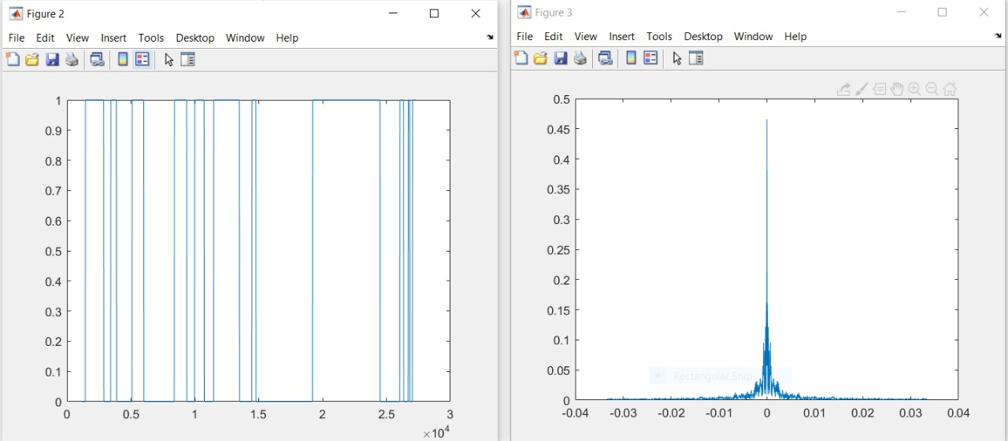
Faculty of Engineering – Ain Shams University (ASU)
Mechatronics Department
Introduction
Overview of Inductive sensor
Analysis of Reading
Accuracy & precision
Fourier series
Overview of Ultrasonic sensor
Analysis of Reading
Accuracy & precision
Fourier series
Overview of Color sensor
Analysis of Reading
Accuracy & precision
Fourier series
correlation between Sensors
Overview of system sorting
Conclusion
Reference

Slide 11
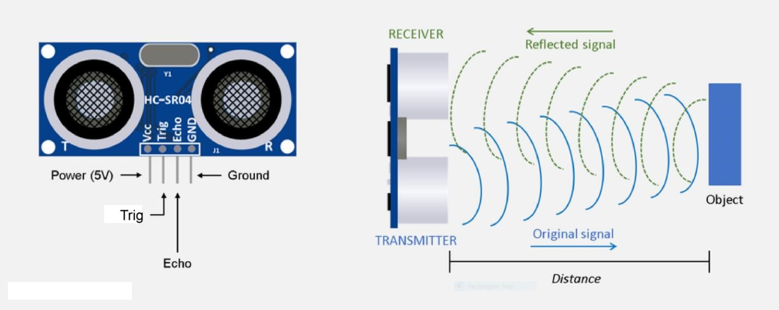
Faculty of Engineering – Ain Shams University (ASU)
Mechatronics Department
Ultrasonic Ranging Module( HC - SR04 ):
The basics of using ultrasound are like this: you shoot out a sound, wait to hear it echo back, and if you have your timing right, you’ll know if anything is out there and how far away it is. This is called echolocation and it’s how bats and dolphins find objects in the dark and underwater, though they use lower frequencies than you can use with your Arduino.
Introduction
Overview of Inductive sensor
Analysis of Reading
Accuracy & precision
Fourier series
Overview of Ultrasonic sensor
Analysis of Reading
Accuracy & precision
Fourier series
Overview of Color sensor
Analysis of Reading
Accuracy & precision
Fourier series
correlation between Sensors
Overview of system sorting
Conclusion
Reference

Slide 12
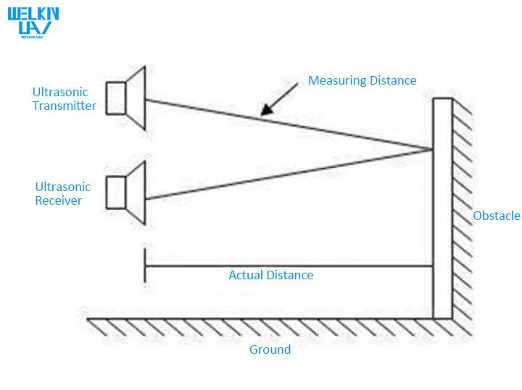
Faculty of Engineering – Ain Shams University (ASU)
Mechatronics Department
The principle of ultrasonic ranging
sound waves are reflected by obstacles, and the speed of sound waves is known, so it is only necessary to know the time difference between transmission and reception, and the measurement distance can be easily calculated, combined with transmitter and receiver. The distance of the device can calculate the actual distance of the obstacle.
Introduction
Overview of Inductive sensor
Analysis of Reading
Accuracy & precision
Fourier series
Overview of Ultrasonic sensor
Analysis of Reading
Accuracy & precision
Fourier series
Overview of Color sensor
Analysis of Reading
Accuracy & precision
Fourier series
correlation between Sensors
Overview of system sorting
Conclusion
Reference
Electrical Specifications
Operating Voltage: 3.3Vdc ~ 5Vdc
Quiescent Current: <2mA
Operating Current: 15mA
Operating Frequency: 40KHz
Operating Range & Accuracy: 2cm ~ 400cm ( 1in ~ 13ft) ± 3mm
Sensitivity: -65dB min
Sound Pressure: 112dB
Effective Angle: 15°

Slide 13
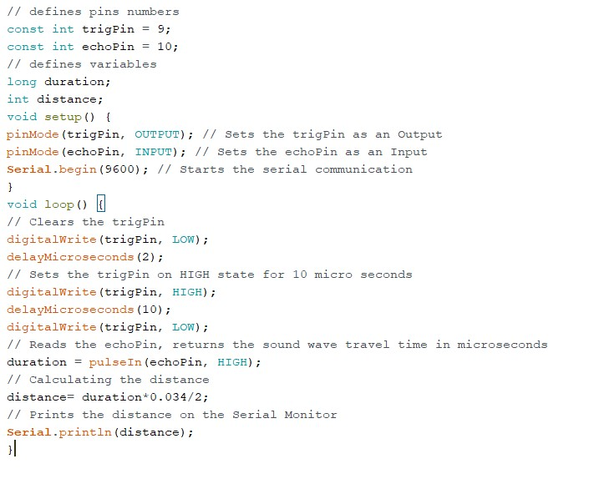
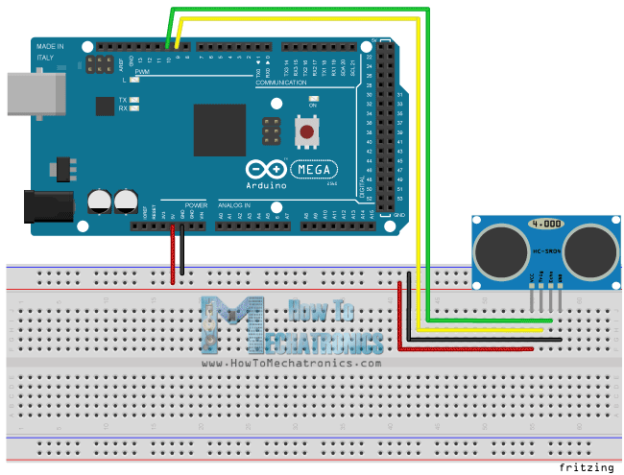
Faculty of Engineering – Ain Shams University (ASU)
Mechatronics Department
Datasheet details that we use during calibration & practical working:
Fixation of the target at 10.7 cm from the ultrasonic.
Introduction
Overview of Inductive sensor
Analysis of Reading
Accuracy & precision
Fourier series
Overview of Ultrasonic sensor
Analysis of Reading
Accuracy & precision
Fourier series
Overview of Color sensor
Analysis of Reading
Accuracy & precision
Fourier series
correlation between Sensors
Overview of system sorting
Conclusion
Reference
The circuit used in the calibration process :

Slide 14
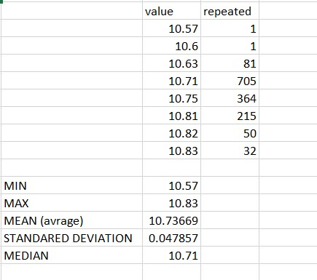
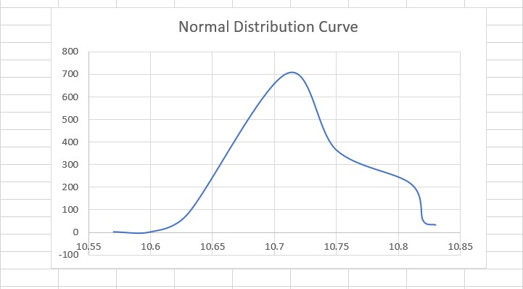
Faculty of Engineering – Ain Shams University (ASU)
Mechatronics Department
Sensor Readings:
Normal Distribution curve:
Introduction
Overview of Inductive sensor
Analysis of Reading
Accuracy & precision
Fourier series
Overview of Ultrasonic sensor
Analysis of Reading
Accuracy & precision
Fourier series
Overview of Color sensor
Analysis of Reading
Accuracy & precision
Fourier series
correlation between Sensors
Overview of system sorting
Conclusion
Reference

Slide 15
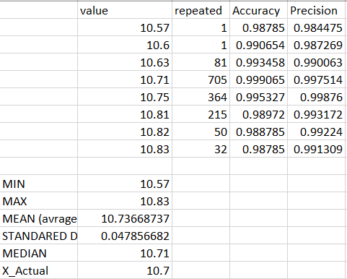
Faculty of Engineering – Ain Shams University (ASU)
Mechatronics Department
Introduction
Overview of Inductive sensor
Analysis of Reading
Accuracy & precision
Fourier series
Overview of Ultrasonic sensor
Analysis of Reading
Accuracy & precision
Fourier series
Overview of Color sensor
Analysis of Reading
Accuracy & precision
Fourier series
correlation between Sensors
Overview of system sorting
Conclusion
Reference

Slide 16
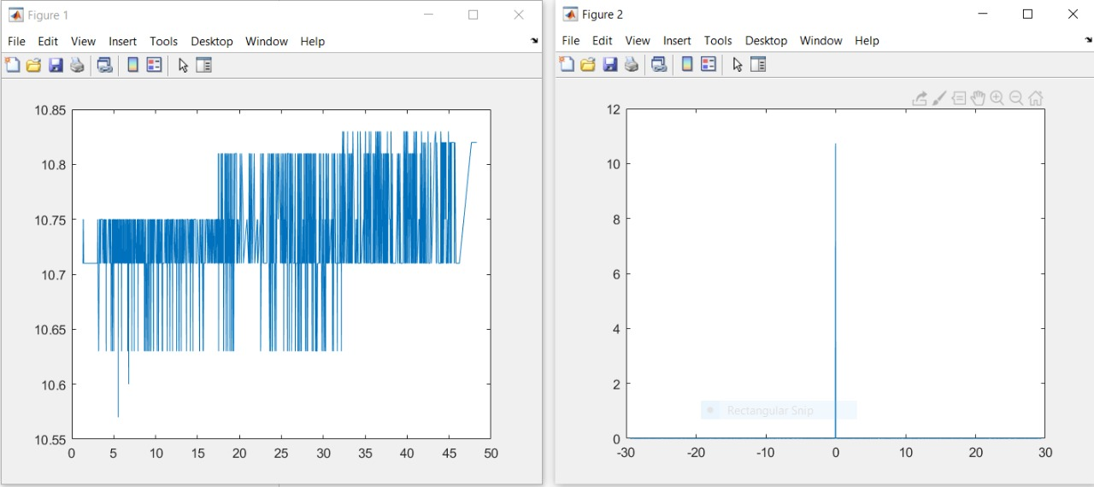
Faculty of Engineering – Ain Shams University (ASU)
Mechatronics Department
Introduction
Overview of Inductive sensor
Analysis of Reading
Accuracy & precision
Fourier series
Overview of Ultrasonic sensor
Analysis of Reading
Accuracy & precision
Fourier series
Overview of Color sensor
Analysis of Reading
Accuracy & precision
Fourier series
correlation between Sensors
Overview of system sorting
Conclusion
Reference

Slide 17
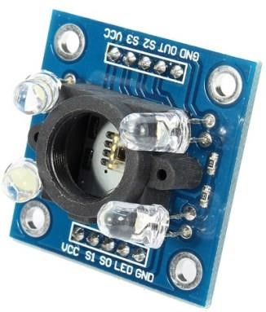
Faculty of Engineering – Ain Shams University (ASU)
Mechatronics Department
Colour Sensor Module( TCS3200):
Introduction
Overview of Inductive sensor
Analysis of Reading
Accuracy & precision
Fourier series
Overview of Ultrasonic sensor
Analysis of Reading
Accuracy & precision
Fourier series
Overview of Color sensor
Analysis of Reading
Accuracy & precision
Fourier series
correlation between Sensors
Overview of system sorting
Conclusion
Reference
This Arduino compatible TCS3200 colour sensor module consist of a TAOS TCS3200 RGB sensor chip and 4 white LEDs. The main part of the module is the TCS3200 chip which is a Colour Light to-Frequency Converter. The white LEDs are used for providing proper lighting for the sensor to detect the object colour correctly. This chip can sense a wide variety of colours and it gives the output in the form of corresponding frequency. This module can be used for making colour sorting robots, test strip reading, colour matching tests, etc.
The TCS3200 chip consist of an 8 x 8 array of photodiodes.
Each photodiode have either a red, green, or blue filter, or no filter. The filters of each colour are distributed evenly throughout the array to eliminate location bias among the colours. Internal circuits includes an oscillator which produces a square-wave output whose frequency is proportional to the intensity of the chosen colour.

Slide 18
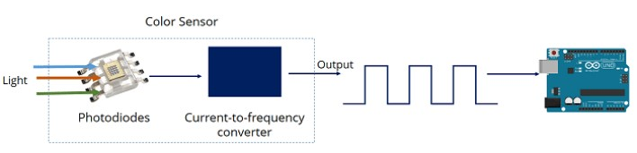
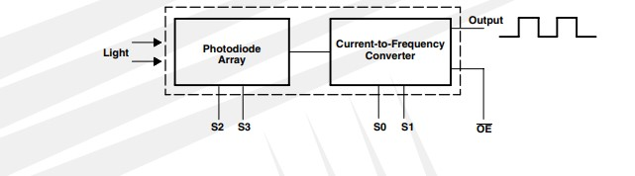
Faculty of Engineering – Ain Shams University (ASU)
Mechatronics Department
The principle of Colour sensor working :
The TCS3200 has an array of photodiodes with 4 different filters. A photodiode is simply a semiconductor device that converts light into current. The sensor has:
16 photodiodes with red filter – sensitive to red wavelength
16 photodiodes with green filter – sensitive to green wavelength
16 photodiodes with blue filter – sensitive to blue wavelength
16 photodiodes without filter
If you take a closer look at the TCS3200 chip you can see the different filters.
By selectively choosing the photodiode filter’s readings, you’re able to detect the intensity of the different colours. The sensor has a current-tofrequency converter that converts the photodiodes’ readings into a square wave with a frequency that is proportional to the light intensity of the chosen colour. This frequency is then, read by the Arduino – this is shown in the figure.
Introduction
Overview of Inductive sensor
Analysis of Reading
Accuracy & precision
Fourier series
Overview of Ultrasonic sensor
Analysis of Reading
Accuracy & precision
Fourier series
Overview of Color sensor
Analysis of Reading
Accuracy & precision
Fourier series
correlation between Sensors
Overview of system sorting
Conclusion
Reference

Slide 19
Faculty of Engineering – Ain Shams University (ASU)
Mechatronics Department
Features and Specifications:
Input voltage: (2.7V to 5.5V)
Interface: Digital TTL
High-resolution conversion of light intensity to frequency
Programmable colour and full-scale output frequency
No need of ADC(Can be directly connected to the digital pins of the microcontroller)
Power down feature
Working temperature: -40oC to 85oC
Size: 28.4x28.4mm(1.12x1.12")
Introduction
Overview of Inductive sensor
Analysis of Reading
Accuracy & precision
Fourier series
Overview of Ultrasonic sensor
Analysis of Reading
Accuracy & precision
Fourier series
Overview of Color sensor
Analysis of Reading
Accuracy & precision
Fourier series
correlation between Sensors
Overview of system sorting
Conclusion
Reference

Slide 20
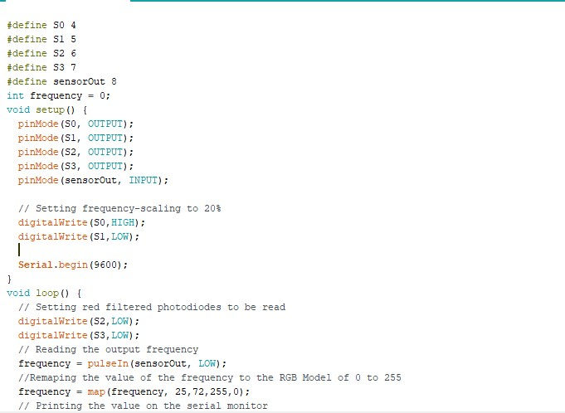
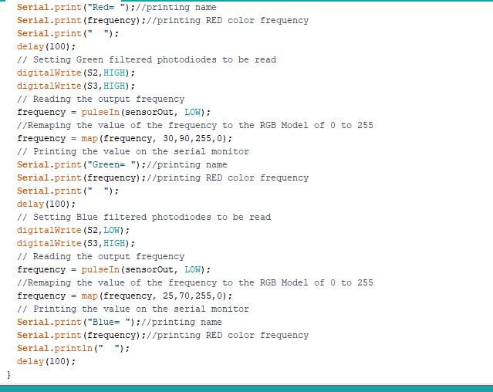
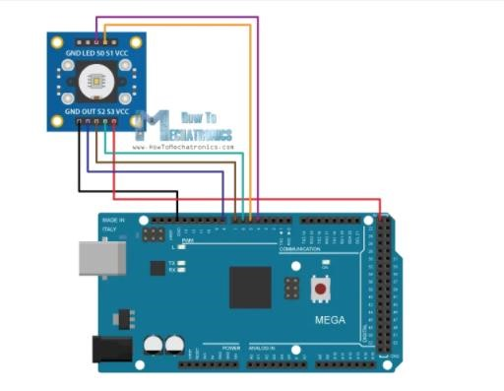
Faculty of Engineering – Ain Shams University (ASU)
Mechatronics Department
Datasheet details that we use during calibration & practical working:
Detecting an object that have Red Colour
Introduction
Overview of Inductive sensor
Analysis of Reading
Accuracy & precision
Fourier series
Overview of Ultrasonic sensor
Analysis of Reading
Accuracy & precision
Fourier series
Overview of Color sensor
Analysis of Reading
Accuracy & precision
Fourier series
correlation between Sensors
Overview of system sorting
Conclusion
Reference
The circuit used in the calibration process :

Slide 21
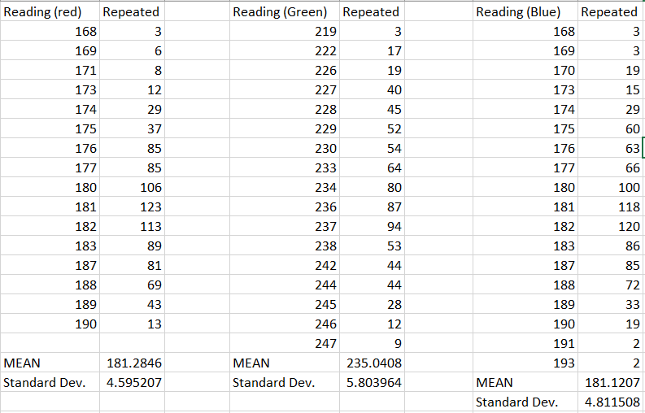
Faculty of Engineering – Ain Shams University (ASU)
Mechatronics Department
Sensor Readings :
Introduction
Overview of Inductive sensor
Analysis of Reading
Accuracy & precision
Fourier series
Overview of Ultrasonic sensor
Analysis of Reading
Accuracy & precision
Fourier series
Overview of Color sensor
Analysis of Reading
Accuracy & precision
Fourier series
correlation between Sensors
Overview of system sorting
Conclusion
Reference

Slide 22
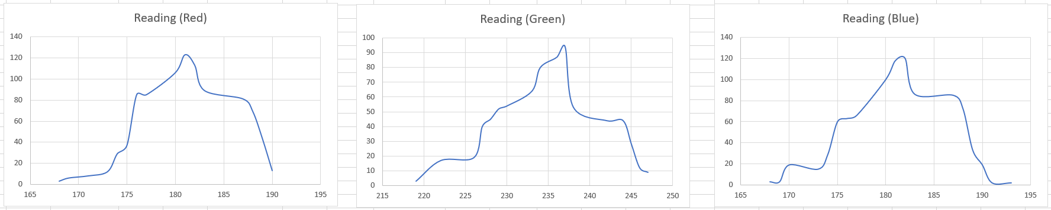
Faculty of Engineering – Ain Shams University (ASU)
Mechatronics Department
Introduction
Overview of Inductive sensor
Analysis of Reading
Accuracy & precision
Fourier series
Overview of Ultrasonic sensor
Analysis of Reading
Accuracy & precision
Fourier series
Overview of Color sensor
Analysis of Reading
Accuracy & precision
Fourier series
correlation between Sensors
Overview of system sorting
Conclusion
Reference
Normal Distribution curve :

Slide 23
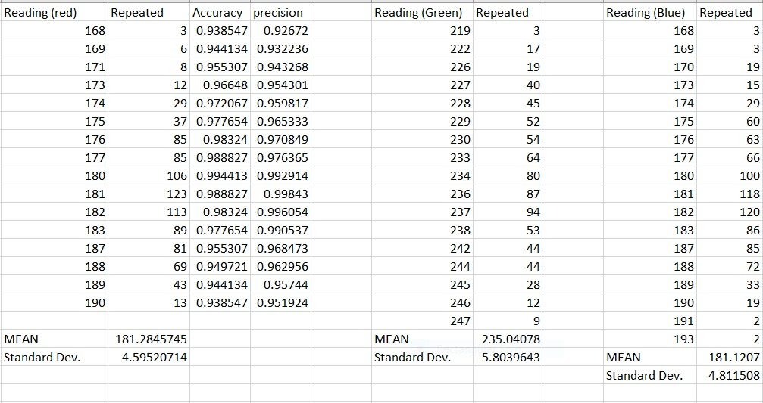
Faculty of Engineering – Ain Shams University (ASU)
Mechatronics Department
Introduction
Overview of Inductive sensor
Analysis of Reading
Accuracy & precision
Fourier series
Overview of Ultrasonic sensor
Analysis of Reading
Accuracy & precision
Fourier series
Overview of Color sensor
Analysis of Reading
Accuracy & precision
Fourier series
correlation between Sensors
Overview of system sorting
Conclusion
Reference

Slide 24
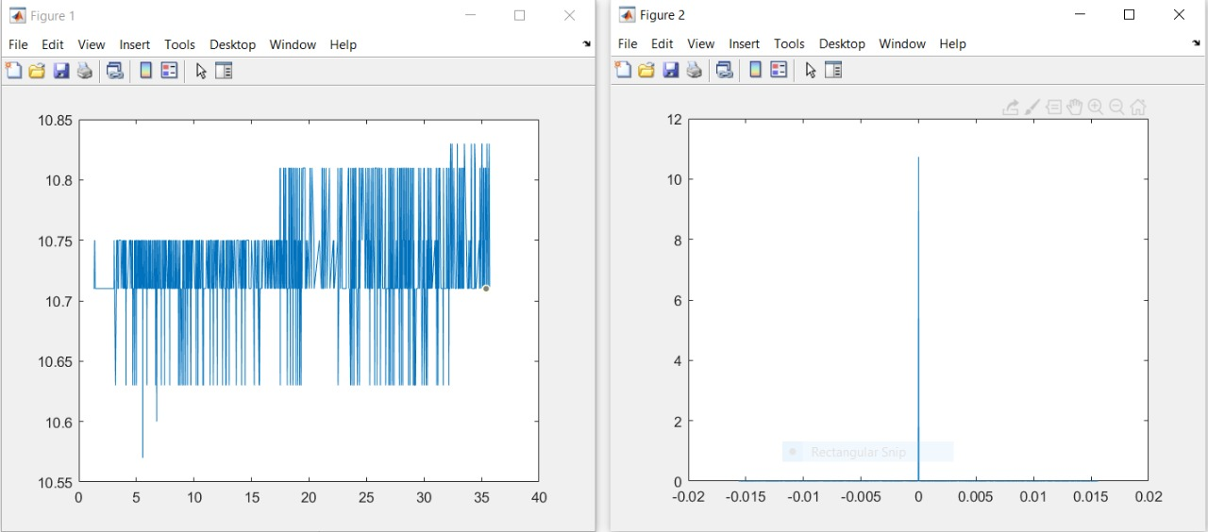
Faculty of Engineering – Ain Shams University (ASU)
Mechatronics Department
Introduction
Overview of Inductive sensor
Analysis of Reading
Accuracy & precision
Fourier series
Overview of Ultrasonic sensor
Analysis of Reading
Accuracy & precision
Fourier series
Overview of Color sensor
Analysis of Reading
Accuracy & precision
Fourier series
correlation between Sensors
Overview of system sorting
Conclusion
Reference
Red Color:

Slide 25
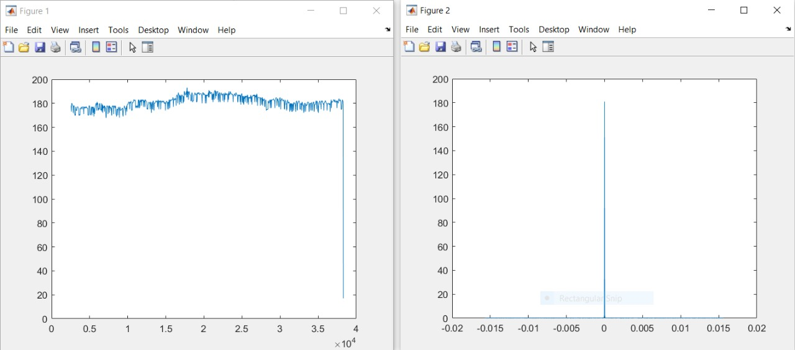
Faculty of Engineering – Ain Shams University (ASU)
Mechatronics Department
Blue Color:
Introduction
Overview of Inductive sensor
Analysis of Reading
Accuracy & precision
Fourier series
Overview of Ultrasonic sensor
Analysis of Reading
Accuracy & precision
Fourier series
Overview of Color sensor
Analysis of Reading
Accuracy & precision
Fourier series
correlation between Sensors
Overview of system sorting
Conclusion
Reference

Slide 26
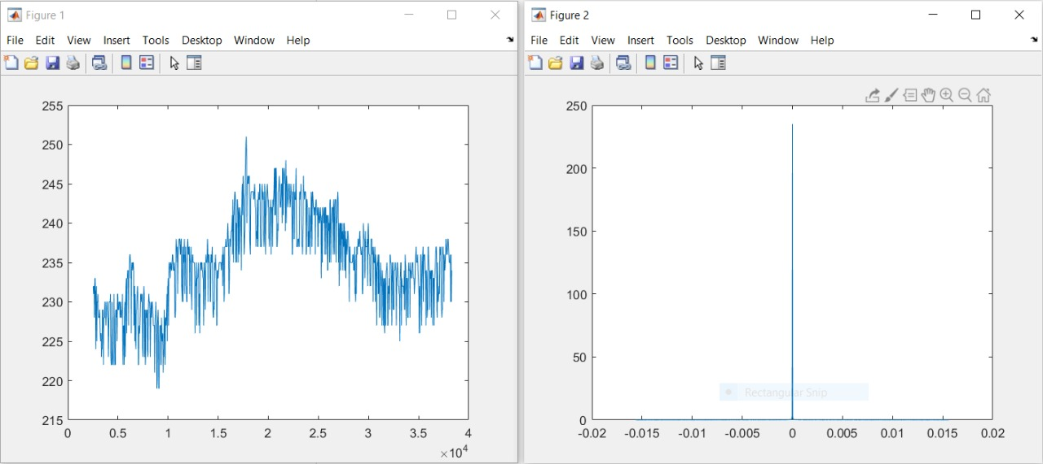
Faculty of Engineering – Ain Shams University (ASU)
Mechatronics Department
Introduction
Overview of Inductive sensor
Analysis of Reading
Accuracy & precision
Fourier series
Overview of Ultrasonic sensor
Analysis of Reading
Accuracy & precision
Fourier series
Overview of Color sensor
Analysis of Reading
Accuracy & precision
Fourier series
correlation between Sensors
Overview of system sorting
Conclusion
Reference
Green Color:

Slide 27
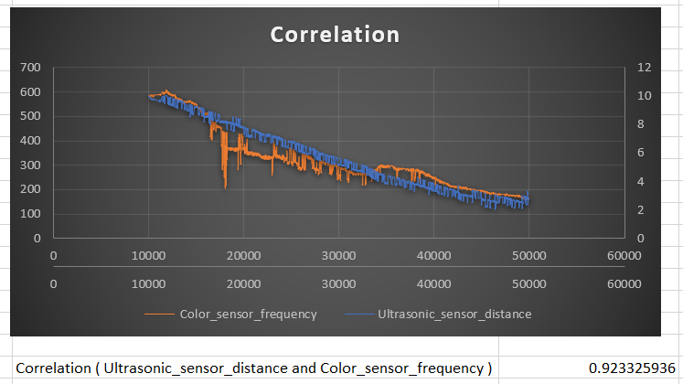
Faculty of Engineering – Ain Shams University (ASU)
Mechatronics Department
Correlation:
( Ultrasonic_sensor_distance and Color_sensor_frequency )
Introduction
Overview of Inductive sensor
Analysis of Reading
Accuracy & precision
Fourier series
Overview of Ultrasonic sensor
Analysis of Reading
Accuracy & precision
Fourier series
Overview of Color sensor
Analysis of Reading
Accuracy & precision
Fourier series
correlation between Sensors
Overview of system sorting
Conclusion
Reference
Correlation at (distance <= 10 )

Slide 28
Faculty of Engineering – Ain Shams University (ASU)
Mechatronics Department
Components:
Arduino Uno
Ultrasonic Sensor(HC-SR04)
Inductive Proximity Sensor(LM12-2004A)
Color Sensor
Stepper Motor(Nema 23)
Nema 23 Driver
Flexible Coupling
Conveyor Belt
LCD Screen
2 Battery (12 v)
Wood Plates
Jumpers
Introduction
Overview of Inductive sensor
Analysis of Reading
Accuracy & precision
Fourier series
Overview of Ultrasonic sensor
Analysis of Reading
Accuracy & precision
Fourier series
Overview of Color sensor
Analysis of Reading
Accuracy & precision
Fourier series
correlation between Sensors
Overview of system sorting
Conclusion
Reference

Slide 29
Faculty of Engineering – Ain Shams University (ASU)
Mechatronics Department
Introduction
Overview of Inductive sensor
Analysis of Reading
Accuracy & precision
Fourier series
Overview of Ultrasonic sensor
Analysis of Reading
Accuracy & precision
Fourier series
Overview of Color sensor
Analysis of Reading
Accuracy & precision
Fourier series
correlation between Sensors
Overview of system sorting
Conclusion
Reference
Pictures of Components

Slide 30
Faculty of Engineering – Ain Shams University (ASU)
Mechatronics Department
Introduction
Overview of Inductive sensor
Analysis of Reading
Accuracy & precision
Fourier series
Overview of Ultrasonic sensor
Analysis of Reading
Accuracy & precision
Fourier series
Overview of Color sensor
Analysis of Reading
Accuracy & precision
Fourier series
correlation between Sensors
Overview of system sorting
Conclusion
Reference
Video of System

Slide 31
Faculty of Engineering – Ain Shams University (ASU)
Mechatronics Department
Introduction
Overview of Inductive sensor
Analysis of Reading
Accuracy & precision
Fourier series
Overview of Ultrasonic sensor
Analysis of Reading
Accuracy & precision
Fourier series
Overview of Color sensor
Analysis of Reading
Accuracy & precision
Fourier series
correlation between Sensors
Overview of system sorting
Conclusion
Reference
Alan S. Morris. (2011). Measurement and Instrumentation Theory and Application(second edition),
Ams Datasheet TCS3200,TCS3210
Elec Freaks Datasheet HC-SR04
Ital-sensor Datasheet LM12-2004A

