Slide 1
Calculator
Under Supervision Of: Dr Ahmed Elnakib
Team Members :
_Nagwa Ebrahem Maher El-Said
_Hala Hany Ahmed
_Neamat Ahmad Ebrahem
_Heba Reda El-Said
_Huda El-Said Hassan Mohamed
_Aya Mohamed Ali Abo-Aljoud
_Merna Mohsen Hassan El-Khireby

Slide 2
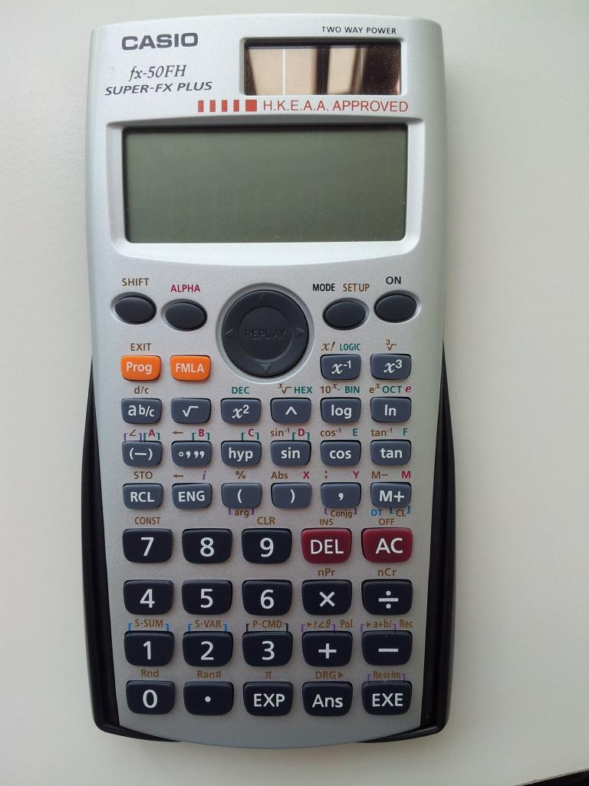
The purpose of the project
the calculator is an extension of a mathematician and it has opened up new possibilities within mathematics. it is a machine though, and it is only capable of doing what it is programmed to do. accordingly, this project aims to develop the internal programmed computational code in the form of a computer program that a simple calculator could use to compute functions such as addition, subtraction, multiplication, division and integer splicing 2 functions.

Slide 3
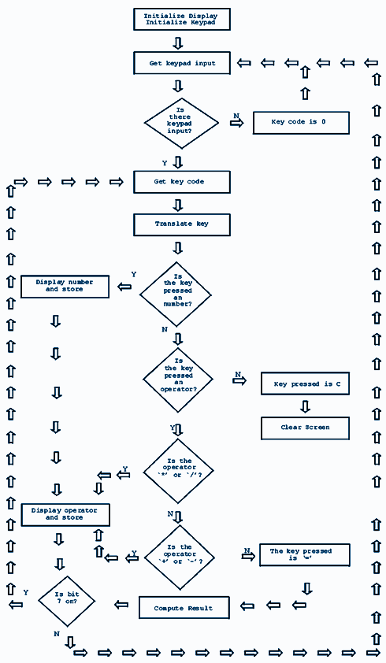
Calculator Program Flowchart

Slide 4
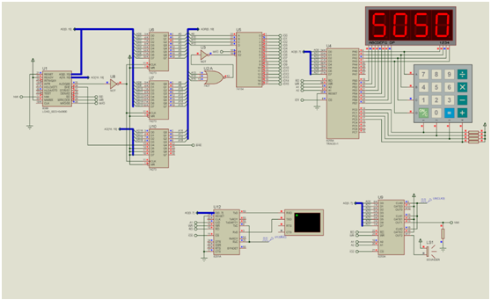
The schematic diagram

Slide 5
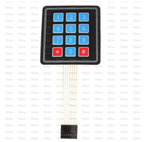
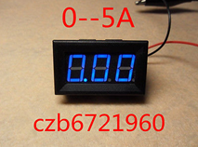
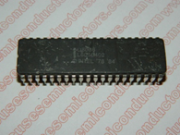
The hardware components
5Pcs Matrix Array 12 Key Membrane Switch Keypad Keyboard For Arduino AVR 4 x 3
2PCS 0.56 inch 4 digit Red led display 7 segment Common cathode
D 8086 / 8086 / INTEL
Microprocessor
Price: US $ 9.95
Price:US $3.13
Price: US $4.57

Slide 6

The code of the calculator (Assembly)
.code ; Skip variable declaration jmp start
; Define some variables charA DB ? charB DB ? result DB ? operator DB ?
Fail:
; Wrong input
mov ah, 09
mov dx, offset msgE
int 21h
Start:
; Put the address of data into ax, ds
mov ax, @data
mov ds, ax
; Ask the user for the first single digit number
mov ah, 09
mov dx, offset
msgA
int 21h
; Use subfunction one to get character from keyboard
mov ah, 01
int 21h
mov charA, al
; Jump if it's less than zero
cmp charA, "0"
jl fail
; Jump if greater than nine
cmp charA, "9"
jg fail
; Ask for second one digit number
mov ah, 09
mov dx, offset msgB
int 21h
; Get input from keyboard for second number mov ah, 01
This program reads two single digit numbers from the Keyboard and performs a mathematical operation on them
_________________________________________________
.model small
.stack ; Stack memory space for program instructions
data
; Some messages to the user
msgA DB "Enter the first one digit number: $"
msgB DB 10, 13, "Enter the second one digit number: $"
msgC DB 10, 13, "Enter which operator must be used: $"
msgD DB 10, 13, 10, 13, "The answer is: $" msgE DB 10, 13, 10, 13, "!! Incorrect input, please retry !!", 10, 13, 10, 13, "$"

Slide 7
; But if it is a minus go to subtraction
cmp operator, "-"
je subtraction
; and if it is a multi go to mutiplication
cmp operator,"."
je multiplication
; If it is neither then jump to fail
jmp fail
addition:
; Add charB to charA and store in ah
mov ah, charA
add ah, charB
; Move ah into result and convert to integer
mov result, ah
sub result, 48
; Jump to extra if the result is >9
cmp result, 58
jnb extra
; Show message
mov ah, 09
int 21h mov charB, a
; Jump if it's less than zero cmp charB, "0" jl fail
; Jump if greater than nine cmp charB, "9" jg fail
; Ask for the operator mov ah, 09 mov dx, offset msgC int 21h
; Store the operator in a variable
mov ah, 01
int 21h
mov operator, al
; If operator is a plus go to addition
cmp operator, "+"
je addition
mov dx, offset msgD
int 21h
; Print the result
mov ah, 02
mov dl, result
int 21h
; Jump to exit
jmp exit
extra:
; Show message "The answer is"
mov ah, 09
mov dx, offset msgD
int 21h
; Load "1" into ah (two single didgit numbers can
; Never be > 18. Therefore we know that if the result
; Is two digits, the first digit must be a "1"
mov ah, 02
mov dl, 49
int 21h

Slide 8
; Find the unit component of the result and print
sub result, 10
mov ah, 02
mov dl, result
int 21h
; Jump to exit
jmp exit
subtraction:
; Jump to negative if charA is below charB
mov ah, charA
cmp ah, charB
jb negative
; Subtract charB from charA
mov ah, charA
sub ah, charB
; Put ah into result and convert to decimal
mov result, ah
add result, 48
; Show message "The answer is" mov ah, 09 mov dx, offset msgD int 21h
; Display result mov ah, 02 mov dl, result int 21h
; Jump to exit jmp exit
negative:
; Subtract charA from charB mov ah, charB sub ah, charA mov result, ah add result, 48
; Display message "The answer is" mov ah, 09 mov dx, offset msgD int 21h
; Print out the negative sign
mov ah, 02
mov dl, 45
int 21h
; Display the result
mov ah, 02
mov dl, result
int 21h
multiplication:
mov ah,charA
mov bh,charB
mul bh ;al*bh always multiply with al register
mov dl,ah
add dl,30h ;show decimal
mov ah,2
int 21h
; Move ah into result and convert to integer
mov result, ah
sub result, 48

Slide 9
; Jump to extra if the result is >9
cmp result, 58
jnb extra
; Show message
mov ah, 09
mov dx, offset msgD
int 21h
; Print the result
mov ah, 02
mov dl, result
int 21h
; Jump to exit
jmp exit
exit:
; Back to system - End program
mov ax, 4c00h
int 21h
; Indicate that no more commands follow
END
" />
How Calculators Works Get The Video:
https://www.youtube.com/watch?v=IyXRiZcIZbw
References
Vintage Calculators Web Museum
http://www.vintagecalculators.com/html/calculator___the_microprocesso.html

