Slide 1
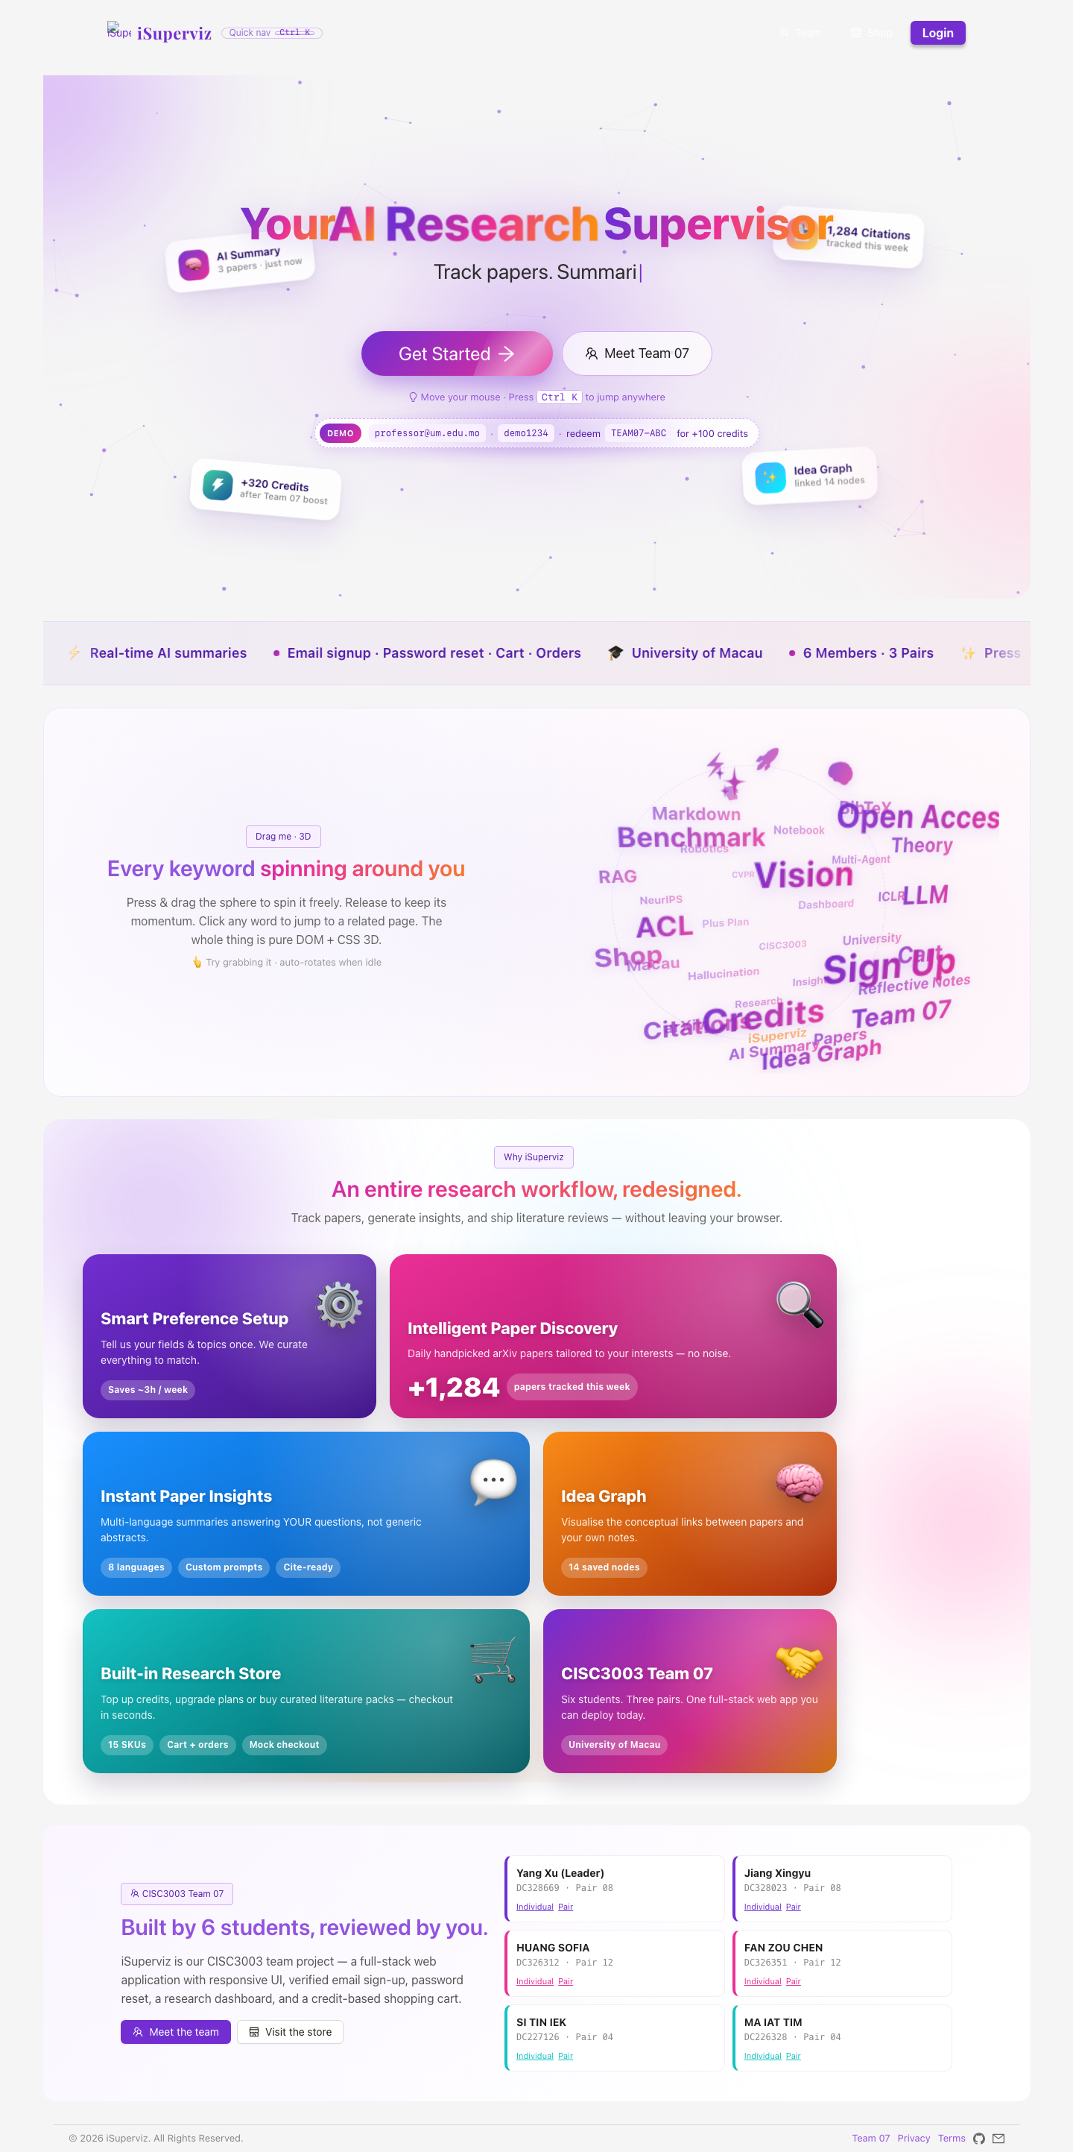
Opening
Personal Digital Story
Yang Xu - Team 07 iSuperviz
Project: iSuperviz - Your AI Research Supervisor
Role: Team lead, integration, frontend and backend work
Goal: show my contribution with website evidence
Yang Xu Personal Digital Story - iSuperviz
1

Slide 2
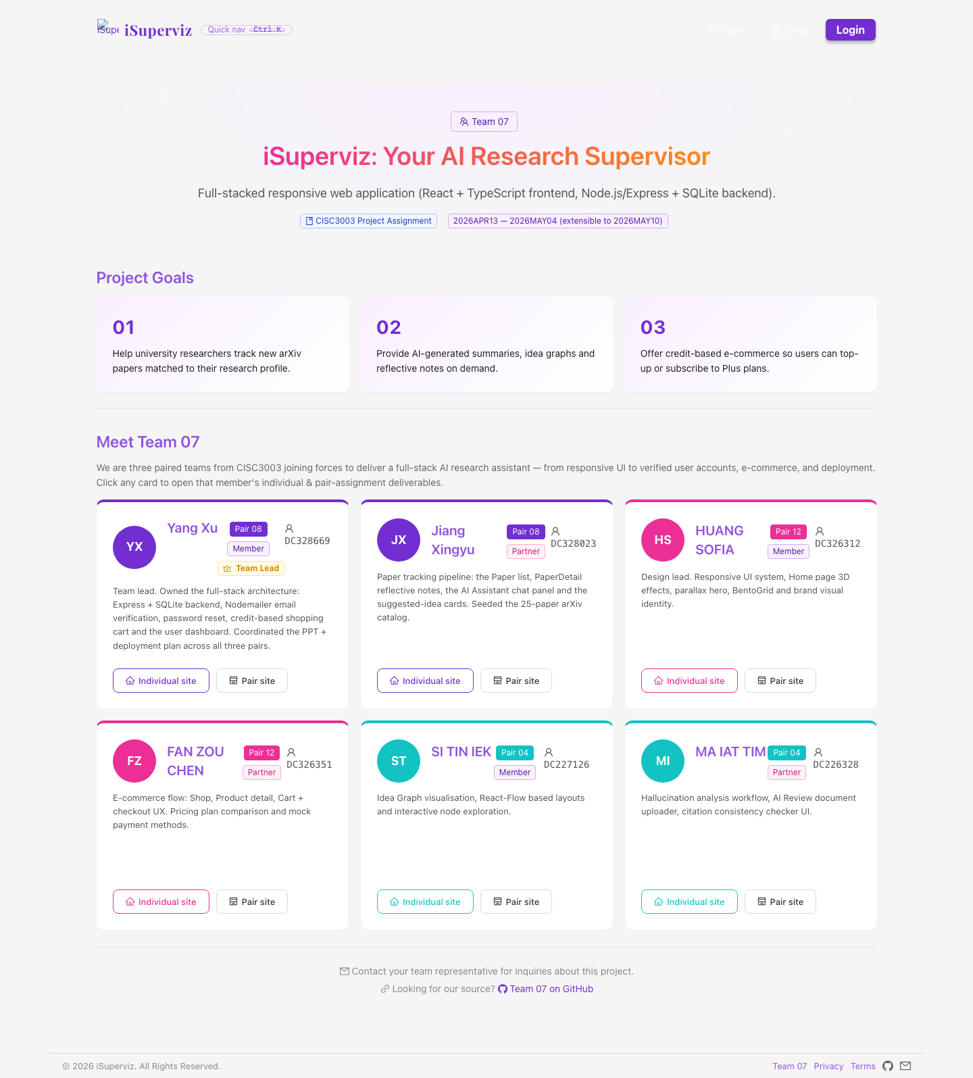
Contribution overview
My Main Responsibilities
Coordinated final project integration
Worked on frontend and backend implementation
Updated deployed GitHub Pages version
Prepared report, coding archive, and submission materials
Yang Xu Personal Digital Story - iSuperviz
2

Slide 3
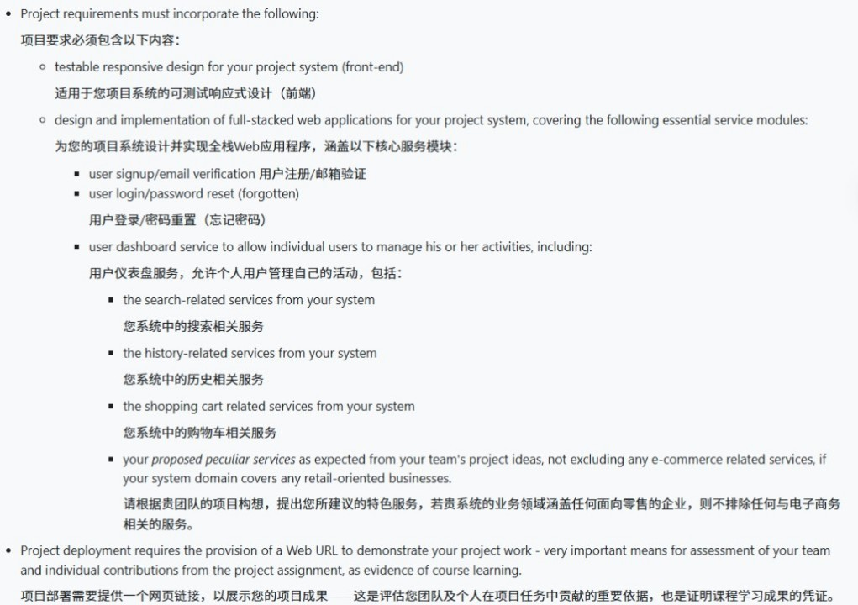
From brief to implementation
Requirement Mapping
Full-stack web application with RWD
Signup, login, password reset, dashboard
Search, history, cart, and special services
Public deployed URL for testing
Yang Xu Personal Digital Story - iSuperviz
3

Slide 4
Frontend, backend, and deployment
React + TypeScript Frontend
Full-Stack Architecture
Frontend: React, TypeScript, Ant Design
Backend: Node.js, Express, SQLite
Mock API for GitHub Pages deployment
Same service logic for online testing
Mock API mirrors backend services for GitHub Pages deployment
Axios API Layer
Shared endpoints: auth, paper, cart, orders, history, credits
Express Backend + SQLite
Yang Xu Personal Digital Story - iSuperviz
4

Slide 5

RWD contribution
Responsive Web Design Evidence
Checked the website on different screen sizes
Used responsive layouts and flexible UI components
Added RWD evidence into the final report
Yang Xu Personal Digital Story - iSuperviz
5

Slide 6
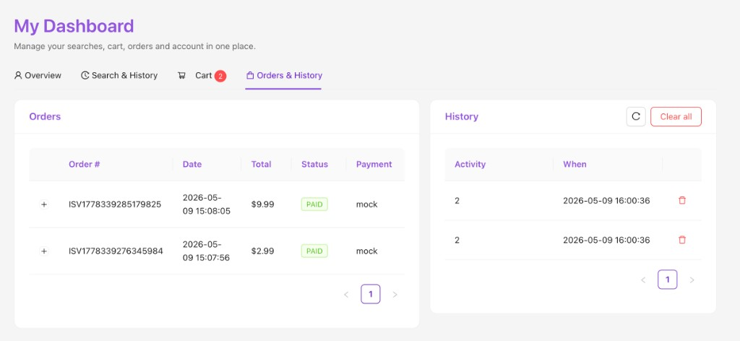
Dashboard service
Dashboard and User Activity
Improved Orders and History display
Connected search history and order records
Made dashboard evidence clear in the report
Yang Xu Personal Digital Story - iSuperviz
6

Slide 7
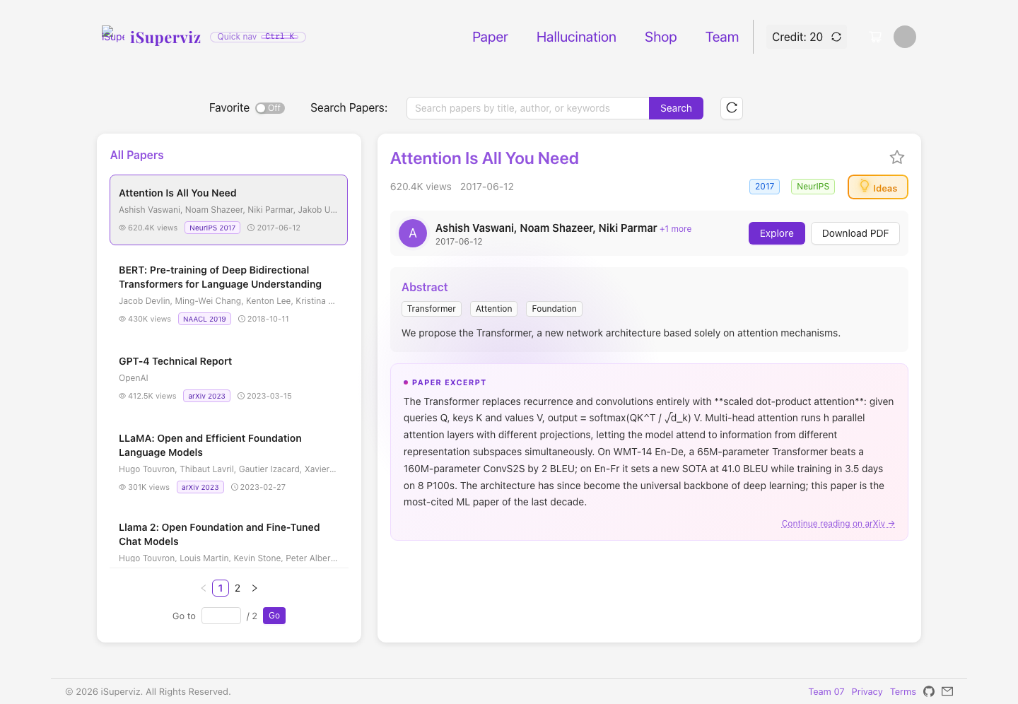
Paper service
Paper Workflow and Credit Actions
Paper search and browsing
Explore paper costs 10 credits
Download PDF costs 10 credits
Header credit balance updates
Yang Xu Personal Digital Story - iSuperviz
7

Slide 8
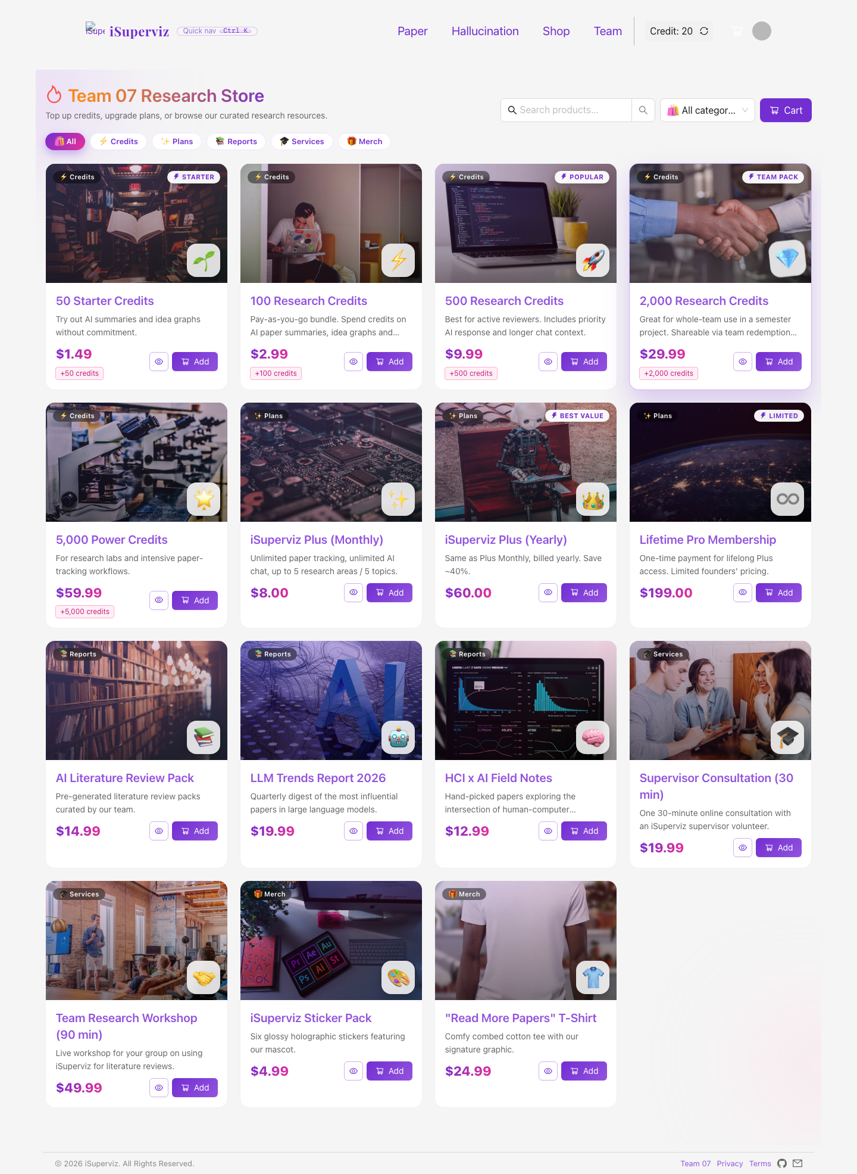
E-commerce service
Shop, Cart, and Checkout
Research store with credit packs and plans
Cart add, update, remove, and checkout
Orders saved after checkout
Yang Xu Personal Digital Story - iSuperviz
8

Slide 9
Public testing URL
Deployment and GitHub Pages Update
Built production bundle
Updated GitHub Pages deployment
Verified new online version
Public URL prepared for forum testing
Yang Xu Personal Digital Story - iSuperviz
9

Slide 10
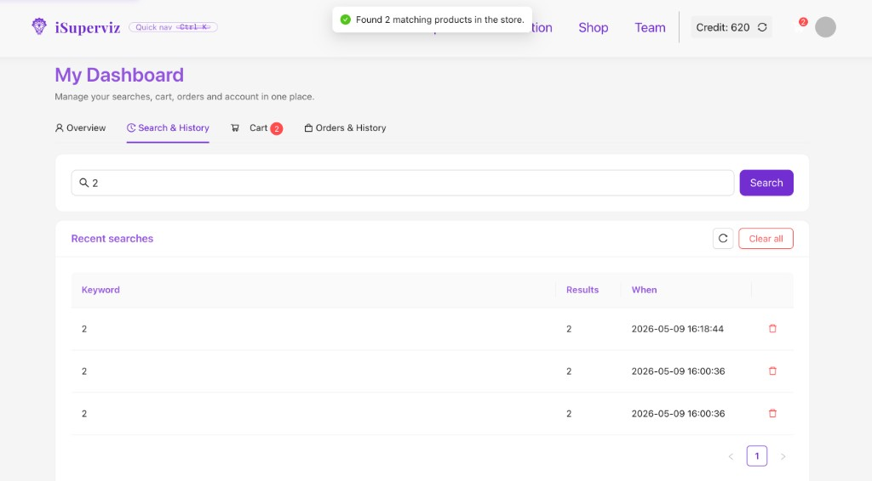
Verification
Testing and Quality Check
Ran project test suite
3 test suites passed
18 tests passed
Checked routes, links, and key workflows manually
Yang Xu Personal Digital Story - iSuperviz
10

Slide 11
Documentation
Report and Submission Materials
Generated final project report
Added screenshots and RWD evidence
Prepared coding archive
Checked requirement coverage
Final Report Prepared
Report includes requirement mapping, RWD evidence, screenshots, references, AI usage declaration, and final checklist.
iSuperviz_Team07_Project_Report_Final.pdf
Yang Xu Personal Digital Story - iSuperviz
11

Slide 12
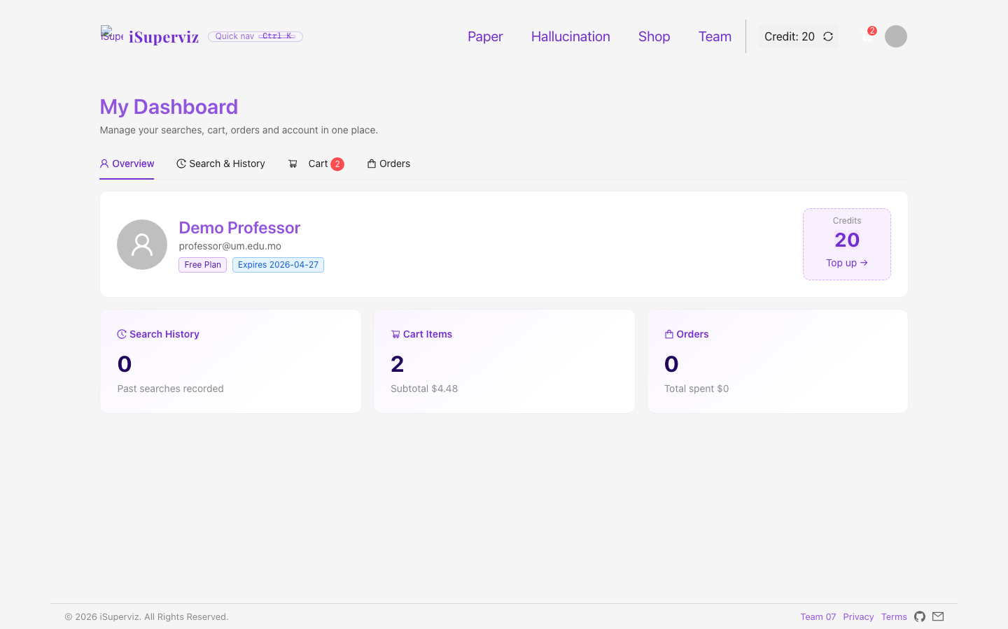
Personal learning
Reflection and Learning
Learned full-stack integration
Practiced deployment and debugging
Improved documentation and requirement mapping
Understood teamwork and final delivery pressure
Yang Xu Personal Digital Story - iSuperviz
12

