Slide 1
New dataset

Slide 2
Raw handcrafted features

Slide 3

Description
SVM settings: nu = 0.1, kernel = linear
Recognition results calculated by the formula: $accuracy= \frac{TP+TN}{TP+TN+FP+FN}$

Slide 4
Results
 | user1 | user2 | user3 | user4 | user5 | user6 | user7 | user8 | user9 | user10 | user11 | user12
Walking | 0,47 | 0,42 | 0,45 | 0,39 | 0,45 | 0,31 | 0,38 | 0,46 | 0,48 | 0,4 | 0,56 | 0,6
 | user13 | user14 | user15 | user16 | user17 | user18 | user19 | user20 | user21 | user22 | user23 | user24
Walking | 0,41 | 0,41 | 0,43 | 0,45 | 0,43 | 0,52 | 0,46 | 0,38 | 0,46 | 0,44 | 0,52 | 0,48
 | user25 | user26 | user27 | user28 | user29 | user30 | user31 | user32 | user33 | user34 | user35 | user36
Walking | 0,42 | 0,38 | 0,62 | 0,37 | 0,4 | 0,41 | 0,5 | 0,4 | 0,41 | 0,42 | 0,45 | 0,42
 | user37 | user38 | user39 | user40 | user41 | user42 | user43 | user44 | user45 | user46 | user47 | user48
Walking | 0,43 | 0,47 | 0,32 | 0,39 | 0,41 | 0,41 | 0,46 | 0,41 | 0,51 | 0,49 | 0,36 | 0,44
 | user49 | user50 | user51 | user52 | user53 | user54 | user55 | user56
Walking | 0,36 | 0,38 | 0,44 | 0,35 | 0,38 | 0,5 | 0,4 | 0,43
Overall accuracy: 0,43
Standard deviation 0,06

Slide 5
Results in terms of FRR and FAR
User: 1
FRR: 0.42857
FAR: 0.53408
User: 2
FRR: 0.42143
FAR: 0.57859
User: 3
FRR: 0.40476
FAR: 0.54657
User: 4
FRR: 0.38293
FAR: 0.60743
User: 5
FRR: 0.46009
FAR: 0.55425
User: 6
FRR: 0.34537
FAR: 0.69250
User: 7
FRR: 0.36201
FAR: 0.61906
User: 8
FRR: 0.44008
FAR: 0.54392
User: 9
FRR: 0.60714
FAR: 0.52491
User: 10
FRR: 0.32251
FAR: 0.60041
User: 11
FRR: 0.53571
FAR: 0.44388
User: 12
FRR: 0.46154
FAR: 0.39741
User: 13
FRR: 0.36369
FAR: 0.59316
User: 14
FRR: 0.41339
FAR: 0.59112
User: 15
FRR: 0.49351
FAR: 0.57377
User: 16
FRR: 0.42207
FAR: 0.54620
User: 17
FRR: 0.41098
FAR: 0.57217
User: 18
FRR: 0.69231
FAR: 0.47745
User: 19
FRR: 0.41516
FAR: 0.54416
User: 20
FRR: 0.38841
FAR: 0.62099
User: 21
FRR: 0.46711
FAR: 0.54388
User: 22
FRR: 0.45511
FAR: 0.56233
User: 23
FRR: 0.48795
FAR: 0.47503
User: 24
FRR: 0.50000
FAR: 0.52155
User: 25
FRR: 0.44186
FAR: 0.57913
User: 26
FRR: 0.36259
FAR: 0.61876
User: 27
FRR: 0.62500
FAR: 0.38299
User: 28
FRR: 0.30144
FAR: 0.63505
User: 29
FRR: 0.41349
FAR: 0.59805
User: 30
FRR: 0.42523
FAR: 0.59499
User: 31
FRR: 0.47793
FAR: 0.50426
User: 32
FRR: 0.37428
FAR: 0.59994
User: 33
FRR: 0.44444
FAR: 0.59494
User: 34
FRR: 0.41667
FAR: 0.57754
User: 35
FRR: 0.41468
FAR: 0.54884
User: 36
FRR: 0.39462
FAR: 0.58600
User: 37
FRR: 0.40898
FAR: 0.57339
User: 38
FRR: 0.41678
FAR: 0.52790
User: 39
FRR: 0.25749
FAR: 0.67933
User: 40
FRR: 0.43115
FAR: 0.60980
User: 41
FRR: 0.36416
FAR: 0.58991
User: 42
FRR: 0.39715
FAR: 0.59222
User: 43
FRR: 0.44668
FAR: 0.53836
User: 44
FRR: 0.39924
FAR: 0.59187
User: 45
FRR: 0.45094
FAR: 0.49212
User: 46
FRR: 0.44024
FAR: 0.51314
User: 47
FRR: 0.36196
FAR: 0.64144
User: 48
FRR: 0.44552
FAR: 0.55689
User: 49
FRR: 0.26068
FAR: 0.63826
User: 50
FRR: 0.41030
FAR: 0.62434
User: 51
FRR: 0.31034
FAR: 0.56259
User: 52
FRR: 0.38487
FAR: 0.65535
User: 53
FRR: 0.38851
FAR: 0.61877
User: 54
FRR: 0.60691
FAR: 0.50265
User: 55
FRR: 0.34767
FAR: 0.60537
User: 56
FRR: 0.38017
FAR: 0.56569
Mean:
FRR: 0.42292
FAR: 0.56723

Slide 6
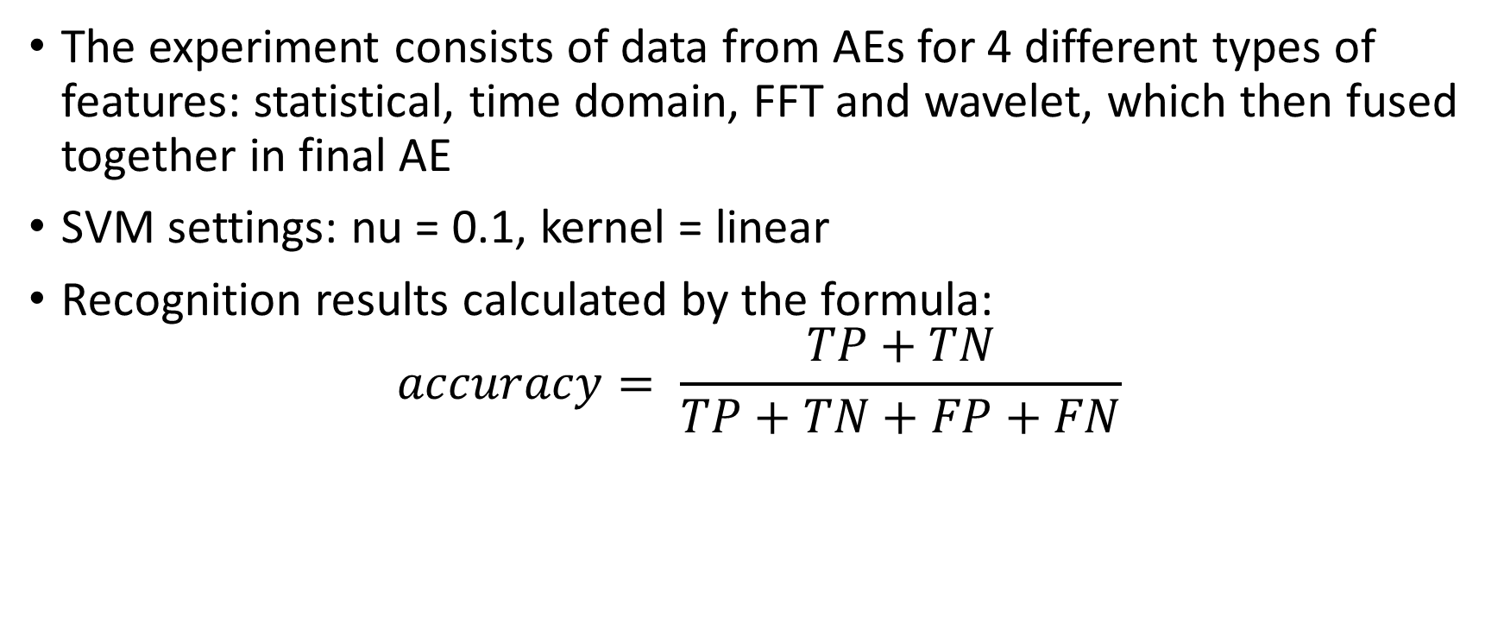
Description
The experiment consists of data from AEs for 4 different types of features: statistical, time domain, FFT and wavelet, which then fused together in final AE
SVM settings: nu = 0.1, kernel = linear
Recognition results calculated by the formula: $accuracy= \frac{TP+TN}{TP+TN+FP+FN}$

Slide 7
Results
 | user1 | user2 | user3 | user4 | user5 | user6 | user7 | user8 | user9 | user10 | user11 | user12
Accuracy | 97,21 | 94,1 | 97,35 | 98,52 | 92,62 | 90,57 | 89,34 | 91,75 | 99,27 | 91,67 | 96,04 | 99,62
Samples | 313 | 696 | 1677 | 2281 | 13026 | 14259 | 15921 | 9676 | 136 | 6461 | 3640 | 126
 | user13 | user14 | user15 | user16 | user17 | user18 | user19 | user20 | user21 | user22 | user23 | user24
Accuracy | 99,92 | 43,78 | 50,02 | 98,51 | 48,93 | 49,2 | 99,89 | 51,25 | 46,41 | 47,29 | 99,92 | 43,78
Samples | 9003 | 5596 | 385 | 2855 | 7467 | 126 | 2769 | 5778 | 7522 | 1613 | 4978 | 1658
 | user25 | user26 | user27 | user28 | user29 | user30 | user31 | user32 | user33 | user34 | user35 | user36
Accuracy | 61,56 | 46,29 | 58,6 | 69,45 | 47,73 | 99,64 | 85,33 | 60,52 | 47,64 | 47,6 | 53,97 | 90,68
Samples | 1288 | 6947 | 196 | 1045 | 1701 | 8121 | 2603 | 4353 | 943 | 7559 | 7559 | 7611
 | user37 | user38 | user39 | user40 | user41 | user42 | user43 | user44 | user45 | user46 | user47 | user48
Accuracy | 46,47 | 51,68 | 50,58 | 59,98 | 48,47 | 44,31 | 51,56 | 55,66 | 48,96 | 50,27 | 50,45 | 47,83
Samples | 2005 | 3572 | 6505 | 6645 | 1728 | 4201 | 3985 | 2628 | 2395 | 5936 | 2441 | 3625
 | user49 | user50 | user51 | user52 | user53 | user54 | user55 | user56
Accuracy | 45,62 | 50,27 | 50,46 | 50,43 | 50,7 | 90,46 | 67,4 | 47,39
Samples | 3391 | 3008 | 870 | 1518 | 3653 | 2313 | 4183 | 602
Overall accuracy: 66,16964
Standard deviation: 21,45852

Slide 8
Results in terms of FRR and FAR
User: 1
FRR: 0.11111
FAR: 0.02863
User: 2
FRR: 0.10000
FAR: 0.06188
User: 3
FRR: 0.10417
FAR: 0.02722
User: 4
FRR: 0.10284
FAR: 0.01467
User: 5
FRR: 0.09632
FAR: 0.07346
User: 6
FRR: 0.09502
FAR: 0.09444
User: 7
FRR: 0.11020
FAR: 0.10594
User: 8
FRR: 0.10434
FAR: 0.08359
User: 9
FRR: 0.35714
FAR: 0.00516
User: 10
FRR: 0.11678
FAR: 0.08184
User: 11
FRR: 0.09203
FAR: 0.03941
User: 12
FRR: 0.23077
FAR: 0.00407
User: 13s
FRR: 0.26923
FAR: 0.00074
User: 14
FRR: 0.30650
FAR: 0.56483
User: 15
FRR: 0.36250
FAR: 0.48859
User: 16
FRR: 0.18182
FAR: 0.01407
User: 17
FRR: 0.41681
FAR: 0.49132
User: 18
FRR: 0.42905
FAR: 0.48172
User: 19
FRR: 0.15385
FAR: 0.00146
User: 20
FRR: 0.23466
FAR: 0.49523
User: 21
FRR: 0.35208
FAR: 0.52004
User: 22
FRR: 0.41395
FAR: 0.50544
User: 23
FRR: 0.15480
FAR: 0.38530
User: 24
FRR: 0.21586
FAR: 0.52785
User: 25
FRR: 0.12651
FAR: 0.42071
User: 26
FRR: 0.10465
FAR: 0.30153
User: 27
FRR: 0.36978
FAR: 0.55627
User: 28
FRR: 0.25000
FAR: 0.00293
User: 29
FRR: 0.14354
FAR: 0.14335
User: 30
FRR: 0.11144
FAR: 0.39824
User: 31
FRR: 0.36923
FAR: 0.52230
User: 32
FRR: 0.21497
FAR: 0.51925
User: 33
FRR: 0.30310
FAR: 0.47638
User: 34
FRR: 0.12169
FAR: 0.09437
User: 35
FRR: 0.37434
FAR: 0.52784
User: 36
FRR: 0.34590
FAR: 0.51397
User: 37
FRR: 0.34340
FAR: 0.50935
User: 38
FRR: 0.11721
FAR: 0.40265
User: 39
FRR: 0.30210
FAR: 0.50874
User: 40
FRR: 0.40354
FAR: 0.54047
User: 41
FRR: 0.31603
FAR: 0.49483
User: 42
FRR: 0.14740
FAR: 0.44159
User: 43
FRR: 0.31748
FAR: 0.52824
User: 44
FRR: 0.37767
FAR: 0.49779
User: 45
FRR: 0.37643
FAR: 0.49837
User: 46
FRR: 0.37787
FAR: 0.51965
User: 47
FRR: 0.32828
FAR: 0.53189
User: 48
FRR: 0.23108
FAR: 0.48642
User: 49
FRR: 0.29793
FAR: 0.50966
User: 50
FRR: 0.22091
FAR: 0.49898
User: 51
FRR: 0.33721
FAR: 0.46733
User: 52
FRR: 0.13218
FAR: 0.09860
User: 53
FRR: 0.09539
FAR: 0.32501
User: 54
FRR: 0.33653
FAR: 0.52003
User: 55
FRR: 0.15767
FAR: 0.44787
User: 56
FRR: 0.37276
FAR: 0.53102
Mean:
FRR: 0.24172
FAR: 0.33808

