Slide 1


System of record
Flat, rigid data
Integrations
System of engagement
Flexible data
Caching / session
Notes:
The example code in this video shows an either/or situation
It's all SQL or it's all Couchbase
But in real projects, SQL and Couchbase can work side by side
Use or keep SQL as a system of record, use Couchbase as a system of engagement
Couchbase can be used as a system of record too, but it might make more sense to your project to keep SQL,
Deal with the flat, rigid data, keep the existing integrations and then…
…use Couchbase when it makes sense to for other parts of the system. As a cache, session provider, profile storage, full text search, when you need schema flexibility, scaling flexibility, etc
But in this session, to keep things simple, it's going to be an either/or: all couchbase or all SQL server

Slide 2
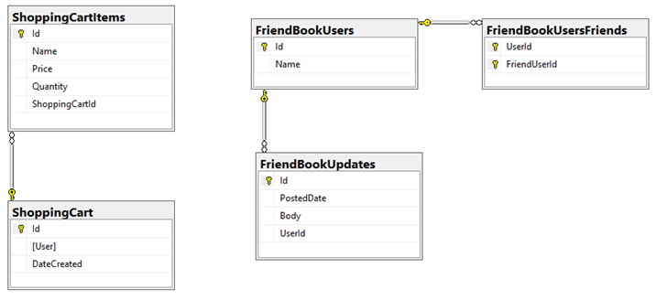

Slide 3
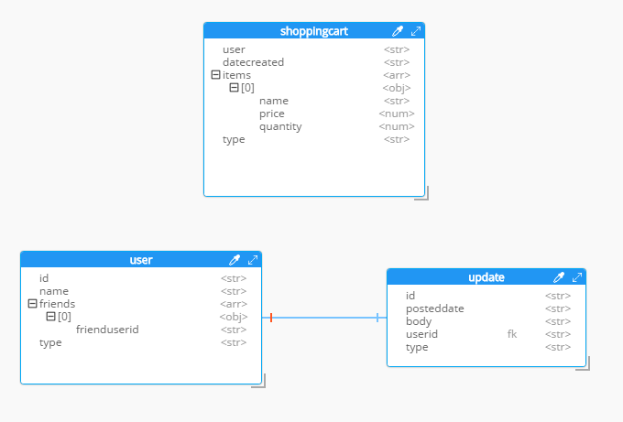


Slide 5
http://tinyurl.com/SqlToCbSrc
https://blog.couchbase.com/moving-from-sql-server-to-couchbase-part-1-data-modeling/

