Slide 1
Note to presenters
This is provided by csunplugged.org, as a demonstration of frustrating user interfaces.
You can use it by asking your audience to call out the COLOUR (not the writing) of each word as you put it up. After a humourous and frustrating time of that, ask them what button you press in Windows XP/98 to stop the computer. This leads to a discussion of frustrating and contradictory interfaces, and the need for interface designers to think more about their audience.
Use the native language of your audience (or to reverse the effect, you can show how it’s much easier to do the exercise if you can’t read the language – another way is to take off your glasses or squint at the image).
Note that data projectors are notorious for making colours look different, so check out the particular projector first. Sometimes it’s better to use physical cards.
For follow-up, consider sites like http://www.useit.com/, and books like Normans “Design of Everyday things”.
If you have any improvements to this file, please share them via tim.bell@canterbury.ac.nz

Slide 2
The Stroop effect...
English
Chinese
Svensk
Japanese
Korean

Slide 3
The Stroop Effect
(English)

Slide 4
BLUE

Slide 5
GREEN

Slide 6
RED

Slide 7
PURPLE

Slide 8
BLACK

Slide 9
YELLOW

Slide 10
PURPLE

Slide 11
GREEN

Slide 12
BLUE

Slide 13
Human-computer interaction

Slide 14
Stop the computer...

Slide 15
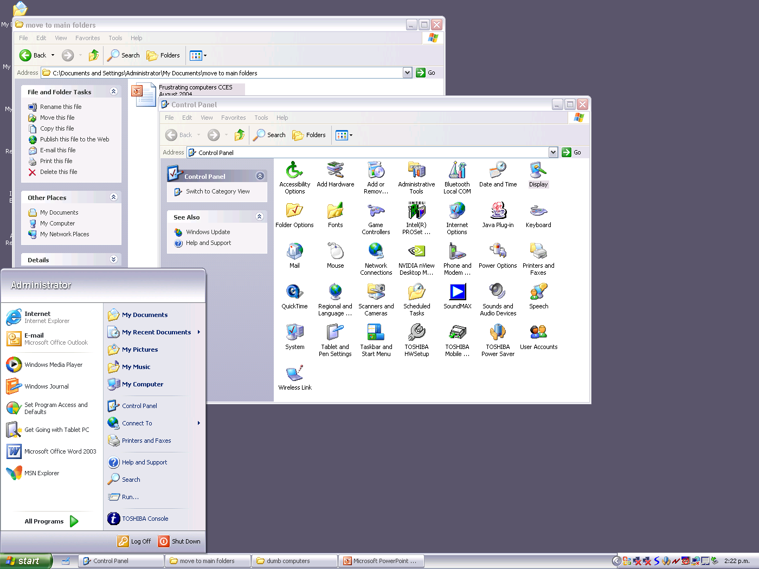
Stop the computer...

Slide 16
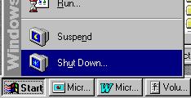
Stop the computer...

Slide 17
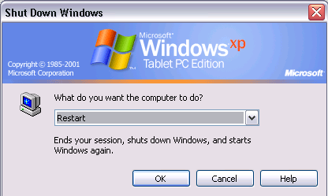
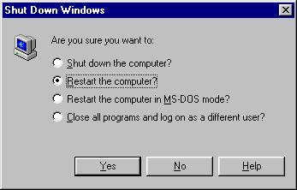

Slide 18
(end)

Slide 19
Stroop effect in Chinese

Slide 20
蓝
Notes:
Color: hon (red)
word: lan (blue)

Slide 21
红
Notes:
Color: lan (blue)
Word: hon(red)

Slide 22
红
Notes:
Color: lju (green)
Word: hon (red)

Slide 23
紫
Notes:
Color: hon (red)
Word: zi (purple)

Slide 24
黑
Notes:
Color: huan (yellow)
Word: hei (black)

Slide 25
黄
Notes:
Color: lju (green)
Word: huan(yellow)

Slide 26
紫
Notes:
Color: hei (black)
Word: zi (purple)

Slide 27
蓝
Notes:
Color: hon (red)
Word: lan (blue)

Slide 28
绿
Notes:
Color: lan (blue)
Word: lju (green)

Slide 30
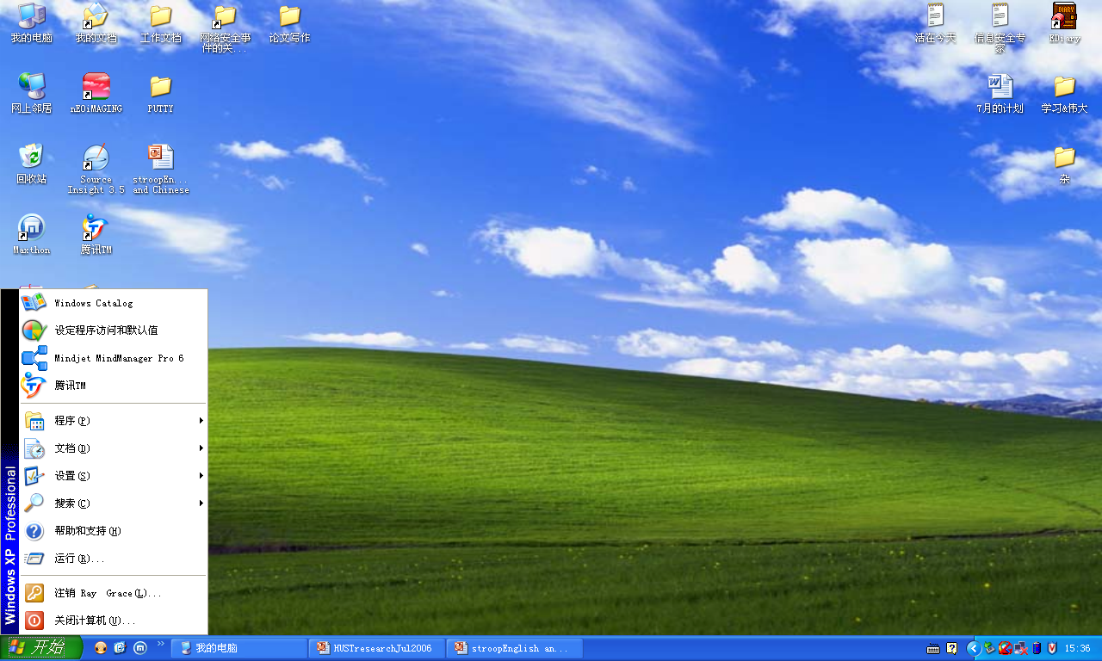

Slide 31
Notes:
kaisi

Slide 32
The Stroop effect...
SV

Slide 33
BLÅ

Slide 34
GRÖN

Slide 35
RÖD

Slide 36
LILA

Slide 37
SVART

Slide 38
GUL

Slide 39
LILA

Slide 40
GRÖN

Slide 41
BLÅ

Slide 42
HCI

Slide 43
Stroop effect in Japanese

Slide 44
青
Notes:
Color: aka (red)
word: ao (blue)

Slide 45
赤
Notes:
Color: ao (blue)
Word: aka(red)

Slide 46
赤
Notes:
Color: midori (green)
Word: aka (red)

Slide 47
紫
Notes:
Color: aka (red)
Word: murasaki (purple)

Slide 48
黒
Notes:
Color: ki (yellow)
Word: kuro (black)

Slide 49
黄
Notes:
Color: midori (green)
Word: ki(yellow)

Slide 50
紫
Notes:
Color: kuro (black)
Word: murasaki (purple)

Slide 51
青
Notes:
Color: aka (red)
Word: ao (blue)

Slide 52
緑
Notes:
Color: ao (blue)
Word: midori (green)

Slide 54

Notes:
kaisi

Slide 55
Korean

Slide 56
파랑
Notes:
Word: palang (blue)
Colour: bigang (red)

Slide 57
초록
Notes:
Word: choro (green)
Colour: parang (blue)

Slide 58
빨강
Notes:
Word: bagang (red)
Colour: choru (green)

Slide 59
보라
Notes:
Word: pora (purple)
Colour: bigang (red)

Slide 60
검정
Notes:
Word: komtong (black)
Colour: norang (yellow)

Slide 61
노랑
Notes:
Word: norang (yellow)
Colour: choru (green)

Slide 62
보라
Notes:
Word: pora (purple)
Colour: kumjung (black)

Slide 63
초록
Notes:
Word: choru (blue)
Colour: parang (blue)

Slide 64
파랑
Notes:
Word: palang (blue)
Colour: bigang (red)

Slide 65
HCI

Slide 66
COMPUTER
SCIENCE
csunplugged.org

