Slide 1
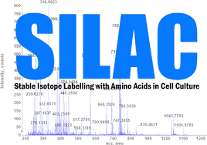


Slide 2
SILAC is predicated on direct addition of selected stable isotope amino acids into the cell culture medium, allowing superior measuring of the cellular proteome compared to other labeling methods. the nice advantages of SILAC exist its straight-forward implementation, quantitative accuracy, and reproducibility over chemical labeling or label-free quantification strategies, favoring its adoption for proteomic research. SILAC has been widely applied to characterize the proteomic changes between different biological samples, to analyze dynamic
introduction
introduction

Slide 3
changes of protein PTMs, to differentiate specific interacting proteins in interaction proteomic analysis, and to investigate protein turnover within the proteome-wide scale. this review summarizes the principles of SILAC technology, its applications
Stable isotope labeling by amino acids in cell culture (SILAC) is a powerful method to study the relative proteomic change under differential treatments, which relies on the mass spectrometry and the metabolic incorporation of amino acids with substituted stable isotopic nuclei. In SILAC, a given 'light'

Slide 4
or 'heavy' form of the amino acid is incorporated into two samples. Two cell populations are grown in culture media that are identical except that one of them contains a 'light' and the other contains a 'heavy' form of a particular amino acid (e.g. 12C and 13C labeled L-lysine, respectively). As the two isotopically labeled amino acids are essentially chemically identical, their incorporation does not interfere with normal cell growth, while leading to proteins/peptides that are distinguishable by mass and thus are ideal for mass spectrometric analysis. SILAC approaches are well suited for monitoring changes in post-translational modifications.

Slide 5
How SILAC works
First, how does mass spectrometry work:
1- Proteins are first ionized by peptides using an ionic source.
2- The resulting ions are separated according to their mass to
charge ratio by mass analysis.
3- Detection of ions.
Two groups of cells are grown in cell culture. Then we feed
one of these two groups with a growth medium containing
regular amino acids. Feeding the other group a growth
medium containing amino acids labeled with stable (non-
radioactive) heavy isotopes, for example arginine, which
contains six carbon-13 atoms instead of normal carbon c12,
and when these cells grow in that medium, heavy arginine
is incorporated into all their proteins . All peptides
containing one arginine are 6Da heavier than their normal
counterparts.

Slide 6
Second, the way the SILAC works
SILAC works in two phases:
1- Adaptation stage:
At this point the cells are cultured in light and even heavy silac medium until all the heavy amino acids have been incorporated into the growing cells, which can be assessed by MS.
2- Experimental phase: The two groups of cells are treated in different ways for the purpose of the research. Then the mixed cell environment is studied first of the protein solution and then the samples are analyzed using LC-MC/MS to determine and measure the ratios of heavy peptides to light peptides.

Slide 7
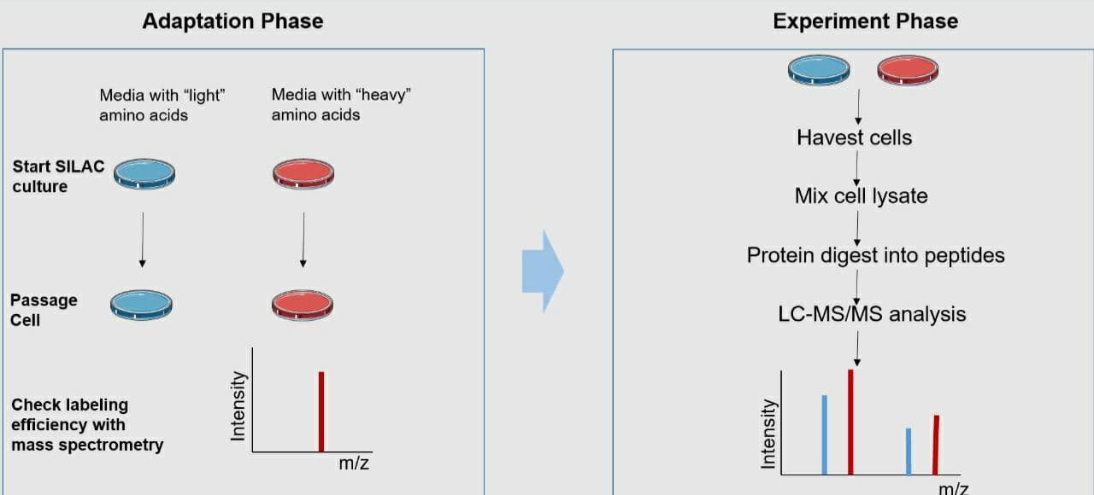


Slide 8
Advantages
1- Efficiency:- The efficiency of SILAC is high, it is not affected
by the solution and may reach 100%.
2- Sensitivity: Silac is highly sensitive as it requires small
samples, usually tens of micrograms of protein per sample.
3- Productivity:- Its productivity is high. It uses a mass meter
that can identify hundreds and thousands of proteins at one
time.

Slide 9
4- High precision:- Multiple samples are mixed, simultaneously digested, and identified. The subsequent experiments have the same effect on the sample, which reduces the impact of experimental operation and equipment, and has higher precision and reproducibility.
5-Comprehensive services: Combined with other technologies, we can provide protien protien iteraction and post translation modification analysis.
6-High activity: The label uses in vivo labeling technology and is closer to the true state of the sample.

Slide 10
THE USES OF SILAC
1- use SILAC for Phosphotyrosine Protein Identification and
Quantitation
- In eukaryotic cells, phosphorylation mainly occurs on
serine, threonine, and tyrosine residues .
- tyrosine phosphorylation plays critical roles in regulating
intracellular signal transduction .
2-Stable isotope labeling by amino acids in cell culture
(SILAC) is an excellent approach for high-accuracy
quantitative
proteomics .

Slide 11
3- use SILAC for quantitative proteomic approach in any cell
culture system.
4- Treatment of Stroke
5-Treatment of Head injury
6-Treatment of Alzheimer's disease
7-Treatment of Dementia in Parkinson's disease
8- use SILAC for quantify protein expression differences in up
to 2 or 3 samples from cells
Cells are grown in identical conditions, with one cell line incorporating heavy isotopic amino acids (usually Arginine and Lys ) thereby taking
9- use Stable isotope labeling is widely for encode and quantify proteins in mass-spectrometry-based proteomics

Slide 12
Team members
1) Elshaymaa Ahmed Hassan
2) Hasnaa Mohamed Kamel
3) Asmaa Hamed Farghali
4) Aya Ahmed Mohamed
5) Youstina Raafat Sobhi
6) Alaa Atef Mubarak

Slide 13
Thank you

