Slide 1
High Performance Web Sites
Much of the material derives from Steve Souders (SpeedCurve) and Tenni Theurer (Visa), formerly at Yahoo!
Copyright 2009 - 2018 Ellis Horowitz and Marco Papa

Slide 2
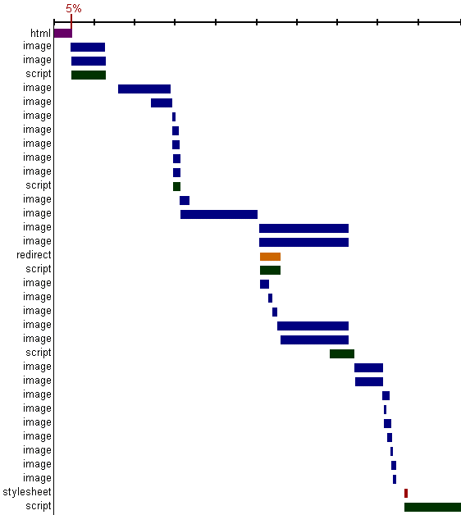
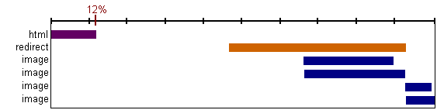
The Importance of Front-End Performance
html
script
script
stylesheet
The graph shows the
time taken to download
an html file and various
associated image files,
JavaScript files, and
the order of downloading;
Note the time to download
the html is a very small
percentage of the total
Time
(See Firebug’s Net tab “timeline”)
Copyright 2009 - 2018 Ellis Horowitz and Marco Papa

Slide 3
Where Is The Most Of The Time Spent
 | Empty Cache | Full Cache
amazon.com | 82% | 86%
aol.com | 94% | 86%
cnn.com | 81% | 92%
ebay.com | 98% | 92%
google.com | 86% | 64%
msn.com | 97% | 95%
myspace.com | 96% | 86%
wikipedia.org | 80% | 88%
yahoo.com | 95% | 88%
youtube.com | 97% | 95%
percentage of time spent on the front-end
A study of popular
web pages and the
time to download them
showed that the vast
majority of time is spent on the client side;
This is true even if the
page has been cached
Copyright 2009 - 2018 Ellis Horowitz and Marco Papa

Slide 4
The Performance Golden Rule
80-90% of the end-user response time is spent on the front-end. So start there
  Greater potential for improvement
  Simpler to optimize
  Proven to work
Copyright 2009 - 2018 Ellis Horowitz and Marco Papa

Slide 5
80/20 Performance Rule
Vilfredo Pareto:
  “80% of the consequences come from 20% of the causes”
  See:
  https://yuiblog.com/blog/2006/11/28/performance-research-part-1/
Software Engineering: “80% of time spent in 20% of the code”
Focus on the 20% that affects 80% of the end-user response time
Web pages: 10% fetch HTML, 90% spent on fetching Images, scripts and stylesheets
I.e. Start at the front-end
Copyright 2009 - 2018 Ellis Horowitz and Marco Papa

Slide 6
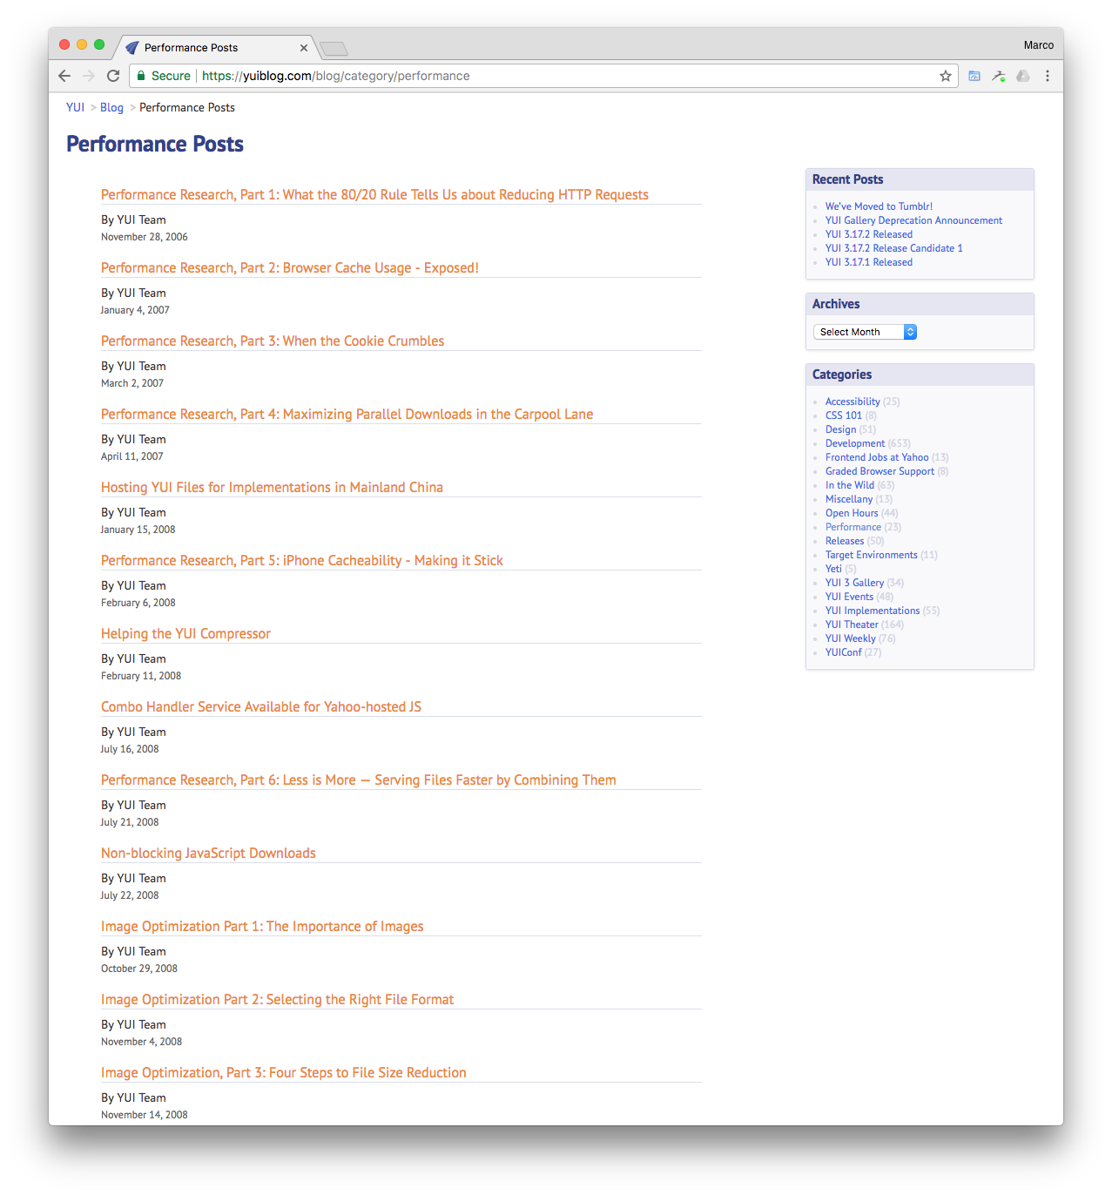
Yahoo Interface / Engineering Blogs
Most of the work on how to improve the performance of Web sites was done by Steve Souders and Tenni Theurer at Yahoo.com. Original blog site contains performance posts (2006-2011)
http://yuiblog.com/blog/category/performance
Steve Souders became Head Performance Engineer at Google, then to Fastly, a CDN, and now is at SpeedCurve. See his work at:
http://stevesouders.com
“SpeedCurve provides insight into the interaction between performance and design to help companies deliver fast and engaging user experiences.”
Tenni Theurer moved to VISA.
Copyright 2009 - 2018 Ellis Horowitz and Marco Papa

Slide 7
Browser Cache Experiment
An “empty cache” means the browser bypasses the disk cache and has to request all the components to load the page.
A “full cache” means all (or at least most) of the components are found in the disk cache and the corresponding HTTP requests are avoided
Experiment: Try to determine what the percentage of people is who load a home page when there are no elements of the page in the user’s cache?
Solution: add a new image (a pixel) to your page, e.g.
<img src=“image/blank.gif” height=“1” width=“1”/>
With the following response headers:
Expires: thu, 15 Apr 2008 20:00:00 GMT (an earlier date than today)
Last-Modified: Wed, 28 Sep 2009 23:49:57 GMT (today’s date)
The Expires makes sure the page is not cached; the Last-Modified makes sure the server will have to check if blank.gif has changed
Requests from a browser will produce one of these response status codes
  200 – the server is sending back the image implying the browser does not have the image in its cache
  304 – the browser has the image in its cache, and the server responds saying it has not been modified
Compute the following numbers:
  Percentage of users who view with an empty cache ::=
    (# unique users with at least one 200 response)/(total # unique users)
  Percentage of page views that are done with an empty cache ::=
    (total # of 200 responses) / (# of 200 + # of 304 responses)
See: https://yuiblog.com/blog/2007/01/04/performance-research-part-2/
Copyright 2009 - 2018 Ellis Horowitz and Marco Papa

Slide 8
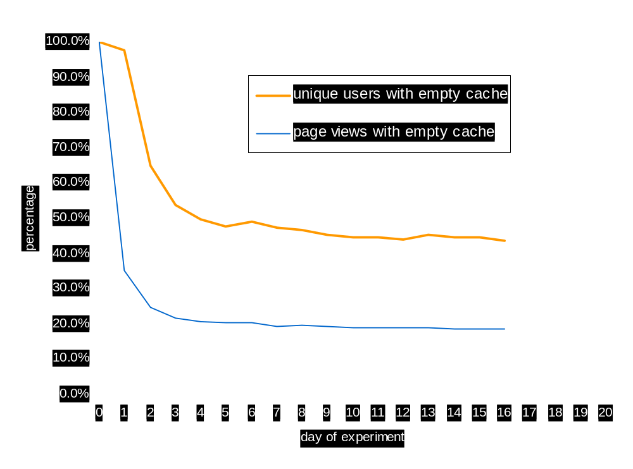
Surprising Results Lessons:
The empty cache user is more prevalent than one might think
users with
empty cache
page views with
empty cache
40-60%
~20%
On the first day no one
has the images cached,
but over time more people
have the image until a
steady state is reached;
Result: 40-60% of yahoo
users have an empty cache
experience and 20% of page
views are done with an
empty cache
Copyright 2009 - 2018 Ellis Horowitz and Marco Papa

Slide 9
Impact of Cookies on Response Time
Cookie Size time Delta
0 bytes 78ms 0ms
500 bytes 79ms +1 ms
1000 bytes 94ms +16ms
1500 bytes 109ms +31ms
2000 bytes 125ms +47ms
2500 bytes 141ms +63ms
3000 bytes 156ms +78ms
ms = millisecond (at ~800kbps, DSL speed)
(Note: today’s cookies are much bigger in size)
See: http://yuiblog.com/blog/2007/03/01/performance-research-part-3/
Copyright 2009 - 2018 Ellis Horowitz and Marco Papa

Slide 10
Analysis of Cookie Sizes Across the Web
Website total Cookie Size (2007)
Amazon 60 bytes
Google 72 bytes
Yahoo 122 bytes
Cnn 184 bytes
Youtube 218 bytes
msn 268 bytes
eBay 331 bytes
MySpace 500 bytes
Lessons
eliminate unnecessary cookies
keep cookie sizes low
set cookies at appropriate
domain level
set Expires date appropriately
an earlier date or none removes
the cookie sooner
Unfortunately today’s cookie sizes are much bigger
Experiment in Firefox: click on Tools | Preferences | Privacy | Accept cookies from sites | select Keep until: "ask me every time” for cookies.
Then load www.amazon.com
Copyright 2009 - 2018 Ellis Horowitz and Marco Papa

Slide 11
The “initial” 14 Rules
Make fewer HTTP requests
Use a CDN (content distribution network)
Add an Expires header
Gzip components
Put stylesheets at the top
Move scripts to the bottom
Avoid CSS expressions
Make JS and CSS external
Reduce DNS lookups
Minify JS
Avoid redirects
Remove duplicate scripts
Configure Etags
Make AJAX cacheable
See: https://developer.yahoo.com/performance/rules.html
Details on all of the rules to follow
Copyright 2009 - 2018 Ellis Horowitz and Marco Papa

Slide 12
Rule 1: Make fewer HTTP requests
Most browsers download only two resources at a time from a given hostname, as suggested in the HTTP/1.1 specification
  However, some browsers open more than two connections per hostname
To reduce the number of HTTP requests
  Combine scripts
  Combine style sheets
  Combine images into an image map
<img usemap=“map1” border=0 src=“/images/imagemap.gif”>
<map name=“map1”>
<area shape=“rect” coords=“0,0,31,31” href=“home.html” title=“Home”>
. . .
</map>
  Combine images using “sprites” (see next slide)
Drawbacks
  Images must be contiguous
  Defining area coordinates is error prone
Copyright 2009 - 2018 Ellis Horowitz and Marco Papa

Slide 13



CSS Sprites
An image sprite is a collection of images put into a single image
Using images sprites reduces the number of server requests and saves bandwidth
Consider img_navsprites.gif
which includes 3 separate images
The code
<!DOCTYPE html>
<html><head><style>
img.home { width:46px; height:44px;
background:url(img_navsprites.gif) 0 0; }
img.next { width:43px ; height:44px;
background:url(img_navsprites.gif) -91px 0; }
</style></head>
<body>
<img class="home" src="img_trans.gif" width="1" height="1" />
<br><br>
<img class="next" src="img_trans.gif" width="1" height="1" />
</body></html>
width:46px;height:44px; - Defines the portion of the image we want to use
background:url(img_navsprites.gif) 0 0; - Defines the background image and its position (left 0px, top 0px)
Check google.com with Firebug’s Net tab. See the image images/nav_logo242.png
Copyright 2009 - 2018 Ellis Horowitz and Marco Papa

Slide 14
Rule 2: Use a CDN
Content Distribution Networks have servers around the world
They distribute your content so downloads can come from a nearby location
Major CDN providers are
  Akamai
    Distributes OS X and iOS updates
  SAVVis
  Limelight
  OnApp
  BityGravity
  Amazon CloudFront
Free CDNs
  CloudFlare
  BootstrapCDN
  Incapsula
amazon.com Akamai
aol.com Akamai
cnn.com cdn.turner.com
ebay.com Akamai, Mirror Image
google.com Google CDN
msn.com SAVVIS
myspace.com Akamai, Limelight
wikipedia.org - not using CDN --
yahoo.com Akamai
youtube.com Google CDN, Akamai
apple.com Akamai
Copyright 2009 - 2018 Ellis Horowitz and Marco Papa

Slide 15
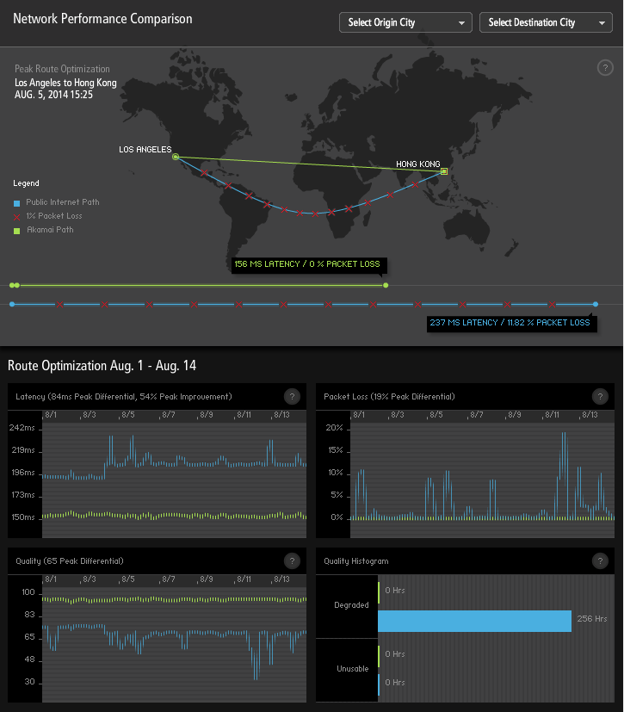

More on Use a CDN: Akamai
Distribute your static content before distributing your dynamic content
see http://www.akamai.com/html/technology/dataviz2.html
(Follow visualizing the internet (twice))
http://wwwnui.akamai.com/gnet/globe/index.html
Copyright 2009 - 2018 Ellis Horowitz and Marco Papa

Slide 16
Rule 3: Add an Expires Header
All caches use a set of rules to determine whether to deliver an object from the cache or request a new version
  If the object’s headers tell the cache not to keep the object, it won’t
  If the object is authenticated or secure, it wont be cached
  A cached object is “fresh” (able to be sent to a client without checking with the server) if
    It has an expiry time or other age-controlling directive that is set and still within the fresh period
    If a browser cache has already seen the object and has been set to check once a session
    If a proxy cache has seen the object recently, and it was modified long ago
  If an object is “stale”, the origin server will be asked to validate the object or tell the cache whether the copy that is has is still good
As part of HTTP protocol there is a Cache-Control header
  Cache-Control is an alternative to Expires
  When cache-control: max-age is present, the response is stale if its current age is greater than the age value given (in seconds) at the time of a new request for the resource
  The max-age directive on a response implies that the response is cacheable
HTTP headers are sent by the server before the HTML, and only seen by the browser and any intermediate caches. Typical HTTP 1.1 response headers might look like this:
HTTP/1.1 200 OK
Date: Fri, 30 Oct 1998 13:19:41 GMT
Server: Apache/1.3.3 (Unix)
Cache-Control: max-age=3600, must-revalidate
Expires: Fri, 30 Oct 1998 14:19:41 GMT
Last-Modified: Mon, 29 Jun 1998 02:28:12 GMT
ETag: "3e86-410-3596fbbc"
Content-Length: 1040
Content-Type: text/html
Copyright 2009 - 2018 Ellis Horowitz and Marco Papa

Slide 17
More on Adding Expire Headers
Here is a way to add an Expires header to files using the Apache httpd.conf file; add the lines:
<FilesMatch "\.(ico|pdf|flv|jpg|jpeg|png|gif|js|css|swf)$">
Header set Expires "Thu, 15 Apr 2010 20:00:00 GMT"
</FilesMatch>
An Apache module enables / modifies expire headers:
Apache Module mod_expire:
  http://httpd.apache.org/docs/2.2/mod/mod_expires.html
  This module controls the setting of the Expires HTTP header and the max-age directive of the Cache-Control HTTP header in server responses. The expiration date can set to be relative to either the time the source file was last modified, or to the time of the client access.
  ExpiresDefault "access plus 1 month”
  ExpiresByType image/gif "modification plus 5 hours 3 minutes”
For information on adding Expire headers and cache control to IIS 7, see:
  http://www.iis.net/configreference/system.webserver/staticcontent/clientcache
  http://stackoverflow.com/questions/10825497/iis-7-5-how-do-you-add-a-dynamic-http-expires-header
Copyright 2009 - 2018 Ellis Horowitz and Marco Papa

Slide 18
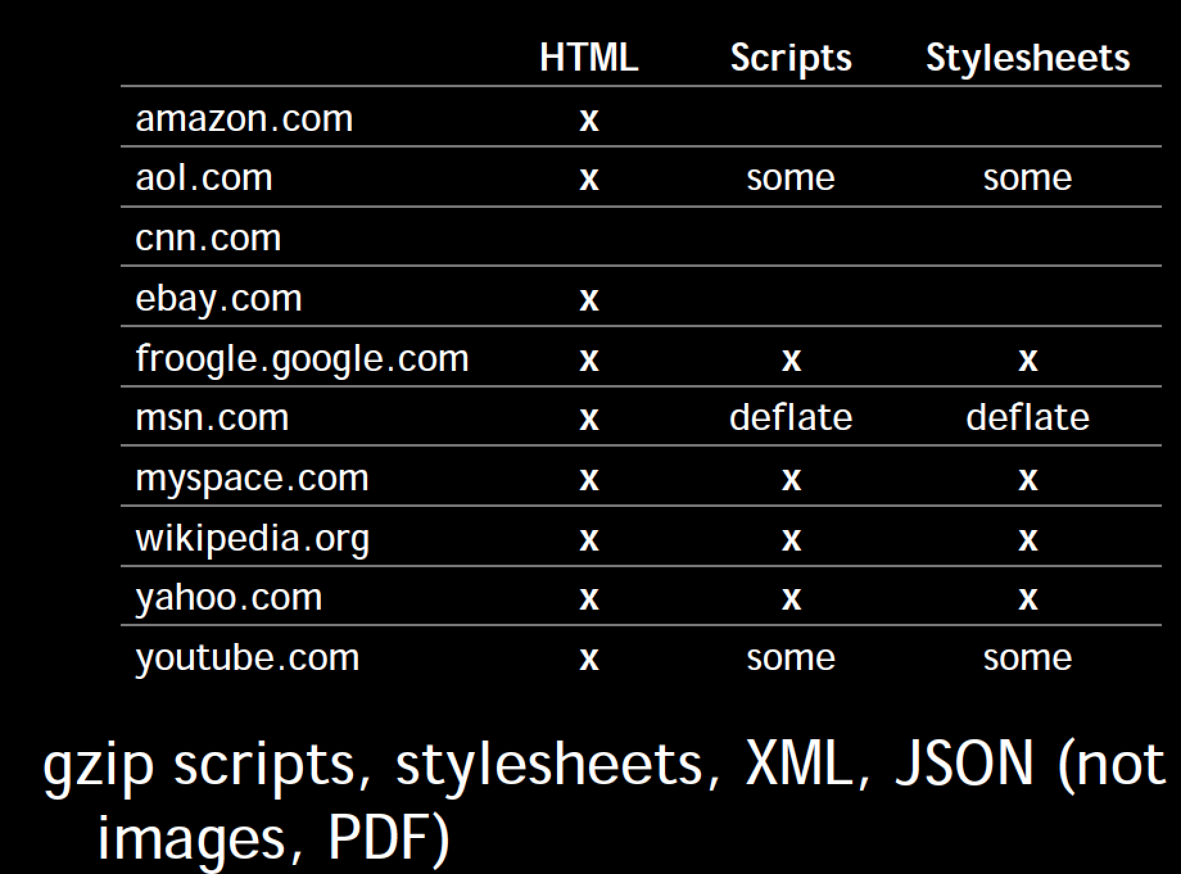
Rule 4: Gzip Components
Compression works when a web server like Apache is set up to "compress" resources and when a client’s browser accepts such compressed resources.
During the initial negotiation, if both browser and server support at least one "common" compression method (gzip, compress, etc) then the transfer is compressed.
Client:
GET / HTTP/1.1
Accept-Encoding: gzip,deflate
Server:
HTTP/1.1 200 OK
Vary: Accept-Encoding
Content-Encoding: gzip
90% of browsers support compression
http://websitetips.com/optimization/#server-side-compression
Copyright 2009 - 2018 Ellis Horowitz and Marco Papa

Slide 19
More on Gzip’ing Components
A couple of Apache modules to enable / modify compression:
Apache Module mod_deflate (supports gzip and deflate):
  http://httpd.apache.org/docs/2.0/mod/mod_deflate.html
  Allows output from the server to be compressed before being sent to the client
  AddOutputFilterByType DEFLATE text/html text/plain text/xml
Apache Module mod_gzip:
  http://sourceforge.net/projects/mod-gzip/
  This is the older compression module for Apache
See “Compressing Web Content with mod_gzip and mod_deflate”:
  http://www.linuxjournal.com/article/6802
Compression can be configured in IIS 7, using the IIS Manager:
  https://technet.microsoft.com/en-us/library/cc771003%28v=WS.10%29.aspx
Copyright 2009 - 2018 Ellis Horowitz and Marco Papa

Slide 20
Rule 5: Put Stylesheets at the top
Stylesheets block rendering in IE; IE will examine all stylesheets before starting to render, so its best to
  Put stylesheets in the <head>
Firefox doesn’t wait, it renders objects immediately and re-draws if it finds a stylesheet; that causes flashing during loading;
  Put stylesheets in the <head>
Use <link> (not @import)
  There are two ways to load stylesheets
  <link> includes the stylesheet in the web page
  <link href=“styles.css” type=“text/css” />
  @import allows you to import one style sheet into another
  <style type=“text/css”>@import url(“styles.css”);</style>
General Rule for using @import
  Link to a stylesheet for a specific page, but import a stylesheet that applies to all pages
Copyright 2009 - 2018 Ellis Horowitz and Marco Papa

Slide 21
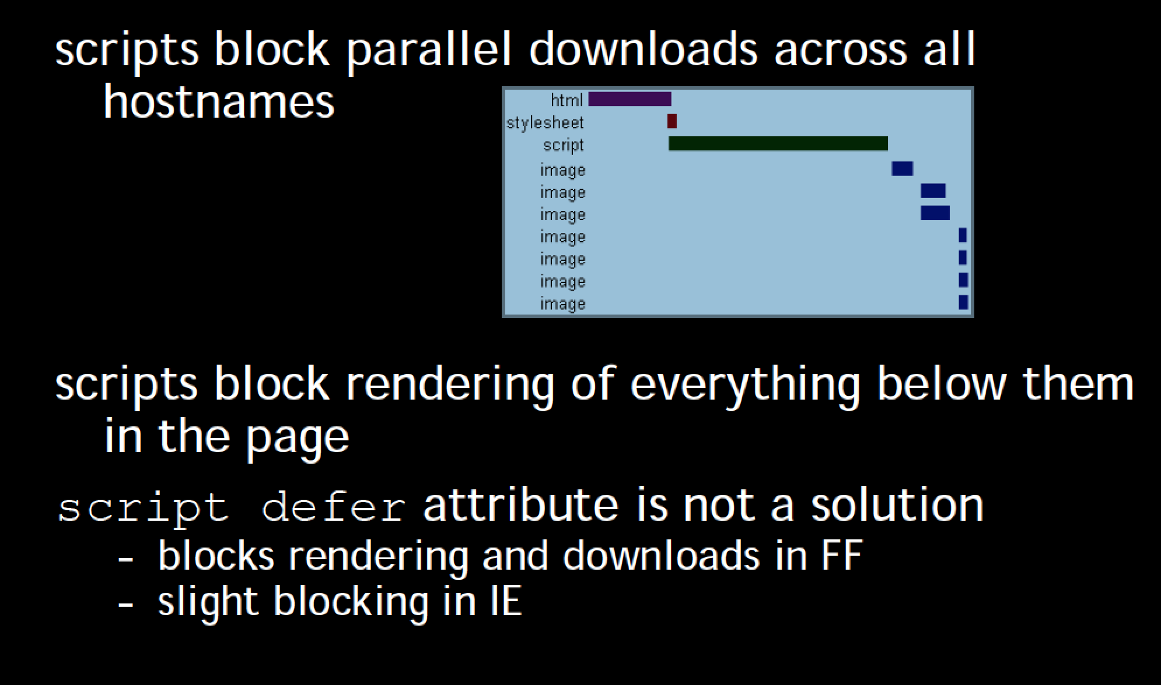
Rule 6: Move Scripts to the Bottom
As the loading of JavaScript can cause the browser to stop rendering the page until the JavaScript is fully loaded, one can avoid the delay by moving scripts to the bottom
Example: move jQuery and Bootstrap libraries reference right before </BODY>
A second option is the defer attribute
<script type="text/javascript" defer="defer"> some script .... </script>
“defer” script attribute indicates that the script is not going to generate any document content. The browser can continue parsing and drawing the page
https://developer.mozilla.org/en-US/docs/Web/HTML/Element/script and
scroll down to "defer"
Copyright 2009 - 2018 Ellis Horowitz and Marco Papa

Slide 22
Rule 7: Avoid CSS Expressions
Used to set CSS properties dynamically in IE
Width: expression(document.body.clientWidth < 600 ? “600px” : “auto”);
Problem: expression may execute many times
  Mouse moves, key press, resize, scroll, etc
Alternatives
  One-time expressions
  Event handlers
Expression overwrites itself
Note: fixed in later versions of IE
<style>
P { background-color: expression(altBgcolor(this)); }
</style>
<script>
function altBgcolor(elem) {
elem.style.backgroundColor =
(new Date()).getHours()%2 ? “F08A00” : “#B8D4FF”; }
</script>
Copyright 2009 - 2018 Ellis Horowitz and Marco Papa

Slide 23
Rule 8: Make JS and CSS External
JavaScript can be placed inline, e.g
<script type=“text/javascript>var foo = “bar”; </script>
Or as an external script, e.g.
<script src=“foo.js” type=“text/javascript”></script>
Placing JavaScript and CSS inline makes the document bigger
Making JavaScript and CSS external implies more HTTP requests, but
  As HTML documents are not typically cached, so inlining JavaScript code will cause the same bytes to be downloaded on every page view
  External JS and CSS can be cached
Defining JavaScript externally is typically better
Download external files after onload
window.onload = downloadComponents;
function downloadComponents ( ) {
var elem = document.createElement(“script”);
elem.src = http://.../file1.js;
document.body.appendChild(elem);
. . . . .
}
Copyright 2009 - 2018 Ellis Horowitz and Marco Papa

Slide 24
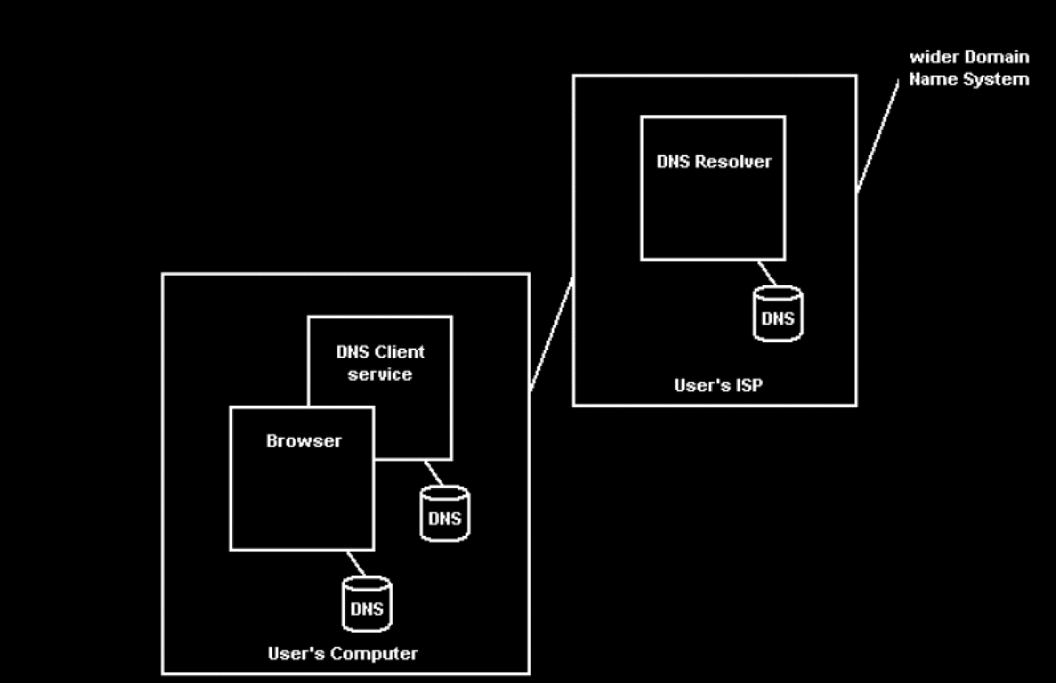
Rule 9: Reduce DNS lookups
Typically each look up takes 20 – 120 milliseconds
DNS lookups will block parallel downloads
The operating system and the browser both have DNS caches
As a general rule it is best to reduce the number of unique hostnames used in a web page
Copyright 2009 - 2018 Ellis Horowitz and Marco Papa

Slide 25
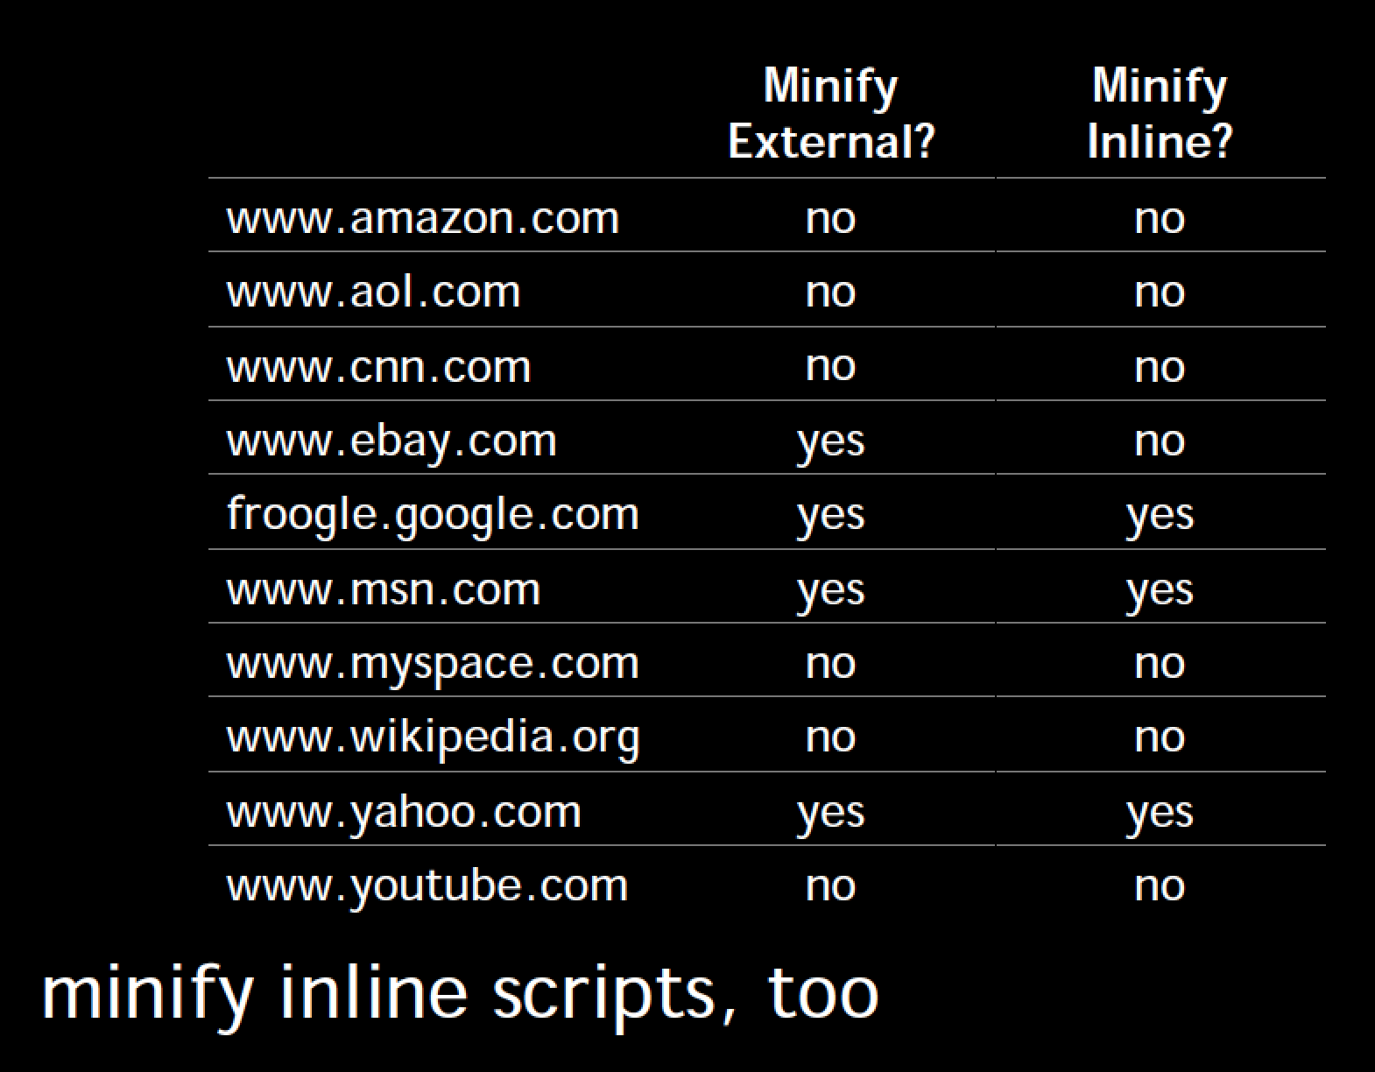
Rule 10: Minify JavaScript
Minification, or minify, is the process of removing all unnecessary characters from source code, without changing its functionality
  Unnecessary characters usually include: white space characters, new line characters, comments , and sometimes block delimiters used to add readability to code, but are not required for execution
  Minified code is especially useful for interpreted languages because it reduces the amount of data that must be transferred
There are many programs that minify JavaScript code, see
http://en.wikipedia.org/wiki/Minify
(JSmin, packer, Google Closure Compiler)
See these websites for examples of minification:
www.google.com
purecss.io
Copyright 2009 - 2018 Ellis Horowitz and Marco Papa

Slide 26
Minified JavaScript
Example of "minified code" is the Google Maps engine at:
http://maps.google.com/
An example of "minified library" is Bootstrap at:
https://maxcdn.bootstrapcdn.com/bootstrap/3.3.0/js/bootstrap.min.js
You can use PHP code from Google (HTTP server for minification) to do the job of minifying CSS & JavaScript :
http://code.google.com/p/minify/
The original minifier from Crockford:
http://www.crockford.com/javascript/jsmin.html
An on-the-fly minifier of JavaScript/CSS for IIS can be found here:
http://highoncoding.com/Articles/777_Minify_CSS_and_JavaScript_in_ASP_NET.aspx
Copyright 2009 - 2018 Ellis Horowitz and Marco Papa

Slide 27
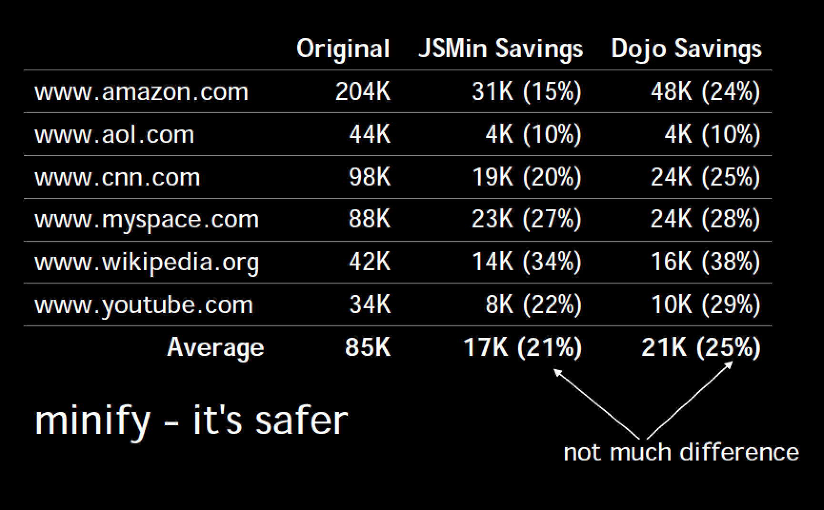
Minify vs. Obfuscate
An obfuscator minifies but also makes modifications to the program,
changing variable names, function names, etc. making it much harder
to understand; JSMin and Dojo are two minifiers
Copyright 2009 - 2018 Ellis Horowitz and Marco Papa

Slide 28
Rule 11: Avoid Redirects
Redirects are used to map users from one URL to another
  However, redirects insert an extra HTTP round-trip between user and origin server
PHP Redirect
<?
Header( "HTTP/1.1 301 Moved Permanently" );
Header( "Location: http://www.new-url.com" );
?>
JSP (Java) Redirect
<%
response.setStatus(301);
response.setHeader( "Location", "http://www.new-url.com/" );
response.setHeader( "Connection", "close" );
%>
CGI PERL Redirect
$q = new CGI;
print $q->redirect("http://www.new-url.com/");
Redirect Old domain to New domain (htaccess redirect)
  Create a .htaccess file with the below code, it will ensure that all your directories and pages of your old domain will get correctly redirected to your new domain.
  The .htaccess file needs to be placed in the root directory of your old website (i.e the same directory where your index file is placed)
Options +FollowSymLinks
RewriteEngine on
RewriteRule (.*) http://www.newdomain.com/$1 [R=301,L]
  REPLACE www.newdomain.com in the above code with your actual domain name.
  contact every backlinking site to modify their backlink to point to your new website.
  Note* This .htaccess method of redirection works ONLY on Linux servers having the Apache Mod-Rewrite module enabled.
Copyright 2009 - 2018 Ellis Horowitz and Marco Papa

Slide 29
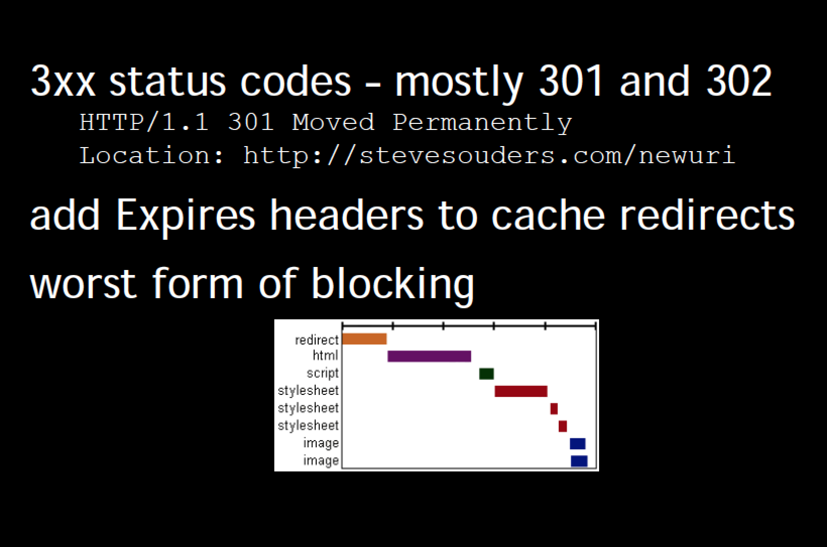
Rule 11: Avoid Redirects
Copyright 2009 - 2018 Ellis Horowitz and Marco Papa

Slide 30
Rule 12: Remove Duplicate Scripts
Hurts performance
  Extra HTTP requests (IE only)
  Extra executions
Is it atypical
  2 of the top 10 websites contain duplicate scripts (JS and CSS)
Copyright 2009 - 2018 Ellis Horowitz and Marco Papa

Slide 31
Rule 13: Configure ETags
Etags are used by clients and servers to verify that a cached resource is valid
  To check that the resource (image, script, stylesheet, etc.) in the browser’s cache matches the one on the server
  If there is a match, the server returns a 304
Unique identifier returned in response
Etag: “c8897e-aee-4165acf0”
Last-Modified: Thu, 07 Oct 2008 20:54:08 GMT
Used in conditional GET requests
If-None-Match: “c8897e-aee-4165acf0”
If-Modified-Since: Thu, 07 Oct 2008 20:54:08 GMT
If Etag doesn’t match, can’t send 304
Etag format varies across web servers
  Apache: inode-size-timestamp
  IIS: FileTimestamp:ChangeNumber
Use ‘em or lose ‘em
  Apache: FileETag none
  IIS: http://support.microsoft.com/kb/922703/
  http://stackoverflow.com/questions/477913/how-do-i-remove-etag-headers-from-iis7
Copyright 2009 - 2018 Ellis Horowitz and Marco Papa

Slide 32
Rule 14: Make AJAX Cacheable and small
The URL of an AJAX request is included inside the HTML; as it is not bookmarked or linked to, the requesting page can be cached by the browser
The AJAX request URL should include a dynamic variable, e.g. dateAndtime, so if the page is changed at the server, the new page will be downloaded
As long as the AJAX request page has not changed, e.g. an address book would change infrequently, it is best to have the browser cache it
See http://blog.httpwatch.com/2009/08/07/ajax-caching-two-important-facts/ for more details. In general, use of these response headers that make AJAX response cacheable:
  Expires, Last-Modified, Cache-Control
  Example: stock quote that updates every 10 seconds
GET /yab/[…]&r=0.5289571 HTTP/1.1
Host: us.xxx.mail.yahoo.com
HTTP/1.1 200 OK
Date: thu, 12 Apr 2007 19:39:09 GMT
Cache-Control: private, max-age=0
Last-Modified: Sat, 31 Mar 2007 01:17:17 GMT
Content-type: text/xml; charset=utf-8
Content-Encoding: gzip
Copyright 2009 - 2018 Ellis Horowitz and Marco Papa

Slide 33
Updated Yahoo Best Practices (2011)
Yahoo updated their list of best practices in 2011. See:
http://developer.yahoo.com/performance/rules.html
Flush the buffer early
Use GET for AJAX requests
Post-load components
Preload Components
Reduce the number of DOM Elements
Split Components Across Domains
Minimize the number of iframes
No 404s
Reduce cookie size
Use cookie-free domains for components
Minimize DOM access
Develop smart event handlers
Avoid filters
Optimize images
Optimize CSS sprites
Don’t scale images in html
Make favicon.ico small and cacheable
Keep components under 25K
Pack components into a multipart document
Avoid Empty image src
Copyright 2009 - 2018 Ellis Horowitz and Marco Papa

Slide 34
Some New Rules (2011)
Avoid empty src or href
You may expect a browser to do nothing when it encounters an empty image src. However, it is not the case in most browsers. IE makes a request to the directory in which the page is located; Safari, Chrome, Firefox make a request to the actual page itself. This behavior could possibly corrupt user data, waste server computing cycles generating a page that will never be viewed, and in the worst case, cripple your servers by sending a large amount of unexpected traffic.
Use GET for AJAX requests
When using the XMLHttpRequest object, the browser implements POST in two steps: (1) send the headers, and (2) send the data. It is better to use GET instead of POST since GET sends the headers and the data together (unless there are many cookies). IE's maximum URL length is 2 KB, so if you are sending more than this amount of data you may not be able to use GET.
Reduce the number of DOM elements
A complex page means more bytes to download, and it also means slower DOM access in JavaScript. Reduce the number of DOM elements on the page to improve performance.
Copyright 2009 - 2018 Ellis Horowitz and Marco Papa

Slide 35
Some New Rules (cont’d)
Avoid HTTP 404 (Not Found) error
Making an HTTP request and receiving a 404 (Not Found) error is expensive and degrades the user experience. Some sites have helpful 404 messages (for example, "Did you mean ...?"), which may assist the user, but server resources are still wasted.
Reduce cookie size
HTTP cookies are used for authentication, personalization, and other purposes. Cookie information is exchanged in the HTTP headers between web servers and the browser, so keeping the cookie size small minimizes the impact on response time.
Use cookie-free domains
When the browser requests a static image and sends cookies with the request, the server ignores the cookies. These cookies are unnecessary network traffic. Make sure that static component requests are cookie-free (i.e., use static.mydomain.com to serve static content).
Do not scale images in HTML
Web page designers sometimes set image dimensions by using the width and height attributes of the HTML image element. Avoid doing this since it can result in images being larger than needed. For example, if your page requires image myimg.jpg which has dimensions 240x720 but displays it with dimensions 120x360 using the width and height attributes, then the browser will download an image that is larger than necessary. (This rule conflicts with Responsive Web Design patterns)
Copyright 2009 - 2018 Ellis Horowitz and Marco Papa

Slide 36
Some New Rules (cont’d)
Make favicon small and cacheable
A favicon is an icon associated with a web page; this icon resides in the favicon.ico file in the server's root. Since the browser requests this file, it needs to be present; if it is missing, the browser returns a 404 error (see "Avoid HTTP 404 (Not Found) error" above). Since favicon.ico resides in the server's root, each time the browser requests this file, the cookies for the server's root are sent. Making the favicon small and reducing the cookie size for the server's root cookies improves performance for retrieving the favicon. Making favicon.ico cacheable avoids frequent requests for it. Set expires header to a few months into the future, and limit size to 1K.
Copyright 2009 - 2018 Ellis Horowitz and Marco Papa

Slide 37
Updated Yahoo Best Practices (2012)
Minimize HTTP Requests
Use a Content Delivery Network
Add an Expires or a Cache-Control Header
Gzip Components
Put Stylesheets at the Top
Put Scripts at the Bottom
Avoid CSS Expressions
Make JavaScript and CSS External
Reduce DNS Lookups
Minify JavaScript and CSS
Avoid Redirects
Remove Duplicate Scripts
Configure Etags
Make Ajax Cacheable
Flush the Buffer Early
Use GET for AJAX Requests
Post-load Components
Preload Components
Reduce the Number of DOM Elements
Split Components Across Domains
Minimize the Number of iframes
No 404s
Reduce Cookie Size
Use Cookie-free Domains for Components
Minimize DOM Access
Develop Smart Event Handlers
Choose <link> over @import
Avoid Filters
Optimize Images
Optimize CSS Sprites
Don't Scale Images in HTML
Make favicon.ico Small and Cacheable
Keep Components under 25K
Pack Components into a Multipart Document
Avoid Empty Image src
Only 23 rules can be tested with YSlow (no longer available)
Copyright 2009 - 2018 Ellis Horowitz and Marco Papa

Slide 38
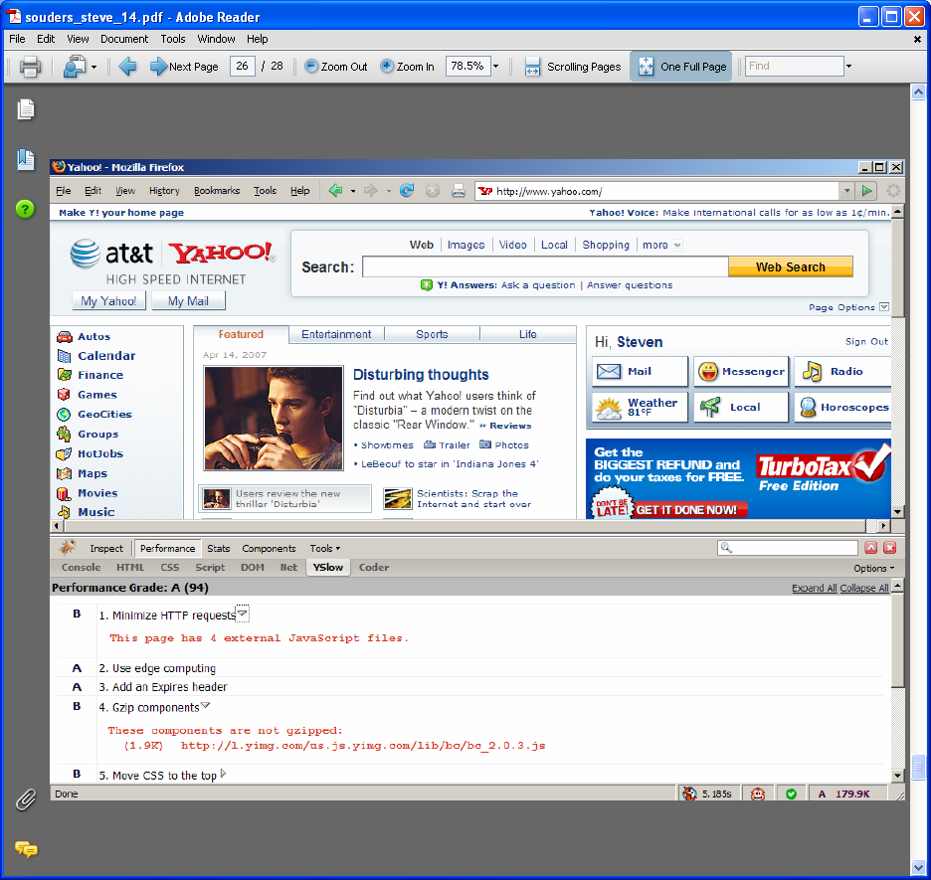
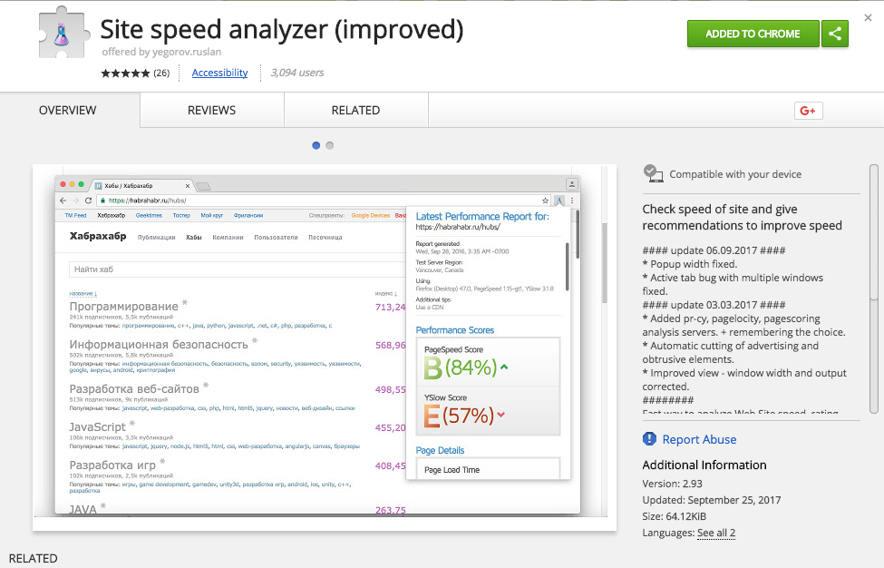
Demo Yslow
http://developer.yahoo.com/yslow
Grades web pages for each rule described earlier
Firefox add-on integrated with Firebug
Minimize HTTP requests
Add an expires header
Gzip components
Tests 23 rules (Yslow V2) or original 14 rules (Classic V1)
Original version stopped working with Firefox 46.
Extensions available for Chrome (Site speed analyzer)
Copyright 2009 - 2018 Ellis Horowitz and Marco Papa

Slide 39
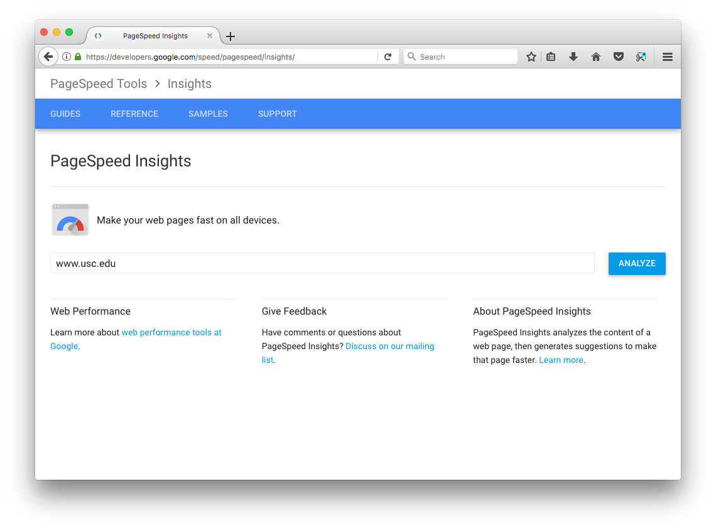
Demonstrate Google’s PageSpeed Insights
Google offers a similar service to Yahoo’s YSlow called PageSpeed Insights. See:
http://developers.google.com/speed/pagespeed/
Enter the URL to test at:
https://developers.google.com/speed/pagespeed/insights/
For Chrome info go to:
https://developers.google.com/speed/pagespeed/insights_extensions
Page Speed is also available in Google Analytics
PageSpeed can integrate with Apache and Nginx web server to automatically optimize your site
Copyright 2009 - 2018 Ellis Horowitz and Marco Papa

Slide 40
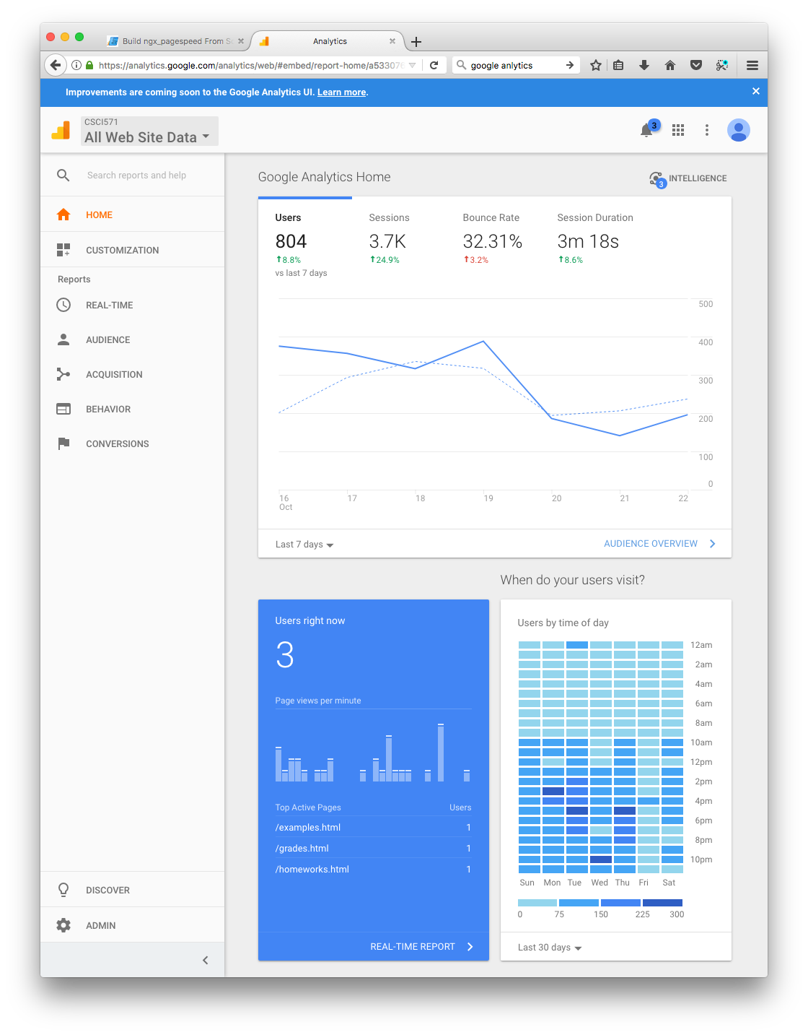
Demonstrate Google Analytics
Google offers PageSpeed Insights inside Google Analytics.
https://analytics.google.com
Select Left Navigation – Behavior – Site Speed – Speed Suggestions – click “x total” under “PageSpeed Suggestions” columns
Copyright 2009 - 2018 Ellis Horowitz and Marco Papa

Slide 41
References
book: http://www.oreilly.com/catalog/9780596514211/
examples: http://stevesouders.com/examples/
image maps: http://www.w3.org/TR/html401/struct/objects.html#h-13.6
CSS sprites: http://alistapart.com/articles/sprites
inline images: http://tools.ietf.org/html/rfc2397
jsmin: http://crockford.com/javascript/jsmin
dojo compressor: http://dojotoolkit.org/docs/shrinksafe
HTTP status codes: http://www.w3.org/Protocols/rfc2616/rfc2616-sec10.html
Fasterfox: http://fasterfox.mozdev.org/
YUIBlog: http://yuiblog.com/blog/2006/11/28/performance-research-part-1/
http://yuiblog.com/blog/2007/01/04/performance-research-part-2/
http://yuiblog.com/blog/2007/03/01/performance-research-part-3/
http://yuiblog.com/blog/2007/04/11/performance-research-part-4/
YDN: http://developer.yahoo.net/blog/archives/2007/03/high_performanc.html
http://developer.yahoo.net/blog/archives/2007/04/rule_1_make
Copyright 2009 - 2018 Ellis Horowitz and Marco Papa

Slide 42
Efficient Loading of JavaScript
Loading JavaScript takes time, but one possible approach is to split the initial payload.
Problems:
  - JavaScript execution in the browser is single threaded, so while you are loading the modules in the background, the rest of your app becomes non-responsive to user actions while the modules load.
  - It is difficult to decide when, and in what order, to load the modules.
The Google Solution
  write each module into a separate script tag and hide the code inside a comment block (/* */). When the resource first loads, none of the code is parsed since it is commented out. To load a module, find the DOM element for the corresponding script tag, strip out the comment block, and eval() the code.
  Implications: Once the code arrives, modules are eval’ed on an as-needed basis, without the delay of actually downloading the script. The eval does take time, but this is minimal and is tied to the user’s actions, so it makes sense from the user’s perspective.
Here is an example of how Google loads its JavaScript (see http://googlecode.blogspot.com/2009/09/gmail-for-mobile-html5-series-reducing.html)
<html>...
<script id="lazy">
// Make sure you strip out (or replace) comment blocks in your JavaScript first.
/* JavaScript of lazy module */
</script>
<script>
function stripOutCommentBlock(code) { return code.replace(/^[\s\xA0]+\/\*|\*\/[\s\xA0]+$/g, ""); }
function lazyLoad() { var lazyElement = document.getElementById('lazy');
var lazyElementBody = lazyElement.innerHTML;
var jsCode = stripOutCommentBlock(lazyElementBody);
eval(jsCode); }
</script>
<div onclick=lazyLoad()> Lazy Load </div></html>
Copyright 2009 - 2018 Ellis Horowitz and Marco Papa

