Slide 1
JavaScript Frameworks

Slide 2
Outline
Node.js
Angular.js

Slide 3
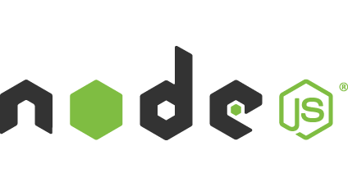
Node.js
Node.js is a JavaScript runtime built on Chrome's V8 JavaScript engine.
Node.js uses an event-driven, non-blocking I/O model that makes it lightweight and efficient.
Node.js allows the creation of Web servers and networking tools using JavaScript and a collection of "modules" that handle various core functionality.
Modules handle file system I/O, networking (DNS, HTTP, TCP, TLS/SSL, or UDP), binary data (buffers), cryptography functions, data streams and other core functions.

Slide 4
Basic functionality
HTTP
To use the HTTP server and client one must require('http').
The HTTP interfaces in Node.js are designed to support many features of the protocol which have been traditionally difficult to use. In particular, large, possibly chunk-encoded, messages. The interface is careful to never buffer entire requests or responses--the user is able to stream data.
http.createServer([requestListener])
Returns a new instance of http.Server.
The requestListener is a function which is automatically added to the 'request' event.
http.request(options[, callback])
Node.js maintains several connections per server to make HTTP requests. This function allows one to transparently issue requests.
options can be an object or a string. If options is a string, it is automatically parsed with url.parse().
http.get(options[, callback])
Since most requests are GET requests without bodies, Node.js provides this convenience method. The only difference between this method and http.request() is that it sets the method to GET and calls req.end() automatically.

Slide 5
Basic functionality
File System
File I/O is provided by simple wrappers around standard POSIX functions. To use this module do require('fs'). All the methods have asynchronous and synchronous forms..
fs.readFile(file[, options], callback)
Asynchronously reads the entire contents of a file.
The callback is passed two arguments (err, data), where data is the contents of the file.
If no encoding is specified, then the raw buffer is returned.
fs.readFileSync(file[, options])
Synchronous version of fs.readFile. Returns the contents of the file.
If the encoding option is specified then this function returns a string. Otherwise it returns a buffer.
.

Slide 6
Basic functionality
Buffer
Prior to the introduction of TypedArray in ECMAScript 2015 (ES6), the JavaScript language had no mechanism for reading or manipulating streams of binary data. The Buffer class was introduced as part of the Node.js API to make it possible to interact with octet streams in the context of things like TCP streams and file system operations.
The Buffer class is a global within Node.js, making it unlikely that one would need to ever use require('buffer').
Buffers and Character Encodings
Buffers are commonly used to represent sequences of encoded characters such as UTF8, UCS2, Base64 or even Hex-encoded data. It is possible to convert back and forth between Buffers and ordinary JavaScript string objects by using an explicit encoding method.

Slide 7
Example usage – Buffer Class
buffer.js:
const buf = new Buffer('hello world', 'ascii');
console.log(buf.toString('hex'));
// prints: 68656c6c6f20776f726c64
console.log(buf.toString('base64'));
// prints: aGVsbG8gd29ybGQ=

Slide 8
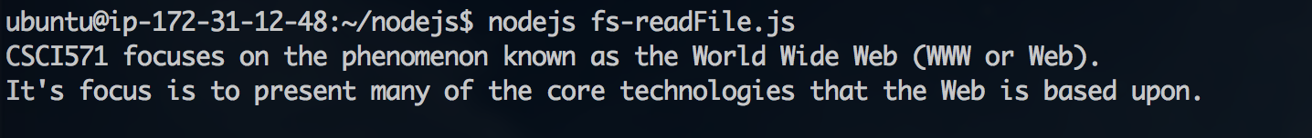
Example usage – ‘fs’Read File
fs-readFile.js:
var fs = require('fs');
fs.readFile('./intro.txt', function (err, data) {
if (err) throw err;
console.log(data);
});
Intro.txt:
JsApp.US is a hosting platform for node.js applications.
It is setup to be a platform to coddle to quick, weekend hack like projects.
Run command:
$ nodejs fs-readFile.js

Slide 9
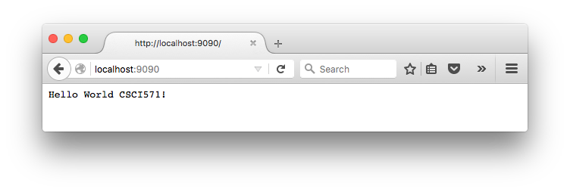
Example usage – ‘http’ Run Web Server
server.js:
const http = require('http');
http.createServer(function (req, res) {
res.writeHead(200, { 'Content-Type': 'text/plain' });
res.end('Hello World CSCI571!\n');
}).listen(9090, '127.0.0.1', function () {
console.log(`Server running at http://localhost:9090/`);});
Run command:
$ sudo node server.js

Slide 10
Node.js Modules
npm: package manager for JavaScript. The npm command-line tool is bundled with Node.js. If you have it installed, then you already have npm too. (see https://www.npmjs.com)
nodemon: monitor script for use during development of a Node.js app. Will watch files in the directory in which nodemon was started. If any files change, it will restart your node app. (see https://nodemon.io)
jshint: a static analysis tool to detect errors and potential problems in JavaScript code and to enforce your team's coding conventions. (see http://jshint.com)

Slide 11
Node.js Modules (cont’d)
express: a fast, minimalist web framework. It provides small, robust tooling for HTTP servers, making it a great solution for single page applications, web sites, hybrids, or public HTTP APIs. (see https://expressjs.com)
cors: a Node.js package for providing a Connect/Express middleware that can be used to enable CORS with various options. (see https://github.com/expressjs/cors)
body-parser: body-parser extracts the entire body portion of an incoming request stream and exposes it on req.body as something easier to interface with. (see https://github.com/expressjs/body-parser)
request: simplified HTTP request client. It supports HTTPS and follows redirects by default. (see https://github.com/request/request)

Slide 12
Node.js Modules (cont’d)
xml2js: a simple XML to JavaScript object converter. (see https://www.npmjs.com/package/xml2js)
async: a utility module which provides straight-forward, powerful functions for working with asynchronous JavaScript. (see https://caolan.github.io/async/)
q: a library for promises. A promise is an object that represents the return value or the thrown exception that the function may eventually provide. (see https://github.com/kriskowal/q)
underscore: a JavaScript library that provides a whole set of useful functional programming helpers without extending any built-in objects. (see http://underscorejs.org)
socket.io: a Node.js real-time framework server. It enables real-time bidirectional event-based communication. (see https://socket.io/docs/)
minimist: a module used to parse command line arguments. (see https://www.npmjs.com/package/minimistx)

Slide 13
Node.js Modules (cont’d)
mocha: a simple, flexible, fun JavaScript test framework for Node.js and the browser. (see https://mochajs.org)
http-server: a simple, zero-configuration command-line http server. Powerful enough for production usage, but it's simple and hackable enough to be used for testing, local development, and learning. (see https://github.com/indexzero/http-server)
mongodb: the official MongoDB driver for Node.js. It provides a high-level API on top of mongodb-core that is meant for end users. (see https://github.com/mongodb/node-mongodb-native)
mongoose: a MongoDB object modeling tool designed to work in an asynchronous environment. (see http://mongoosejs.com)

Slide 14
express Module Example
var express = require('express');
var app = express();
//respond with "hello world" when a GET request is made to the homepage
app.get('/', function (req, res) {
res.send('Hello World')
});
//server listening on port 3000
app.listen(3000);

Slide 15
cors Module Example
var express = require('express');
var cors = require('cors');
var app = express();
app.use(cors());
app.get('/products/:id', function (req, res, next) {
res.json({msg: 'This is CORS-enabled for all origins!'})
});
app.listen(80, function () {
console.log('CORS-enabled web server listening on port 80')
});

Slide 16
xml2js Module Example
var parseString = require('xml2js').parseString;
var xml = "<root>Hello xml2js!</root>”;
//”result” is the result of parsing xml
parseString(xml, function (err, result) {
console.dir(result);
});

Slide 17
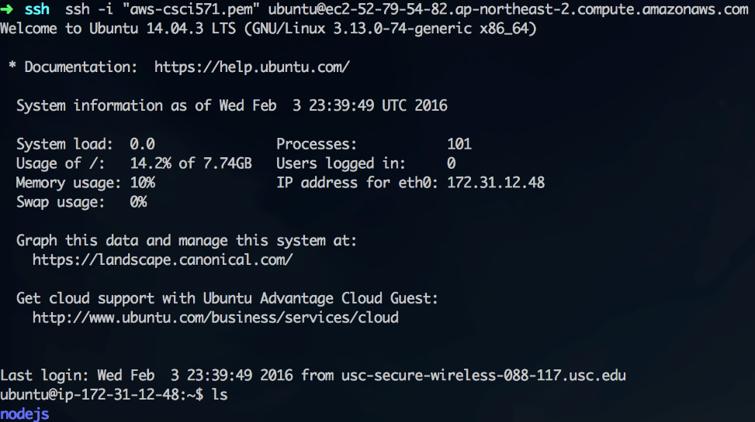
Node.js on AWS
Create Ubuntu Micro EC32 instance
ssh to the AWS ubuntu server
Download node.js using ‘wget’
Execute the binaries, make, and install:
./configure && make && sudo make install
Alternatively, use AWS Elastic Beanstalk and select the Node.js Preconfigure Platform when creating Environment
64bit Amazon Linux running Node.js 6.11.1
nginx Proxy server
Supports static file mappings and gzip compression
See Homework #7 slides

Slide 18
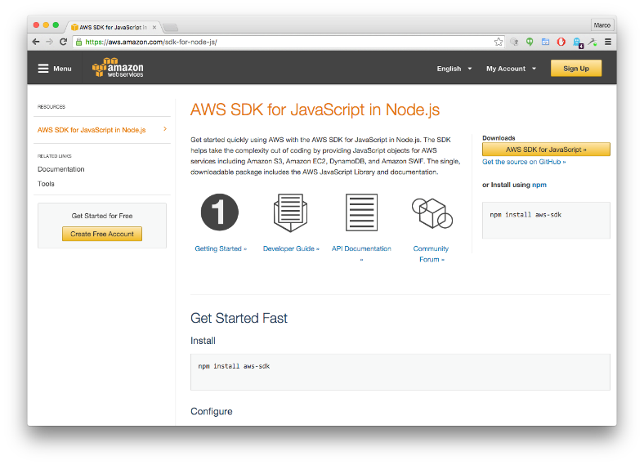
Node.js on AWS (cont’d)
AWS SDK for JavaScript in Node.js
Provides JavaScript objects for AWS services including Amazon S3, Amazon EC2, DynamoDB, Amazon Elastic Beanstalk and many more.
Single, downloadable package includes the AWS JavaScript Library and documentation
See: https://aws.amazon.com/sdk-for-node-js/

Slide 19
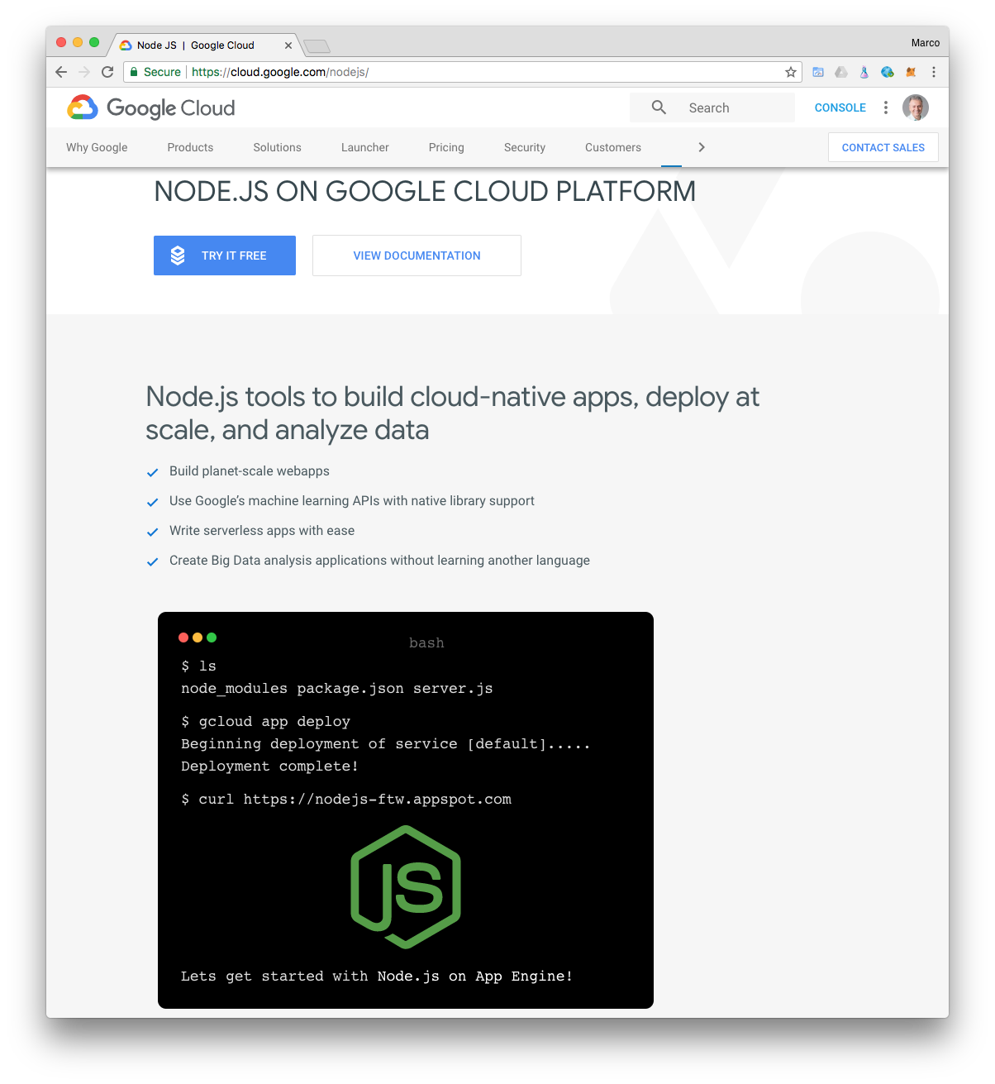
Node.js on Google Cloud Platform
Node.js app deployed using Google App Engine Managed VMs
Scales to serve millions of requests
Supports structures and binary data, authentication, logging, events
See: https://cloud.google.com/nodejs
See Homework #7 slides

Slide 20
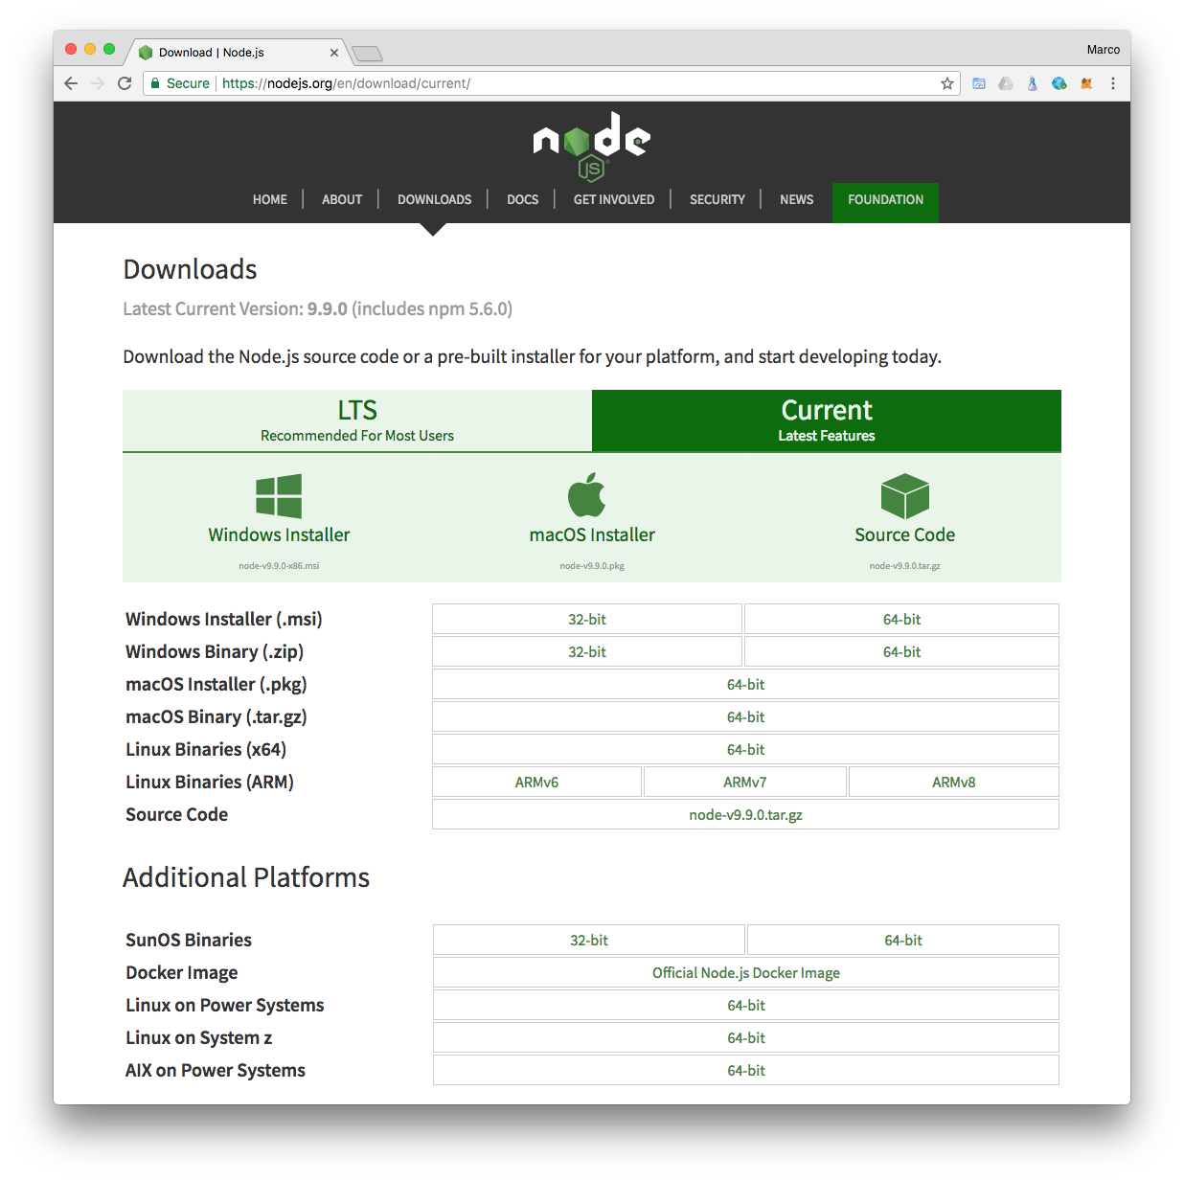
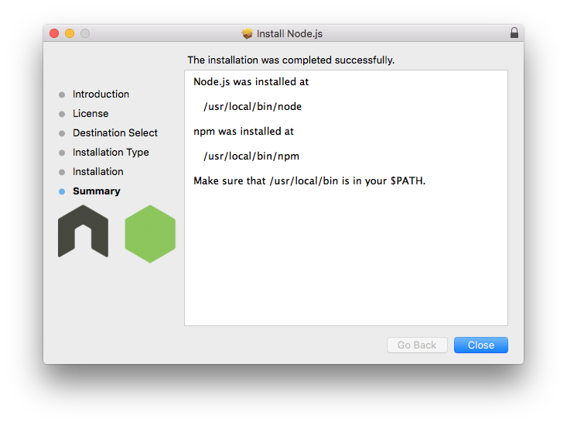
Node.js on macOS and Windows
Download macOS (64bit) and Windows package at https://nodejs.org/en/
Learn Node.js on you local MacBook or Windows PC
Latest version is 9.9

Slide 21
Related URLs
Node.js website: https://nodejs.org/
Node.js on Github: https://github.com/nodejs/node
NPM: https://www.npmjs.com/
Learn Node.js in terminal: https://github.com/workshopper/learnyounode
Tools: http://gruntjs.com/

Slide 22

Introduction
AngularJS is a complete JavaScript-based open-source front-end web application framework.
Its mainly maintained by Google and some community of individuals.
It provides a framework for client-side model–view–controller (MVC) and model–view–viewmodel (MVVM) architectures.
AngularJS is the frontend part of the MEAN stack, consisting of MongoDB database, Express.js web application server framework, Angular.js itself, and Node.js runtime environment.

Slide 23
Angular.js
Why AngularJS?
HTML is great for declaring static documents, but it falters when we try to use it for declaring dynamic views in web-applications. AngularJS lets you extend HTML vocabulary for your application. The resulting environment is extraordinarily expressive, readable, and quick to develop.
Alternatives
Other frameworks deal with HTML’s shortcomings by either abstracting away HTML, CSS, and/or JavaScript or by providing an imperative way for manipulating the DOM. Neither of these address the root problem that HTML was not designed for dynamic views.
Extensibility
AngularJS is a toolset for building the framework most suited to your application development. It is fully extensible and works well with other libraries. Every feature can be modified or replaced to suit your unique development workflow and feature needs. Read on to find out how.

Slide 24
Basic functionality
Control of the app
Data Binding
Data-binding is an automatic way of updating the view whenever the model changes, as well as updating the model whenever the view changes. This is awesome because it eliminates DOM manipulation from the list of things you have to worry about.
Controller
Controllers are the behavior behind the DOM elements. AngularJS lets you express the behavior in a clean readable form without the usual boilerplate of updating the DOM, registering callbacks or watching model changes.
Plain JavaScript
Unlike other frameworks, there is no need to inherit from proprietary types in order to wrap the model in accessors methods. Angular models are plain old JavaScript objects. This makes your code easy to test, maintain, reuse, and again free from boilerplate.

Slide 25
Basic functionality (cont’d)
Wire up a Backend
Deep Linking
A deep link reflects where the user is in the app, this is useful so users can bookmark and email links to locations within apps. Round trip apps get this automatically, but AJAX apps by their nature do not. AngularJS combines the benefits of deep link with desktop app-like behavior.
Form Validation
Client-side form validation is an important part of great user experience. AngularJS lets you declare the validation rules of the form without having to write JavaScript code. Write less code, go have beer sooner.
Server Communication
AngularJS provides built-in services on top of XHR (XMLHttpRequest) as well as various other backends using third party libraries. Promises further simplify your code by handling asynchronous return of data.

Slide 26
Basic functionality (cont’d)
Create Components
Directives
Directives is a unique and powerful feature available only in Angular. Directives let you invent new HTML syntax, specific to your application.
Reusable Components
We use directives to create reusable components. A component allows you to hide complex DOM structure, CSS, and behavior. This lets you focus either on what the application does or how the application looks separately.
Localization
An important part of serious apps is localization. Angular's locale aware filters and stemming directives give you building blocks to make your application available in all locales.

Slide 27







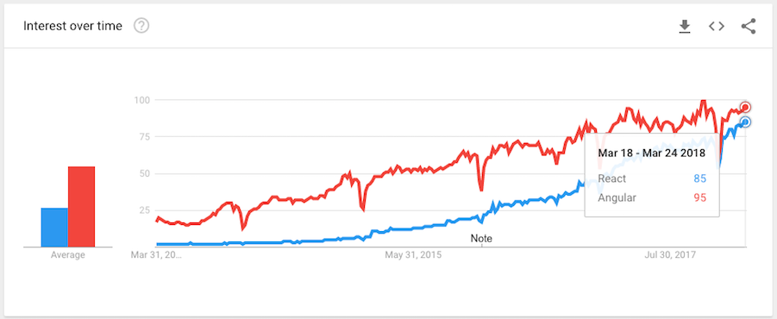
Companies that Use Angular JS
There are approximately 12,000 other sites out of 1 million tested in May 2017 that use Angular JS
Companies that use Angular JS [1] - http://libscore.com/?#angular (React is only on 1,455 sites)
React rising (85). Angular (95) still on top on Google Trends: https://trends.google.com/trends/explore?date=today%205-y&q=%2Fm%2F012l1vxv,Angular

Slide 28
Goals
AngularJS de-emphasizes explicit DOM manipulation with the goal of improving testability and performance.
Design goals are
It decouples DOM manipulation from application logic
It decouple the client side of an application from the server side.
It provides structure for building an application
Designing the UI
Writing the business logic
Testing

Slide 29
Goals (cont’d)
Angular JS framework adapts and extends traditional HTML.
It supports dynamic content through two-way data-binding.
Two-way data-binding allows for the automatic synchronization of models and views.
The tasks in angular bootstrapper occur in 3 phases
Creation of a new Injector
Compilation of the directives that decorate the DOM
Linking of all directives to scope

Slide 30
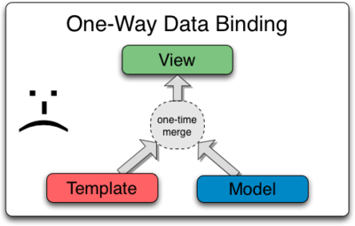
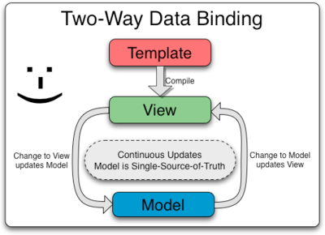
Data Binding
Classical
Angular
Any changes that the user makes to the view are not reflected in the model
The view is just a projection of the model. So there is automatic refresh of the data between view and model

Slide 31
Angular Directives
AngularJS directives allows to specify custom reusable HTML-like elements and attributes.
Some of the Angular Directives are
ng-app
ng-controller
ng-bind
ng-model
ng-class
ng-repeat

Slide 32
Angular Directives (Cont’d)
ng-app
Declares the root element of an AngularJS application.
ng-controller
Specifies a JavaScript controller class that evaluates HTML expressions.
ng-bind
Sets the text of a DOM element to the value of an expression.
ng-model
Similar to ng-bind, but establishes a two-way data binding between the view and the scope.
ng-repeat
Instantiate an element once per item from a collection.

Slide 33
Code Snippet – Angular Instantiation
<script>
var app = angular.module(“myApp", []);
app.controller(“myController", function($scope,$http) {
// $scope holds your model (metadata) for your application
$scope.topic = “CSCI 571”;
});
</script>
<body ng-app=“myApp" ng-controller=“myController">
</body>
An AngularJS module defines an application.
The module is a container for controllers
Controllers always belong to a module.

Slide 34
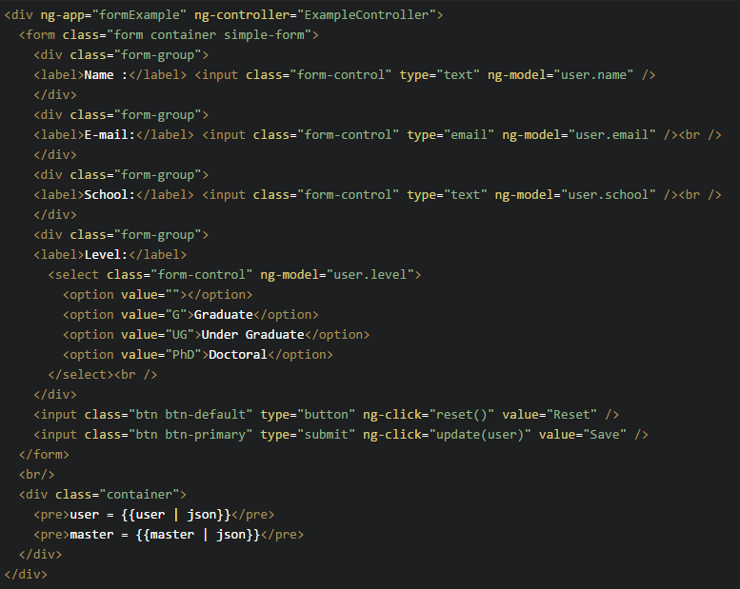
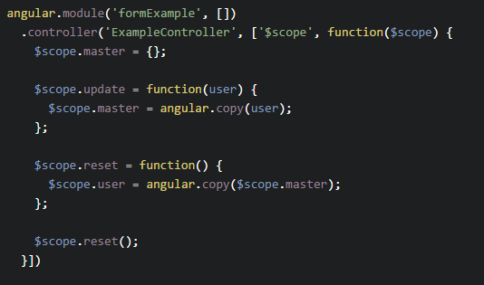
Angular Module - Example
A simple example which shows how angular JS process model.

Slide 35
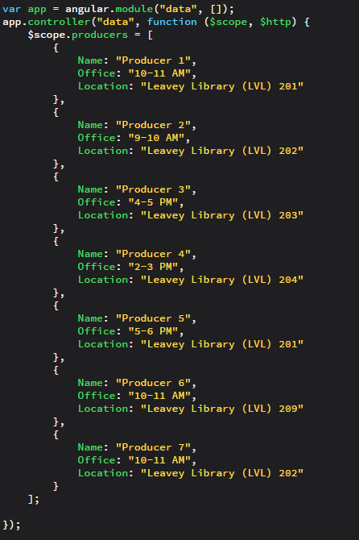
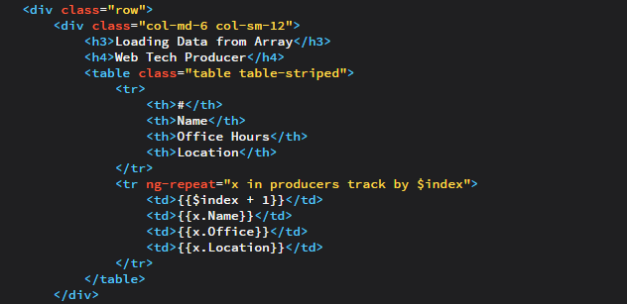
Angular Repeat with data from static array
ng-repeat works like a for loop and replicates the template to the number of rows in the model

Slide 36
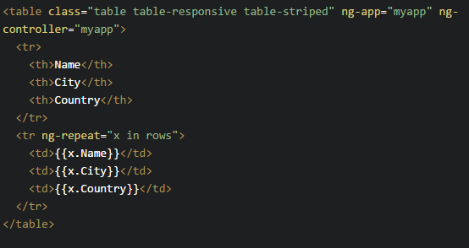
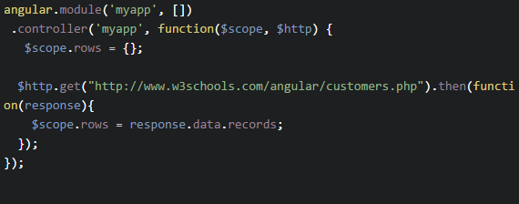
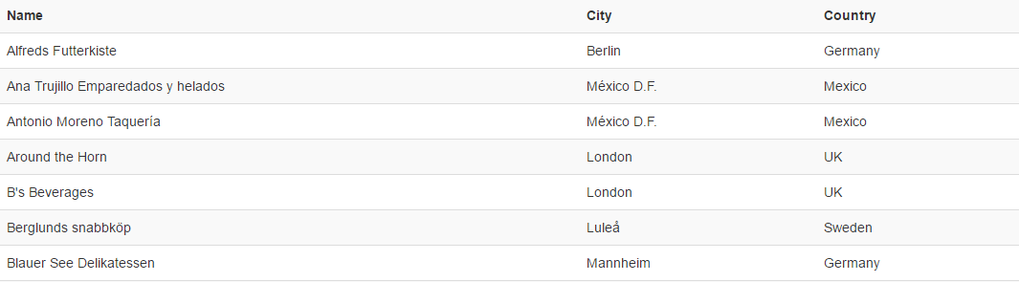
Angular Repeat from external source
$http holds the xml http request handler in Angular.

Slide 37
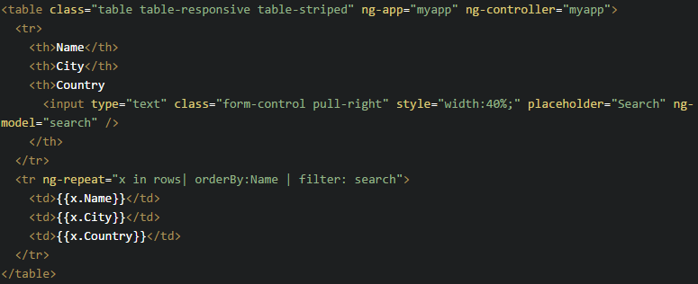
Angular Sort and Search
orderBy: sort the Column ascending
orderBy:<column>:<reverse>
<column> - the column you want to sort
<reverse> - true-descending, false-ascending
Filter: search the rows in the model
Filter:<searchstring> e.x. filter: search
Or
Filter:<column_based_search> e.x. filter:{<column>:search}

Slide 38
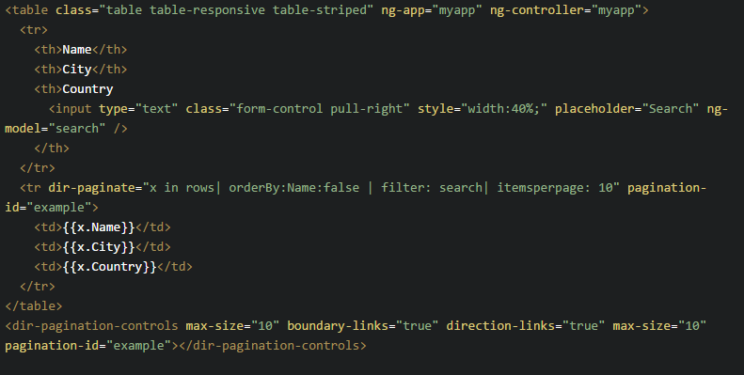
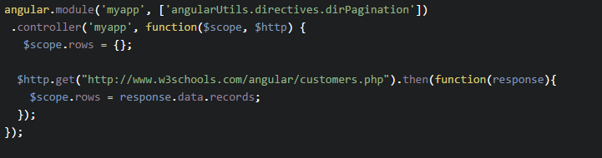
Angular External UI Components
External components need to be added to the angular application.
angular.module(‘myapp’, [<external_components>])

Slide 39
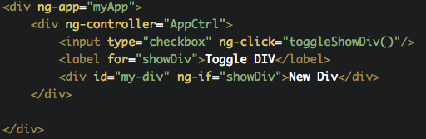
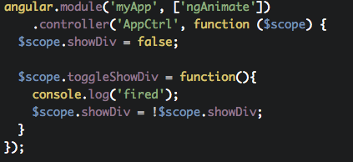
AngularJS Remove and Insert DOM Element

Slide 40
About Angular 2+
Angular 2+ is a ground-up rewrite of AngularJS and has many unique qualities.
There are few upgrade possibilities of AngularJS to Angular 2+ and in most cases the only suitable possible option is to rewrite the application in Angular 2+.
There is no Angular 3 because the Angular Router package had already been in version 3 before. The Angular team would like to avoid confusion and decided to skip version 3 for Angular and continue with Version 4.

Slide 41
Differences between versions
 | AngularJS | Angular 2 | Angular 4
Architecture | Based on MVC | Based on service/component | Same as v2, bundled file size is reduced by 60%
Javascript vs TypeScript | Uses JavaScript | Uses TypeScript (a superset of JavaScript ) | Same as v2, compatible with TypeScript 2.1 and TypeScript 2.2
Component-based UI |  | Can split application features into various components and call required UI, which increases reusability and flexibility | Same as v2
Mobile Support |  | Possible to accomplish the native applications for a mobile platform | Same as v2
SEO (Search Engine Optimization) Friendly | Difficult to develop search engine friendly Single Page Applications | Possible to build Single Page Applications SEO friendly by rendering plain HTML at the server side | Same as v2

Slide 42
Features of Angular 4
Smaller and Faster
View engine with less code
The view engine is introduced in Angular 4 where the produced code of components can be reduced up to 60%. The bundles are reduced to thousands of KBs.
Improved *ngIf directive
A new “else” statement is added
Animation
Animations are pulled from the Angular core and set in their own package
TypeScript 2.1 and 2.2 Compatibility
Source Maps for Templates
Now whenever there's an error caused by something in one of the templates, source maps are created which provide a meaningful context concerning the original template.

Slide 43
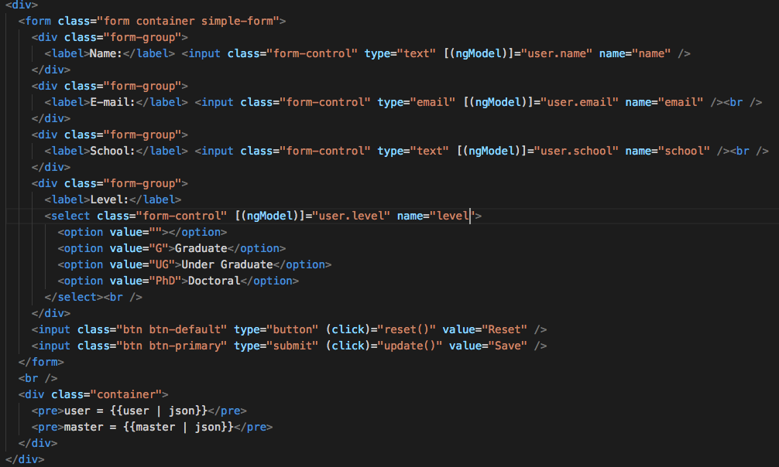
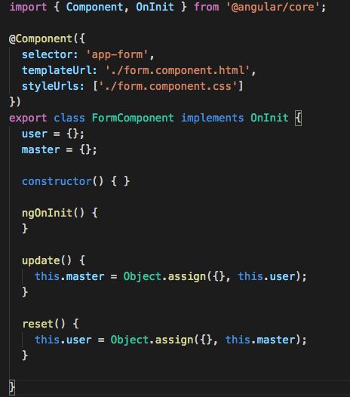
Angular 2+ Component Example

Slide 44
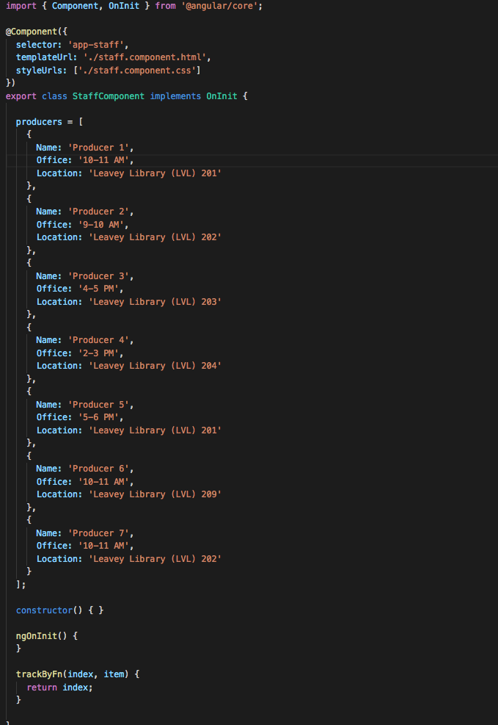
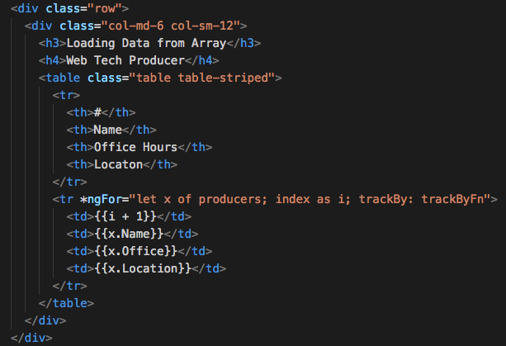
Angular 2+ Repeat with data from static array

Slide 45
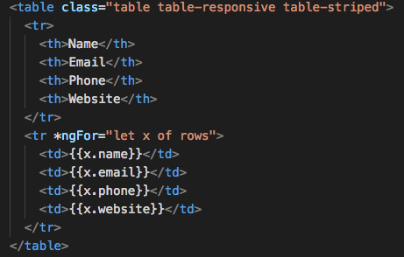
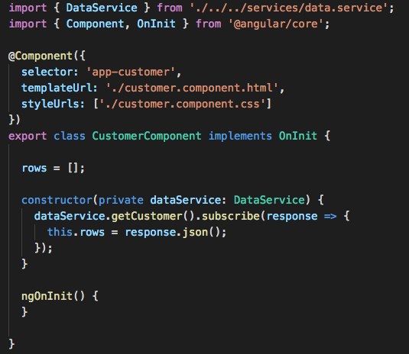
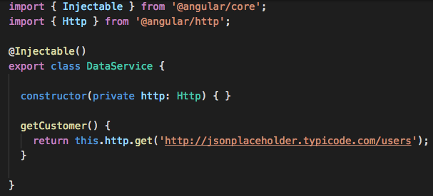
Angular 2+ Repeat from external source

Slide 46
Angular 2+ Sort and Search
Angular 2+ doesn’t support FilterPipe or OrderByPipe mainly because they are expensive operations and they have often been abused in AngularJS apps.
To learn more about why FilterPipe and OrderByPipe are not supported and what the alternatives are, see this page:
https://angular.io/guide/pipes#appendix-no-filterpipe-or-orderbypipe.

Slide 47
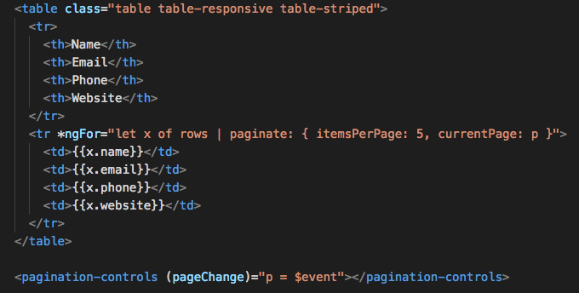
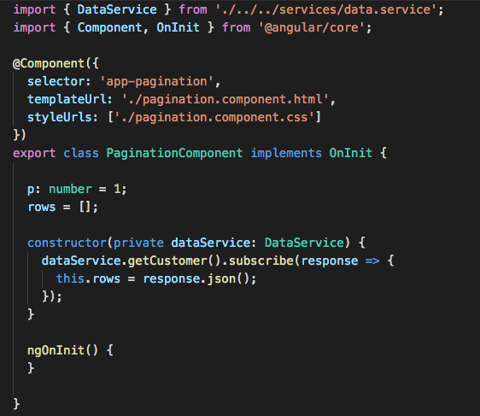
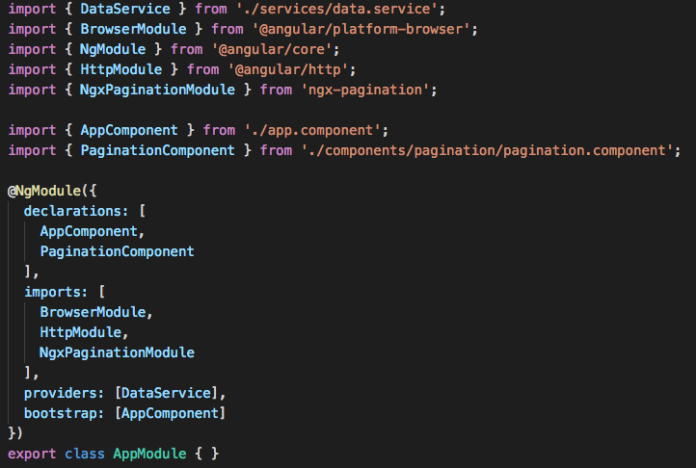
Angular 2+ External UI Components

Slide 48
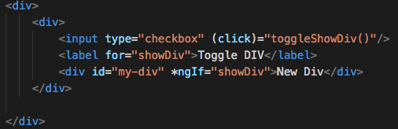
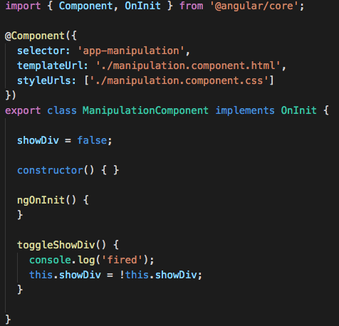
Angular 2+ Remove and Insert DOM Element

Slide 49
TypeScript
Open source programming language developed and maintained by Microsoft
Syntactical superset of JavaScript
Developed by Anders Hejlsberg, C# Architect and creator of Turbo Pascal
First made public in October 2012 (version 0.8)
Built-in support for TypeScript in Visual Studio 2013
TypeScript 2.0 released September 2016
TypeScript program can seamlessly consume JavaScript
TypeScript compiler written in TypeScript

Slide 50
TypeScript Features
Extensions to ECMAScript 5th Ed.
Type annotations and compile-time type checking
Type inference
Type erasure
Interfaces
Enumerated type
Mixin
Generic
Namespaces
Tuple
Await
Backported features from ECMAScript 2015
Classes
Modules
Arrow syntax for anonymous functions
Optional and default parameters

Slide 51
TypeScript and Angular
Angular IDE, optimized for Angular 2 and 4
Commercial product from Webclipse
https://www.genuitec.com/products/angular-ide/
TypeScript 2.x validation and debugging
Angular HTML Template Intelligence
Validation
Detection of misdefined element tags
HTML elements auto-complete
TypeScript expressions auto-complete
Angular-CLI Integration
Angular Source Navigation
TypeScript Debugging
Live Preview
Free download for Windows, MacOS and Linux at:
https://www.genuitec.com/products/angular-ide/download/

Slide 52
Example usage & Related URLs
Examples
Hello World: https://angularjs.org/#the-basics
Todo List: https://angularjs.org/#add-some-control
Advanced Single Page App: https://angularjs.org/#wire-up-a-backend
Related URLs
Angular.js website: https://angularjs.org
Angular.js on Github: https://github.com/angular/angular.js
Tutorial: https://docs.angularjs.org/tutorial
Angular.js Course
http://campus.codeschool.com/courses/shaping-up-with-angular-js/level/1/section/1/creating-a-store-module
Angular 2: https://angular.io/
Angular 2 docs: https://angular.io/docs
Angular 2 IDEs, Tools, Libraries, UI Components: https://angular.io/resources

