Slide 1
ReactJS
A JavaScript library for building user interfaces
Copyright © 2018 Marco Papa and Chenglong Hao

Slide 2
Outline
ReactJS Overview
Introducing JSX
Components
States
Lifecycle
React Native
References
Copyright © 2018 Marco Papa and Chenglong Hao

Slide 3
What is ReactJS?
Developed by Facebook
React is a view layer library, not a framework like Backbone, Angular etc.
You can’t use React to build a fully-functional web app
React challenges established best practices in traditional MV* frameworks
Copyright © 2018 Marco Papa and Chenglong Hao
Notes:
http://slides.com/alexanderfarennikov/react-js-fundamentals/fullscreen#/1/1
http://coenraets.org/present/react/#5

Slide 4
Why was ReactJS developed?
Complexity of two-way data binding
Bad UX from using “cascading updates” of DOM tree
A lot of data on a page changing over time
Complexity of Facebook’s UI architecture
Shift from MVC mentality
Copyright © 2018 Marco Papa and Chenglong Hao
Notes:
http://slides.com/alexanderfarennikov/react-js-fundamentals/fullscreen#/1/1

Slide 5

Who uses ReactJS?
See: https://github.com/facebook/react/wiki/Sites-Using-React
Copyright © 2018 Marco Papa and Chenglong Hao

Slide 6
Why use ReactJS?
Easy to understand what a component will render
Easy to mix HTML and JS
Uses full power of JS
No complex two-way data flow
React is fast!
React dev tools
Server-side rendering
Copyright © 2018 Marco Papa and Chenglong Hao
Notes:
Easy to understand what a component will render:
Declarative code → predictable code
You don't really need to study JS in the view file in order to understand what the file does
Easy to mix HTML and JS
You do it already with template libraries (e.g. Handlebars, Mustache, Underscore etc.)
Uses full power of JS
Decoupling templates from logic does not rely on the templates’ primitive abstractions, but uses full power of JavaScript in displaying views
No complex two-way data flow:
Uses simple one-way reactive data flow
Easier to understand than two-way binding
Uses less code
React is fast!
Real DOM is slow
JavaScript is fast
Using virtual DOM objects enables fast batch updates to real DOM, with great productivity gains over frequent cascading updates of DOM tree
React dev tools
React Chrome extension makes debugging so much easier
Server-side rendering
React.renderToString() returns pure HTML

Slide 7
Introducing JSX
JSX (JavaScript XML) is a syntax extension to JavaScript.
const element = <h1 className="greeting">Hello, world!</h1>;
You can embed any JavaScript expression in JSX by wrapping it in curly braces.
function formatName(user) {
return user.firstName + ' ' + user.lastName;
}
const element = (
<h1>
Hello, {formatName(user)}!
</h1>
);
Copyright © 2018 Marco Papa and Chenglong Hao
Notes:
https://reactjs.org/docs/introducing-jsx.html

Slide 8
Introducing JSX
JSX represents objects. Like XML, JSX tags have tag names, attributes and children.
Fundamentally, JSX just provides syntactic sugar for the React.createElement(component, props, ...children) function.
<MyButton color="blue" shadowSize={2}>
Click Me
</MyButton>
compiles into:
React.createElement(
MyButton,
{color: 'blue', shadowSize: 2},
'Click Me'
)
Copyright © 2018 Marco Papa and Chenglong Hao
Notes:
https://reactjs.org/docs/introducing-jsx.html

Slide 9
Components
Components let you split the UI into independent, reusable pieces, and think about each piece in isolation.
Conceptually, components are like JavaScript functions. They accept arbitrary inputs (called “props”) and return React elements describing what should appear on the screen.
function Welcome(props) {
return <h1>Hello, {props.name}</h1>;
}
class Welcome extends React.Component {
render() {
return <h1>Hello, {this.props.name}</h1>;
}
}
Copyright © 2018 Marco Papa and Chenglong Hao
Notes:
The simplest way to define a component is to write a JavaScript function:
This function is a valid React component because it accepts a single “props” (which stands for properties) object argument with data and returns a React element. We call such components “functional” because they are literally JavaScript functions.
You can also use an ES6 class to define a component:
The above two components are equivalent from React’s point of view.
Classes have some additional features that we will discuss in the next sections. Until then, we will use functional components for their conciseness.
https://reactjs.org/docs/components-and-props.html

Slide 10
Composing Components
Components can refer to other components in their output.
function Welcome(props) {
return <h1>Hello, {props.name}</h1>;
}
function App() {
return (
<div>
<Welcome name="Sara" />
<Welcome name="Cahal" />
<Welcome name="Edite" />
</div>
);
}
Try it on CodePen
https://reactjs.org/redirect-to-codepen/components-and-props/composing-components
Copyright © 2018 Marco Papa and Chenglong Hao
Notes:
Components can refer to other components in their output. This lets us use the same component abstraction for any level of detail. A button, a form, a dialog, a screen: in React apps, all those are commonly expressed as components.
For example, we can create an App component that renders Welcome many times
https://reactjs.org/docs/components-and-props.html

Slide 11
Rendering a Component
When React sees an element representing a user-defined component, it passes JSX attributes to this component as a single object. We call this object “props”.
For example, this code renders “Hello, Sara” on the page:
function Welcome(props) {
return <h1>Hello, {props.name}</h1>;
}
const element = <Welcome name="Sara" />;
ReactDOM.render(
element,
document.getElementById('root')
);
Try it on CodePen
https://reactjs.org/redirect-to-codepen/components-and-props/rendering-a-component
Copyright © 2018 Marco Papa and Chenglong Hao
Notes:
We call ReactDOM.render() with the <Welcome name="Sara" /> element.
React calls the Welcome component with {name: 'Sara'} as the props.
Our Welcome component returns a <h1>Hello, Sara</h1> element as the result.
React DOM efficiently updates the DOM to match <h1>Hello, Sara</h1>.
https://reactjs.org/docs/components-and-props.html

Slide 12
State
Represents internal state of the component
Accessed via this.state
When a component’s state data changes, the rendered markup will be updated by re-invoking render() method
render: function() {
return <h3>Click count:
<span className=‘label label- default'>{this.state.clicks}</span>
</h3>;
}
Copyright © 2018 Marco Papa and Chenglong Hao

Slide 13
State vs Props
State is referred to the local state of the component which cannot be accessed and modified outside of the component and can only be used & modified inside the component.
Props, on the other hand, make components reusable by giving components the ability to receive data from the parent component in the form of props.
State:
Internal data
Can be changed
Private for component
Props:
External data
Can’t be changed
Copyright © 2018 Marco Papa and Chenglong Hao

Slide 14
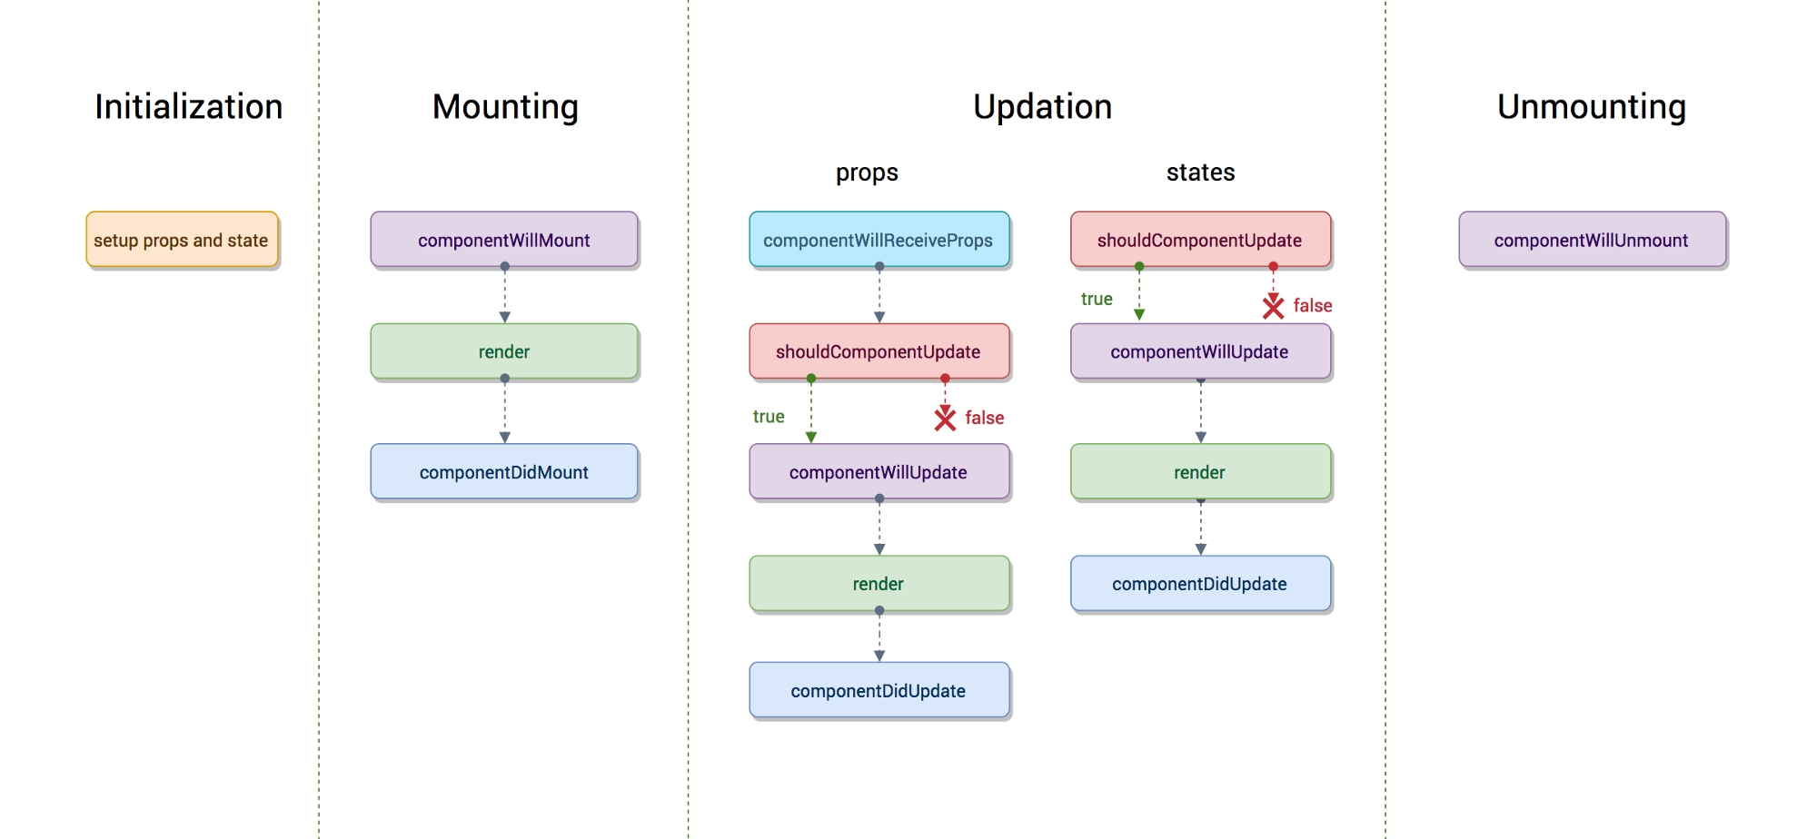
Component Lifecycle
Copyright © 2018 Marco Papa and Chenglong Hao
Notes:
https://hackernoon.com/reactjs-component-lifecycle-methods-a-deep-dive-38275d9d13c0

Slide 15
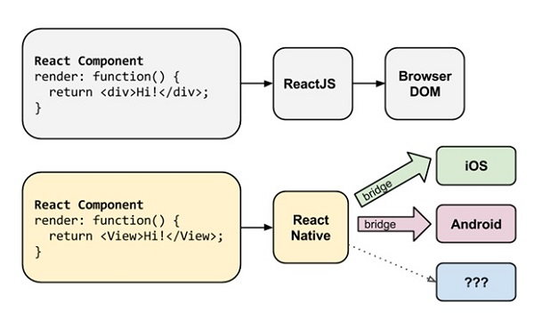
React Native
Build native mobile apps using JavaScript and React
Copyright © 2018 Marco Papa and Chenglong Hao
Notes:
https://www.infoq.com/articles/react-native-introduction

Slide 16
React Native - Overview
An embedded instance of JavaScriptCore.
React components with bindings to Native UI components.
Manipulating calls into Objective C & java for behavior.
And polyfills for some web APIs.
Native App
React Native Library
JavaScript Engine
React JS
React Native JS Library
Your app
Copyright © 2018 Marco Papa and Chenglong Hao
Notes:
Referenced from an online ppt:
https://www.slideshare.net/fitc_slideshare/intro-to-react-native-59209578

Slide 17
React vs React Native
React (a.k.a. ReactJS or React.js) is is a JavaScript library you use for building dynamic, high performing, responsive UI for your web interfaces.
React Native is an entire platform allowing you to build native, cross-platform mobile apps.
React.js is the heart of React Native, and it embodies all React’s principles and syntax, so the learning curve is easy.
Copyright © 2018 Marco Papa and Chenglong Hao
Notes:
https://www.cognitiveclouds.com/insights/what-is-the-difference-between-react-js-and-react-native/
Remember, React.js is just the V part of the MVC framework, a library meant for rendering your views.

Slide 18
React Native - Components
React Native provides a number of built-in components.
Basic Components
IOS
Components
Android
Components
View
DatePicker
BackHandler
Text
ImagePicker
ProgressBar
Image
ActionSheet
TimePicker
TextInput
ProgressView
Toast
ScrollView
TabBar
Toolbar
Copyright © 2018 Marco Papa and Chenglong Hao
Notes:
React Native is really just React, but with some key differences. React Native components look much like React components for the browser, but your basic building blocks have changed. In lieu of tags such as <div>, <img>, and <p>, React Native provides you with basic components such as <Text> and <View>. In the example below, the basic components used are <ScrollView>, <TouchableHighlight>, and <Text>, all of which map to Android and iOS-specific views.
https://www.infoq.com/articles/react-native-introduction
Components: https://facebook.github.io/react-native/docs/components-and-apis.html

Slide 19
React Native - Stylesheets
React Native implements a strict subset of CSS.
Here's an example of how stylesheets are created in React Native:
var styles = StyleSheet.create({
container: {
flex: 1,
marginTop: 30
}
});
Then, that style is applied using inline syntax:
<View style={styles.container}>
...
</View>
Copyright © 2018 Marco Papa and Chenglong Hao
Notes:
In order to make rendering simpler and more effective, as well as to encourage maintainable styling code, React Native implements a strict subset of CSS. This means that you don't need to learn a platform-specific way of designing your views, but it'll take you some time to learn how to use React Native's styles.
The biggest difference is that you don't have to worry about specificity rules, since style inheritance is severely curtailed and React Native uses inline style syntax.
https://www.infoq.com/articles/react-native-introduction

Slide 20
React Native - Installation
The easiest way is to use GitHub’s Create React Native App:
https://github.com/react-community/create-react-native-app
Make sure you have Node v6 or later. No Xcode or Android Studio installation required. Use ‘npm’:
npm install -g create-react-native-app
Then run the following commands to create and run a new React Native project:
create-react-native-app MyApp
cd MyApp
npm start
npm run ios (for iOS emulator)
npm run android (for android emulator)
Copyright © 2018 Marco Papa and Chenglong Hao
Notes:
http://facebook.github.io/react-native/docs/getting-started.html

Slide 21
React Native – Modify and Run your app
The “npm start” starts a development server for you, and print a QR code in your terminal.
Install the Expo Client app on your iOS or Android phone and connect to the same wireless network as your computer. Using the Expo Client app, scan the QR code from your terminal to open your project. See:
https://expo.io/
Open App.js in your text editor of choice and edit some lines. The application should reload automatically once you save your changes.
Copyright © 2018 Marco Papa and Chenglong Hao
Notes:
http://facebook.github.io/react-native/docs/getting-started.html

Slide 22
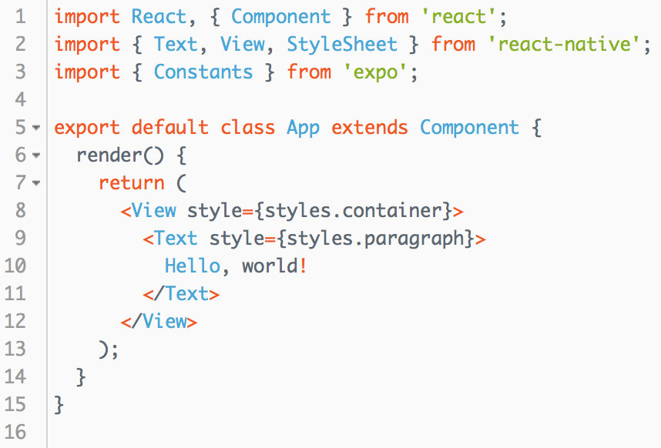
React Native – Hello World
Copyright © 2018 Marco Papa and Chenglong Hao
Notes:
https://snack.expo.io/BJ-uC-nrb
Hello World Example

Slide 23
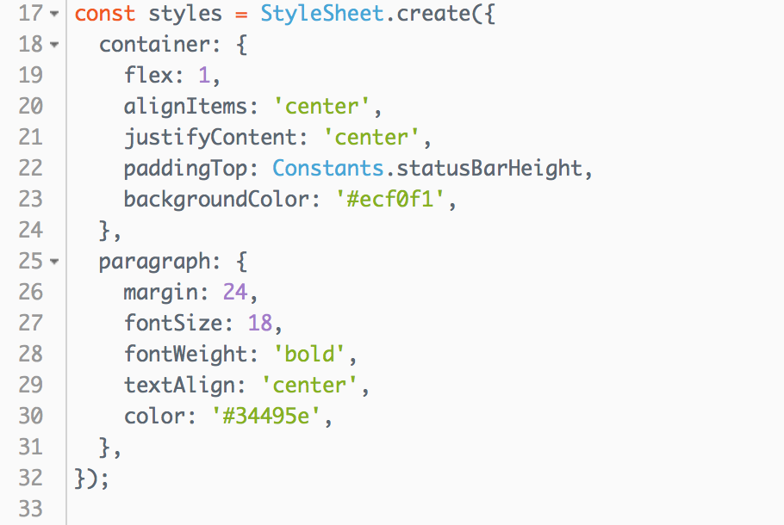
React Native – Hello World (cont’d)
Copyright © 2018 Marco Papa and Chenglong Hao
Notes:
https://snack.expo.io/BJ-uC-nrb
Hello World Example

Slide 24

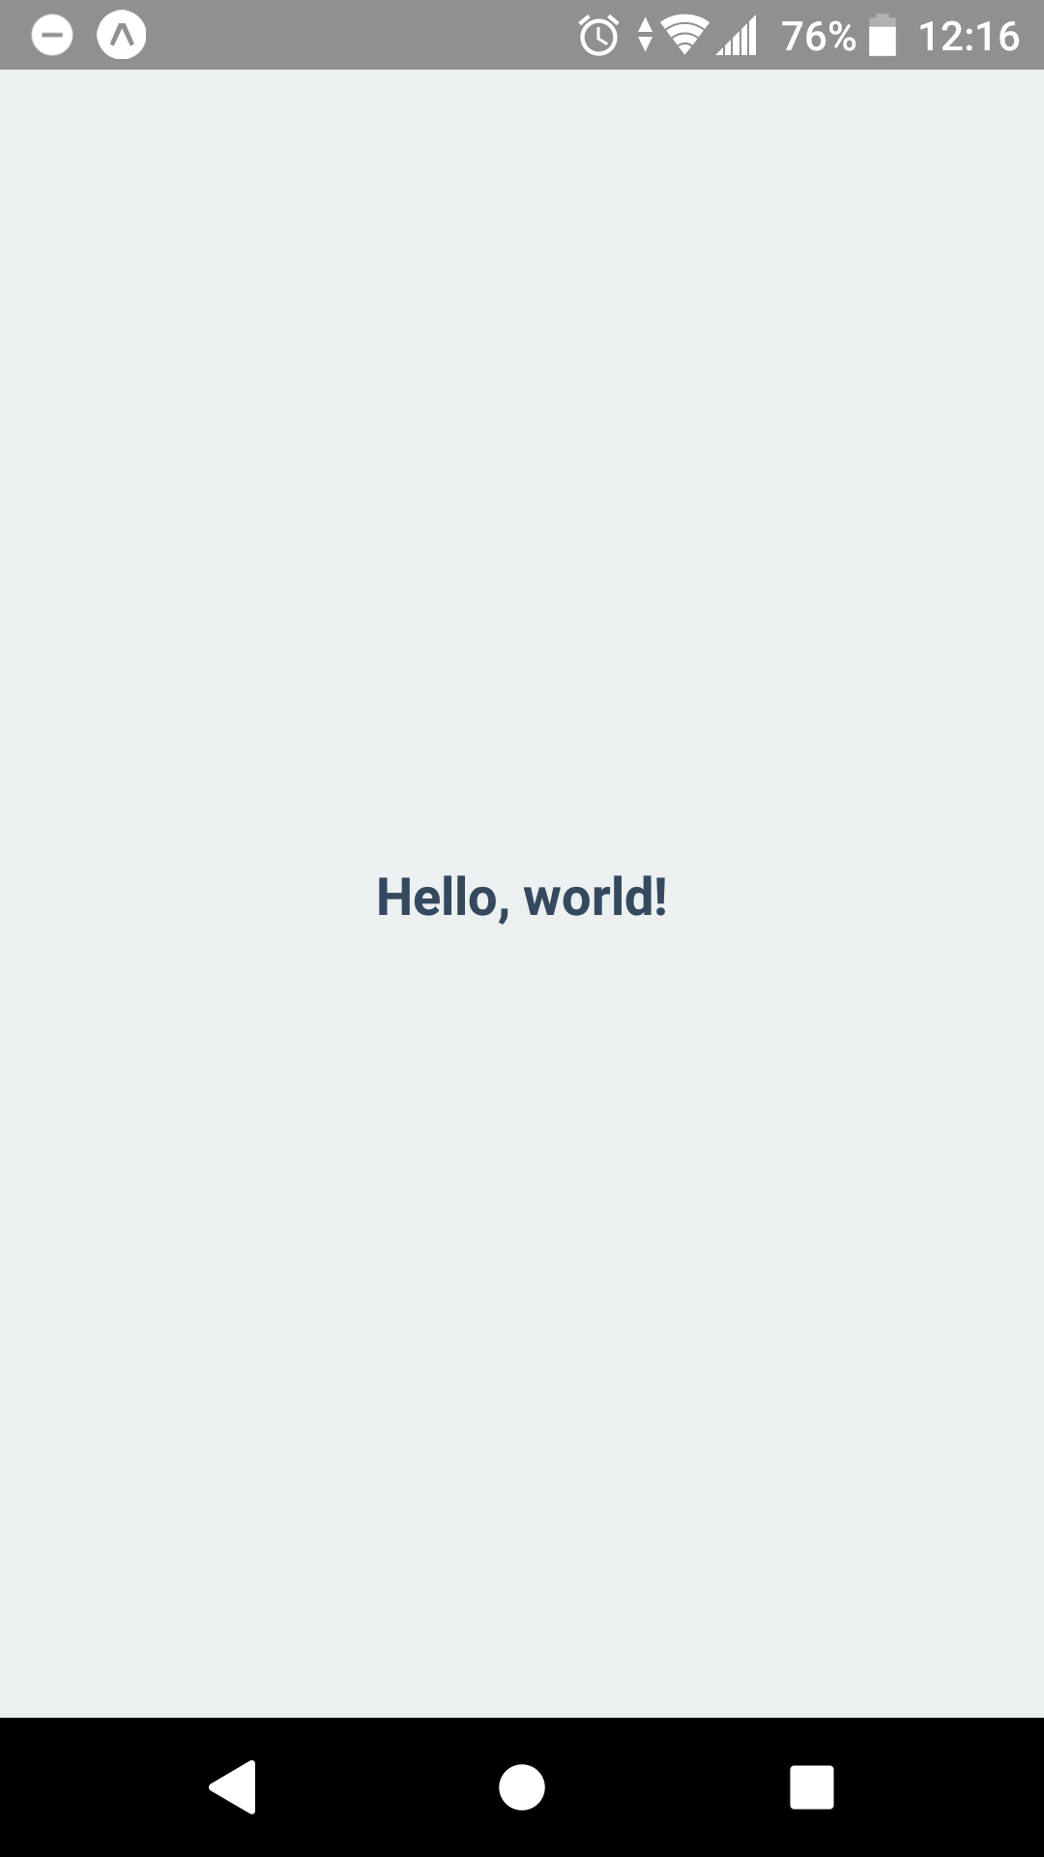
React Native – Hello World (cont’d)
iOS
Android
Copyright © 2018 Marco Papa and Chenglong Hao
Notes:
https://snack.expo.io/BJ-uC-nrb
Hello World Example

Slide 25

React Native – A calculator example
Laying out the Calculator
render() {
return (
<View style={{flex: 1}}>
<View style={{flex: 2, backgroundColor: '#193441'}}></View>
<View style={{flex: 8, backgroundColor: '#3E606F'}}></View>
</View>
)
}
Put styles into a style.js
import Style from './Style';
...
<View style={Style.rootContainer}>
<View style={Style.displayContainer}></View>
<View style={Style.inputContainer}></View>
</View>
Copyright © 2018 Marco Papa and Chenglong Hao
Notes:
What we’ve done here is create a container View that wraps the two sections, and takes up the full width and height available by styling it with flex: 1. Each Component can only have one root View, hence why the container is necessary.
Inside the container, we create two Views that take up 20 and 80 percent of the root container, by styling them with flex: 2 and flex: 8respectively. In order to better see the two distinct components, we assign each a background color as well.
https://kylewbanks.com/blog/react-native-tutorial-part-2-designing-a-calculator

Slide 26
React Native – A calculator example (cont’d)
Adding the Input Buttons: creating an InputButton class that will be used for displaying each button on the calculator
// InputButton.js
import React, { Component } from 'react';
import {
View,
Text
} from 'react-native';
import Style from './Style';
export default class InputButton extends Component {
render() {
return (
<View style={Style.inputButton}>
<Text style={Style.inputButtonText}>{this.props.value}</Text>
</View>
)
}
}
Copyright © 2018 Marco Papa and Chenglong Hao
Notes:
Two things to note here:
We export the class directly using export default on the class definition.
The Text view uses this.props.value. Props are essentially static data that we can pass to child components, as we’ll see when we return to the Calculator class shortly.
https://kylewbanks.com/blog/react-native-tutorial-part-2-designing-a-calculator

Slide 27
React Native – A calculator example (cont’d)
Adding the Input Buttons in the calculator class
// App.js
...
import InputButton from './InputButton';
// Define the input buttons that will be displayed in the calculator.
const inputButtons = [
[7, 8, 9],
[4, 5, 6],
[1, 2, 3],
[‘+’ , 0, '=',] ,
[“Show History”]
];
class ReactCalculator extends Component {
render() {
return (
<View style={Style.rootContainer}>
<View style={Style.displayContainer}></View>
<View style={Style.inputContainer}>
{this._renderInputButtons()}
</View>
</View>
)
}
}
Copyright © 2018 Marco Papa and Chenglong Hao
Notes:
First we will define a multi-dimensional array that represents the rows and inputs that will be displayed in the calculator. Next, we’ll create a function to dynamically generate the buttons, and call this from within render. This new function, _renderInputButtons, will iterate each row in the inputButtons array, and for each input in the row, create an InputButton and add it to the row.
https://kylewbanks.com/blog/react-native-tutorial-part-2-designing-a-calculator

Slide 28
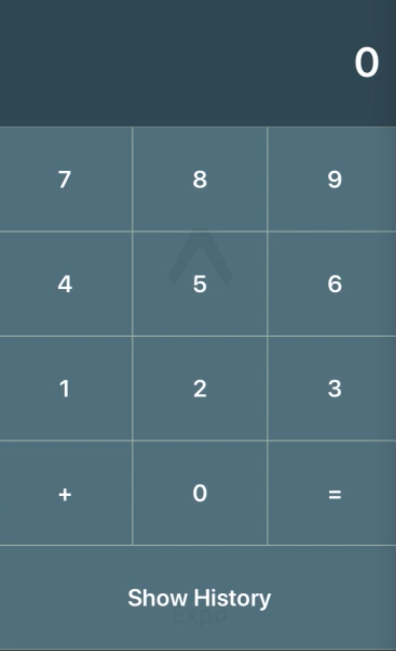

React Native – A calculator example (cont’d)
Adding the Input Buttons in the calculator class
/**
* For each row in `inputButtons`, create a row View and add create an InputButton for each input in the row.
*/
_renderInputButtons() {
let views = [];
for (var r = 0; r < inputButtons.length; r ++) {
let row = inputButtons[r];
let inputRow = [];
for (var i = 0; i < row.length; i ++) {
let input = row[i];
inputRow.push(
<InputButton value={input} key={r + "-" + i} />
);
}
views.push(<View style={Style.inputRow} key={"row-" + r}>{inputRow}</View>)
}
return views;
}
Copyright © 2018 Marco Papa and Chenglong Hao
Notes:
First we will define a multi-dimensional array that represents the rows and inputs that will be displayed in the calculator. Next, we’ll create a function to dynamically generate the buttons, and call this from within render. This new function, _renderInputButtons, will iterate each row in the inputButtons array, and for each input in the row, create an InputButton and add it to the row.
https://kylewbanks.com/blog/react-native-tutorial-part-2-designing-a-calculator

Slide 29
React Native – A calculator example (cont’d)
Handling Touch Events: Firstly update the InputButton to use a Touchable view instead of the View it currently uses
// InputButton.js
...
render() {
return (
<TouchableHighlight style={Style.inputButton}
underlayColor="#193441"
onPress={this.props.onPress}>
<Text style={Style.inputButtonText}>{this.props.value}</Text>
</TouchableHighlight>
)
}
...
You should also notice that we pass on the onPress prop to the TouchableHighlight view, so we’ll need to provide that from our presenting Component:
Copyright © 2018 Marco Papa and Chenglong Hao
Notes:
Don’t forget to import TouchableHighlight from react-native for this to work! You should also notice that we pass on the onPress prop to the TouchableHighlight view, so we’ll need to provide that from our presenting Component:
https://kylewbanks.com/blog/react-native-tutorial-part-3-developing-a-calculator

Slide 30
React Native – A calculator example (cont’d)
Handling Touch Events: Update the calculator class which uses the input buttons
// App.js Calculator class
...
_renderInputButtons() {
...
inputRow.push(
  <InputButton
  value={input}
  onPress={this._onInputButtonPressed.bind(this, input)}
  key={r + "-" + i}/>
);
}
_onInputButtonPressed(input) {
//handle press button events here
}
...
Copyright © 2018 Marco Papa and Chenglong Hao
Notes:
In the _renderInputButtons function we set the onPress prop with a reference to a new function called _onInputButtonPressed. We also bind the function with a reference to the input value, which will allow us to know what action to take based on which InputButtonwas clicked.
Now that we can handle touch events, and we know which button is being touched, we can start to develop the actual calculator functionality.
https://kylewbanks.com/blog/react-native-tutorial-part-3-developing-a-calculator

Slide 31
React Native – A calculator example (cont’d)
Using State: State allows us to update the UI of our applications based on dynamic data.
The first thing we’ll use State for is to update the display based on the numbers entered by the user
// App.js
...
class ReactCalculator extends Component {
constructor(props) {
super(props);
this.state = {
inputValue: 0
}
}
Copyright © 2018 Marco Papa and Chenglong Hao
Notes:
The constructor takes a single props argument and passes it up the the super constructor. What we’re more interested in however is where we set state equal to { inputValue: 0 }. During the constructor is the only time you can modify state directly, after which it must be deemed immutable and can only be modified using setState, as we’ll see in a moment.
https://kylewbanks.com/blog/react-native-tutorial-part-3-developing-a-calculator

Slide 32
React Native – A calculator example (cont’d)
Using State: State allows us to update the UI of our applications based on dynamic data.
The first thing we’ll use State for is to update the display based on the numbers entered by the user
// App.js
...
render() {
return (
<View style={Style.rootContainer}>
<View style={Style.displayContainer}>
<Text style={Style.displayText}>{this.state.inputValue}</Text>
</View>
<View style={Style.inputContainer}>
{this._renderInputButtons()}
</View>
</View>
)
}
Running the app, you should see that zero is displayed in Text view. That’s because we set the value to this.state.inputValue, which we initialized to zero during the constructor.
Copyright © 2018 Marco Papa and Chenglong Hao
Notes:
Okay, so we have this inputValue, but how does it help us? We’ll, we’re going to use it in the display portion of the calculator. We’ll modify render to add a Text view to the displayContainer that displays the value of inputValue.
https://kylewbanks.com/blog/react-native-tutorial-part-3-developing-a-calculator

Slide 33
React Native – A calculator example (cont’d)
More things to do regarding the state:
  Modify the inputValue in the button pressed events handler
  Add more states to save intermediate results and used as status indicators
  Saving calculation histories
Copyright © 2018 Marco Papa and Chenglong Hao
Notes:
Skip these code here

Slide 34
React Native – A calculator example (cont’d)
Now we have a home screen to display the calculator, and we need to add another screen to show calculation history
Using FlatList to display a list of results (like a UITableView in IOS)
class HistoryScreen extends React.Component {
render() {
return (
<View style={{ flex: 1}}>
<FlatList
data={historyData}
renderItem={({item}) => <Text style={Style.historyItem}>{item.key}</Text>}
/>
</View>
);
}
}
Copyright © 2018 Marco Papa and Chenglong Hao

Slide 35
React Native – A calculator example (cont’d)
React Navigation: Navigation between the Home Screen (Calculator) and the History Screen
Install React Navigation in your project
Then you can quickly create an app with a home screen and a history screen:
npm install --save react-navigation
import {
StackNavigator,
} from 'react-navigation';
const App = StackNavigator({
Home: { screen: HomeScreen },
History: { screen: HistoryScreen },
});
Copyright © 2018 Marco Papa and Chenglong Hao
Notes:
The community solution to navigation is a standalone library that allows developers to set up the screens of an app with just a few lines of code.
https://facebook.github.io/react-native/docs/navigation.html

Slide 36
React Native – A calculator example (cont’d)
The Final Stretch: pass history data from calculator screen to history screen
//Calculator Screen
...
_handleShowHistoryButtonPressed() {
this.props.navigation.navigate('History', {history: equations});
}
...
//History Screen
...
Render() {
const { params } = this.props.navigation.state;
const historyData = params ? params.history : [];
}
...
Copyright © 2018 Marco Papa and Chenglong Hao
Notes:
The community solution to navigation is a standalone library that allows developers to set up the screens of an app with just a few lines of code.
https://facebook.github.io/react-native/docs/navigation.html

Slide 37
React Native – A calculator example (cont’d)
Demo: Run the React Calculator in the IOS emulator
Copyright © 2018 Marco Papa and Chenglong Hao

Slide 38
References
React JS – Get Started https://reactjs.org/docs/hello-world.html
Tutorial: Intro To React https://reactjs.org/tutorial/tutorial.html
Free & Paid Courses for React JS https://reactjs.org/community/courses.html
More Project Examples of React JS https://reactjs.org/community/examples.html
React Native – Get Started https://facebook.github.io/react-native/docs/getting-started.html
Copyright © 2018 Marco Papa and Chenglong Hao

