Slide 1
Serverless Applications Google Cloud Functions

Slide 2
Outline
Google Cloud Platform Functions + API Management

Slide 3
Google Cloud Functions
Why Google Cloud Functions?
Serverless Applications on Google’s Infrastructure. Construct applications from bite-sized business logic billed to the nearest 100 milliseconds, only while your code is running. Serve users from zero to planet-scale, all without managing any infrastructure.
Microservices Over Monoliths
Developer agility comes from building systems composed of small, independent units of functionality focused on doing one thing well. Cloud Functions lets you build and deploy services at the level of a single function, not at the level of entire applications, containers, or VMs.
Connect & Extend Cloud Services
Cloud Functions provides a connective layer of logic that lets you write code to connect and extend cloud services. Listen and respond to events such as a file upload to Cloud Storage, an incoming message on a Cloud Pub/Sub topic, a log change in Stackdriver Logging, or a mobile-related event from Firebase.
Serverless Economics
Cloud Functions are ephemeral, spinning up on-demand and back down in response to events in the environment. Pay only while your function is executing, metered to the nearest 100 milliseconds, and pay nothing after your function finishes.

Slide 4
Google Cloud Functions (cont’d)
Mobile Ready
Mobile app developers can use Cloud Functions directly from Firebase, Google Cloud’s mobile platform. Firebase natively emits events to which Cloud Functions can respond, including from Firebase Analytics, Realtime Database, Authentication, and Storage.
Just Add Code
Run in a fully-managed, serverless environment where Google handles servers, operating systems, and runtime environments completely on your behalf. Each Cloud Function runs in its own isolated secure execution context, scales automatically, and has a lifecycle independent from other functions.
Open and Familiar
Cloud Functions are written in JavaScript and execute in a standard Node.js runtime environment. We don’t assume anything proprietary all the way down to the operating system, which means your functions will just work—including native libraries you bring to the platform. Discover a superior, open developer experience that comes from working hand-in-hand with the Node.js Foundation, with our Google colleagues and with the community through the open source V8 engine.

Slide 5
Google Cloud Functions Use Cases
Mobile Backend
Use Google’s mobile platform for app developers, Firebase, and extend your mobile backend with Cloud Functions. Listen and respond to events from Firebase Analytics, Realtime Database, Authentication, and Storage.
APIs & Microservices
Compose applications from lightweight, loosely coupled bits of logic that are quick to build and scale automatically. Your functions can be event-driven or invoked directly over HTTP/S.
Data Processing / ETL
Listen and respond to Cloud Storage events such as when a file is created, changed, or removed. Process images, do video transcoding, validate or transform data, and invoke any service on the Internet from your Cloud Function.
Webhooks
Via a simple HTTP trigger, respond to events originating from 3rd party systems like GitHub, Slack, Stripe, or from anywhere that can send HTTP/S requests.
IoT
Imagine tens or hundreds of thousands of devices streaming data into Cloud Pub/Sub automatically launching Cloud Functions to process, transform and store data. Cloud Functions lets you do this in a way that’s completely serverless.

Slide 6
Google Cloud Functions Features
Cloud Pub/Sub Triggers
Cloud Functions can be triggered by messages on a Cloud Pub/Sub topic, and multiple functions can subscribe to the same topic.
Cloud Storage Triggers
You can associate a Cloud Function to mutation events on a Cloud Storage bucket. Every time a file in your bucket is created, deleted or modified, your function will execute.
Firebase Triggers
Mobile developers will find first-class integration between Firebase and Cloud Functions.
HTTP/S Invocation
Functions deployed with an HTTP trigger are given a fully qualified domain together with a dynamically generated TLS certificate for secure communication.
GitHub/Bitbucket
Using Cloud Source Repositories you can deploy Cloud Functions directly from your Github or Bitbucket repository without needing to upload code or manage versions yourself.
Logging, Monitoring & Debugging
Logs emitted from your Cloud Functions are automatically written to Stackdriver Logging and performance telemetry is recorded in Stackdriver Monitoring. Stackdriver Debugger lets you investigate your code’s behavior in production.

Slide 7
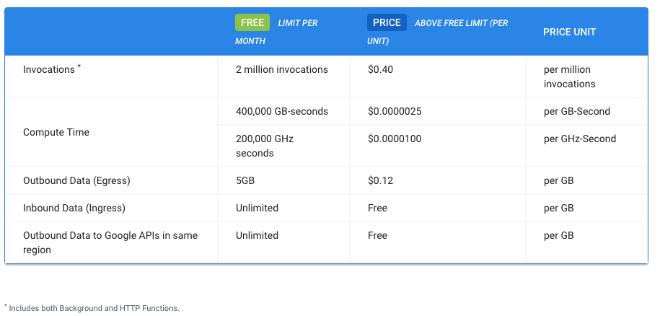
Google Cloud Functions Pricing

Slide 8
Create a Simple HTTP service using Google Cloud Functions
In this exercise you will demonstrate writing, deploying, and triggering an HTTP Cloud Function. The Cloud Function is triggered by and HTTP request and outputs a “Hello World” in our browser. This tutorial uses billable components of Cloud Platform, including: Google Cloud Functions.

Slide 9
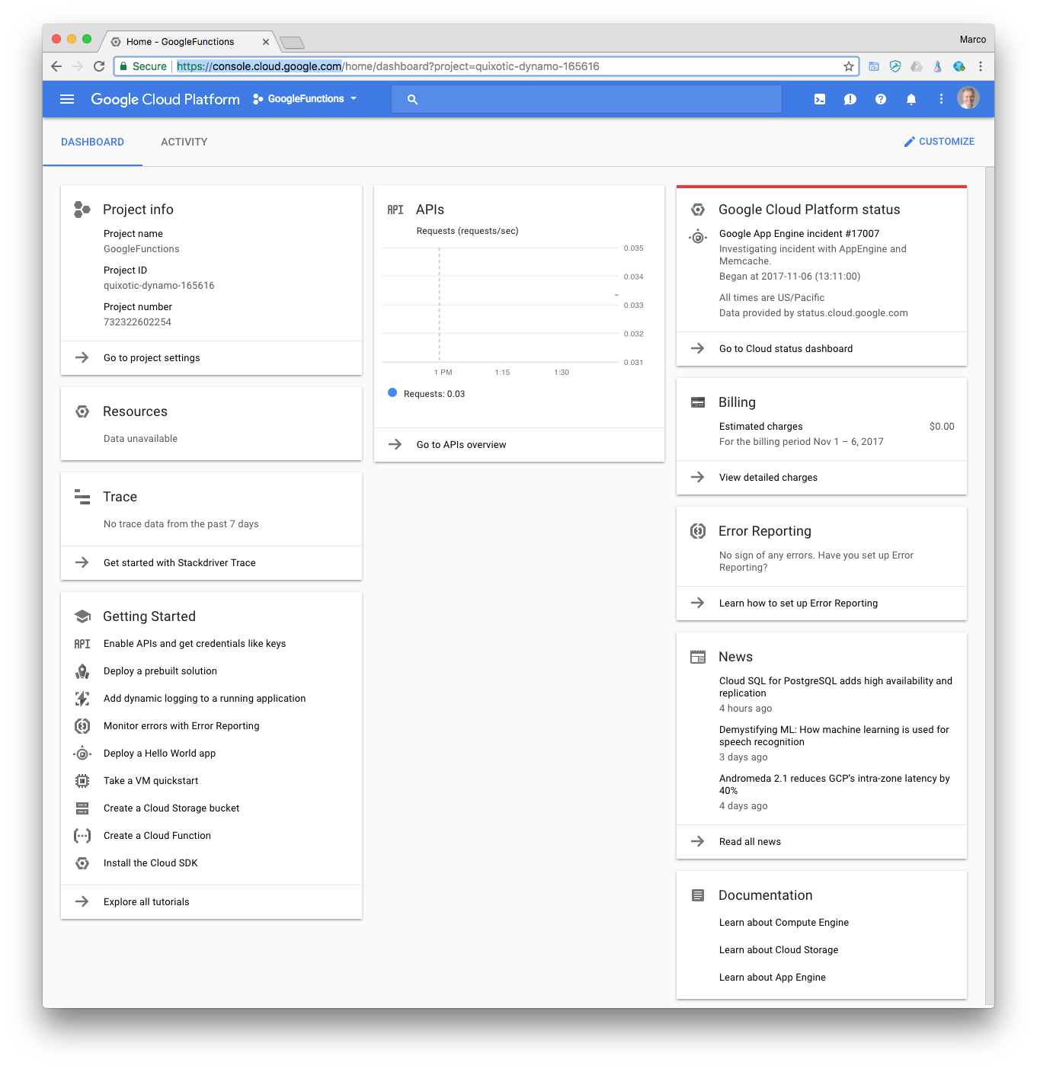
Google Cloud Functions (cont’d)
Follow the steps in this section to create a new Google Cloud function and an API endpoint to trigger it:
Sign in to the Google Cloud Platform at:
https://console.cloud.google.com

Slide 10
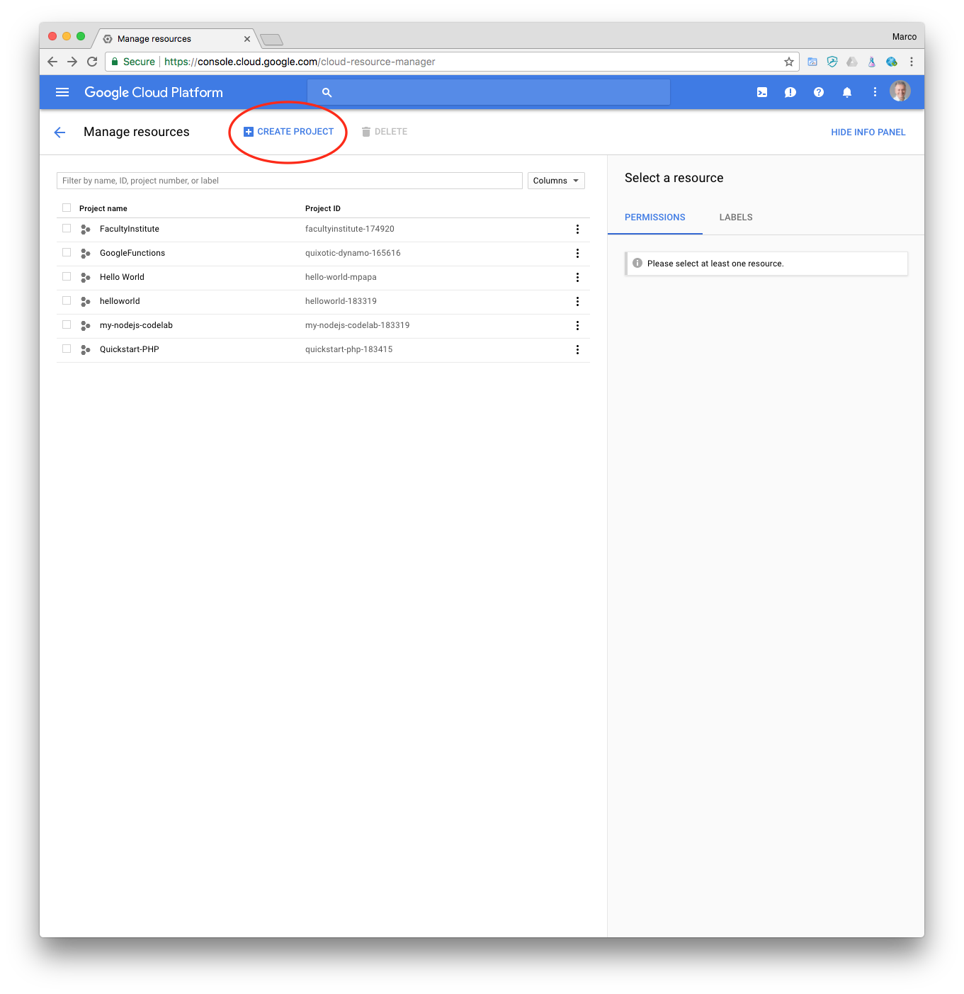
Google Cloud Functions (cont’d)
Select or create a Cloud Platform project. Go to the Projects page at:
https://console.cloud.google.com/project
Select CREATE PROJECT.

Slide 11
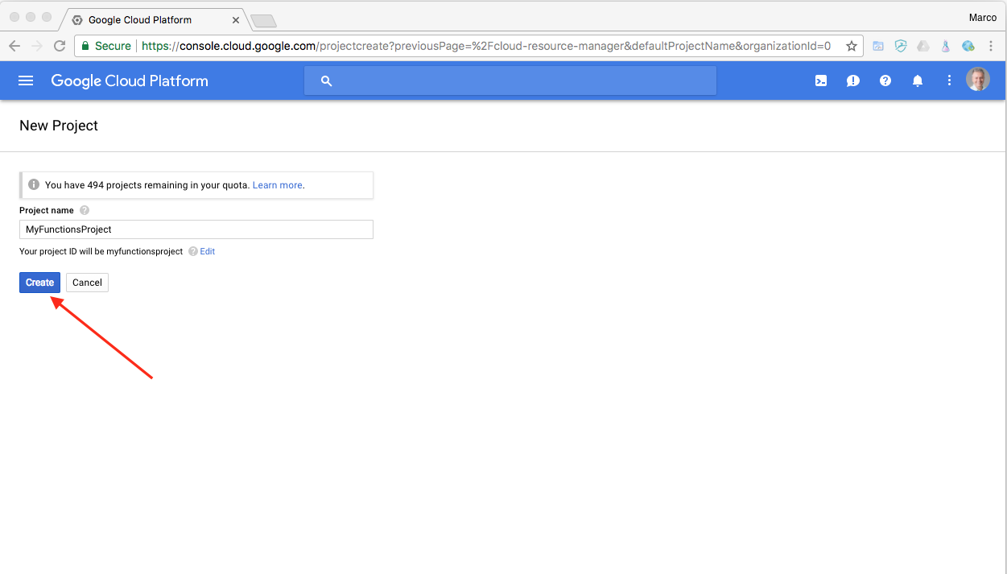
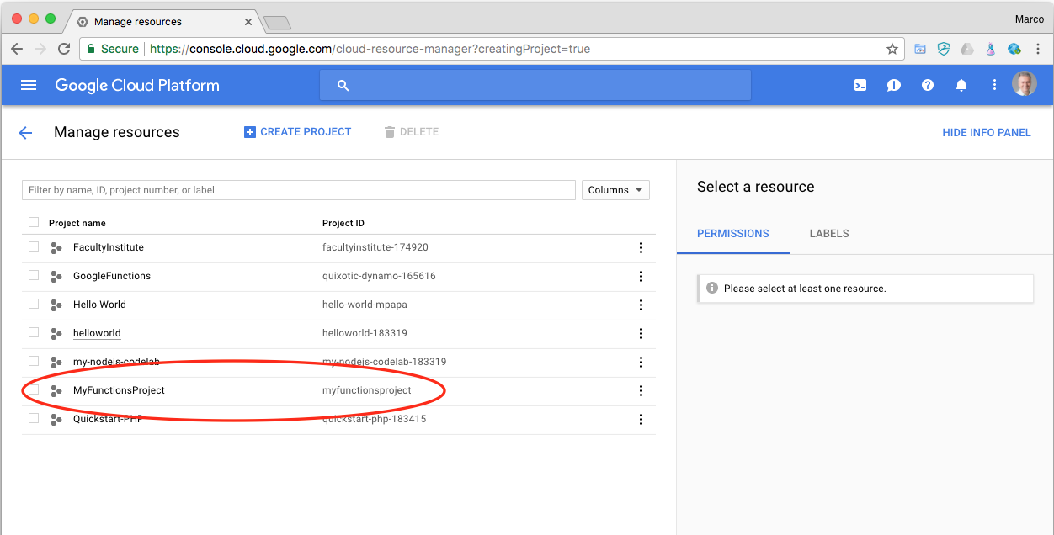
Google Cloud Functions (cont’d)
Enter your project name, such as MyFunctionsProject. Notice the project ID.
Click Create.
You may have to refresh the page to see your new project.
Click on the project name, MyFunctionsProject, in this example.
Click the Products and Services “3 bars” icon on top left, and select Home.

Slide 12
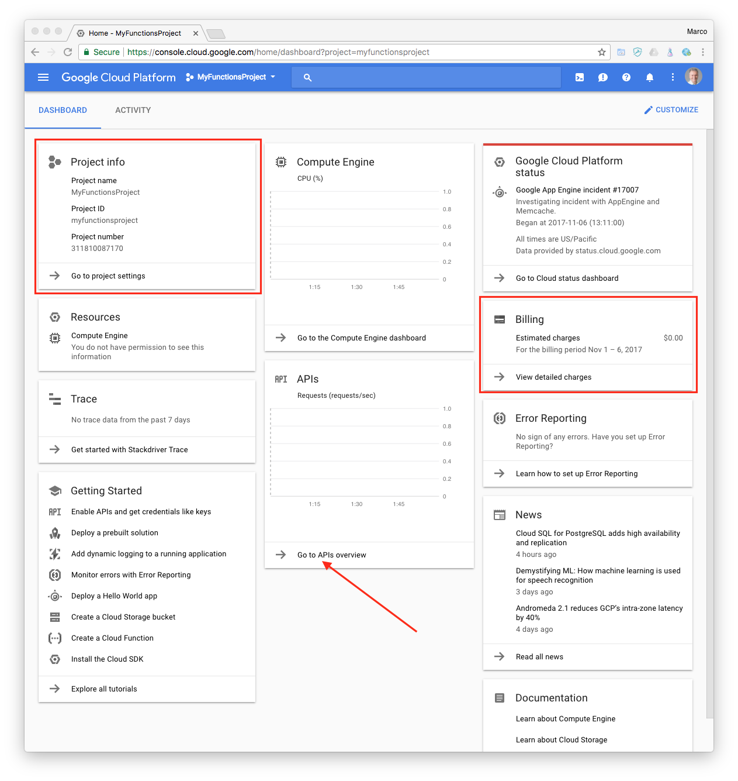
Google Cloud Functions (cont’d)
Enable billing for a project
How you enable billing depends on whether you're creating a new project or you're re-enabling billing for an existing project.
When you create a new project, you're prompted to choose which of your billing accounts you want to link to the project. If you have only one billing account, that account is automatically linked to your project.
Click on Go to APIs overview.

Slide 13
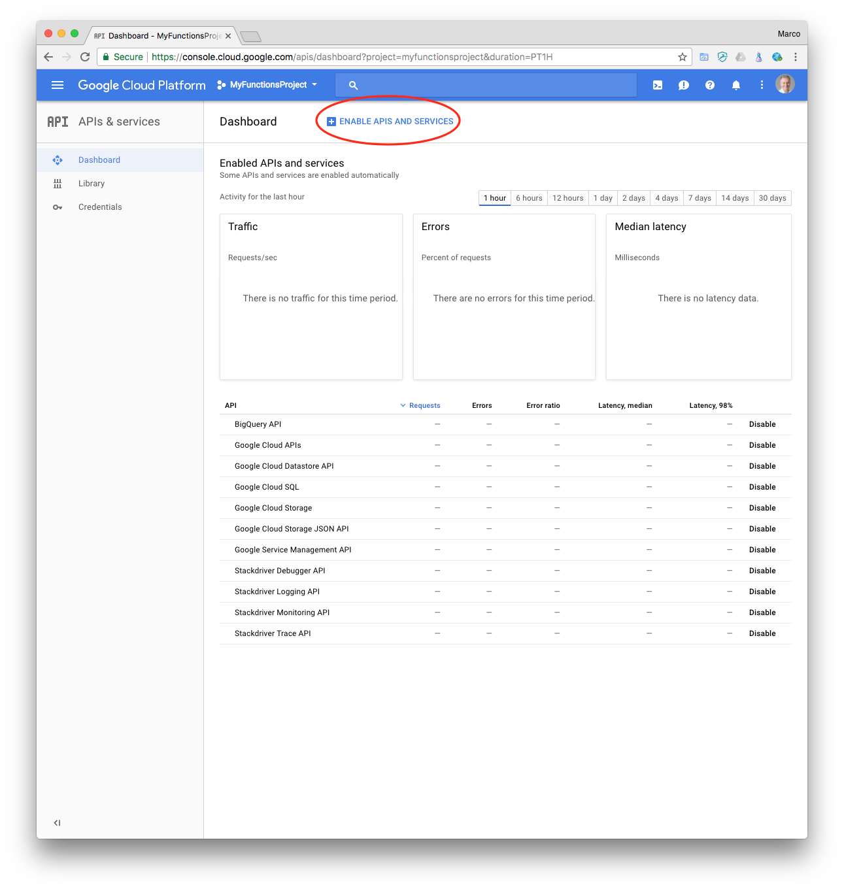
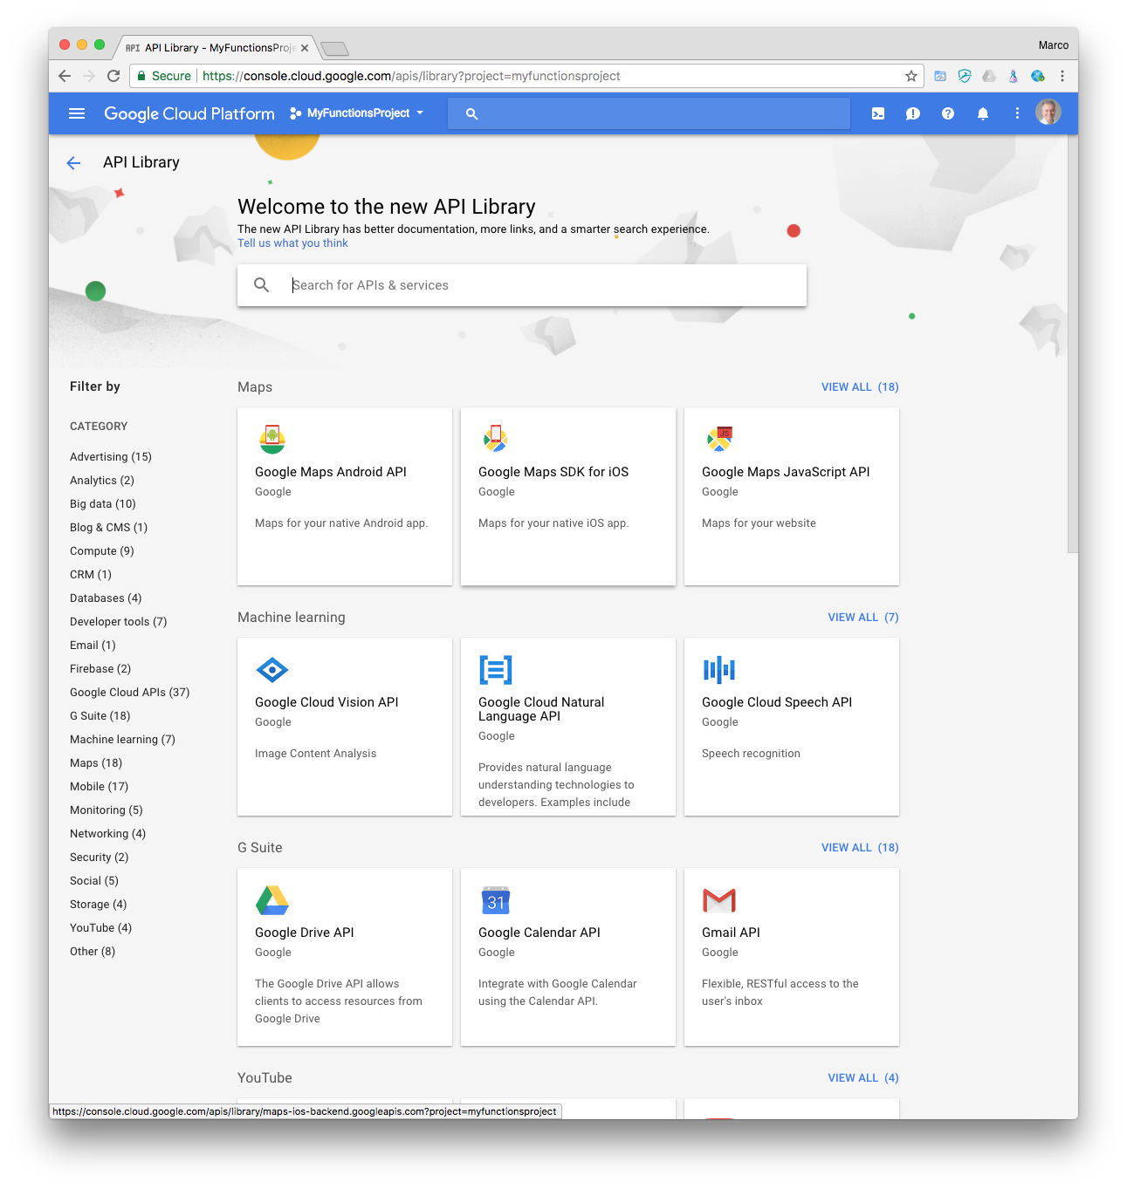
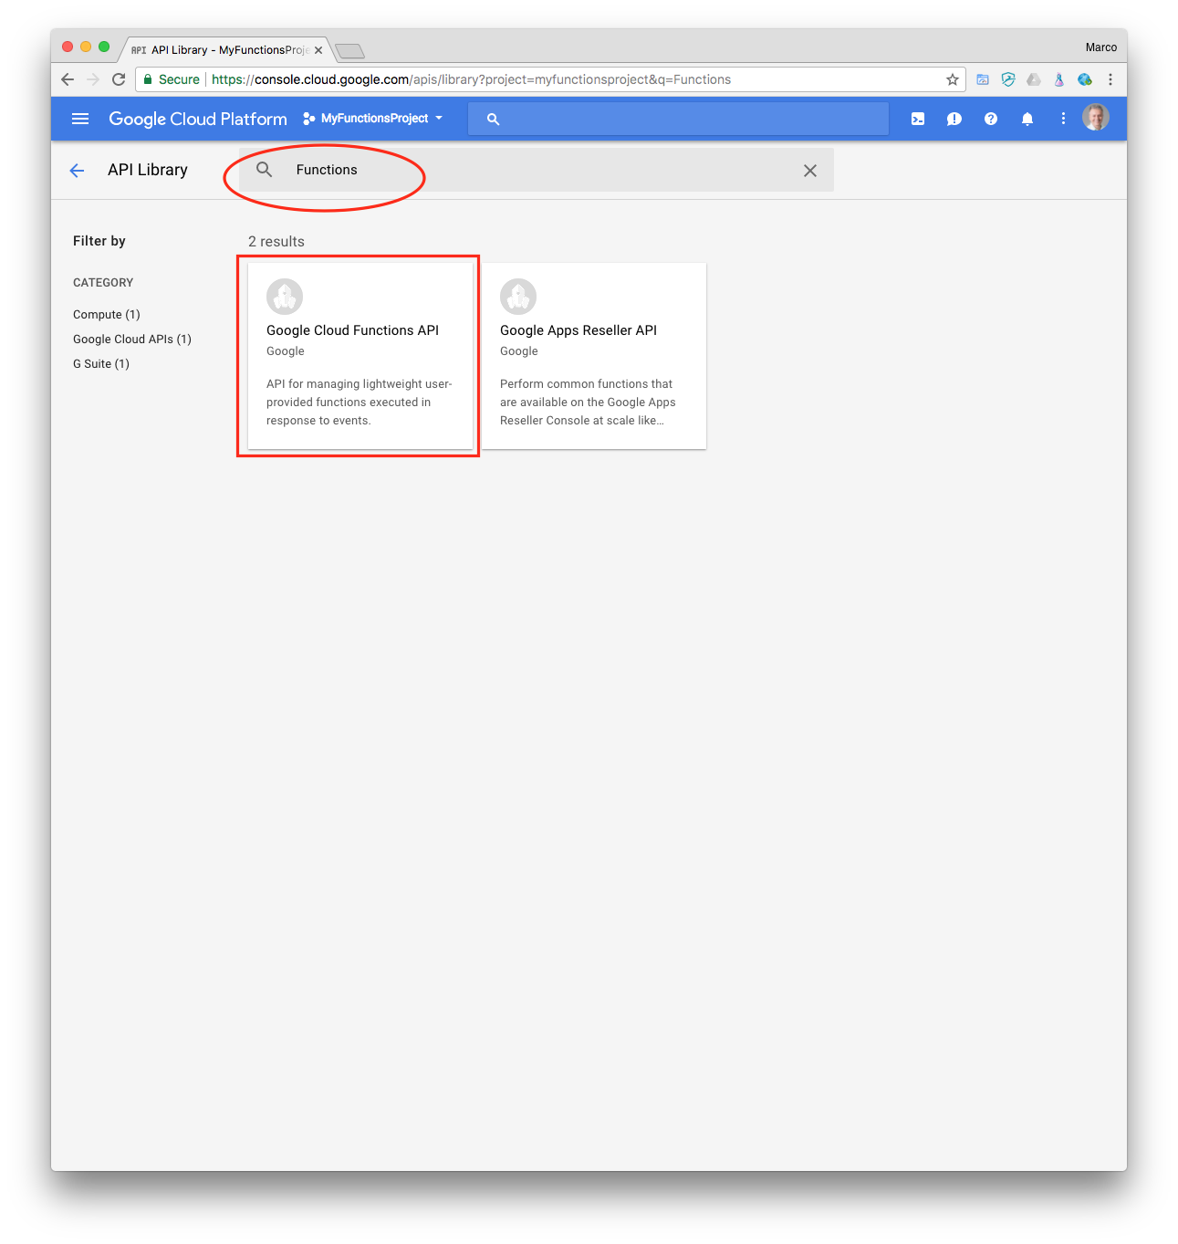
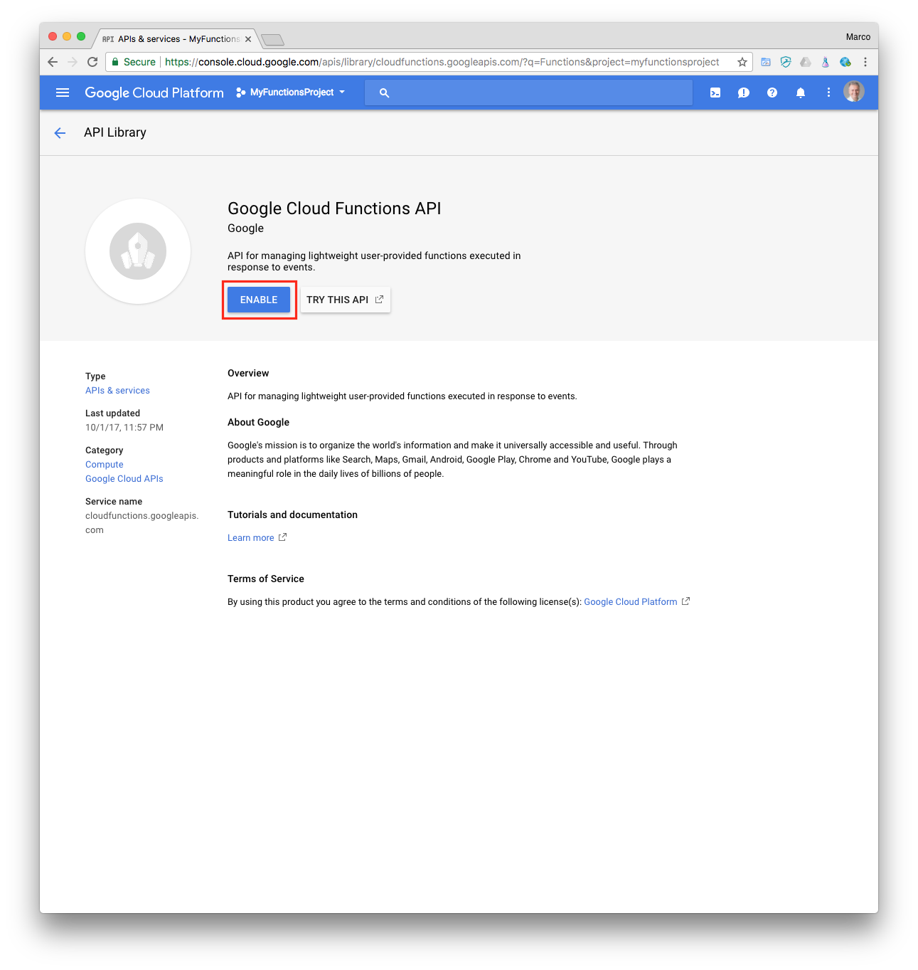
Google Cloud Functions (cont’d)
Enable the Cloud Functions API. In the API & Services Dashboard, click ENABLE APIS AND SERVICES. The page titled “Welcome to the new API Library” appears.
Enter “Functions” in the edit box. Then click Google Cloud Functions API.
Click ENABLE. Wait while “Enabling API.”

Slide 14
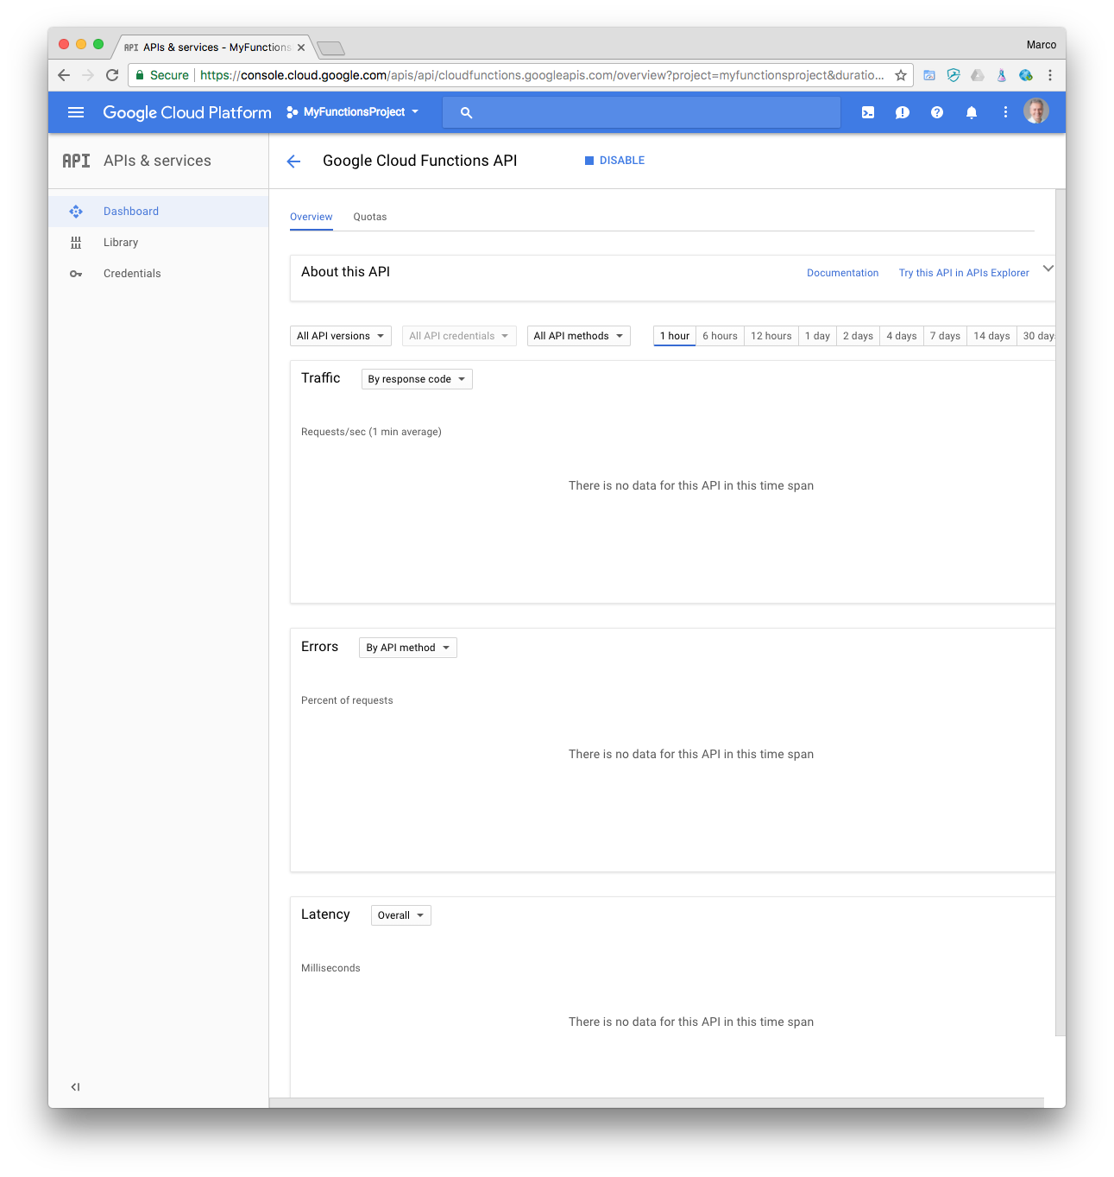
Google Cloud Functions (cont’d)
The Google Cloud Functions API “Overview” page is shown from the Dashboard.

Slide 15
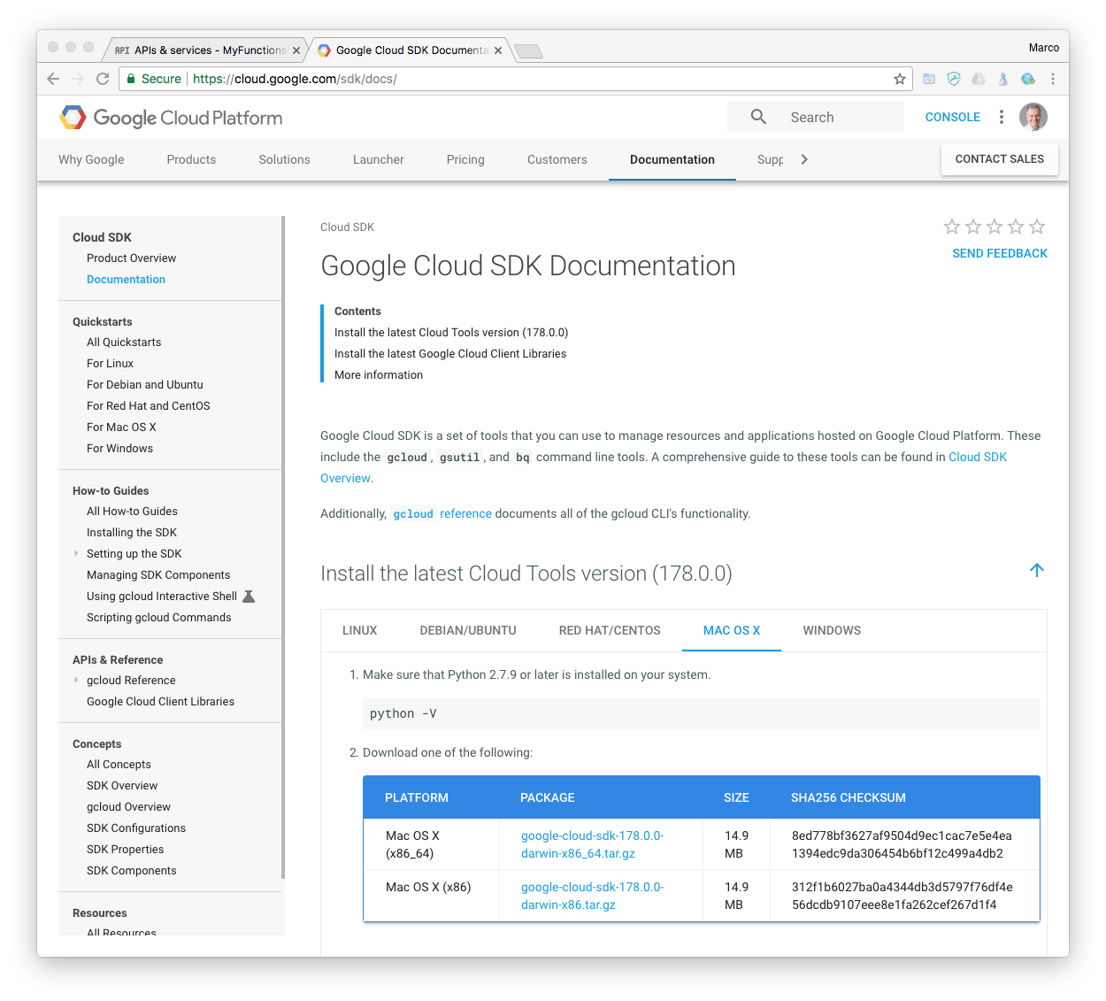
Google Cloud Functions (cont’d)
Install and initialize the Cloud SDK at:
https://cloud.google.com/sdk/docs/
In the section titled Install the latest Cloud Tools version, select your platform several versions of Linux, Mac OSX or Windows)
Make sure that Python 2.7.9 or later is installed on your system:
python –V
Download your selected package. (google-cloud-sdk-178.0.0-darwin-x86_64.tar on macOS)
Extract the file to any location on your file system.

Slide 16
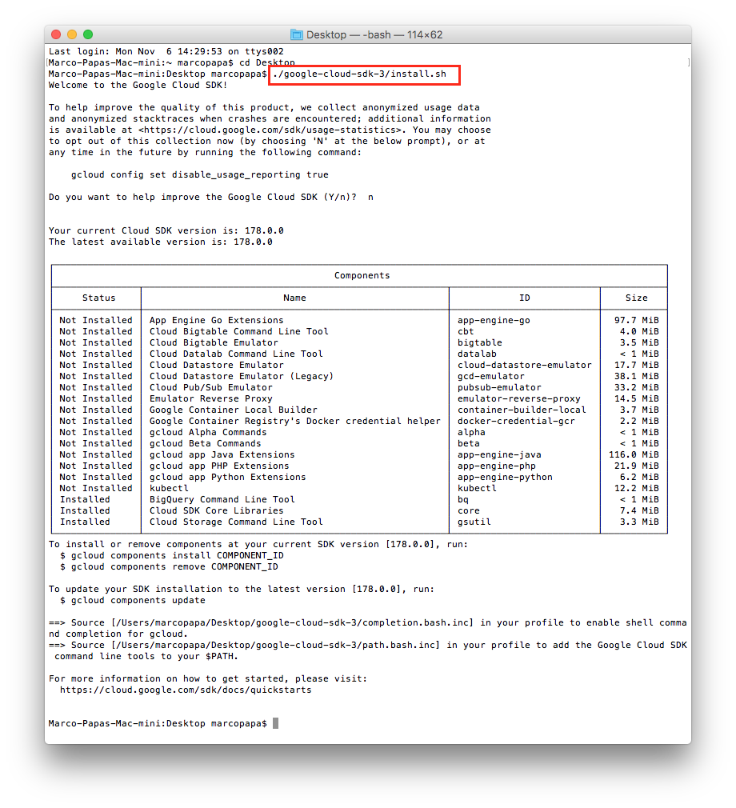
Google Cloud Functions (cont’d)
Run the install script to add SDK tools to your path, enable command completion in your bash shell, and/or and enable usage reporting.
./google-cloud-sdk-3/install.sh
Note: you may have to rename the SDK folder google-cloud-sdk-3 from “google-cloud-sdk 3”.
Open a new terminal so that the changes take effect.

Slide 17
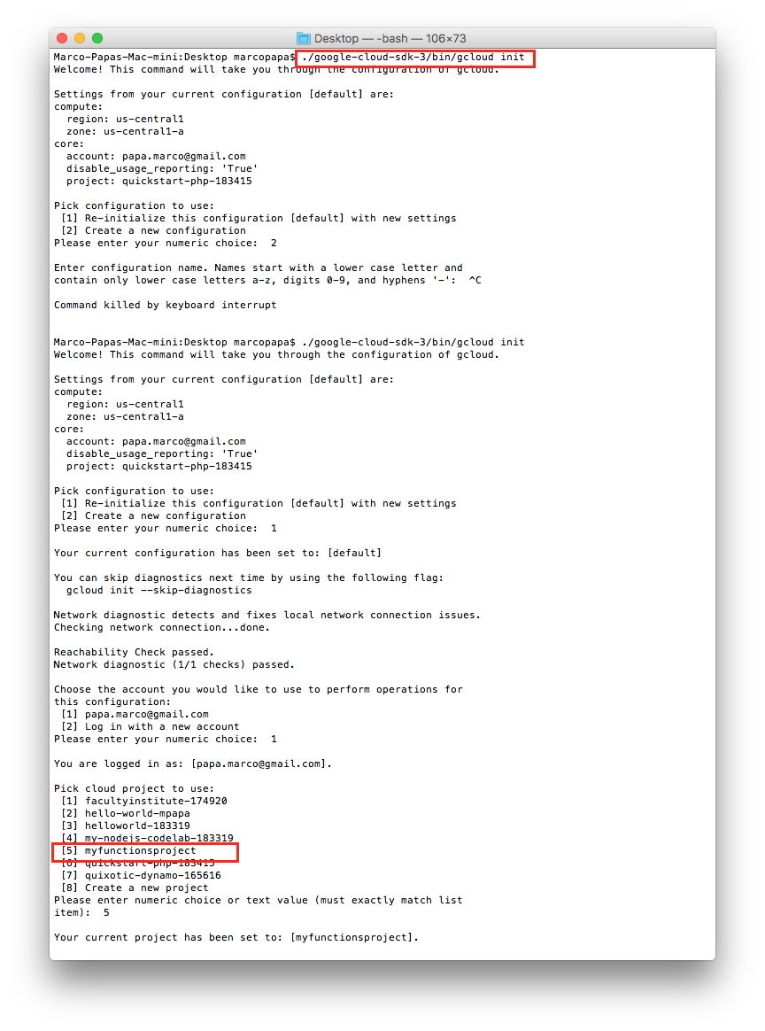
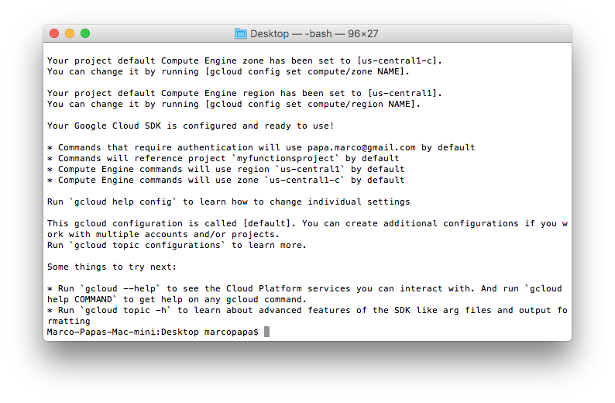
Google Cloud Functions (cont’d)
Run gcloud init to initialize the SDK:
./google-cloud-sdk/bin/gcloud init
You will be asked to select the project.
You maybe asked to “enable” API [compute.googleapis.com] and “configure” Google Compute Engine. Answer Y to both.

Slide 18
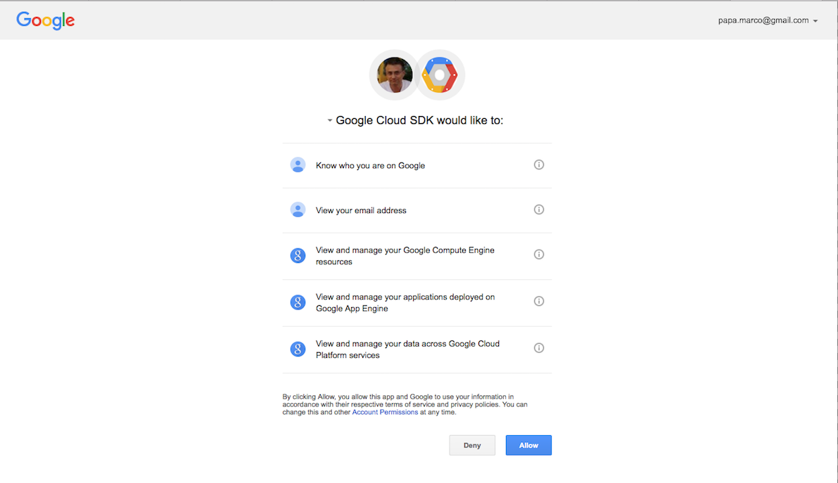
Google Cloud Functions (DELETE)
Run gcloud init to initialize the SDK:
./google-cloud-sdk/bin/gcloud init
You will be asked to log in to continue. Answer Y (Yes).
Click Allow when asked about your Google Cloud SDK credentials.
Run gcloud auth login to obtain your credentials (if not automatically asked)
./google-cloud-sdk/bin/gcloud auth login

Slide 19
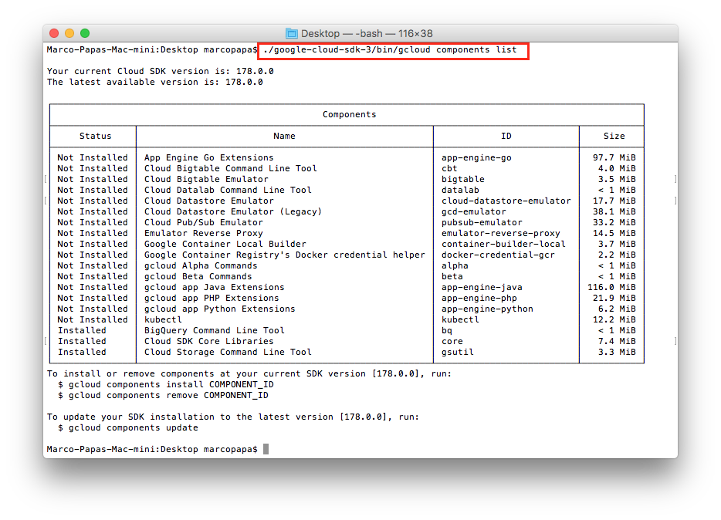
Google Cloud Functions (cont’d)
Verify all gcloud installed components:
./google-cloud-sdk-3/bin/gcloud components list

Slide 20
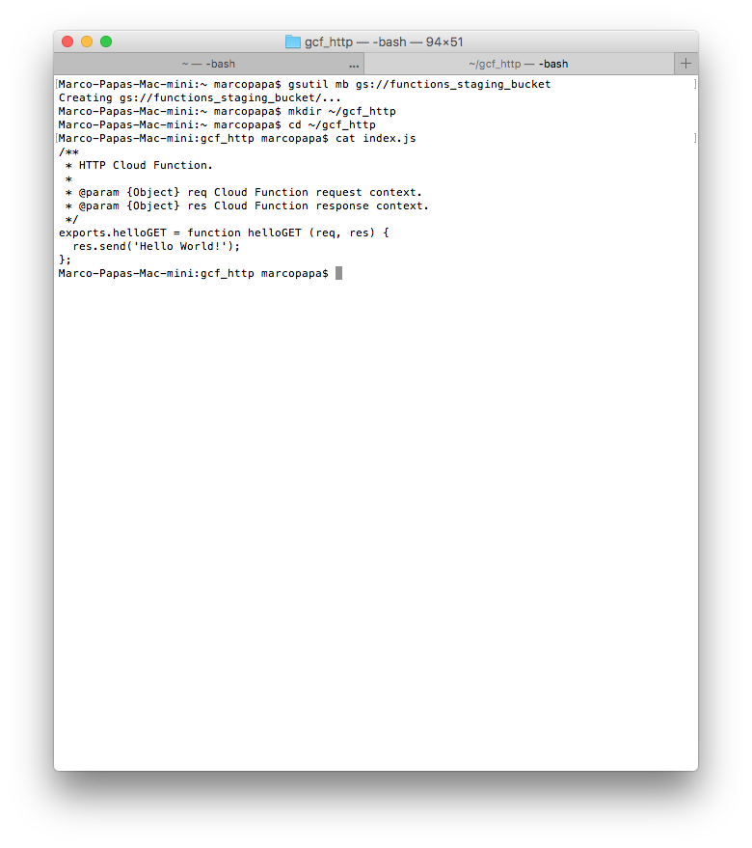
Google Cloud Functions (cont’d)
Now prepare the application. Create a Cloud Storage bucket to stage your Cloud Functions files, where [YOUR_STAGING_BUCKET_NAME] is a globally-unique bucket name:
gsutil mb gs://[YOUR_STAGING_BUCKET_NAME]
As in:
gsutil mb gs://functions_staging_bucket
Create a directory on your local system for the application code:
Linux or Mac OS X:
mkdir ~/gcf_http
cd ~/gcf_http
Windows:
mkdir %HOMEPATH%\gcf_http
cd %HOMEPATH%\gcf_http

Slide 21
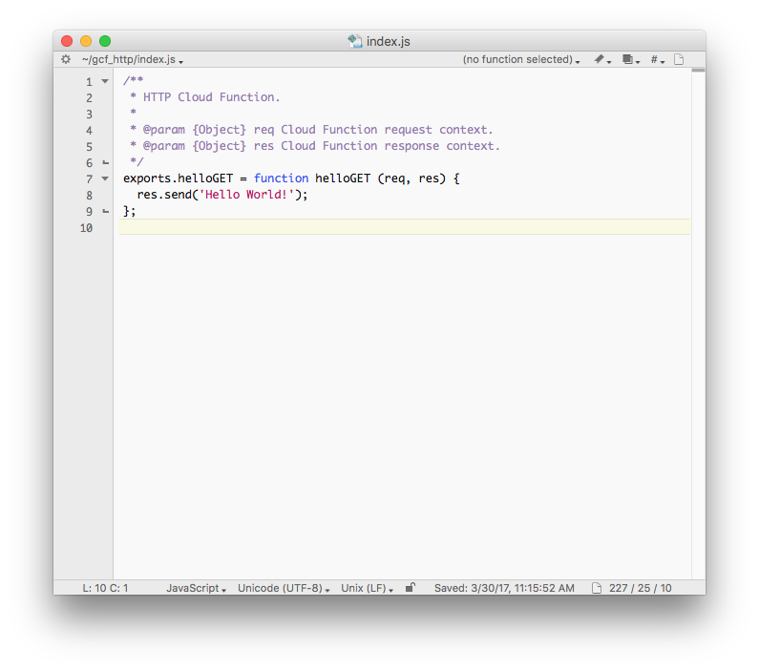
Google Cloud Functions (cont’d)
Create an index.js file in the gcf_http directory with the following contents:
/** * HTTP Cloud Function. * * @param {Object} req Cloud Function request context. * @param {Object} res Cloud Function response context. */ exports.helloGET = function helloGET (req, res) { res.send('Hello World!'); };
The helloGET function is exported by the module and is executed when you make an HTTP request to the function's endpoint.

Slide 22
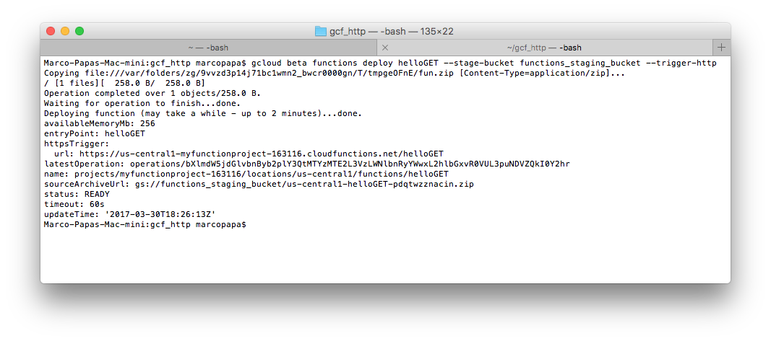
Google Cloud Functions (cont’d)
Deploying the Function. To deploy the helloGET function with an HTTP trigger, run the following command in the gcf_http directory:
gcloud beta functions deploy helloGET --stage-bucket [YOUR_STAGING_BUCKET_NAME] --trigger-http
where [YOUR_STAGING_BUCKET_NAME] is the name of your staging Cloud Storage Bucket, as in:
gcloud beta functions deploy helloGET --stage-bucket functions_staging_bucket
--trigger-http

Slide 23
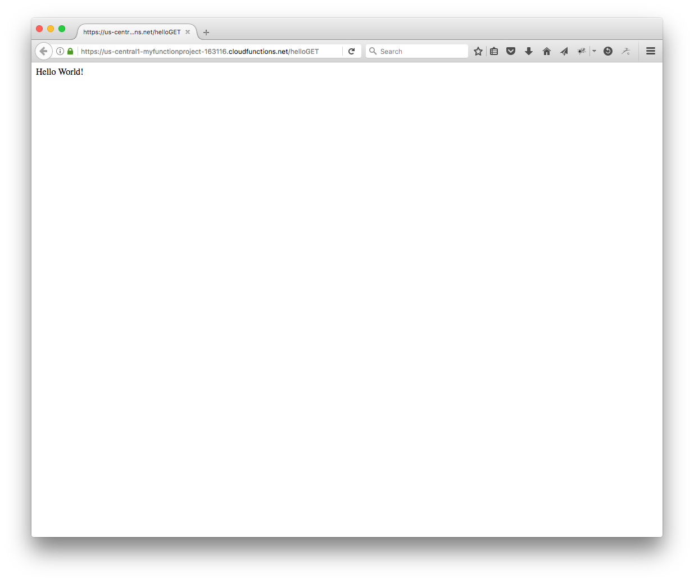
Google Cloud Functions (cont’d)
Triggering the function. Notice of the value of the url of httpsTrigger.
https://us-central1-myfunctionproject-163116.cloudfunctions.net/helloGET
Make an HTTP request to your function, using curl or visit the function's endpoint in your browser to see the "Hello World!" message.

Slide 24
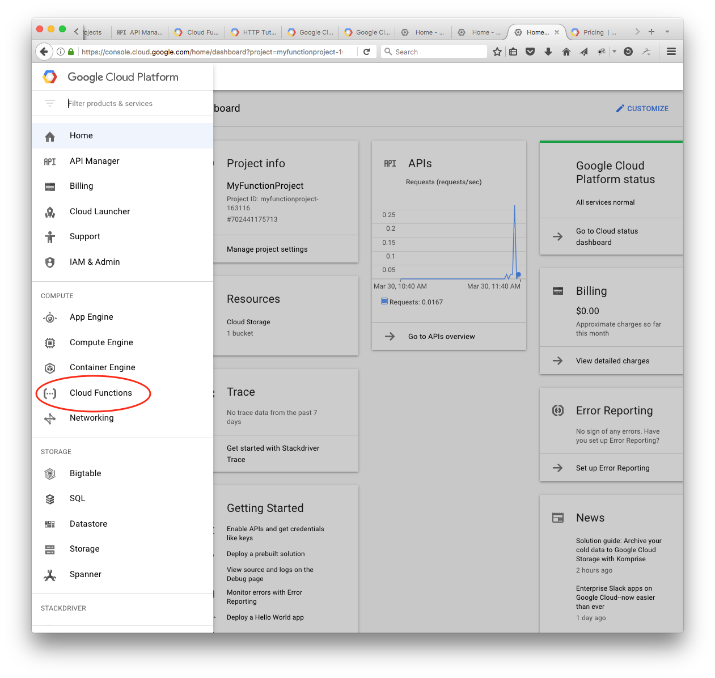
Google Cloud Functions (cont’d)
Monitor the function. From the Google Cloud Platform menu, select Cloud Functions.

Slide 25
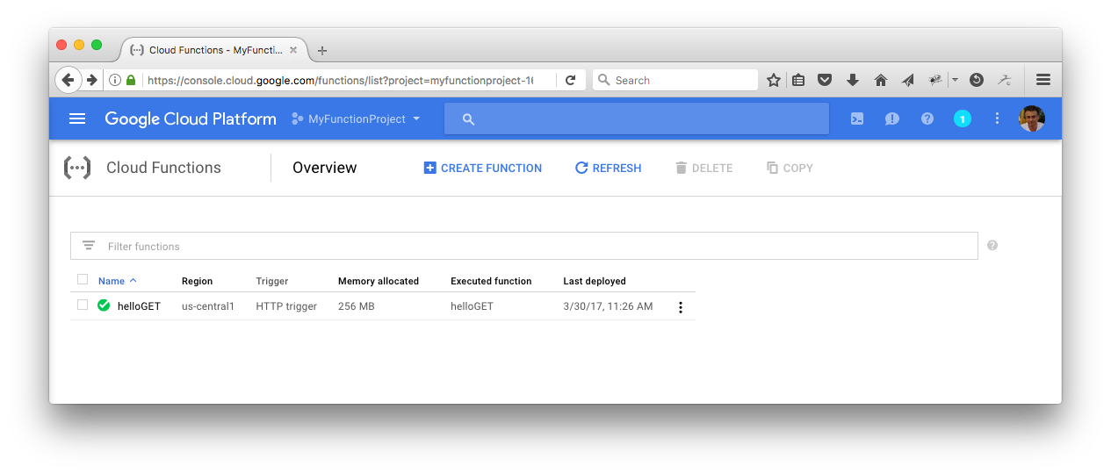
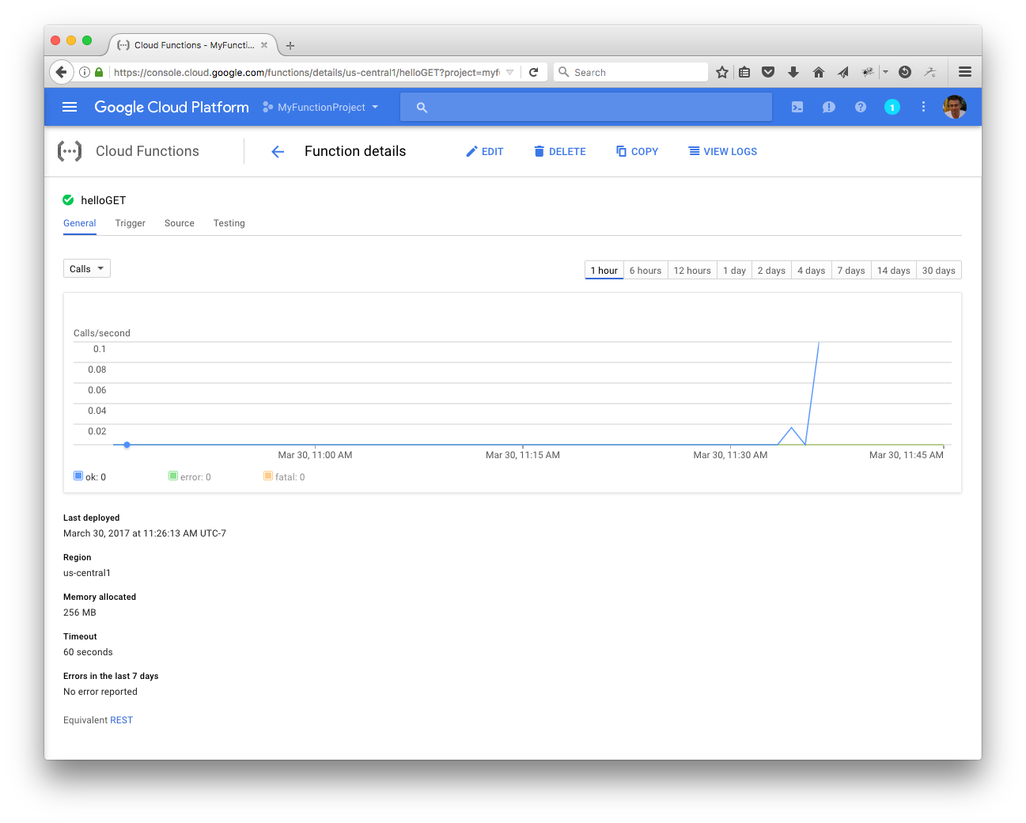
Google Cloud Functions (cont’d)
Click on helloGet.
Click on the Trigger, Source and Testing tabs.

