Slide 1
Lecture
Forms and Common Gateway Interface Mechanism
Copyright © Ellis Horowitz 1999-2018

Slide 2
Forms
Used to create a set of pages that contain fields in which the viewer can select and supply information
  Introduced very early in HTML 2.0
  Allows WWW users to perform data entry
  Permit direct interaction with customers for inquiries, registration, sales of products, and services
  To create a capability requires two steps:
    Use HTML form elements to create the pages that contain the form
    Write a server-side script to process form data; this program must be placed so the WWW server can execute it
Copyright © Ellis Horowitz 1999-2018

Slide 3
The Original Set of User Interface Elements
<INPUT>
Text
Checkbox
Radio button
Submit
Reset
Password
File
Browse
submit
reset
****
<TEXTAREA>
Red
Green
Blue
<SELECT>
Red
Copyright © Ellis Horowitz 1999-2018

Slide 4
FORM Element and Some Attributes
Syntax <FORM>...</FORM>
Attribute Specifications
  ACTION=URI (form handler)
  METHOD=[ get | post ] (HTTP method for submitting form)
    GET is the default; form contents are appended to the URL
    POST causes the fill-out form contents to be sent in a data body as standard input
  ENCTYPE=ContentType (content type to submit form as)
    Defaults to application/x-www-urlencoded which returns name/value pairs, separated by &, spaces replaced by + and reserved characters (like #) replaced by %HH, H a hex digit
  ACCEPT-CHARSET=Charsets (supported character encodings)
  TARGET=FrameTarget (frame to render form result in, in HTML4)
    (a browsing context name or keyword, in HTML5, such as _self, _blank, _parent, _top, iframename)
  ONSUBMIT=Script (form was submitted)
  ONRESET=Script (form was reset)
  https://developer.mozilla.org/en-US/docs/Web/HTML/Element/form
Copyright © Ellis Horowitz 1999-2018

Slide 5
<INPUT> Tag
Used inside <FORM> tag to specify a data-entry object
Has 19 attributes, here are a few
  TYPE: User input type (default is TEXT)
  NAME: Name of data entry object whose value the user will supply
  VALUE: Required for radio and checkboxes
  CHECKED: For radio buttons and checkboxes
  SIZE: Specific to each type of field
  MAXLENGTH: Limit on accepted characters
  SRC: Image file used as a graphical submit button when TYPE=IMAGE
  DISABLED unavailable in this context
  READONLY for text and passwords
HTML5 adds several new attributes for validation
E.g. see http://www.w3schools.com/tags/tag_input.asp
Copyright © Ellis Horowitz 1999-2018

Slide 6
<INPUT> Element, Type Options(cont’d)
TYPE:[CHECKBOX⏐FILE⏐HIDDEN⏐IMAGE⏐PASSWORD⏐
RADIO⏐RESET⏐SUBMIT⏐TEXT]
[HTML5 adds 13 new input types. See later slides]
    CHECKBOX: A single value, on/off; each generates name/value pair
    <INPUT TYPE=CHECKBOX CHECKED NAME="MARRIED" VALUE="yes">
    FILE: Users attach a file to the form contents; a text field holds the file name and a button permits browsing
    <INPUT TYPE=FILE NAME=“fname">
    HIDDEN: The field is not rendered, so servers can maintain state information
    <INPUT TYPE=HIDDEN NAME="BANKACCT" VALUE="A057-23-789">
Copyright © Ellis Horowitz 1999-2018

Slide 7
<INPUT> Element, Type Options(cont’d)
RESET: Defines a button that users click to reset fields to their initial state
  <INPUT TYPE=RESET VALUE="CLEAR">
SUBMIT: Defines a button that users click to submit the form’s contents to the server
  <INPUT TYPE=SUBMIT VALUE="submit data">
TEXT: An input field of a single line where users can enter data
  <INPUT TYPE=TEXT SIZE=20 NAME="lastname" VALUE=“type your last name">
Copyright © Ellis Horowitz 1999-2018

Slide 8
<INPUT> Element, Type Options(cont’d)
IMAGE: Used for graphical submit buttons
  <INPUT TYPE=IMAGE SRC="banner.gif“ VALUE="gohome">
PASSWORD: Just like TYPE=TEXT, but the input is echoed with *
  <INPUT TYPE=PASSWORD SIZE=10 NAME="pw">
RADIO: Used for attributes that take a single value from a set of alternatives; all buttons have same name and explicit value
  <INPUT TYPE=RADIO NAME="AGE" VALUE="0-20">
  <INPUT TYPE=RADIO NAME="AGE" VALUE="21-50">
  <INPUT TYPE=RADIO NAME="AGE" VALUE="51-100" CHECKED>
Copyright © Ellis Horowitz 1999-2018

Slide 9
<INPUT> Element, Type Options
TYPE:[COLOR⏐DATE⏐DATETIME⏐DATETIME-LOCAL⏐EMAIL⏐
MONTH⏐NUMBER⏐RANGE⏐SEARCH|TEL|TIME|URL|WEEK]
    COLOR: Used for input fields that should contain a color
    Select color: <INPUT TYPE="COLOR" name=”favcolor">
    DATE: Allows the user to select a date
    Birthday: <INPUT TYPE="DATE" NAME="bday">
    DATETIME: Allows the user to select a date and time (with time zone)
    Birthday: <INPUT TYPE="DATETIME" NAME="BDAYTIME”
    EMAIL: Allows the user to enter an e-mail address
    E-Mail: <INPUT TYPE="EMAIL" NAME="email”
    MONTH: Allows the user to select month/year
    Birthday (M/Y): <INPUT TYPE="MONTH" NAME="bdaymonth"
Copyright © Ellis Horowitz 1999-2018

Slide 10
<INPUT> Element, Type Options (cont’d)
    NUMBER: Used to enter a numeric value
    Quantity (1-5): <INPUT TYPE="NUMBER" name="quantity" min="1" max="5">
    RANGE: Used to enter a value from a range of numbers
    <INPUT TYPE="RANGE" NAME="points">
    SEARCH: Used for search fields (behaves like regular TEXT)
    Search Google: <INPUT TYPE="SEARCH" NAME="GOOGLESEARCH”>
    TEL: Allows the user to enter a telephone num.
    Telephone: <INPUT TYPE="TEL" NAME="ustel"
    TIME: Allows the user to select a time
    Time: <INPUT TYPE="TIME" NAME="ustime"
Copyright © Ellis Horowitz 1999-2018

Slide 11
<INPUT> Element, Type Options (cont’d)
    URL: Used to enter a URL address
    Add Homepage: <INPUT TYPE="URL" name="homepage"
    WEEK: Used to select a week and year
    Select a week: <INPUT TYPE="WEEK" NAME="week_YR">
    DATETIME-LOCAL: Used selct date and time(no time zone)
    Birthday: <INPUT TYPE="DATETIME-LOCAL” NAME="bday">
Copyright © Ellis Horowitz 1999-2018

Slide 12
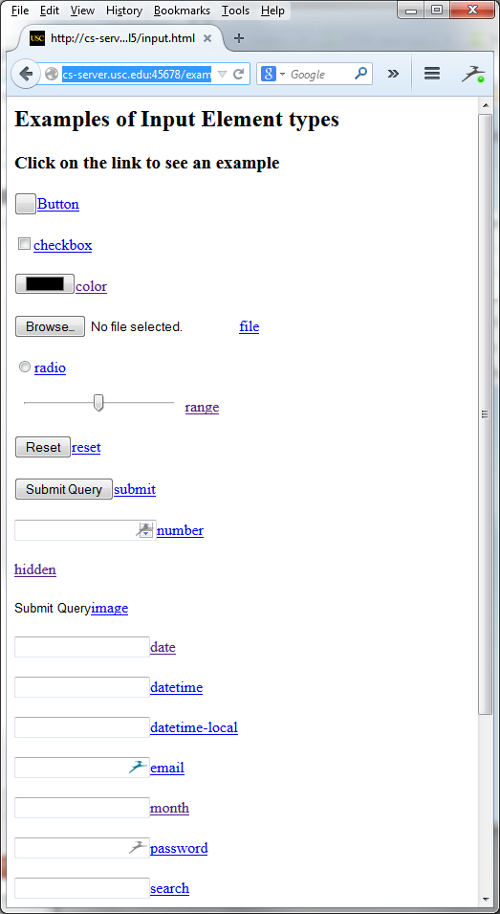
<INPUT> Element, Type Options (cont’d)
Examples of all of the <input>
element types, including the most
recent in HTML5
provided by w3schools
http://cs-server.usc.edu:45678/examples/html5/input.html
Copyright © Ellis Horowitz 1999-2018

Slide 13
Example of <FORM> With Text Widgets
<HTML><HEAD><TITLE>Testing Text Widgets</TITLE> </HEAD>
<BODY>
<FORM METHOD="POST"
ACTION="/cgi-bin/post-query">
Name: <INPUT NAME="in_name" TYPE="text" SIZE=40><P>
Date of Birth: <INPUT TYPE="text” NAME="in_dob"><P>
Social Security Number: <INPUT TYPE="text" NAME="in_ssn"><P>
You can submit by clicking the SEND button:
<INPUT TYPE="submit" VALUE="SEND">
</FORM></BODY></HTML>
Note:post-query is a standard Apache CGI
program distributed by web servers and used
to check that form elements are being
properly sent to the server
Copyright © Ellis Horowitz 1999-2018

Slide 14
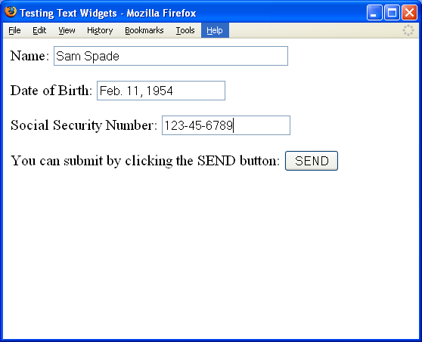
Browser Output of Text Widgets Example
Copyright © Ellis Horowitz 1999-2018

Slide 15
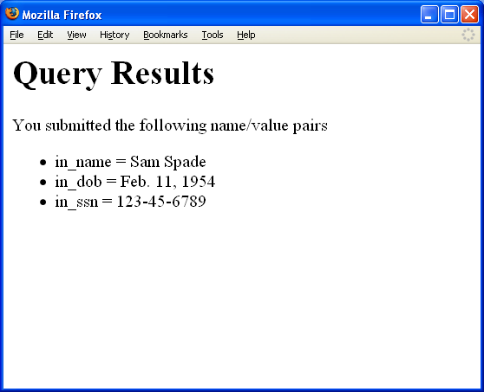
Query Results for Text Widget Example
Copyright © Ellis Horowitz 1999-2018

Slide 16
Example of <FORM> With Checkboxes
  <HTML><HEAD><TITLE>Testing Checkboxes</TITLE></HEAD>
  <BODY>
  <FORM METHOD="POST" ACTION="/cgi-bin/post-query">
  Fill in facts about yourself:<P>
  <INPUT TYPE="checkbox" NAME="house" VALUE="yes">own a house<BR>
  <INPUT TYPE="checkbox" NAME="car" VALUE="yes">own a car<BR>
  <INPUT TYPE="checkbox" NAME="boat" VALUE="yes">own a boat<BR>
  <INPUT TYPE="checkbox" NAME="degree" VALUE="yes">have a college degree<BR>
  To reset the checkboxes, click here
  <INPUT TYPE=reset VALUE="RESET"><P>
  You can submit by clicking on the SEND button:
  <INPUT TYPE=submit VALUE="SEND"><P>
  </FORM></BODY></HTML>
Copyright © Ellis Horowitz 1999-2018

Slide 17
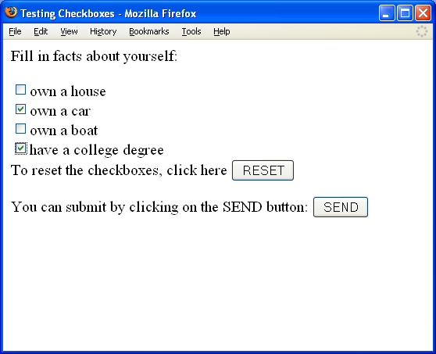
Browser Output of Checkbox Example
Copyright © Ellis Horowitz 1999-2018

Slide 18
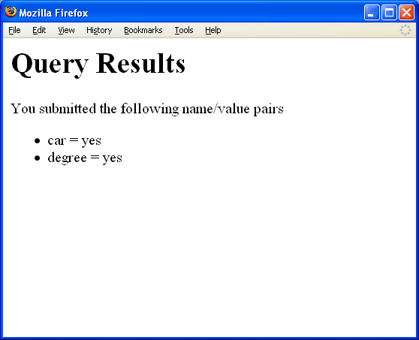
Query Results of Checkbox Example
Copyright © Ellis Horowitz 1999-2018

Slide 19
Example of <FORM> With Radio Buttons
  <HTML><HEAD><TITLE>Testing Radio Buttons</TITLE></HEAD>
  <BODY><FORM METHOD="POST" ACTION="/cgi-bin/post-query">
  How would you like to pay? Choose one of the following:<P>
  <OL><LI><INPUT TYPE="radio" Name="paymethod" VALUE="billme" CHECKED>Bill me<BR>
  <LI><INPUT TYPE="radio" Name="paymethod" VALUE="check">Check<BR>
  <LI><I> Credit Card </I>
  <UL><LI><INPUT TYPE="radio" Name="paymethod" VALUE="mastercard">mastercard<BR>
  <LI><INPUT TYPE="radio" Name="paymethod" VALUE="visa">Visa<BR>
  <LI><INPUT TYPE="radio" Name="paymethod" VALUE="amer">American Express<BR>
  </UL></OL><INPUT TYPE="submit" VALUE="Submit Query">
  </FORM></BODY></HTML>
Copyright © Ellis Horowitz 1999-2018

Slide 20
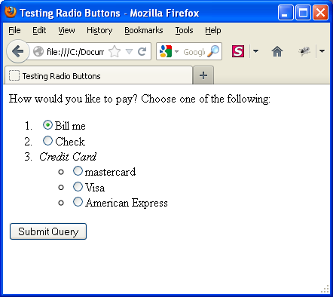
Browser Output of Radio Buttons
Copyright © Ellis Horowitz 1999-2018

Slide 21
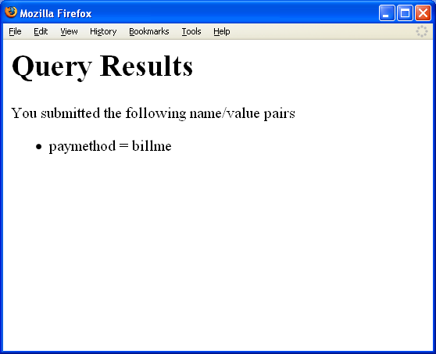
Query Results for Radio Buttons Example
Copyright © Ellis Horowitz 1999-2018

Slide 22
<TEXTAREA> Tag
specifies a large rectangular text-entry object with multi-line input and scroll bars
Attributes:
  NAME=name specifies a name for the data entry object to be sent to the server-side script
  COLS=num
  Width (in characters) of a text-entry region on the screen
  If user types more than COLS characters, field is scrolled
  ROWS=num
  Height (in characters) of a text-entry region on the screen
  If user types more than ROWS lines, field is scrolled
Copyright © Ellis Horowitz 1999-2018

Slide 23
Example of Multiline Input Areas
  <HTML><HEAD><TITLE>Form Example with Multiple Multiline Inputs</TITLE></HEAD> <body>
  <form method="POST" action="/cgi-bin/postquery">
  <TEXTAREA NAME="largearea" ROWS=10 COLS=30>This is 10 x 30</TEXTAREA><BR>
  Here is a 10 x 30 text area.<BR>
  <TEXTAREA NAME="smallarea" ROWS=2 COLS=20>This is 2 x 20</TEXTAREA><BR>
  Here is a 2 x 20 text area.<BR>
  <TEXTAREA NAME="narrowarea" ROWS=1 COLS=40>This is 1 x 40</TEXTAREA><BR>
  Here is a 1 x 40 area <BR>
  To submit your comments, press this button:
  <INPUT TYPE="submit" VALUE="Submit Comments"><BR>
  </FORM></BODY></HTML>
Copyright © Ellis Horowitz 1999-2018

Slide 24
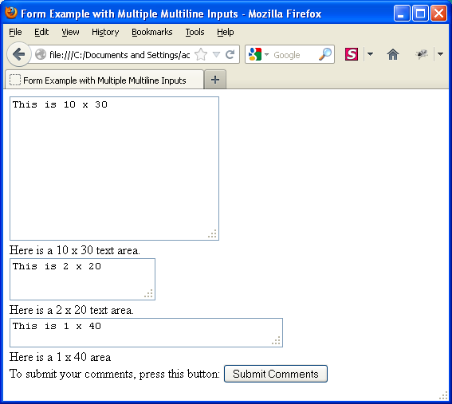
Browser Output of Multiline Input Areas
Initial Screen
Copyright © Ellis Horowitz 1999-2018

Slide 25
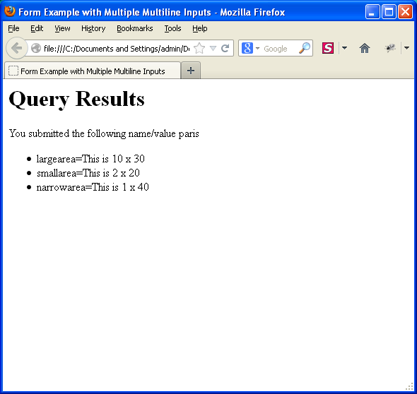
Query Results of Textarea Example
Copyright © Ellis Horowitz 1999-2018

Slide 26
<SELECT> Tag
Used inside the <FORM> element to specify a selection list object (a list of items or a pop-down menu that the user can select from)
Attributes:
  NAME=name
    Specifies a name for the data entry object to be passed to the server-side script
  SIZE=num
    Number of lines of the list to display at a time
    If SIZE is 1 or unspecified, browser will display as a drop-down list box
    If SIZE is greater than 1, browser will display as a scrollable list with only SIZE options visible at a time
Copyright © Ellis Horowitz 1999-2018

Slide 27
<SELECT> Tag Attributes
  MULTIPLE
    Specifies that multiple list items may be selected (whereas normally only 1 item can be selected)
    All selected values are sent to server-side script as separate name/value pairs
  HTML5 adds more attributes:
    AUTOFOCUS: drop-down list should automatically get focus
    FORM: defines one of more forms the select fields belongs to
    REQUIRED: user is required to select a value before submitting the form
Copyright © Ellis Horowitz 1999-2018

Slide 28
<OPTION> Tag
Used inside the <SELECT> tag to specify the start of a new menu item in the selection list
Syntax as follows:
  <OPTION attributes> Text
Attributes:
  SELECTED
    Menu item is pre-selected in the list
  VALUE="text"
    Text specifies the value to be sent to the script if the option is selected
    By default, the text following the OPTION element is sent
  DISABLED
    Specifies a “grayed”, non-selectable item
  HTML5 adds the REQUIRED attribute
Copyright © Ellis Horowitz 1999-2018

Slide 29
Example of <SELECT>, <OPTION> Tags
    <HTML><HEAD><TITLE>Forms Example with Options</TITLE></HEAD><BODY>
    <FORM METHOD="POST“ ACTION="/cgi-bin/post-query">
    Which School would you like to apply to? <BR>
    <SELECT NAME="school" SIZE=5>
    <OPTION> Letters&Science</OPTION>
    <OPTION SELECTED> Engineering</OPTION>
    <OPTION> Business</OPTION>
    <OPTION>Law</OPTION><OPTION> Medicine</OPTION></SELECT><BR>
    What semester do you wish to start? <BR>
    <SELECT NAME="semester">
    <OPTION SELECTED> Fall</OPTION>
    <OPTION> Spring</OPTION>
    <OPTION>Summer</OPTION></SELECT><BR>
    To submit your choices, press this button: <INPUT TYPE="submit" VALUE="Submit Choices">. <BR >
    To reset the form, press this button: <INPUT TYPE="reset" VALUE="Reset">.
    </FORM></BODY></HTML>
Copyright © Ellis Horowitz 1999-2018

Slide 30
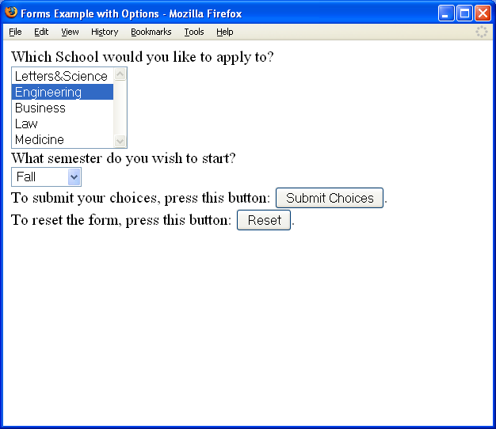
Browser Output of <SELECT>, <OPTION> Example
Copyright © Ellis Horowitz 1999-2018

Slide 31
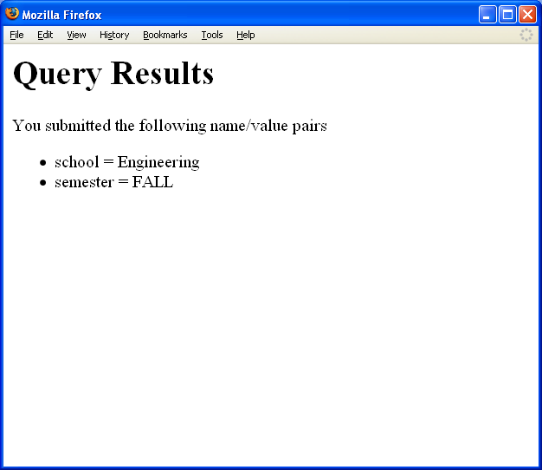
Query Results for <SELECT> Example
Copyright © Ellis Horowitz 1999-2018

Slide 32
FIELDSET – Form Control Group
The FIELDSET element defines a form control group.
  By grouping related form controls, authors can divide a form into smaller, more manageable parts, improving the usability problem that can strike when confronting users with too many form controls.
  The grouping provided by FIELDSET also helps the accessibility of forms to those using aural browsers by allowing these users to more easily orient themselves when filling in a large form.
The content of a FIELDSET element must begin with a LEGEND to provide a caption for the group of controls. Following the LEGEND, FIELDSET may contain any HTML element, including another FIELDSET.
Copyright © Ellis Horowitz 1999-2018

Slide 33
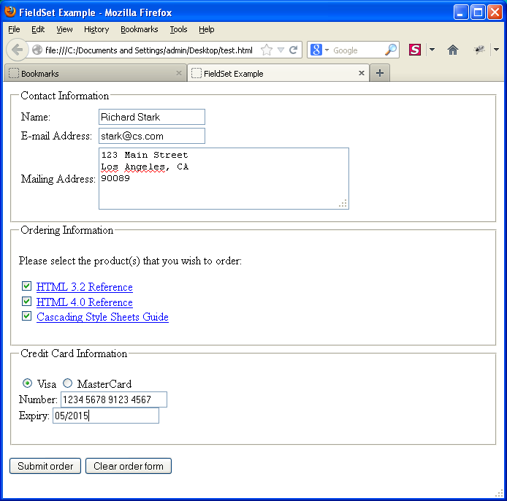
Browser Output
3 Fieldsets Grouping form elements
Run through Tab order:
Name
E-mail
Mailing Address
HTML 3.2
HTML 4.0
.
.
Etc
To test ACCESSKEY in Chrome use
ALT + ACCESSKEY (I, O, C)
To test ACCESSKEY in Firefox use
ALT + SHIFT + ACCESSKEY
http://cs-server.usc.edu:45678/examples/html5/fieldsettest.html
Copyright © Ellis Horowitz 1999-2018

Slide 34
Fieldset Example (see next slide)
3 fieldsets with legends
ACCESSKEY specifies a single
character for giving focus
<FORM METHOD=post ACTION="/cgi-bin/order.cgi">
<FIELDSET> <LEGEND ACCESSKEY=I>Contact Information</LEGEND>
<TABLE> <TR> <TD> <LABEL FOR=name ACCESSKEY=N>Name:</LABEL> </TD>
<TD> <INPUT TYPE=text NAME=name ID=name> </TD> </TR>
<TR> <TD> <LABEL FOR=email ACCESSKEY=E>E-mail Address:</LABEL> </TD>
<TD> <INPUT TYPE=text NAME=email ID=email> </TD> </TR>
<TR> <TD> <LABEL FOR=addr ACCESSKEY=A>Mailing Address:</LABEL> </TD>
<TD> <TEXTAREA NAME=address ID=addr ROWS=4 COLS=40></TEXTAREA> </TD> </TR> </TABLE> </FIELDSET>
<FIELDSET> <LEGEND ACCESSKEY=O>Ordering Information</LEGEND>
<P>Please select the product(s) that you wish to order:</P>
<P> <LABEL ACCESSKEY=3>
<INPUT TYPE=checkbox NAME=products VALUE="HTML 3.2 Reference">
<A HREF="/reference/wilbur/">HTML 3.2 Reference</A> </LABEL> <BR> <LABEL ACCESSKEY=4> <INPUT TYPE=checkbox NAME=products VALUE="HTML 4.0 Reference">
<A HREF="/reference/html40/">HTML 4.0 Reference</A> </LABEL> <BR> <LABEL ACCESSKEY=S> <INPUT TYPE=checkbox NAME=products VALUE="CSS Guide"> <A HREF="/reference/css/">Cascading Style Sheets Guide</A> </LABEL> </P> </FIELDSET>
<FIELDSET> <LEGEND ACCESSKEY=C>Credit Card Information</LEGEND> <P> <LABEL ACCESSKEY=V> <INPUT TYPE=radio NAME=card VALUE=visa> Visa </LABEL> <LABEL ACCESSKEY=M>
<INPUT TYPE=radio NAME=card VALUE=mc> MasterCard </LABEL> <BR>
<LABEL ACCESSKEY=u> Number: <INPUT TYPE=text NAME=number> </LABEL> <BR>
<LABEL ACCESSKEY=E> Expiry: <INPUT TYPE=text NAME=expiry> </LABEL> </P> </FIELDSET>
<P> <INPUT TYPE=submit VALUE="Submit order"> <INPUT TYPE=reset VALUE="Clear order form"> </P> </FORM>
Copyright © Ellis Horowitz 1999-2018

Slide 35
Purpose of the CGI
Common Gateway Interface (CGI) is a mechanism by which programs, called scripts, can be used to create dynamic Web documents
  – Scripts are placed in a server directory often named cgi-bin
  – Scripts can deliver information that is not directly readable by clients
  – Scripts dynamically convert data from a non-Web source (e.g. DBMS) into a Web-compatible document
Current version of CGI is 1.1
The reason for the term “common gateway” is these programs act as gateways between the WWW and any other type of data or service
See http://www.w3.org/CGI/
Copyright © Ellis Horowitz 1999-2018

Slide 36
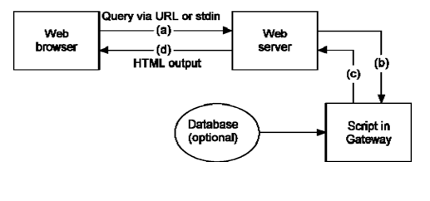
Basic Operation
An executable program that can be run without being directly invoked by users
The browser issues a query, (a), which is sent to the server; the server interprets it and invokes the proper CGI script, passing it the input data, (b); output from the script is returned, (c), via the server, to the browser, (d); output may be HTML, but it may instead be a URL, which is fetched by the server
Copyright © Ellis Horowitz 1999-2018

Slide 37
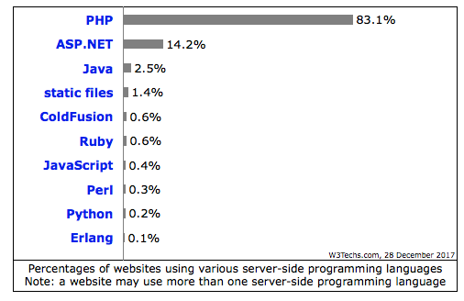
Languages to Write Gateway Programs
Any language that can produce an executable file
Some typical ones are:
  Traditional compiled languages such as C/C++
  Or interpreted languages such as:
    PHP, JavaScript or Java
Interpreted languages are often preferred as they are
  Easy to write and portable, and speed is usually not a factor
http://w3techs.com/technologies/overview/programming_language/all
Copyright © Ellis Horowitz 1999-2018

Slide 38
Anchors Are Used to Invoke CGI Scripts
A hypertext reference can refer to:
  A remote file
  <A HREF="http://domain_name/path/myfile.html">
  An executable script in the cgi-bin directory <A HREF="http://domain_name/cgi-bin/scriptname">
  An executable script with arguments <A HREF="http://domain_name/cgi-bin/scriptname?arg1+arg2">
URLs produced by the query “bicycle tours”:
http://search.yahoo.com/bin/search?p=bicycle+tours
http://search.msn.com/results.asp?RS=CHECKED&FORM=MSNH&v=1&q=bicycle+tours&zip=90211
the current versions are somewhat different
Copyright © Ellis Horowitz 1999-2018

Slide 39
CGI Script Environment Variables
Environment variables
  are a set of pre-defined dynamic values that can affect a running program
  they are generally part of the operating environment in which a program runs;
  UNIX (its variants) and Windows all use these as a means of passing information about the environment of a process
  CGI environment variables are created by the web server and set immediately before the web server executes a gateway script
  the CGI script can retrieve the values and use the data they send
  CGI environment variables are defined in
  http://tools.ietf.org/html/rfc3875
Copyright © Ellis Horowitz 1999-2018

Slide 40
CGI Environment Variables
Can be classified into two major categories:
  1. Non-request specific
  2. Request specific
Non-request-specific environment variables are the same for all requests:
    SERVER_SOFTWARE, the name and version of the information server software answering the request
    e.g. SERVER_SOFTWARE = Apache/1.3.15
    SERVER_NAME, server’s hostname, DNS alias, or IP address
    e.g. SERVER_NAME = nunki.usc.edu
    GATEWAY_INTERFACE, the revision of the CGI specification with which this server complies
    SERVER_PROTOCOL, the name and revision of the information protocol with which this request came in
    e.g. SERVER_PROTOCOL = HTTP/1.0
    SERVER_PORT, the port number to which the request was sent
    e.g. SERVER_PORT = 8088
Copyright © Ellis Horowitz 1999-2018

Slide 41
CGI Environment Variables (cont’d)
Request-specific environment variables
  These variables are set depending on each request
    REQUEST_METHOD, the method with which the request was made; e.g., (GET, POST)
    PATH_INFO, the extra path information as given by the client; e.g.,
    given http://nunki.usc.edu:8080/cgi-bin/test.cgi/extra/path
    then PATH_INFO = /extra/path
    PATH_TRANSLATED, the PATH_INFO path translated into an absolute document path on the local system
    PATH_TRANSLATED = /auto/home-scf-03/csci571/WebServer/apache_1.2.5/htdocs/extra/path
    SCRIPT_NAME, the path and name of the script being accessed as referenced in the URL
    SCRIPT_NAME = /cgi-bin/test.cgi
    QUERY_STRING, the information that follows the ? in the URL that referenced this script
Copyright © Ellis Horowitz 1999-2018

Slide 42
CGI Environment Variables (cont’d)
  REMOTE_HOST, Internet domain name of the host making the request
  REMOTE_ADDR, the IP address of the remote host making the request
  AUTH_TYPE, the authentication method required to authenticate a user who wants access
  REMOTE_USER, user name that server and script have authenticated
  REMOTE_IDENT, the remote user name retrieved by the server using inetd identification (RFC 1413)
  CONTENT_TYPE, for queries that have attached information, such as POST method, this is the MIME content type of the data
  CONTENT_LENGTH, the length of the content as given by the client
Copyright © Ellis Horowitz 1999-2018

Slide 43
CGI Environment Variables (cont’d)
Also, every item of information in an HTTP request header is stored in an environment variable
  Capitalize the name in the request header field
  Convert dashes to underscores
  Add the prefix HTTP_
For example:
  HTTP_USER_AGENT contains the request header User_Agent field data
  e.g. HTTP_USER_AGENT = Mozilla/4.7 [en]C-DIAL (WinNT; U)
  HTTP_ACCEPT contains the request header Accept field, of the form type/subtype
  HTTP_REFERER contains the URL of the document that generated this request
Copyright © Ellis Horowitz 1999-2018

Slide 44
CGI Script Output
The script sends its output to stdout; the server adds appropriate headers and returns this output to the client
Output from a script to the server could be:
  A document generated by a script
  The type of document could be: HTML, plain text, image, video or audio clip, and many other types
  Instructions to the server for retrieving the desired output elsewhere
  an error indicator
Copyright © Ellis Horowitz 1999-2018

Slide 45
Server Directives
The output of scripts begins with a small header consisting of text lines containing server directives
  This must be followed by a blank line
Any headers that are not server directives are sent directly back to the client
Server directives are used by CGI scripts to inform the server about the type of output
The current CGI specification defines three server directives:
  Content-type
  Location
  Status
Copyright © Ellis Horowitz 1999-2018

Slide 46
Server Directives (cont’d)
1. Content-type: type/subtype
  The MIME type of the document being returned
  For example,
  content-type: text/html (HTML document)
  content-type: text/plain (plain-text document)
2. Location
  Alerts the server that the script is returning a reference to a document, not an actual document
  If the argument is a URL, the server will issue a redirect to the client; for example,
  location: http://www.ncsa.uiuc.edu/
  If the argument is a path, the document specified will be retrieved by the server, starting at the document root; for example,
  location: /path/doc.txt
Copyright © Ellis Horowitz 1999-2018

Slide 47
Server Directives (cont’d)
3. Status
  This is used to give the server an HTTP/1.1 status line to send to the client
  The format is nnn xxxx, where
    nnn is the three-digit status code
    xxxx is the informative message
  E.g., 403 Forbidden
Copyright © Ellis Horowitz 1999-2018

Slide 48
Things to Check Before Running CGI Scripts
The following need to be readable and executable by the server
  CGI scripts
  Other programs that the scripts call
  The directory in which the scripts reside
In UNIX, check the read/write/execute permissions of the files and directories
In Windows, check the web server settings of the script directories
Copyright © Ellis Horowitz 1999-2018

Slide 49
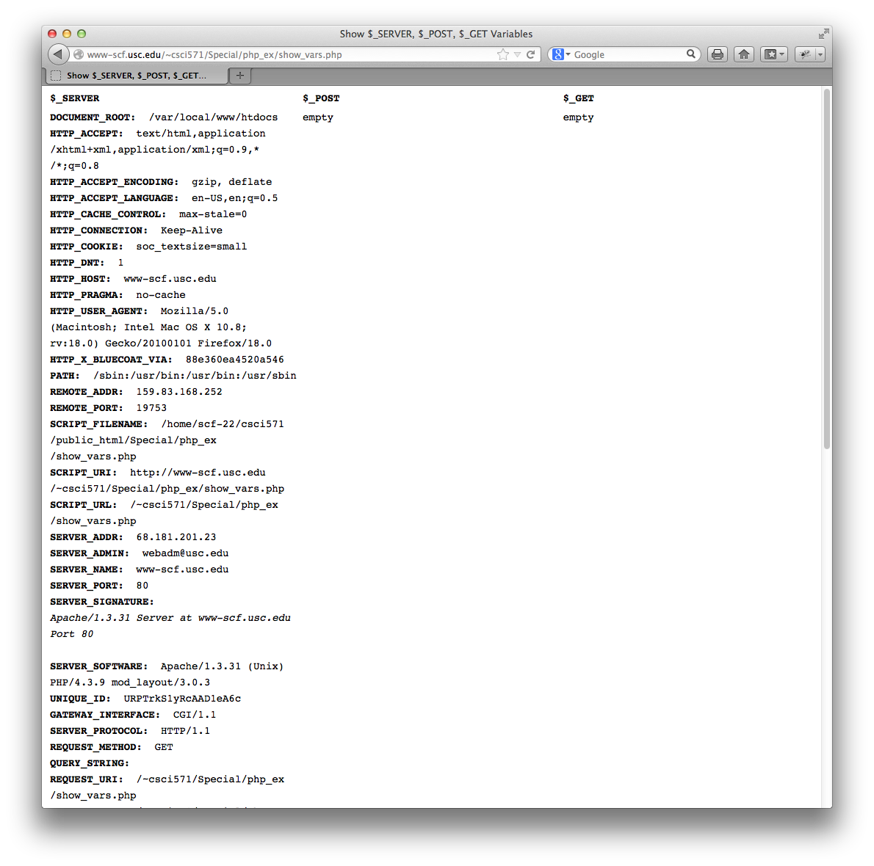
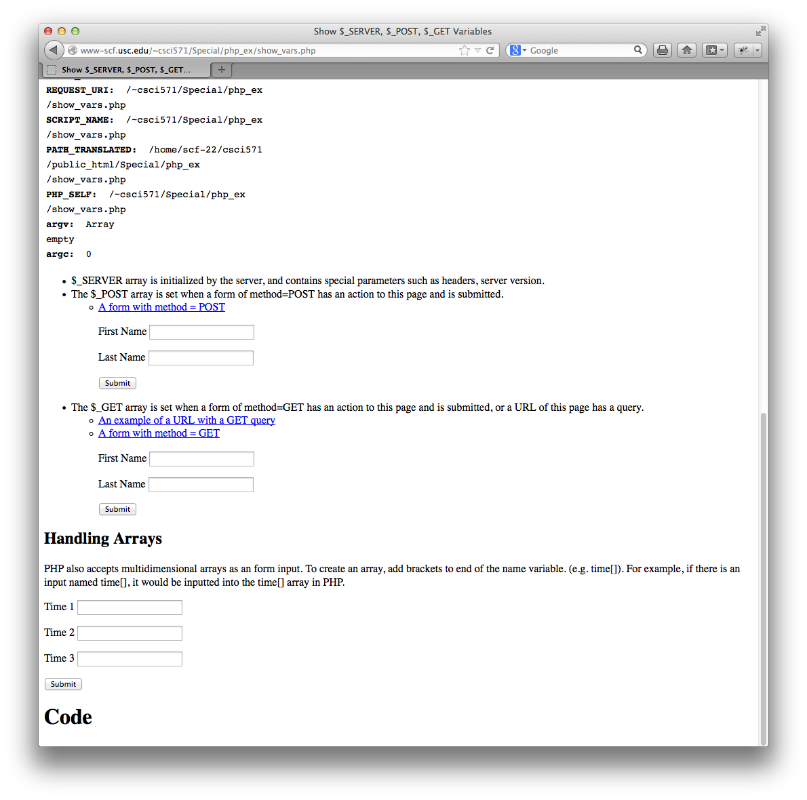
show_vars.php
PHP is a language with built-in ability to access environment variables
show_vars.php is a program that prints environment variables
The code is available at:
http://cs-server.usc.edu:45678/examples/php/show_vars.php
Below is some sample output
Copyright © Ellis Horowitz 1999-2018

Slide 50
show_vars.php – output tabs & arrays
<!doctype html><html>
<head><title>Show $_SERVER, $_POST, $_GET Variables</title></head>
<body>
<?php
function print_tabs($tabs) {
for($i = 0; $i < $tabs; $i++) {
echo "&nbsp;&nbsp;&nbsp;&nbsp;&nbsp;";
} }
function print_array($arr, $tabs = 0) {
if(!empty($arr)) {
foreach($arr as $k=> $v) {
print_tabs($tabs);
echo "<b>" . $k . "</b>: &nbsp;" . $v . "<br/>";
if(is_array($v)) {
print_array($v, $tabs+1);
}
}
} else {
echo "empty<br/>";
} }
?>
Copyright © Ellis Horowitz 1999-2018

Slide 51
show_vars.php – $_SERVER, $_POST, $_GET
<table>
<tr><th width="33%">$_SERVER</th><th width="34%">$_POST</th><th width="33%">$_GET</th></tr>
<tr>
<td valign="top">
<?php print_array($_SERVER); ?>
</td>
<td valign="top">
<?php print_array($_POST); ?>
</td>
<td valign="top">
<?php print_array($_GET); ?>
</td>
</tr>
</table>
Copyright © Ellis Horowitz 1999-2018

Slide 52
show_vars.php – POST
<ul>
<li>$_SERVER array is initialized by the server, and contains special parameters such as headers, server version.</li>
<li>The $_POST array is set when a form of method=POST has an action to this page and is submitted.
<ul>
<li>
<a href="?fname=Hello&lname=World">A form with method = POST</a>
<div>
<form method="POST" action="">
<p>
<label for="fname">First Name</label>
<input type="text" value="" name="fname"></p>
<p>
<label for="lname">Last Name</label>
<input type="text" value="" name="lname"></p>
<p>
<input type="submit" value="Submit" name="submit"></p>
</form></div></li></ul>
Copyright © Ellis Horowitz 1999-2018

Slide 53
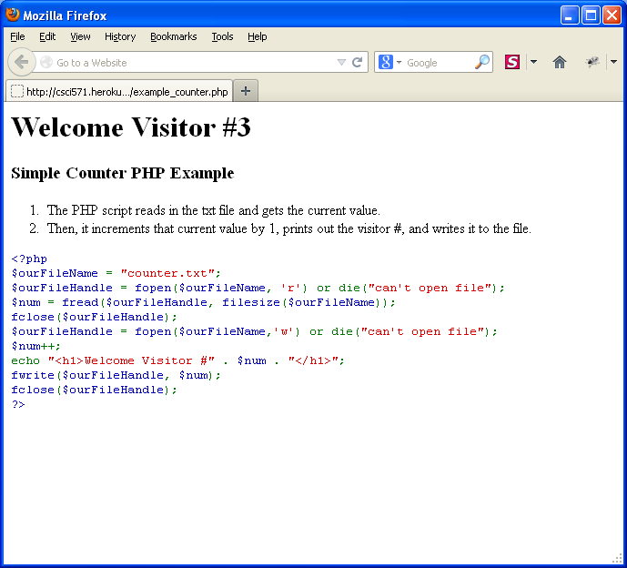
Another PHP Example
http://cs-server.usc.edu:45678/examples.html#php
click on Simple Example of a Counter in PHP
Copyright © Ellis Horowitz 1999-2018

Slide 54
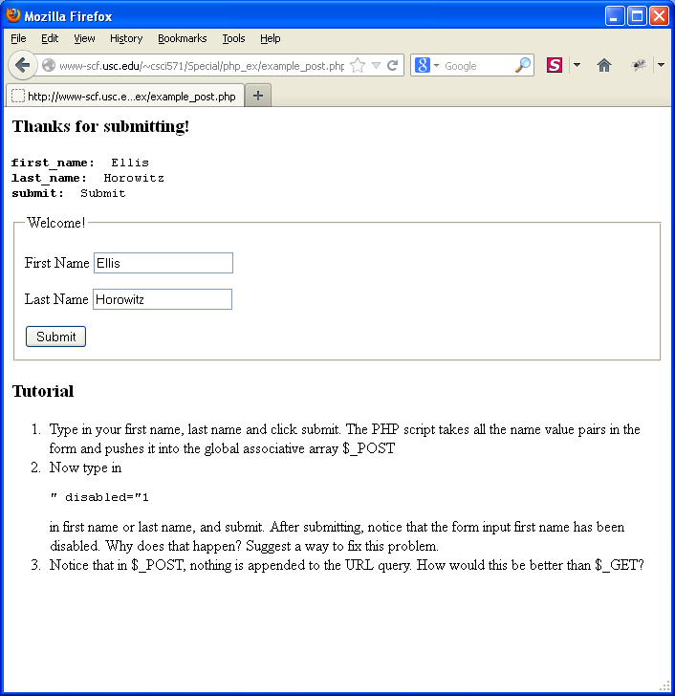
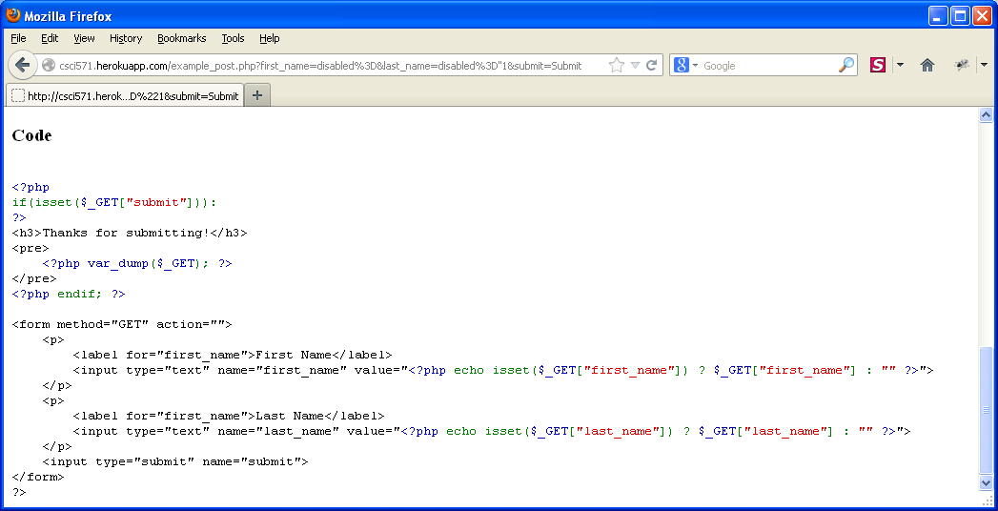
Another PHP Example http://cs-server.usc.edu:45678/examples.html#php
Click on Simple Example Handling Form Data in PHP
Copyright © Ellis Horowitz 1999-2018

Slide 55
Discussion session
Firefox developer Tools
  Built-in, no download required
  Similar tools as Firebug, but sometimes named differently
  Provides additional tools not available in Firebug (now retired)
Copyright © Ellis Horowitz 1999-2018

Slide 56
Firebug vs. Firefox Developer Tools
Migration Guide available at: https://developer.mozilla.org/en-US/docs/Tools/Migrating_from_Firebug
Tool | Firebug | Firefox Developer Tools
Activation | based on same origin | ab based
Open Tools | F12 | F12 + more shortcuts
Web Console | Console Panel | Web Console
Filter Log Messages | Options menu + filter buttons | Filter buttons inside toolbar
Console API | Console API (console.*) | Console API (same)
Persist Logs | Persist button in toolbar | Enable Persistent Logs (Toolbox Options panel)
Command History | Command Line | ↑/↓ within command line
Inspect Object Properties | Click on object – inspect in DOM panel | Show Properties / Methods in Web Console side panel
Show Network Request | AJAX Request in Console Panel | Net>XHR in Web Console
View JSON/XML | Special Tabs expanding Console Panel | Response Tab in Web Console
Multi-line command | Command Editor | Scratchpad separate Tool
Copyright © Ellis Horowitz 1999-2018

Slide 57
Firebug vs. Firefox Developer Tools
Tool | Firebug | Firefox Developer Tools
Response Preview | Preview Tab in expanded network request, logged to the Console | Response Tab in Web Console (missing HTML, XML & SVG)
Inspector | HTML Panel (edit HTML/XML/SVH/CSS) | Page Inspector
Edit HTML | Edit tag attributes and content incline | Same
Copy HTML | Copy inner and outer HTML/CSS/XPath | Same, but no XPath
Edit CSS | View/Edit CSS rule by Style side panel | Same with Rule side panel
CSS auto-complete | CSS property names. values in Rules view | NA (requested)
Copy& Paste CSS | Style side panel | Rules side panel
Only show applied styles | Option in Style side panel | NA (requested)
Inspect box model | Layout side panel | Computed side panel
Inspect computed styles | Computed side panel | Computed side panel
Inspect events | Events side panel | Click ‘ev’ icon beside element
Copyright © Ellis Horowitz 1999-2018

Slide 58
Firebug vs. Firefox Developer Tools
Tool | Firebug | Firefox Developer Tools
Debugger | Script panel | Debugger panel
Switch between sources | Script Location Menu | Sources side panel (left side)
Managing breakpoints | Breakpoints side panel | Sources side panel (below script source)
Step through code | Continue, Step Over, Step Into, Step Out | Same
Examine call stack | Stack side panel | Call Stack side panel
Examine variables | Watch side panel | Variables side panel
Style Editor | CSS panel | Style Editor
Switch between sources | CSS Location Menu in CSS panel | Style editor sidebar
Edit style sheet | CSS panel (inline, source and live edit) | Live Edit mode only
Validate CSS selectors | Selectors panel | NA (requested)
Performance Tool | Profile button in Console panel | Performance Tool
Copyright © Ellis Horowitz 1999-2018

Slide 59
Firebug vs. Firefox Developer Tools
Tool | Firebug | Firefox Developer Tools
View JS call performance | Profiler output | Call Tree view in Performance panel
Jump to function declaration | Profiler output: right side of Console panel | Call Tree view right side
Network Monitor | Net panel | Network Monitor
Inspect request info | Click request | Click request
View request timings | Hover Timeline column in Net panel | Timings side panel of request
View remote address | Remote IP column | Remote Address in Headers tab
Storage Inspector | Cookie panel | Storage Inspector
Inspect cookies | Cookies panel | Storage Inspector Cookies section
Edit cookies | Right-click cookie, choose Edit | Double-click and inline edit
Delete Cookies | Menu Cookie > Remove Cookies | Right-click & Delete All
Display error count | Start button | Developer Toolbar
Copyright © Ellis Horowitz 1999-2018

