Slide 1
JSON – JavaScript Object Notation
Some of the slides taken from
Douglas Crockford / Paypal Inc.
2008-2018 Copyright E. Horowitz, M. Papa

Slide 2
What is JSON
JSON, short for JavaScript Object Notation, is a lightweight data interchange format.
  It is a text-based, human-readable format for representing simple data structures and associative arrays (called objects).
The JSON format is specified in RFC 4627 by Douglas Crockford.
  The official MIME type for JSON is application/json. The JSON file extension is .json.
The JSON format is often used for transmitting structured data over a network connection in a process called serialization.
  Its main application is in Ajax web application programming, where it serves as an alternative to the use of the XML format.
Code for parsing and generating JSON data is readily available for a large variety of programming languages. The www.json.org website provides a comprehensive listing of existing JSON bindings, organized by language.
2008-2018 Copyright E. Horowitz, M. Papa

Slide 3

Brief History
JSON was based on a subset of the JavaScript programming language (specifically, Standard ECMA-262 - now in its 8th Edition)
  however it is considered to be a language-independent data format.
  For the complete specification see
  https://www.ecma-international.org/publications/standards/Ecma-262.htm
  The JavaScript ECMA standard is based upon Netscape’s JavaScript and Microsoft’s Jscript
Douglas Crockford was the original developer of JSON while he was at State Software, Inc. He is now Senior JavaScript Architect at Paypal
http://www.json.org/, is a website devoted to JSON discussions and includes many JSON parsers
2008-2018 Copyright E. Horowitz, M. Papa

Slide 4
How to use the JSON format
A JSON file allows one to load data from the server or to send data to it.
Working with JSON involves three steps: (i) the browser processing, (ii) the server processing, and (iii) the data exchange between them.
Client side (browser)
The content of a JSON file (or stream), or the definition of JSON data is assigned to a variable, and this variable becomes an object of the program.
Server side
a JSON file (or stream) on the server can be operated upon by various programming languages, including PHP and Java thanks to parsers that process the file and may even convert it into classes and attributes of the language.
Data exchange
Loading a JSON file from the server may be accomplished in JavaScript in several ways:
- directly including the file into the HTML page, as a JavaScript .json external file.
- loading by a JavaScript command
- using XMLHttpRequest
To convert JSON into an object, it can be passed to the JavaScript eval() function.
Sending the file to the server may be accomplished by XMLHttpRequest. The file is sent as a text file and processed by the parser of the programming language that uses it.
2008-2018 Copyright E. Horowitz, M. Papa

Slide 5
JSON and XMLHttpRequest Example
The XMLHttpRequest code:
var req = new XMLHttpRequest();
req.open("GET", "file.json", true);
req.onreadystatechange = myCode; // the callback
req.send(null);
The JavaScript callback: eval() parses JSON, creates an object and assigns it to variable doc
  function myCode() {
  if (req.readyState == 4) {
  if (req.Status == 200) {
  var doc = eval('(' + req.responseText + ')');
  }
  }
Using the data:
  var menuName = doc.getElementById('menu'); // finding a field menu
  doc.menu.value = "my name is"; // assigning a value to the field
How to access data:
  doc.commands[0].title // read value of the "title" field in the array
  doc.commands[0].action // read value of the "action" field in the array
2008-2018 Copyright E. Horowitz, M. Papa

Slide 6
JavaScript eval()
The JavaScript eval( ) function evaluates a string and executes it as if it was JavaScript code, e.g.
<script type="text/javascript">
eval("x=10;y=20;document.write(x*y)");
document.write("<br />");
document.write(eval("2+2"));
document.write("<br />");
var x=10;
document.write(eval(x+17));
document.write("<br />"); </script>
produces the output
200
4
27
Because JSON-formatted text is also syntactically legal JavaScript code, an easy way for a JavaScript program to parse JSON-formatted data is to use the built-in JavaScript eval() function
the JavaScript interpreter itself is used to execute the JSON data to produce native JavaScript objects.
The eval() technique is subject to security vulnerabilities if the data and the entire JavaScript environment is not within the control of a single trusted source; See:
https://developer.mozilla.org/en-US/docs/Web/JavaScript/Reference/Global_Objects/eval
2008-2018 Copyright E. Horowitz, M. Papa

Slide 7
JSON Basic Data Types
String (double-quoted unicode with backslash escaping)
Numbers (integer, real, or floating point)
Booleans (true and false)
Object (collection of key:value pairs, comma-separated and enclosed in curly brackets)
Array (an ordered sequence of values, comma-separated and enclosed in square brackets)
Null (a value that isn’t anything)
2008-2018 Copyright E. Horowitz, M. Papa

Slide 8
String
Sequence of 0 or more Unicode characters
No separate character type
  A character is represented as a string with a length of 1
Wrapped in "double quotes"
Backslash escapement
2008-2018 Copyright E. Horowitz, M. Papa

Slide 9
Object
Objects are unordered containers of key/value pairs
Objects are wrapped in { }
, separates key/value pairs
: separates keys and values
Keys are strings
Values are JSON values
Can be used to represent: struct, record, hashtable, object
2008-2018 Copyright E. Horowitz, M. Papa

Slide 10
Example Object
{"name":"Jack B. Nimble","at large": true,"grade":"A","level":3, "format":{"type":"rect","width":1920, "height":1080,"interlace":false, "framerate":24}}
2008-2018 Copyright E. Horowitz, M. Papa

Slide 11
Example Object Formatted
{
"name": "Jack B. Nimble",
"at large": true,
"grade": "A",
"level": 3,
"format": {
"type": "rect",
"width": 1920,
"height": 1080,
"interlace": false,
"framerate": 24
}
}
2008-2018 Copyright E. Horowitz, M. Papa

Slide 12
Array
Arrays are ordered sequences of values
Arrays are wrapped in [ ] (square brackets)
, separates values
JSON does not talk about indexing.
  An implementation can start array indexing at 0 or 1.
2008-2018 Copyright E. Horowitz, M. Papa

Slide 13
Two Examples of JSON Arrays
One dimensional
["Sunday", "Monday", "Tuesday", "Wednesday", "Thursday", "Friday", "Saturday"]
Two dimensional
[
  [0, -1, 0],
  [1, 0, 0],
  [0, 0, 1]
]
2008-2018 Copyright E. Horowitz, M. Papa

Slide 14
Arrays vs Objects
Use objects when the key names are arbitrary strings
Use arrays when the key names are sequential integers
2008-2018 Copyright E. Horowitz, M. Papa

Slide 15
JSON is Not XML
JSON
Objects
Arrays
Strings
Numbers
Booleans
null
XML
element
attribute
Attribute string
content
<![CDATA[ ]]>
Entities
Declarations
Schema
Stylesheets
Comments
Version
namespace
2008-2018 Copyright E. Horowitz, M. Papa

Slide 16
JSON vs. XML Example
JSON
{
"menu": "File",
"commands": [
{
"title": "New",
"action":"CreateDoc"
},
{
"title": "Open",
"action": "OpenDoc"
},
{
"title": "Close",
"action": "CloseDoc"
}
]
}
XML Equivalent
<?xml version="1.0" ?>
<root>
<menu>File</menu>
<commands>
<item>
<title>New</value>
<action>CreateDoc</action>
</item>
<item>
<title>Open</value>
<action>OpenDoc</action>
</item>
<item>
<title>Close</value>
<action>CloseDoc</action>
</item>
</commands>
</root>
2008-2018 Copyright E. Horowitz, M. Papa

Slide 17
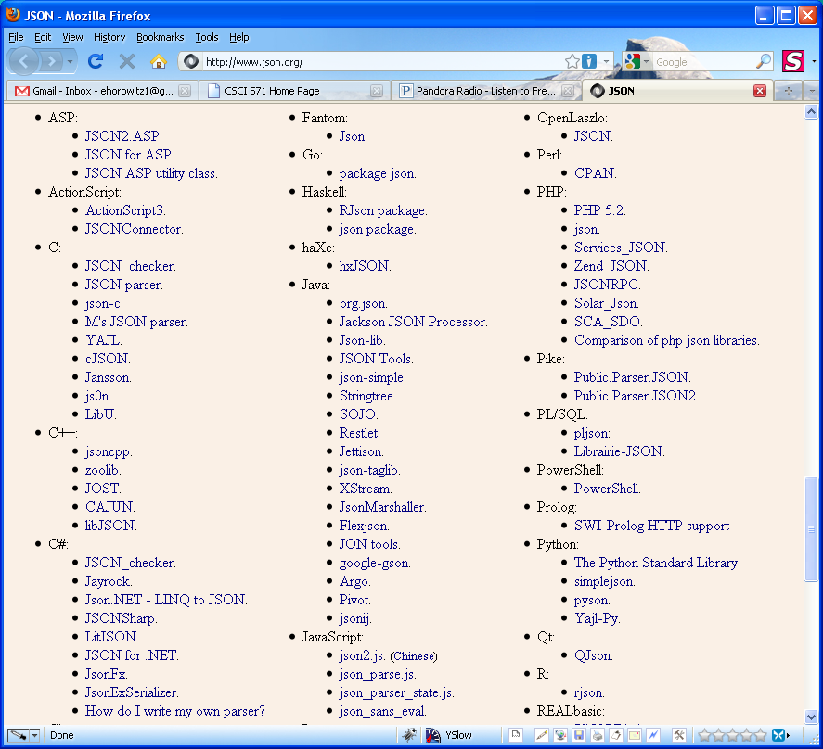
Rules for JSON Parsers
A JSON decoder must accept all well-formed JSON text
A JSON decoder may also accept non-JSON text
A JSON encoder must only produce well-formed JSON text
A list of decoders for JSON can be found at
http://www.json.org/
JSON parsers for programming
languages include: C, C++,
C#, Java, JavaScript, Perl, PHP
2008-2018 Copyright E. Horowitz, M. Papa

Slide 18
Same Origin Policy
Same origin policy is a security feature that browsers apply to client-side scripts
It prevents a document or script loaded from one “origin” from getting or setting properties of a document from a different “origin”
  Rationale: the browser should not trust content loaded from arbitrary websites
Given the URL: http://www.example.com/dir/page.html
URL | Outcome | Reason
http://www.example.com/dir2/other.json | Success | Same protocol and host
http://www.example.com/dir/inner/other.json | Success | Same protocol and host
http://www.example.com:81/dir2/other.json | Failure | Same protocol and host but different port
https://www.example.com/dir2/other.json | Failure | Different protocol
http://en.example.com/dir2/other.json | Failure | Different host
http://example.com/dir2/other.json | Failure | Different host
2008-2018 Copyright E. Horowitz, M. Papa

Slide 19
JSON: The Cross-Domain Hack
JSON and the <script> tag provide a way to get around the Same Origin Policy
<script src=http://otherdomain.com/data.js>
</script>
The src attribute of a script tag can be set to a URL from any server, and every browser will go and retrieve it, and read it into your page
So a script tag can be set to point at a URL on another server with JSON data in it, and that JSON will become a global variable in the webpage
So JSON can be used to grab data from other servers, without the use of a server-side proxy
2008-2018 Copyright E. Horowitz, M. Papa
2008 Copyright E. Horowitz, M. Papa

Slide 20
JSON and Dynamic Script Tag “Hack”
Using JSON it is possible to get around the limitation that data can only come from a single domain
To do this one needs to
  to find a website that returns JSON data, and
  A JavaScript program that contains a JSONScriptRequest class that creates a dynamic <script> tag and its contents
The implementation of this class can be found at the class website under Special Topics - JSON:
http://cs-server.usc.edu:45678/jsr_class.js
and also at
http://www.xml.com/lpt/a/1636
The most important line in the script (the "hack") is the following one:
this.scriptObj.setAttribute("src", this.fullUrl + this.noCacheIE);
which sets the src attribute of the <script> tag to a new URL
2008-2018 Copyright E. Horowitz, M. Papa

Slide 21
Source Code for jsr_class.js
// Constructor -- pass a REST request URL to the constructor
function JSONscriptRequest(fullUrl) {
// REST request path
this.fullUrl = fullUrl;
// Keep IE from caching requests
this.noCacheIE = '&noCacheIE=' + (new Date()).getTime();
// Get the DOM location to put the script tag
this.headLoc = document.getElementsByTagName("head").item(0);
// Generate a unique script tag id
this.scriptId = 'JscriptId' + JSONscriptRequest.scriptCounter++; }
// Static script ID counter
JSONscriptRequest.scriptCounter = 1;
// buildScriptTag method
JSONscriptRequest.prototype.buildScriptTag = function () {
// Create the script tag
this.scriptObj = document.createElement("script");
// Add script object attributes
this.scriptObj.setAttribute("type", "text/javascript");
this.scriptObj.setAttribute("charset", "utf-8");
this.scriptObj.setAttribute("src", this.fullUrl + this.noCacheIE);
this.scriptObj.setAttribute("id", this.scriptId); }
// removeScriptTag method
JSONscriptRequest.prototype.removeScriptTag = function () {
// Destroy the script tag
this.headLoc.removeChild(this.scriptObj); }
// addScriptTag method
JSONscriptRequest.prototype.addScriptTag = function () {
// Create the script tag
this.headLoc.appendChild(this.scriptObj); }
Critical line
2008-2018 Copyright E. Horowitz, M. Papa

Slide 22
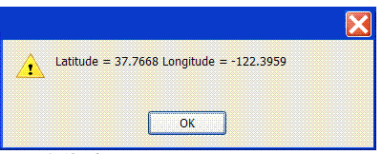
Example Using JSON and JSONscriptRequest class
<html><body>
// Include the JSONscriptRequest class
<script type="text/javascript" src="jsr_class.js"> </script>
<script type="text/javascript">
// Define the callback function
function getGeo(jsonData) {
alert('Latitude = ' + jsonData.ResultSet.Result[0].Latitude + ' Longitude = ' + jsonData.ResultSet.Result[0].Longitude);
bObj.removeScriptTag();
}
// The web service call
var req = 'http://api.local.yahoo.com/MapsService/V1/geocode?appid=YahooDemo&output=json&callback=getGeo&location=94107';
// Create a new request object
bObj = new JSONscriptRequest(req);
// Build the dynamic script tag
bObj.buildScriptTag();
// Add the script tag to the page
bObj.addScriptTag();
</script></body></html>
output
buildScriptTag creates
<script src=“getGeo({"ResultSet":{"Result":[{"precision":"zip”,...>
Adding the <script> tag to the page causes getGeo to be called
And the JSON-encoded data to be passed to the getGeo function;
The JavaScript interpreter automatically turns JSON into a
JavaScript object, and the returned data can be referenced
immediately
2008-2018 Copyright E. Horowitz, M. Papa

Slide 23
MarkitOnDemand Example
MarkitOnDemand provides Stock Lookup and Stock Quote APIs. Results are in JSON format.
To access the service you do not need an Application ID.
Stock Lookup JSON REST call looks like this:
http://dev.markitondemand.com/MODApis/Api/v2/Lookup/json?input=AAP
Stock Quote JSON REST call looks like this:
http://dev.markitondemand.com/MODApis/Api/v2/Quote/json?symbol=AAPL
MarkitOnDemand will return data in multiple formats including JSON and XML
2008-2018 Copyright E. Horowitz, M. Papa

Slide 24
Lookup Sample JSON Result
Here is an example of the MarkitOnDemand Lookup API returning JSON
http://dev.markitondemand.com/MODApis/Api/v2/Lookup/json?input=AAP
[{
"Symbol": "AAP",
"Name": "Advance Auto Parts Inc",
"Exchange": "NYSE"
}, {
"Symbol": "AAP",
"Name": "Advance Auto Parts Inc",
"Exchange": "BATS Trading Inc"
}, {
"Symbol": "AAPL",
"Name": "Apple Inc",
"Exchange": "NASDAQ"
}, {
"Symbol": "AVSPY",
"Name": "AAPL ALPHA INDEX",
"Exchange": "NASDAQ"
}, {
"Symbol": "AIX",
"Name": "NAS OMX Alpha AAPL vs. SPY Settle",
"Exchange": "NASDAQ"
}]
2008-2018 Copyright E. Horowitz, M. Papa

Slide 25
Quote Sample JSON Result
Here is an example of the MarkitOnDemand Quote API returning JSON
http://dev.markitondemand.com/MODApis/Api/v2/Quote/json?symbol=AAPL
{
"Status": "SUCCESS",
"Name": "Apple Inc",
"Symbol": "AAPL",
"LastPrice": 106.01,
"Change": 1.43000000000001,
"ChangePercent": 1.36737425894053,
"Timestamp": "Wed Mar 16 15:59:00 UTC-04:00 2016",
"MSDate": 42445.6659722222,
"MarketCap": 587781243830,
"Volume": 2953715,
"ChangeYTD": 105.26,
"ChangePercentYTD": 0.712521375641269,
"High": 106.31,
"Low": 104.6,
"Open": 104.62
}
2008-2018 Copyright E. Horowitz, M. Papa

Slide 26
XMLHttpRequest Compared to the Dynamic Script Tag
 | XmlHttpRequest | Dynamic script Tag
Cross-browser compatible? | No | Yes
Cross-domain browser security enforced? | Yes (*) | No
Can receive HTTP status codes? | Yes | No (fails on any HTTP status other than 200)
Supports HTTP GET and POST? | Yes | No (GET only)
Can send/receive HTTP headers? | Yes | No
Can receive XML? | Yes | Yes (but only embedded in a JavaScript statement)
Can receive JSON? | Yes | Yes (but only embedded in a JavaScript statement)
Offers synchronous and asynchronous calls? | Yes | No (asynchronous only)
Dynamic script tag is used by
internet advertisers who use it to pull
their ads into a web page
The script tag's main advantages
are that it is not bound by the web
browser's cross-domain security
restrictions and that it runs identically
on more web browsers than
XMLHttpRequest.
If your web service
happens to offer JSON output and a
callback function, you can easily
access web services from
within your JavaScript applications
without having to parse the returned data
* CORS-compatible browsers allow cross-domain XMLHttpRequest
2008-2018 Copyright E. Horowitz, M. Papa

Slide 27
Arguments against JSON
JSON doesn’t have namespaces
JSON has no validator
  Every application is responsible for validating its inputs
JSON is not extensible
  But it does not need to be
JSON is not XML
  But a JavaScript compiler is a JSON decoder
2008-2018 Copyright E. Horowitz, M. Papa

Slide 28
Features that make JSON well-suited for data transfer
It is both a human and machine-readable format;
It has support for unicode, allowing almost any information in any human language to be communicated
The format is self-documenting in that it describes structure and field names as well as specific values
The strict syntax and parsing requirements allow the parsing algorithms to remain simple, efficient, and consistent
JSON has the ability to represent the most general of computer science data structures: records, lists and trees
2008-2018 Copyright E. Horowitz, M. Papa

Slide 29
Eval() and JSON.parse() Security
The eval() function is very fast. However, it can compile and execute any JavaScript program, so there can be security issues
In general
  your browser should not trust machines not under your absolute control
  Your server must validate everything the client tells it
To help guard the browser from insecure JSON input, use JSON.parse() instead of eval ; e.g. JSON.parse() is used this way
var myObject = JSON.parse(JSONtext [, reviver]);
The optional reviver parameter is a function that will be called for every key and value at every level of the final result. Each value will be replaced by the result of the reviver function. This can be used to reform generic objects into instances of pseudoclasses, or to transform date strings into Date objects.
JSON.parse() is included in ECMAScript since 5th Ed. and all recent desktop browsers (Chrome, Firefox 3.5+, IE 8+, Opera 10.5+, Safari 4+) and all mobile browsers. JSON.parse() compiles faster than eval(). See:
https://developer.mozilla.org/en-US/docs/Web/JavaScript/Reference/Global_Objects/JSON/parse
2008-2018 Copyright E. Horowitz, M. Papa

Slide 30
More Discussion of JSON.parse
In JavaScript there is a function called JSON.parse. It uses a single call to eval to do the conversion, guarded by a single regexp test to assure that the input is safe.
The input object is traversed recursively, and various functions are called for each member of the object in post-order (i.e. every object is reviewed after all its members have been reviewed).
For each member, the following occurs:
  If reviewer returns a valid value, the member value is replaced with the value returned by reviewer.
  If reviewer returns what it received, the structure is not modified.
  If reviewer returns null or undefined, the object member is deleted.
The reviewer argument is often used to transform JSON representation of ISO date strings into UTC format Date objects.
Here is the original source code for JSON.parse
JSON.parse = function (text) {
return
(/^(\s|[,:{}\[\]]|"(\\["\\bfnrtu]|[^\x00-\x1f"\\])*"|-?\d+(\.\d*)?([eE][+-]?\d+)?|true|false|null)+$/.test(text))
&& eval('(' + text + ')'); };
According to Doug Crockford, “It is ugly, but it is really efficient. “
For the actual source implementation and explanation of the behavior of the "reference implementation" of JSON.parse see
  https://github.com/douglascrockford/JSON-js and http://www.json.org/js.html
  (for applications that need to run on obsolete browsers)
JQuery provides implicit ParseJSON() and responseJSON property. See
  http://api.jquery.com/jquery.parsejson/ and http://api.jquery.com/jQuery.ajax/
2008-2018 Copyright E. Horowitz, M. Papa

Slide 31
Douglas Crockford Discusses AJAX
Go to
https://www.youtube.com/watch?v=-C-JoyNuQJs
Start video at -27 minutes and run it as long as it is interesting
He gets to JSON at -13 minutes
2008-2018 Copyright E. Horowitz, M. Papa

Slide 32
JSONP
JSONP or "JSON with padding" is a JSON extension wherein the name of a callback function is specified as an input argument of the call itself.
It is now used by many Web 2.0 applications such as Dojo Toolkit Applications or Google Toolkit Applications.
Further extensions of this protocol have been proposed
Because JSONP makes use of script tags, calls are essentially open to the world. For that reason, JSONP may be inappropriate to carry sensitive data
JSONP is supported by jQuery. See:
https://learn.jquery.com/ajax/working-with-jsonp/
2008-2018 Copyright E. Horowitz, M. Papa

Slide 33
JSONP Example
Consider the following <script> tag which includes a src attribute referring to a Google spreadsheet
<script src="http://spreadsheets.google.com/feeds/list/o03712292828507838454.2635427448373779250/od6/public/basic?alt=json-in-script&callback=listTasks"> </script>
the URL in the above script will return the following JSON result:
listTasks ({"version":"1.0","encoding":"UTF-8”, "feed":{
"entry":[{
{"title":
{"type":"text","$t":"Make google gadget w/spreadsheet example"},
"content":{"type":"text","$t":"Status: Done"}},
{"title":
{"type":"text","$t":"Do final project for class"},
"content":{"type":"text","$t":"Status: NotStarted"}
}]} });
notice the src attribute’s URL has alt=json-in-script and callback=listTasks. This tells google that it wants not just JSON (data) but JSONP (data passed as a parameter of the listed function listTasks).
The about output is JSON data, surrounded by the Procedure call "listTasks", with the data as a "parameter".
Try this in a browser: http://spreadsheets.google.com/feeds/list/o03712292828507838454.2635427448373779250/od6/public/basic?alt=json-in-script&callback=listTasks
2008-2018 Copyright E. Horowitz, M. Papa

Slide 34
What is Actually Returned Today (since 2010)
listTasks ({"version":"1.0","encoding":"UTF-8", "feed":{"xmlns":"http://www.w3.org/2005/Atom",
"xmlns$openSearch":"http://a9.com/-/spec/opensearchrss/1.0/",
"xmlns$gsx":"http://schemas.google.com/spreadsheets/2006/extended",
"id":{"$t":"https://spreadsheets.google.com/feeds/list/o03712292828507838454.2635427448373779250/od6/public/basic"},
"updated":{"$t":"2006-12-05T10:35:42.800Z"},"category":[{"scheme":"http://schemas.google.com/spreadsheets/2006",
"term":"http://schemas.google.com/spreadsheets/2006#list"}],"title":{"type":"text","$t":"Sheet1"},
"link":[{"rel":"alternate","type":"text/html",
"href":"https://spreadsheets.google.com/pub?key\u003do03712292828507838454.2635427448373779250"},
{"rel":"http://schemas.google.com/g/2005#feed","type":"application/atom+xml",
"href":"https://spreadsheets.google.com/feeds/list/o03712292828507838454.2635427448373779250/od6/public/basic"},
{"rel":"self","type":"application/atom+xml",
"href":"https://spreadsheets.google.com/feeds/list/o03712292828507838454.2635427448373779250/od6/public/basic?alt\u003djson-in-script"}],
"author":[{"name":{"$t":"pamela.fox"},"email":{"$t":"pamela.fox@gmail.com"}}],"openSearch$totalResults":{"$t":"2"},
"openSearch$startIndex":{"$t":"1"},
"entry":[{"id":{"$t":"https://spreadsheets.google.com/feeds/list/o03712292828507838454.2635427448373779250/od6/public/basic/cokwr"},
"updated":{"$t":"2006-12-05T10:35:42.800Z"},"category":[{"scheme":"http://schemas.google.com/spreadsheets/2006",
"term":"http://schemas.google.com/spreadsheets/2006#list"}],"title":{"type":"text",
"$t":"Make google gadget w/spreadsheet example"},"content":{"type":"text","$t":"status: Done"},
"link":[{"rel":"self","type":"application/atom+xml",
"href":"https://spreadsheets.google.com/feeds/list/o03712292828507838454.2635427448373779250/od6/public/basic/cokwr"}]},
{"id":{"$t":"https://spreadsheets.google.com/feeds/list/o03712292828507838454.2635427448373779250/od6/public/basic/cpzh4"},
"updated":{"$t":"2006-12-05T10:35:42.800Z"},"category":[{"scheme":"http://schemas.google.com/spreadsheets/2006",
"term":"http://schemas.google.com/spreadsheets/2006#list"}],"title":{"type":"text","$t":"Do final project for class"},
"content":{"type":"text","$t":"status: NotStarted"},"link":[{"rel":"self","type":"application/atom+xml",
"href":"https://spreadsheets.google.com/feeds/list/o03712292828507838454.2635427448373779250/od6/public/basic/cpzh4"}]}]}});
2008-2018 Copyright E. Horowitz, M. Papa

Slide 35
JSONP Example, Cont’d
When dynamically executed (e.g. using JavaScript’s "eval" on it), it invokes the function listTasks :
function listTasks(root) {
var feed = root.feed;
var entries = feed.entry || [];
var html = [''];
html.push('<ul>');
for (var i = 0; i < feed.entry.length; ++i) {
var entry = feed.entry[i];
var title = entry.title.$t;
var content = entry.content.$t;
html.push('<li>', title, ' (', content, ') </li>');
}
html.push('</ul>');
document.getElementById("agenda").innerHTML =
html.join("");
}
The "output" of such a function in the example would be like this:
<ul>
<li> Make google gadget w/spreadsheet example (Status: Done) </li>
<li> Do final project for class (Status: NotStarted) </li>
<ul>
and it is stored in the "html" variable.
You then assign such HTML to the "innerHTML" of the element with Id "agenda", which then shows it on the web page.
For more discussion of JSONP see
http://www.west-wind.com/Weblog/posts/107136.aspx
2008-2018 Copyright E. Horowitz, M. Papa

Slide 36
PHP Includes JSON functionality
As of PHP 5.2, the JSON extension is bundled and compiled into PHP by default
JSON functions include
  json_encode - returns the JSON representation of a value
  json_decode - decodes a JSON string
  json_last_error - returns the last error that occurred
  Json_last_error_message – returns error string of last json_encode or json_decode
See:
http://php.net/manual/en/book.json.php
2008-2018 Copyright E. Horowitz, M. Papa

Slide 37
Example of json_encode
<?php
$arr = array('a' => 1, 'b' => 2, 'c' => 3, 'd' => 4, 'e' => 5);
echo json_encode($arr);
?>
which produces the following output
{"a":1,"b":2,"c":3,"d":4,"e":5}
2008-2018 Copyright E. Horowitz, M. Papa

Slide 38
Example: How PHP objects can be converted into JSON
<?php
class Emp { public $name = "";
public $hobbies = "";
public $birthdate = ""; }
$e = new Emp();
$e->name = "robert";
$e->hobbies = "sports";
# $e->birthdate = date('m/d/Y h:i:s a', "8/5/1974 12:20:03 p");
$e->birthdate = date('m/d/Y h:i:s a', strtotime("8/5/1974 12:20:03"));
echo json_encode($e);
?>
which produces the following result:
{"name":"robert","hobbies":"sports","birthdate":"08\/05\/1974 12:20:03 pm"}
2008-2018 Copyright E. Horowitz, M. Papa

Slide 39
Example: Decoding JSON in PHP
<?php
$json = '{"a":1,"b":2,"c":3,"d":4,"e":5}';
var_dump(json_decode($json, true));
?>
which produces the following result
array(5) {
["a"] => int(1)
["b"] => int(2)
["c"] => int(3)
["d"] => int(4)
["e"] => int(5)
}
Parameters of json_decode
json_string: It is encoded string which must be
UTF-8 encoded data
assoc: It is a boolean type parameter,
when set to TRUE, returned objects will be
converted into associative arrays.
depth: It is an integer type parameter which
specifies recursion depth
options: It is an integer type bitmask of
JSON decode, JSON_BIGINT_AS_STRING is
supported
2008-2018 Copyright E. Horowitz, M. Papa

Slide 40
JQuery JSON Support
JQuery Ajax APIs provide extensive support for JSON and JSONP
jQuery.ajax([settings]) includes the following JSON-related settings:
  crossDomain (default: false for same-domain requests, true for cross-domain requests) - If you wish to force a crossDomain request (such as JSONP) on the same domain, set the value of crossDomain to true. This allows, for example, server-side redirection to another domain.
  dataType (xml, json, script, or html) - The type of data that you're expecting back from the server.
    "json": Evaluates the response as JSON and returns a JavaScript object. The JSON data is parsed in a strict manner.
    If json dataType is specified, the response is parsed using jQuery.parseJSON before being passed, as an object, to the success handler. The parsed JSON object is made available through the responseJSON property.
    "jsonp": Loads in a JSON block using JSONP. Adds an extra "?callback=?" to the end of your URL to specify the callback.
    If jsonp is specified, $.ajax() will automatically append a query string parameter of (by default) callback=? to the URL.
  jsonp - Override the callback function name in a JSONP request. This value will be used instead of 'callback' in the 'callback=?' part of the query string in the url.
  See http://api.jquery.com/jquery.ajax/
2008-2018 Copyright E. Horowitz, M. Papa

Slide 41
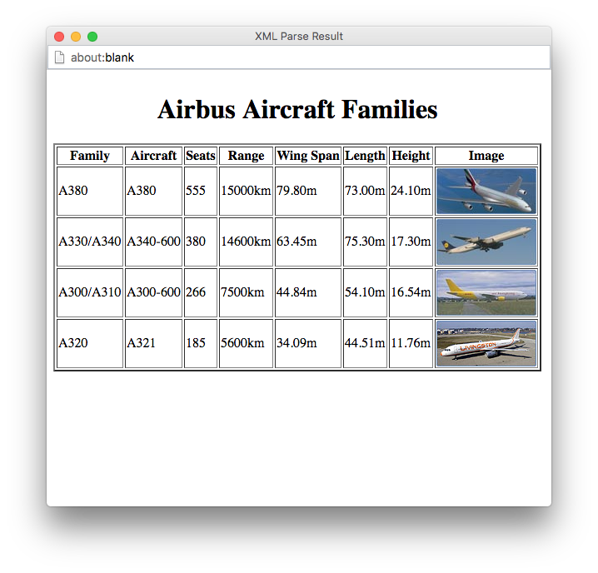
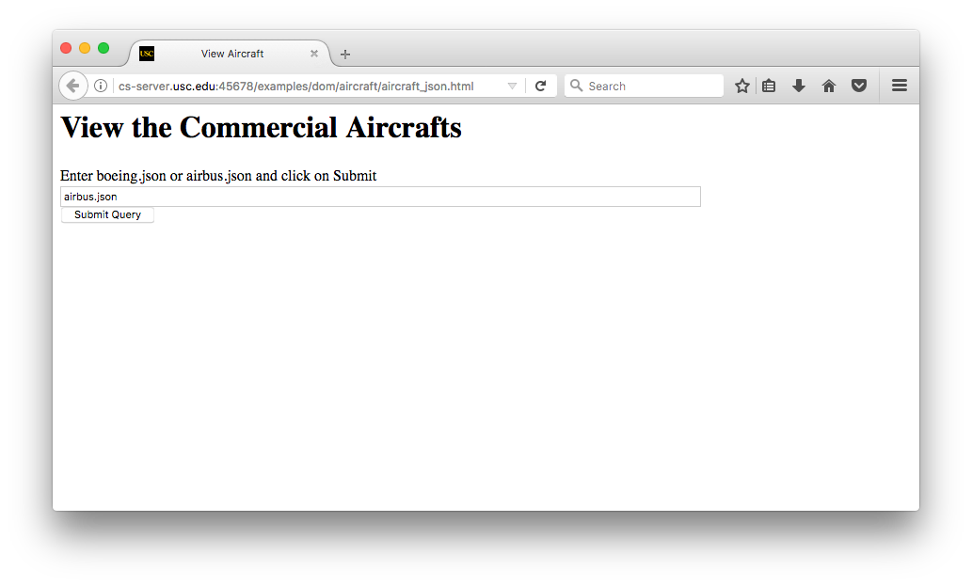
Example 14: A Longer DOM Example in JSON
Given a URL of a JSON file that
describes a set of aircraft, re-format
the data into an HTML page
2008-2018 Copyright E. Horowitz, M. Papa

Slide 42
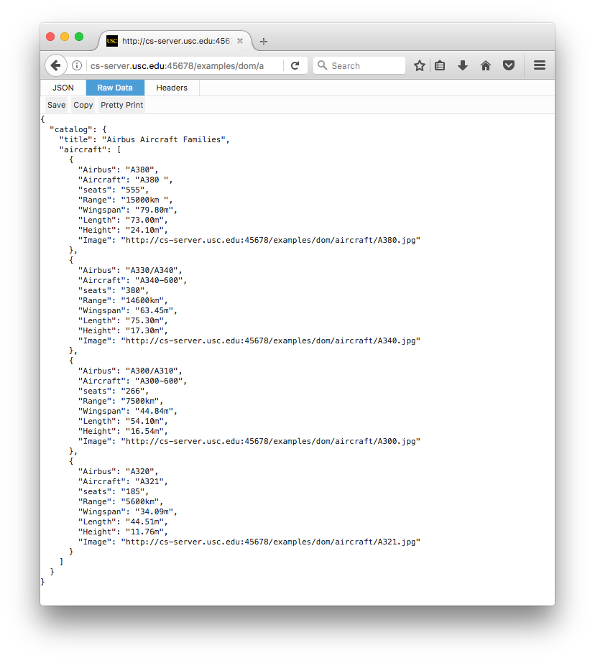
airbus.json
2008-2018 Copyright E. Horowitz, M. Papa

Slide 43
HTML Code for the Initial Input
<h1>View the Commercial Aircrafts </h1>
Enter XML file
<form name="myform" method="POST" id="location">
<input type="text" name="URL" maxlength="255" size="100" value="airbus.xml" />
<br />
<input type="button" name="submit" value="Submit Query" onClick="viewJSON(this.form)" />
</form>
2008-2018 Copyright E. Horowitz, M. Papa

Slide 44
viewXML Routine
function viewJSON(what){
var URL = what.URL.value;
function loadJSON(url) {
if (window.XMLHttpRequest)
{// code for IE7+, Firefox, Chrome, Opera, Safari
xmlhttp=new XMLHttpRequest();
} else {// code for IE6, IE5
xmlhttp=new ActiveXObject("Microsoft.XMLHTTP"); }
xmlhttp.open("GET",url,false); // "synchronous"
xmlhttp.send();
jsonObj= JSON.parse(xmlhttp.responseText);
return jsonObj; }
jsonObj = loadJSON(URL);
if (window.ActiveXObject) //if IE, simply execute script (due to async prop).
{ if (jsonObj.parseError.errorCode != 0) {
var myErr = jsonObj.parseError;
generateError(jsonObj);
hWin = window.open("", "Error", "height=300,width=340");
hWin.document.write(html_text);
} else { generateHTML(jsonObj);
hWin = window.open("", "Assignment4", "height=800,width=600");
hWin.document.write(html_text); }
} else //else if FF, execute script once JSON object has loaded
{ jsonObj.onload=generateHTML(jsonObj);
hWin = window.open("", "Assignment4", "height=800,width=600");
hWin.document.write(html_text); } hWin.document.close(); }
2008-2018 Copyright E. Horowitz, M. Papa

Slide 45
generateXML Routine
function generateHTML(jsonObj) {
root=jsonObj.DocumentElement;
html_text="<html><head><title>JSON Parse Result</title></head><body>";
html_text+="<table border='2'>";
caption=jsonObj.catalog.title;
html_text+="<caption align='left'><h1>"+caption+"</h1></caption>";
planes=jsonObj.catalog.aircraft; // an array of planes
planeNodeList=planes[0];
html_text+="<tbody>";
html_text+="<tr>";
x=0; y=0;
// output the headers
var header_keys = Object.keys(planeNodeList);
for(i=0;i<header_keys.length;i++) {
header=header_keys[i];
if(header=="Airbus") { header="Family"; x=120; y=55; } if(header=="Boeing") { header="Family"; x=100; y=67; }
if(header=="seats") header="Seats";
if(header=="Wingspan") header="Wing Span";
if(header=="height") header="Height";
html_text+="<th>"+header+"</th>";
}
2008-2018 Copyright E. Horowitz, M. Papa

Slide 46
generateXML Routine (cont’d)
html_text+="</tr>";
// output out the values
for(i=0;i<planes.length;i++) //do for all planes (one per row)
{
planeNodeList=planes[i]; //get properties of a plane (an object)
html_text+="<tr>"; //start a new row of the output table
var aircraft_keys = Object.keys(planeNodeList);
for(j=0;j<aircraft_keys.length;j++)
{
prop = aircraft_keys[j];
if(aircraft_keys[j]=="Image")
{//handle images separately html_text+="<td><img src='"+ planeNodeList[prop] +"' width='"+x+"' height='"+y+"'></td>"; } else {
html_text+="<td>"+ planeNodeList[prop] +"</td>";
}
}
html_text+="</tr>";
}
html_text+="</tbody>";
html_text+="</table>";
html_text+="</body></html>"; }
2008-2018 Copyright E. Horowitz, M. Papa

