Slide 1
PHP Tutorial

Slide 2
What is PHP?
PHP == ‘PHP: Hypertext Preprocessor’ (recursive backronym)
Open-source, server-side scripting language
Used to generate dynamic web-pages
PHP scripts reside between reserved PHP tags
This allows the programmer to embed PHP scripts within HTML pages

Slide 3
History of PHP
PHP began in 1995 when Rasmus Lerdorf developed a Perl/CGI script toolset he called the Personal Home Page or PHP
PHP 2 released 1997 (PHP now stands for Hypertex Processor). Lerdorf developed it further, using C instead
PHP 3 released in 1998 (50,000 users)
PHP 4 released in 2000 (3.6 million domains). Considered debut of functional language and including Perl parsing, with other major features
PHP 5.0.0 released July 13, 2004 (113 libraries>1,000 functions with extensive object-oriented programming)
PHP 5.6.31 released July 6, 2017
PHP 7.0 released December 2015
Documentation available at: http://www.php.net/docs.php
PHP 7.1 and 7.2 are current “stable” releases. PHP 5.6 still updated.

Slide 4
What is PHP (cont’d)
Interpreted language, scripts are parsed at run-time rather than compiled beforehand
Executed on the server-side
Source-code not visible by client: e.g. ‘View Source’ in browsers does not display the PHP code
Various built-in functions allow for fast development
Compatible with many popular databases
Provides
  SAPI, Server Application Programming Interface (Direct Module)
  ISAPI, The Internet Server Application Programming Interface (IIS)
  CGI interface
  CLI (Command Line Interface)

Slide 5
What does PHP code look like?
Structurally similar to C/C++
Supports procedural and object-oriented paradigm (to some degree)
All PHP statements end with a semi-colon
Each PHP script must be enclosed in the reserved PHP tag
<?php
…
?>

Slide 6
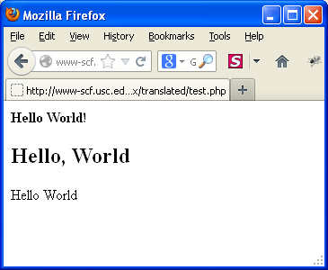
A Simple Example
Save as sample.php:
<!– sample.php -->
<html><body>
<strong>Hello World!</strong><br />
<?php
echo "<h2>Hello, World</h2>";
?>
<?php
$myvar = "Hello World";
echo $myvar;
?>
</body></html>

Slide 7
Comments in PHP
Standard C, C++, and shell comment symbols
// C++ and Java-style comment
# Shell-style comments
/* C-style comments
These can span multiple lines */

Slide 8
Variables in PHP
PHP variables must begin with a “$” sign
The variable name must be followed by a letter or underscore
Case-sensitive ($Foo != $foo != $fOo)
Static, Global and locally-scoped variables
  Global variables can be used anywhere (declared outside a function)
  Local variables restricted to a function or class
  Variable declared “static” do not disappear when a function is completed
  Superglobals: predefined variables available in all ‘scopes’
Superglobal examples:
  Form variables ($_POST, $_GET)
  Server variables ($_SERVER, $HTTP_SERVER_VARS removed)
  State variables ($_COOKIE, $_SESSION)
  Environment variables ($_ENV, $HTTP_ENV_VARS deprecated)

Slide 9
PHP Variables
Variables are not statically typed
Integers can become floats, then can become strings
Variables take the type of the current value
Variable types include :
Boolean
Integer
Float
String
Array
Object
Resource
NULL

Slide 10
PHP Variables
Assigned by value
$foo = "Bob"; $bar = $foo;
Assigned by reference, this links vars
$bar = &$foo;
Some variables are pre-assigned, e.g. server and env vars
For example, there are PHP vars
  PHP_SELF, an index variable that returns the current script being executed, including its name and path (Ex: $_SERVER[‘PHP_SELF’] )
  $_GET, an associative array of variables passed to the current script ($HTTP_GET_VARS deprecated)
  $_POST, an associative array of variables passed to the current script ($HTTP_POST_VARS deprecated)

Slide 11
Displaying Variables
To display a variable with the echo statement, pass the variable name to the echo statement without enclosing it in quotation marks :
  $VotingAge = 18;
  echo $VotingAge;
To display both text strings and variables, send them to the echo statement as individual arguments, separated by commas :
echo "<p>The legal voting age is ", $VotingAge, ".</p>";

Slide 12
Naming Variables
The following rules and conventions must be followed when naming a variable:
  Variable names must begin with a dollar sign ($)
  Variable names may contain uppercase and lowercase letters, numbers, or underscores (_). The first character after the dollar sign must be a letter or underscore.
  Variable names cannot contain spaces
  Variable names are case sensitive

Slide 13
PHP Constants
Constants are special variables that cannot be changed
Constant names do not begin with a dollar sign ($)
Start with letter or underscore (_) followed by letters, numbers or underscores
Use them for named items that will not change
Constant names use all uppercase letters
Use the define() function to create a constant
  define("CONSTANT_NAME", value);
The value you pass to the define() function can be a text string, number, or Boolean value
Constants have global scope

Slide 14
PHP Operators
Standard Arithmetic operators
+, -, *, / and % (modulus)
String concatenation with a period (.)
  $car = “SEAT” . “ Altea”;
echo $car; would output “SEAT Altea”
Basic Boolean comparison with “==”
Using only = will overwrite a variable value
Less than < and greater than >
<= and >= as above but include equality

Slide 15
PHP Operators (cont’d)
Assignment (=) and combined assignment
  $a = 3;
  $a += 5; // sets $a to 8;
  $b = "Hello ";
  $b .= "There!"; // sets $b to "Hello There!";
Bitwise (&, |, ^, ~, <<, >>)
  $a ^ $b(Xor: Bits that are set in $a or $b but not both are set.)
  ~ $a (Not: Bits that are set in $a are not set, and vice versa.)

Slide 16
Data Types
PHP is not strictly typed
PHP support 8 “primitive” types:
  4 scalar types: boolean, integer, double (floating-point), string
  2 compound types: array and object
  2 special types; resource and null
PHP decides what type a variable is
PHP can use variables in an appropriate way automatically
E.g.
  $vat_rate = 0.175; /* VAT Rate is numeric */
  echo $vat_rate * 100 . “%”; //outputs “17.5%”
$vat_rate is converted to a string for the purpose of the echo statement

Slide 17
Numeric Data Types
PHP supports two numeric data types:
  An integer is a positive or negative number and 0 with no decimal places (-250, 2, 100, 10,000)
  A floating-point number (double) is a number that contains decimal places or that is written in exponential notation (-6.16, 3.17, 2.7541)

Slide 18
Boolean Values
A Boolean value is a value of TRUE or FALSE
It decides which part of a program should execute and which part should compare data
In PHP programming, you can only use TRUE or FALSE Boolean values
In other programming languages, you can use integers such as 1 = TRUE, 0 = FALSE

Slide 19
Variable usage
<?php
$foo = 25; //Numerical variable
$bar = "Hello"; //String variable
$foo = ($foo * 7); //Multiples foo by 7
$bar = ($bar * 7); //Invalid expression
?>

Slide 20
echo example
<?php
$foo = 25; // Numerical variable
$bar = "Hello"; // String variable
echo $bar; // Outputs Hello
echo $foo,$bar; // Outputs 25Hello
echo "5x5=",$foo; // Outputs 5x5=25
echo "5x5=$foo"; // Outputs 5x5=25
echo ‘5x5=$foo‘; // Outputs 5x5=$foo
?>
Notice how echo ‘5x5=$foo‘ outputs $foo rather than replacing it with 25
Strings in single quotes (‘‘) are not interpreted or evaluated by PHP
This is true for both variables and character escape-sequences (such as “\n” or “\\”)

Slide 21
Arithmetic Operations
<?php
$a=15;
$b=30;
$total=$a+$b;
Print $total;
Print "<p><h1>$total</h1>";
// total is 45
?>
$a - $b // subtraction
$a * $b // multiplication
$a / $b // division
$a += 5 // $a = $a+5 - also works for *= and /=

Slide 22
Concatenation
Use a period to join strings into one.
<?php
$string1="Hello";
$string2="PHP";
$string3=$string1 . " " . $string2;
Print $string3;
?>
Hello PHP

Slide 23
Escaping the Character
If the string has a set of double quotation marks that must remain visible, use the \ [backslash] before the quotation marks to ignore and display them.
<?php
$heading="\"Computer Science\"";
Print $heading;
?>
"Computer Science"

Slide 24
PHP Control Structures
Control Structures: the structures within a language that allow us to control the flow of execution through a program or script.
Grouped into conditional / branching structures (e.g. if/else) and repetition structures (e.g. while loops).
Example if/else if/else statement:
  if ($foo == 0) {
  echo ‘The variable foo is equal to 0’;
  }
  else if (($foo > 0) && ($foo <= 5)) {
  echo ‘The variable foo is between 1 and 5’;
  }
  else {
  echo ‘The variable foo is equal to ‘.$foo;
  }

Slide 25
If ... Else...
<?php
If($user=="John")
{
Print "Hello John.";
}
Else
{
Print "You are not John.";
}
?>
If (condition)
{
Statements;
}
Else
{
Statement;
}
No ‘Then’ in PHP !

Slide 26
While Loops
General format:
While (condition)
{
Statements;
}
<?php
$count=0;
While($count<3)
{
Print "hello PHP. ";
$count += 1;
// $count = $count + 1;
// or
// $count++;
}
?>
hello PHP. hello PHP. hello PHP.

Slide 27
Date Display
$datedisplay=date("yyyy/m/d");
Print $datedisplay;
# If the date is April 1st, 2012
# It would display as 2012/4/1
$datedisplay=date("l, F j, Y"); (see next slide for symbol meanings)
Print $datedisplay;
# If the date is April 1st, 2012
# Wednesday, April 1, 2012
2012/4/1
Wednesday, April 1, 2012

Slide 28
Month, Day & Date Format Symbols
M | Jan
F | January
m | 01
n | 1
Day of Month | d | 01
Day of Month | j | 1
Day of Week | l | Monday
Day of Week | D | Mon

Slide 29
Functions
Functions MUST be defined before they can be called
Function headers are of the format
  Note that no return type is specified
Unlike variables, function names are not case sensitive
  (foo(…) == Foo(…) == FoO(…))
function functionName($arg_1, $arg_2, …, $arg_n)

Slide 30
Functions example
<?php
// This is a function
  function foo($arg_1, $arg_2)
  {
  $arg_2 = $arg_1 * $arg_2;
  return $arg_2;
  }
  $result_1 = foo(12, 3); // Store the function
  echo $result_1; // Outputs 36
  echo foo(12, 3); // Outputs 36
?>

Slide 31
Include Files
Include “footer.php” by placing within the HTML the line
  <?php include 'footer.php'; ?>
The file footer.php might look like:
  <hr SIZE=11 NOSHADE WIDTH=“100%”>
  <i>Copyright © 2010-2012 USC </i></font><br>
  <i>ALL RIGHTS RESERVED</i></font><br>
  <i>URL: http://www.usc.edu</i></font><br>

Slide 32
Some simple examples
These examples can be found at
http://cs-server.usc.edu:45678/examples/php/php_ex/translated/index.html

Slide 33
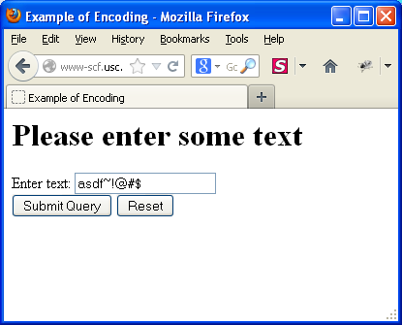
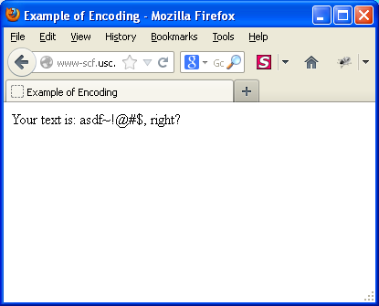
Example – Encoding Form Data
before
after

Slide 34
Example – Encoding Form Data Script
<HTML>
<HEAD><TITLE>Example of Encoding</TITLE></HEAD>
<BODY>
<?php if($_POST["submit"]): ?>
Your text is: <?php echo $_POST["input"]; ?>, right?
<?php else: ?>
<H1>Please enter some text</H1>
<FORM ACTION="" METHOD=POST>
Enter text: <INPUT NAME=input><BR>
<INPUT TYPE=submit name="submit">
<INPUT TYPE=reset></form>
<?php endif; ?>
</BODY>
</HTML>
Note: PHP 5.4+ warns if not doing this: if (isset($_POST["submit"])

Slide 35
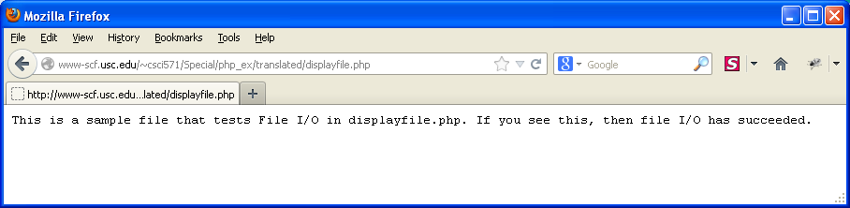
Example – Displaying a Text File
This php program is invoked by clicking on the link
<a href=http://cs-server.usc.edu:45678/examples/php/php_ex/translated/displayfile.php>
Example – Displaying a text file</a>
Resulting Output

Slide 36
Example – Source of displayfile.php Script
<?php
$ourFileName = "apple.txt";
$ourFileHandle = fopen($ourFileName, "r") or die("can't open file");
$file = fread($ourFileHandle, filesize($ourFileName));
fclose($ourFileHandle);
header("Content-type: text/plain");
echo $file;
?>

Slide 37
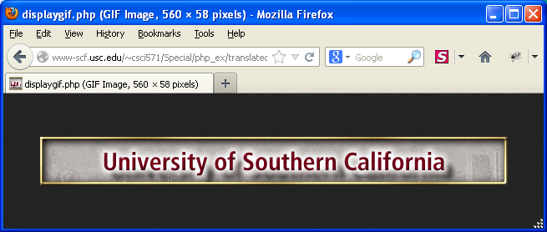
Example – Returning a GIF Image
This program is also invoked by clicking on a link
<a href=http://cs-server.usc.edu:45678/examples/php/php_ex/translated/displaygif.php>
Example – Returning a GIF Image</a>
Resulting Output

Slide 38
Example – Source for displaygif.php Script
<?php
$ourFileName = "BanS_USC.gif";
$ourFileHandle = fopen($ourFileName, "r") or die("can't open file");
$file = fread($ourFileHandle, filesize($ourFileName));
fclose($ourFileHandle);
header("Content-type: image/gif");
echo $file;
?>

Slide 39
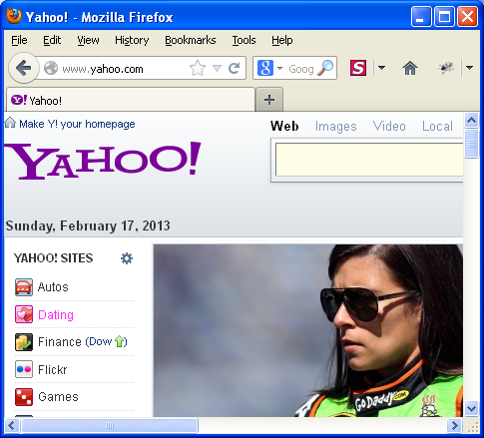
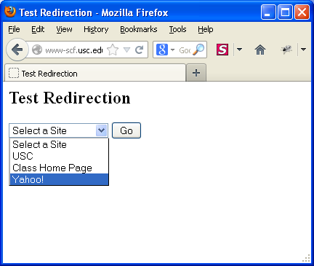
Example – Redirection in php
This program is also invoked by clicking on a link
<a href=http://cs-server.usc.edu:45678/examples/php/php_ex/translated/redirection.php>
Example – Redirection</a>
Before
After

Slide 40
Example – redirection.php Script
<?php if($_POST["submit"]): ?>
<?php header("Location: $_POST[url]"); ?>
<?php else: ?>
<html><head><title>Test Redirection</title></head>
<body>
<h2>Test Redirection</h2>
<form method="post" action="">
<select name="url">
<option selected=selected value="">Select a Site</option>
<option value="http://www.usc.edu">USC</option>
<option value="http://www-scf.usc.edu/~csci571/index.html">Class Home Page</option>
<option value="http://www.yahoo.com">Yahoo!</option>
</select> <input type="submit" value="Go" name="submit">
</form></body></html>
<?php endif; ?>

Slide 41
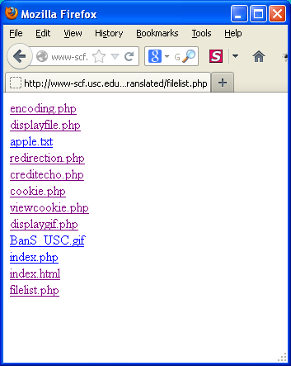
Example - Creating a File List
This program is also invoked by clicking on a link
<a href=http://cs-server.usc.edu:45678/examples/php/php_ex/translated/filelist.php>
Example – Creating a File List</a>
Result

Slide 42
Example – Source for filelist.php Script
<?php
//echo getcwd(); get current working directory
if ($handle = opendir('/home/scf-22/csci571/public_html/Special/php_ex/translated')) {
while (false !== ($entry = readdir($handle))) {
if ($entry != "." && $entry != "..") {
echo "<a href='$entry'>$entry</a><br/>\n";
}
}
closedir($handle);
}
?>

Slide 43
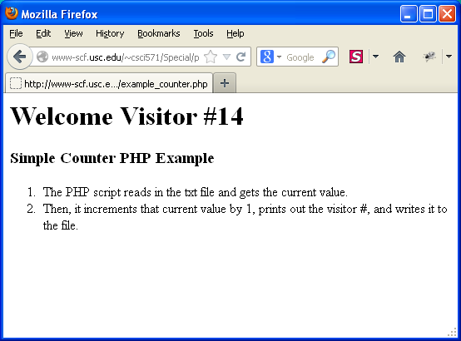

Simple counter example
This example is currently stored at: http://csci571.herokuapp.com/example_counter.php

Slide 44
Simple counter script
<?php
$ourFileName = "counter.txt";
$ourFileHandle = fopen($ourFileName, "r") or die("can't open file");
$num = fread($ourFileHandle, filesize($ourFileName));
fclose($ourFileHandle);
$ourFileHandle = fopen($ourFileName,"w") or die("can't open file");
$num++;
echo "<h1>Welcome Visitor #" . $num . "</h1>";
fwrite($ourFileHandle, $num);
fclose($ourFileHandle);
?>
<h3>Simple Counter PHP Example</h3>
<ol>
<li>The PHP script reads in the txt file and gets the current value.</li>
<li>Then, it increments that current value by 1, prints out the visitor
#, and writes it to the file.</li>
</ol>

Slide 45
PHP - Dealing with the client
<form method="post" action="file.php" id="frmid" >
  Method specifies how the data will be sent
  Action specifies the file to go to. E.g., file.php
  id gives the form a unique name
Post method sends all contents of a form with basically hidden headers (not easily visible to users)
Get method sends all form input in the URL requested using name=value pairs separated by ampersands (&)
  E.g., process.php?name=trevor&number=345
  Is visible in the URL shown in the browser

Slide 46
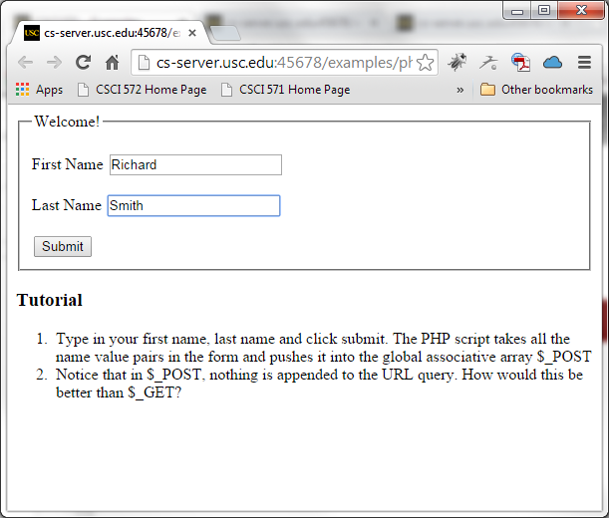
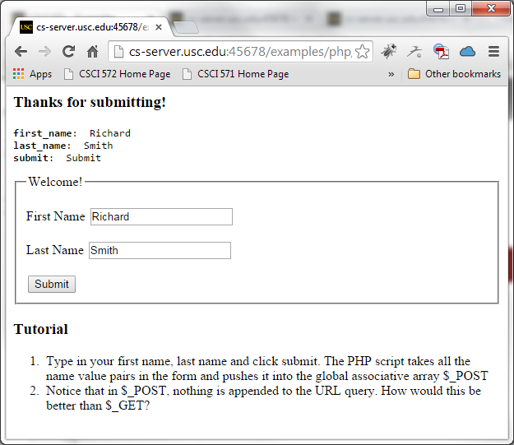
PHP - Example Using POST
<?php
include_once("inc.php");
if(isset($_POST["submit"])):
?>
<h3>Thanks for submitting!</h3>
<pre>
<?php print_array($_POST); ?>
</pre>
<?php endif; ?>
<form method="POST" action="">
<fieldset>
<legend>Welcome!</legend>
<p><label for="first_name">First Name</label>
<input type="text" name="first_name"
value="<?php echo isset($_POST["first_name"]) ? $_POST["first_name"] : "" ?>"></p>
<p><label for="first_name">Last Name</label>
<input type="text" name="last_name" value="<?php echo isset($_POST["last_name"]) ? $_POST["last_name"] : "" ?>">
</p>
<input type="submit" name="submit" value="Submit">
</fieldset></form>

Slide 47
PHP - Dealing with the client
Summary
  Form elements contain input elements
  Each input element has an id
  If a form is posted, the file stated as the action can use:
    $_POST["inputid"]
  If a form uses the get method:
    $_GET["inputid"]
Ensure you set all id attributes for form elements and their contents

Slide 48
EXAMPLE - CGI Env. Access
<?php
$env["REMOTE_ADDR"] = getenv("REMOTE_ADDR");
$env["SERVER_SOFTWARE"] = getenv("SERVER_SOFTWARE");
$env["SERVER_NAME"] = getenv("SERVER_NAME");
$env["GATEWAY_INTERFACE"] = getenv("GATEWAY_INTERFACE");
$env["SERVER_PROTOCOL"] = getenv("SERVER_PROTOCOL");
$env["SERVER_PORT"] = getenv("SERVER_PORT");
$env["REQUEST_METHOD"] = getenv("REQUEST_METHOD");
$env["PATH_INFO"] = getenv("PATH_INFO");
$env["PATH_TRANSLATED"] = getenv("PATH_TRANSLATED");
$env["DOCUMENT_ROOT"] = getenv("DOCUMENT_ROOT");
$env["SCRIPT_NAME"] = getenv("SCRIPT_NAME");
$env["QUERY_STRING"] = getenv("QUERY_STRING");
$env["REMOTE_HOST"] = getenv("REMOTE_HOST");
$env["AUTH_TYPE"] = getenv("AUTH_TYPE");
$env["REMOTE_USER"] = getenv("REMOTE_USER");
$env["REMOTE_IDENT"] = getenv("REMOTE_IDENT");
$env["CONTENT_TYPE"] = getenv("CONTENT_TYPE");
$env["CONTENT_LENGTH"] = getenv("CONTENT_LENGTH");
$env["HTTP_ACCEPT"] = getenv("HTTP_ACCEPT");
$env["HTTP_HOST"] = getenv("HTTP_HOST");
$env["HTTP_USER_AGENT"] = getenv("HTTP_USER_AGENT");
$env["HTTP_REFERER"] = getenv("HTTP_REFERER");
$env["HTTP_REFERRER"] = getenv("HTTP_REFFERER");
print "<table border=1 cellspacing=0 cellpadding=2>";
print "<caption>Environment Variables</caption>";
while ( list( $key, $val ) = each( $env ) ) {
print "<tr><td bgcolor=#CCCCCC><b>$key</b></td><td bgcolor=#EEEEEE><i>$val</i></td></tr>";
}
print "</table>"; } ?>

Slide 49
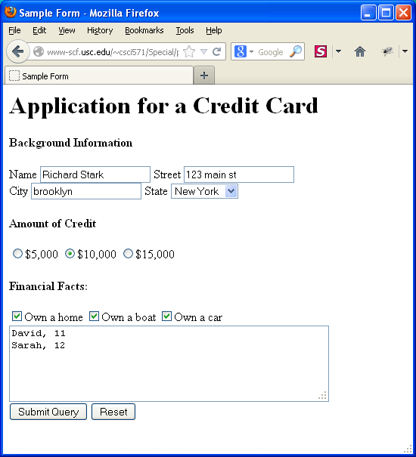
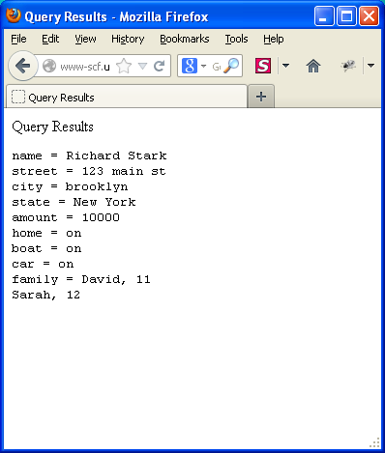
Example – Echoing Inputs
Input
Output
For the following slides, see “Translated PHP Examples from Perl”:
http://cs-server.usc.edu:45678/examples/php/php_ex/translated/index.html

Slide 50
Example – Echoing Inputs Scripts
<?php if($_GET["submit"]): ?>
<HTML><HEAD><TITLE>Query Results</TITLE></HEAD><BODY>
Query Results<pre>
<?php
foreach($_GET as $key => $value) {
if ($key !== "submit") {
echo $key . " = " . $value . "\n";
}
}
?>
</pre></BODY></HTML>
<?php else: ?>
<HTML><HEAD><TITLE>Sample Form</TITLE></HEAD><BODY>
<H1>Application for a Credit Card</H1>
<FORM METHOD="GET" ACTION="">
<H4>Background Information</H4>
Name <INPUT name=name> Street <INPUT name=street><BR>
City <INPUT name=city> State <SELECT name=state>
<OPTION> Alabama <OPTION> California <OPTION> New York<OPTION> Wisconsin </SELECT>
<H4>Amount of Credit</H4> <INPUT type=radio name=amount value=5000>$5,000
<INPUT type=radio name=amount value=10000>$10,000
<INPUT type=radio name=amount value=15000>$15,000
<H4>Financial Facts:</H4> <INPUT type=checkbox name=home>Own a home
<INPUT type=checkbox name=boat>Own a boat
<INPUT type=checkbox name=car>Own a car<BR>
<TEXTAREA rows=5 cols=50 name=family>
Please describe here the names and ages of people in your family and the number of cards
you are requesting. </TEXTAREA>
<INPUT type=submit name="submit"> <INPUT type=reset></FORM></BODY>
</HTML>
<?php endif; ?>

Slide 51
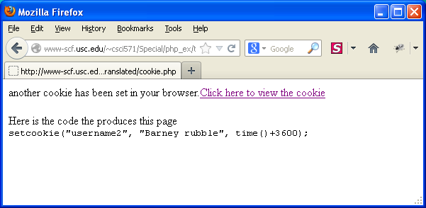
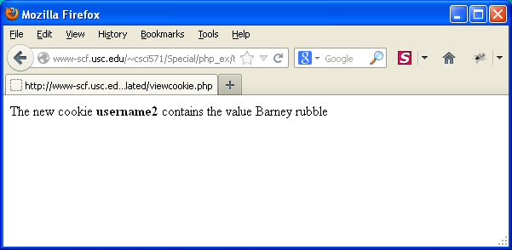
Example - Setting a Cookie
before
after

Slide 52
Set / View cookie
Set cookie:
<?php
setcookie("username2", "Barney Rubble”, time() + 3600 );
?>
View cookie:
<?php
if(isset($_COOKIE["username2"])) {
echo "The new cookie <b>username2</b> contains the value " . $_COOKIE["username2"];
}
?>

Slide 53
Why PHP Sessions?
Whenever you want to create a website that allows you to store and display information about a user, determine which user-groups a person belongs to, or utilize permissions on your website, PHP Sessions are vital to each of these features.
PHP has a set of functions that can achieve the same results of Cookies without storing information on the user's computer. PHP Sessions store the information on the web server in a location that you chose in special files. These files are connected to the user's web browser via the server and a special ID called a "Session ID". This is virtually invisible to the user.

Slide 54
PHP Sessions
Sessions store their identifier in a cookie in the client’s browser
Every page that uses session data must be preceeded by the session_start() function
Session variables are then set and retrieved by accessing the global $_SESSION[]
Sample session.php code:
<?php
session_start();
if (!$_SESSION["count"])
$_SESSION["count"] = 0;
if ($_GET["count"] == "yes")
$_SESSION["count"] = $_SESSION["count"] + 1;
echo "<h1>".$_SESSION["count"]."</h1>";
?>
<a href="session.php?count=yes">Click here to count</a>

Slide 55
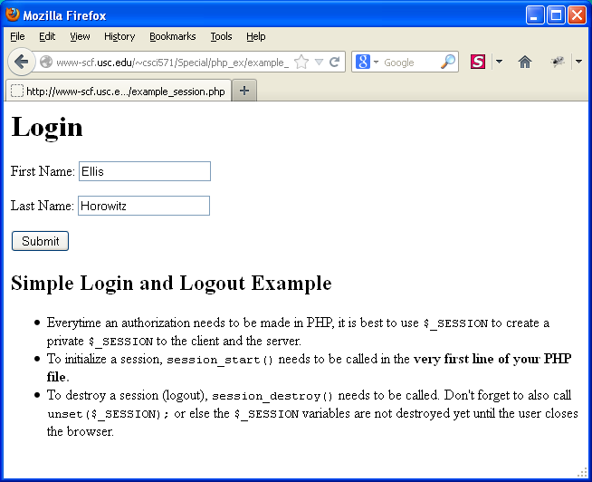
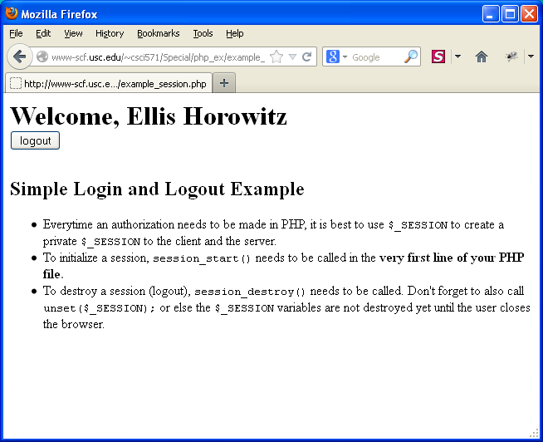
EXAMPLE – SESSIONS
Initial Login Screen
Resulting Screen
$_SESSION creates a private ID; session_start() and session_destroy()

Slide 56
example-session.php
<?php
session_start();
if(isset($_POST["submit"])) {
$_SESSION["fname"] = $_POST["fname"];
$_SESSION["lname"] = $_POST["lname"];
}
if(isset($_POST["logout"])) {
session_destroy();
unset($_SESSION);
}
?>
<?php if(!(isset($_SESSION["fname"],$_SESSION["lname"]))): ?>
<h1>Login</h1>
<form method="POST">
<p><label for="username">First Name:</label>
<input type="text" name="fname" />
</p> <p>
<label for="lname">Last Name:</label>
<input type="text" name="lname" />
</p> <p><input type="submit" name="submit" value="Submit"></p>
</form>

Slide 57
example-session.php (cont’d)
<?php else: ?>
<h1>Welcome, <?php echo ucwords($_SESSION["fname"] . " " . $_SESSION["lname"]);
?>
<form method="POST">
<input type="submit" name="logout" value="logout">
</form>
<?php endif; ?>
<h2>Simple Login and Logout Example</h2>
<ul>
<li>Everytime an authorization needs to be made in PHP, it is best to use
<code>$_SESSION</code> to create a private <code>$_SESSION</code> to the client and the server.</li>
<li>To initialize a session, <code>session_start()</code> needs to be
called in the <b>very first line of your PHP file.</b></li>
<li>To destroy a session (logout), <code>session_destroy()</code> needs
to be called. Don't forget to also call <code>unset($_SESSION);</code> or else
the <code>$_SESSION</code> variables are not destroyed yet until the user closes
the browser.</li>
</ul>
Note: The ucwords() function converts the first character of each word in a string to uppercase.

Slide 58
Connecting to a Database
PHP Has a set of functions that can be used with MySQL
First step is to setup a link to the desired database
See “MySQL Functions” docs at:
http://php.net/manual/en/ref.mysql.php
See MySQL API docs at:
http://php.net/manual/en/book.mysql.php
$link = mysql_connect($host, $user, $password);
Mysql_select_db($database);

Slide 59
Making a Query
Once a link is established, querying is easy
Errors for any given function are returned by mysql_error()
$query = “SELECT * FROM $table;”;
$result = mysql_query($query);

Slide 60
MySQL Result Set
The value returned by mysql_query() is a reference to an internal data structure
It can be parsed by various functions
$row = mysql_fetch_array($result);
$num_rows = mysql_num_rows($result);
$affected = mysql_affected_rows($result);

Slide 61
Associative Arrays
An array that can be indexed by a string
A set of key->value pairs
Very similar to a hash in Perl
$row[‘id’] = $id;
$row = array(‘id’ => $id);
echo $row[‘id’];

Slide 62
PHP foreach
Similar to the Perl equivalent
Allows iterating through each element of an array
foreach($arr as $item) {}
foreach($row as $key=>$value) {}

Slide 63
Put it All Together
<html><body>
<?php
// setup a query
$link = mysql_connect($host, $user, $password);
mysql_select_db($database);
$query = “SELECT * FROM $table WHERE id = ‘$id’;”;
$result = mysql_query($query);
>

Slide 64
Put it All Together (cont’d)
//Display a table
echo “<table>”;
While ($row = mysql_fetch_array($result)) {
echo “<tr>”;
foreach ($row as $key => $value) {
echo “<td>$value</td>”;
}
echo “</tr>”;
}
echo “</table>”;
mysql_close($link);
?>
</body></html>

Slide 65
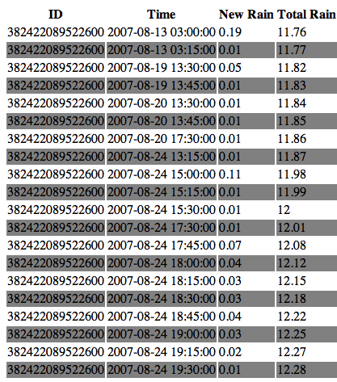
The Results

Slide 66
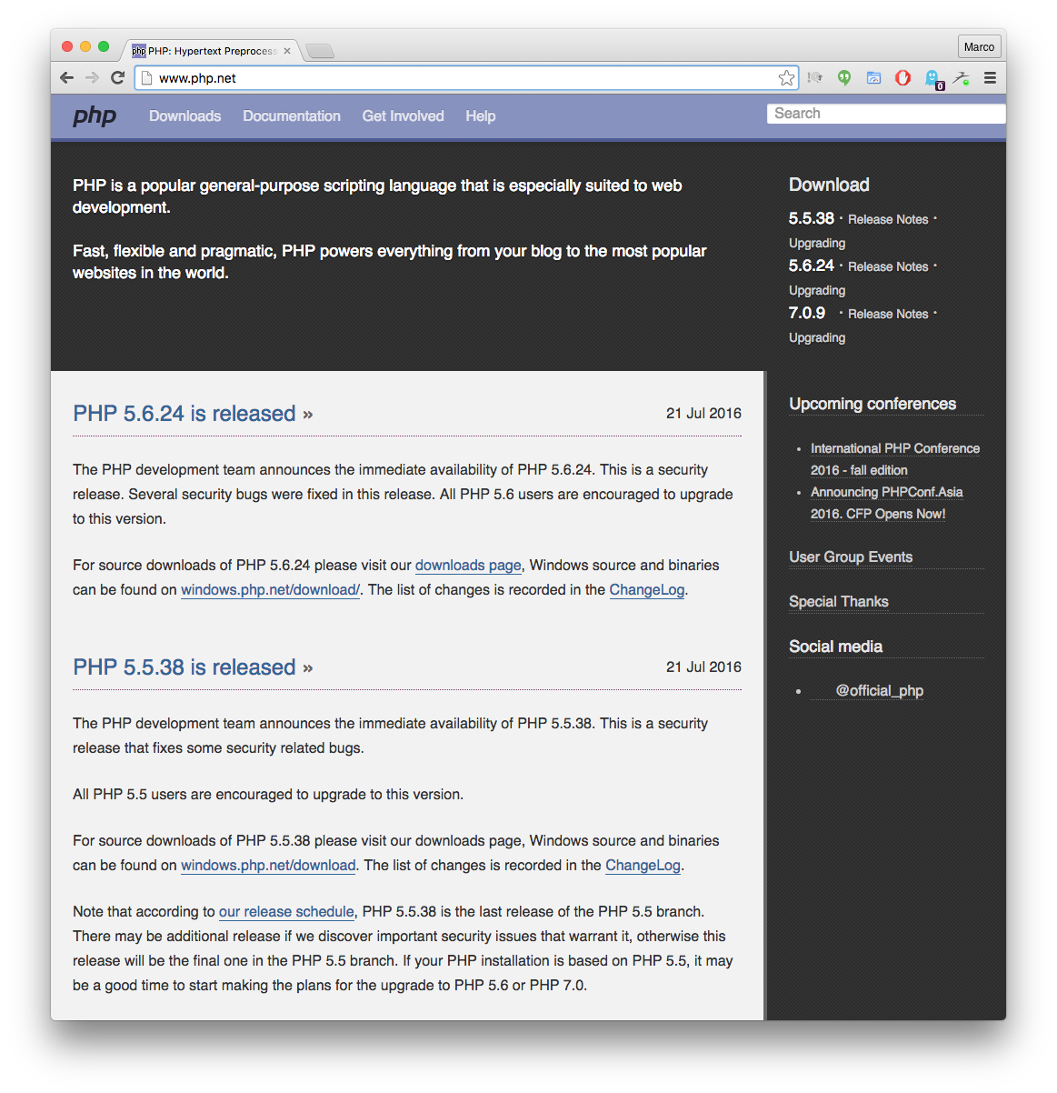
www.php.net
www.php.net is the main destination for PHP. The site includes all source/binary releases of PHP plus tutorials and discussion groups. Another excellent site for PHP is www.phphelp.com.

