Slide 1
Lecture
The Web Server
Copyright © Ellis Horowitz 1998-2018

Slide 2
Outline
Available Web Servers
Server Features
  Document Root
  Authentication
  Proxy Servers
  Caching
  CGI Scripting
  Application Program Interface
Configuring a Server
Analyzing a Server’s Performance
Server Log Files
Copyright © Ellis Horowitz 1998-2018

Slide 3
What Does the WWW Server Do?
Enables browser requests
Mainly provides
  – Support for retrieving hypertext documents
  – Manages access to the Web site
  – Provides several mechanisms for executing server-side scripts
    Common Gateway Interface (CGI)
    Application Program Interface (API)
    Direct Module Interfaces (SAPI)
  – provides log files and usage statistics
Copyright © Ellis Horowitz 1998-2018

Slide 4
What to Look for in a Web Server
Main features
  platform they run on;
  complete support for HTTP 1.1
  Multithreading, load balancing
Security features
  ability to provide IP address restriction
  ability to provide domain name restriction
  Support for secure transactions: SSL
  Ability to act as a proxy server
Copyright © Ellis Horowitz 1998-2018

Slide 5
How Servers Handle Multiple Requests
For each request, a complete copy of the server is made and executed
  Initially a parent process waits for requests; for each new request a child process is spawned
Or, a single server program handles many requests simultaneously (multithreaded)
  the server must keep track of all requests and switch between them as needed
  writing multithreaded programs is easier in a language that supports multiple threads, e.g. Java
Copyright © Ellis Horowitz 1998-2018

Slide 6
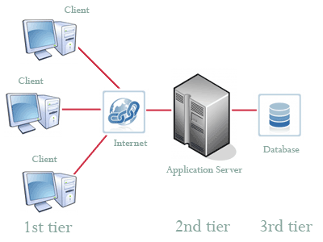
Application Web Server
An application server is software that typically interfaces one or more databases to convey processed data to and from a user interface such as a web browser
An application server acts as a set of components accessible through an API
For web applications, these components are usually performed in the same machine where the
web server is running, and their main job is to support the construction of dynamic pages.
For example, Apache Tomcat is a popular, light-weight application container, but not a full
application server as it doesn't provide the services specified in the J2EE specification.
The web modules include servlets and JavaServer Pages. Business logic resides in Enterprise
JavaBeans (EJB).
Copyright © Ellis Horowitz 1998-2018

Slide 7
Some Available Web & Application Servers
Publisher Product Platform URL
Web Servers
apache apache Win32/UNIX http://httpd.apache.org/
Microsoft IIS 7-10.0 Win32 http://www.iis.net
NGINX nginx (open source) Linux, BSD, Win32 http://nginx.org
NGINX Software NGINX Plus Ubuntu, AWS http://www.nginx.com
Google Cloud, Microsoft Azure
Application Servers
Oracle GlassFish 4.1 Solaris/Win32/Linux https://glassfish.java.net
Java EE Reference Implementation
IBM WebSphere V 9 Win32/UNIX/Linux http://www.ibm.com/software/websphere/
Oracle WebLogic Server 12c Win32/UNIX/Linux
https://www.oracle.com/middleware/weblogic/index.html
For a comparison of web servers see http://www.serverwatch.com/, click on Server Comparison Tool
Copyright © Ellis Horowitz 1998-2018

Slide 8
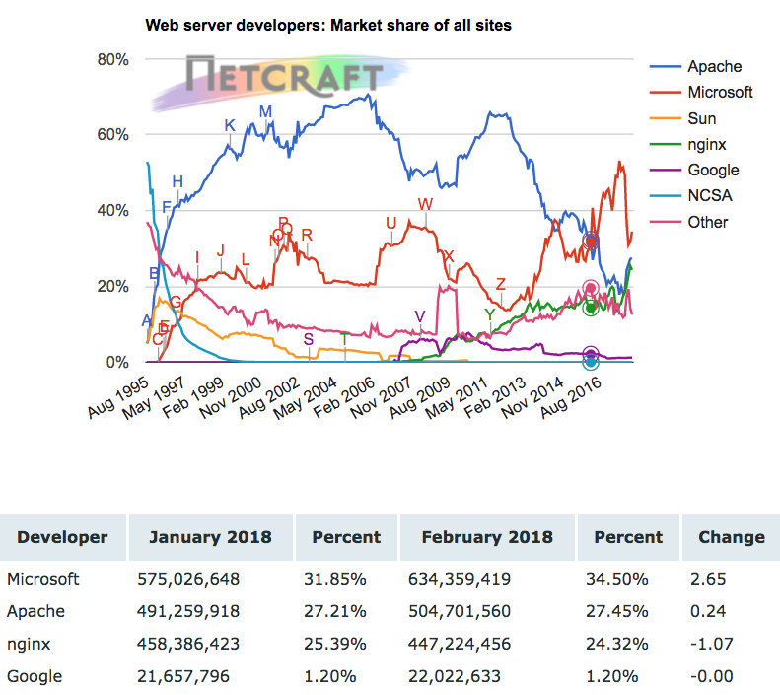
Web Server Usage
Netcraft has identified more than 1,838,000,000 sites (2/2018)
  Apache no longer dominates Internet servers
  Microsoft on top, NGINX closing in to Apache at #2
Statistics on intranets are difficult to determine
  http://news.netcraft.com/archives/category/web-server-survey/
In July 2014, for the first time since measurements began, Microsoft’s IIS had taken the lead, and retook it in July 2016.
Almost 200,000 Apache servers (7%) are Western Digital MyCloud servers, consumer devices that can be accessed using public hostnames similar to device1000000-a1b2c3d4.wd2go.com
Copyright © Ellis Horowitz 1998-2018

Slide 9
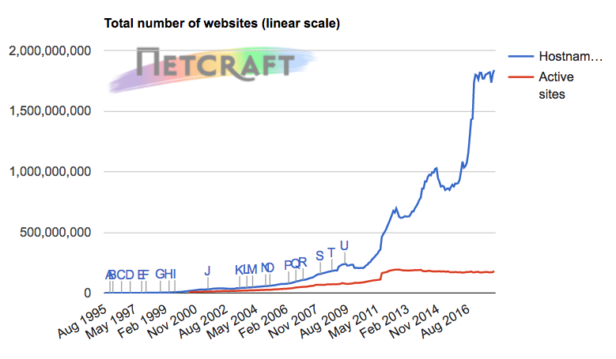
Web Server Survey Takeaways
From Netcraft February 2017 survey we can make these observations
  Microsoft dominated this month's domain growth, with an extra 1.1 million domains (+2.0%) taking its market share up by 0.41 percentage points to 26.5%, while Apache lost 115,000 domains.
  Although Nginx computer growth continued to be strong – gaining 44,000 this month – it lost 11.2 million hostnames globally. The primary cause of this was more than 15 million sites switching from nginx to Apache. Most of these sites were previously hosted by Raksmart in China, but are now hosted by Data Foundry in the United States.
  All four of the largest major vendors – Apache, nginx, Google and Microsoft – gained active sites this month.
Copyright © Ellis Horowitz 1998-2018

Slide 10
Web Server Features
Document Root
Authentication
Proxy Servers
Caching
CGI Scripting
Application Program Interface
Copyright © Ellis Horowitz 1998-2018

Slide 11
Web Server Features - Document Root
The Web server has access to a tree of files that it can deliver
  the files are created by content providers
  files may contain text, images, sound, video, other programs, etc.
the document tree is organized by the web site administrator
The root of the document tree is given to the web server when it starts
Copyright © Ellis Horowitz 1998-2018

Slide 12
Managing the Document Tree
http://domain/cs is mapped to /serverhome/htdocs/cs/index.html
/serverhome
index.html
other
htdocs
<A HREF=page.html>Click here</a>
usr
ee
cs
<A HREF=images/banner.gif>Display Image</a>
index.html
public
page.html index.html
images
<A HREF=../ee/index.html>Click Here</a>
home.html
banner.gif
<A HREF=/serverhome/other/usr/public/home.html>
The document root is /serverhome/htdocs
The last link is an error
Copyright © Ellis Horowitz 1998-2018

Slide 13
Web Server Features
Virtually Hosted Document Roots
Hosting multiple web sites by the same web server
It uses the host name or IP address to distinguish the document roots, e.g.
GET /index.html HTTP/1.0
Host: www.hardware.com
might return documents from /htdocs/hardware, while
GET /index.html HTTP/1.0
Host: www.antiques.com
might return documents from /htdocs/antiques
This might be configured in, say apache by writing
<VirtualHost www.hardware.com> <VirtualHost www.antiques.com>
ServerName www.hardware.com ServerName www.antiques.com
DocumentRoot /htdocs/hardware DocumentRoot /htdocs/antiques
</VirtualHost> </VirtualHost>
Copyright © Ellis Horowitz 1998-2018

Slide 14
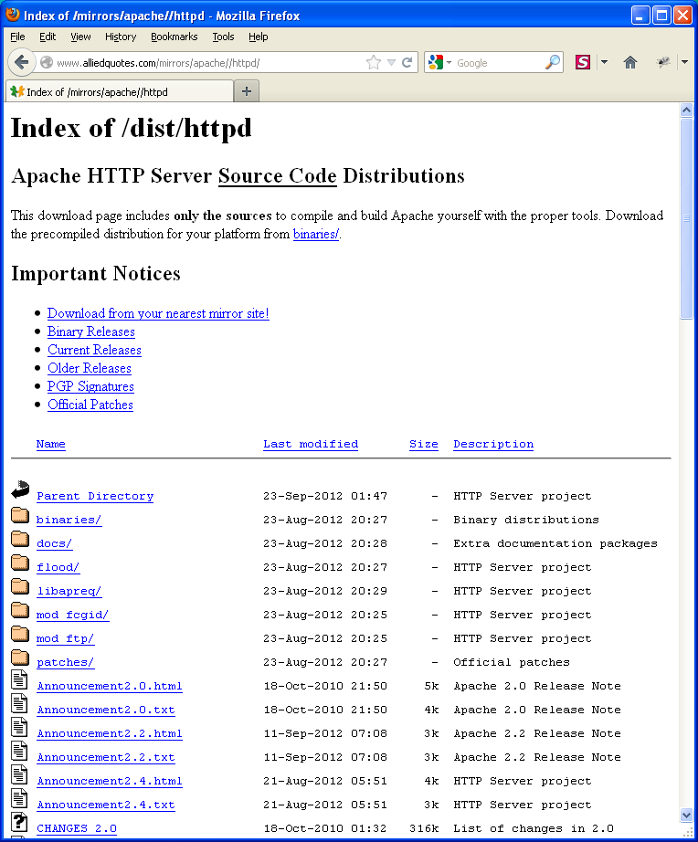
Web Server Features - Directory Listing
When the URL path resolves to a directory, not to a file, a web server can be configured to return more than just a default file; to the right you see the server returning a list of files in the directory including special icons for files and folders
Important Note: Turn off this feature! Remove “Indexes” from Options Indexes in httpd.conf
Copyright © Ellis Horowitz 1998-2018

Slide 15
Web Server Features
Basic User Authentication
Basic authentication is supported by all HTTP servers
  The server administrator creates secure directories accessible via password files maintained by the server
  Client requests a resource from a secure directory; e.g., GET /secure/test.html HTTP/1.0
  Server responds with authentication request to the client; e.g., HTTP/1.0 401 Unauthorized
  Browser requests user name and password, scrambles them, and retries the request
  GET http://domain/secure/test.html HTTP/1.0
  Authorization: Basic 0<V%L:EB.G-E8W))$J
  Server decodes name and password and checks it against its password file
Copyright © Ellis Horowitz 1998-2018

Slide 16
Web Server Features
Creating Server-Side Applications
Web Servers offer several mechanisms
  Application Programming Interface (API)
  Common Gateway Interface (CGI)
  J2EE / .NET interfaces
  Chrome V8 JavaScript Engine (Google)
    Node.js
  Direct Module Interfaces (PHP)
    Apache offers a PHP module
Microsoft IIS server-side supports:
  CGI applications
  API applications compiled as DLL
  Active Server Pages (written in VBScript)
  ASP.NET applications (written in C++, VB.NET, C#, or HTML/CSS/JavaScript)
Copyright © Ellis Horowitz 1998-2018

Slide 17
Configuring a Server
No matter which operating system or server, you will need to define the
  location of the server (server root)
  location of documents to deliver (document root)
  location of CGI scripts or server-side components to execute
You may also wish to define
  Access restrictions
  Fancy indexing
  Sys admin e-mail
  Other features
Copyright © Ellis Horowitz 1998-2018

Slide 18
Port Numbers
A typical computer will have thousands of ports
System ports: 0 - 1023, are reserved for certain functions, typically assigned by IANA (Internet Assigned Number Authority), http://www.iana.org/
Well-known TCP / UDP ports:
http://en.wikipedia.org/wiki/List_of_TCP_and_UDP_port_numbers#Well-known_ports
  programs running on these ports must be started under root
TCP/UDP ports used by Apple products:
http://support.apple.com/kb/HT6175
Dynamic ports 49152 - 65535, ports that are freely available (check OS X possible conflicts)
Copyright © Ellis Horowitz 1998-2018

Slide 19
Some Well-Known Port Numbers
Port Protocol Purpose
20 ftp ftp data connection
21 ftp ftp control connection
23 telnet telnet session
25 SMTP simple mail transfer protocol
53 DNS domain name service
70 gopher gopher protocol
79 finger finger protocol
80 http hypertext transfer protocol
88 kerberos kerberos authentication protocol
110 pop3 post office protocol
113 ident remote identity service
nntp network news transfer protocol
143 IMAP email access
161 snmp simple network management proto
162 snmp snmp traps
194 irc internet relay chat
280 http mgmt http management
389 ldap lightweight directory access pr
Copyright © Ellis Horowitz 1998-2018

Slide 20
Standard Port Numbers (cont’d)
Port Protocol Purpose
427 srvloc server location protocol
443 https secure http (SSL)
465 smtps secure email (SSL)
535 iiop internet inter-orb protocol
551 cybercash secure money transaction
snews secure news (SSL)
614 ssl shell ssl shell
636 ldaps secure ldap (SSL)
989 ftps secure ftp data connection
990 ftps secure ftp control connection
992 telnets secure telnet (SSL)
993 imaps secure imap (SSL)
994 ircs secure irc (SSL)
995 pop3s secure pop3 (ssl)
1080 socks socks protocol, circuit level
Copyright © Ellis Horowitz 1998-2018

Slide 21
The Apache Web Server
Copyright © Ellis Horowitz 1998-2018

Slide 22
Apache Web Server
Apache is based on code and ideas developed at NCSA in httpd version 1.3 (early 1995)
The name “Apache” comes from the fact that it is A set of PAtCHEs to NCSA’s httpd
Apache is free and is downloadable from
http://httpd.apache.org
Apache version 2.4.25 included in OS X Sierra:
https://coolestguidesontheplanet.com/get-apache-mysql-php-and-phpmyadmin-working-on-macos-sierra/
Using Apache in Windows 8:
http://www.techscio.com/install-apache-on-windows-8/
Using Apache in Windows 10
http://dalaris.com/how-to-install-and-run-apache-web-server-on-windows-10/
Copyright © Ellis Horowitz 1998-2018

Slide 23
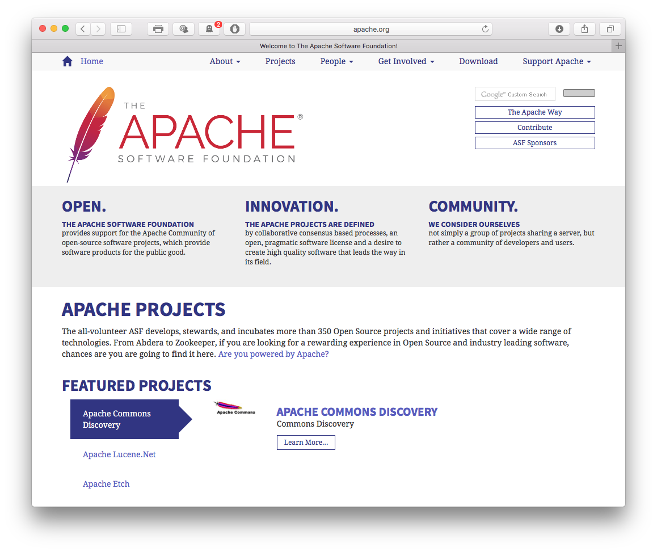
Apache Home Page
Available for
many platforms:
Win64 (Win7-10), Win32, Solaris, Linux,
Mac OS X,
etc.
Copyright © Ellis Horowitz 1998-2018

Slide 24
Apache httpd server
The Apache httpd server
  is a powerful, flexible, HTTP/1.1 compliant web server
  implements the latest protocols, including HTTP/1.1 (RFC2616)
  is highly configurable and extensible with third-party modules
  can be customized by writing 'modules' using the Apache module API
  provides full source code and comes with an unrestrictive license
  runs on Windows, Netware, Mac OS X, Linux, and most versions of Unix, as well as several other operating systems
Copyright © Ellis Horowitz 1998-2018

Slide 25
Configuring Apache
server functionality is available through modules which are either built-into or loaded into the server
server instructions
  apache reads its run-time configuration instructions from text files
no GUI available (visual start/stop available on Windows)
182 configuration directives in the basic package
On UNIX, Apache starts several processes to implement the server and handle requests
On Windows there are only two processes, a parent and a child that handles all requests. Within the child all requests are handled by separate “threads”
See http://httpd.apache.org/docs/2.2/configuring.html
Copyright © Ellis Horowitz 1998-2018

Slide 26
How does Apache Work?
Apache runs under a multitasking operating system, e.g. UNIX, OS/2, Windows
the binary is called httpd
Key directories include:
  conf contains configuration files
  htdocs contains html files
  logs contains logging data
  cgi-bin contains executable scripts
  icons set of *.gif files used e.g. in directory listings
  src contains actual source code if you download the source distribution
Apache idles, listening to an IP address and port
Copyright © Ellis Horowitz 1998-2018

Slide 27
Configuring Apache - conf Directory
In the conf directory there is a file provided with model configuration parameters
  httpd.conf
This file must be edited
Partial contents of the mime.types file
text/html html htm
text/plain txt
text/richtext rtx
video/mpeg mpeg mpg mpe
video/quicktime qt mov
video/x-msvideo avi
x-world/x-vrml wrl vrml
Copyright © Ellis Horowitz 1998-2018

Slide 28
Apache Settings - httpd.conf
Directives are keywords followed by their value,e.g.
Listen 9637
ServerAdmin horowitz@usc.edu
ServerRoot /home/scf-03/csci571/WebServer/apache_2.2
ErrorLog logs/error_log
DocumentRoot "/home/scf-17/csci571c/apache2/htdocs“
ScriptAlias /cgi-bin/ "/home/scf-17/csci571c/apache2/cgi-bin/"
the above are ones that must be set
Note: A complete set of instructions for how to install Apache 2 can be found on the class web page under Download Course Software category
http://cs-server.usc.edu:45678/hw/hw5/HW5_Apache_Installation.pdf
Copyright © Ellis Horowitz 1998-2018

Slide 29
Some Apache Settings - httpd.conf
# Timeout: The number of seconds before receives and sends time out
Timeout 300
# KeepAlive: Whether or not to allow persistent connections (more than one request per connection). Set to "Off" to deactivate.
KeepAlive On
# MaxKeepAliveRequests: The maximum number of requests to allow during a persistent connection. Set to 0 to allow an unlimited amount. They recomend you leave this number high, for maximum performance.
MaxKeepAliveRequests 100
# KeepAliveTimeout: Number of seconds to wait for the next request
KeepAliveTimeout 15
Copyright © Ellis Horowitz 1998-2018

Slide 30
Apache Settings – http-mpm.conf
# Server-pool size regulation. Apache dynamically adapts to the load it sees --- it tries to maintain enough server processes to handle the current load, plus a few spare servers to handle transient load spikes. It does this by periodically checking how many servers are waiting for a request. If there are fewer than MinSpareServers, it creates a new spare. If there are more than MaxSpareServers, some of the spares die off.
MinSpareServers 2
MaxSpareServers 2
StartServers 2 #number of servers to start
MaxClients 2
Copyright © Ellis Horowitz 1998-2018

Slide 31
Apache Settings - httpd.conf
# DocumentRoot: The directory out of which you will serve your documents.
DocumentRoot /home/cscixxx/WebServer/apache/htdocs
# UserDir: The name of the directory which is appended onto a user's home directory if a ~user request is received.
UserDir public_html
# DirectoryIndex: Name of the file or files to use as a pre-written HTML
DirectoryIndex index.html
# FancyIndexing is whether you want fancy directory indexing or standard
IndexOptions FancyIndexing
Copyright © Ellis Horowitz 1998-2018

Slide 32
Apache Settings - Scripting
# ScriptAlias: This controls which directories contain server scripts. Format: ScriptAlias fakename realname
ScriptAlias /cgi-bin/ /home/cscixxx/WebServer/apache/cgi-bin/
# If you want to use server side includes, or CGI outside ScriptAliased directories, uncomment the following lines.
# AddType allows you to tweak mime.types without actually editing it, or to make certain files to be certain types. Format: AddType type/subtype ext1
# To use CGI scripts:
#AddHandler cgi-script .cgi
# To use server-parsed HTML files
#AddType text/html .shtml
#AddHandler server-parsed .shtml
Copyright © Ellis Horowitz 1998-2018

Slide 33
Authentication in Apache
There are two methods for controlling access to directories
  the file access.conf in the conf/ directory can be used
    placing access directives in a <Directory> block is the preferred method
  per-directory access rules can be set by a file placed in a specific directory
    the name of the file is set by the directive AccessFileName
    .htaccess is the default name
    however, using .htaccess slows down the server;
    NOTE: initially .htaccess is turned OFF
When the server attempts to retrieve a document, it looks for an access control file in the directory or the parent directory.
The file it looks for is set by the directive AccessFileName
Copyright © Ellis Horowitz 1998-2018

Slide 34
Some Sectioning Directives
The server configuration files use sectioning directives to define special access rights within a section or sub-directory
Example: <Directory> specifies directory to which directives apply
Options controls which server features are available
  None
  All
  FollowSymLinks follow symbolic links
  ExecCGI execution of CGI scripts allowed
  Includes server-side includes are enabled
  Indexes will automatically return a list of files in the directory
Copyright © Ellis Horowitz 1998-2018

Slide 35
Limit Sectioning Directive
<Limit> controls which clients can access a directory; directives within LIMIT include:
  order in which deny and allow are evaluated
  deny from host1, host2, ...
  allow from host1, host2, ...
  require named-users or group-users or AuthUserFile
  referer allows access only from this directory
  satisfy all or any
Copyright © Ellis Horowitz 1998-2018

Slide 36
Using LIMIT
Host Filtering is used to limit document trees to certain machines
Example 1: to limit access to the cscixxx public_html documents to USC only
<Directory /usr/~cscixxx/public_html/>
<Limit GET>
order deny,allow
deny from all
allow from .usc.edu
</Limit>
</Directory>
If someone tries to access documents in this directory from outside of usc they get a 403 Forbidden message
Copyright © Ellis Horowitz 1998-2018

Slide 37
Using LIMIT (cont’d)
Example 2: to limit documents so USC people CANNOT access them
<Directory /usr/~cscixxx/public_html/>
<Limit GET>
order allow,deny
allow from all
deny from from .usc.edu
</Limit>
</Directory>
Copyright © Ellis Horowitz 1998-2018

Slide 38
Using LIMIT (cont’d)
Example 3: a directive used to limit access to only USC and ISI domains
<limit GET>
order deny, allow
deny from all
allow from 128.125
allow from 128.9
</Limit>
Copyright © Ellis Horowitz 1998-2018

Slide 39
Using LIMIT (cont’d)
Example 4: Suppose you want to restrict files in a directory called secure/ to the user named student1 and password XXXYYY
Step 1. create a file called .htaccess in directory secure/ that contains these 7 lines:
AuthUserFile /otherdir/.htpasswd must be a full UNIX pathname
AuthGroupFile /dev/null there is no group file
AuthName ByPassword any name is OK here
AuthType Basic Basic or Digest is OK
<Limit GET>
require user student1
</Limit>
Copyright © Ellis Horowitz 1998-2018

Slide 40
Using LIMIT (cont’d)
Step 2. Next create the password file /otherdir/.htpasswd using the htpasswd program distributed with apache.
Type
htpasswd -c /otherdir/.htpasswd student1
and enter the password twice.
You are done.
Step 3. To add other names and passwords run htpasswd without the -c option.
Copyright © Ellis Horowitz 1998-2018

Slide 41
Using LIMIT (cont’d)
To generalize this example to include several students,
Step 4. create a group file called /otherdir/.htgroup which looks like:
my-users: student1 student2 student3 student4
Alter the .htaccess file to look like
AuthUserFile /otherdir/.htpasswd
AuthGroupFile /otherdir/.htgroup Now it points to the group file
AuthName ByPassword
AuthType Basic
<Limit GET>
require group my-users
</Limit>
Copyright © Ellis Horowitz 1998-2018

Slide 42
Contents of .htaccess
The .htaccess file contains pointers to the users file, the group file, and defines the name and type of authorization
nunki.usc.edu(10): more .htaccess
AuthUserFile /home-scf-03/cscixxx/pwd/.htpasswd
AuthGroupFile /home-scf-03/cscixxx/pwd/.htgroup
AuthName OnlineCourse
AuthType Basic
Copyright © Ellis Horowitz 1998-2018

Slide 43
Contents of .htpasswd
This file contains a set of names and passwords
nunki.usc.edu(13): more .htpasswd
admin:kjpokufbLdrXU
chungw:2Ds5QooEqT1HM
csci351:ykGZC.bMvV8SY
csci351notes:7814Vi6oJtq9c
csci565:t.OSxBunNhigg
csci571:NUKyNCCLvgLH.
nunki.usc.edu(13): more .htgroup
admin: admin csci571 csci565
student: admin csci571 csci565
Copyright © Ellis Horowitz 1998-2018

Slide 44
Adding a Smart Error Page
When someone requests a page or directory that does not exist it is better to return an error page than a 404 Not Found message
For an example try: http://www.usc.edu/x.html
Look at /conf/httpd.conf
find the section that describes the properties of your domain, e.g.
<VirtualHost www.test.com>
ServerAdmin webmaster@test.com
DocumentRoot /web/test
ServerName www.test.com
ErrorLog /log/test/error_log
transferLog /log/test/access_log
AgentLog /log/test/agent_log
RefererLog /log/test/refer_log
</VirtualHost>
Copyright © Ellis Horowitz 1998-2018

Slide 45
Adding a Smart Error Page
Insert the line
ErrorDocument 404 /error-page.html
place the error page at
DocumentRoot/ErrorDocument or in this case
/web/test/error-page.html
Sample contents of error-page.html:
<HTML><HEAD><TITLE>Test Error Page</TITLE></HEAD>
<BODY>Error. You have requested a page that cannot be found. You may wish to return to the <A HREF=http://www.test.com/>home page by clicking here.</A>
</BODY></HTML>
Copyright © Ellis Horowitz 1998-2018

Slide 46
Apache Approaches to Server-Side Processing
CGI - the standard way to invoke an external process, e.g. perl & perl.exe
Fast CGI, Java Servlets - Apache passes a request to another running server which executes the request and returns the result
  see mod_fastcgi at http://www.fastcgi.com
Interpreters embedded in the server itself. There are roughly two categories
  Modules that answer or modify requests directly, e.g. mod_perl (Perl)
  Modules aimed to process commands embedded in HTML pages before serving it to the client. e.g. mod_php5 (PHP)
Copyright © Ellis Horowitz 1998-2018

Slide 47
Virtual Hosting
Virtual hosting is a way of setting up your server so that it can appear to be multiple Web sites at once, depending upon how it’s accessed by clients
ISPs do this a lot
The Apache Web server software allows you to create as many such virtual site identities as your system’s limits will allow;
Example of a virtual host definition.
<VirtualHost 10.0.0.1>
ServerName WWW.Mydomain.Com
ServerAdmin Webmaster@Mydomain.Com
DocumentRoot /home/httpd/mydomain
CustomLog logs/mydomain_log CLF
</VirtualHost>
Copyright © Ellis Horowitz 1998-2018

Slide 48
Virtual Hosting (cont’d)
there are two ways to do virtual hosting
  address-based virtual hosting uses IP addresses
  name-based hosting allow a single IP address to have multiple identities, e.g.
NameVirtualHost 10.0.0.1 this example assigns
<VirtualHost 10.0.0.1> two domain names to the
ServerName WWW.Mydomain.Com same IP address
ServerAlias WWW.X.Com WWW.Y.Org
ServerAdmin Webmaster@Mydomain.Com
DocumentRoot /home/httpd/mydomain
CustomLog logs/mydomain_log_CLF
</VirtualHost>
<VirtualHost 10.0.0.1>
ServerName WWW.Other.Org
ServerAlias WWW.Z.Net WWW.A.Org
ServerAdmin Webmaster@Other.Org
DocumentRoot /home/httpd/other
CustomLog logs/other_log_CLF
</VirtualHost>
Copyright © Ellis Horowitz 1998-2018

Slide 49
Content Negotiation
The client provides a set of preferences concerning the preferred attributes of a document, and the server tries to come up with the best match from the versions available
  If there's only one version of a document, then that's what the server is going to send
The set of all versions of a document that are available to the server is called the resource's list of variants.
The ways in which they differ, such as by language or encoding, are called its dimensions.
The Apache server can negotiate along the
  content-type,
  encoding, and
  language dimensions
Copyright © Ellis Horowitz 1998-2018

Slide 50
Content Negotiation
The primary use of negotiation on the Web today is to select translations of text.
  Typically a work is prepared in a default language such as English, and the result put in a file named text.html or some such. Then translated versions are prepared, and each is put into an appropriate-named file: text.html.da for Danish, text.html.fr for French, text.html.en‑gb for English (Great Britain dialect), and so on.
You can either prepare a list of variants yourself, or you can allow Apache's mod_negotiation module to calculate the list itself by scanning the directory.
The latter method is more common, since it is easier and automatically pick up new variants as soon as they are available, but it does impose a slight performance penalty due to the directory scan.
Copyright © Ellis Horowitz 1998-2018

Slide 51
Apache as a Proxy Server
proxy servers are frequently used in fire walled environments to provide a single point of contact between the users inside and the Web outside the firewall.
  The users ask for a page, the browser sends the request to the proxy server, the proxy server sends the request to the origin server, and the data flows back the same way.
A second function commonly associated with proxy servers is caching.
To use the proxy functions in your Apache Web server, the mod_proxy module must be activated, either by being statically linked in (less common than formerly), or turned on at run-time with directives, e.g.
AddModule mod_proxy.c
Copyright © Ellis Horowitz 1998-2018

Slide 52
Apache as a Proxy Server, Proxy Directives
ProxyRequests – This is the 'master directive,' which enables and disables proxy operation overall. It takes a single keyword argument, which must be either On or Off
ProxyRemote – tells the Apache server that certain requests are to be forwarded to yet another system rather than being handled locally, allowing for cascading of proxies
ProxyBlock – allows you to selectively block the fetching of certain resources through the proxy. It takes a list of space-separated case-insensitive phrases or URI substrings which should be blocked.
  "ProxyBlock foo" would block all requests in which "foo" appeared, in any combination of upper- and lower-case, including "http://foo.com/bar/" and "http://bar.org/zardofoo.html". You can block all proxy requests with "ProxyBlock *"
Copyright © Ellis Horowitz 1998-2018

Slide 53
Controlling the Apache Cache
CacheRoot – Defines the directory that's the top of the cache hierarchy
  Apache uses its own naming conventions for the stuff it stores.
CacheSize – Specifies the largest number of kilobytes of space you want to allocate to the proxy cache.
CacheDirLevels – Controls how deep the cache directory tree is allowed to grow
CacheDirLength – Used to define the number of characters used in naming each level of cache subdirectory
NoCache – Identifies proxy-accessed documents that shouldn't be cached. The format is the same as for the ProxyBlock directive.
Copyright © Ellis Horowitz 1998-2018

Slide 54
Proxy Host Example
Usually a proxy server is set up as a completely separate virtual host from the rest of the server's operation (which is likely to be handling normal requests).
You can do this with a <VirtualHost> stanza. The <IfModule> container will only be evaluated if the proxy module is part of the running server
<IfModule mod_proxy.c>
Listen 10.0.0.1:8080
<VirtualHost 10.0.0.1:8080>
ProxyRequests On
DocumentRoot /home/httpd/htdocs/proxy
</VirtualHost>
</IfModule>
Copyright © Ellis Horowitz 1998-2018

Slide 55
Analyzing Web Server Log Files
A sample entry from a log file
Host date/time method file HTTP ver status bytes
marmot.usc.edu - - [17/Feb/2009:23:21:09 -0800] "GET / HTTP/1.0" 200 1316
There are different log file formats
  W3C Extended Log File Format
    Date/time, server port, URL and query, protocol version, user agent and cookie, referrer, etc.
  Microsoft IIS log file format
    IP, user, date/time, server name, server IP, bytes received, bytes sent, protocol, method, etc.
  Other file formats
    Cerfnet, apache extended, CERN common, Lotus Domino, Netscape Common, etc.
Copyright © Ellis Horowitz 1998-2018

Slide 56
Definition of Terms
A hit: a request for a page, image, cgi script, etc.
A page view: a request for an html page
Unique host vs. unique visitor: aol.com is a unique host, so this statistic may not be useful; cookies are best way to track unique visitors
An impression: is a view of an advertisement
A click-through is when an advertisement is actually clicked on
Copyright © Ellis Horowitz 1998-2018

Slide 57
Common Log Format
Each visit to your site produces a record of the request in log file
log files in Apache are typically stored in the logs directory
Some fields include:
  Host client hostname or IP address
  ident remote identity, often a dash
  usr authenticated user name
  time date/time request is received
  req HTTP request
  s1 server’s HTTP response status code
  c1 Content-length
Example entries from access log
marmot.usc.edu - - [17/Feb/2008:23:21:09 -0800] "GET / HTTP/1.0" 200 1316
128.125.229.195 - - [23/Feb/2008:10:32:09 -0800] "GET / HTTP/1.1" 200 1316
Copyright © Ellis Horowitz 1998-2018

Slide 58
Other Entries in access Log
ciscoserv-229-180.usc.edu - - [17/Feb/2008:23:16:51 -0800] "GET /cgi-bin/secure/admin/student.pl HTTP/1.1" 401 362
128.125.229.195 - admin [23/Feb/2008:10:56:21 -0800] "POST /cgi-bin/secure/admin/student.pl HTTP/1.1" 200 807
209.85.18.67 - - [27/Feb/2008:01:12:38 -0800] "GET /ftp/templates.zip HTTP/1.1” 200 30780
nunki.usc.edu - - [28/Feb/2008:00:48:22 -0800] "GET / HTTP/1.0" 200 955
nunki.usc.edu - - [28/Feb/2008:00:48:26 -0800] "GET /cgi-bin/Count.cgi?df=count.dat HTTP/1.0" 200 207
Copyright © Ellis Horowitz 1998-2018

Slide 59
access_log Contents
Here are some lines from a single user session
  lvl-sun702.usc.edu - - [09/Feb/2008:19:15:36 -0800] "GET /newsdigest/index.html HTTP/1.0" 200 3630
  lvl-sun702.usc.edu - - [09/Feb/2008:19:15:37 -0800] "GET / HTTP/1.0" 200 955
  lvl-sun702.usc.edu - - [09/Feb/2008:19:15:39 -0800] "GET /newsdigest/index.html HTTP/1.0" 200 3630
A user session includes all hits and requests made by a user terminated by “n” minutes of inactivity
Copyright © Ellis Horowitz 1998-2018

Slide 60
Sample error_log Contents
Here are some lines from the error_log file
  The file was not found
  [Mon Jan 29 11:47:36 2008] httpd: access to /home/
  scf-13/csci665/www/pleader/horohome.html failed for internet-gw.watson.ibm.com, reason: No file matching URL: /pleader/horohome.html from -
    authorization entered is incorrect
  [Thu Sep 24 10:17:41 2008] [error] [client 128.125.50.47] user csci571 not found: /cgi-bin/secure/test-cgi
    Perl script fails
  [Sun Sep 30 01:15:01 2008] [error] [client 71.140.65.229] Premature end of script headers: /auto/home-scf-22/csci571/WebServer/Apache_1.3.36/cgi-bin/cgipm/test6.pl
Copyright © Ellis Horowitz 1998-2018

Slide 61
More Examples of Error Log File Entries
Undefined subroutine &main::Export_to_Excel called at /home/scf-03/csci571/WebServer/apache_1.2.5/cgi-bin/admin/student_db.pl line 75.
[Tue Dec 29 02:07:47 2008] access to /auto/home-scf-03/csci571/WebServer/apache_1.2.5/htdocs/robots.txt failed for 193.189.227.21, reason: File does not exist
[Tue Dec 29 20:11:22 2008] send directory lost connection to client 128.125.223.237
Copyright © Ellis Horowitz 1998-2018

Slide 62
Performance and Security Considerations
Don’t log more than needed
Look for 401 (unauthorized) and 403 forbidden status codes
Look at the response times
  Which parts of the web site have the longest response times?
  Where are the bottlenecks
Look for failed page hits (404, 5xx)
Look for cached hits
Look for browsers and platforms of clients
Copyright © Ellis Horowitz 1998-2018

Slide 63
Tools to Analyze Log Files
Some commercially available tools for IIS
  WebTrends
  http://www.webtrends.com
  See also
  http://cs-server.usc.edu:45678/resources/web_servers/webtrends/report2.html
  Marketware, webmanager, MS site server, LiveStats
For any web server
  Google Analytics. See:
  http://www.google.com/analytics/
Copyright © Ellis Horowitz 1998-2018

Slide 64
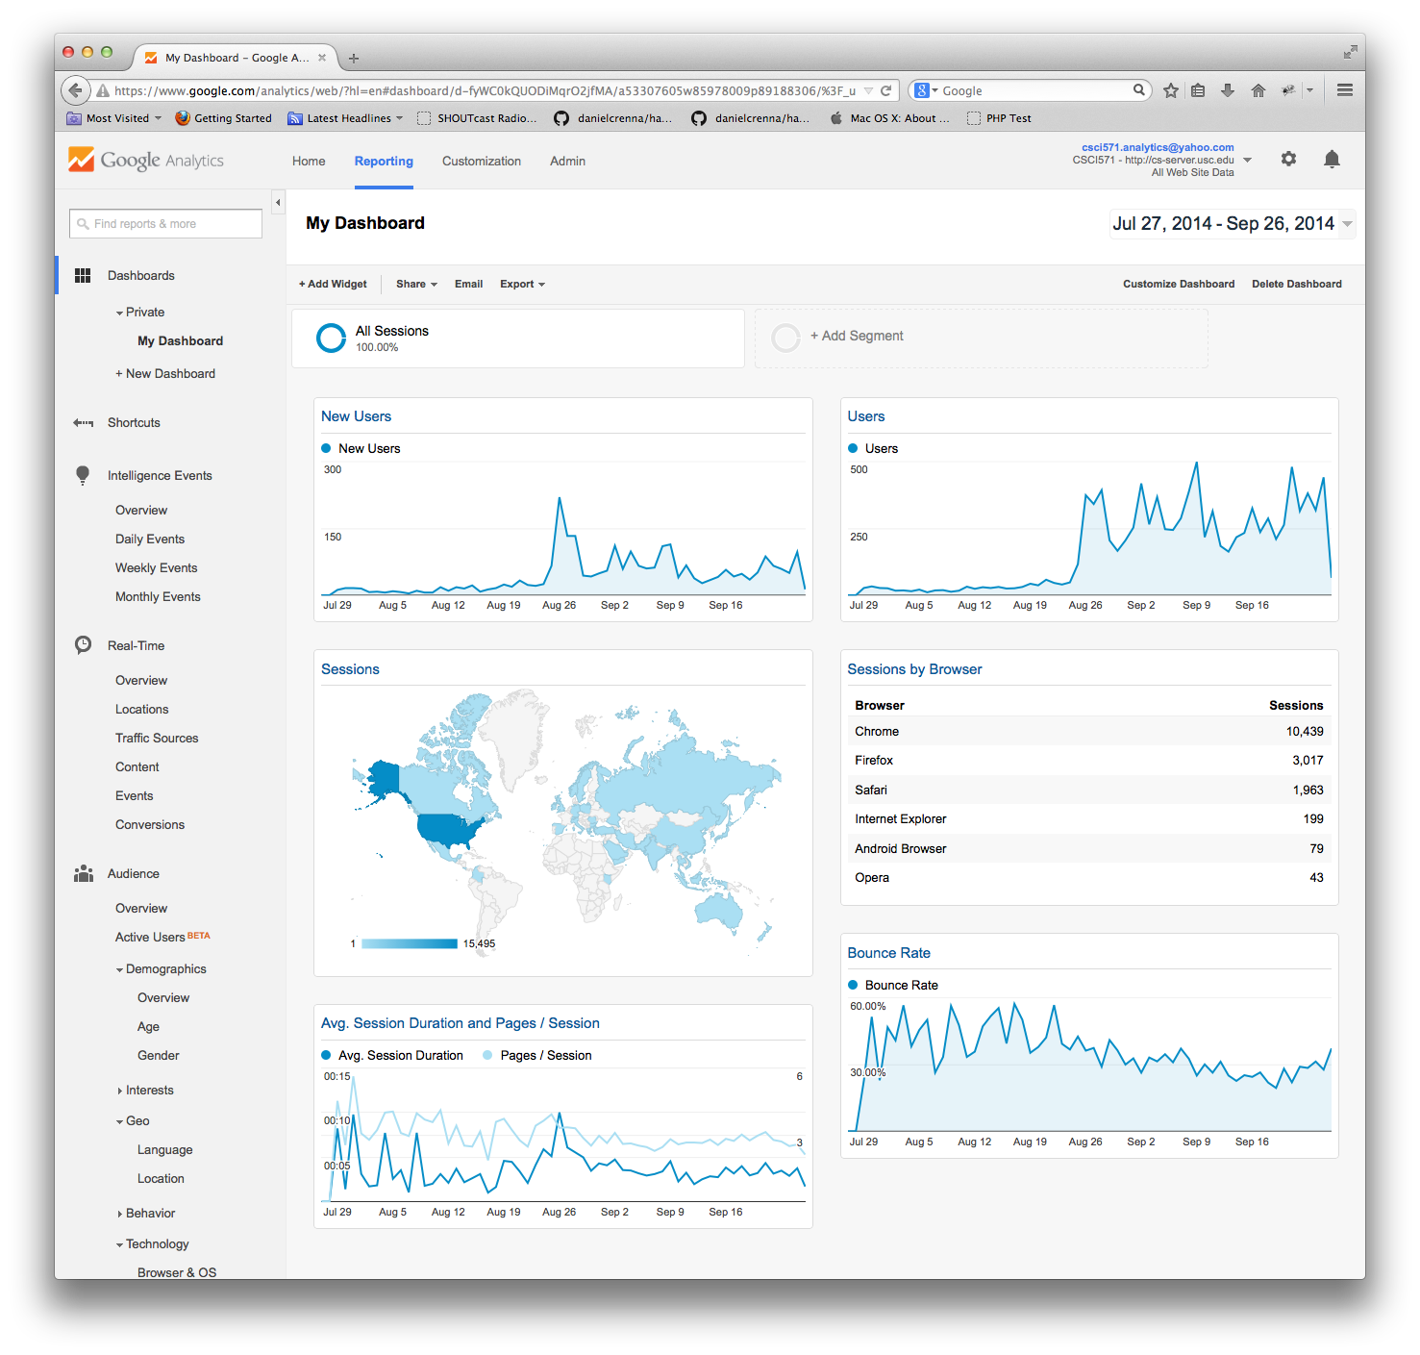
Google Analytics
Copyright © Ellis Horowitz 1998-2018

