Slide 1
Daftari
Keep your paper notebook. Take one photo.
Get your records, totals and who owes you money.
Team Daftari | Hacktoberfest Hack Day Kigali 2026 | Built with Gemma 4
Notes:
Hi, I'm Thierry. This is Daftari.

Slide 2
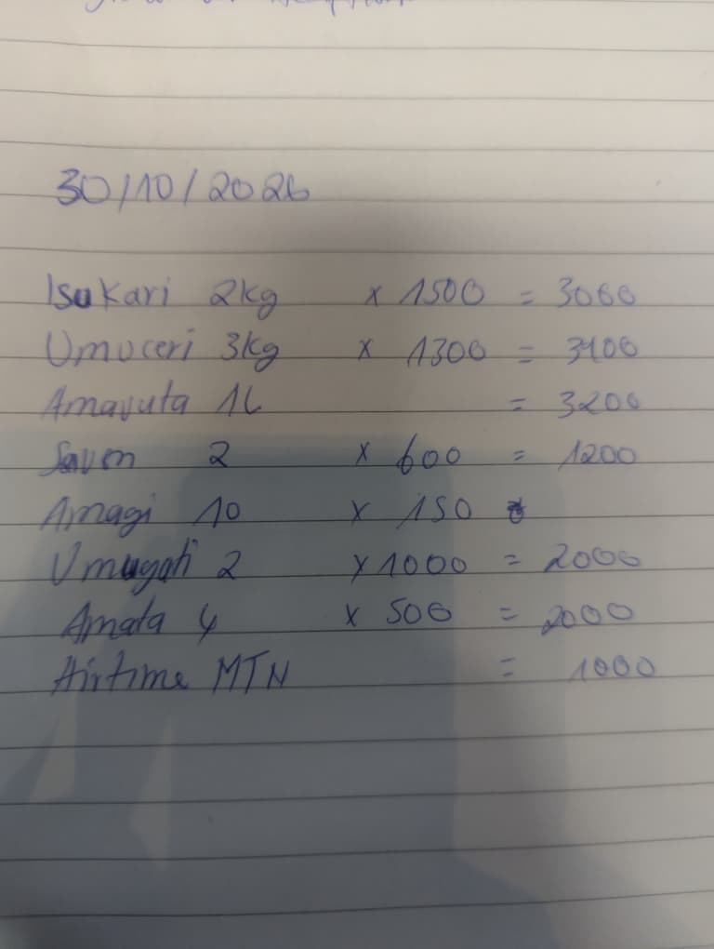
Every small shop already keeps a notebook
Hard to total
Owners rarely know their real daily or weekly revenue.
Easy to forget who owes
Credit sales sit on old pages and quietly become lost money.
No proof of income
Without clean records, a SACCO or microfinance loan is out of reach.
Apps don't stick
Typing every sale is too slow, so the notebook always wins.
Notes:
Walk into any boutique in Kigali and ask how much they sold this week. The owner opens a notebook like this one. Every sale and every debt is in there, but nobody can total it, search it or show it to a bank. Accounting apps exist, but typing every sale takes too long, so the notebook always wins.

Slide 3
Daftari doesn't fight the notebook
1
2
3
4
Write
Photograph
Check
Know
The owner keeps writing sales and debts in the notebook, in any language.
Once a day, one photo. Gemma 4 reads the handwriting into a table.
The owner fixes any row before saving. The AI drafts, the owner decides.
Cash sales, money owed, top items and answers in their own language.
Kinyarwanda, French and English handwriting, including terms like "ideni" (debt) and shorthand like "1.5k".
Notes:
Daftari doesn't fight the notebook. You keep writing. Once a day you take one photo.

Slide 4
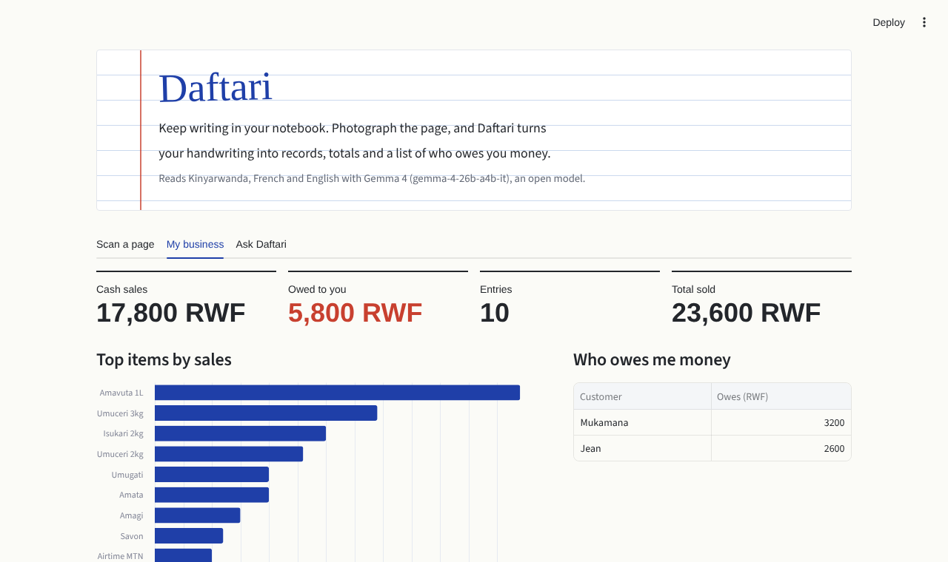
What the owner sees after scanning
48,900 RWF
cash sales over 3 days
10,900 RWF
owed to the shop
4,100 RWF
owed by Kalisa across two days
One page shown here. The live demo adds three days of pages.
Notes:
Live demo. Pages 1 and 2 are already saved. Upload page 3, click Read this page. Point out Riz: no total written, Daftari computed 6,500. Save. Open My business: 48,900 cash, 10,900 owed in red, Kalisa owes on two days. Ask tab: Combien j'ai vendu en 3 jours ?

Slide 5
One open model reads and reasons
Reads the page
Answers questions
Gemma 4 takes the notebook photo and returns structured rows: item, quantity, price, total, customer, paid or credit.
Gemma 4 answers only from the saved records, in the language the owner asks in.
Model: gemma-4-26b-a4b-it via the Gemini API
Stack: Python, Streamlit, pandas, Altair, Pillow, deployed on Render
Open: MIT licensed on GitHub. Open weights mean Daftari can run offline for shops with poor internet.
Notes:
Everything runs on Gemma 4 through the Gemini API, one open-weight model doing both vision and reasoning. The code is open source under MIT. Because Gemma is open weight, Daftari can run offline on a local device.

Slide 6
From notebook to first financial record
Next
WhatsApp channel: send a photo, get your summary back. Voice answers in Kinyarwanda.
Then
Saved records per shop, marking debts as repaid, monthly income reports.
Impact
Owners share verified income with SACCOs and microfinance lenders to access credit.
Business model: a small monthly fee for owners, or lenders paying for verified income data on small borrowers.
Notes:
Next comes WhatsApp, voice in Kinyarwanda, and monthly income reports owners can share with SACCOs and lenders. For millions of small businesses, this notebook becomes their first financial record.

Slide 7
Thank you
Team
Potiphar Gaye Vaye
Aime Serge Ukobizaba
Ahourdet Donambi Thierry
Ndatimana Jean de Dieu
Apongseh Iyan
Try it: daftari-zu84.onrender.com
Code: github.com/Elthiero/daftari
Hacktoberfest Hack Day Kigali 2026
Notes:
Thank you. Happy to take questions.

