Slide 1
DukaAI
Keep your paper notebook. Take one photo.
Get your records, totals and who owes you money.
Team DukaAI | Hacktoberfest Hack Day Kigali 2026 | Built with Gemma 4
Notes:
Hi, we're Team DukaAI. Duka means shop in Swahili: this is AI for the shop.

Slide 2
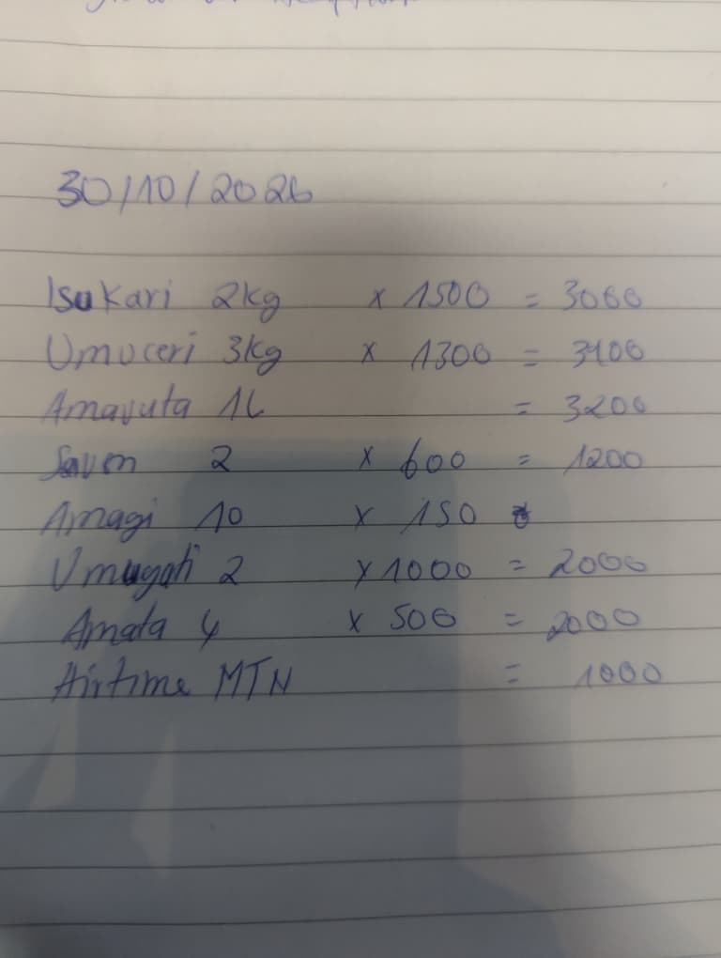
Every small shop already keeps a notebook
Hard to total
Owners rarely know their real daily or weekly revenue.
Easy to forget who owes
Credit sales sit on old pages and quietly become lost money.
No proof of income
Without clean records, a SACCO or microfinance loan is out of reach.
Apps don't stick
Typing every sale is too slow, so the notebook always wins.
Notes:
Walk into any boutique in Kigali and ask how much they sold this week. The owner opens a notebook like this one. Every sale and every debt is in there, but nobody can total it, search it or show it to a bank.

Slide 3
This is how most of Rwanda's economy runs
269,326
92.2%
business establishments counted in Rwanda
of enterprises are micro, with 1 to 3 workers
88%
53.7%
are informal: not tax registered and not keeping regular accounts
are in wholesale and retail trade, the shops DukaAI is built for
Sources: NISR Establishment Census 2023; NISR Integrated Business Enterprise Survey 2023
Notes:
This isn't a niche. NISR counted almost 270,000 establishments. 92% are micro businesses with 1 to 3 workers, 88% are informal, and more than half are in wholesale and retail: exactly the shops with a notebook on the counter.

Slide 4
No records means no access to finance
36.1%
of informal enterprises report difficulty accessing loans and credit
$331B
SME finance gap across Africa
51%
of formal MSMEs in Sub-Saharan Africa need more finance than they can get
Sources: NISR IBES 2023 (chart, 36.1%); IFC and SME Finance Forum (Africa gap, 51%)
Notes:
And informality has a cost. Informal shops barely use insurance or savings products compared with formal ones, and over a third of informal businesses report difficulty getting loans. Lenders need records. Across Africa the SME finance gap is estimated at 331 billion dollars.

Slide 5
DukaAI doesn't fight the notebook
1
2
3
4
Write
Photograph
Check
Know
The owner keeps writing sales and debts in the notebook, in any language.
Once a day, one photo. Gemma 4 reads the handwriting into a table.
The owner fixes any row before saving. The AI drafts, the owner decides.
Cash sales, money owed, top items and answers in their own language.
Reads Kinyarwanda, French and English handwriting, including terms like "ideni" (debt) and shorthand like "1.5k".
Notes:
DukaAI doesn't fight the notebook. You keep writing. Once a day you take one photo.

Slide 6
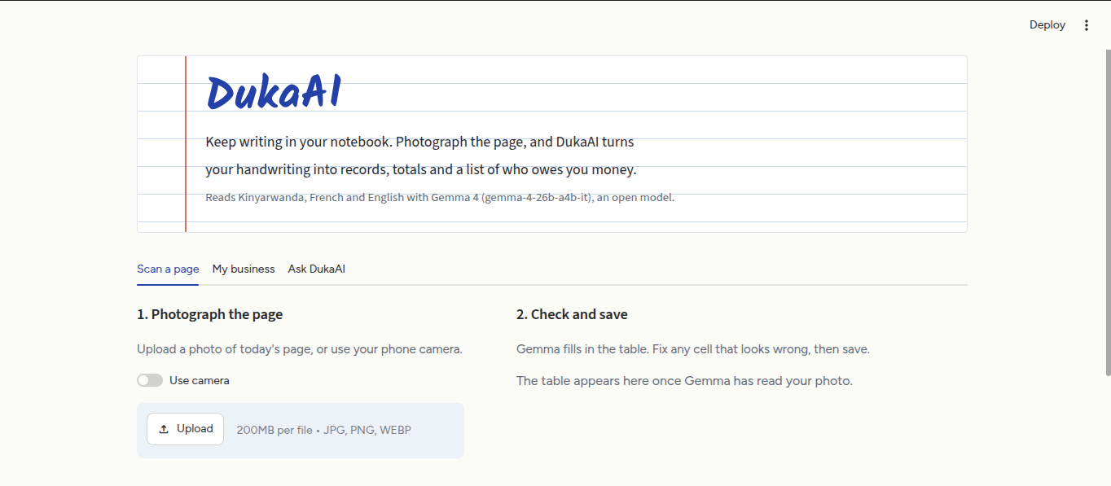
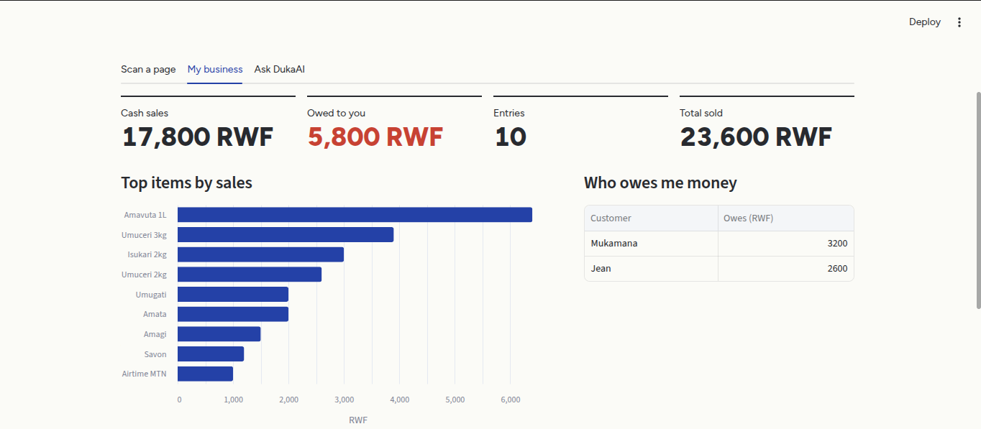
From photo to the owner's business, in seconds
1. Photograph the page
2. See the business
Upload or use the phone camera. Gemma 4 returns every line as a row the owner can check.
Cash sales, money owed in red, top items, and who owes what.
Live demo now: three days of notebook pages, read and totalled.
Notes:
Switch to the live app. Pages 1 and 2 already saved. Upload page 3, click Read this page. Riz has no total written: DukaAI computed 6,500. Save. My business: 48,900 cash, 10,900 owed in red, Kalisa owes on two days. Ask tab: Combien j'ai vendu en 3 jours ?

Slide 7
Why this works now
86%
No new habit
Owners keep the notebook. DukaAI adds value after the fact instead of asking them to type.
of Rwandan adults use mobile money, so a phone photo is already part of daily business.
Open models are now good enough
Gemma 4 reads mixed-language handwriting and answers questions from one lightweight, open-weight model.
Source: FinScope Rwanda 2024
Built for trust
Every row is reviewed by the owner, so the record is theirs and lenders can rely on it.
Notes:
Why now: mobile money is everywhere, so phones are already business tools. Open models like Gemma 4 can now read handwriting well enough. And because the owner reviews every row, the record is trustworthy.

Slide 8
One open model reads and reasons
Reads the page
Answers questions
Gemma 4 takes the notebook photo and returns structured rows: item, quantity, price, total, customer, paid or credit.
Gemma 4 answers only from the saved records, in the language the owner asks in.
Model: gemma-4-26b-a4b-it via the Gemini API
Stack: Python, Streamlit, pandas, Altair, Pillow, Docker, deployed on ThalesOps and Render
Speed: photos resized and auto-rotated, thinking off, results cached
Open: MIT licensed on GitHub. Open weights mean DukaAI can run offline for shops with poor internet.
Notes:
One open-weight model, Gemma 4, does both vision and reasoning. Code is open source under MIT. Open weights mean DukaAI can run offline on a local device.

Slide 9
Start with Rwanda's shops, then the region
144,671
Who pays
Shop owners: free to start, then a small monthly fee for history and reports
SACCOs and microfinance lenders: pay for owner-approved income reports on small borrowers
Distributors and wholesalers: credit insights on the shops they supply
wholesale and retail establishments in Rwanda: our first market
229,000+
informal enterprises with no regular accounts today
Sources: NISR Establishment Census 2023; NISR IBES 2023
Notes:
Our beachhead is Rwanda's 145,000 retail and wholesale establishments. Owners start free. Lenders and SACCOs pay for owner-approved income reports, because they need records to lend.

Slide 10
From notebook to first financial record
Next
WhatsApp channel: send a photo, get your summary back. Voice answers in Kinyarwanda.
Then
Saved records per shop, marking debts as repaid, monthly income reports.
Impact
Owners share verified income with SACCOs and microfinance lenders to access credit.
Measured by: shops active weekly, debts recovered, and owners who access a first loan with DukaAI records.
Notes:
Next comes WhatsApp and voice in Kinyarwanda, then income reports owners can share with lenders. For many small businesses, this notebook becomes their first financial record.

Slide 11
Thank you
Team
Potiphar Gaye Vaye
Aime Serge Ukobizaba
Ahourdet Donambi Thierry
Ndatimana Jean de Dieu
Apongseh Iyan
Try it: dukaai.apps.thalesops.com
Mirror: daftari-zu84.onrender.com
Code: github.com/Elthiero/daftari
Hacktoberfest Hack Day Kigali 2026
Notes:
Thank you. Happy to take questions.

Slide 12
Sources
NISR, Establishment Census 2023 (published 2025)
269,326 establishments; 92.2% of enterprises micro (1 to 3 workers); 88.1% informal; 53.7% (144,671) in wholesale and retail trade.
NISR, Integrated Business Enterprise Survey 2023 (published 2025)
88% of 260,780 enterprises informal; financial product use, formal vs informal; 36.1% of informal enterprises report difficulty accessing loans and credit.
Access to Finance Rwanda, FinScope Rwanda 2024
86% of Rwandans use mobile money.
IFC and SME Finance Forum
USD 331 billion SME finance gap in Africa; 51% of formal MSMEs in Sub-Saharan Africa need more finance than they can access.
Click a source name to open it.
Notes:
Appendix: sources for every figure in the deck. Show only if asked.

