Slide 1
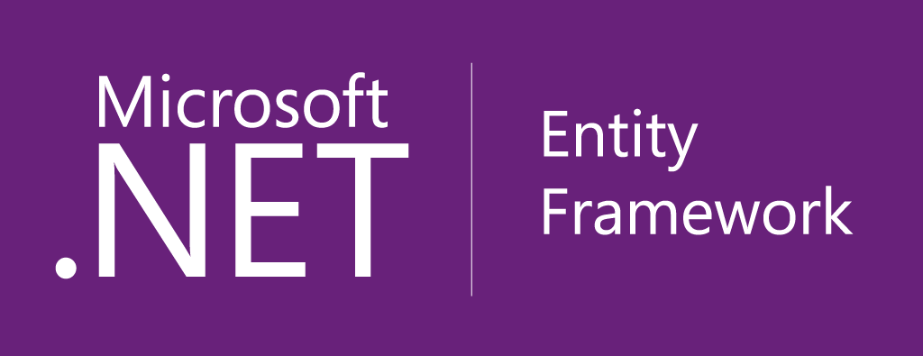
Entity Framework 6
<Your Name>
<Position>
<Company>

Slide 2
Agenda
Developer workflows
Out of band
Open source
What’s new in EF6
Demos
What are we working on now

Slide 3
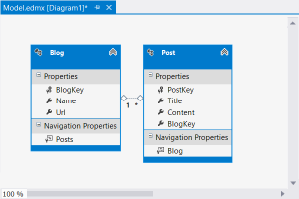
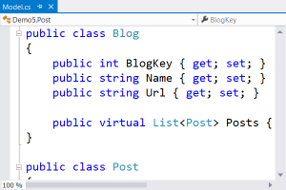
Developer workflows
Designer Centric
Code Centric
New Database
Model First
Create model in EF Designer
Generate database from model
Classes auto-generated from model
Code First
Define classes and mapping in code
Database created from code
Migrations apply model changes to database
Existing Database
Database First
Reverse engineer model in EF Designer
Classes auto-generated from model
Code First
Define classes and mapping in code
EF Power Tools provide reverse engineer

Slide 4
Out of band | Release history
Entity Framework 6.1
Entity Framework 6.0.2
Runtime out-of-band (NuGet)
Tooling out-of-band (Microsoft Download Center)
Latest version “chained in” to new Visual Studio releases
Entity Framework 6.0.1
Entity Framework 6
Entity Framework 5
Runtime
Core components in .NET
DbContext API & Code First out-of-band (NuGet)
Latest version “chained in” to new Visual Studio releases
Tooling in Visual Studio
Entity Framework 4.3
Entity Framework 4.2
Entity Framework 4.1
Entity Framework 4
Runtime in .NET Framework
Tooling in Visual Studio
Entity Framework 3.5 SP1

Slide 5
Out of band | Upgrading to EF6
Types copied from .NET are in new namespaces
DbContext API = no/minimal changes required
ObjectContext API = namespace changes
Detailed guidance at msdn.com/data/UpgradeEF6
Providers/tooling need to recompile
We provide SQL Server & SQL Compact
Working with 3rd party providers
Some providers already support EF6 previews (incl. Devart Oracle, SQLite, Firebird)

Slide 6
Open Source
EntityFramework.codeplex.com
Not just the code
Source code
Nightly builds
Issue tracking
Feature specs
Design meeting notes

Slide 7
Open Source
Accepting contributions
Only EF team has commit rights
Same code review process as internal changes
EF6 had 25 pull requests, 21 accepted
8 contributors
Only affects how we develop, not how we ship
Same license
Same support
Same quality

Slide 8
What’s new in EF6?
Code First & EF Designer
Asynchronous query and save
Connection resiliency
Code-based configuration
Database command interception/logging
Code First Only
Custom conventions
Insert, update, & delete stored procedures

Slide 9
What else is new in EF6?
From the EF team
Nested entity types
Improved transaction Support
Multiple contexts per database
DbModelBuilder.HasDefaultSchema
Configurable migrations history table
Creating context with an open connection
Enums, spatial and better performance on .NET 4.0
Default transaction isolation level changed to READ_COMMITTED_SNAPSHOT
From our contributors
Custom migrations operations
Improved warm up time for large models
Pluggable pluralization & singularization service
DbModelBuilder.Configurations.AddFromAssembly
DbSet.AddRange/RemoveRange

Slide 10
Demos
EF6 in action

Slide 11
Custom Code First conventions
What is it?
Bulk configuration for multiple entities/properties
Why did we build it?
Avoid repetitive, error prone configuration
When should you use it?
Patterns in your model don’t match Code First conventions (e.g. primary key naming)
You don’t like the default conventions (e.g. column naming, data types, etc.)

Slide 12
Database command logging
What is it?
Log of every command/query sent to database
Why did we build it?
Easy way to see what’s happening ‘under the hood’
When should you use it?
Understanding and learning Entity Framework
Debugging unexpected behavior/results
Troubleshooting performance issues

Slide 13
Code First stored procedure mapping
What is it?
Configuring stored procedures for insert, update & delete
Why did we build it?
Many enterprises require the use of stored procedures
When should you use it?
Mapping to existing database that uses stored procedures
Business mandates the use of stored procedures
Need to run additional save logic best performed within database
EF can’t map to your database schema

Slide 14
Async query & save
What is it?
Task based async pattern for query and save
Why did we build it?
Appropriate use of async can improve performance and scalability
When should you use it?
Reduce server resource usage by freeing up blocked threads
Improve client UI responsiveness by not blocking main thread
Parallelism – but not on the same context instance

Slide 15
Code-based configuration
What is it?
Code centric alternative to <entityFramework> section in web/app.config
Why did we build it?
Code is easier and more discoverable than xml
When should you use it?
Any time you want to change configuration (e.g. database providers)
Using an IoC container to control configuration

Slide 16
Code-based configuration
DbConfiguration
Simple, discoverable methods to perform configuration
Automatically discovered within same assembly as your context
Dependency Resolver
Exposed from DbConfiguration
Flexible but more complex than simple DbConfiguration methods
Web/App.config wins over code-based config

Slide 17
Resources
Documentation – http://msdn.com/data/ef
Team blog – http://msdn.com/blogs/adonet
Project – http://EntityFramework.codeplex.com
Twitter – @efmagicunicorns
Facebook – http://facebook.com/efmagicunicorns
Demo source code - https://github.com/rowanmiller/Demo-EF6Simple

