Slide 1
Advanced Software Development for Autonomous Mobile Robots
FINAL PROJECT
Team : PHOENIX
Team Members :
Elton Wilroy Braggs
Rishabh Rana 32977

Slide 2
Introduction
Reaching given goal points in arena and collecting reward points, avoiding obstacles in the path.
Given four robots competing same time, our robot need to avoid also the collision with other robots and reaching early to goal points.

Slide 3
How robot will choose next goal
Goal points list is sorted on the basis of distance between goal and robot.
Robot will move towards nearest Goal and collect reward.
Topics to which we subscribed:
‘/goals’ – to get the goals
‘amcl_pose’ – to localize tutrtlebot in given map.
[geometry_msgs/PoseWithCovarianceStamped]

Slide 4
move_base package
In this project, we used an action client that communicates with action server /move_base that uses a message MoveBaseAction.
{client = actionlib.SimpleActionClient("move_base", MoveBaseAction)}
It provides an implementation of an action that, given a goal in the world, will attempt to reach it with a mobile base. T
he move_base node links together a global and local planner to accomplish its global navigation task.

Slide 5
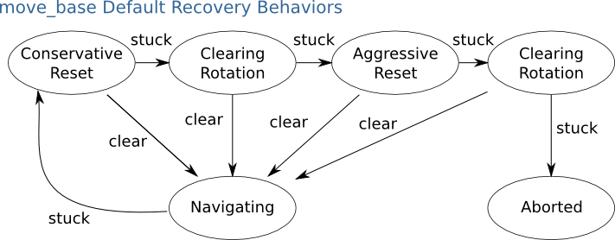
Move_base default Recovery Behaviors
Published Topic : cmd_vel (geometry_msgs/Twist)

