Slide 1

:Foo
:Foo
xyz()
xyz()
:Foo
:Bar
:Foo
:Bar
abc()
abc()
def()
def()

Slide 2
xyz()
xyz()
a
a
:Bar
:Foo
abc()
def()
:Foo
:Foo
:Foo
:Bar
abc()
def()
Foo
Foo

Slide 3
:Foo
:Bar
:Foo
:Bar
abc()
abc()
def()
def()
yes
good
is good?
no
not good

Slide 4
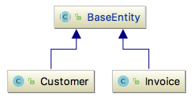
Non-UML diagrams
Non-standard notations
Too much details
Dealing with built-in objects such as ArrayLists, Strings
Repetitive diagrams
Use of aggregation
Formatting errors e.g., tables
Image size

