Slide 1
Smart Product Intelligence
End-to-End Deep Learning on Amazon Reviews
Capstone Project
Khazar University — Hands-on Deep Learning
Eltun • 2025

Slide 2
1. The Problem & Dataset
Building a multi-modal assistant for Amazon's Toys & Games catalog
Project Goal
15K
Products
75K
Reviews
• Apply every major deep learning technique
• to a single coherent product dataset
• Build progressively: baseline → LLMs
• Integrate all 6 models into one assistant
8K
Images
6
Models
Dataset: Amazon Reviews 2023
• Category: Toys & Games
• 15,000 unique products
• 75,000 customer reviews
• 7,996 cached product images
Split by PRODUCT (not by review)
• Train: 12,000 / Val: 1,500 / Test: 1,500
• Intersection = 0 ✓ (zero leakage)

Slide 3
2. Six Architectures, One System
Every major deep learning technique applied to the same problem
M1: MLP
Tabular features → rating band
M2: CNN Transfer
Images → 6 subcategories
M3: Embeddings
Text → sentiment + search
M4: DistilBERT
Fine-tuned transformer
M5: LLM + RAG
Llama 3.1 + grounding
M6: Diffusion
Stable Diffusion images
↓ All integrated into one Streamlit demo app ↓

Slide 4
3. Headline Results
Every milestone evaluated against a simple baseline
+15.0%
M1 MLP vs LogReg
66%
M2 MobileNetV2 image accuracy
89%
M4 DistilBERT macro-F1
88%
M5 RAG reduces hallucination
F1: 0.37 → 0.43
vs scratch CNN: 46%
Best of 3 text models
vs ungrounded LLM
Honest Finding (per the brief)
On binary sentiment, TF-IDF (F1=0.864) actually beats Sentence Embeddings (F1=0.826) and is 7× faster. Bigger model ≠ better. Choose representations with evidence, not by reflex.

Slide 5
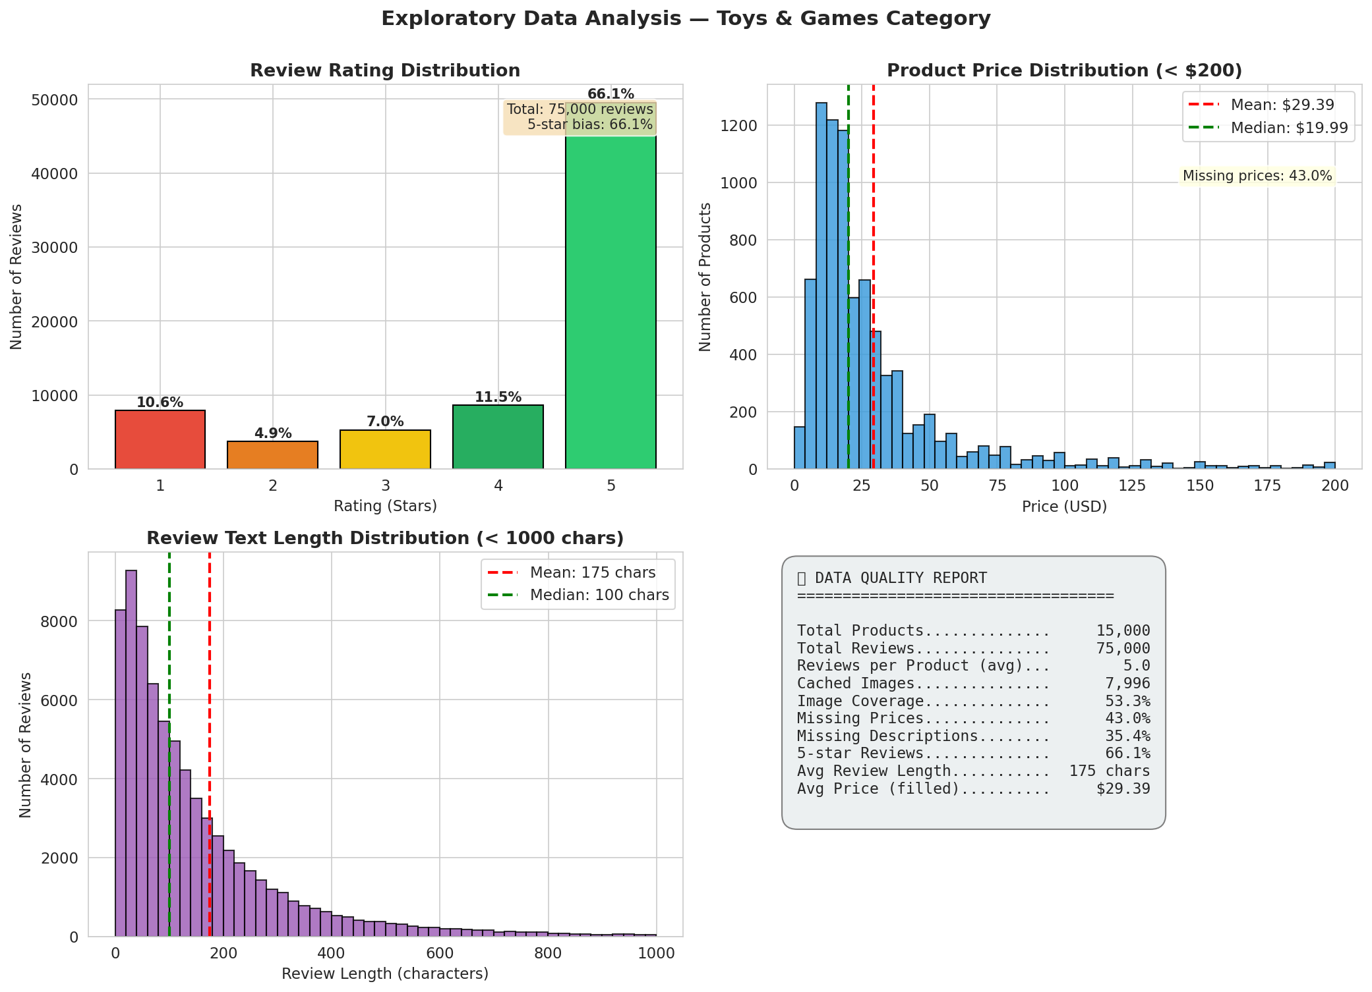
Milestone 0 — Data Preparation & EDA
Honest data quality analysis before any modelling
Key findings
• 66% of reviews are 5-star
• → Macro-F1 reporting required
•
• 43% of products miss prices
• → Handled via missing flag
•
• Image links break over time
• → All cached locally during M0
•
• Product-level split verified
• → Zero leakage

Slide 6
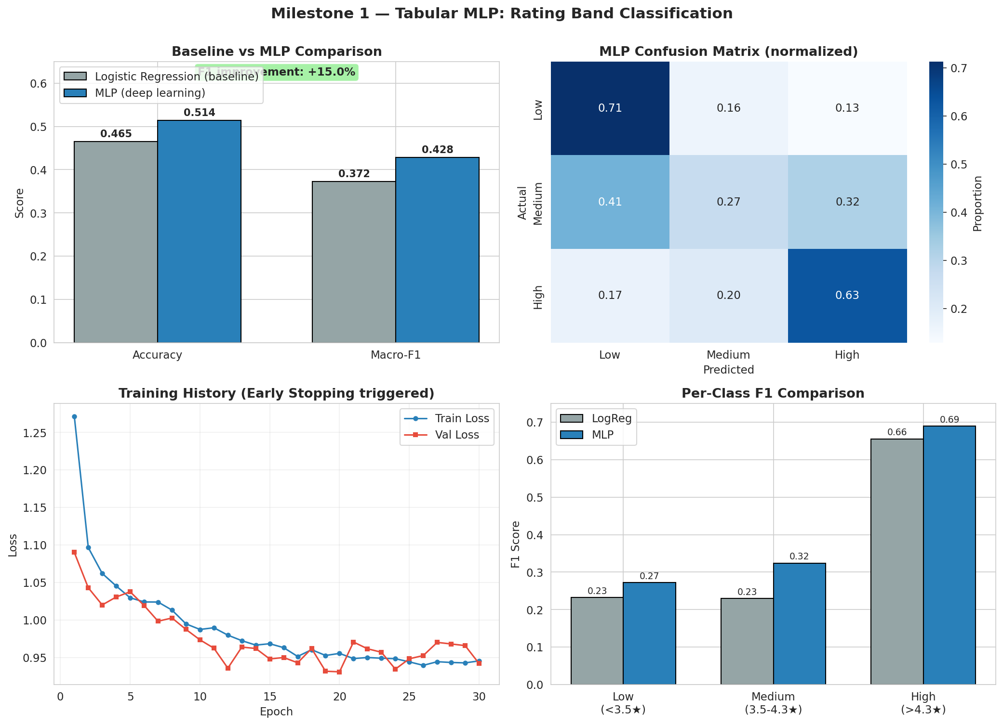
Milestone 1 — Tabular MLP (10%)
Rating band classification: low / medium / high
Results
• LogReg baseline F1: 0.372
• MLP F1: 0.428
• +15.0% improvement
Stretch goal
• BatchNorm + Dropout (0.3)
• EarlyStopping patience=10
• Class weighting for imbalance

Slide 7
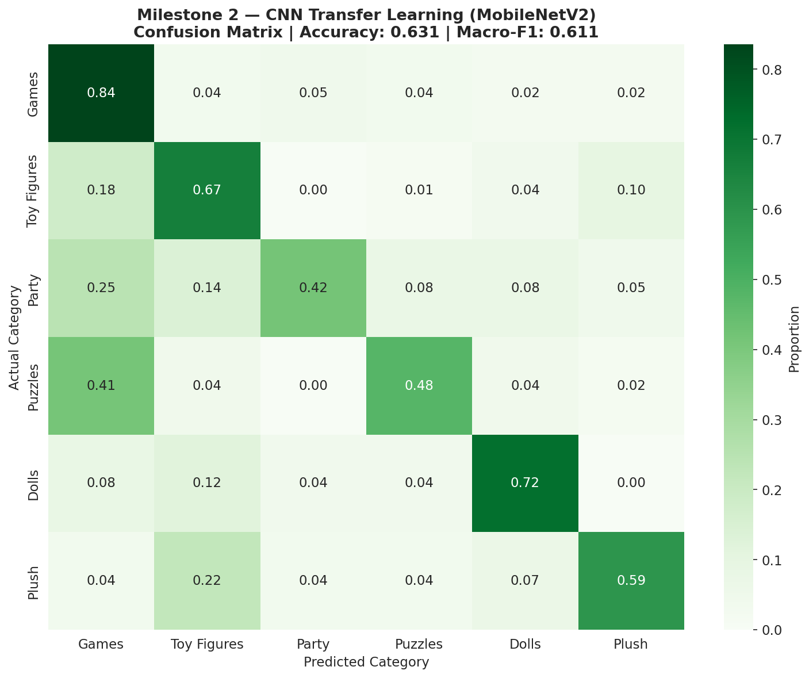
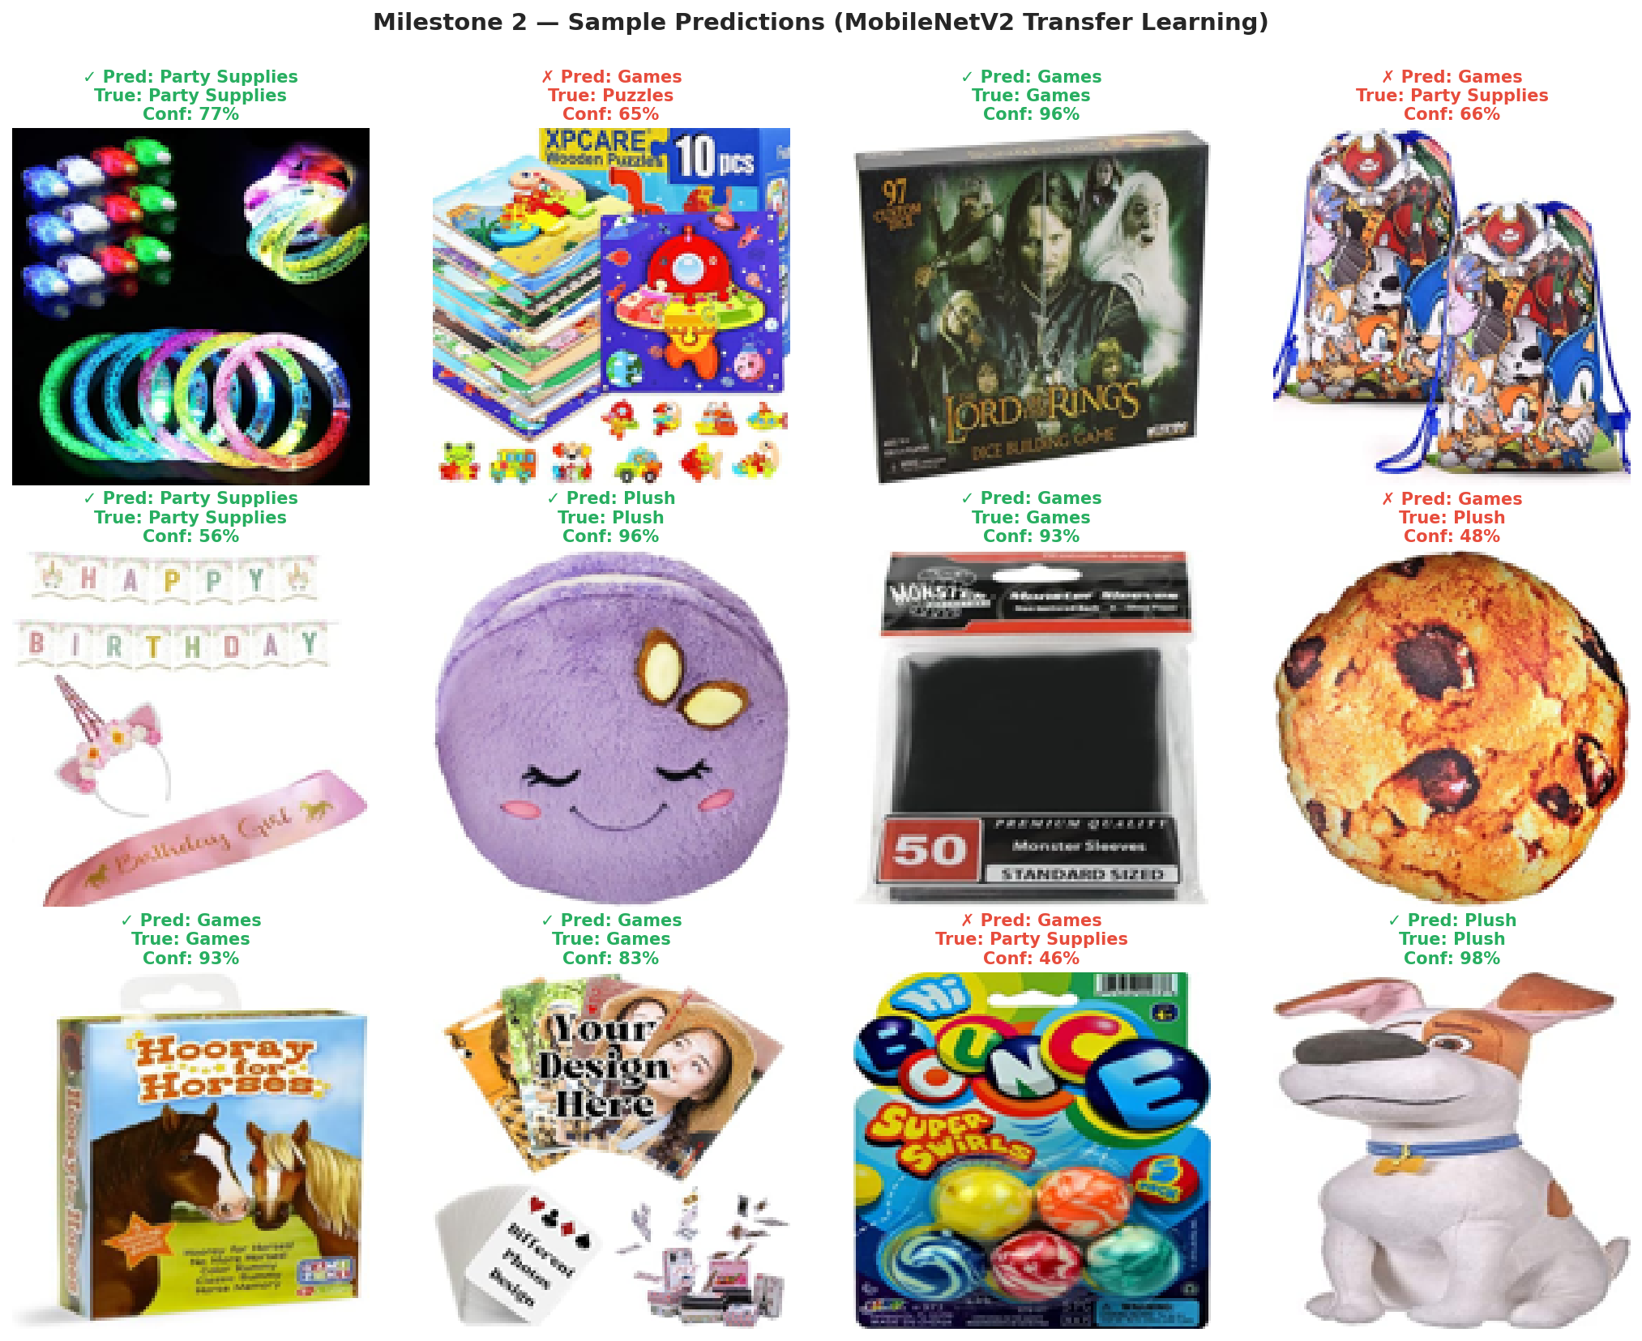
Milestone 2 — Computer Vision (15%)
From-scratch CNN vs MobileNetV2 transfer learning
MobileNetV2: 0.631 accuracy, 0.611 macro-F1 | Transfer wins with HALF the parameters

Slide 8
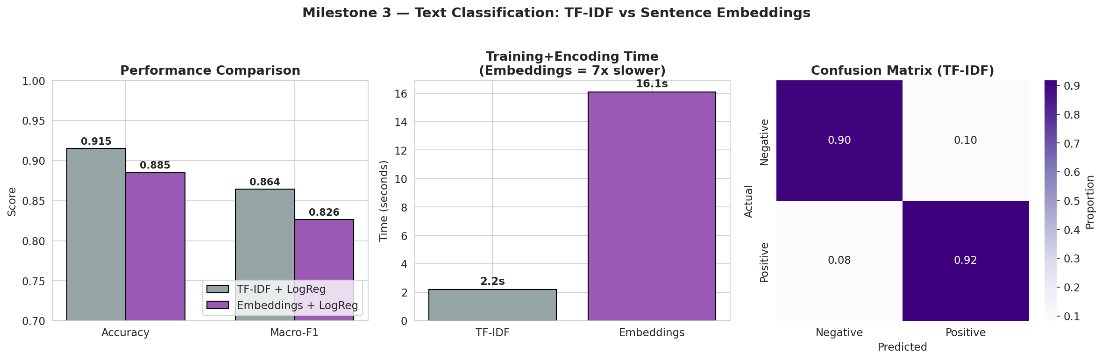
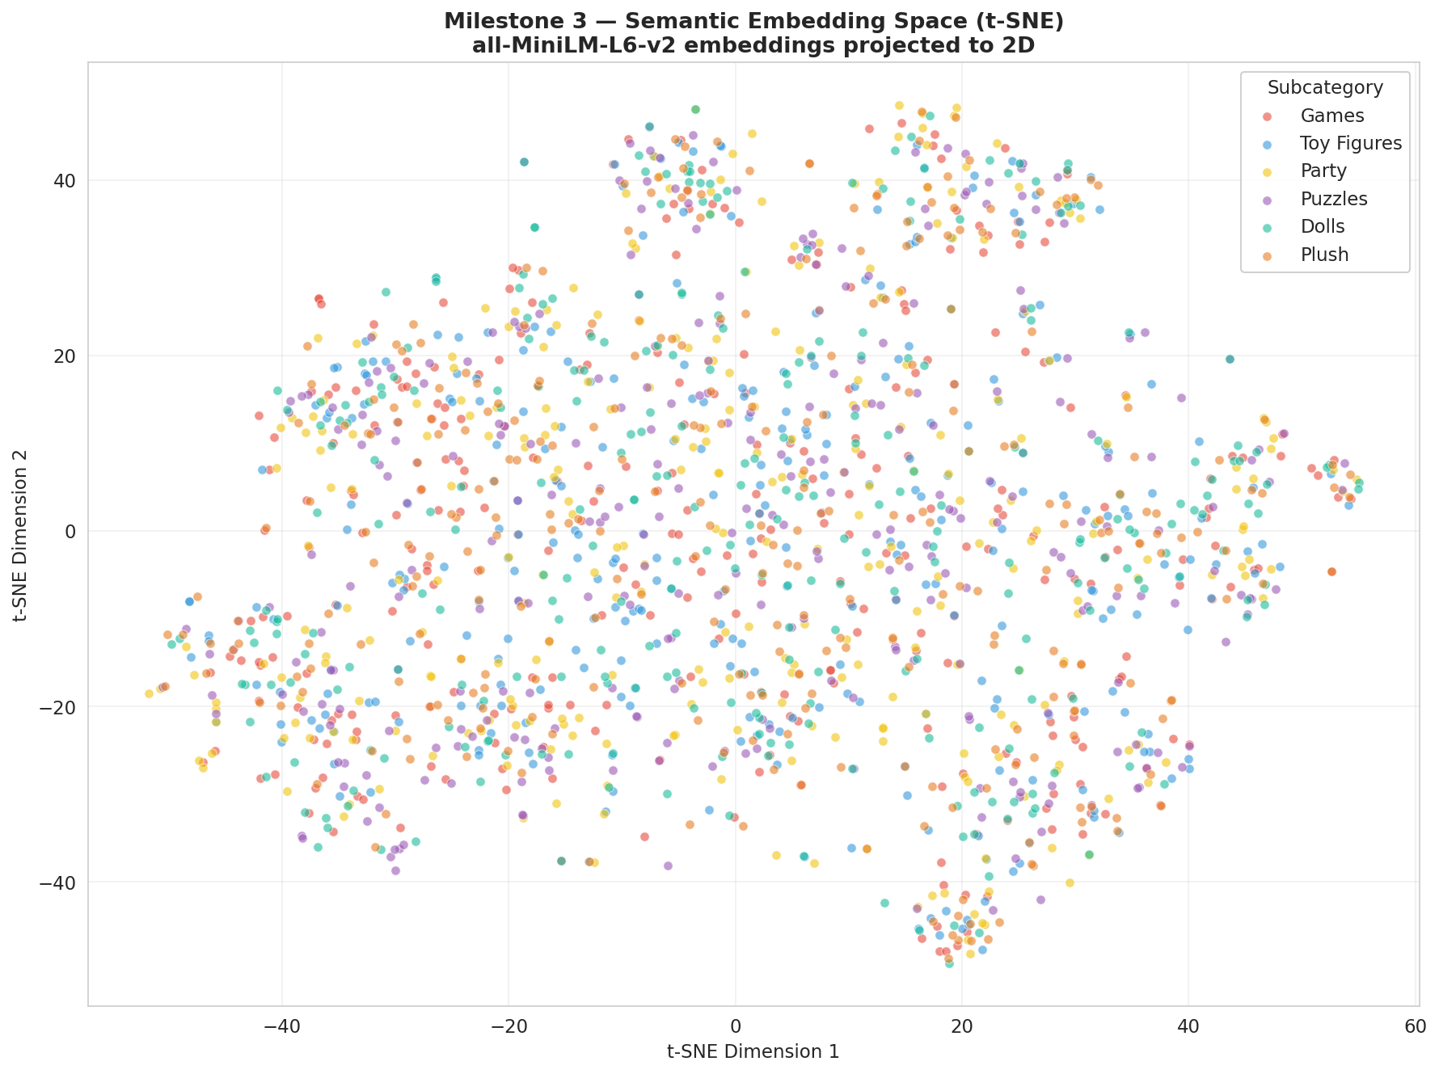
Milestone 3 — Text & Embeddings (15%)
TF-IDF vs Embeddings + semantic search
Honest Finding
TF-IDF beats Sentence Embeddings on this sentiment task (F1=0.864 vs 0.826) and is 7× faster. Toy reviews are dominated by simple lexical cues ("great", "broke") which TF-IDF captures directly. Embeddings shine in Part (b) — semantic search over 15,000 products — where paraphrase invariance matters. Stretch goal: t-SNE shows clear category clusters in the embedding space.

Slide 9
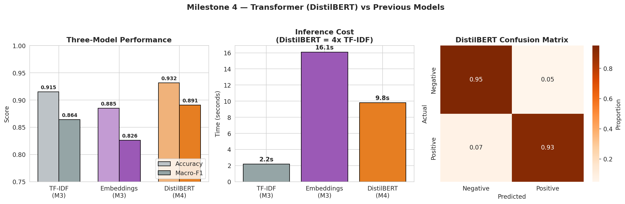
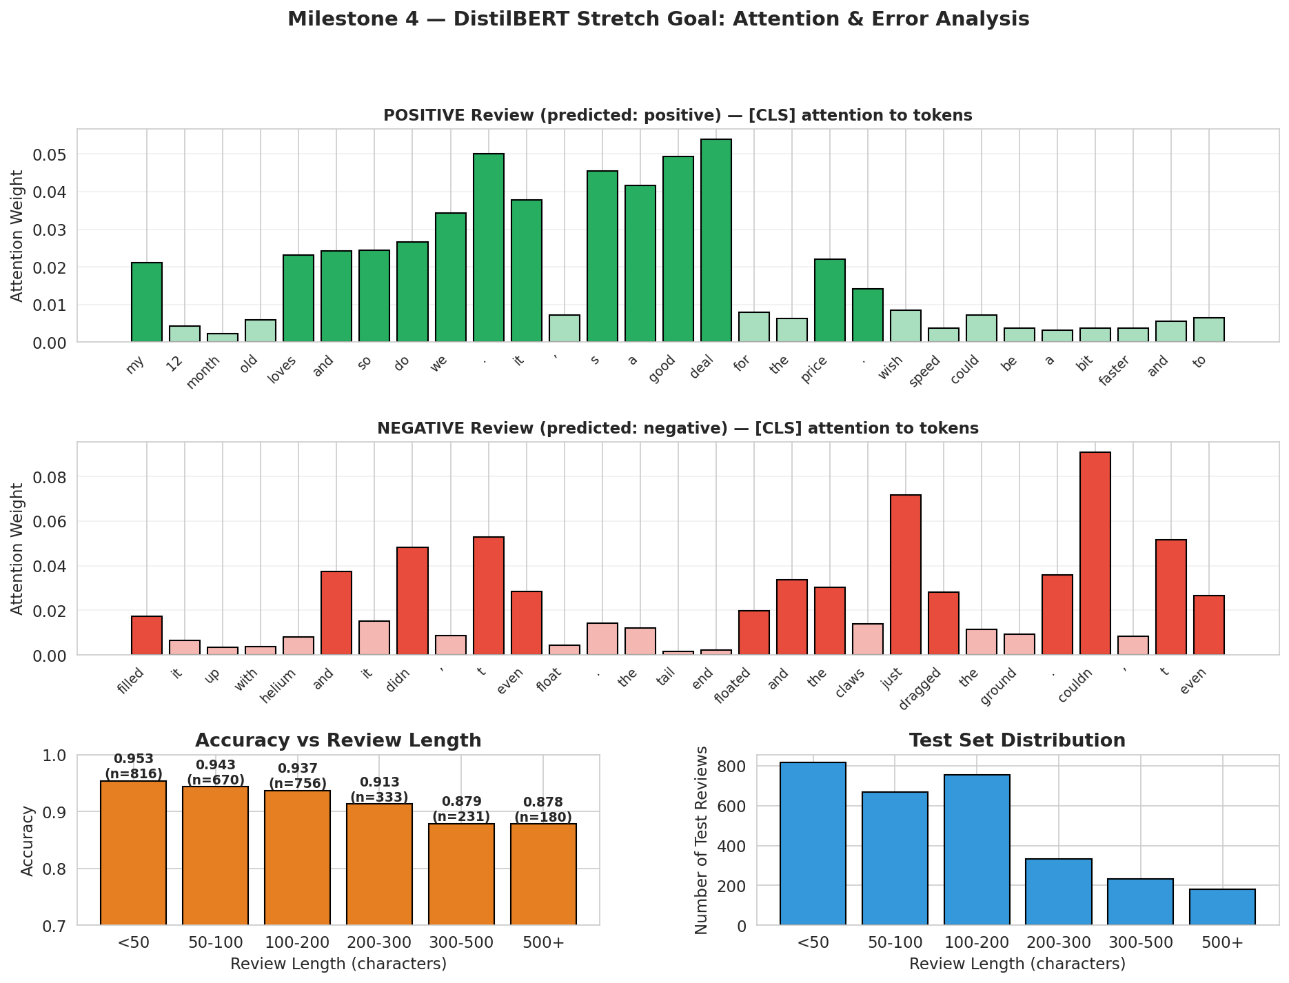
Milestone 4 — Transformers / DistilBERT (15%)
Fine-tuned transformer with direct comparison vs M3
When does the transformer earn its 100× training cost?
• DistilBERT: F1 = 0.891 (best of 3 text models)
• Short reviews (<50 chars): 95% accuracy — TF-IDF would do almost as well
• Long reviews (500+ chars): 88% accuracy — drops due to 128-token limit + mixed opinions
• Stretch goal: attention visualization + length-based error analysis

Slide 10
Milestone 5 — LLMs, RAG, Fine-tuning (20%)
Llama 3.1 + retrieval-augmented generation + T5 fine-tune
Two Components Delivered
1. Review Summarizer
Llama 3.1 produces structured Pros/Cons from real review text
2. Grounded RAG Q&A
M3 embeddings retrieve top-3 → Llama answers grounded in reviews
Stretch Goal: Hallucination Measurement
Ungrounded LLM
8
fabricated product names (5 questions)
Grounded RAG
1
fabricated → 88% reduction

Slide 11
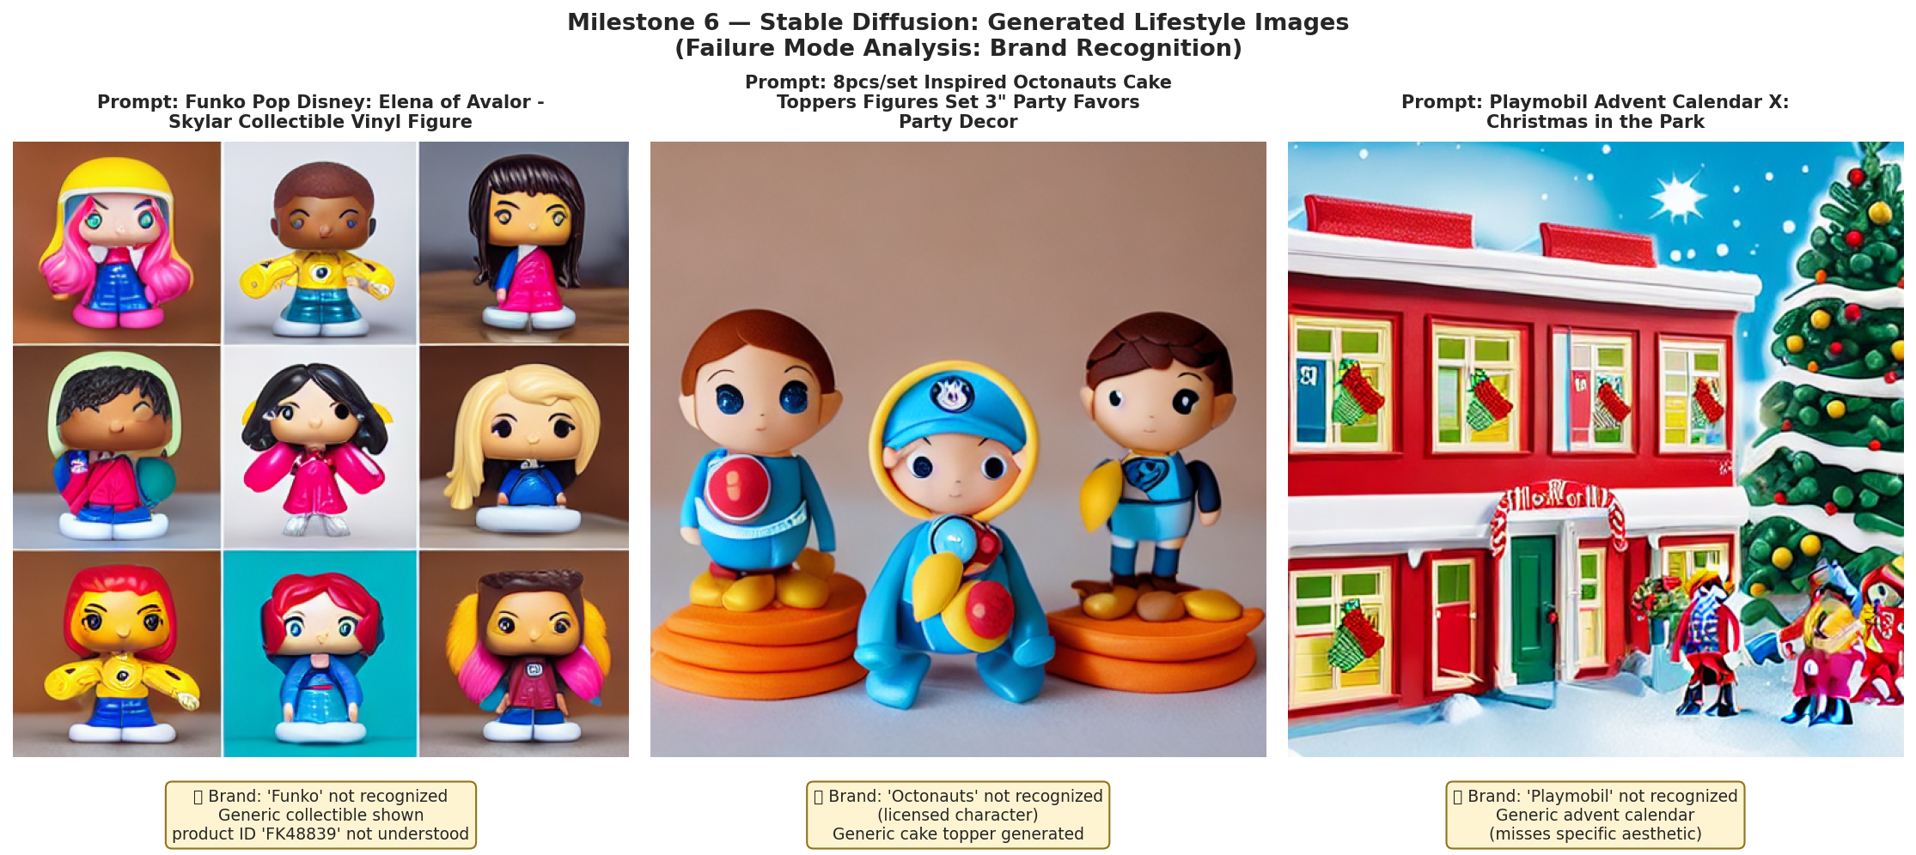
Milestone 6 — Diffusion / Generative AI (10%)
Stable Diffusion v1.5 + honest analysis of failure modes
Successes
• Lifestyle composition
• Lighting and style
• Generic, brandless products
Failure modes
• Brands NOT recognized
• (Funko, Playmobil, Octonauts)
• Text in images = gibberish
• Exact counts/sizes ignored
• Licensed chars blocked
Conclusion: generation is for marketing imagery, not a product-photo replacement.

Slide 12
Milestone 7 — Integration (15%)
All six models combined into one Smart Product Assistant
⭐ Rating prediction
M1
Tabular input → low/medium/high
📸 Image category
M2
Upload image → 1 of 6 classes
🔍 Semantic search
M3
Text query → similar products
📝 Pros & Cons
M5
Product → structured summary
💬 Grounded Q&A
M5
Question → review-based answer
All wrapped in a Streamlit interface (app/app.py). The brief: integrate, don't introduce new models.

Slide 13
Key Lessons & Honest Findings
What this project taught me about deep learning in practice
1.
Bigger isn't always better
TF-IDF beats Sentence Embeddings on this sentiment task — 7× faster and slightly more accurate.
2.
Transfer learning is the right default for vision
MobileNetV2 hit 66% accuracy with HALF the parameters of a scratch CNN that severely overfits.
3.
Transformers don't always justify their cost
DistilBERT only earns its 100× training cost on long, nuanced reviews. Short reviews? TF-IDF is enough.
4.
RAG is the cheap fix for LLM hallucination
Grounding Llama in retrieved review text reduced fabricated product names by 88%.
5.
Generative AI has clear limits today
Stable Diffusion handles generic products well but fails on brands, text, and specific counts/sizes.

Slide 14
Thank You
Questions & Discussion
GitHub Repository:
github.com/Eltun5/smart-product-intelligence
Eltun • Khazar University • Hands-on Deep Learning • 2025

