Slide 1
Ch 10. Decision Tree
Notes:
1

Slide 2
Feature Types
Numerical data (数值数据)
e.g. {1.2, 4.5, 3.3}
Distance metric can be calculated between patterns
Method of pattern classification based on metric
Nominal data (标称数据)
e.g. {red，gloss，sweet，small}
There is no concept of distance between patterns
Non-metric method

Slide 3
Decision Tree
What is a decision tree?
Decision tree is a tree structure similar to flow chart. Each internal node represents a test(query), each branch of the node represents a result of the test, and each leaf node represents a category.
Composition of a decision tree
Root (根节点)
Branch (分支)
Leaf node (叶节点)

Slide 4
Decision Tree

Slide 5
Decision Tree
Classification process of a decision tree
Question the value of a certain attribute from the root
Color?
Different branches connected to the root correspond to different values of this attribute
green; yellow; red;
According to different answers, turn to the corresponding branch
green
Make the same branch decision at the new node
Size? – big.
This process continues until reaching a leaf node, then outputs the leaf node’s category tag
Watermelon

Slide 6
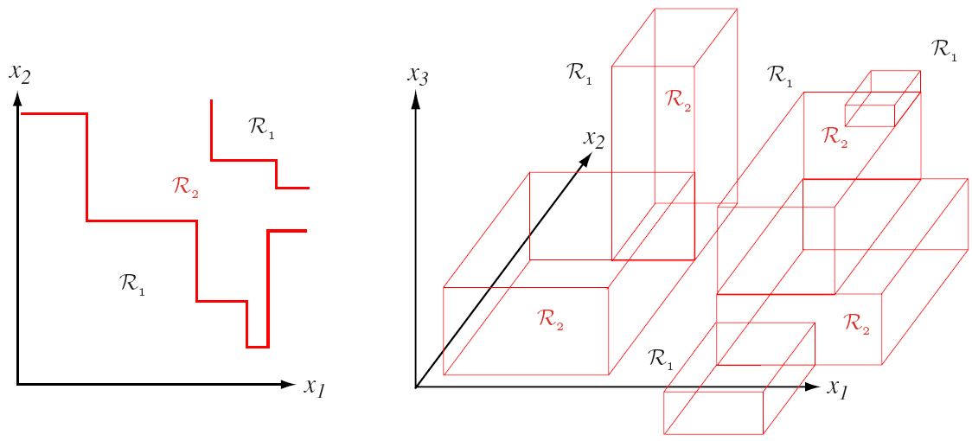
Decision Tree
decision surface of a decision tree

Slide 7
Decision Tree
Advantages of a decision tree:
Semantic representability
Express from the root to the leaf node as a conjunction
（color=yellow）AND（shape=slender） banana
Obtain a clear description of a class by using conjunction and disjunction
apple=（green AND medium-size）OR（red AND medium-size）
Fast classification
A series of simple queries can be used to determine the categories of patterns
The prior knowledge of experts can be embedded naturally

Slide 8
Decision Tree Learning Algorithm
Research history of decision tree:
The first decision tree algorithm is called as CLS (Concept Learning System) [E. B. Hunt, J. Marin, and P. T. Stone’s book “Experiments in Induction”published by Academic Press in 1966]
ID3 triggered the upsurge of decision tree research [J. R. Quinlan’s paper in a book “Expert Systems in the Micro Electronic Age” edited by D. Michie, published by Edinburgh University Press in 1979]
C4.5 is the most popular decision tree algorithm [J. R. Quinlan’s book “C4.5: Programs for Machine Learning” published by Morgan Kaufmann in 1993]

Slide 9
Decision Tree Learning Algorithm
Research history of decision tree:
CART (Classification and Regression Tree) is the general decision tree algorithm [L. Breiman, J. H. Friedman, R. A. Olshen, and C. J. Stone’s book “Classification and Regression Trees” published by Wadsworth in 1984]
Ensemble learning algorithm based on decision tree：Random Forests [L. Breiman’s MLJ’01 paper “Random Forests”]

Slide 10
Construct A Decision Tree
Basic process
From top to bottom, divide-and-conquer (分而治之), recursive growth
Initially, all samples are at the root
All attributes are nominal(in case of continuous numerical type, discretization is required)
All samples are divided recursively according to each selected attribute
The selected attribute is called a split or test or query
Query selection is based on heuristic or statistical characteristics

Slide 11
Construct A Decision Tree
Basic process
If one of the following conditions is met, the partition operation stops
All samples falling into the same node belong to the same category
This node becomes a leaf node, labeled this category
No feature can be further used to partition the sample set
This node becomes a leaf node, and its category label is the category which most samples falling into
No samples fall into a node
This node becomes a leaf node, and its category label is the category of most samples falling into the parent node

Slide 12
CART
Classification And Regression Tree, CART(分类和回归树)
CART is a general tree growth algorithm framework, which involves the following problems:
Is the value of the property binary or multivalued? How many branches can a node have?
How to determine which attribute should be tested at a node?
When to make a node as a leaf node?
If the tree grows too large, how to make it smaller and simpler, that is, how to cut branches?
If not all the samples falling into a leaf node belong to the same category, how to assign a class tag to the leaf node?

Slide 13
Number of branches
The number of branches that are divided out of the same node is referred to as the branching ratio（分支率）
Any decision tree can be represented by a decision tree with a branch factor of 2 ( binary tree)
Binary tree is the most common form of decision tree

Slide 14
Number of branches

Slide 15
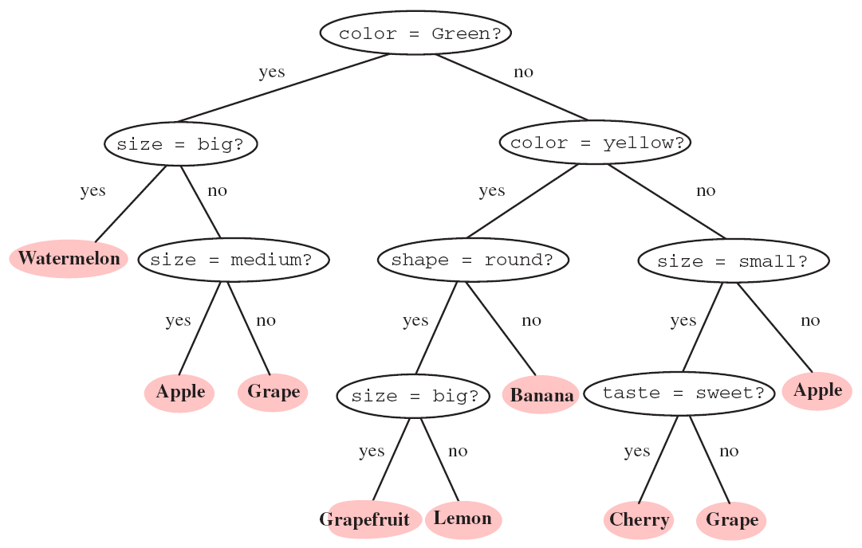
Number of branches

Slide 16
Selection of tests
One of the core issues in decision tree design
Basic idea: Make the data of subsequent nodes as "pure" as possible
Impurity of node N （不纯度）i(N)
When all patterns on N nodes come from the same category, i(N)=0；
When the pattern classes on N nodes are evenly distributed ，i(N) should be large

Slide 17

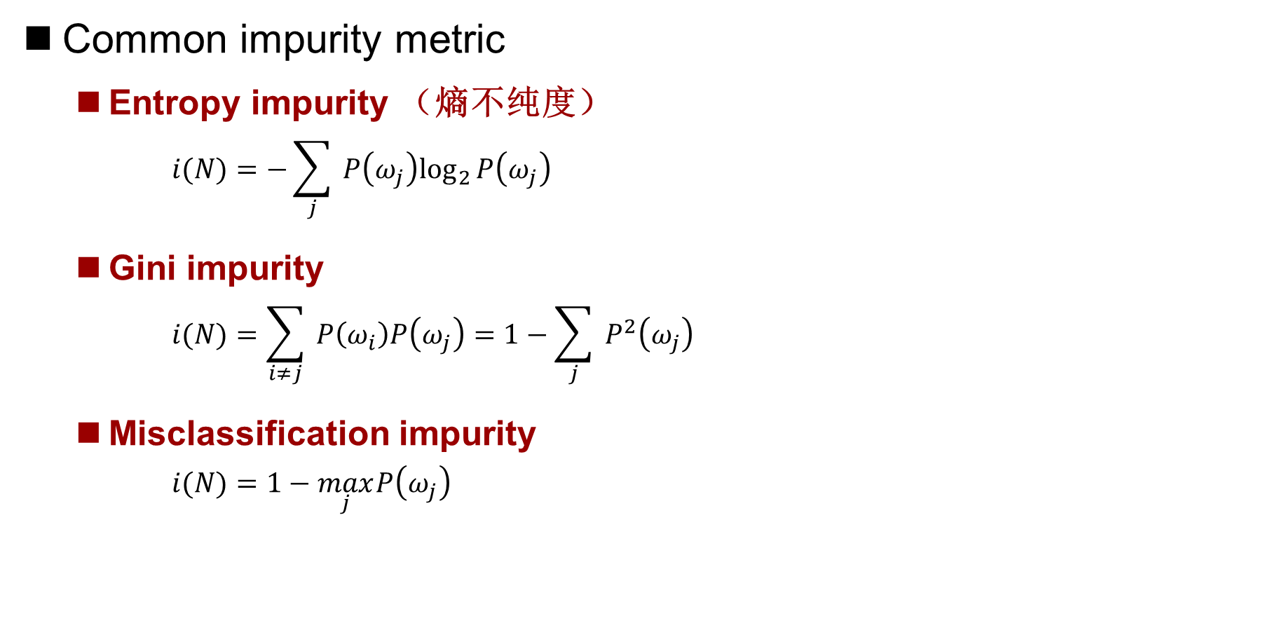
Selection of tests
Common impurity metric
Entropy impurity （熵不纯度）
$$i(N)=−\sum_{j}{ }P\left(ω_{j}\right)\log_{2}⁡P\left(ω_{j}\right)$$
Gini impurity
$$i(N)=\sum_{i≠j}{ }P\left(ω_{i}\right)P\left(ω_{j}\right)=1−\sum_{j}{ }P^{2}\left(ω_{j}\right)$$
Misclassification impurity
$$i(N)=1−\max_{j} P\left(ω_{j}\right)$$

Slide 18
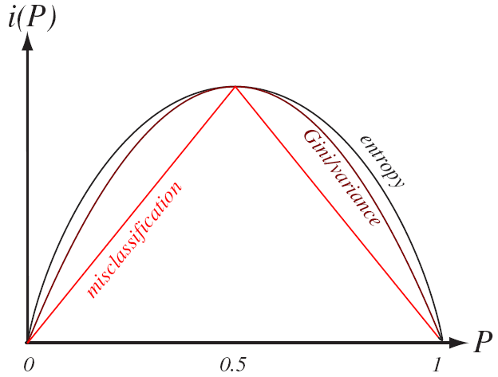
Selection of tests
Common impurity metric

Slide 19
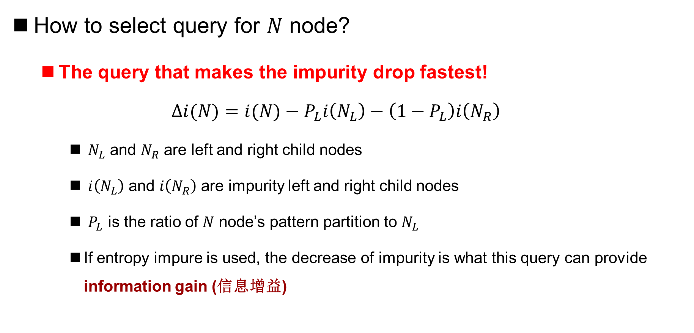
Selection of tests
How to select query for $N$ node?
The query that makes the impurity drop fastest!
$$Δi(N)=i(N)−P_{L}i\left(N_{L}\right)−\left(1−P_{L}\right)i\left(N_{R}\right)$$
$N_{L}$ and $N_{R}$ are left and right child nodes
$i\left(N_{L}\right)$ and $i\left(N_{R}\right)$ are impurity left and right child nodes
$P_{L}$ is the ratio of $N$ node’s pattern partition to $N_{L}$
If entropy impure is used, the decrease of impurity is what this query can provide information gain (信息增益)

Slide 20



Information gain
Information gain （信息增益）
：Total number of samples on node N
：Number of samples belong to （i=1,2, …, m）
： The j-th value of attribute a （j=1,2, …, v）
Entropy impurity at this node
Attribute A divides S into V subsets
The number of samples belonging to class in is

Slide 21
Information gain
Information gain （信息增益）
Using A as a query, the information entropy of V branches is generated:
Information gain with A as query:
Select the attribute with the largest information gain as the query of N node

Slide 22
Information gain
Example
Training set
S1: buys_computer= “yes”, S2: buys_computer= “no”
rid | age | income | student | credit_rating | Class: buys_computer
1 | ＜30 | High | No | Fair | No
2 | ＜30 | High | No | Excellent | No
3 | 30-40 | High | No | Fair | Yes
4 | ＞40 | Medium | No | Fair | Yes
5 | ＞40 | Low | Yes | Fair | Yes
6 | ＞40 | Low | Yes | Excellent | No
7 | 30-40 | Low | Yes | Excellent | Yes
8 | ＜30 | Medium | No | Fair | No
9 | ＜30 | Low | Yes | Fair | Yes
10 | ＞40 | Medium | Yes | Fair | Yes
11 | ＜30 | Medium | Yes | Excellent | Yes
12 | 30-40 | Medium | No | Excellent | Yes
13 | 30-40 | High | Yes | Fair | Yes
14 | ＞40 | Medium | no | Excellent | No

Slide 23
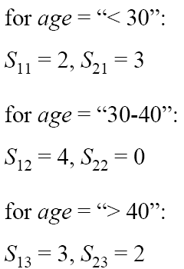
Information gain
Entropy impurity on the root
Age as the information entropy of query

Slide 24
Information gain
Age as the information entropy of query
Similarly, the information gain of all attributes can be calculated
The information gain of age is the largest, so age is selected as the query of root to partition the training set for the first time

Slide 25
Information gain ratio
The disadvantages of information gain as query selection criteria are as follows: Preference for attributes with more different values
In order to overcome this shortcoming, J. R. Quinlan used the gain ratio (信息增益率) as the selection criterion in his famous C4.5 algorithm

Slide 26
Information gain ratio
Example

Slide 27
Gini Impurity
： Total number of samples on node n
： The number of samples belonging to class （i=1,2, …, m）
： The j-th value of attribute A（j=1,2, …, v）
Gini impurity at this node
Attribute A divides S into v subsets
The number of samples belonging to class in is
Notes:
中国2006年Gini系数0.47

Slide 28
Gini Impurity
Gini impurity with a query of A resulting in V branches
Select the attribute with the greatest Gini impurity difference (the smallest Gini(A)) as the query for the N node

Slide 29
Gini Impurity
Example

Slide 30
Branch Stop Criterion
If the decision tree continues to grow until all the leaf nodes reach the minimum impurity, then "over-fitting" will generally occur.
Extreme case: all leaf nodes correspond to only one training sample, in which case the decision tree degenerates to a lookup table
If the branch stops too early, the training samples are poorly fitted, resulting in poor classification performance
Common Branch Stop Criteria
Cross-validation
Preset a threshold for impurity drop
Monitor if the number of samples represented by each node is less than a threshold

Slide 31

Branch Stop Criterion
Minimize the following metric
Statistical significant analysis of impurity decrease
Stop branching if a division does not significantly reduce impurity
Regular Item
Notes:
Size指树的大小，包括节点数或者连接数

Slide 32
Pruning
Pruning（剪枝）to eliminate overfitting
Pre-pruning and post-pruning
Pre-pruning refers to the branch-stop technique mentioned earlier, i.e. stopping the division when the tree is growing to a certain condition
Post-pruning refers to first letting the tree grow sufficiently until the leaf nodes have the least impurity, then pruning the tree
Cross-validation techniques can be used to determine which branches are cut off
Cut off branches that minimize impurity growth
In general, post-pruning performs better, but requires more computation

Slide 33
Marker of leaf node
If the corresponding sample of a leaf node comes from the same category, the leaf node is marked with this category
In general, leaf nodes have pure impurity, and the leaf node is marked with the dominant sample category

Slide 34
ID3
ID3: Interactive Dichotomizer-3（交互式二分法第三版）
Only for nominal (out of order) data If real-value data is involved, it needs to be discretized and then processed as nominal data
The branching factor for each partition is equal to the number of values of the query attributes
Using Information Gain Ratio as the Base for Selecting Queries
The algorithm stops until all leaf nodes have the least impurity or no attributes available for partitioning
No pruning steps in Standard Edition

Slide 35
C4.5
C4.5: Succession and improvement of ID3 algorithm
Can process real value data
The branching factor for each partition is equal to the number of values of the query attributes
Using Information Gain Rate as the Base for Selecting Queries
First allow the tree to grow sufficiently, then use the statistical significance of the branches to prune
C4.5 is one of the most popular decision tree algorithms at present

Slide 36
Ch 11. Clustering
Notes:
36

Slide 37
Unsupervised Learning
Supervised（有监督）learning
Each sample in the training set has a category label
All categories are known in advance
Commonly used in: classification, regression
Unsupervised（无监督）learning
The category label of samples in training set is unknown
Given a set of samples, find its intrinsic properties, such as category or clustering
Commonly used in: clustering, probability density estimation

Slide 38
Motivation of unsupervised learning
Collecting and tagging a large number of patterns is often costly
We hope to train a rough classifier on a small labeled sample set, and then let the classifier run unsupervised on a large sample set
Or a large number of unlabeled samples are used to train the classifier to automatically discover the groups in the data, and then labeled these groups with more expensive methods(such as manual)
In many applications, the characteristics of patterns change over time
The classification performance will be greatly improved if this feature change can be captured by a classifier running in unsupervised mode

Slide 39
Motivation of unsupervised learning
Unsupervised methods can be used to extract features or preprocess existing features to prepare for subsequent pattern recognition problems
e.g. PCA dimensionality reduction
In any exploratory work, unsupervised methods can reveal some internal structures and laws of observation data
The inner clustering or grouping of patterns may provide a basis for classifier design

Slide 40
Clustering
clustering（聚类）
An independent data clustering is the process of naturally grouping physical or abstract objects so that each group is made up of similar objects
Clustering is an unsupervised learning (无监督学习) process because training set samples have no category labels
A cluster (聚类) is a set of samples that are similar to those belonging to the same cluster but not to other clusters.
Clustering can be used as:
analysis tool for analyzing the intrinsic characteristics of data
A data preprocessing method for subsequent pattern recognition services

Slide 41
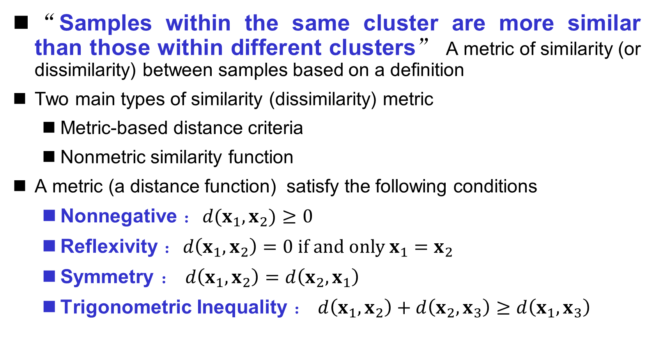
Similarity metric
“Samples within the same cluster are more similar than those within different clusters” A metric of similarity (or dissimilarity) between samples based on a definition
Two main types of similarity (dissimilarity) metric
Metric-based distance criteria
Nonmetric similarity function
A metric (a distance function) satisfy the following conditions
Nonnegative ：$d(x_{1},x_{2})≥0$
Reflexivity ：$d\left(x_{1},x_{2}\right)=0 if and only x_{1}=x_{2}$
Symmetry ： $d\left(x_{1},x_{2}\right)=d\left(x_{2},x_{1}\right)$
Trigonometric Inequality ： $d\left(x_{1},x_{2}\right)+d\left(x_{2},x_{3}\right)≥d\left(x_{1},x_{3}\right)$

Slide 42
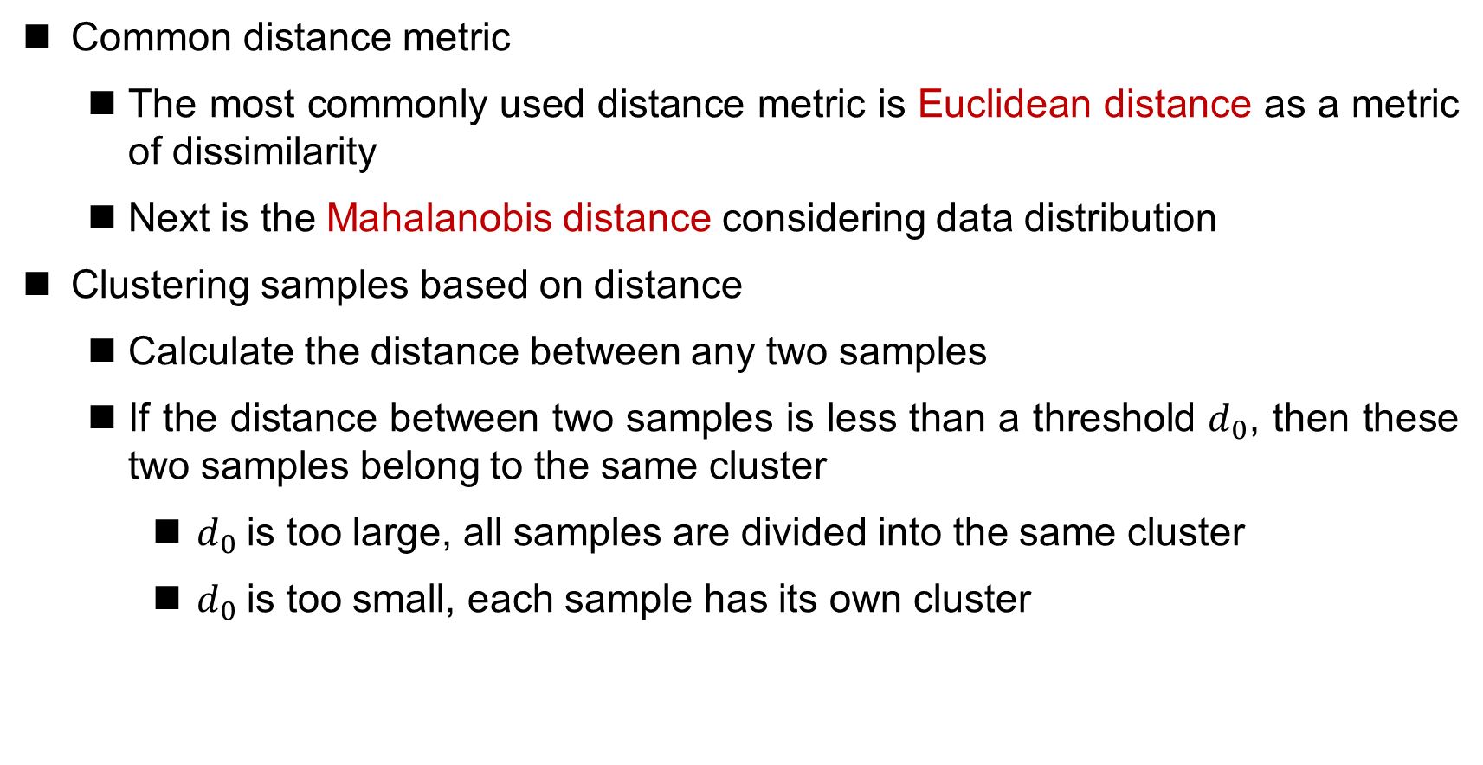
Distance metric
Common distance metric
The most commonly used distance metric is Euclidean distance as a metric of dissimilarity
Next is the Mahalanobis distance considering data distribution
Clustering samples based on distance
Calculate the distance between any two samples
If the distance between two samples is less than a threshold $d_{0}$, then these two samples belong to the same cluster
$d_{0}$is too large, all samples are divided into the same cluster
$d_{0}$is too small, each sample has its own cluster

Slide 43

Distance metric
Euclidean distance
The smaller $d_{0}$, the smaller each cluster and the larger the number of clusters

Slide 44
Distance metric
Scaling coordinate scales
causes changes in clustering results

Slide 45
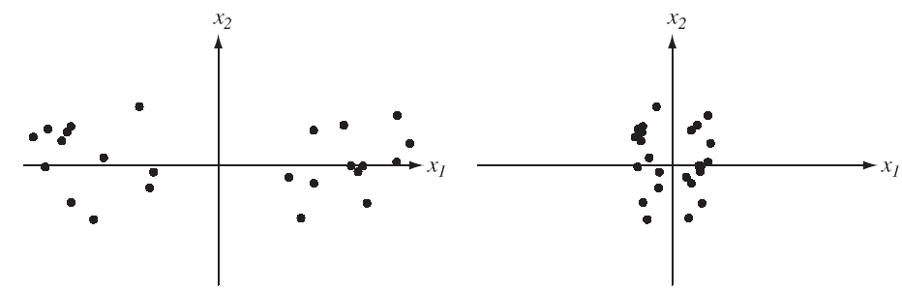
Normalization
Raw data can be normalized (规格化) before clustering to achieve invariance
Displacement and Scaling Invariance
By shifting and scaling, new features have zero mean and unit variance
Rotation Invariance
Rotate the axis so that it is parallel to the eigenvectors of the sample covariance matrix
Normalization cannot be abused!
Zero Mean Unit Variance

Slide 46
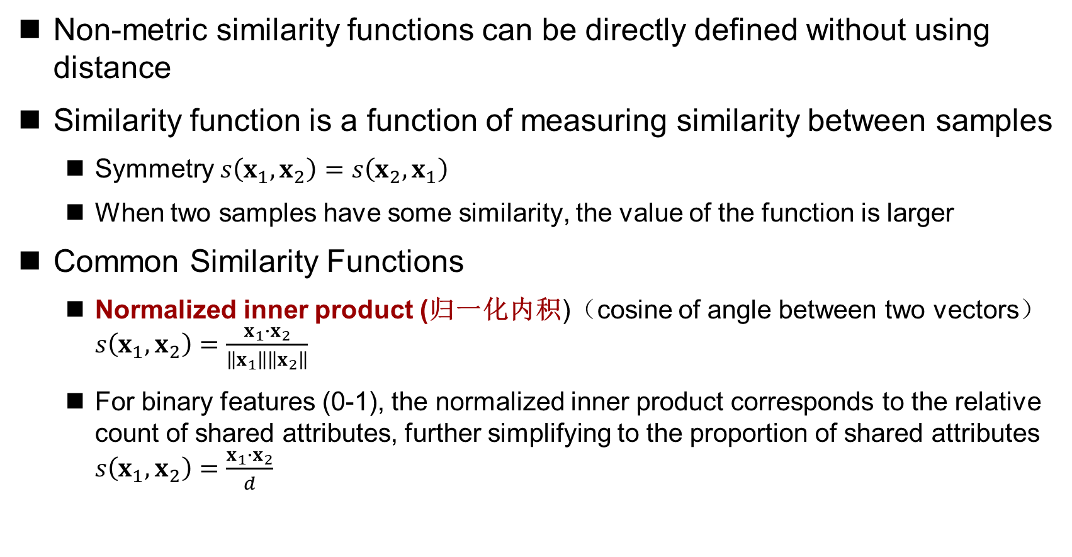
Similarity function
Non-metric similarity functions can be directly defined without using distance
Similarity function is a function of measuring similarity between samples
Symmetry $s\left(x_{1},x_{2}\right)=s\left(x_{2},x_{1}\right)$
When two samples have some similarity, the value of the function is larger
Common Similarity Functions
Normalized inner product (归一化内积)（cosine of angle between two vectors） $s\left(x_{1},x_{2}\right)=\frac{x_{1}∙x_{2}}{\left\|x_{1}\right\|\left\|x_{2}\right\|}$
For binary features (0-1), the normalized inner product corresponds to the relative count of shared attributes, further simplifying to the proportion of shared attributes $s\left(x_{1},x_{2}\right)=\frac{x_{1}∙x_{2}}{d}$

Slide 47
What is a good cluster?
A good clustering process produces high-quality clustering
High similarity within clusters
Low similarity between clusters
The quality of clustering results depends on the similarity metric used and the implementation of clustering algorithm
Evaluating clustering results is often subjective

Slide 48
Criterion functions for clustering
“One cluster partition is better than another” is a criterion function based on some kind of clustering
Clustering can be viewed as a discrete optimization problem
Criterion functions are used to metric the quality of a partition of a data cluster
The goal is to find a partition that minimizes (enlarges) the criterion function
Different criterion functions may result in different clustering results
Common Criterion Functions
Square error criterion
Minimum variance criterion
Dispersion Criteria

Slide 49
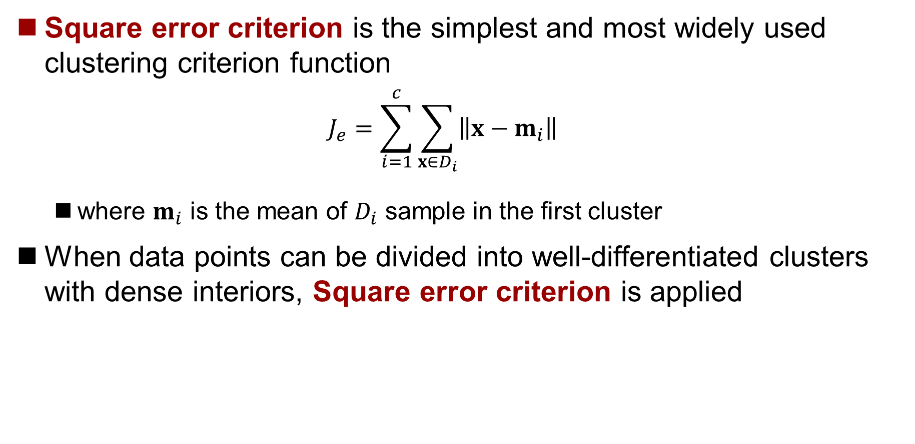
Square error criterion
Square error criterion is the simplest and most widely used clustering criterion function
$$J_{e}=\sum_{i=1}^{c}{\sum_{x∈D_{i}}{\left\|x−m_{i}\right\|}}$$
where $m_{i}$ is the mean of $D_{i}$ sample in the first cluster
When data points can be divided into well-differentiated clusters with dense interiors, Square error criterion is applied

Slide 50
Square error criterion
Possible problems with using square error criterion
When there is a large difference in the number of samples contained in different clusters, splitting a large cluster may result in a smaller sum of squared errors

Slide 51
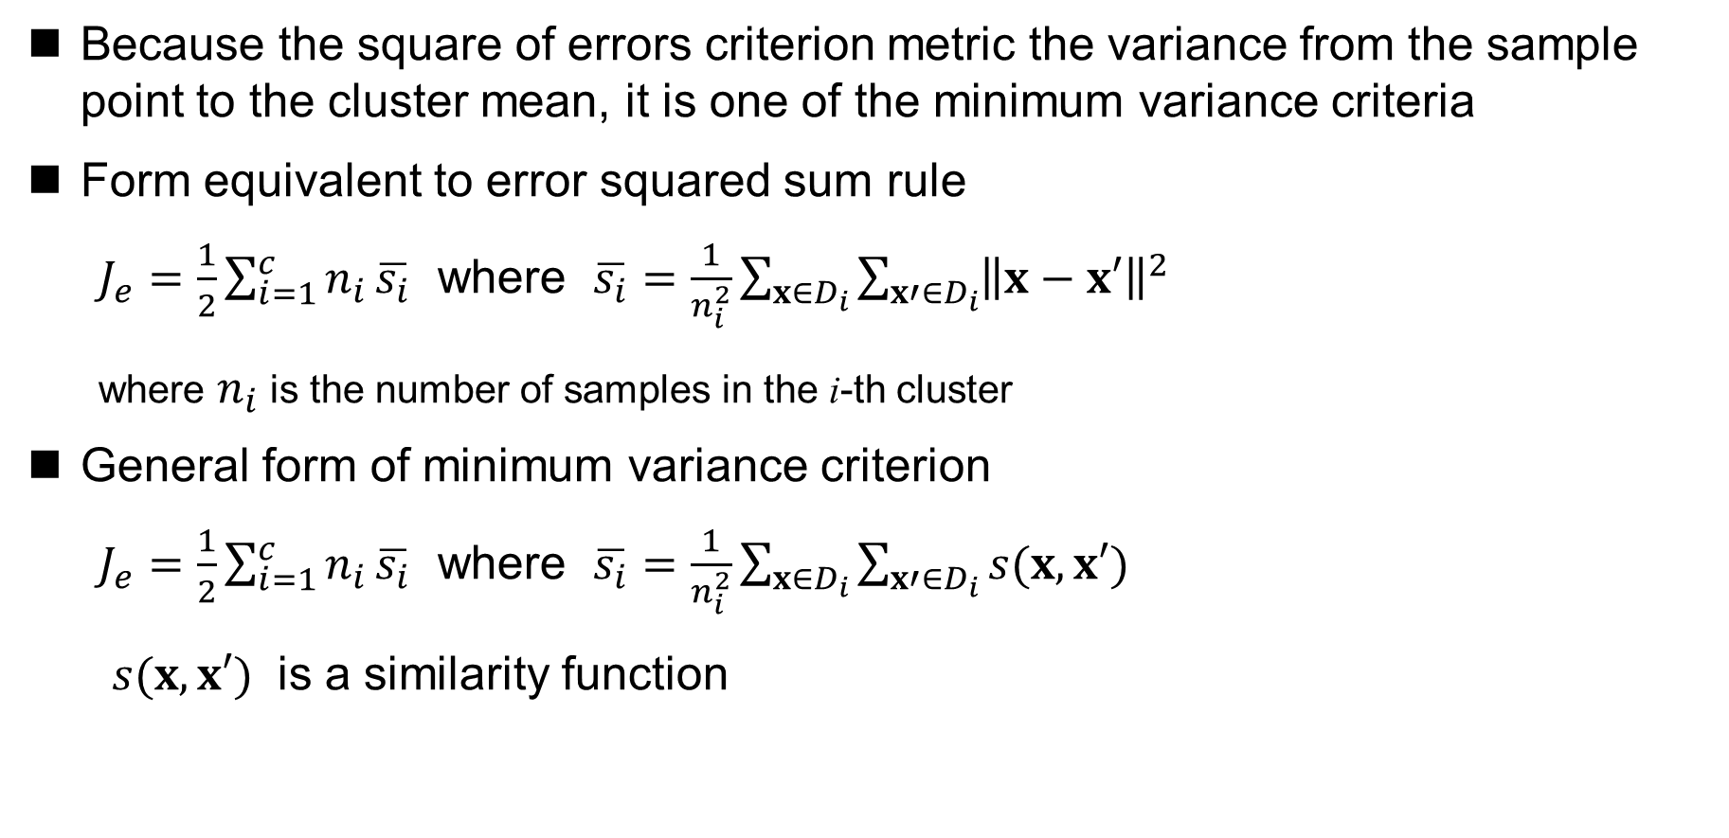
Minimum variance criterion
Because the square of errors criterion metric the variance from the sample point to the cluster mean, it is one of the minimum variance criteria
Form equivalent to error squared sum rule
$J_{e}=\frac{1}{2}\sum_{i=1}^{c}{n_{i}}\overline{s_{i}}$ where $\overline{s_{i}}=\frac{1}{n_{i}^{2}}\sum_{x∈D_{i}}{\sum_{x′∈D_{i}}{{\left\|x−x′\right\|}^{2}}}$
where $n_{i}$ is the number of samples in the i-th cluster
General form of minimum variance criterion
$J_{e}=\frac{1}{2}\sum_{i=1}^{c}{n_{i}}\overline{s_{i}}$ where $\overline{s_{i}}=\frac{1}{n_{i}^{2}}\sum_{x∈D_{i}}{\sum_{x′∈D_{i}}{s(x,x′)}}$
$s(x,x′)$ is a similarity function

Slide 52

Dispersion Criteria
Mean Vector
Mean Vector of the i-th Cluster
$$m_{i}=\frac{1}{n_{i}}\sum_{x∈D_{i}}{x}$$
Total Mean Vector
$$m_{i}=\frac{1}{n}\sum_{x∈D}{x=\frac{1}{n}\sum_{i=1}^{c}{n_{i}}}m_{i}$$

Slide 53
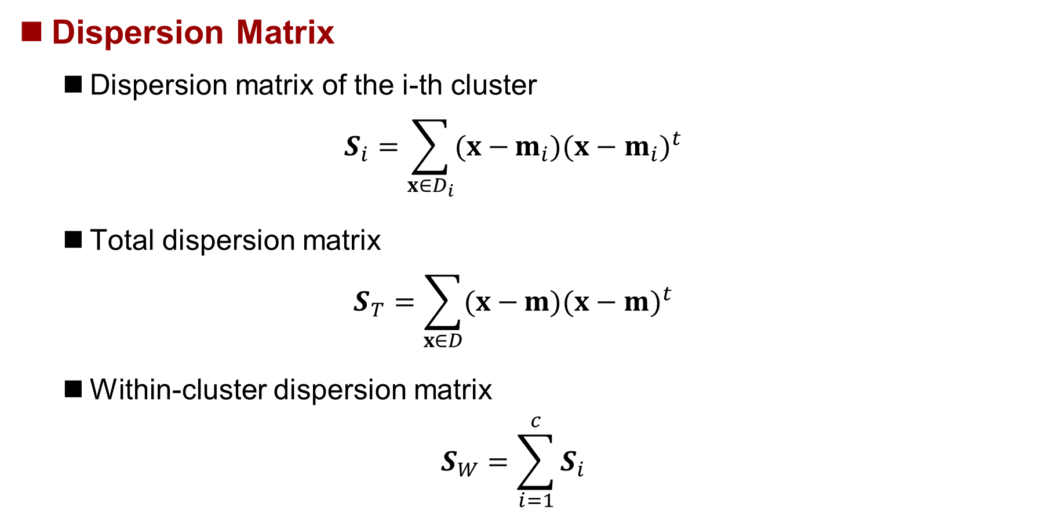
Dispersion Criteria
Dispersion Matrix
Dispersion matrix of the i-th cluster
$$S_{i}=\sum_{x∈D_{i}}{(x−}m_{i}){(x−m_{i})}^{t}$$
Total dispersion matrix
$$S_{T}=\sum_{x∈D}{(x−}m){(x−m)}^{t}$$
Within-cluster dispersion matrix
$$S_{W}=\sum_{i=1}^{c}{S_{i}}$$

Slide 54
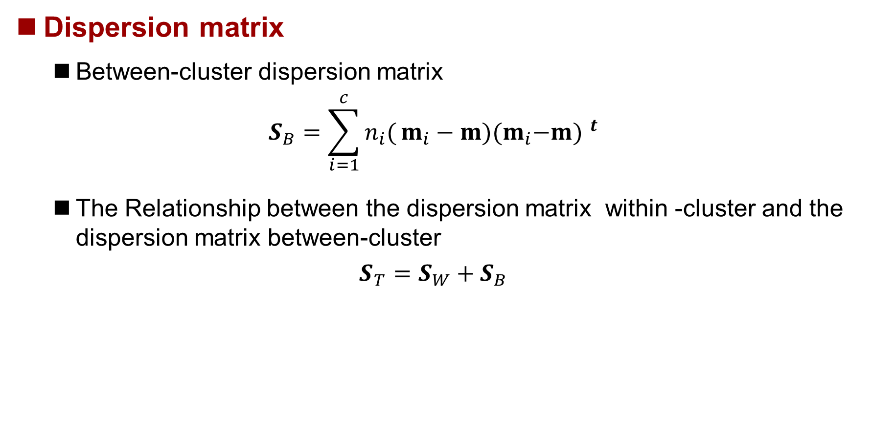
Dispersion Criteria
Dispersion matrix
Between-cluster dispersion matrix
$$S_{B}=\sum_{i=1}^{c}{n_{i}(}m_{i}−m){{(m}_{i}−m) }^{t}$$
The Relationship between the dispersion matrix within -cluster and the dispersion matrix between-cluster
$$S_{T}=S_{W}+S_{B}$$

Slide 55
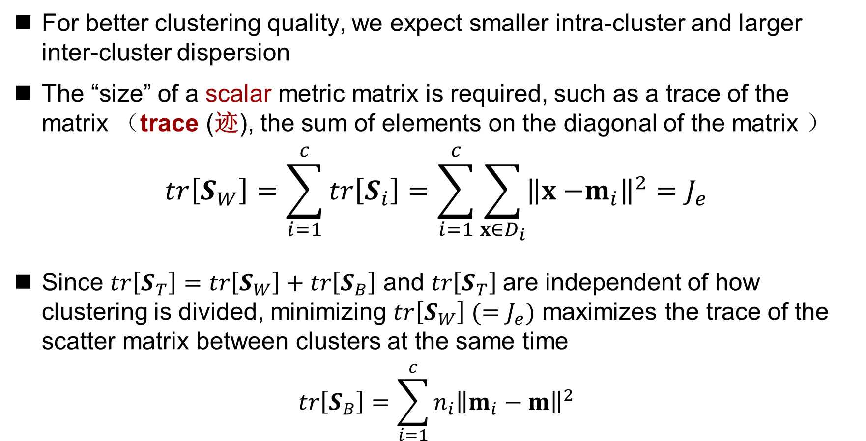
Dispersion Criteria
For better clustering quality, we expect smaller intra-cluster and larger inter-cluster dispersion
The “size” of a scalar metric matrix is required, such as a trace of the matrix （trace (迹), the sum of elements on the diagonal of the matrix ）
$$tr\left[S_{W}\right]=\sum_{i=1}^{c}{tr\left[S_{i}\right]=\sum_{i=1}^{c}{\sum_{x∈D_{i}}{{\left\|x{−m}_{i}\right\|}^{2}}}}=J_{e}$$
Since $tr\left[S_{T}\right]=tr\left[S_{W}\right]+tr\left[S_{B}\right]$ and $tr\left[S_{T}\right]$are independent of how clustering is divided, minimizing $tr\left[S_{W}\right] (=J_{e})$ maximizes the trace of the scatter matrix between clusters at the same time
$$tr\left[S_{B}\right]=\sum_{i=1}^{c}{{n_{i}\left\|m_{i}−m\right\|}^{2}}$$
Scalar metric can also use the determinant of a matrix

Slide 56
Iterative optimization
For a finite sample set, the number of possible partitions is limited, and in theory the optimal solution can be found by the method of exhaustion. However, the method of exhaustion is often too computationally intensive to achieve
Iterative optimization methods are often used to find optimal partitions
Start with some reasonable initial division
Then move some samples from one cluster to another -- if this improves the criteria function
Repeat iteration until no significant improvement is achieved
This iteration method guarantees convergence to local optimum, but not global optimum

Slide 57
Partition-based clustering method
Given a dataset, the dataset is divided into k subsets based on partitioning, each of which corresponds to a cluster
Two scenarios
Each cluster is represented by the mean of the sample it contains
Each cluster is represented by a sample (center point) close to the cluster center
Typical algorithm
k-means
k-medoids
Notes:
Medoid: 中心点

Slide 58
k-means algorithm
Each cluster is represented by the mean value of the samples it contains
Step 1: randomly select k samples as the centers of K clusters
Step 2: each remaining sample is divided into the cluster whose center is closest to the sample
Step 3: calculate the mean value of each cluster as the new center
Step 4: if there is no change in the cluster center, the algorithm will stop. Otherwise, return to step 2

Slide 59
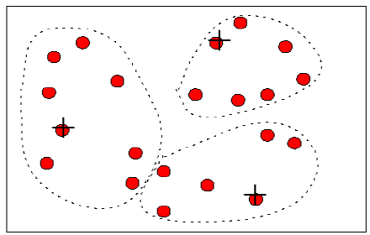
k-means algorithm

Slide 60
K-medoids algorithm
Each cluster is represented by a sample near the center of the cluster
Step 1: randomly select k samples as the centers of K clusters
Step 2: each remaining sample is divided into the cluster whose center is closest to the sample
Step 3: calculate the medoid of each cluster（The sample nearest to the mean）
Step 4: if there is no change in the medoid of clustering, the algorithm will stop, otherwise return to step 2

Slide 61
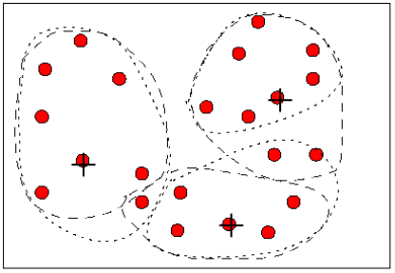
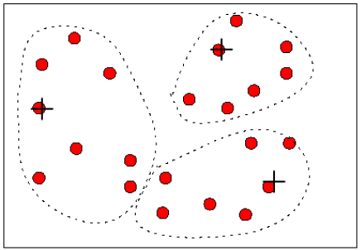
K-medoids algorithm

