Slide 1
Ch 08. Multilayer Neural Network
Notes:
1

Slide 2
What is Neural Network?
Neural Network(NN,神经网络) as known as artificial neural network (人工神经网络)
“neural networks are massively parallel interconnected networks of simple (usually adaptive) elements and their hierarchical organizations which are intended to interact with the objects of the real world in the same way as biological nervous systems do”
[T. Kohonen, NN88]

Slide 3
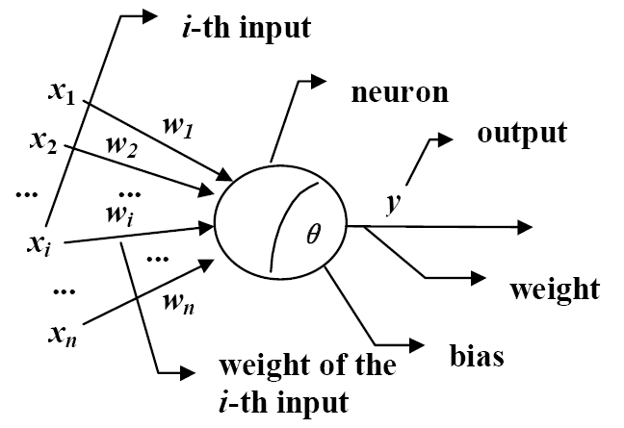
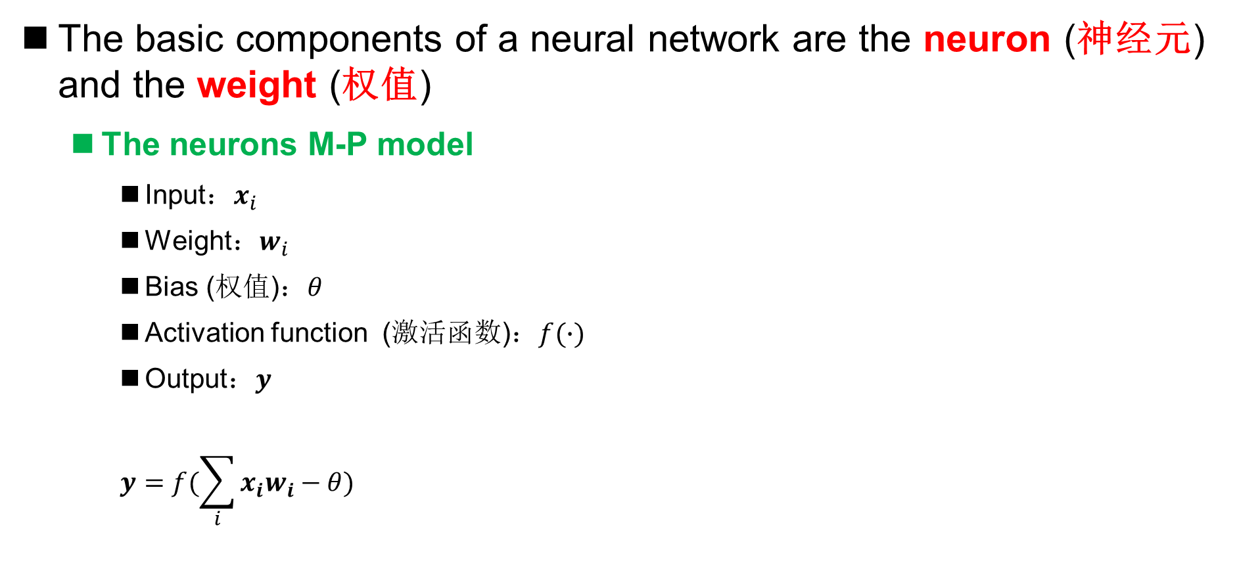
What is Neural Network?
The basic components of a neural network are the neuron (神经元) and the weight (权值)
The neurons M-P model
Input：$x_{i}$
Weight：$w_{i}$
Bias (权值)：$θ$
Activation function (激活函数)：$f(∙)$
Output：$y$
$$y=f(\sum_{i}{x_{i}w_{i}−θ})$$
Neuron is sometimes called “unit“ (单元)

Slide 4
What is Neural Network?
The basic components of a neural network are the neuron (神经元) and the weight (权值)
Neurons are connected by weights
The knowledge acquired by neural network learning is encoded by weights and biases in neurons, that is, the neural network training process determines all weights and biases through training data
The bias is sometimes represented by a special neuron: the bias unit

Slide 5
Feedforward Neural Network
Feedforward neural network (前馈神经网络)
Generally, feedforward neural network refers to the neural network that each neuron is only connected to the next layer of neurons
input layer
Hidden layer
output layer
three-layer feedforward neural network

Slide 6
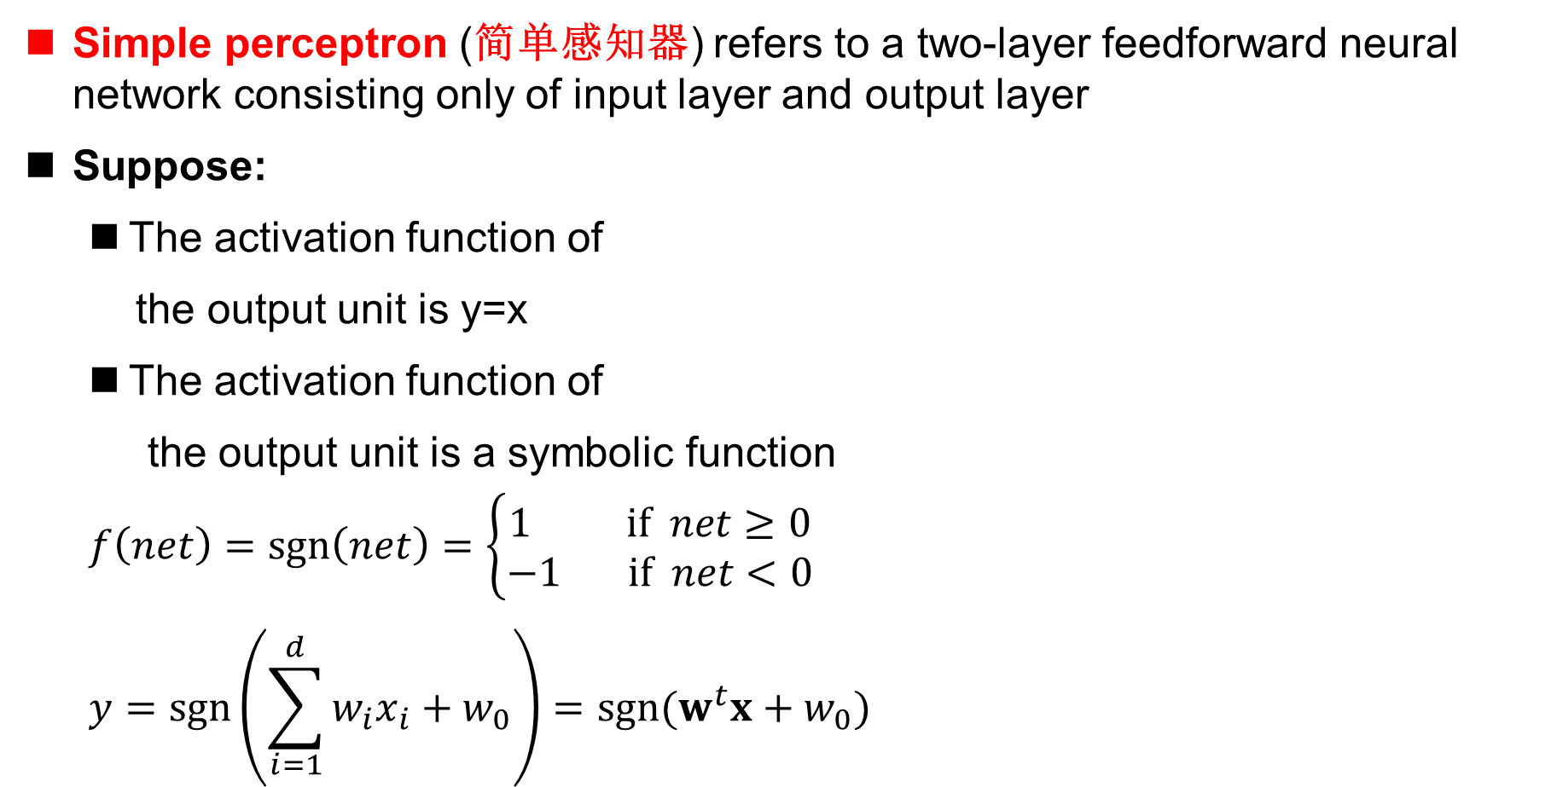
Simple Perceptron
Simple perceptron (简单感知器) refers to a two-layer feedforward neural network consisting only of input layer and output layer
Suppose:
The activation function of
the output unit is y=x
The activation function of
the output unit is a symbolic function
$$f\left(net\right)=sgn\left(net\right)=\left\{\begin{aligned}1 if net≥0 \\ −1 if net<0\end{aligned}\right.$$
$$y=\operatorname{sgn}\left(\sum_{i=1}^{d}{w_{i}x_{i}+w_{0}}\right)=sgn⁡(w^{t}x+w_{0})$$
input layer
output layer
x
y

Slide 7
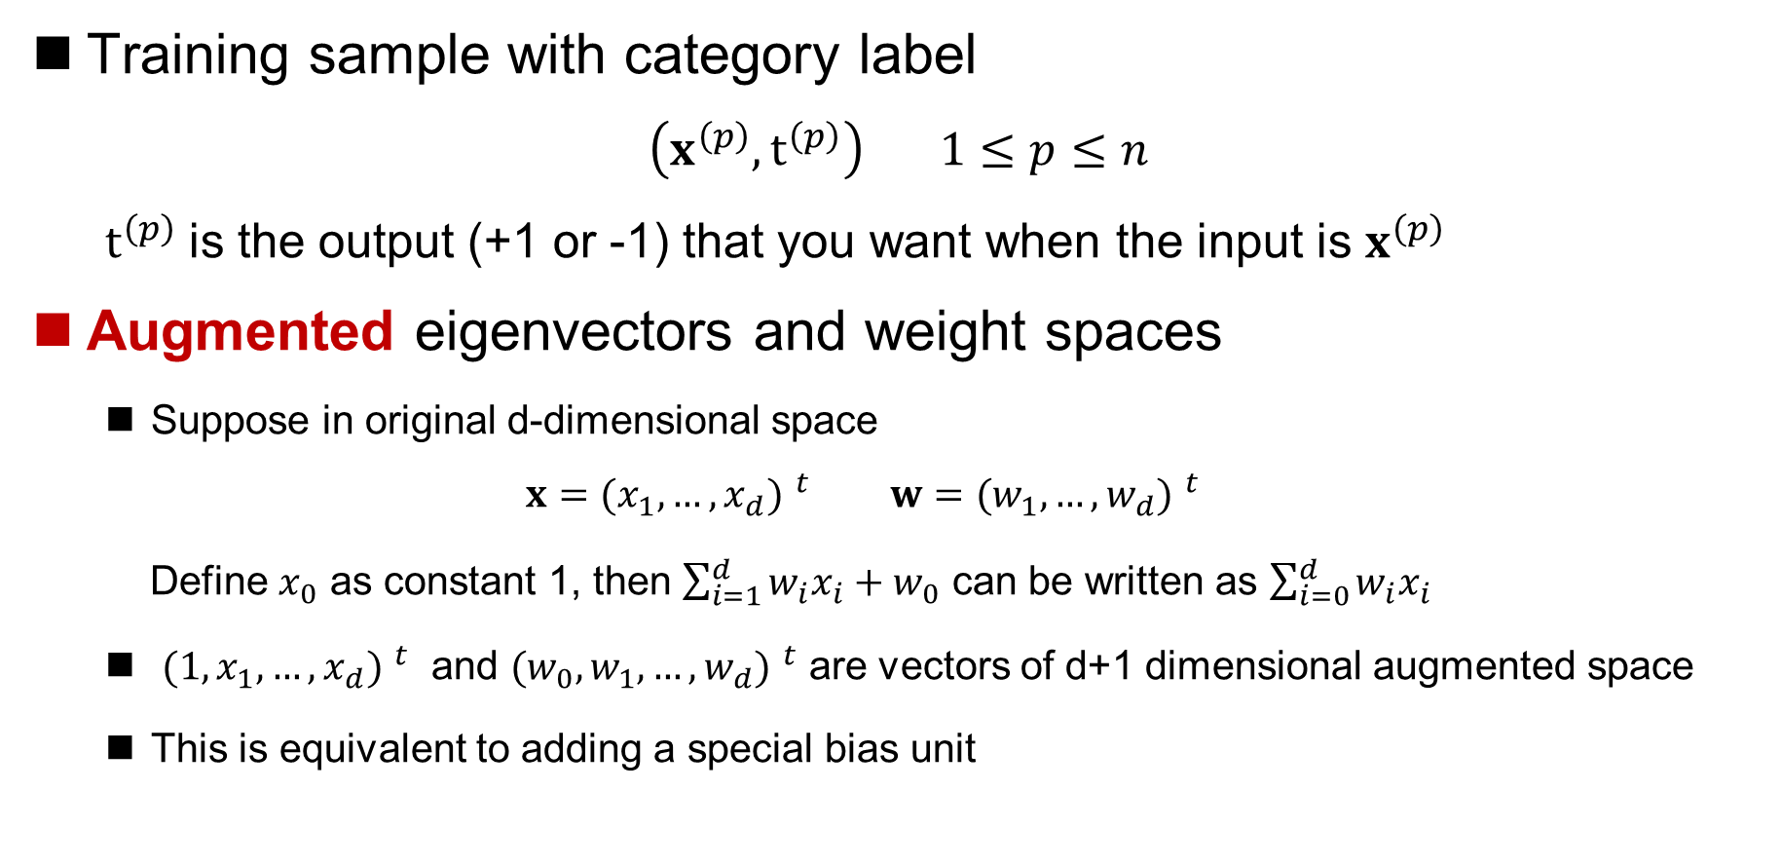
Simple Perceptron
Training sample with category label
$\left(x^{\left(p\right)},t^{\left(p\right)}\right) 1≤p≤n$
$t^{\left(p\right)}$is the output (+1 or -1) that you want when the input is $x^{\left(p\right)}$
Augmented eigenvectors and weight spaces
Suppose in original d-dimensional space
$$x={{(x}_{1},…,x_{d}) }^{t} w={{(w}_{1},…,w_{d}) }^{t}$$
Define $x_{0}$ as constant 1, then $\sum_{i=1}^{d}{w_{i}x_{i}+w_{0}}$ can be written as $\sum_{i=0}^{d}{w_{i}x_{i}}$
${{(1, x}_{1},…,x_{d}) }^{t}$ and ${{(w_{0},w}_{1},…,w_{d}) }^{t}$ are vectors of d+1 dimensional augmented space
This is equivalent to adding a special bias unit

Slide 8
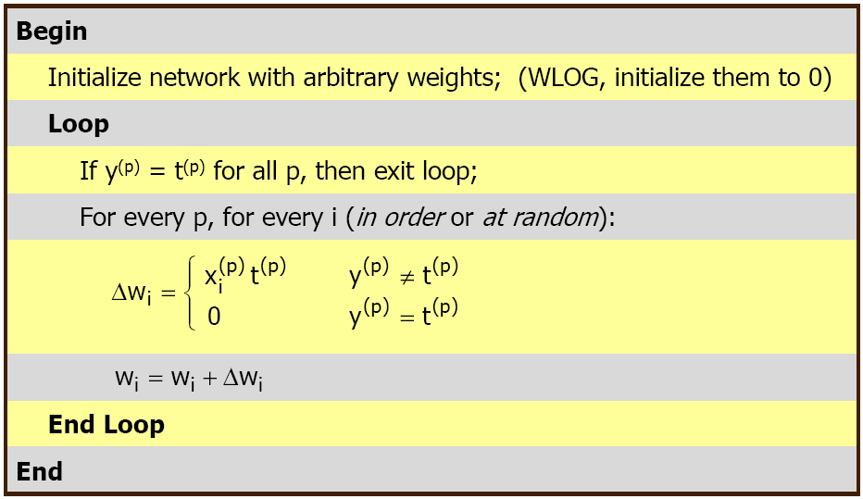
Simple Perceptron
Perceptron learning process
Notes:
Without loss of generality

Slide 9
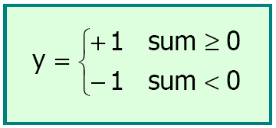
Simple Perceptron
Example
training dataset
Input layer
Output layer
x
y

Slide 10

Simple Perceptron
Example
The initial value of w is $w_{0}=w_{1}=w_{2}=0$

Slide 11

Simple Perceptron
Example
The convergent solution of w is $w_{0}=−1, w_{1}=2,w_{2}=−1$

Slide 12
Simple Perceptron
The shortage of perceptron
Can only deal with linearly separable case
Even in the case of linear separability, the optimal solution may not be given
perceptron solution
optimal solution

Slide 13
Multilayer Feedforward Neural Network
The feedforward neural network containing at least one hidden layer
output layer
hidden layer
input layer
three-layer feedforward neural network

Slide 14
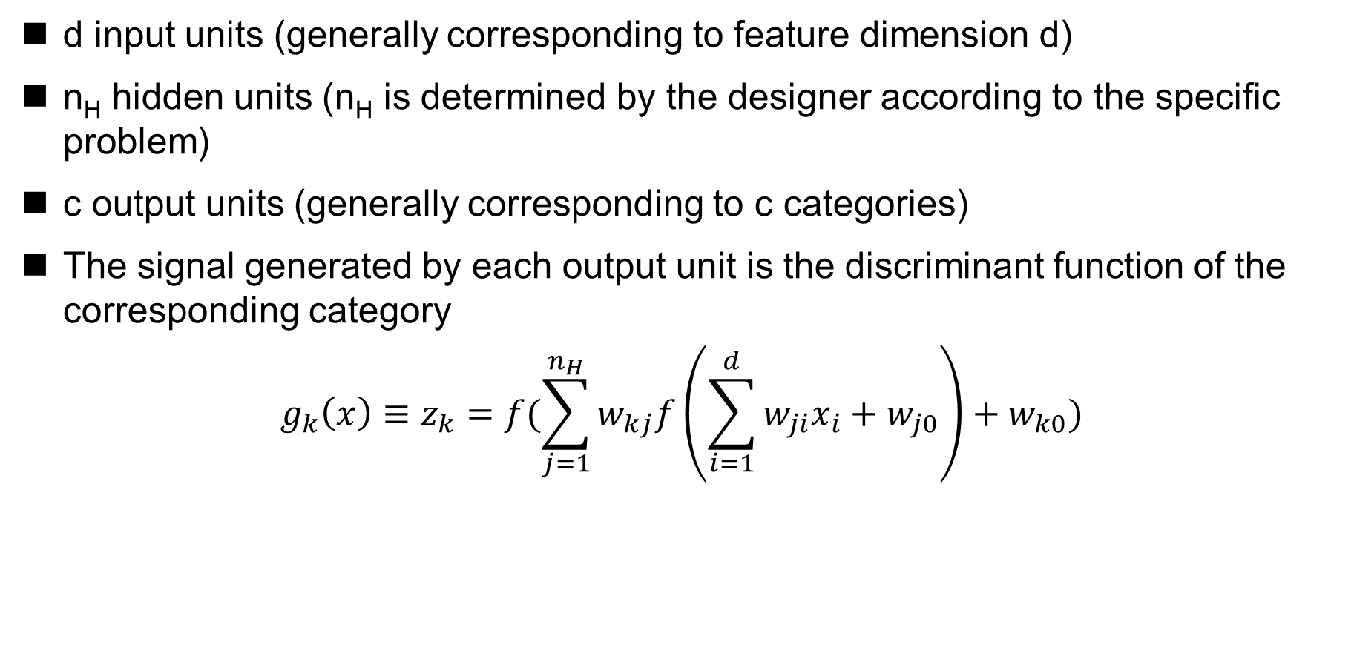
General Feedforward Computation
d input units (generally corresponding to feature dimension d)
n_{H} hidden units (n_{H} is determined by the designer according to the specific problem)
c output units (generally corresponding to c categories)
The signal generated by each output unit is the discriminant function of the corresponding category
$$g_{k}\left(x\right)≡z_{k}=f(\sum_{j=1}^{n_{H}}{w_{kj}f\left(\sum_{i=1}^{d}{w_{ji}x_{i}}+w_{j0}\right)+w_{k0}})$$

Slide 15
The Representation Ability of Multilayer Networks
sigmoid function (S形函数)
Universal approximation (一般逼近) theory
[Cybenko 1989; Hornik et al. 1989]
One layer of hidden units with sigmoid activation function is sufficient for approximating any function with finitely many discontinuities to arbitrary precision.
Notes:
双曲正切

Slide 16
The Representation Ability of Multilayer Networks
Any discriminant function can be implemented by a three-layer neural network !
But……
It only makes theoretical sense that a multilayer network can achieve arbitrary decisions
The theory tells us "Can" but not "How“
The structure design and training methods of the network require specific analysis of specific problems

Slide 17
Neural Network Learning
Neural network learning algorithm
backpropagation algorithm (反向传播算法) [Rumelhart et al. 1985]
Similar solutions have been proposed independently by others [Werbos 1974; Parker 1985; Le Cun 1985]
Complex decision surfaces can be learned
The optimal solution cannot be guaranteed, but a better solution can be obtained

Slide 18
Neural Network Learning
Three-layer neural network

Slide 19
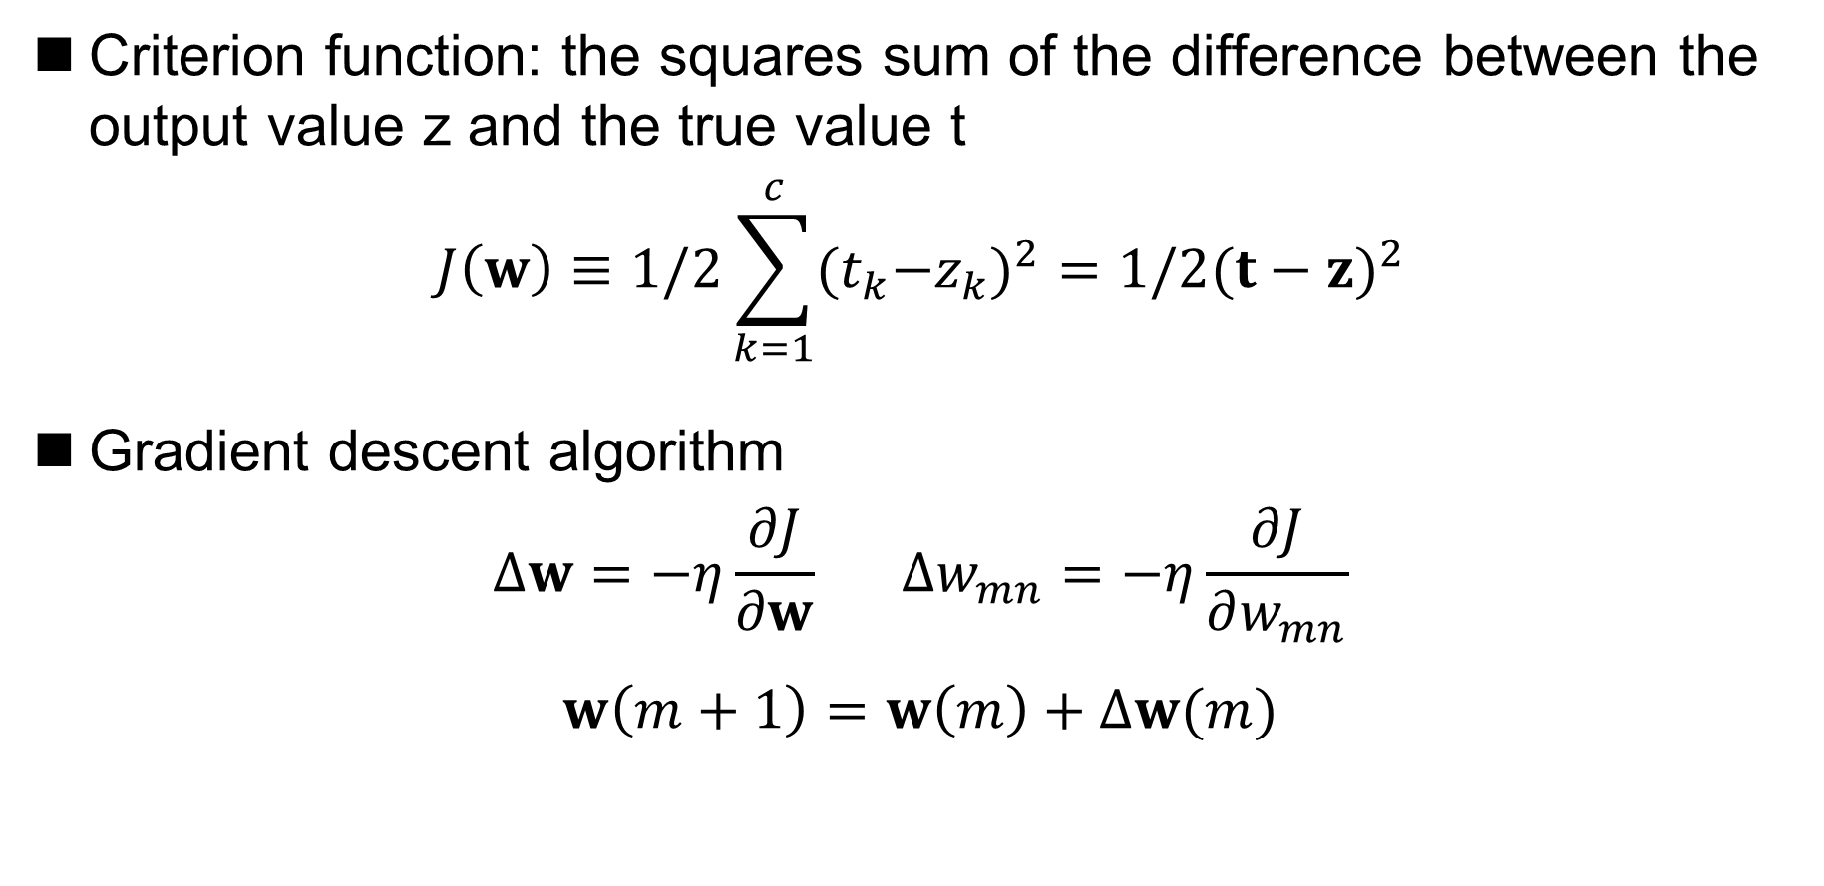
Backpropagation Algorithm
Criterion function: the squares sum of the difference between the output value z and the true value t
$$J\left(w\right)≡1/2\sum_{k=1}^{c}{{{(t}_{k}−z_{k})}^{2}=1/2{(t−z)}^{2}}$$
Gradient descent algorithm
$$Δw=−η\frac{∂J}{∂w} Δw_{mn}=−η\frac{∂J}{∂w_{mn}}$$
$$w\left(m+1\right)=w\left(m\right)+Δw(m)$$

Slide 20
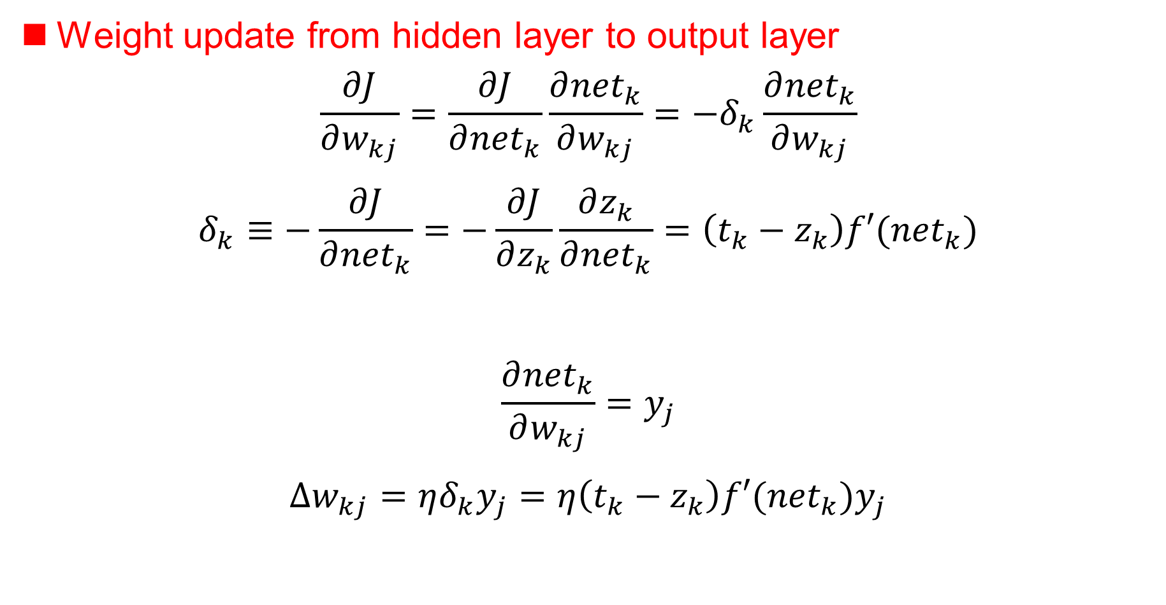
Backpropagation Algorithm
Weight update from hidden layer to output layer
$$\frac{∂J}{∂w_{kj}}=\frac{∂J}{∂{net}_{k}}\frac{∂{net}_{k}}{∂w_{kj}}=−δ_{k}\frac{∂{net}_{k}}{∂w_{kj}}$$
$$δ_{k}≡−\frac{∂J}{∂{net}_{k}}=−\frac{∂J}{∂z_{k}}\frac{∂z_{k}}{∂{net}_{k}}=\left(t_{k}−z_{k}\right)f′({net}_{k})$$
$$\frac{∂{net}_{k}}{∂w_{kj}}=y_{j}$$
$$Δw_{kj}=ηδ_{k}y_{j}=η\left(t_{k}−z_{k}\right)f′({net}_{k})y_{j}$$
sensitivity (敏感度)
Notes:
链式微分法则

Slide 21
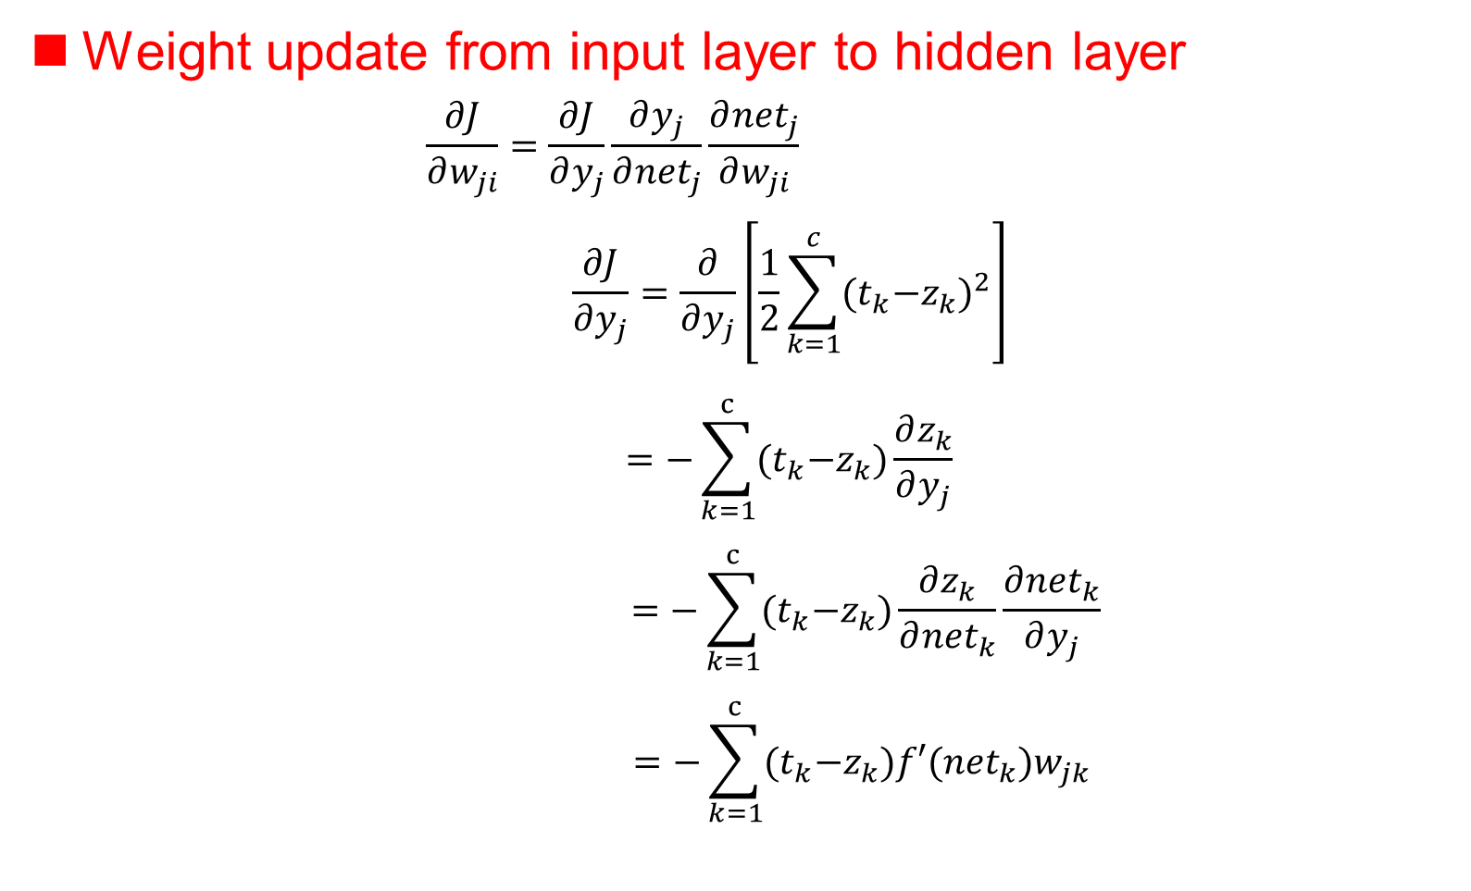

Backpropagation Algorithm
Weight update from input layer to hidden layer
$$\frac{∂J}{∂w_{ji}}=\frac{∂J}{∂y_{j}}\frac{∂y_{j}}{∂{net}_{j}}\frac{∂{net}_{j}}{∂w_{ji}}$$
$$\frac{∂J}{∂y_{j}}=\frac{∂}{∂y_{j}}\left[\frac{1}{2}\sum_{k=1}^{c}{{{(t}_{k}−z_{k})}^{2}}\right]$$
$$=−\sum_{k=1}^{c}{{(t}_{k}−z_{k})\frac{∂z_{k}}{∂y_{j}}}$$
$$=−\sum_{k=1}^{c}{{(t}_{k}−z_{k})\frac{∂z_{k}}{∂{net}_{k}}\frac{∂{net}_{k}}{∂y_{j}}}$$
$$=−\sum_{k=1}^{c}{{(t}_{k}−z_{k})f′({net}_{k})w_{jk}}$$
$$δ_{k}$$

Slide 22
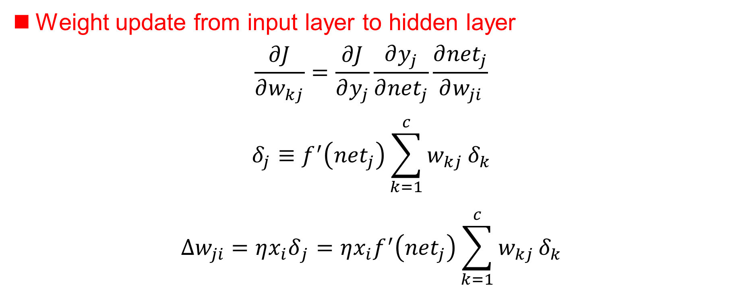
Backpropagation Algorithm
Weight update from input layer to hidden layer
$$\frac{∂J}{∂w_{kj}}=\frac{∂J}{∂y_{j}}\frac{∂y_{j}}{∂{net}_{j}}\frac{∂{net}_{j}}{∂w_{ji}}$$
$$δ_{j}≡f^{′}\left({net}_{j}\right)\sum_{k=1}^{c}{w_{kj}}δ_{k}$$
$$Δw_{ji}=η{x_{i}δ}_{j}=ηx_{i}f^{′}\left({net}_{j}\right)\sum_{k=1}^{c}{w_{kj}}δ_{k}$$
The sensitivity of the output unit is propagated back to the hidden unit

Slide 23
Backpropagation Algorithm
Backpropagation of sensitivity

Slide 24
Backpropagation Algorithm
Training protocol
How to adjust weights based on training samples during neural network training
Stochastic training (随机训练)
The pattern is randomly selected from the training set, and the weight is updated once each pattern is entered
Batch training (成批训练)
All patterns are sent to the network all at once, and then the weight is updated once
Online training (在线训练)
Each pattern is provided only once, each pattern is provided, and the weight is updated once

Slide 25
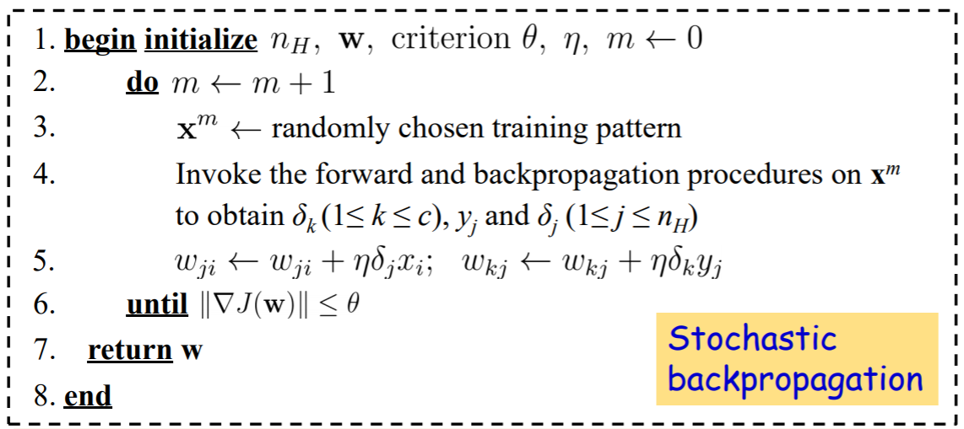
Backpropagation Algorithm
Stochastic backpropagation

Slide 26
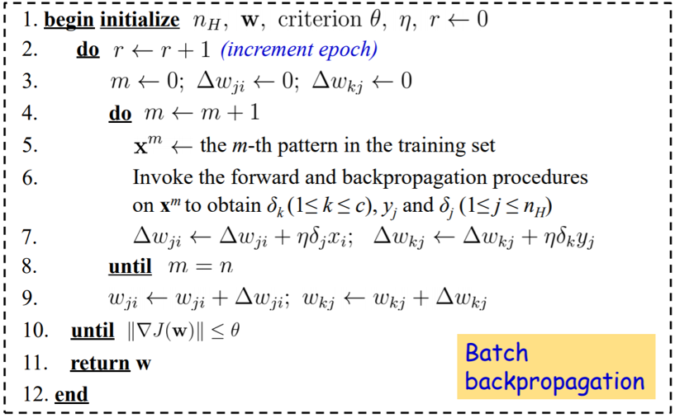
Backpropagation Algorithm
Batch backpropagation
epoch (回合): All patterns are provided once called one epoch

Slide 27
Backpropagation Algorithm
Online backpropagation
Online
backpropagation

