Slide 1
Ch 05. Non-parametric Method
Part 1 Parzen Window Estimation

Slide 2




Approaches to Pattern Classification
Approach 1：Estimate class-conditional probability density
  Through and , calculate posterior probability with Bayes’ rule, then make decisions with maximum posterior probability
  Two Methods
    Method 1a：Parameter estimation of probability density
      Based on parametric description of
    Method 1b： Non-parametric estimation of probability density
      Based on non-parametric description of
Approach 2：Estimate posterior probability
  Don’t have to estimate in advance
Approach 3：Compute discrimination function
  Don’t have to estimate or

Slide 3
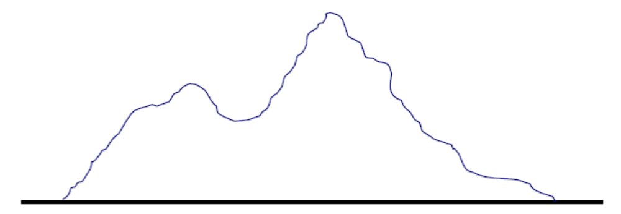
Possible Problems of Parameter Estimation
The form of the probability density function is unknown
The classical density function cannot describe the real data well
  The parametric form of the classical density function is generally unimodular
  Real data is often multimodal
  Some complex data are difficult to model in parametric form
Solution： non-parametric method （非参数方法）

Slide 4
Non-parametric Method
can handle any probability density
don't have to assume the parametric form of the density function
No Free Lunch!
  The training samples required by non-parametric methods to obtain better results are generally much larger than those of parametric methods

Slide 5

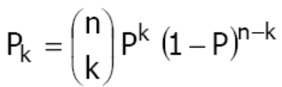


Non-parametric Density Estimation
Suppose the probability density of x is p(x), then the probability of any x falling into region R is
The basic idea of non-parametric density estimation
  Estimate p of x by estimating the probability of a small region R around x
Suppose there are n i.i.d. samples, and the probability of k samples falling into R is
The expectation value of k
When the amount of data n is large, P_{K} has a very significant peak near nP, and E(k) can be replaced by the observed value of k
binomial distribution
Notes:
（）表示组合C_n^k
P_k在nP附近显著，表明可以粗略认为k=nP

Slide 6
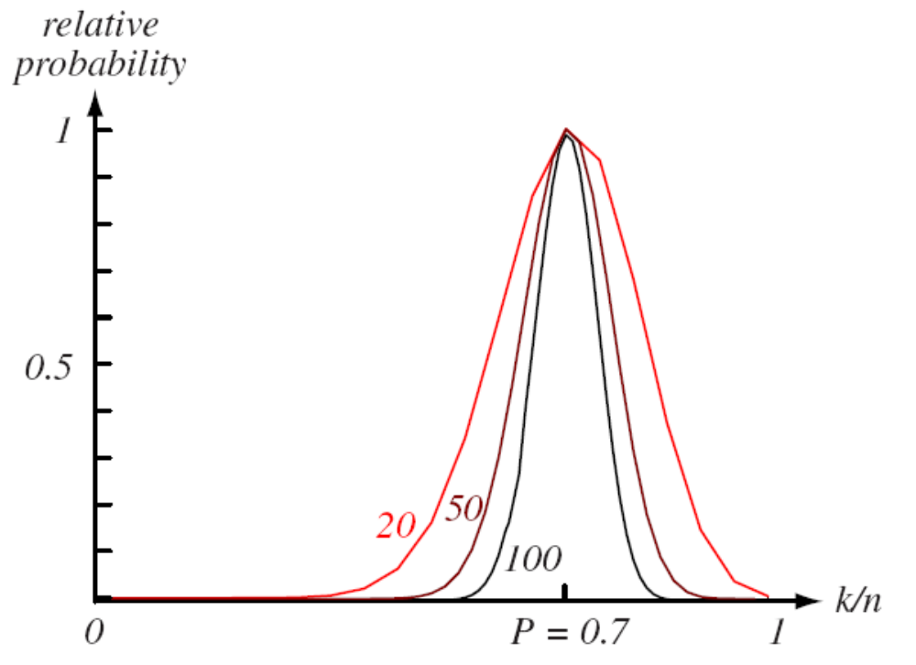
Non-parametric Density Estimation

Slide 7
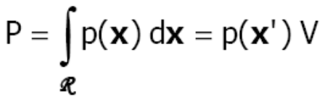
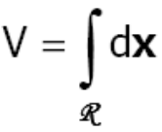

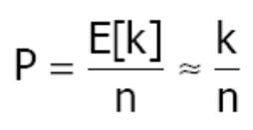
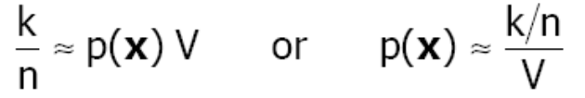
Non-parametric Density Estimation
Mean value theorem of integrals
  is the measure of the size of region R (length, area,
  volume, etc.)
  x’ is a certain point of R
If R is small enough so that the change in p of x is small in R, then
  x is any point in R
Put into，get

Slide 8
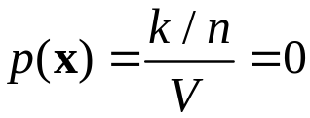
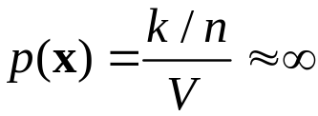





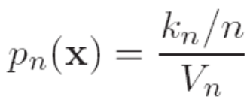
The Choice of V
In the case of a finite number of samples n
  V is too large
    p(x) is smoothed
  V approaches 0
    If there are no sample points in R, then
    If there happens to be a sample in R,then
Suppose number of samples can be unlimited
  Construct a series of regions containing x:
    uses one sample
    uses two samples
    ……
The number of samples that fall into
Estimate by
The volume of

Slide 9




The Choice of V
If , the following conditions must be satisfied
    The smoothed P/V can converge to p(x)
    The ratio of frequency k/n can converge to P
    Even if the samples falling in R tend to infinity, their proportion in the entire data set is still small

Slide 10

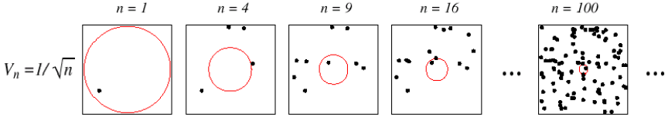

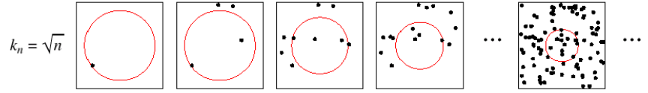
The Choice of V
Two approaches
  To gradually shrink a given initial interval according to a given volume function, e.g
    Parzen window method
  Identify k_{n} as some function of n
    k_{n}-nearest neighbor method

Slide 11

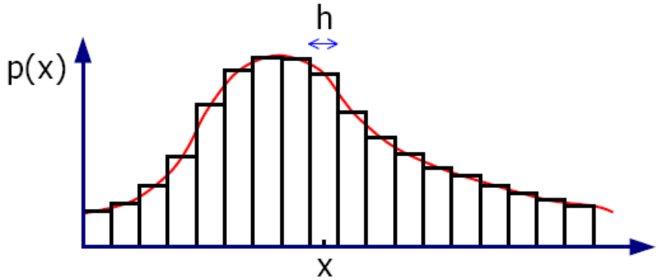


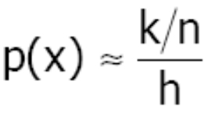
A simple example
Given a data set containing n samples
Use histograms to
simulate p(x)
Suppose k samples fall into a small bar (width h) with x as the midpoint. If n is large enough, then
According to the above two approximations, get
Notes:
黑板画图讲解

Slide 12
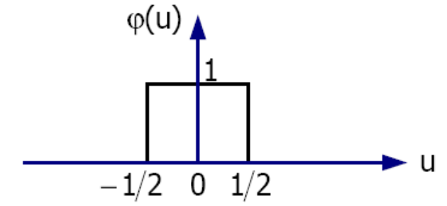
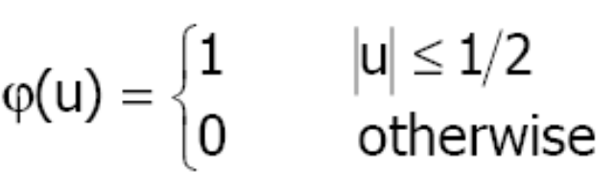

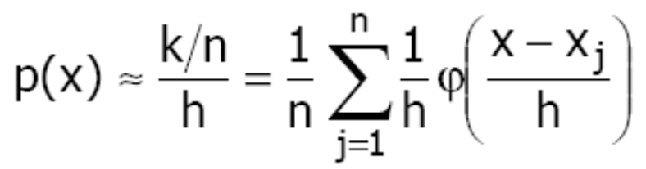
A simple example
Define window function (kernel function, potential function)
The number of samples that fall into bars of width h and midpoint x
Non-parametric simulation of p(x)
The mean of a certain function of x_{j}
Notes:
phi

Slide 13




Parzen Window Method
Suppose R is a d-dimensional hypercube with side length h, then the volume of R is
Define window function
The number of samples that fall into R
Approximate p(x) with n samples

Slide 14


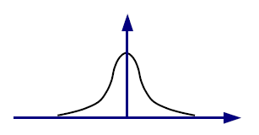
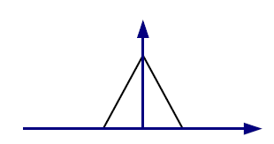
Parzen Window Method
Define
  Then the approximation to p(x) can be rewritten as
Basic idea
  Each sample x_{j} makes a contribution to the estimation of p(x), which is represented by some form of interpolation function based on the distance from x_{j} to x
Generalization：examples of interpolation functions
interpolation function

Slide 15


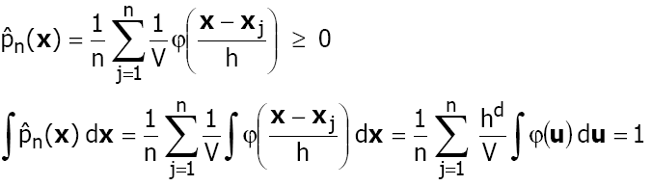


Parzen Window Method
Because ，and ，so
  It shows that the estimated is a reasonable probability density function
Discreteness
  if is discrete，then is discrete
  if is continuous，then is continuous

Slide 16
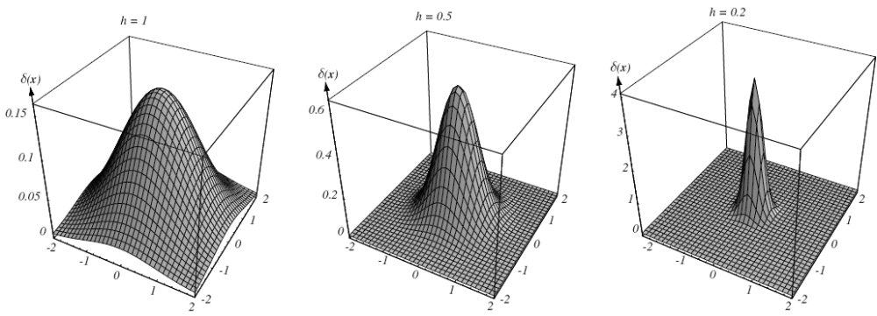
Parzen Window Method

Slide 17


Parzen Window Method
The effect of h(or V) on
  When h is very large, the distance between x_{j} and x has little effect on
    is the sum of n wide, slowly varying functions
    is a very smooth estimate of p(x) -- the defocus estimate
    The resolution of the estimated results is low
  When h is very small, the peak of is very sharp
    is the superposition of n sharp pulses centered on sample points
    is a noisy estimate of p(x)
    The statistical stability of the estimated results is insufficient

Slide 18
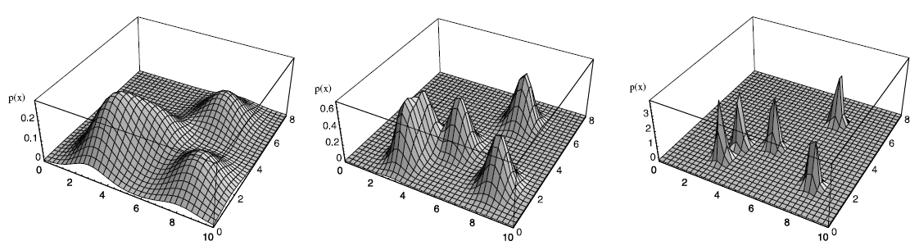
Parzen Window Method
Under the constraint of finite number of samples n, h (or V) should take some acceptable compromise
With the increase of n, h (or V) should be reduced gradually to make the estimate of P (x) more accurate

Slide 19
Parzen Window Method
Generalization of the window function
  Don't have to specify R as a hypercube, but rather some generalized form defined by the window function, which satisfies the conditions
  to make be a reasonable probability density function
  h：the width of window

Slide 20



Example One
p(x) is a normal distribution of zero mean value, unit variance and univariate
window function is
the volume
Parzen window estimation

Slide 21

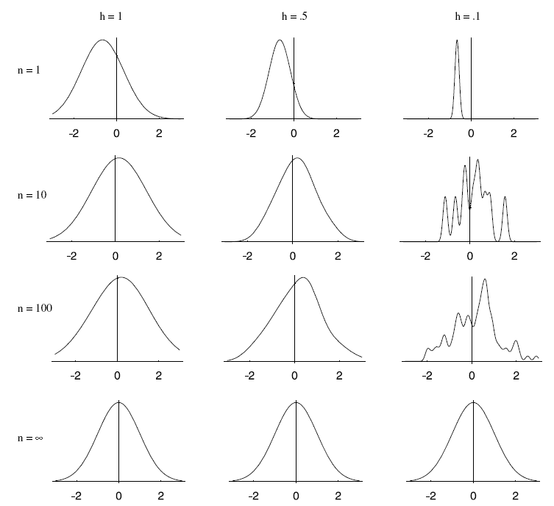
Example One

Slide 22
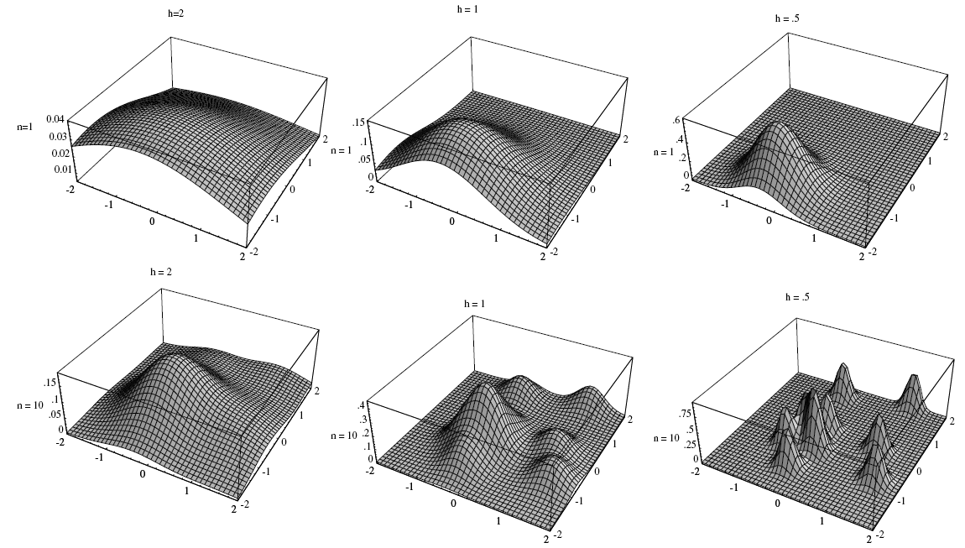
Example One : The Two-dimensional Case

Slide 23
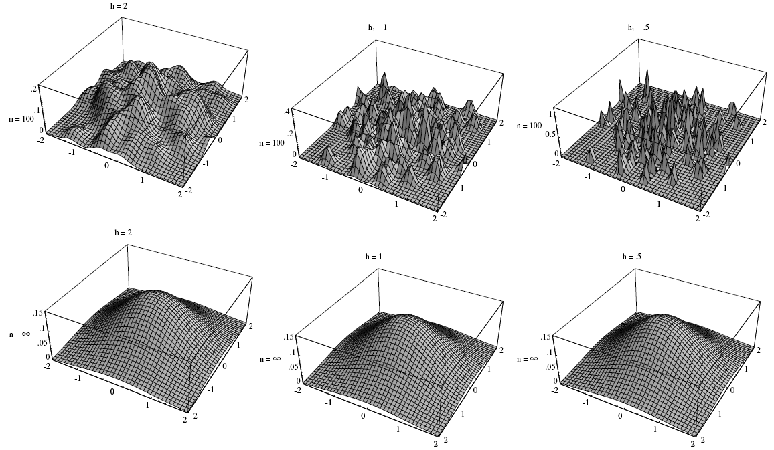
Example One: The Two-dimensional Case

Slide 24
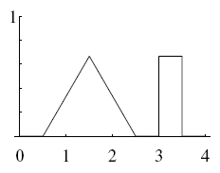

Example Two
p(x) is a mixed distribution of a uniform distribution and a triangular distribution
the window function
the width of window

Slide 25
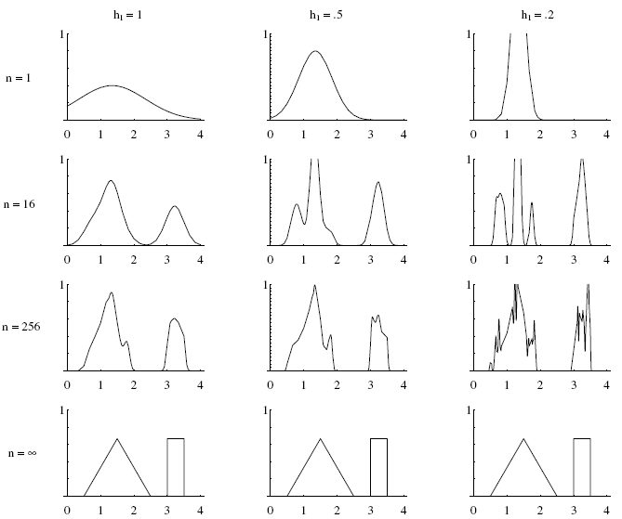
Example Two

Slide 26


Classification
The classifier based on Parzen window estimation
  for each class, use the Parzen window to estimate the class-conditional probability density
  then, calculate the posterior probability by using Bayes formula
  Classification according to the principle of "maximum posterior probability" (MAP)

Slide 27
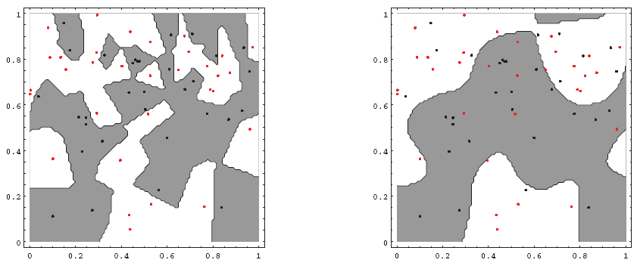
Classification
Parzen window classifier's decision domain and window function
small window width
large window width
Notes:
上半部较适合小窗宽，下半部适合大窗宽

Slide 28
Advantages vs. Disadvantages
Non-parametric method
  Advantages
    Generality: It is possible to estimate distributions without knowing their forms
    When training samples are sufficient, no matter what the form of the actual probability density function is, a reliable convergence result will definitely be obtained in the end
  Disadvantages
    A large number of training samples are required, which are often much larger than the number of training samples required for parameter estimation given the parametric form of the distribution
    The curse of dimensionality (维数灾难) for the number of training samples increases exponentially with the dimensionality of the feature space

