Slide 1
Ch 05. Non-parametric method
Part 2 k_{n}-Nearest neighbor estimation

Slide 2
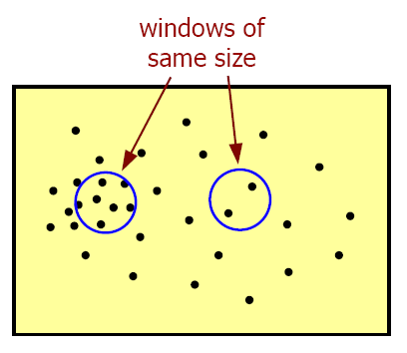
The problem of Parzen Window Estimation
If the distribution of p(x) is non-uniform, using the same width of window in the entire feature space may not get satisfactory results.
The same width of two windows

Slide 3
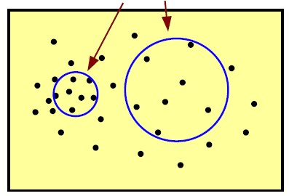
k_{n}-Nearest neighbor estimation
A method to solve the problem of Parzen window estimation with fixed window width
  The window width is not fixed, but the number of samples k around x is fixed.
  k is denoted as k_{n} , because it usually depends on the total number of samples n
  The density around x is large, the window width becomes smaller (high resolution)
  The density around x is small, the window width becomes larger (low resolution)
  The k_{n} samples included by the window are called the k_{n} nearest neighbors of x
The same number of samples in the window

Slide 4





k_{n}-Nearest neighbor estimation
Let ,
The necessary and sufficient conditions for to converge to the true distribution p(x) are
A common choice that satisfies this condition

Slide 5


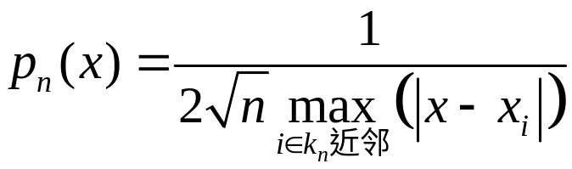
An Example
One-dimensional distribution ，
  When n=1，
  When ，
Notes:
黑板作图

Slide 6
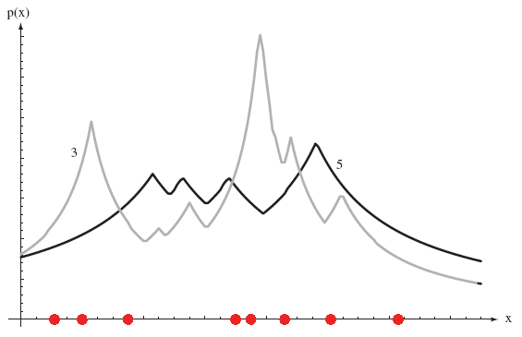
An Example
n=8, k=3 or 5
Notes:
尖锐的变化源自体积V的突然变化

Slide 7
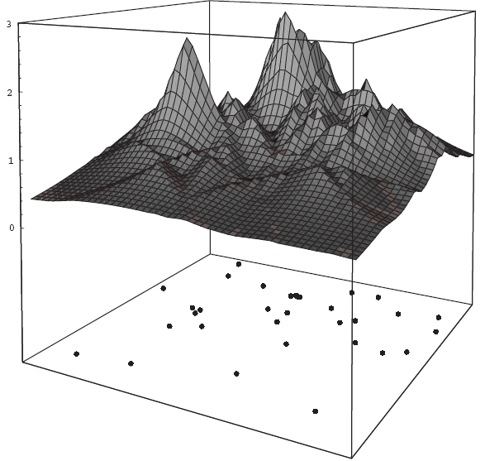
An Example
K=5

Slide 8
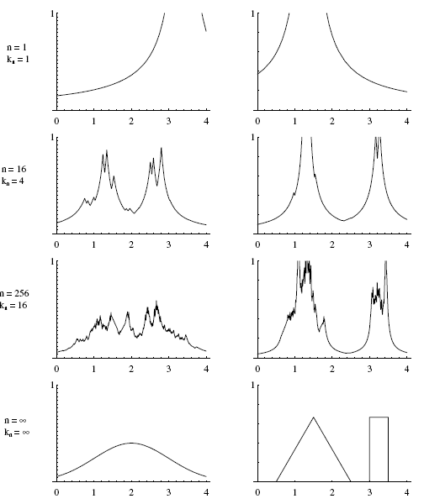

An Example

Slide 9
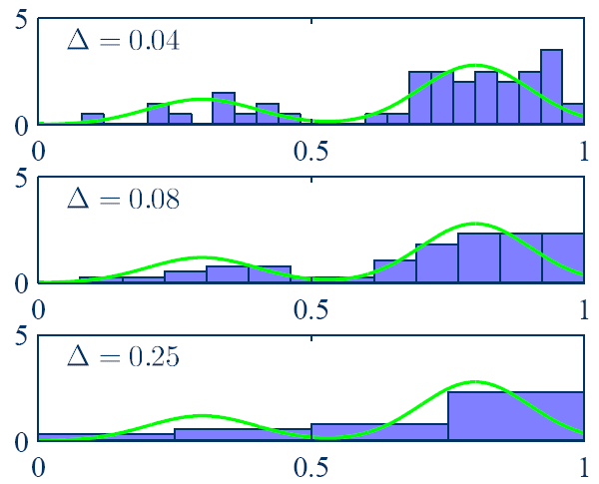
More Examples for Non-parametric Estimation
Histogram estimation
Notes:
把一维空间切分成若干小区间，数一数每个区间中有多少样本，落入某个区间中的个数k除以总数就是其对应格子的概率

Slide 10
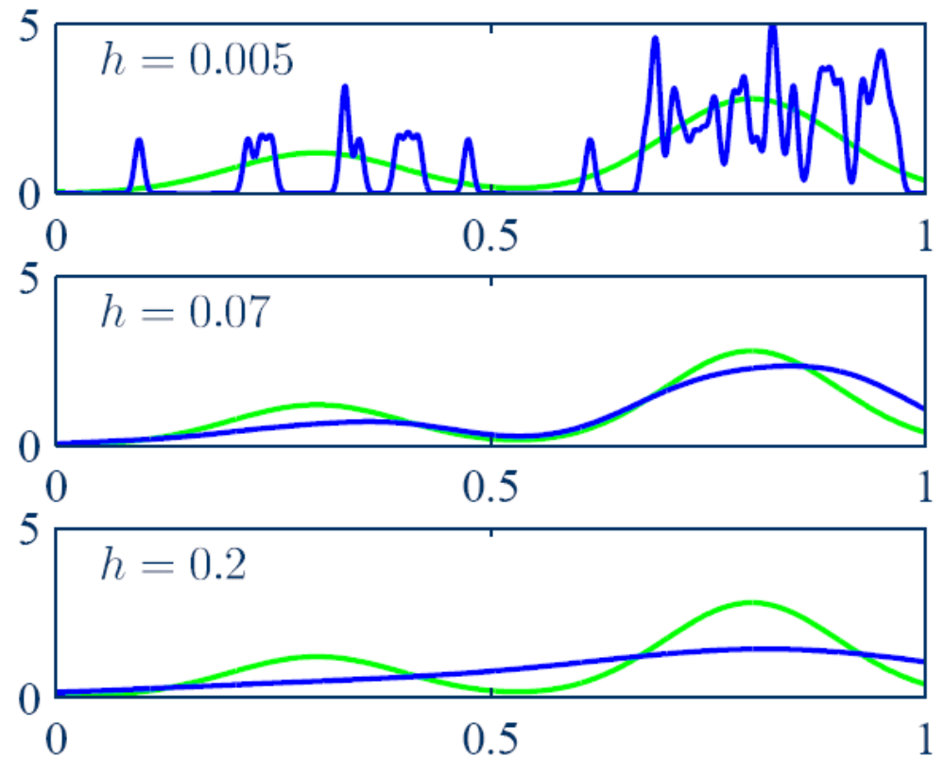
More Examples for Non-parametric Estimation
Parzen window estimation

Slide 11
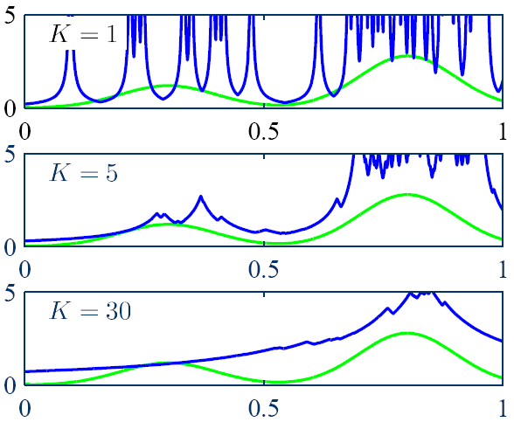
More Examples for Non-parametric Estimation
k_{n}-Nearest neighbor estimation

Slide 12
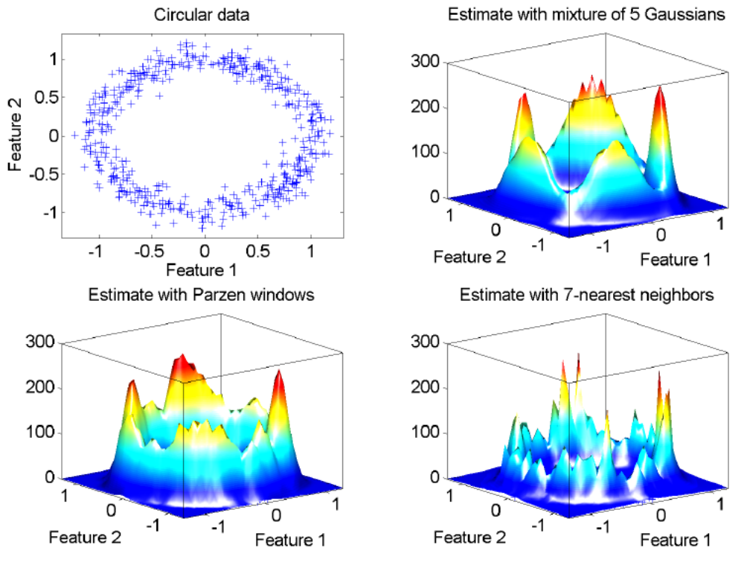
More Examples for Non-parametric Estimation

Slide 13
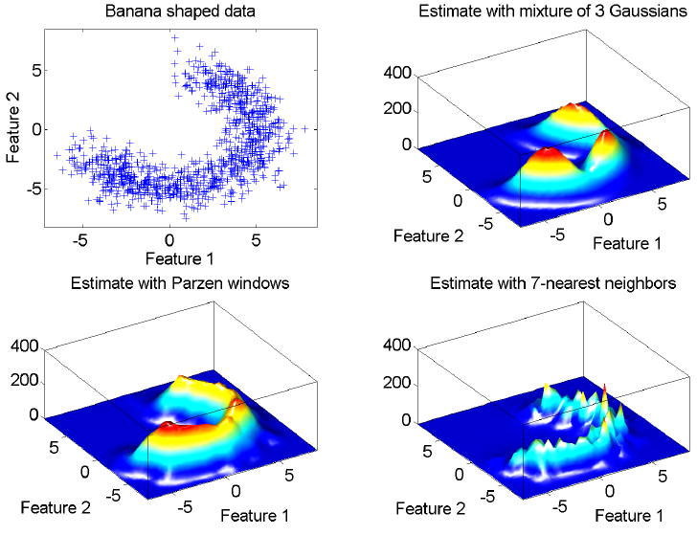
More Examples for Non-parametric Estimation

Slide 14
Ch 05. Non-parametric method
Part 3 k-nearest neighbor rule

Slide 15




Approaches to Pattern Classification
Approach 1：Estimate class-conditional probability density
  Through and , calculate posterior probability with Bayes’ rule, then make decisions with maximum posterior probability
  Two Methods
    Method 1a：Parameter estimation of probability density
      Based on parametric description of
    Method 1b： Non-Parametric estimation of probability density
      Based on non-parametric description of
Approach 2：Estimate posterior probability
  Don’t have to estimate in advance
Approach 3：Compute discrimination function
  Don’t have to estimate or

Slide 16


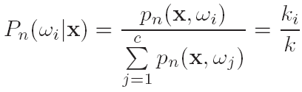


Non-parametric Estimation of Posterior Probability
Suppose a region R near x can be included into k samples, where k_{i} samples belong to the category ,
Posterior probability
Decision
  Parzen window estimation: select the category with the largest value of
  k_{n}-Nearest neighbor estimation: select the category with the largest value of
k-nearest neighbor classifier

Slide 17



Nearest Neighbor Rule
k-nearest neighbor decision when k=1
  Judge x as the category of the training sample x’ closest to it
Given training set , which includes n samples from c different categories
For test sample x, if is the training sample closest to x (according to some distance measurement), then the nearest neighbor (1-NN) rule is
The nearest neighbor rule is a suboptimal method, and the usual error rate is greater than the least possible (i.e., Bayesian error rate)
If x_{k} belongs to a class , the class of x is judged to be

Slide 18

Nearest Neighbor Rule
Intuitive understanding
  When the number of samples is large, x’ can be considered close enough to x to make
  i.e. the nearest neighbor rule is a valid approximation to the true posterior probability

Slide 19
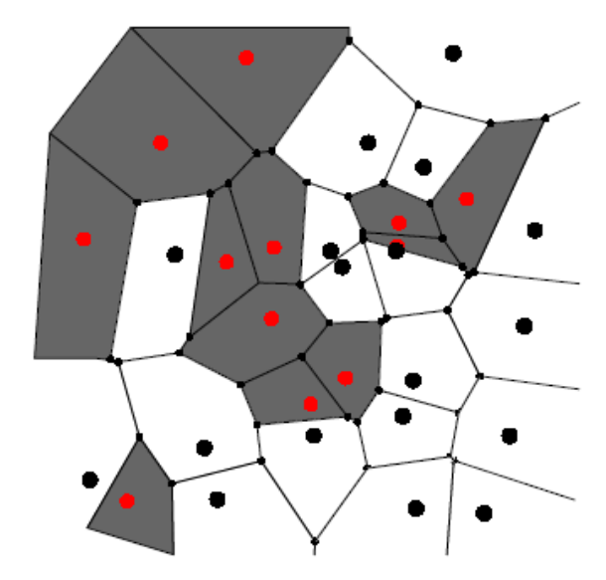
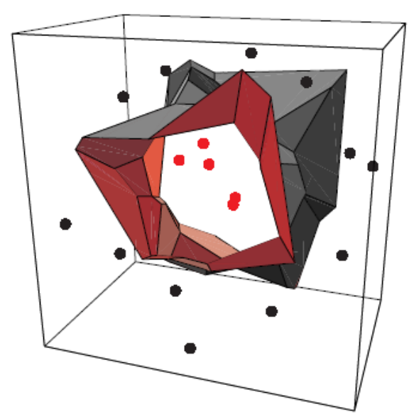
Voronoi Grid
The nearest neighbor rule divides the feature space into a grid cell structure called Voronoi grid
  Each unit contains a training sample point x’
  The distance from any point x in the unit to x’ is less than the distance from other training sample points
  All sample points in this unit are judged to belong to the category of x’

Slide 20

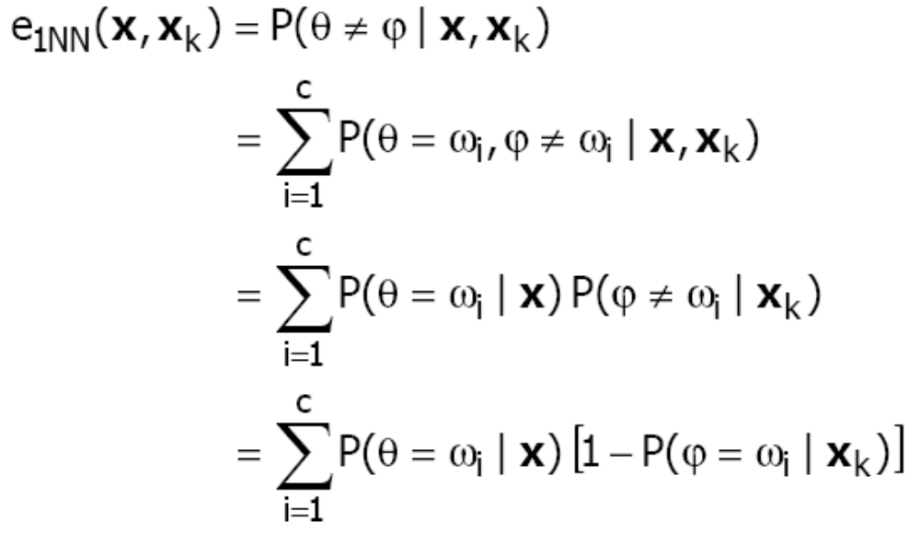
Error Rate of The Nearest Neighbor Rule
Given a training set , which includes n samples from c different categories
For test sample x, let be the training sample closest to x
The category labels for x and x_{k} are and ,respectively
Conditional error probability

Slide 21

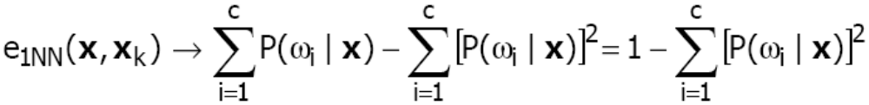
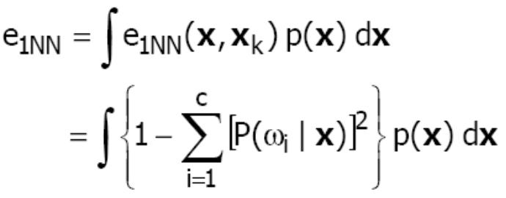
Error Rate of The Nearest Neighbor Rule
Conditional error probability（cont’）
  When , suppose D contains enough samples to make
  and when ，then
Average error rate（when ）

Slide 22

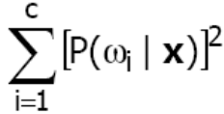
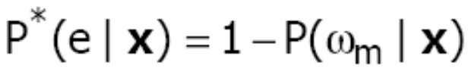
Error Bound of The Nearest Neighbor Rule
The lower bound of the average error rate
The upper bound of the average error rate
  When takes the minimum of each x, is the maximum
  Let the true class of x be , then the Bayesian error rate is expressed as

Slide 23




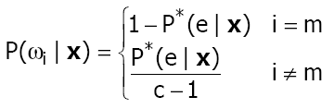
Error Bound of The Nearest Neighbor Rule
The upper bound of the average error rate （cont’）
  Given （i.e. given ））
  This equation is smallest when the second term is the smallest. The second term is the smallest when
  is equal for all i except m, i.e.
Notes:
平方和的最小值当所有值相等时发生

Slide 24
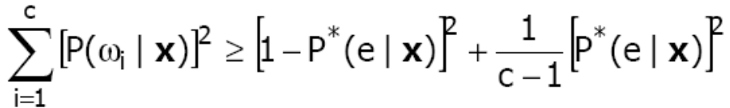

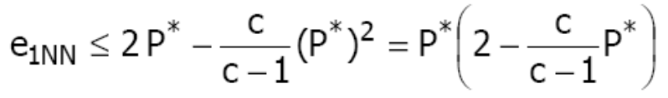

Error Bound of The Nearest Neighbor Rule
The upper bound of the average error rate （cont’）
  so
  or
  so
  When P* is small, the upper bound of the nearest neighbor rule's average error rate is：
Notes:
板书推导

Slide 25
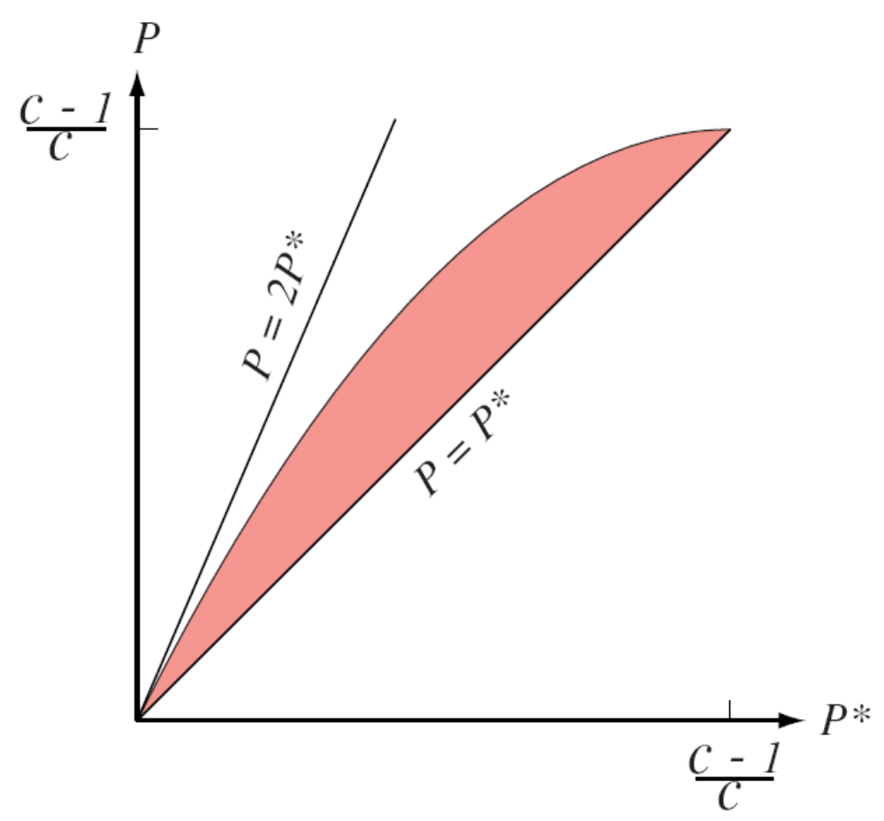
Error Bound of The Nearest Neighbor Rule

Slide 26


k-Nearest Neighbor Rule
The k-nearest neighbor (k-NN) rule is an extension of the nearest neighbor (1-NN) rule, i.e. multiple nearest neighbors are considered
Given a training set , which includes n samples from c different categories
For test sample x, let the set contain k training samples closest to x
k-nearest neighbor rule
If is the class that appears most frequently in S, then the class of x is judged to be

Slide 27
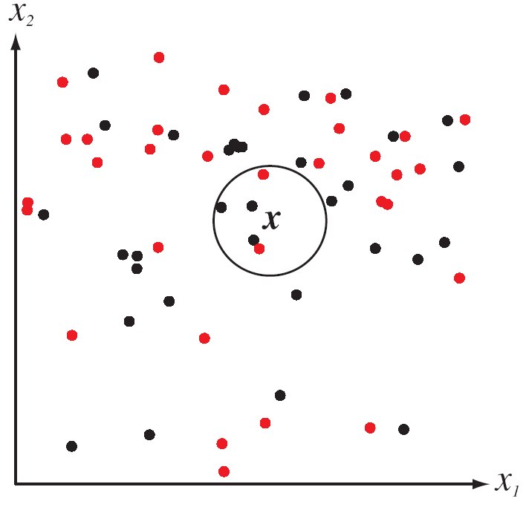
k-Nearest Neighbor Rule

Slide 28





k-Nearest Neighbor Rule
The lower bound of the average error rate
Bayes error rate
The upper bound of the average error rate
  When ，and ，then
  When k is large enough, but small enough relative to n, applying the k-NN rule to the large number of samples approximates the optimal decision

Slide 29
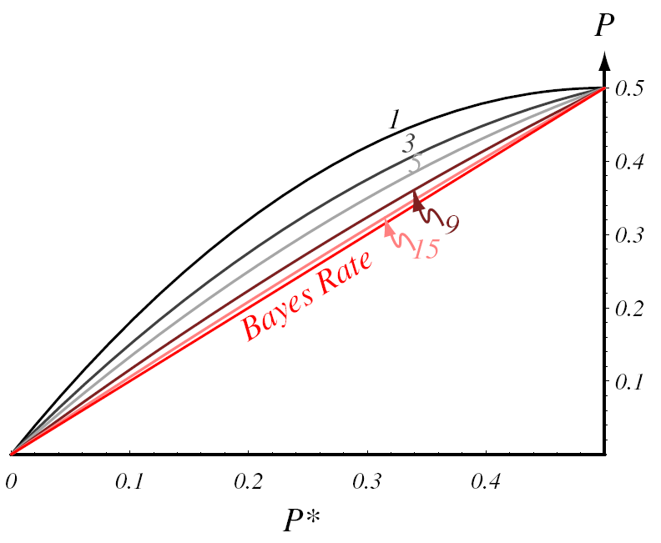
Error Bound of The k-Nearest Neighbor Rule

Slide 30



The Choice of k
The k-nearest neighbor rule can be regarded as a way to estimate the posterior probability directly from the sample
To get a reliable estimate (with a low margin of error), bigger k is better
In order for to be as close to as possible, the nearest neighbors of x are as close to x as possible, i.e. k is as small as possible
According to the actual problem, the value of k shoud be trade-off
When n tends to infinity, and k also tends to infinity at a slower speed, the k-nearest neighbor rule is the optimal classification rule

Slide 31
Example
k = 3 (Odd number)， x = (0.10, 0.25)
k nearest neighbors of x:
{(0.10, 0.28, ω₂); (0.09, 0.30, ω₅); (0.12, 0.20,ω₂)}
According to the k-nearest neighbor rule, the category of x is judged to be ω₂
Training set | category
(0.15, 0.35) (0.10, 0.28) (0.09, 0.30) (0.12, 0.20) | ω₁ ω₂ ω₅ ω₂

Slide 32
Computational Complexity
Direct method
  Suppose training set D consists of n d-dimensional samples
  Given a test sample x, the distance between it and all sample x_{i} in the training set should be calculated, and the computational complexity is O(dn).
  When n is large, the time and space complexity will be high!
The method to reduce computational complexity
  Calculate partial distance
  Pre-build structure
  Clip training samples

Slide 33
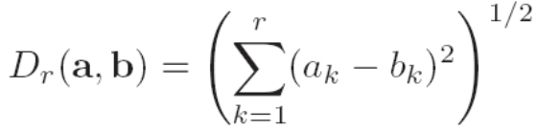
Calculate Partial Distance
When calculating distances, only one subset r of d dimensions is used
When more dimensions are added gradually, the value of partial distance is strictly non-decreasing
How to save computational cost when calculating the nearest neighbor of test sample x?
  When calculating the nearest neighbor of x, the current nearest neighbor of x can be updated with each training sample examined
  If the partial distance from x to a certain training sample on subset r is already greater than the distance from its nearest neighbor, the calculation can be stopped immediately, discarding the training sample and continuing to investigate the next sample
  This technique is especially useful when calculating distances if the dimensions with large variances are calculated first

Slide 34



Pre-build Structure
Pre-build some form of search tree, and organize them according to the relative distance between training sample points
After the search tree is established, searching the nearest neighbor to x only need to visit a portion of the entire tree, thus the amount of computational cost can be saved
For example
  Suppose that the samples obey a uniform distribution within the unit square
  Select four root nodes and
  For test point x, first calculate the distance from it to the 4 root nodes, and select the nearest one. Then, the search is only limited to the quadrant represented by this root node, and the remaining 3/4 training samples are not necessary to access
  There's no guarantee of finding x's true nearest neighbor

Slide 35
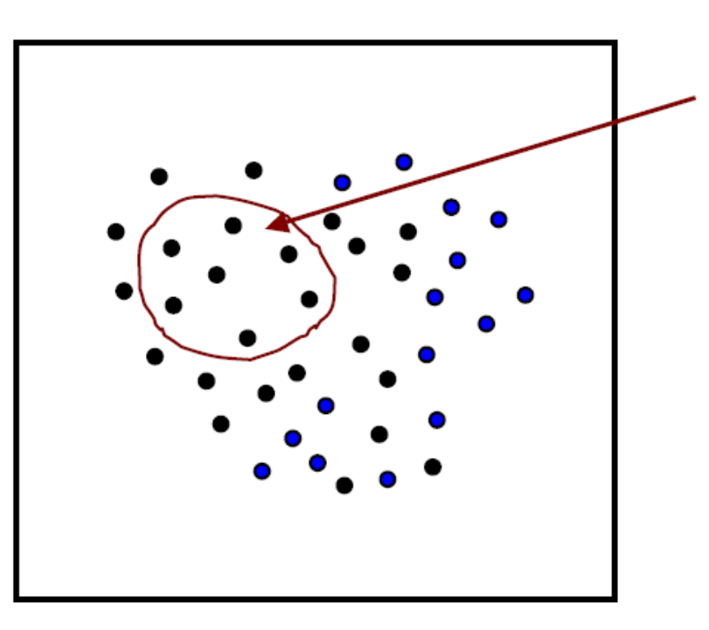
Training Samples Clip
Eliminate the "useless" training samples
Which samples are "useless"?
  Samples surrounded by samples of the same category!
useless samples

Slide 36
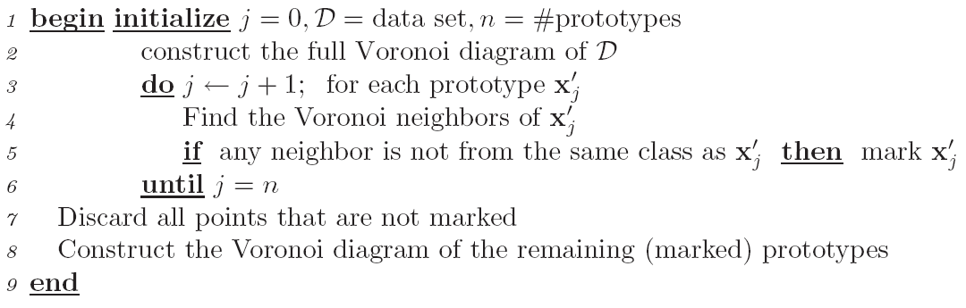
Training Samples Clip
Nearest-neighbor editing

Slide 37
Ch 05. Non-parametric Method
Part 4 Distance Metric

Slide 38




Distance Metric
The nearest neighbor rule or k-nearest neighbor rule is based on a metric that measures the distance between patterns (samples)
Distance metric is one of the core issues in the field of pattern recognition
A generic representation of metric
The properties that matric must satisfy
  Nonnegativity:
  Reflexivity:
  Symmetry:
  Triangle inequality:

Slide 39
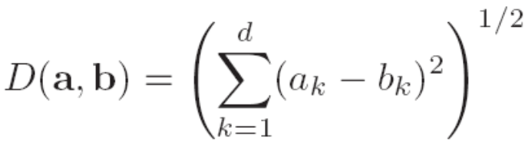
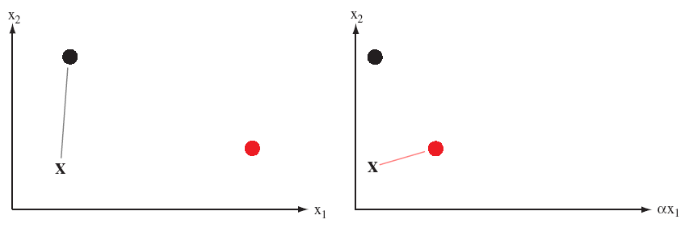
Euclidean Distance
Euclidean distance in d-dimensional space
The transformation of characteristic scale will seriously affect the nearest neighbor relationship calculated by Euclidean distance

Slide 40
Euclidean Distance
Solution
  Perform scale equalization on the distribution of each dimension (feature), so that the range of change on each dimension is equal, such as all normalization into interval [0, 1]

Slide 41
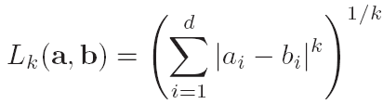
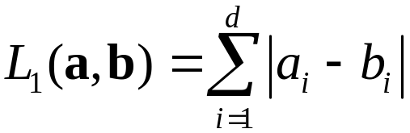

Minkowski Distance
Minkowski distance in d-dimensional space
  Also known as the L_{k}-norm
  L₂-norm——Euclidean distance
  L₁-norm——Manhattan distance（block distance）
  -norm——The maximum projection distance of a and b on d-axes
Notes:
黑板画图说明L_1和L_2的区别

Slide 42
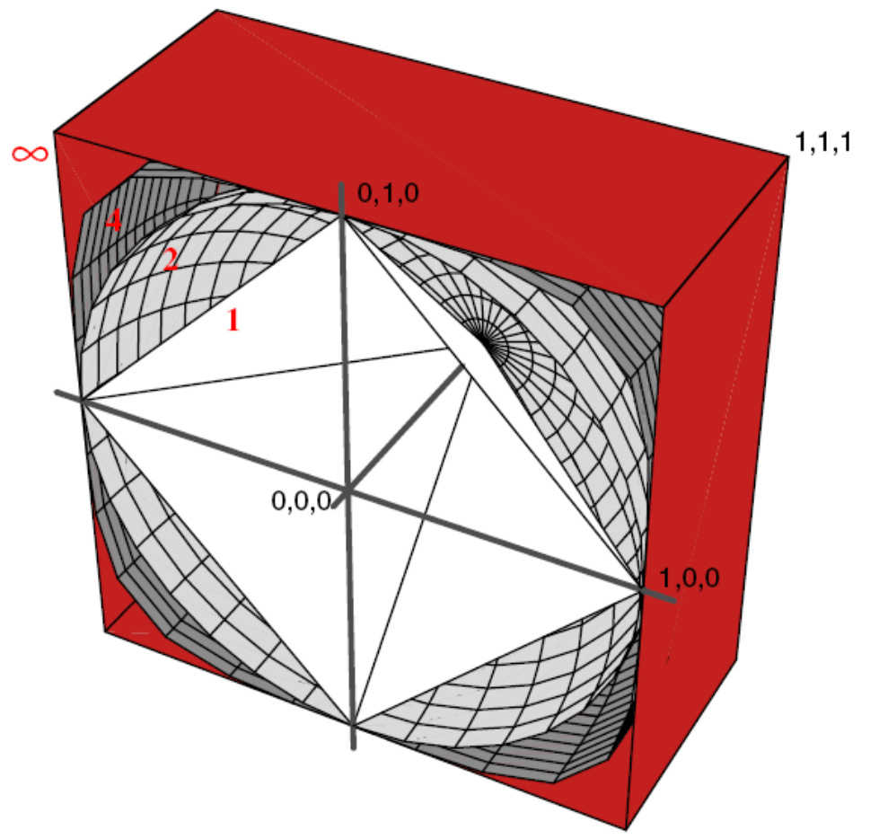
Minkowski Distance
Isometric surface to the origin

Slide 43

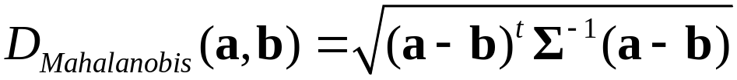

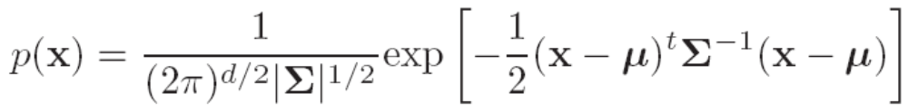
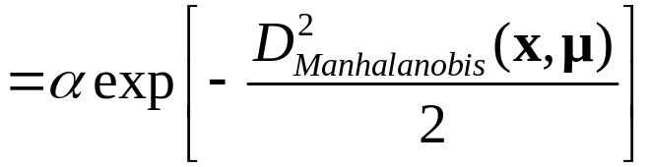
Mahalanobis Distance
Mahalanobis distance (马氏距离) considers the covariance between features when calculating the distance
The relationship between Mahalanobis distance and multivariable normal distribution

Slide 44

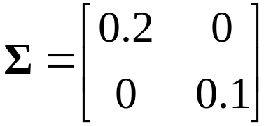
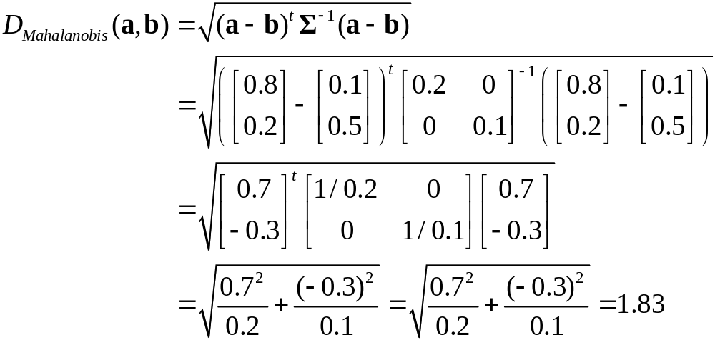
Mahalanobis Distance
For example
  a：[0.8, 0.2]^{T}，b： [0.1, 0.5]^{T} extracted from normal distribution ，
  where ，Calculate the Mahalanobis
  distance between a and b
  Solution：

Slide 45
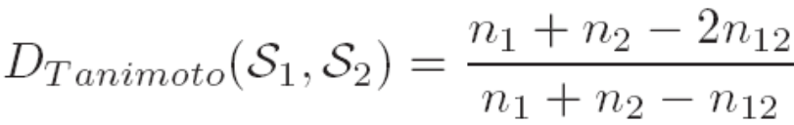
Distance Metric Between Sets
Tanimoto distance
  n₁ and n₂ are the numbers of elements in set S₁ and S₂ respectively
  n₁₂ is the number of elements in the intersection of two sets
  Application scenarios
    The two patterns (features) are either the same or different, and the similarity of a certain level cannot be calculated
    For example, for the Tanimoto distance between two words, each word can be regarded as a set of letters

Slide 46
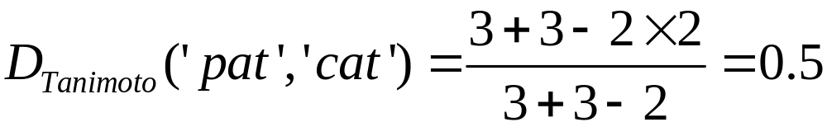
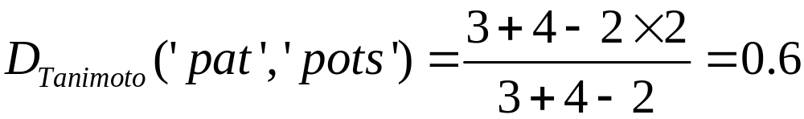
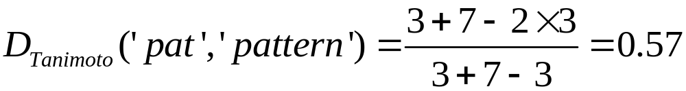
Distance Metric Between Sets
Tanimoto distance
  For example
  According to the Tanimoto distance, determine which of the following words most closely resembles' pat ':
  ‘cat’，‘pots’，‘pattern’
  Solution
  So 'cat' is the closest word to 'pat'

Slide 47

Distance Metric Between Sets
Hausdorff distance
  "The maximum value of the minimum distance from a point in one set to a point in another set"
  is a certain metric of the distance between two points a and b
    Euclidean distance
    Manhattan distance
    Mahalanobis distance
    ……
Notes:
黑板作图

Slide 48
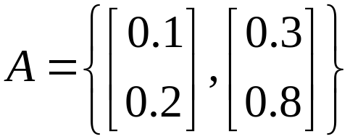
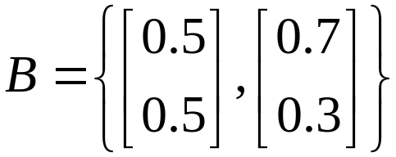




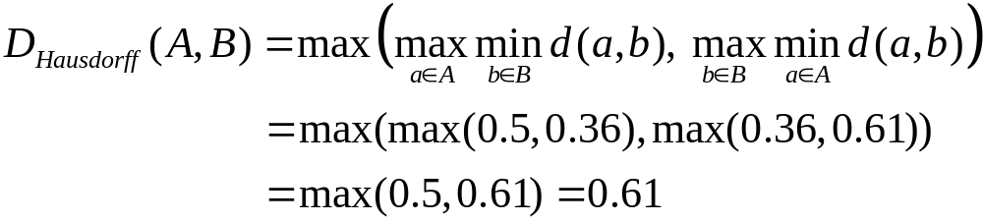
Distance Metric Between Sets
Hausdorff diatance
  For example
  Compute the Hausdorff distance between
  and
  Solution

Slide 49
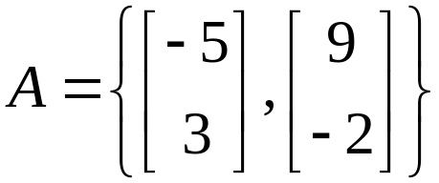
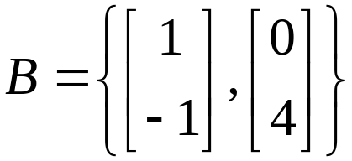
Distance Metric Between Sets
Hausdorff distance
  Exercise
  Compute the Hausdorff distance between
  and

Slide 50
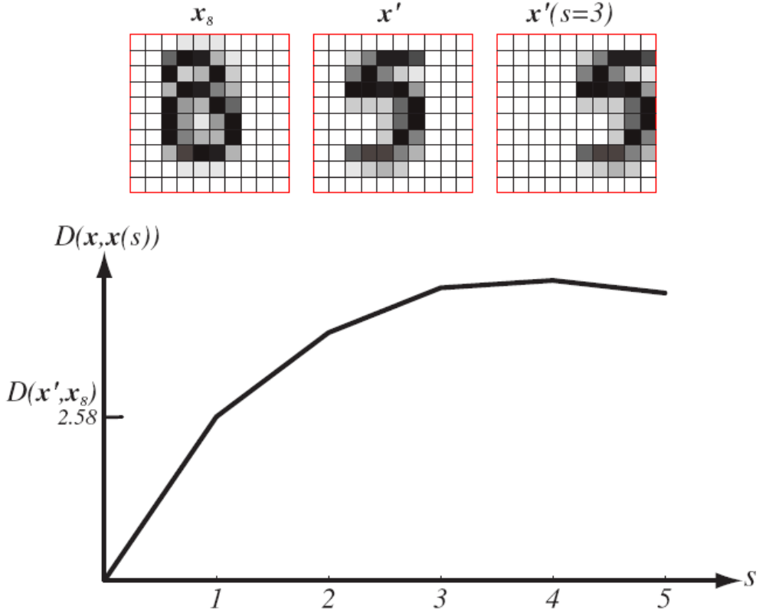
Tangent Space Distance
In many practical problems, arbitrarily choosing a distance metric, such as the most commonly used Euclidean distance, may result in poor results

Slide 51
Tangent Space Distance
invariance （不变量）problem
  Translation
  Rotation
  Scale transformation
  Thinning
  ……
Solution
  Pretreatment
  Use more general (with ** invariance) distance metric

Slide 52



Tangent Space Distance
Tangent space distance has the invariance of arbitrary transformation
  Suppose that the problem might involve r transformations
  Perform all possible transformations for each training sample x’, expressed as , i=1,2,...,r, where is the parameter of the i-th transformation, such as translation distance, rotation angle, etc.
  For each transformation, a tangent vector （切向量） can be constructed:
  The tangent vectors of all transformations are spanned into a tangent space（切空间） of x’, which is a linear approximation of all possible transformations of x’, where each point corresponds to a possible transformation
  The tangent space distance from test point x to x’ is the minimum distance from x to x’, so it can be considered to have arbitrary transformation invariance

Slide 53
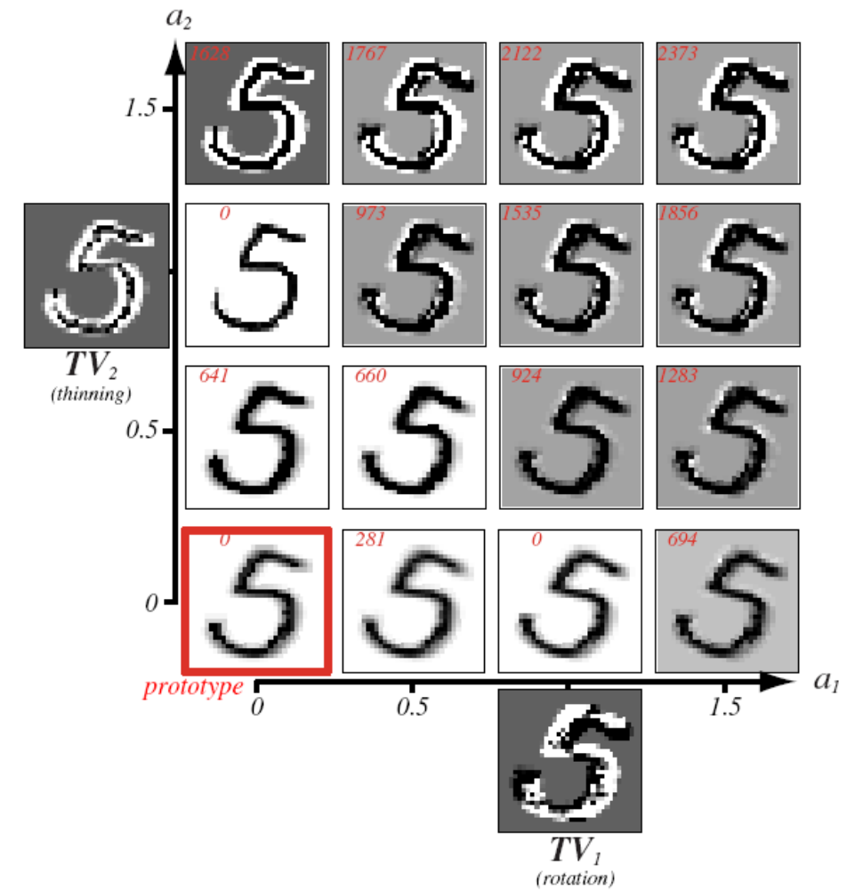
Tangent Space Distance
For example：tangent space of rotation and thinning

Slide 54
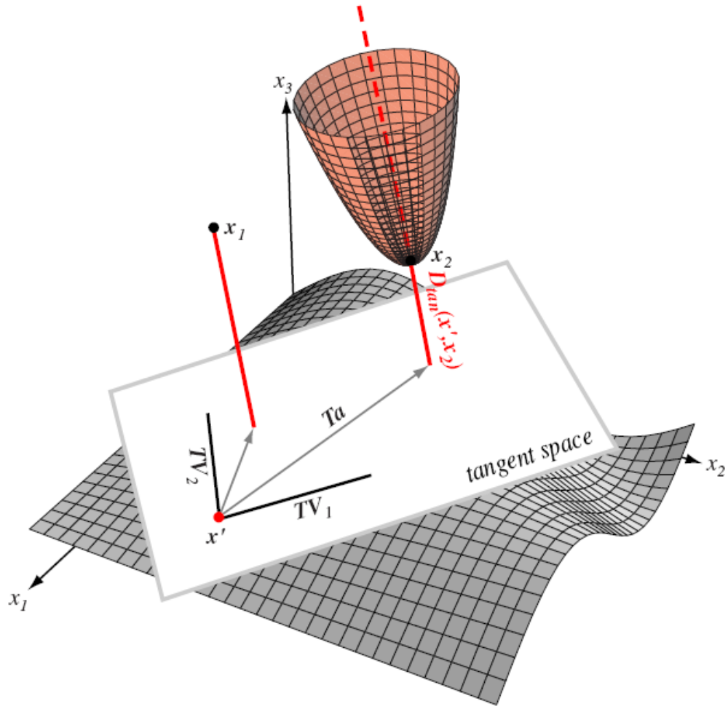
Tangent Space Distance
Calculate the tangent space distance from x to x’

Slide 55
Tangent Space Distance
The nearest neighbor classifier based on tangent space distance usually has high accuracy
However, the calculation of tangent space distance requires the designer to know all possible transformations in advance and be able to apply these transformations on each prototype point (training sample point), which sometimes cannot be satisfied in practice
The computational complexity of tangent space distance is high, and the computational complexity may be unbearable when the data set is large

