Slide 1
Ch 07. Linear Discriminant Function
Notes:
1

Slide 2
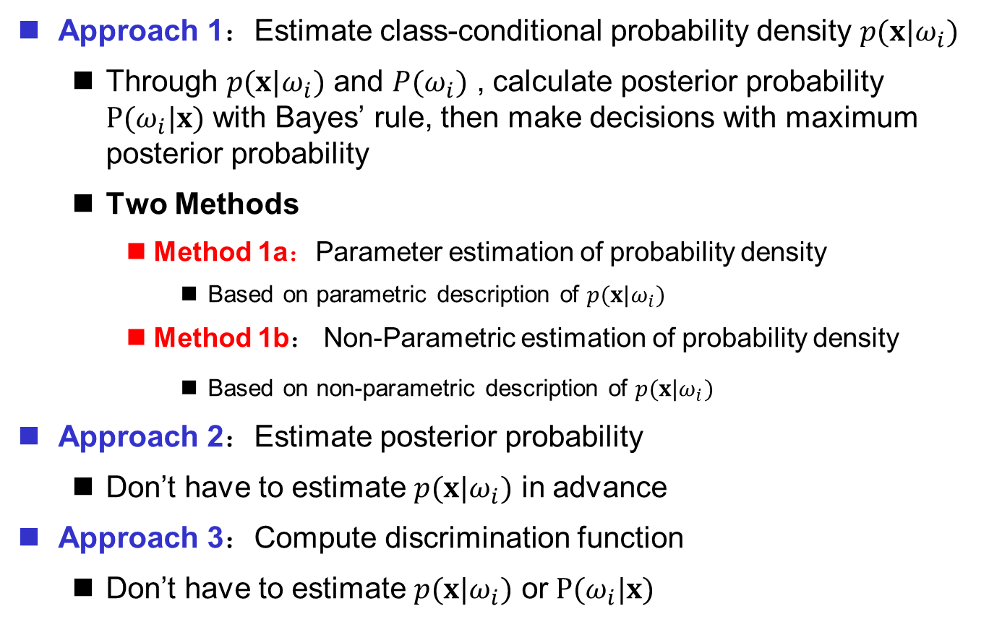
Approaches to Pattern Classification
Approach 1：Estimate class-conditional probability density $p(x|ω_{i})$
Through $p(x|ω_{i})$ and $P(ω_{i})$ , calculate posterior probability $P(ω_{i}|x)$ with Bayes’ rule, then make decisions with maximum posterior probability
Two Methods
Method 1a：Parameter estimation of probability density
Based on parametric description of $p(x|ω_{i})$
Method 1b： Non-Parametric estimation of probability density
Based on non-parametric description of $p(x|ω_{i})$
Approach 2：Estimate posterior probability
Don’t have to estimate $p(x|ω_{i})$ in advance
Approach 3：Compute discrimination function
Don’t have to estimate $p(x|ω_{i})$ or $P(ω_{i}|x)$

Slide 3
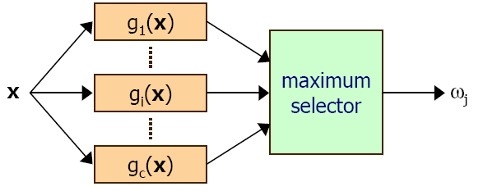

Discriminant Function
The most common expression of classifier is discriminant function $g_{i}\left(x\right), i=1,…,c$, and each category corresponds to a discriminant function
Decision rule based on discriminant function
If $g_{j}\left(x\right)≥g_{i}\left(x\right), ∀i≠j$, then the pattern is $ω_{j}$

Slide 4
Discriminant Function
Suppose that the discriminant function form of each category is known
The parameters in the function can be estimated by using the training sample set
Discriminant function example
linear discriminant function
quadratic discriminant function

Slide 5
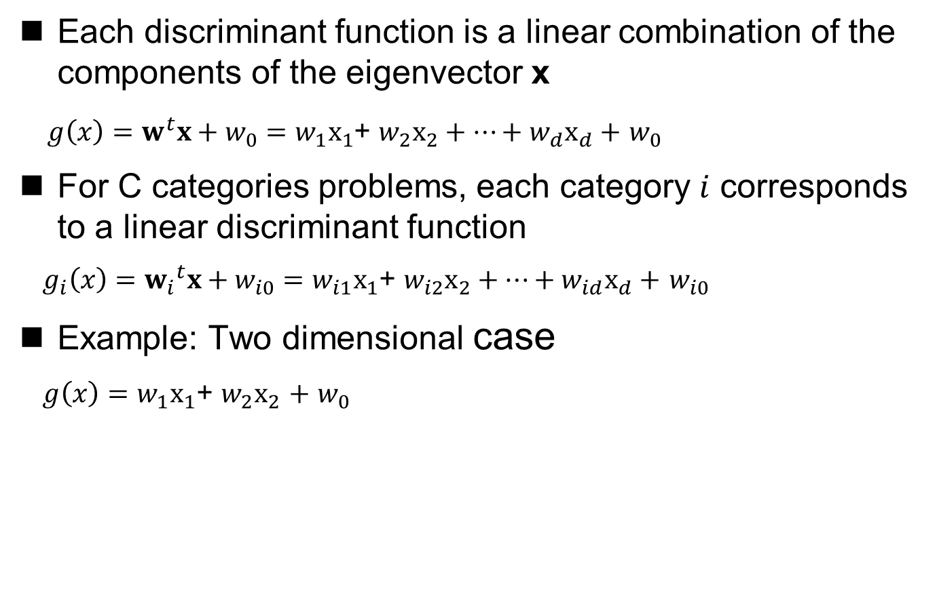
Linear Discriminant Function
Each discriminant function is a linear combination of the components of the eigenvector x
$g\left(x\right)=w^{t}x+w_{0}=$ $w_{1}x_{1}$+ $w_{2}x_{2}+…+w_{d}x_{d}+$ $w_{0}$
For C categories problems, each category $i$ corresponds to a linear discriminant function
$g_{i}\left(x\right)={w_{i}}^{t}x+w_{i0}=$ $w_{i1}x_{1}$+ $w_{i2}x_{2}+…+w_{id}x_{d}+$ $w_{i0}$
Example: Two dimensional case
$g\left(x\right)=w_{1}x_{1}\text{+ }w_{2}x_{2}$ $+$ $w_{0}$

Slide 6
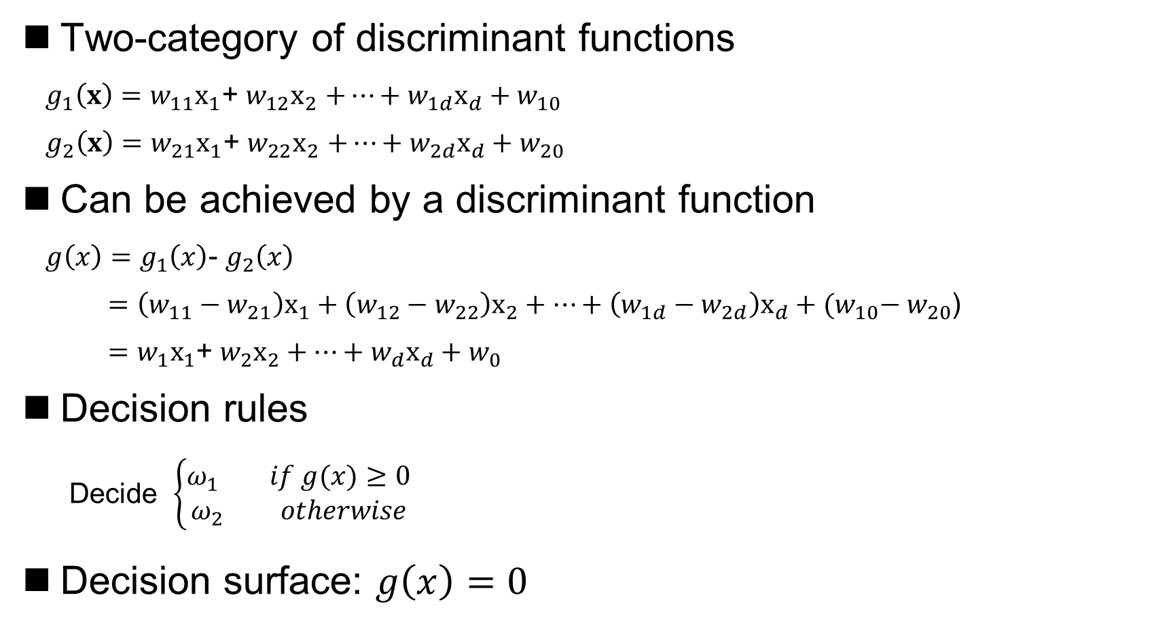
Linear discriminant functions – two-category case
Two-category of discriminant functions
$g_{1}\left(x\right)=w_{11}x_{1}\text{+ }w_{12}x_{2}$ $+…+w_{1d}x_{d}+w_{10}$
$g_{2}\left(x\right)=w_{21}x_{1}\text{+ }w_{22}x_{2}$ $+…+w_{2d}x_{d}+w_{20}$
Can be achieved by a discriminant function
$g\left(x\right)=$ $g_{1}\left(x\right)$- $g_{2}\left(x\right)$
$=\left(w_{11}−w_{21}\right)x_{1}+\left(w_{12}−w_{22}\right)x_{2}+…+\left(w_{1d}−w_{2d}\right)x_{d}+{(w}_{10}− w_{20}$)
$=$ $w_{1}x_{1}$+ $w_{2}x_{2}+…+w_{d}x_{d}+w_{0}$
Decision rules
Decide $\left\{\begin{aligned}ω_{1} if g(x)≥0 \\ ω_{2} otherwise\end{aligned}\right.$
Decision surface: $g\left(x\right)=0$

Slide 7
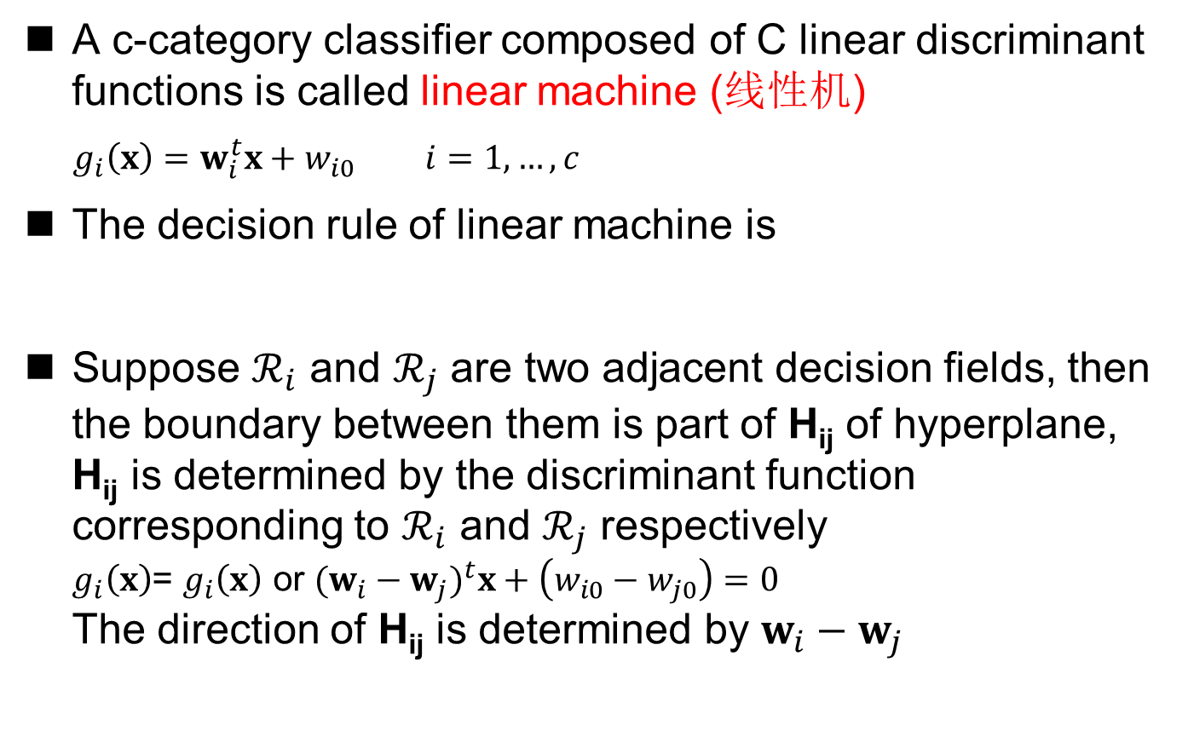

Linear discriminant functions – Multi-category case
A c-category classifier composed of C linear discriminant functions is called linear machine (线性机)
$g_{i}\left(x\right)=w_{i}^{t}x+w_{i0} i=1,…,c$
The decision rule of linear machine is
Suppose $ℛ_{i}$ and $ℛ_{j}$ are two adjacent decision fields, then the boundary between them is part of H_{ij} of hyperplane, H_{ij} is determined by the discriminant function corresponding to $ℛ_{i}$ and $ℛ_{j}$ respectively $g_{i}\left(x\right)$= $g_{i}\left(x\right)$ or ${(w_{i}−w_{j})}^{t}x+\left(w_{i0}−w_{j0}\right)=0$ The direction of H_{ij} is determined by $w_{i}−w_{j}$
Decide $ω_{j}$, if $g_{j}\left(x\right)≥g_{i}\left(x\right), ∀i≠j$

Slide 8
Linear discriminant functions – Multicategory case
The decision domains and decision surfaces of a linear machine

Slide 9
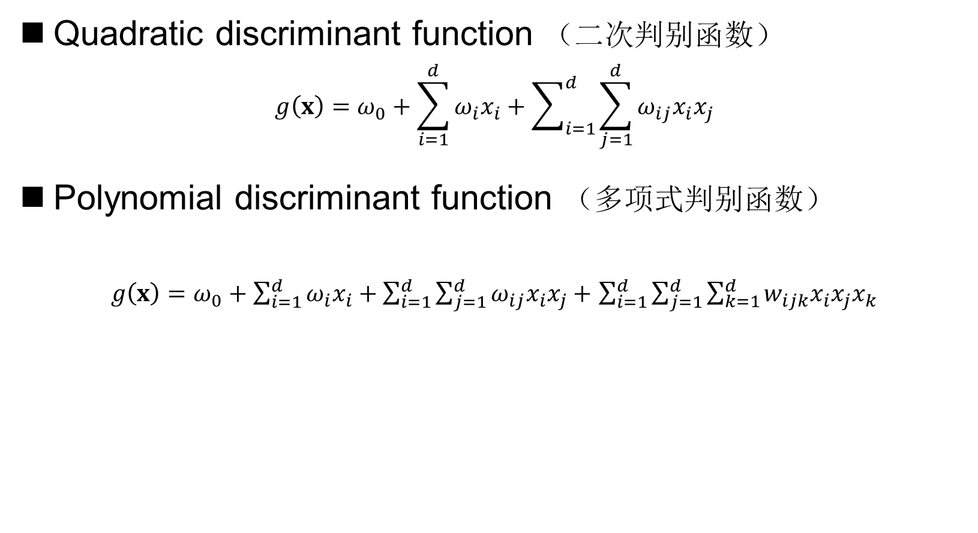
Generalized Linear Discriminant Function
Quadratic discriminant function （二次判别函数）
$$g\left(x\right)=ω_{0}+\sum_{i=1}^{d}{ω_{i}x_{i}+\sum_{i=1}^{d}{\sum_{j=1}^{d}{ω_{ij}x_{i}x_{j}}}}$$
Polynomial discriminant function （多项式判别函数）
$g\left(x\right)=ω_{0}+\sum_{i=1}^{d}{ω_{i}x_{i}+\sum_{i=1}^{d}{\sum_{j=1}^{d}{ω_{ij}x_{i}x_{j}+}}}$ $\sum_{i=1}^{d}{\sum_{j=1}^{d}{\sum_{k=1}^{d}{w_{ijk}x_{i}x_{j}x_{k}}}}$

Slide 10
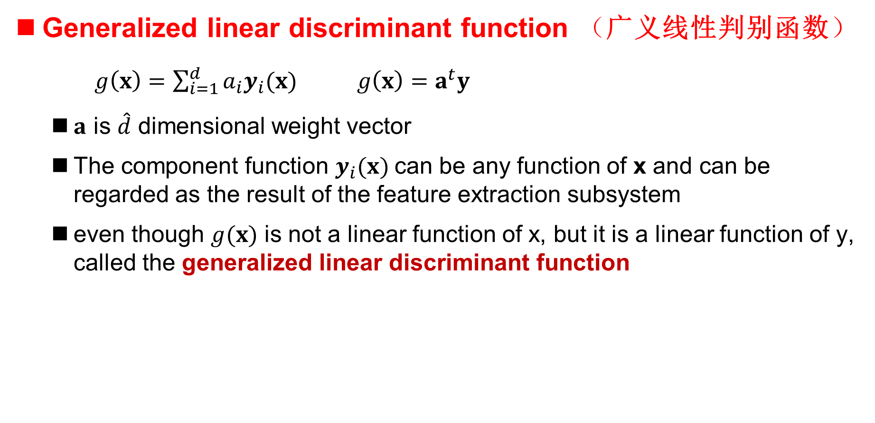
Generalized Linear Discriminant Function
Generalized linear discriminant function （广义线性判别函数）
$g\left(x\right)=\sum_{i=1}^{d}{a_{i}y_{i}(x)}$ $g\left(x\right)=a^{t}y$
$a$ is $\hat{d}$ dimensional weight vector
The component function $y_{i}(x)$can be any function of x and can be regarded as the result of the feature extraction subsystem
even though $g(x)$ is not a linear function of x, but it is a linear function of y, called the generalized linear discriminant function

Slide 11
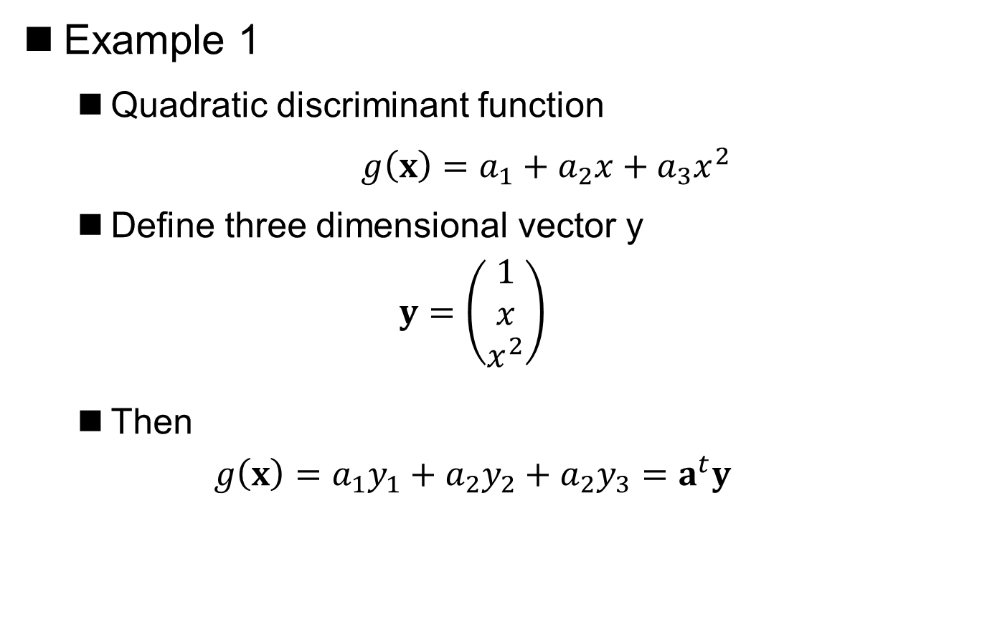
Generalized Linear Discriminant Function
Example 1
Quadratic discriminant function
$g\left(x\right)=a_{1}+a_{2}x+a_{3}x^{2}$
Define three dimensional vector y
$$y=\left(\begin{aligned}1 \\ x \\ x^{2}\end{aligned}\right)$$
Then
$$g\left(x\right)=a_{1}y_{1}+a_{2}y_{2}+a_{2}y_{3}=a^{t}y$$
Notes:
11

Slide 12
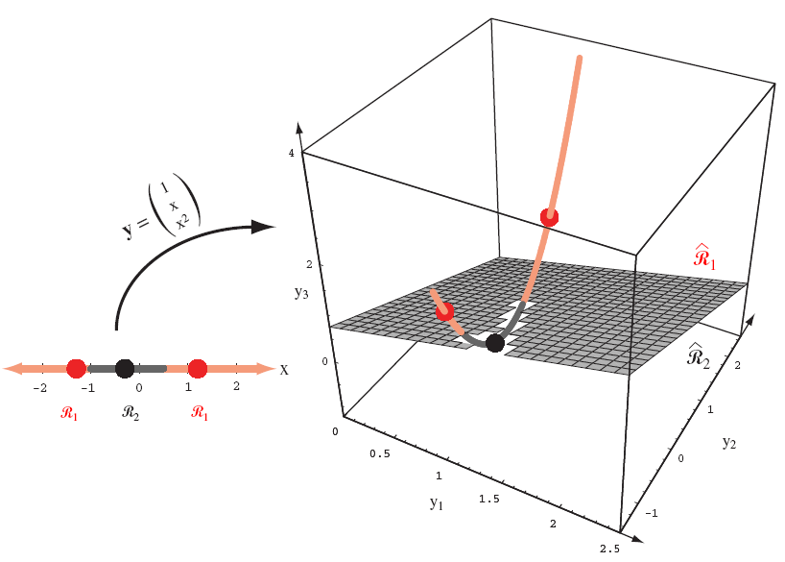

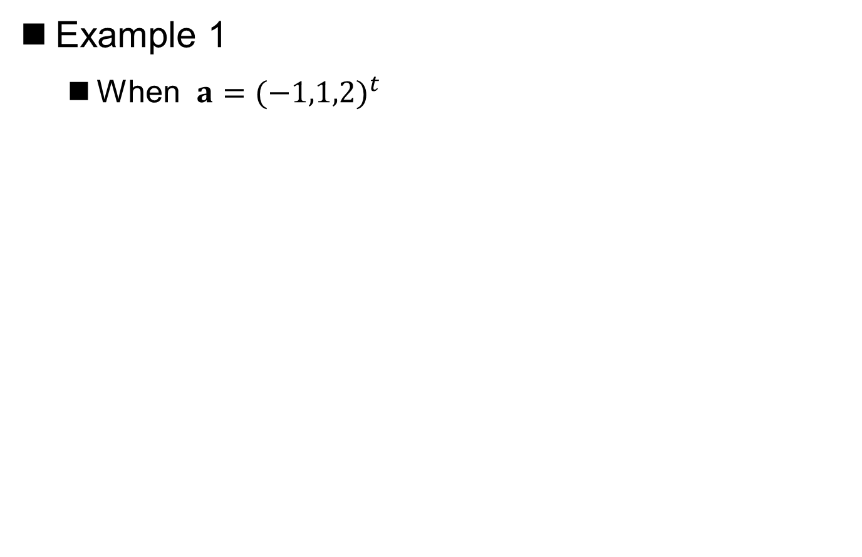
Generalized Linear Discriminant Function
Example 1
When $a={(−1,1,2)}^{t}$
Notes:
板书推导R1:x<-1或x>0.5
12

Slide 13
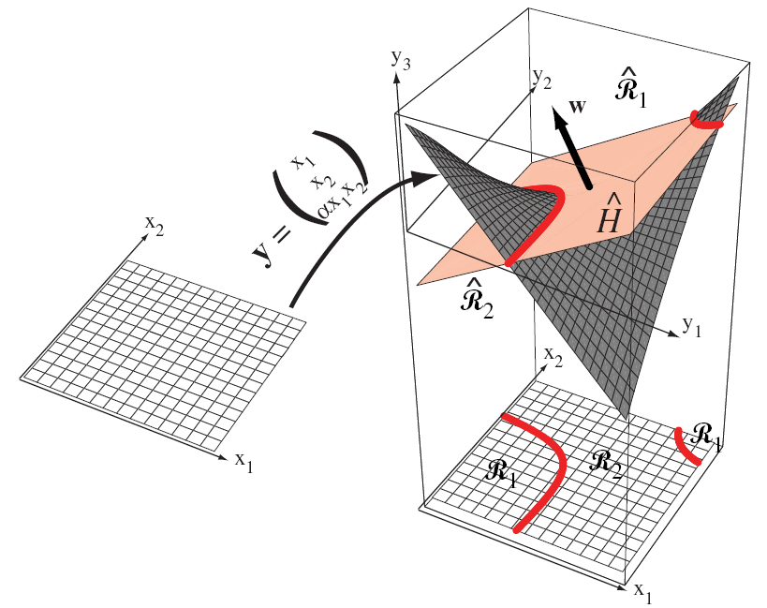
Generalized Linear Discriminant Function
Example 2
Notes:
变换空间y中的判决面总是一个超平面，因为广义线性
13

Slide 14
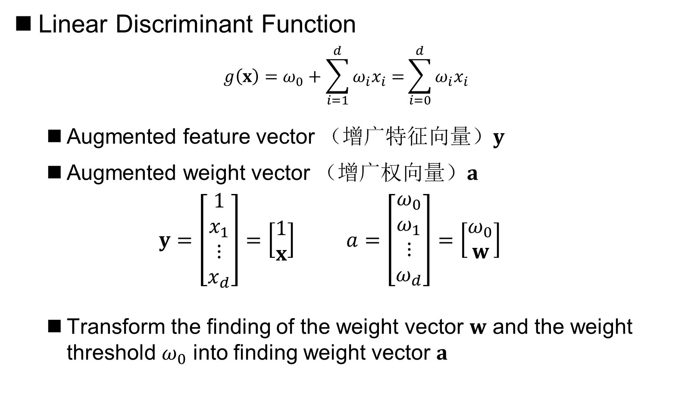
Generalized Linear Discriminant Function
Linear Discriminant Function
$$g\left(x\right)=ω_{0}+\sum_{i=1}^{d}{ω_{i}x_{i}=}\sum_{i=0}^{d}{ω_{i}x_{i}}$$
Augmented feature vector （增广特征向量）$y$
Augmented weight vector （增广权向量）$a$
$$y=\left[\begin{aligned}1 \\ x_{1} \\ ⋮ \\ x_{d}\end{aligned}\right]=\left[\begin{aligned}1 \\ x\end{aligned}\right] a=\left[\begin{aligned}ω_{0} \\ ω_{1} \\ ⋮ \\ ω_{d}\end{aligned}\right]=\left[\begin{aligned}ω_{0} \\ w\end{aligned}\right]$$
Transform the finding of the weight vector $w$ and the weight threshold $ω_{0}$ into finding weight vector $a$

Slide 15
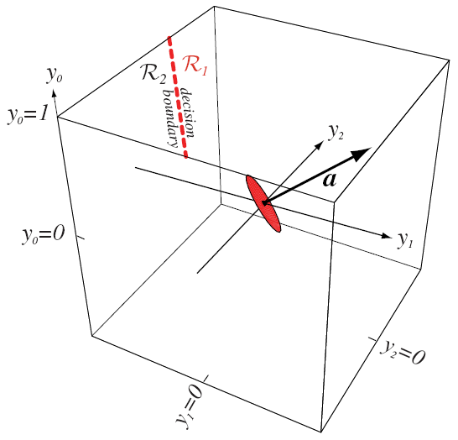
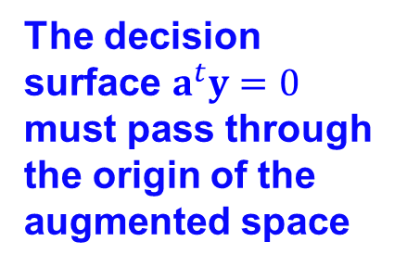
Generalized Linear Discriminant Function
The decision surface $a^{t}y=0$ must pass through the origin of the augmented space
By adjusting a, a certain linear decision surface in the original space (y₀=1 plane) can be projected

Slide 16
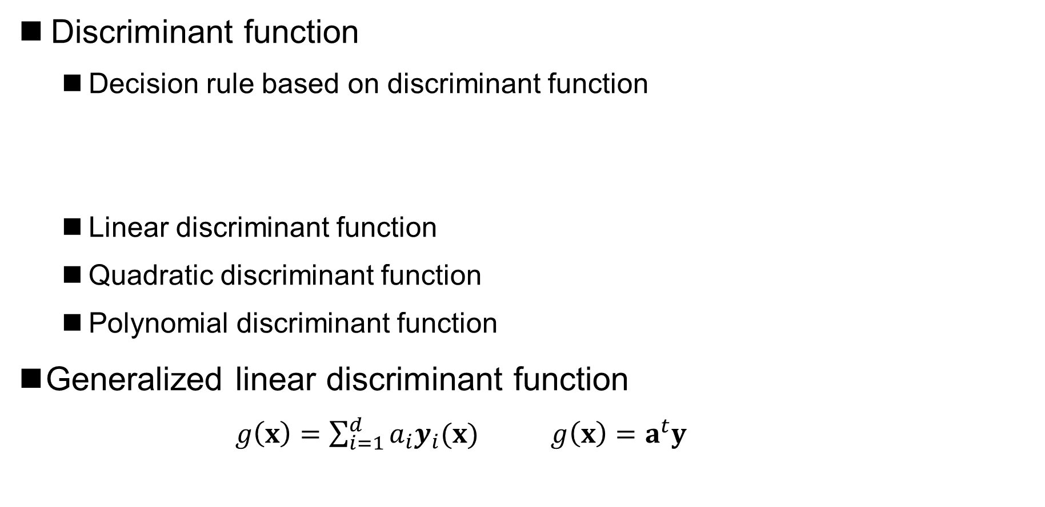
Summary
Discriminant function
Decision rule based on discriminant function
Linear discriminant function
Quadratic discriminant function
Polynomial discriminant function
Generalized linear discriminant function
$g\left(x\right)=\sum_{i=1}^{d}{a_{i}y_{i}(x)}$ $g\left(x\right)=a^{t}y$
If $g_{j}\left(x\right)≥g_{i}\left(x\right), ∀i≠j$, then the pattern is $ω_{j}$

Slide 17
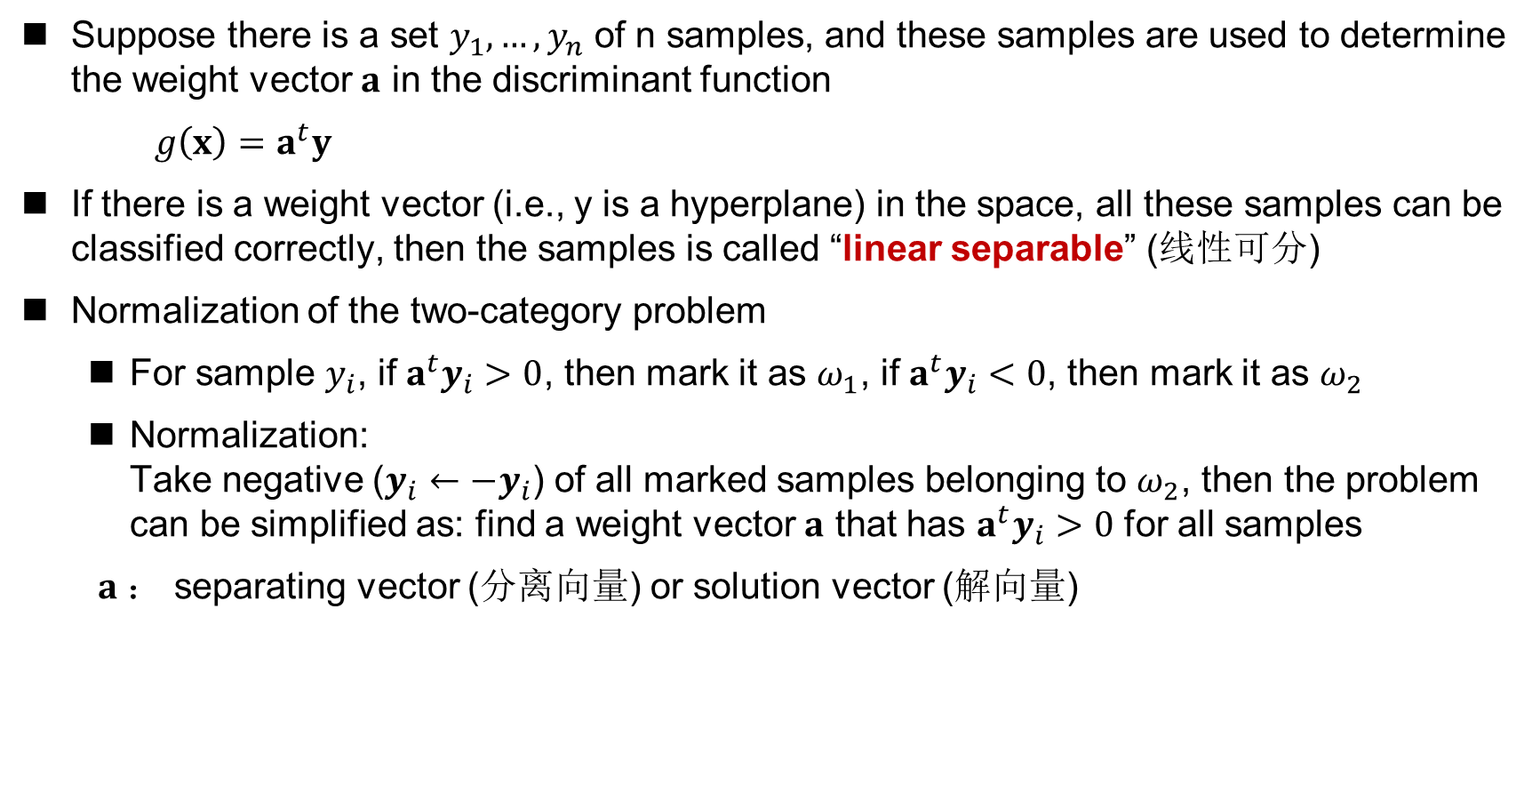
Two-Category Linearly Separable Case
Suppose there is a set $y_{1},…,y_{n}$ of n samples, and these samples are used to determine the weight vector $a$ in the discriminant function
$g\left(x\right)=a^{t}y$
If there is a weight vector (i.e., y is a hyperplane) in the space, all these samples can be classified correctly, then the samples is called “linear separable” (线性可分)
Normalization of the two-category problem
For sample $y_{i}$, if $a^{t}y_{i}>0$, then mark it as $ω_{1}$, if $a^{t}y_{i}<0$, then mark it as $ω_{2}$
Normalization: Take negative ($y_{i}←−y_{i}$) of all marked samples belonging to $ω_{2}$, then the problem can be simplified as: find a weight vector $a$ that has $a^{t}y_{i}>0$ for all samples
$a$： separating vector (分离向量) or solution vector (解向量)

Slide 18
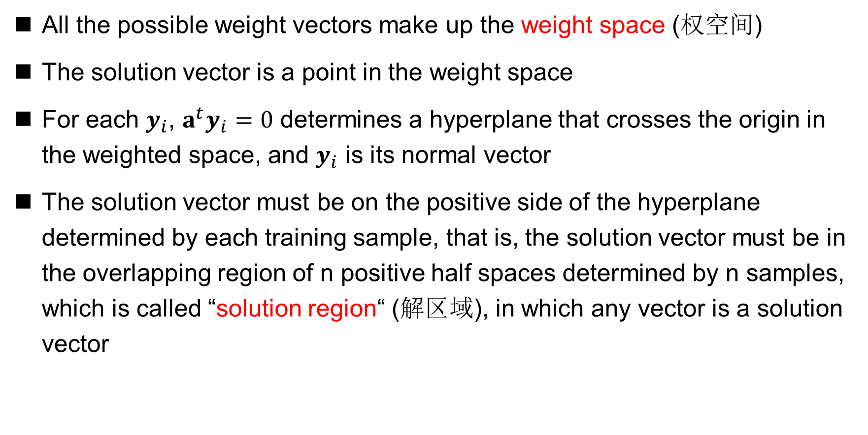
Weight Space and Solution Region
All the possible weight vectors make up the weight space (权空间)
The solution vector is a point in the weight space
For each $y_{i}$, $a^{t}y_{i}=0$ determines a hyperplane that crosses the origin in the weighted space, and $y_{i}$ is its normal vector
The solution vector must be on the positive side of the hyperplane determined by each training sample, that is, the solution vector must be in the overlapping region of n positive half spaces determined by n samples, which is called “solution region“ (解区域), in which any vector is a solution vector

Slide 19
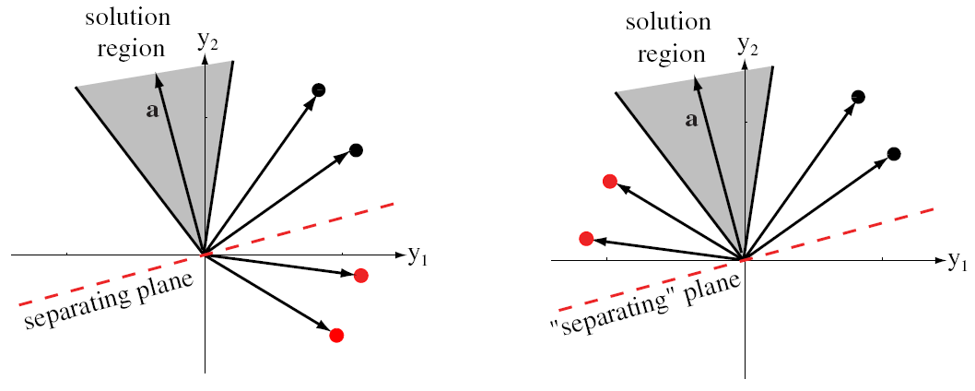
Weight Space and Solution Region
Before Normalized
After Normalized

Slide 20
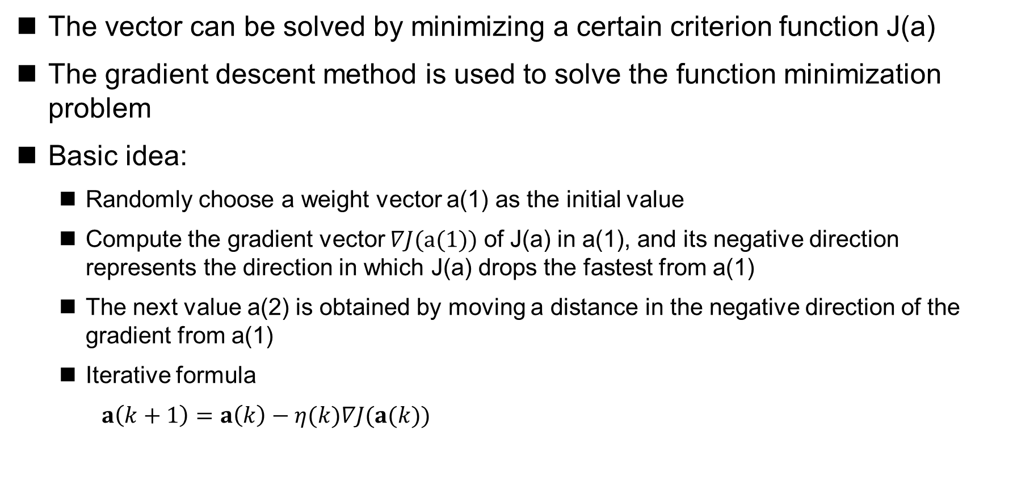
Gradient Descent Algorithm
The vector can be solved by minimizing a certain criterion function J(a)
The gradient descent method is used to solve the function minimization problem
Basic idea:
Randomly choose a weight vector a(1) as the initial value
Compute the gradient vector $∇J(a(1))$ of J(a) in a(1), and its negative direction represents the direction in which J(a) drops the fastest from a(1)
The next value a(2) is obtained by moving a distance in the negative direction of the gradient from a(1)
Iterative formula
$a\left(k+1\right)=a\left(k\right)−η(k)∇J(a(k))$
Learning rate (学习率)

Slide 21
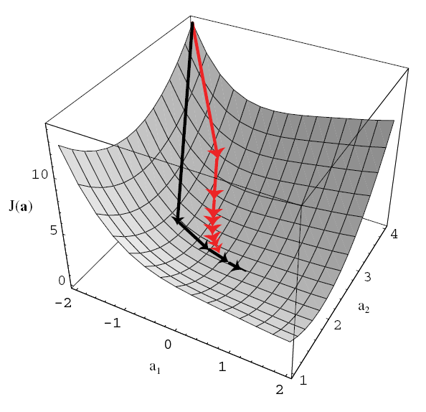
Gradient Descent Algorithm

Slide 22
Gradient Descent Algorithm
Basic gradient descent algorithm

Slide 23
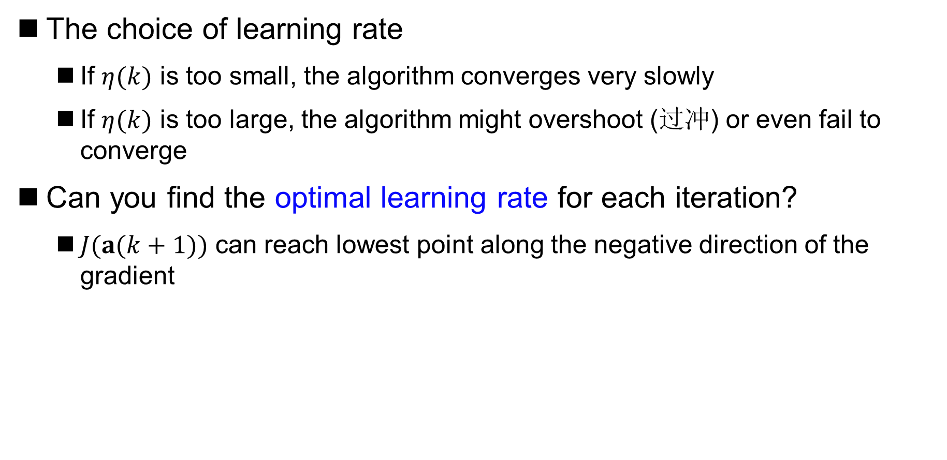
Gradient Descent Algorithm
The choice of learning rate
If $η(k)$ is too small, the algorithm converges very slowly
If $η(k)$ is too large, the algorithm might overshoot (过冲) or even fail to converge
Can you find the optimal learning rate for each iteration?
$J(a(k+1))$ can reach lowest point along the negative direction of the gradient

Slide 24
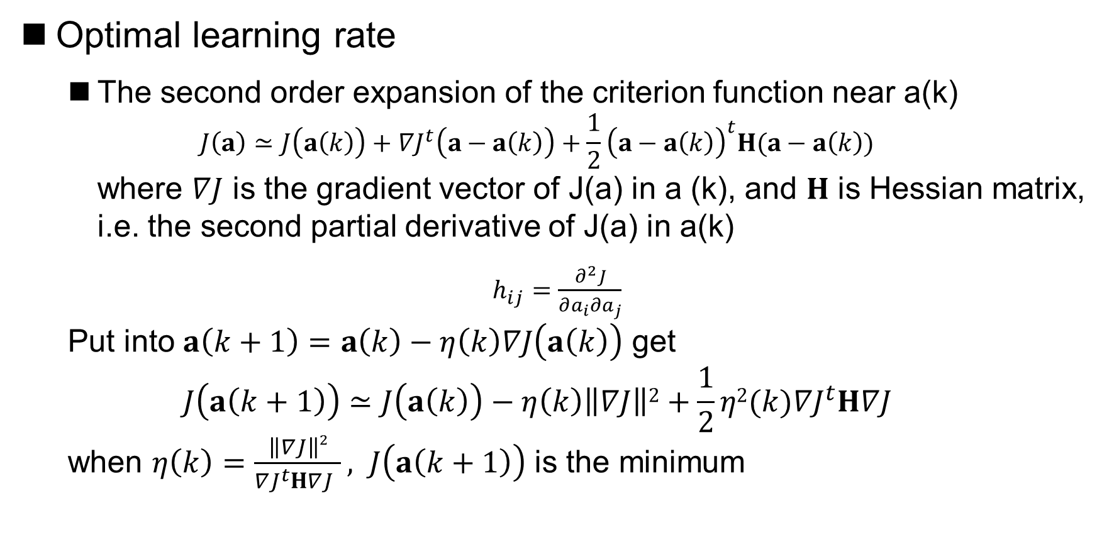
Gradient Descent Algorithm
Optimal learning rate
The second order expansion of the criterion function near a(k) $J\left(a\right)≃J\left(a\left(k\right)\right)+∇J^{t}\left(a−a\left(k\right)\right)+\frac{1}{2}{\left(a−a\left(k\right)\right)}^{t}H(a−a\left(k\right))$ where $∇J$ is the gradient vector of J(a) in a (k), and $H$ is Hessian matrix, i.e. the second partial derivative of J(a) in a(k)
$h_{ij}=\frac{∂^{2}J}{∂a_{i}∂a_{j}}$ Put into $a\left(k+1\right)=a\left(k\right)−η\left(k\right)∇J\left(a\left(k\right)\right)$ get $$J\left(a\left(k+1\right)\right)≃J\left(a\left(k\right)\right)−η\left(k\right)\left\|∇J\right\|2+\frac{1}{2}η2(k){∇J}^{t}H∇J$$ when $η\left(k\right)=\frac{\left\|∇J\right\|2}{{∇J}^{t}H∇J }, J\left(a\left(k+1\right)\right)$ is the minimum
optimal learning rate
Notes:
在a(k)处的泰勒展开

Slide 25
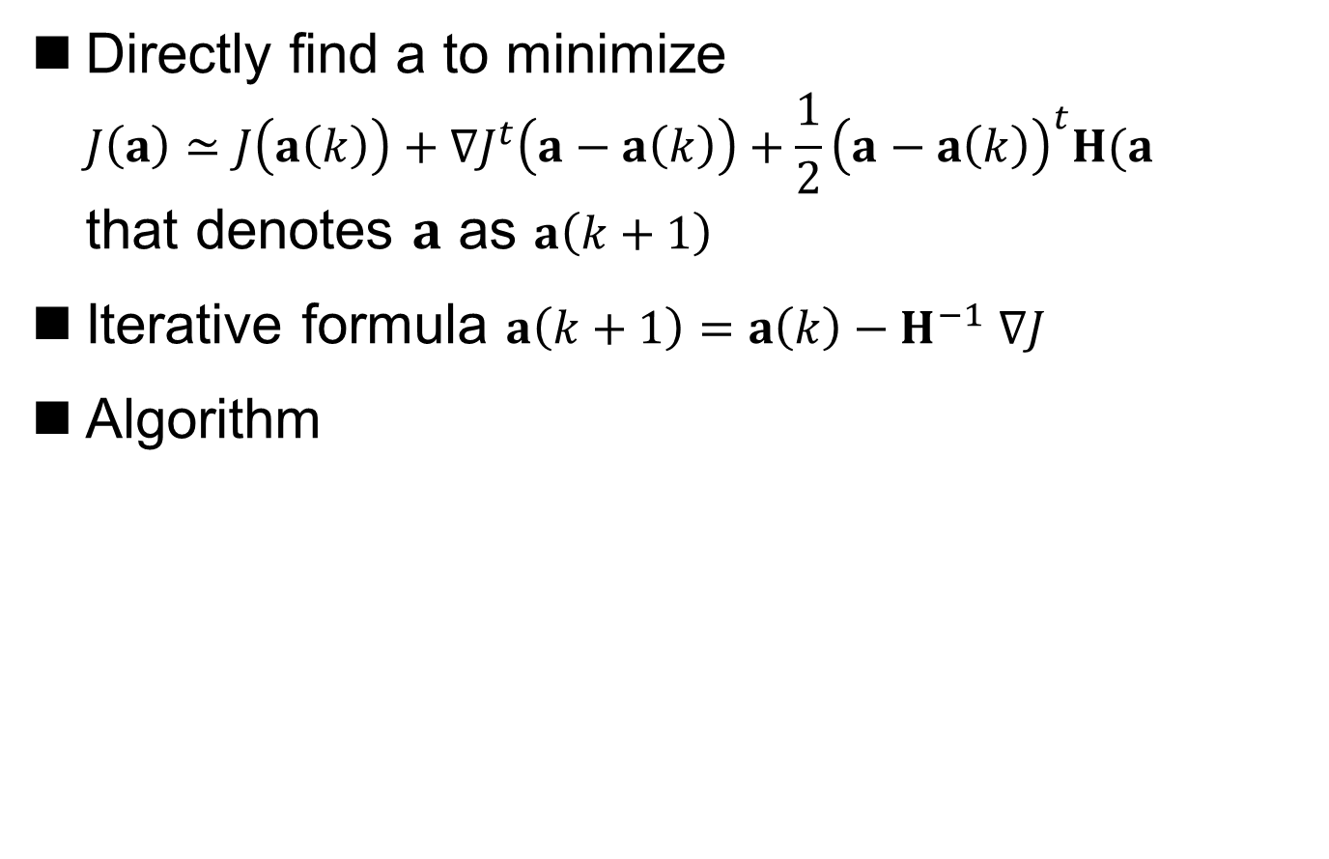
Newton Descent Algorithm
Directly find a to minimize $J\left(a\right)≃J\left(a\left(k\right)\right)+∇J^{t}\left(a−a\left(k\right)\right)+\frac{1}{2}{\left(a−a\left(k\right)\right)}^{t}H(a−a\left(k\right))$ that denotes $a$ as $a\left(k+1\right)$
Iterative formula $a\left(k+1\right)=a\left(k\right)−H^{−1}$ $∇J$
Algorithm

Slide 26
Newton Descent Algorithm
Advantage
The Newton descent method gives a better step size at each step than the gradient descent method
Disadvantage
When the Hessian matrix H is singular, the Newton descent method cannot be applied
Even if H is not singular, the computational complexity of computing the inverse matrix of H is O(d³)

Slide 27
Newton Descent Algorithm

Slide 28
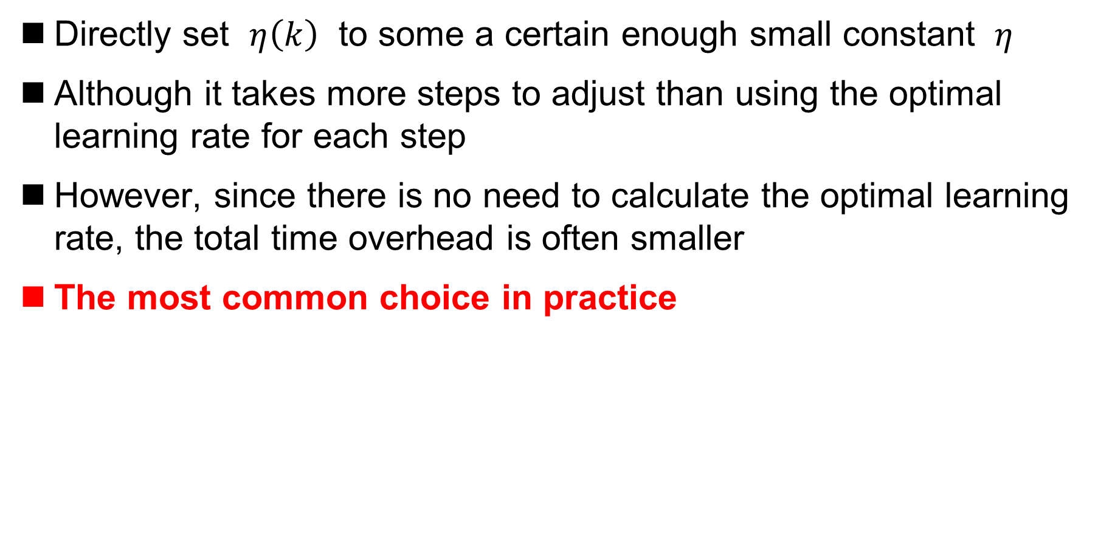
The Choice of Learning Rate in Practice
Directly set $η\left(k\right)$ to some a certain enough small constant $η$
Although it takes more steps to adjust than using the optimal learning rate for each step
However, since there is no need to calculate the optimal learning rate, the total time overhead is often smaller
The most common choice in practice

Slide 29
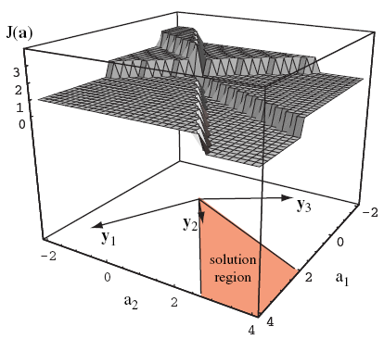
Perceptron Criterion Function
How to construct the criterion function J(a) to solve the vector?
Let J(a) be equal to the number of samples misclassified by the decision surface determined by a
Piecewise constant function, not be conducive to gradient search
(gradient is often 0)

Slide 30
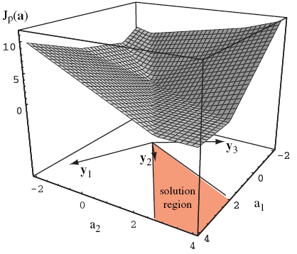
Perceptron Criterion Function
How to construct the criterion function J(a) to solve the vector?
Perceptron criterion function （感知器准则函数）
where is the sample set
misclassified by a
The perceptron criterion function
is proportional to the sum of
the distance from the wrong
sample to the decision surface

Slide 31
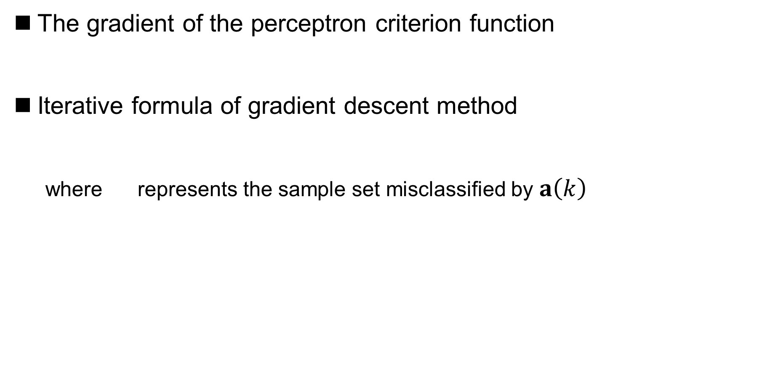
Perceptron Criterion Function Minimization
The gradient of the perceptron criterion function
Iterative formula of gradient descent method
where represents the sample set misclassified by $a\left(k\right)$

Slide 32
Perceptron Criterion Function Minimization
Batch perceptron algorithm
Batch processing: The weight vector a is corrected every time, and all training samples need to be considered in “batch”

Slide 33
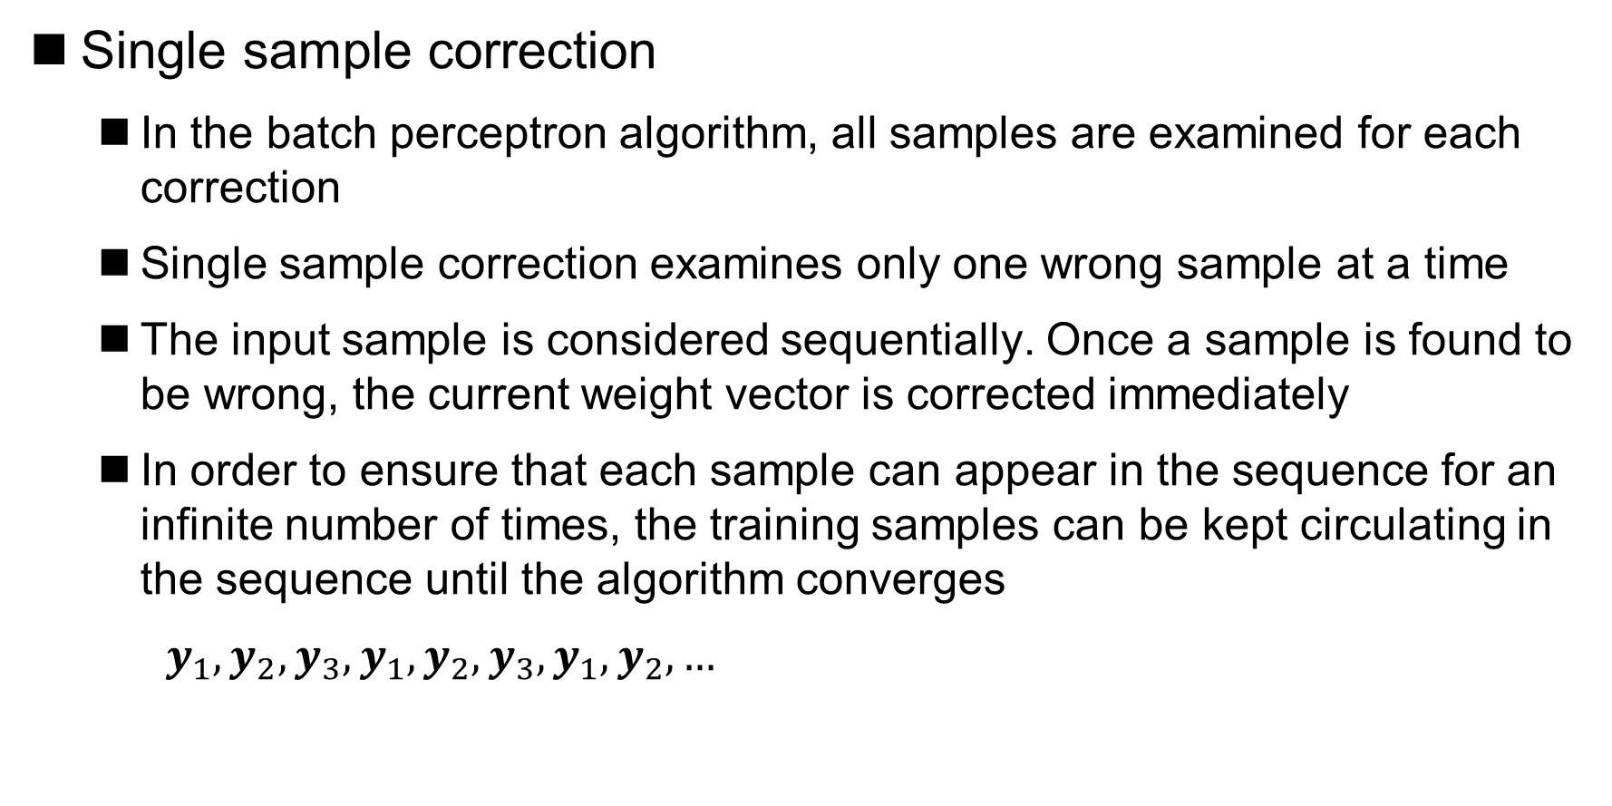
Perceptron Criterion Function Minimization
Single sample correction
In the batch perceptron algorithm, all samples are examined for each correction
Single sample correction examines only one wrong sample at a time
The input sample is considered sequentially. Once a sample is found to be wrong, the current weight vector is corrected immediately
In order to ensure that each sample can appear in the sequence for an infinite number of times, the training samples can be kept circulating in the sequence until the algorithm converges
$y_{1},y_{2},y_{3},y_{1},y_{2},y_{3},y_{1},y_{2},…$

Slide 34
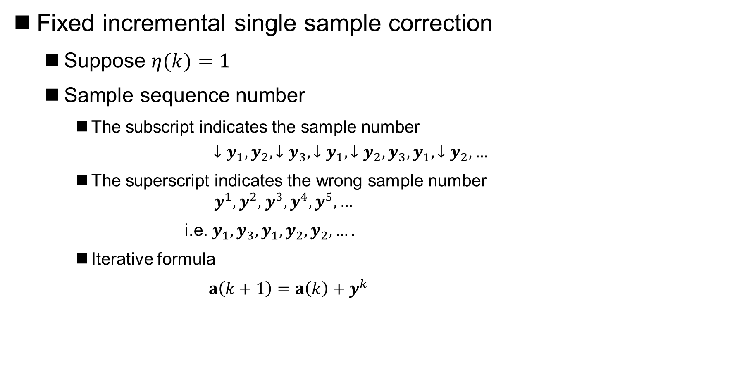
Perceptron Criterion Function Minimization
Fixed incremental single sample correction
Suppose $η(k)=1$
Sample sequence number
The subscript indicates the sample number
$$↓y_{1},y_{2},{↓y}_{3},{↓y}_{1},{↓y}_{2},y_{3},y_{1},{↓y}_{2},…$$
The superscript indicates the wrong sample number $y^{1},y^{2},$ $y^{3}, y^{4},y^{5},…$
i.e. $y_{1},y_{3},y_{1},y_{2},y_{2},….$
Iterative formula
$a\left(k+1\right)=a\left(k\right)+y^{k}$
Notes:
34

Slide 35

Perceptron Criterion Function Minimization
Fixed incremental single sample perceptron algorithm
$$a\left(k+1\right)=a\left(k\right)+y^{k}$$
1. begin initialize a,
2. do
3.
4.
if y_{i} is misclassified by a
5.
then
6. until
k is kept unchanged for n consecutive rounds
7. return a
Fixed-Increment Single-Sample Perceptron
8. end
Notes:
35

Slide 36
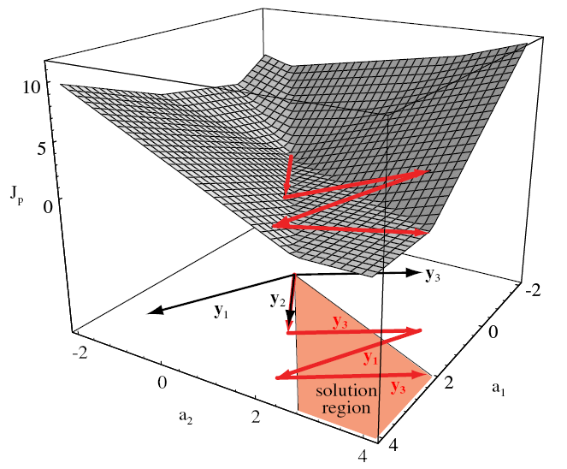
Perceptron Criterion Function Minimization

Slide 37
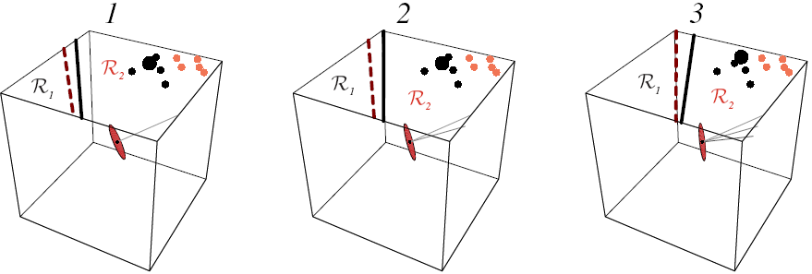
Perceptron Criterion Function Minimization

Slide 38
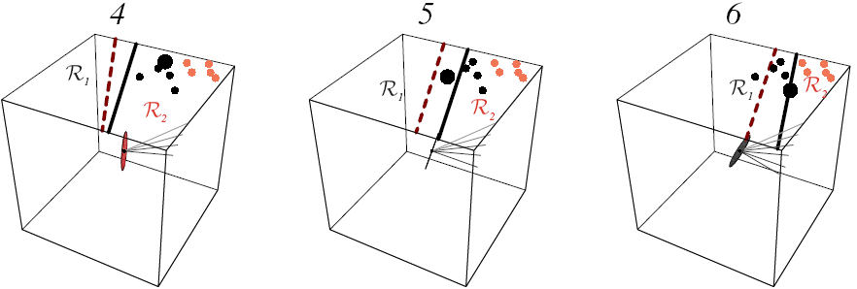
Perceptron Criterion Function Minimization

Slide 39
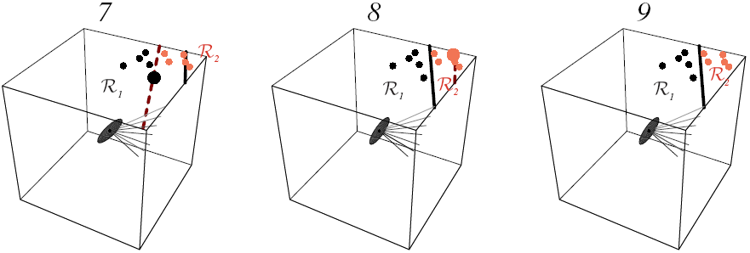
Perceptron Criterion Function Minimization

Slide 40

Perceptron Criterion Function Minimization
Variable incremental perceptron algorithm with margin
$$a\left(k+1\right)=a\left(k\right)+y^{k}$$
1. begin initialize a, margin b,
2. do
3.
4.
if
5.
then
6. until
k is kept unchanged for n consecutive rounds
7. return a
Variable-Increment Perceptron with Margin
8. end

Slide 41
Linearly Inseparable Case
The perceptron algorithms can be summarized as “Error-Correction Procedure” (误差校正方法) in essence
If the problem itself is linearly inseparable, the correction process may never end

Slide 42
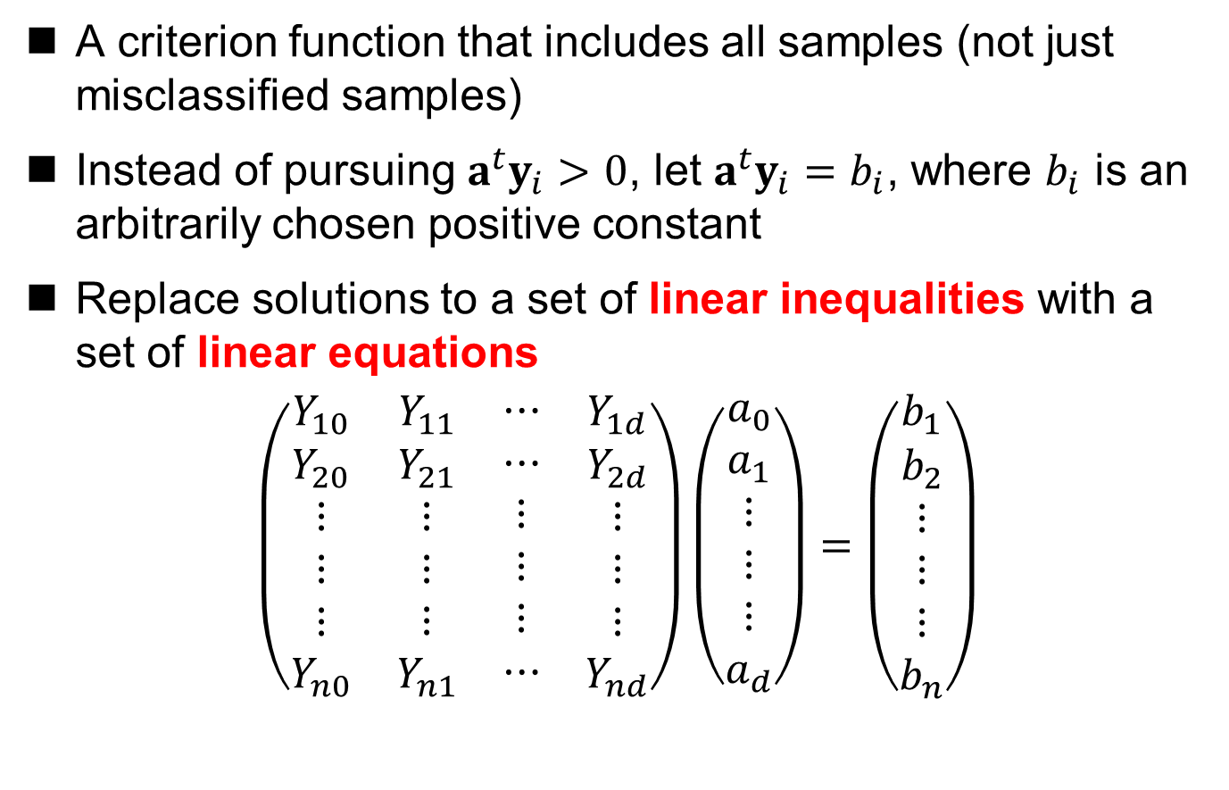
Minimum Squared Error
A criterion function that includes all samples (not just misclassified samples)
Instead of pursuing $a^{t}y_{i}>0$, let $a^{t}y_{i}=b_{i}$, where $b_{i}$ is an arbitrarily chosen positive constant
Replace solutions to a set of linear inequalities with a set of linear equations
$$\left(\begin{matrix}\begin{aligned}Y_{10} \\ Y_{20} \\ ⋮ \\ ⋮ \\ ⋮ \\ Y_{n0}\end{aligned} & \begin{aligned}Y_{11} \\ Y_{21} \\ ⋮ \\ ⋮ \\ ⋮ \\ Y_{n1}\end{aligned} & \begin{matrix}\begin{aligned}⋯ \\ ⋯ \\ ⋮ \\ ⋮ \\ ⋮ \\ ⋯\end{aligned} & \begin{aligned}Y_{1d} \\ Y_{2d} \\ ⋮ \\ ⋮ \\ ⋮ \\ Y_{nd}\end{aligned}\end{matrix}\end{matrix}\right)\left(\begin{aligned}a_{0} \\ a_{1} \\ ⋮ \\ ⋮ \\ ⋮ \\ a_{d}\end{aligned}\right)=\left(\begin{aligned}b_{1} \\ b_{2} \\ ⋮ \\ ⋮ \\ ⋮ \\ b_{n}\end{aligned}\right)$$

Slide 43
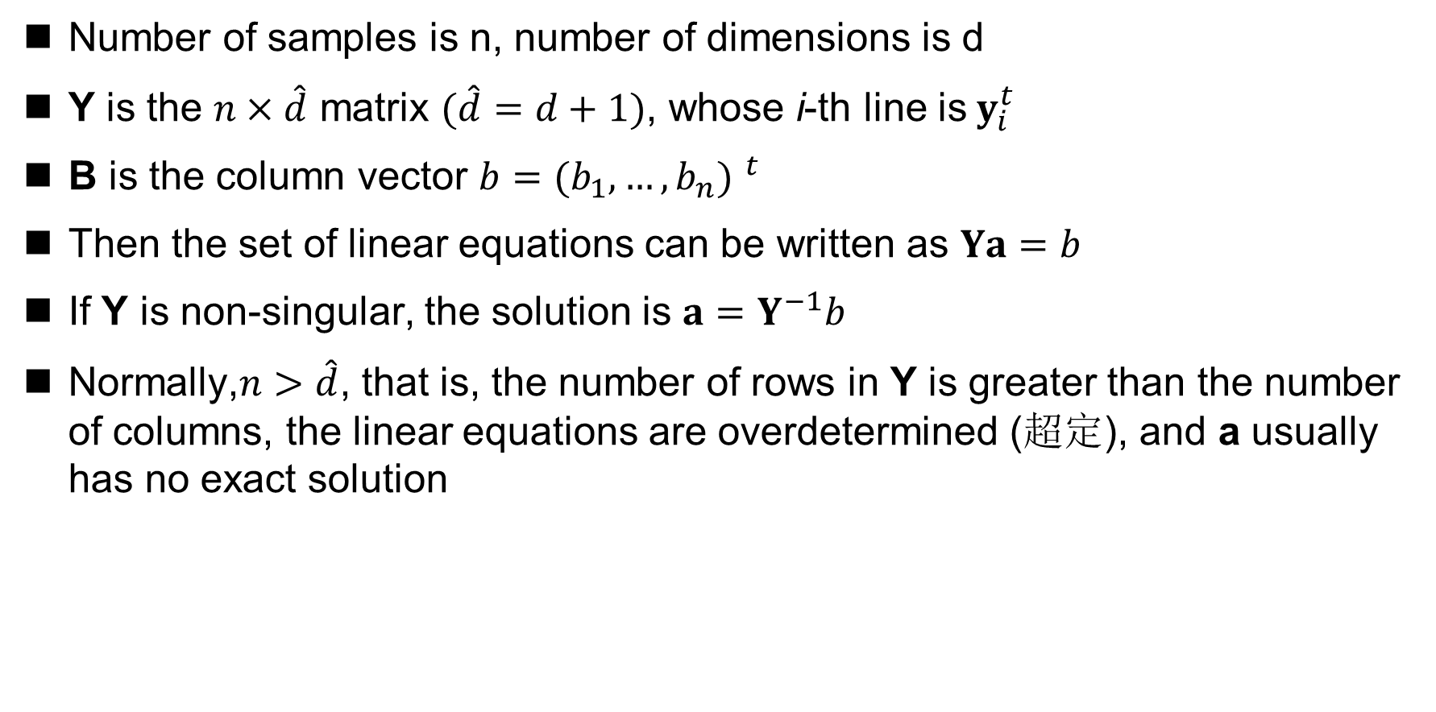
Minimum Squared Error
Number of samples is n, number of dimensions is d
Y is the $n×\hat{d}$ matrix $(\hat{d}=d+1)$, whose i-th line is$y_{i}^{t}$
B is the column vector $b={{(b}_{1},…,b_{n}) }^{t}$
Then the set of linear equations can be written as $Ya=b$
If Y is non-singular, the solution is $a=Y^{−1}b$
Normally,$n>\hat{d}$, that is, the number of rows in Y is greater than the number of columns, the linear equations are overdetermined (超定), and a usually has no exact solution

Slide 44
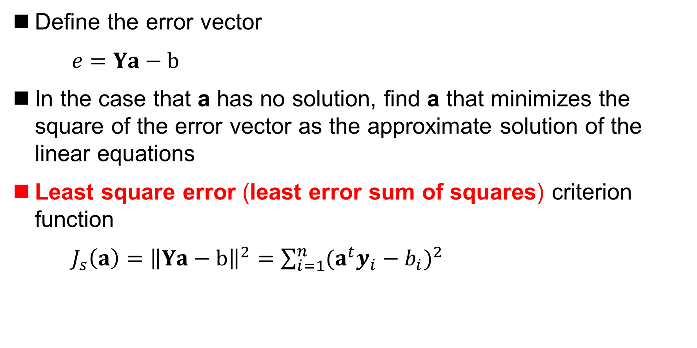
Minimum Squared Error
Define the error vector
$e=Ya−b$
In the case that a has no solution, find a that minimizes the square of the error vector as the approximate solution of the linear equations
Least square error (least error sum of squares) criterion function
$J_{s}\left(a\right)={\left\|Ya−b\right\|}^{2}=\sum_{i=1}^{n}{{(a^{t}y_{i}−b_{i})}^{2}}$

Slide 45
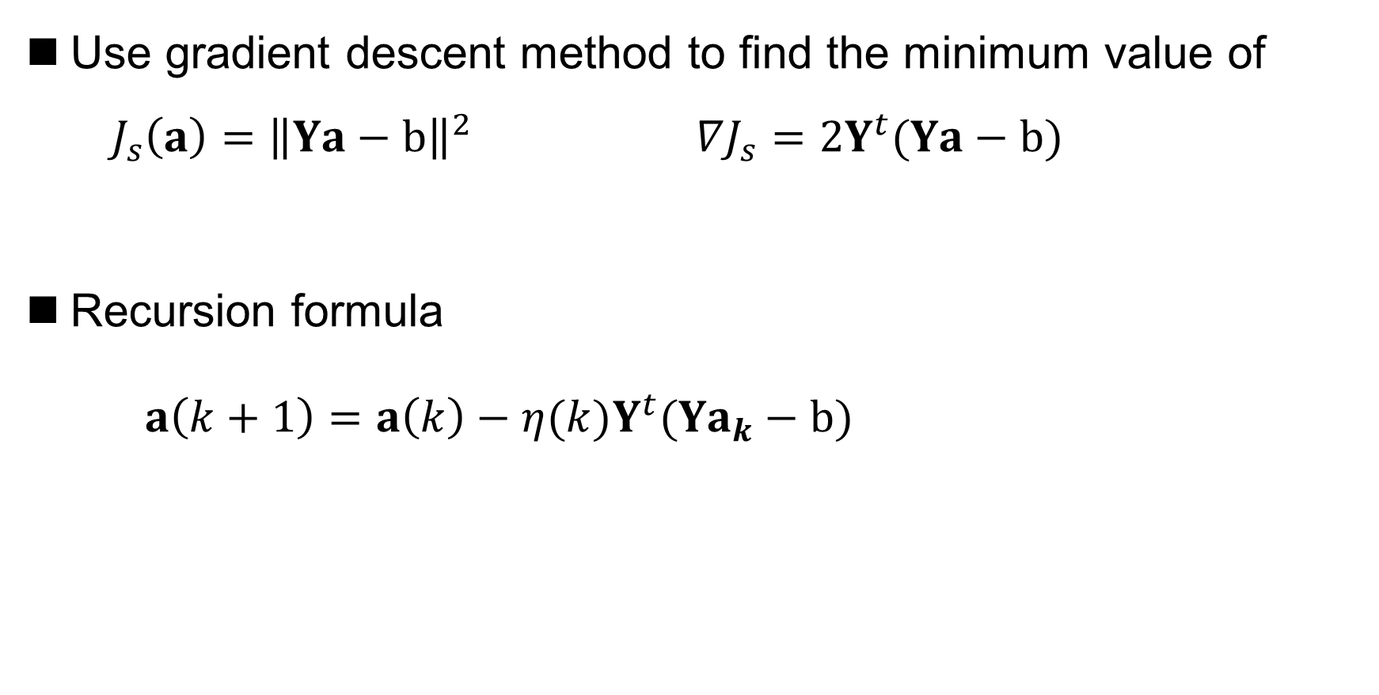
Widrow-Hoff Algorithm
Use gradient descent method to find the minimum value of ${ J}_{s}\left(a\right)={\left\|Ya−b\right\|}^{2} ∇J_{s}=2Y^{t}(Ya−b)$
Recursion formula
$a\left(k+1\right)=a\left(k\right)−η(k)Y^{t}(Ya_{k}−b)$

Slide 46

Widrow-Hoff Algorithm
Consider the single sample case: Widrow-Hoff algorithm or least mean square (LMS) algorithm Algorithm description
1. begin initialize a, b, threshold ,
2. do
3.
4.
5. until
6. return a
LMS (least-mean-squared)
7. end

Slide 47
Widrow-Hoff Algorithm
Widrow-Hoff algorithm minimizes the sum of squares of the distance between the training point and the hyperplane
Even in the case of linear separability, the solution of Widrow-Hoff algorithm may not be able to classify all the training samples completely correctly
However, Widrow-Hoff algorithm can get good approximate solutions in both linearly separable and inseparable cases

Slide 48

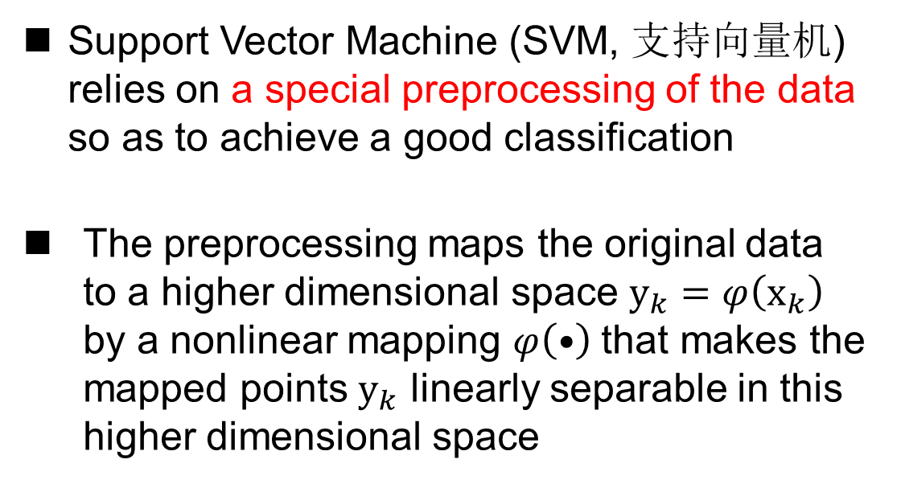
Support Vector Machine
Support Vector Machine (SVM, 支持向量机) relies on a special preprocessing of the data so as to achieve a good classification
The preprocessing maps the original data to a higher dimensional space $y_{k}=φ\left(x_{k}\right)$ by a nonlinear mapping $φ\left(•\right)$that makes the mapped points $y_{k}$ linearly separable in this higher dimensional space
Vladimir N. Vapnik, 1963—

Slide 49
Support Vector Machine
The development of support vector machine
Cortes and Vapnik:
Support Vector Networks
SVM with soft margin
Statistical learning theory
Jayadeva and Chandra:
Twin SVM
1964
1992
1998
1995
2007
Vapnik and Chervonenkis:
Support vector
Boser, Cuyon and Vapnik:
SVM with hard margin.
First to formulate SVM in its current form.
Vapnik:
Multi-class SVM

Slide 50

Support Vector Machine
Which linear decision surface is the best?

Slide 51
Support Vector Machine
Margin (间隔)
The minimum distance from the model to the decision surface is called the classification margin (分类间隔)
The larger the classification margin, the better the decision surface
The sample point
closest to the decision
surface is called the
support vector
(支持向量)
optimal hyperplane
support vector
maximum margin
support vector

Slide 52
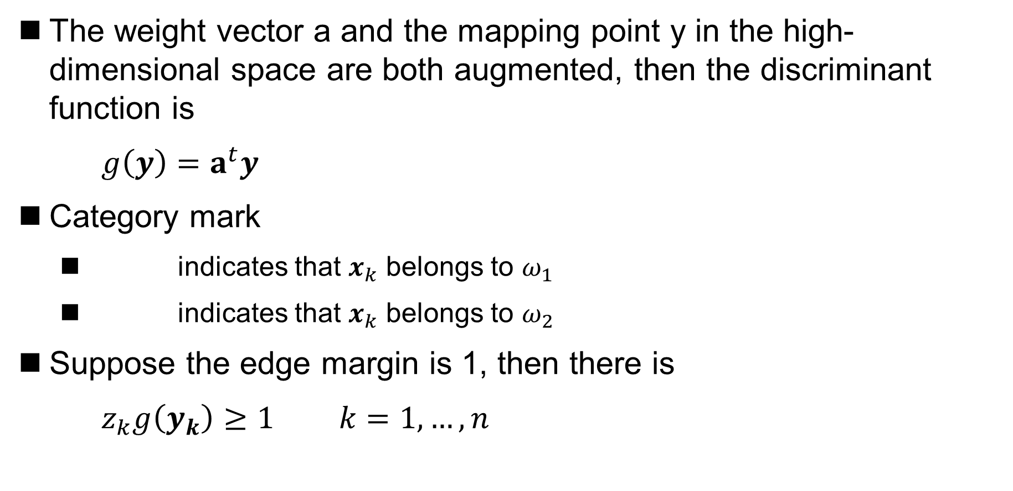
Support Vector Machine
The weight vector a and the mapping point y in the high-dimensional space are both augmented, then the discriminant function is
$g\left(y\right)=a^{t}y$
Category mark
indicates that $x_{k}$ belongs to $ω_{1}$
indicates that $x_{k}$ belongs to $ω_{2}$
Suppose the edge margin is 1, then there is
$z_{k}g\left(y_{k}\right)≥1 k=1,…,n$

Slide 53
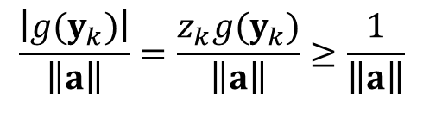

Support Vector Machine
Distance from sample point to decision surface
Optimization objectives
maximizes $\frac{1}{\left\|a\right\|}$, that is, minimize $\left\|a\right\|$
s.t. $z_{k}g\left(y_{k}\right)≥1$
$$\frac{\left|g(y_{k})\right|}{\left\|a\right\|}=\frac{z_{k}g(y_{k})}{\left\|a\right\|}≥\frac{1}{\left\|a\right\|}$$
classification margin

Slide 54
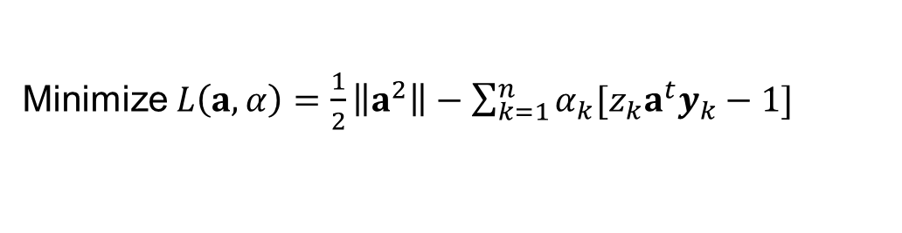


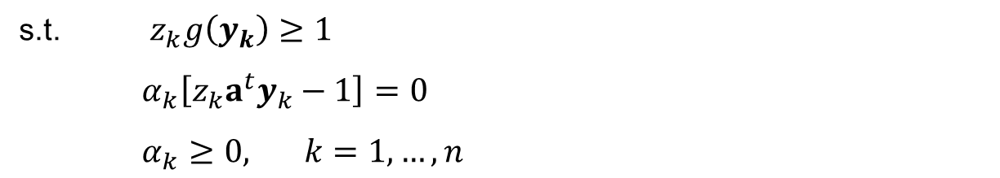
Support Vector Machine
The training of SVM
Kuhn-Tucker construction method
Minimize $L\left(a,α\right)=\frac{1}{2}\left\|a^{2}\right\|−\sum_{k=1}^{n}{α_{k}[z_{k}a^{t}y_{k}−1]}$
s.t. $z_{k}g\left(y_{k}\right)≥1$
$α_{k}\left[z_{k}a^{t}y_{k}−1\right]=0$
$α_{k}≥0, k=1,…,n$
quadratic programming problem
Maximize $L\left(α\right)=\sum_{k=1}^{n}{α_{k}−\frac{1}{2}\sum_{k,j}^{n}{α_{k}α_{j}z_{k}z_{j}y_{j}^{t}y_{k}}}$
conjugate gradient method
interior point method
active set
……
$$\sum_{k=1}^{n}{α_{k}z_{k}=0}$$
s.t.
$$α_{k}≥0, k=1,…,n$$

Slide 55
Support Vector Machine
Support Vector Machine with Soft Margin
misclassification
Hard Margin:
The optimal solution may not exist
It more likely tends to be overfitting
Soft Margin:
The existence of optimal solution is guaranteed
The generalization performance of model is improved
The anti-interference ability is enhanced
maximum margin
misclassification

Slide 56
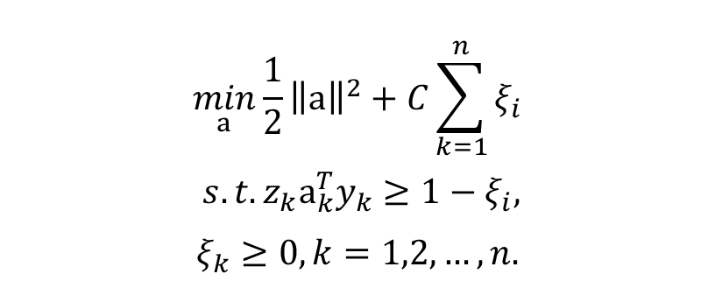
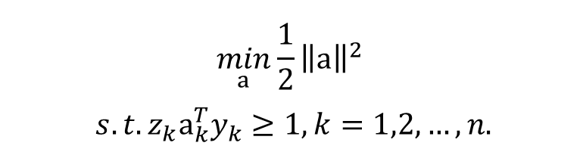

Support Vector Machine
Support Vector Machine with Soft Margin
$$\min_{a}\frac{1}{2}{\left\|a\right\|}^{2}$$
$s.t.z_{k}a_{k}^{T}y_{k}≥1, k=1,2,…,n.$
misclassification
Optimization Objective with Hard Margin
slack variable $ξ>0$
Empirical Loss
$$\min_{a}\frac{1}{2}{\left\|a\right\|}^{2}+C\sum_{k=1}^{n}{ξ_{i}}$$
$s.t.z_{k}a_{k}^{T}y_{k}≥1−ξ_{i},$
$$ξ_{k}≥0, k=1,2,…,n.$$
Optimization Objective with Soft Margin
maximum margin
misclassification

Slide 57
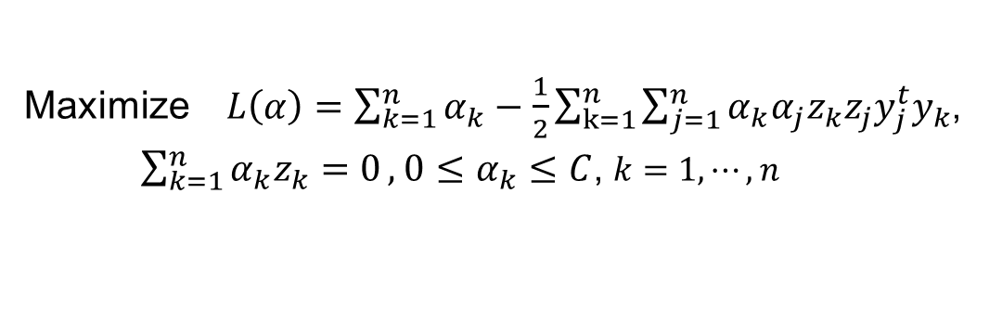
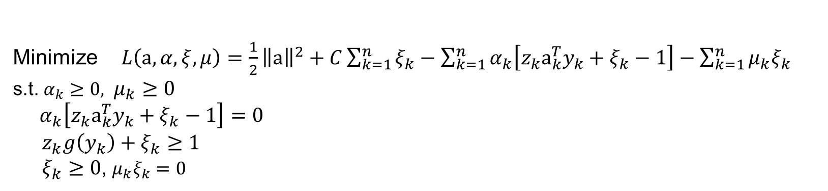
Support Vector Machine
The training of SVM with soft margin
Karush-Kuhn-Tucher construction method
Minimize $L\left(a,α,ξ,μ\right)=\frac{1}{2}{\left\|a\right\|}^{2}+C\sum_{k=1}^{n}{ξ_{k}}−\sum_{k=1}^{n}{α_{k}\left[z_{k}a_{k}^{T}y_{k}+ξ_{k}−1\right]}−\sum_{k=1}^{n}{μ_{k}ξ_{k}}$
s.t. $α_{k}≥0, μ_{k}≥0$
$α_{k}\left[z_{k}a_{k}^{T}y_{k}+ξ_{k}−1\right]=0$
$z_{k}g\left(y_{k}\right)+ξ_{k}≥1$
$ξ_{k}≥0$, $μ_{k}ξ_{k}=0$
Maximize $L\left(α\right)=\sum_{k=1}^{n}{α_{k}}−\frac{1}{2}\sum_{k=1}^{n}{\sum_{j=1}^{n}{α_{k}α_{j}z_{k}z_{j}y_{j}^{t}y_{k}}}$,
$\sum_{k=1}^{n}{α_{k}z_{k}=0},$ $0≤α_{k}≤C$, $k=1,⋯,n$
quadratic programming problem
s.t.

Slide 58

Support Vector Machine
Non-linear mapping
$$φ: y_{k}=φ(x_{k})$$
Basic idea: when the original training sample is linearly inseparable, a certain nonlinear transformation can be used to map the sample points in the original data space to a high-dimensional space, so that the mapping points in this high-dimensional space tend to linearly separable

Slide 59
Support Vector Machine
Non-linear mapping

Slide 60

Support Vector Machine
Non-linear mapping
Non-linear mapping $φ$ reflects the prior knowledge of the designer
Without prior knowledge, commonly used nonlinear mapping functions include: polynomial function, Gaussian function, etc.

Slide 61


Support Vector Machine
Kernel trick (核技巧)
Linear classifiers only rely on inner product computations $x_{i}^{t}x_{j}$
If all sample points map to a higher dimensional (or even infinite dimensional) space $φ: y_{k}=φ(x_{k})$, the inner product $φ(x_{i})^{t}φ(x_{j})$ in this higher dimensional space is often difficult or impossible to compute at all
Kernel function refers to the function in the original data space corresponding to the inner product calculation in the transformed space
$$k(x_{i},x_{j})=φ(x_{i})^{t}φ(x_{j})$$
This shows that the inner product computation in the complex higher dimensional space can be done indirectly through the kernel function in the lower dimensional space
If a problem involves only inner product computation, you can specify no specific mapping function, but only the kernel function corresponding to that mapping function

Slide 62

Support Vector Machine
Kernel trick (核技巧)
What kind of function can be a kernel?
Mercer theorem Any positive semi-definite symmetric function can be used as a kernel
positive semi-definite The matrix A composed of $a_{ij}=k(x_{i},x_{j})$ is a positive semi-definite matrix, that is, for any non-zero real vector z, there is $z^{t}Az≥0$
symmetric
$k(x_{i},x_{j})=k(x_{j},x_{i})$

Slide 63



Support Vector Machine
Kernel trick (核技巧)
Commonly used kernel functions
Polynomial kernel
Gaussian kernel
Sigmoid kernel
$$k(x,y)=(x^{t}y+1)^{d}$$
$$k(x,y)=\exp\left(−\frac{{\left\|x−y\right\|}^{2}}{2σ^{2}}\right)$$
$$k(x,y)=\tanh{(}kx^{t}y−δ)$$

Slide 64

Generalize to Multicategory Problem
The algorithm mentioned above assumes the two-category premises
Generalize to multicategory problems
If $y_{1},y_{2},…,y_{n}$ is linearly separable, then there is a set of weight vectors $\hat{a_{1}},…\hat{a_{c}}$, when $y_{k}∈𝒴_{i}$, for all $j≠i,$ there is ${\hat{a}}_{i}^{t}y_{k}>{\hat{a}}_{j}^{t}y_{k}$
When $\hat{a_{1}},…\hat{a_{c}}$ are determined, for test sample y, if for all $j≠i$,there is ${\hat{a}}_{i}^{t}y>{\hat{a}}_{j}^{t}y.$Then y belongs to category $i$

Slide 65

Generalize to Multicategory Problem
Kesler construction method
Suppose $y ∈𝒴_{1}$ , then
${\hat{a}}_{1}^{t}y−{\hat{a}}_{j}^{t}y>0, j=2, …, c$
Equivalently，$c\hat{d}$-dimensional weight vector $\hat{a}=\left[\begin{aligned}a_{1} \\ a_{2} \\ ⋮ \\ a_{c}\end{aligned}\right]$ Can correctly classify the c-1 $c\hat{d}$ -dimensional sample set (as shown on the following page)

Slide 66


Generalize to Multicategory Problem
Kesler construction method
$η_{12}=\left[\begin{aligned}y \\ −y \\ 0 \\ ⋮ \\ 0\end{aligned}\right]$, $η_{12}=\left[\begin{aligned}y \\ 0 \\ −y \\ ⋮ \\ 0\end{aligned}\right], ⋯,η_{1c}=\left[\begin{aligned}y \\ 0 \\ 0 \\ ⋮ \\ −y\end{aligned}\right]$
Each $η_{1j}$ corresponds to normalizing the samples belonging to $ω_{1}$ and $ω_{j}$, that is, negative samples belonging to $ω_{j}$. In this way, ${\hat{α}}^{t}η_{1j}>0$can be guaranteed and multi-category problem can be successfully converted into two-category problem

Slide 67

Generalize to Multicategory Problem
Kesler construction method
When $y ∈𝒴_{i}$, c-1$c\hat{d}$ dimensional training samples can be similarly constructed, where the $i$-th sub-vector is y, the $j$-th sub-vector is -y, and the rest are 0
If there is ${\hat{α}}^{t}η_{ij}>0$ for all $j≠i$ , then the components in $\hat{α}$ constitute c weight vectors of the linear machine that can correctly classify the multi-category sample set

