Slide 1
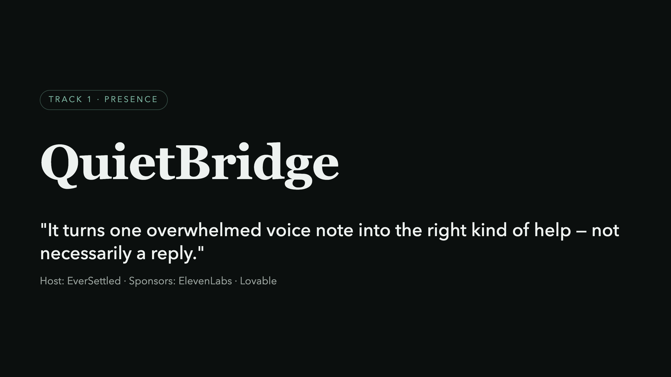
Notes:
Open cold. No logo parade. Say the one-liner slowly, let it land, then pause before advancing.

Slide 2
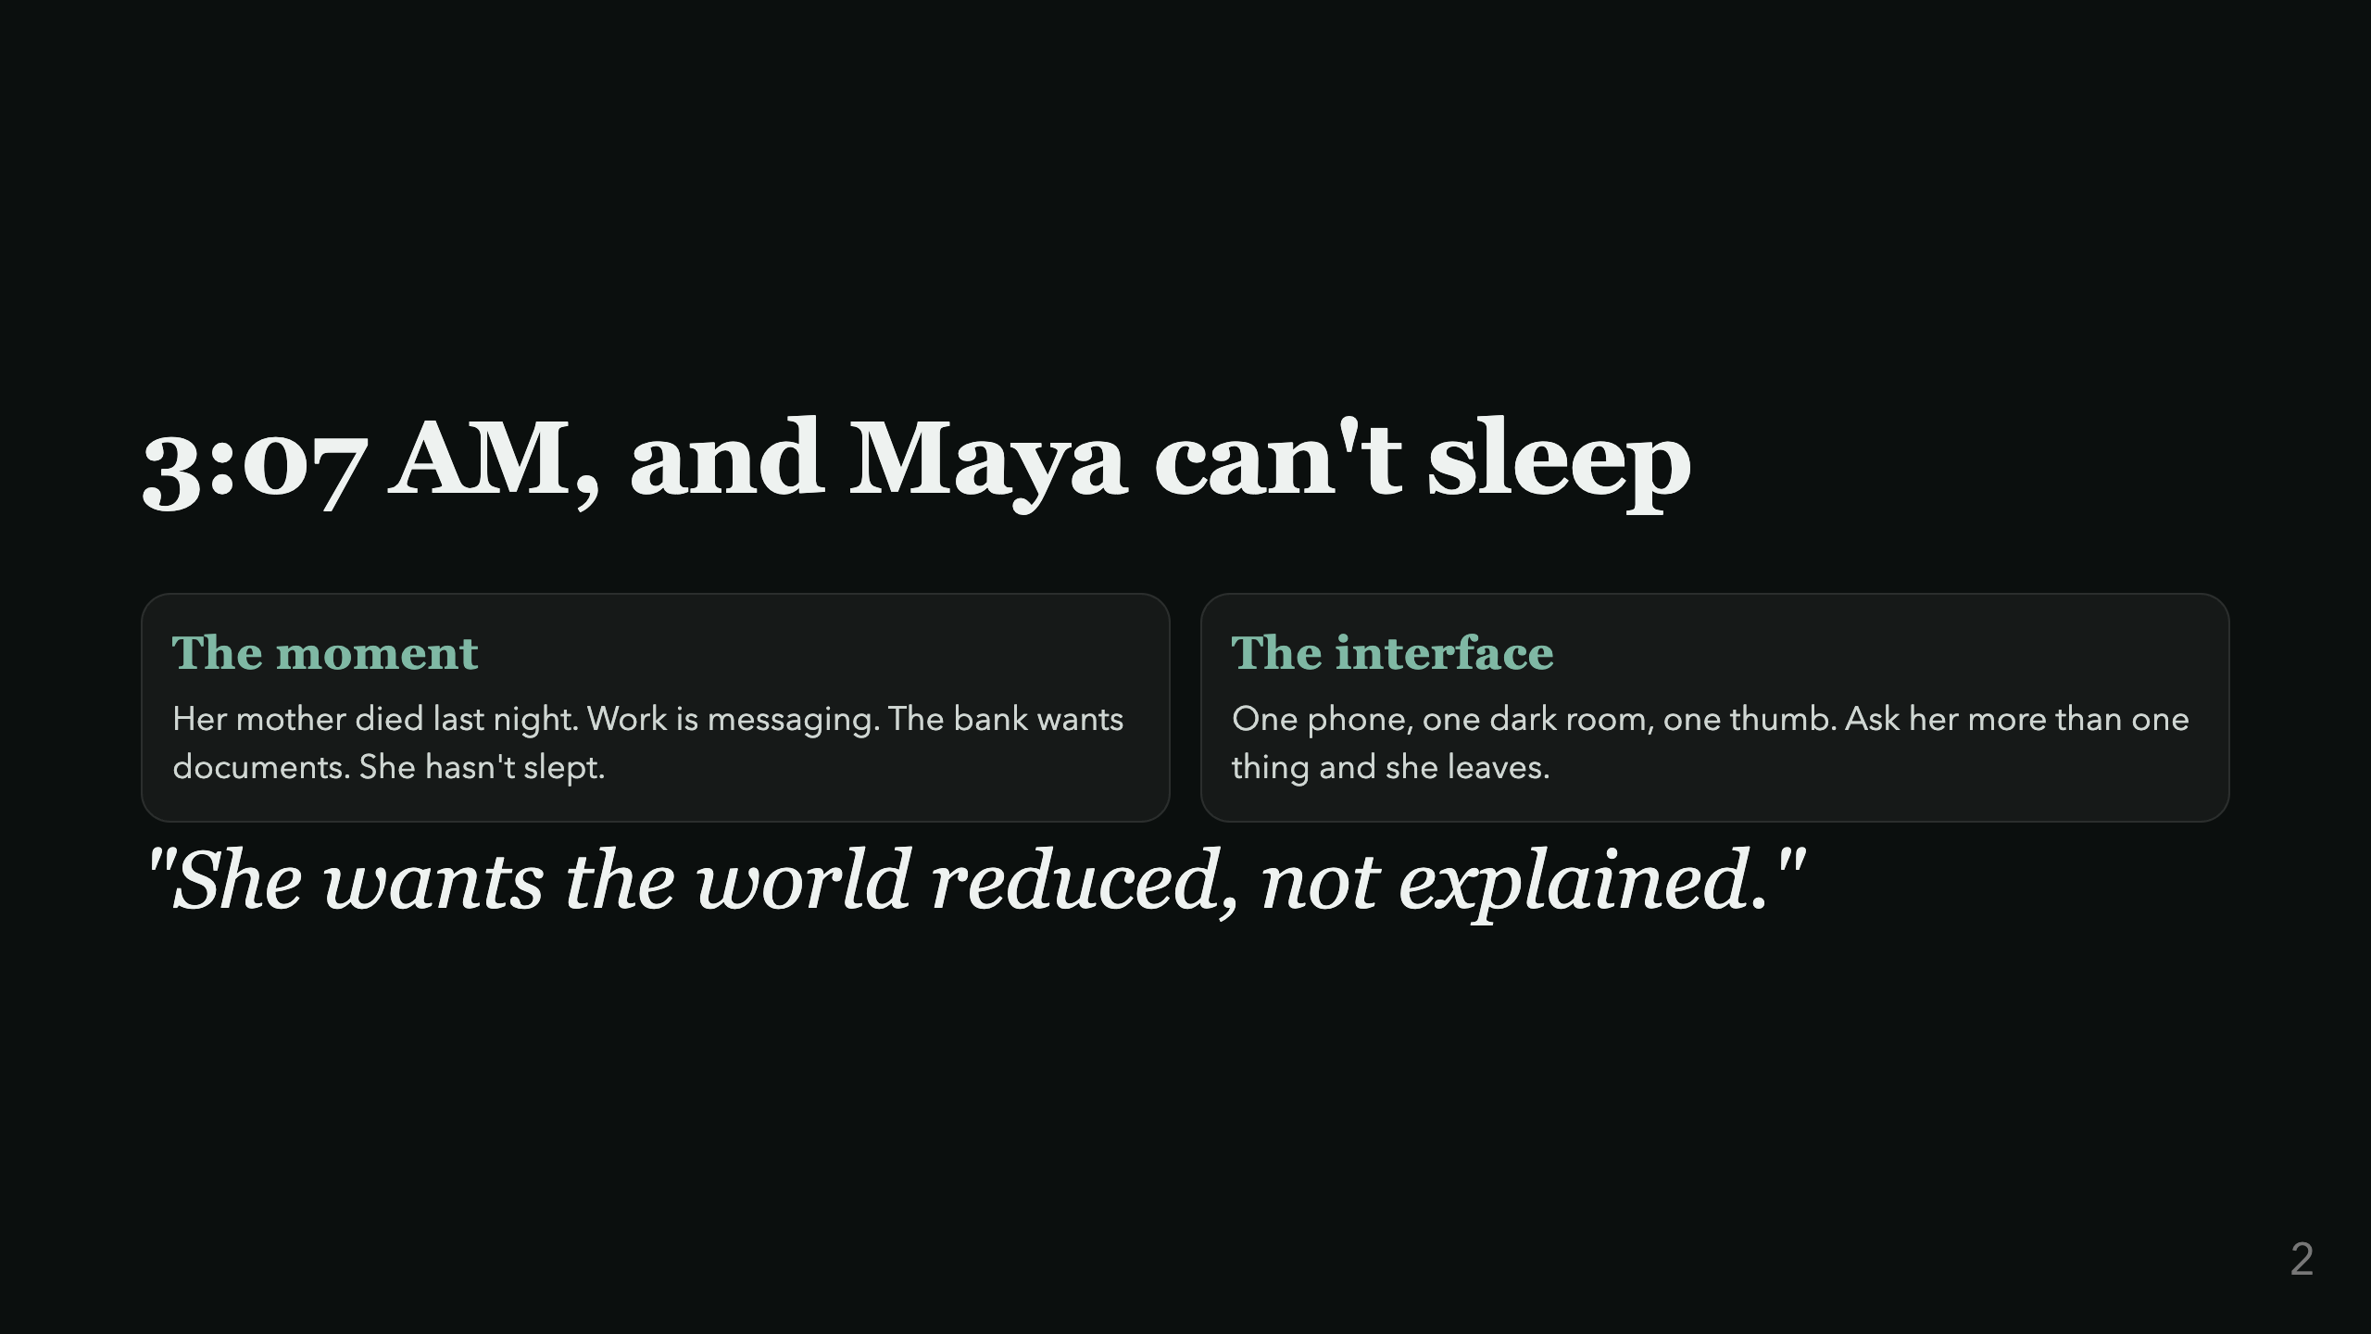
Notes:
Maya, 38, is the demo persona. Ground the room in her before any architecture talk.

Slide 3
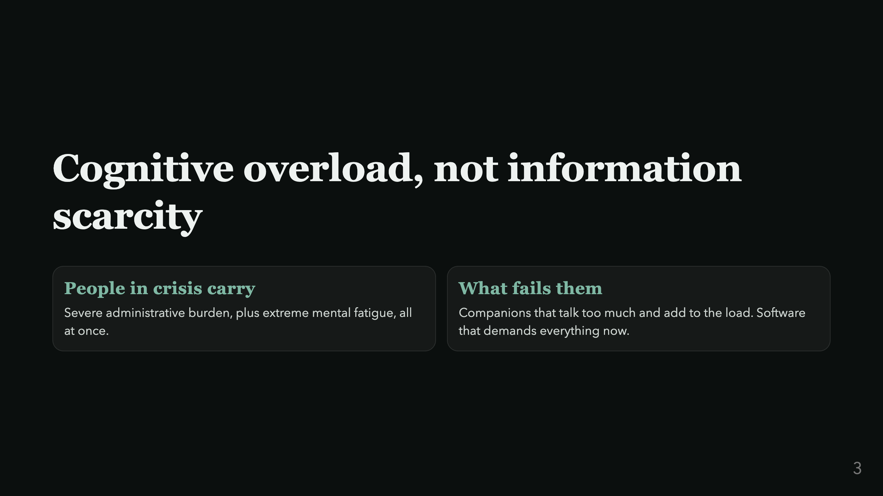
Notes:
Why every other AI companion misses this. Land it before the thesis.

Slide 4
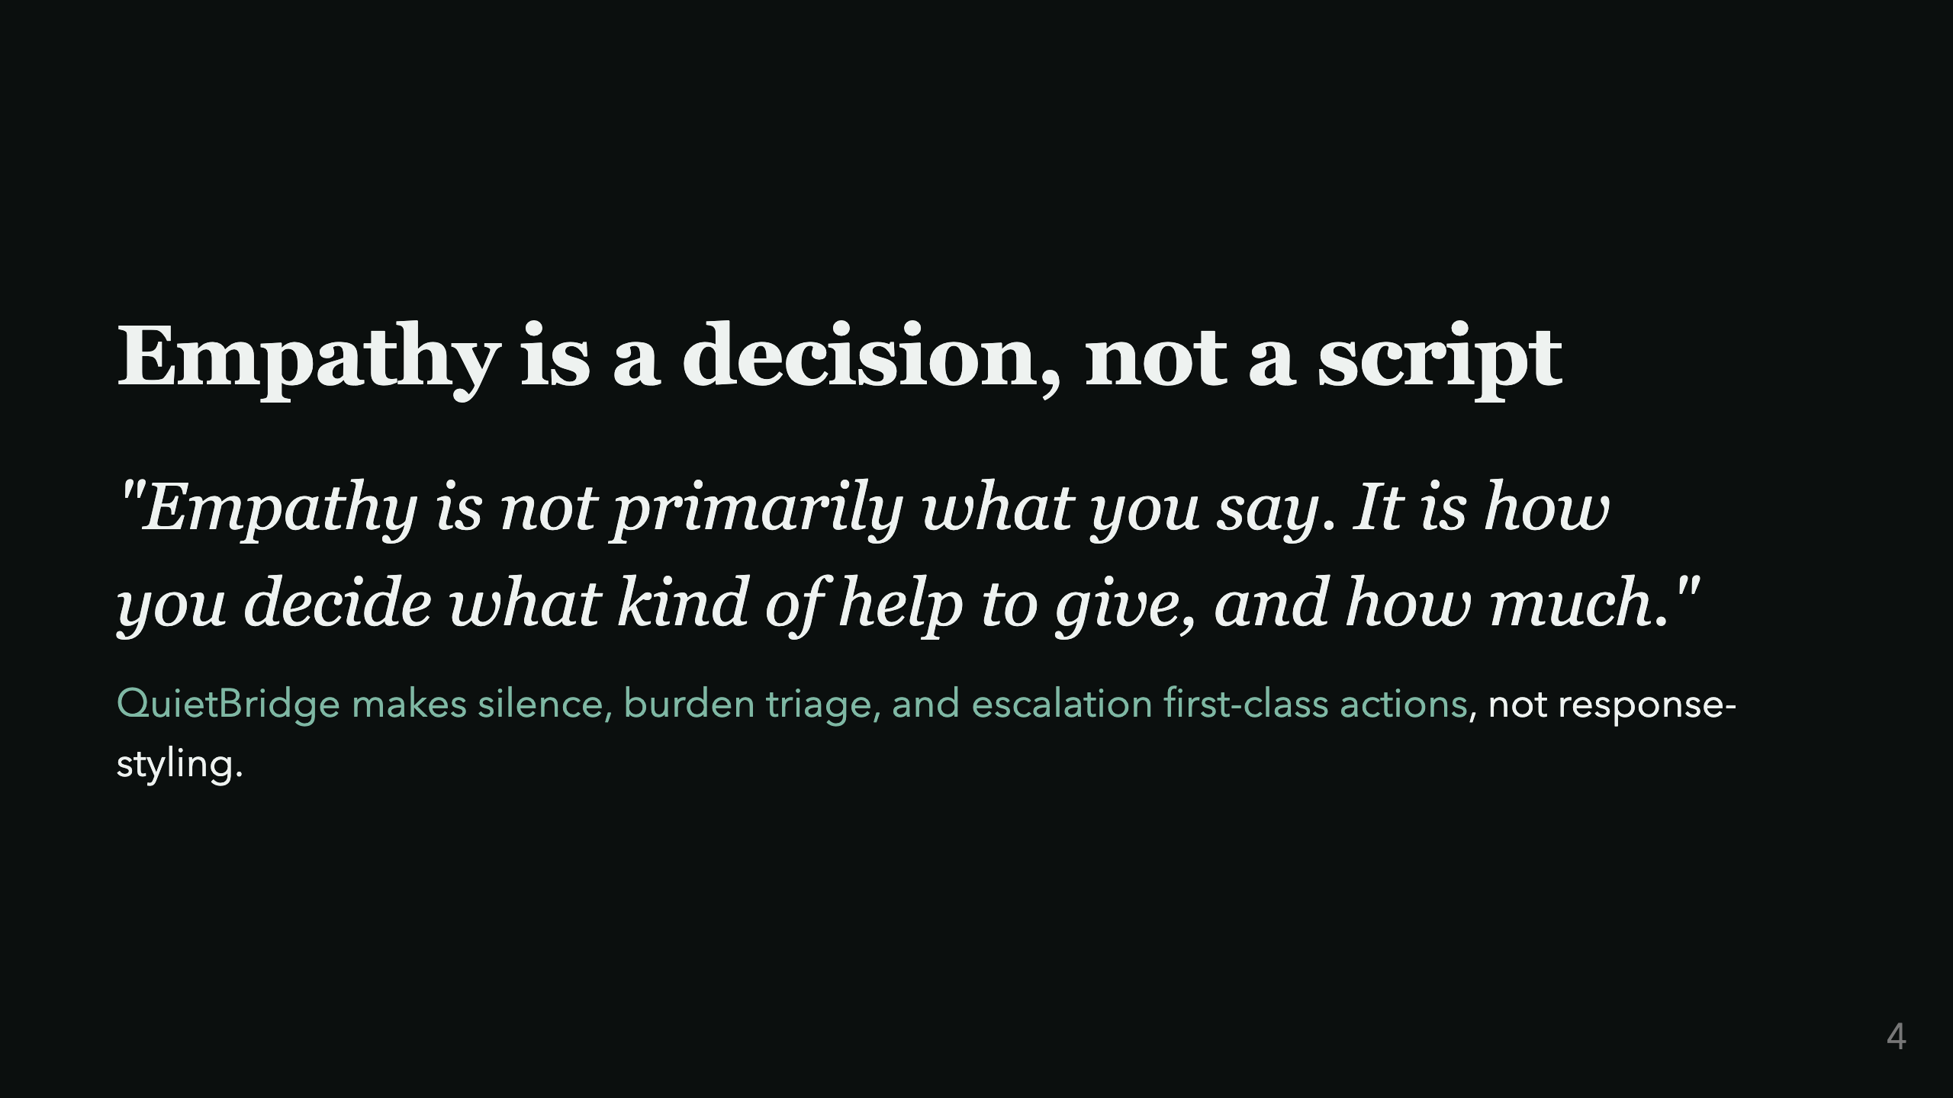
Notes:
This is the spine of the deck. Say it, pause. Everything after this slide is proof of this sentence.

Slide 5
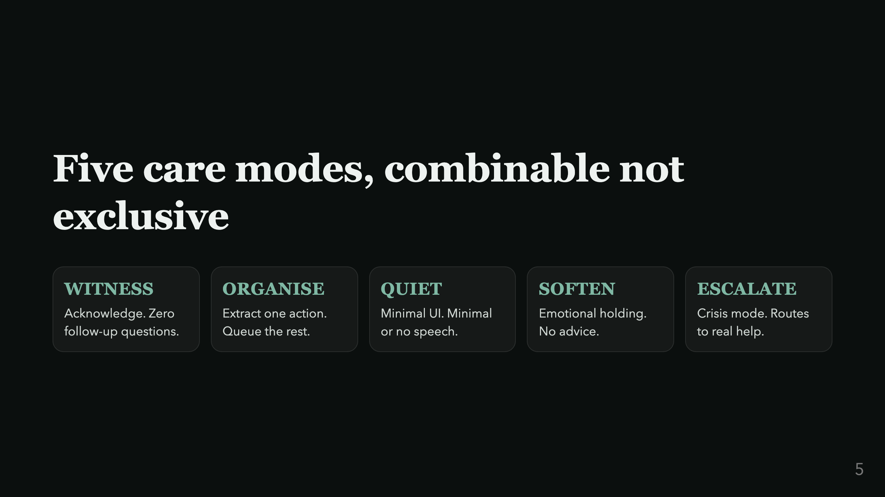
Notes:
Emphasize "combinable": a real state is often two modes at once, e.g. QUIET + ORGANISE.

Slide 6
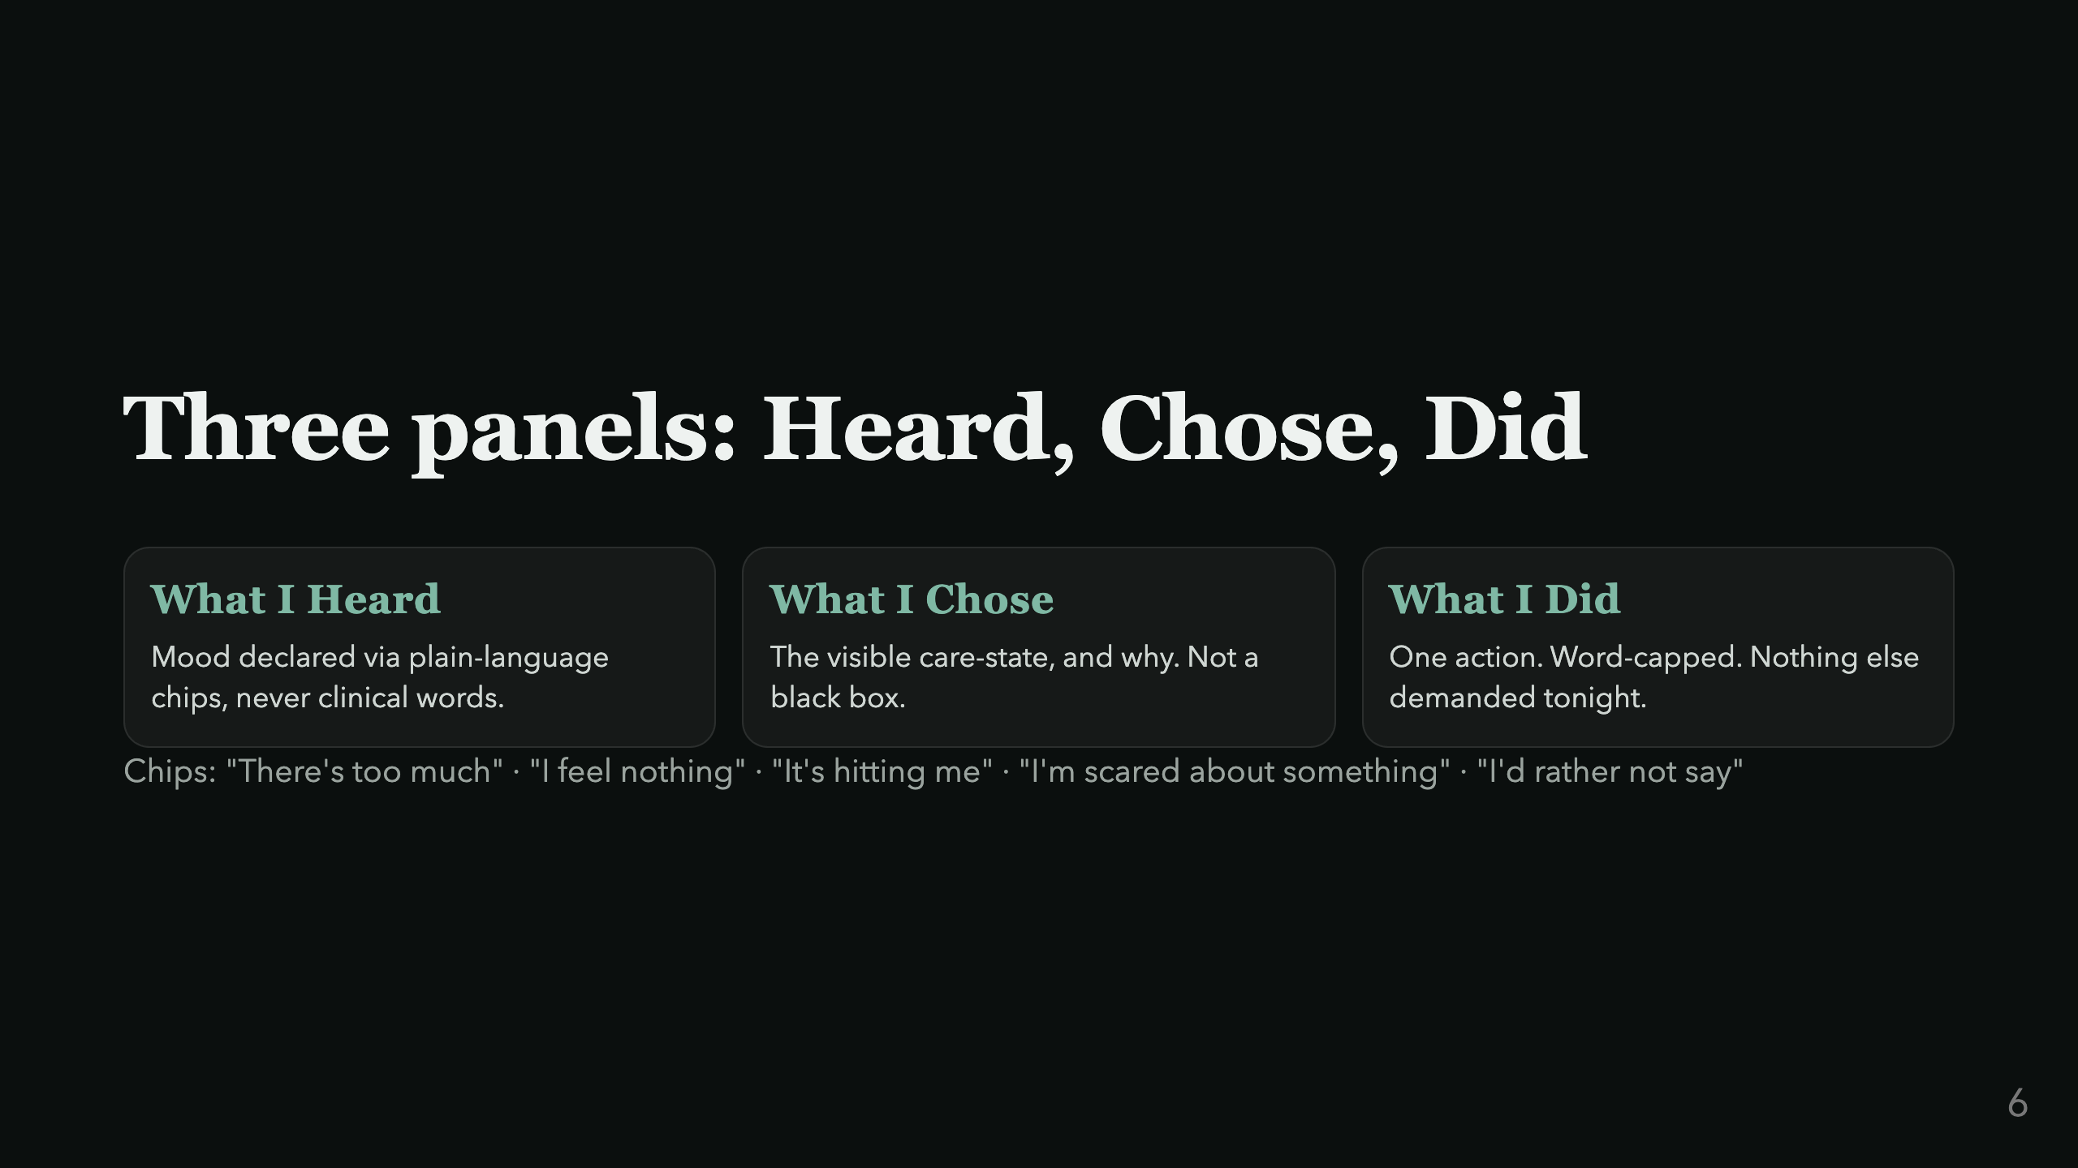
Notes:
Mood chips avoid diagnostic language on purpose: a clinical label invites the person to argue with it instead of picking it.

Slide 7
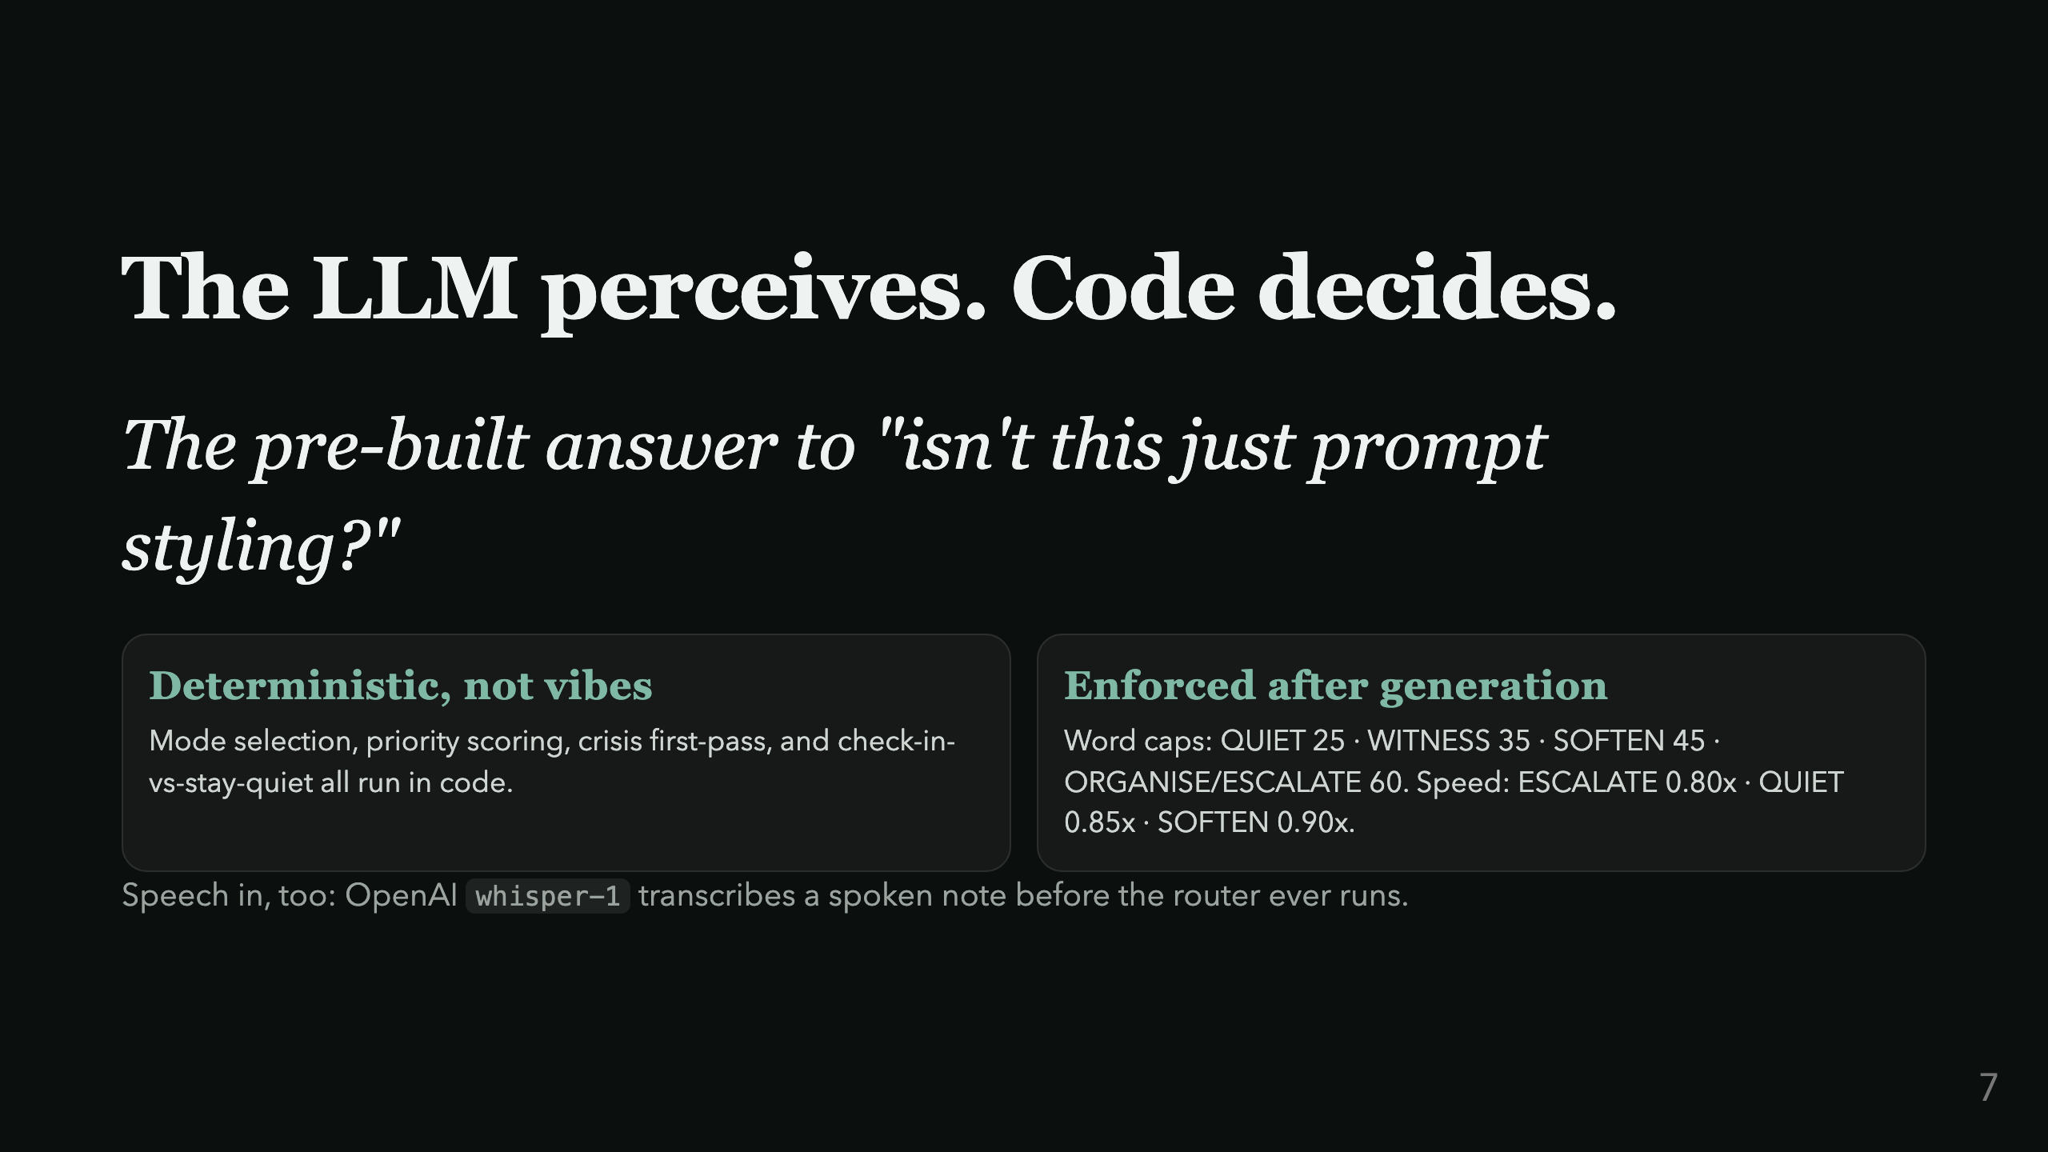
Notes:
Preempts the two hardest judge questions: "isn't this just prompt styling" and "isn't this just if-statements." Say both out loud.

Slide 8
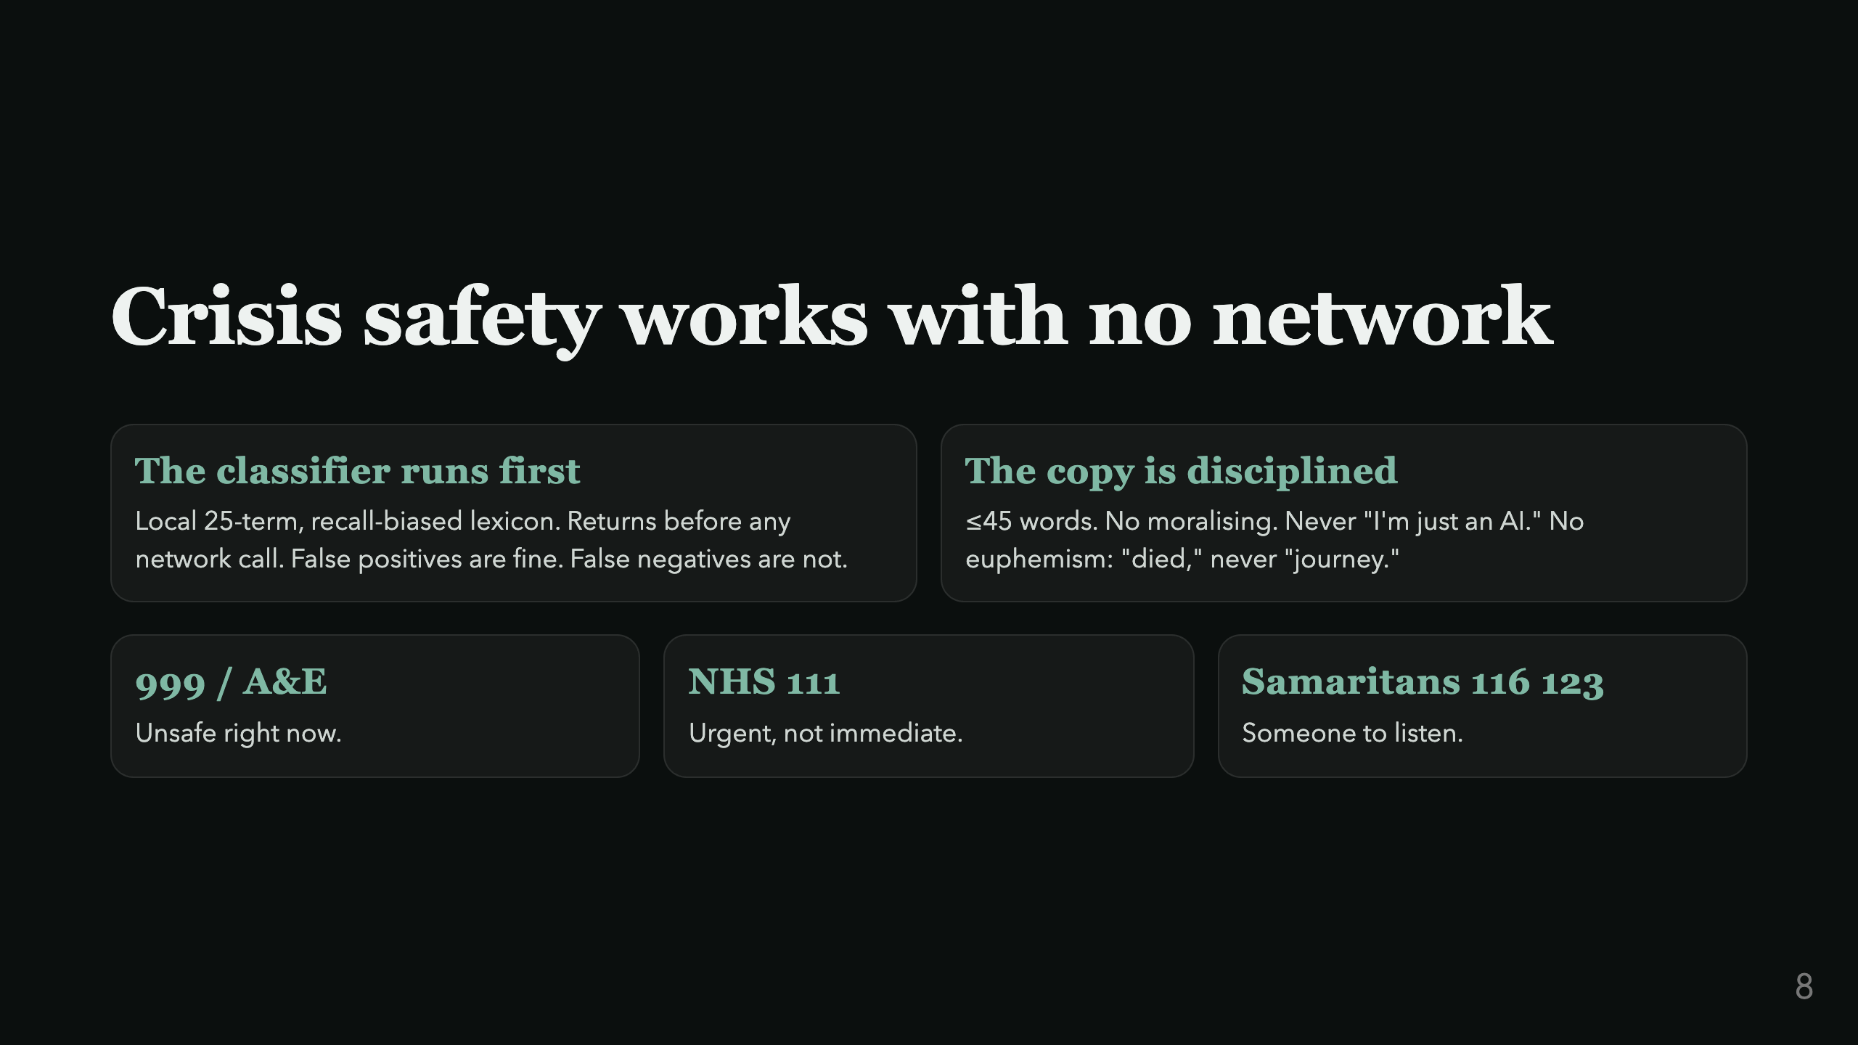
Notes:
Say plainly: this classifier works even with the wifi off. That's the point.

Slide 9
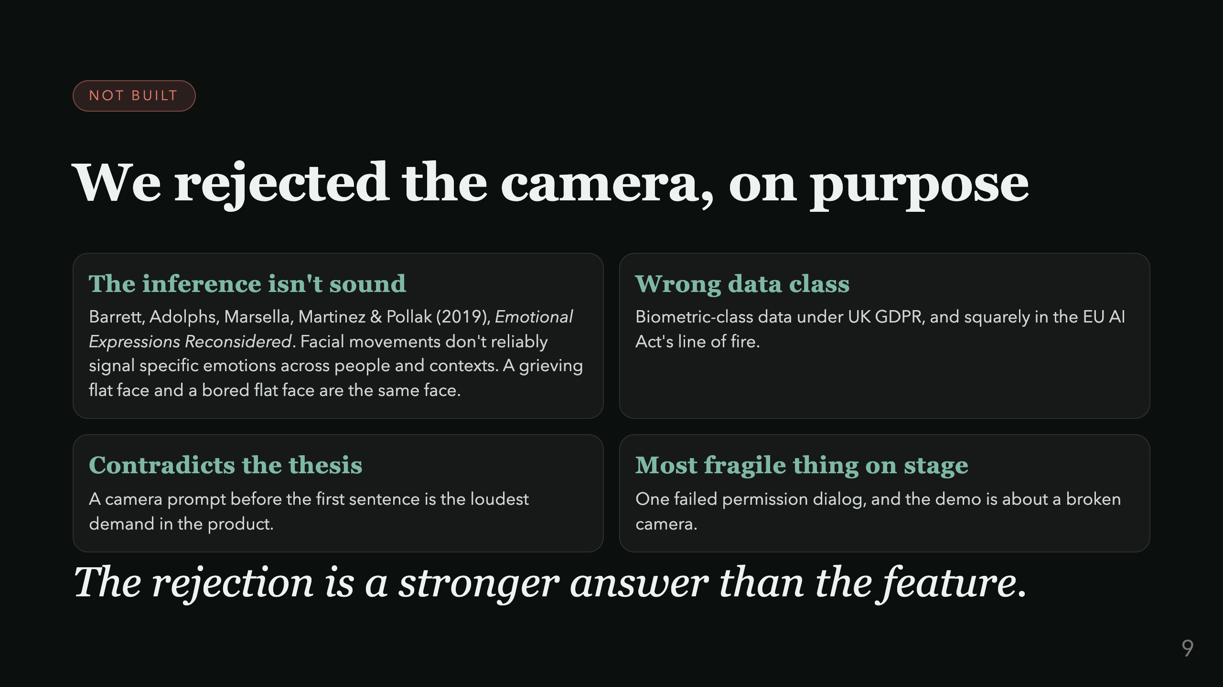
Notes:
Say "not built" plainly: this is where it goes next, not a claim the system reads faces today.

Slide 10
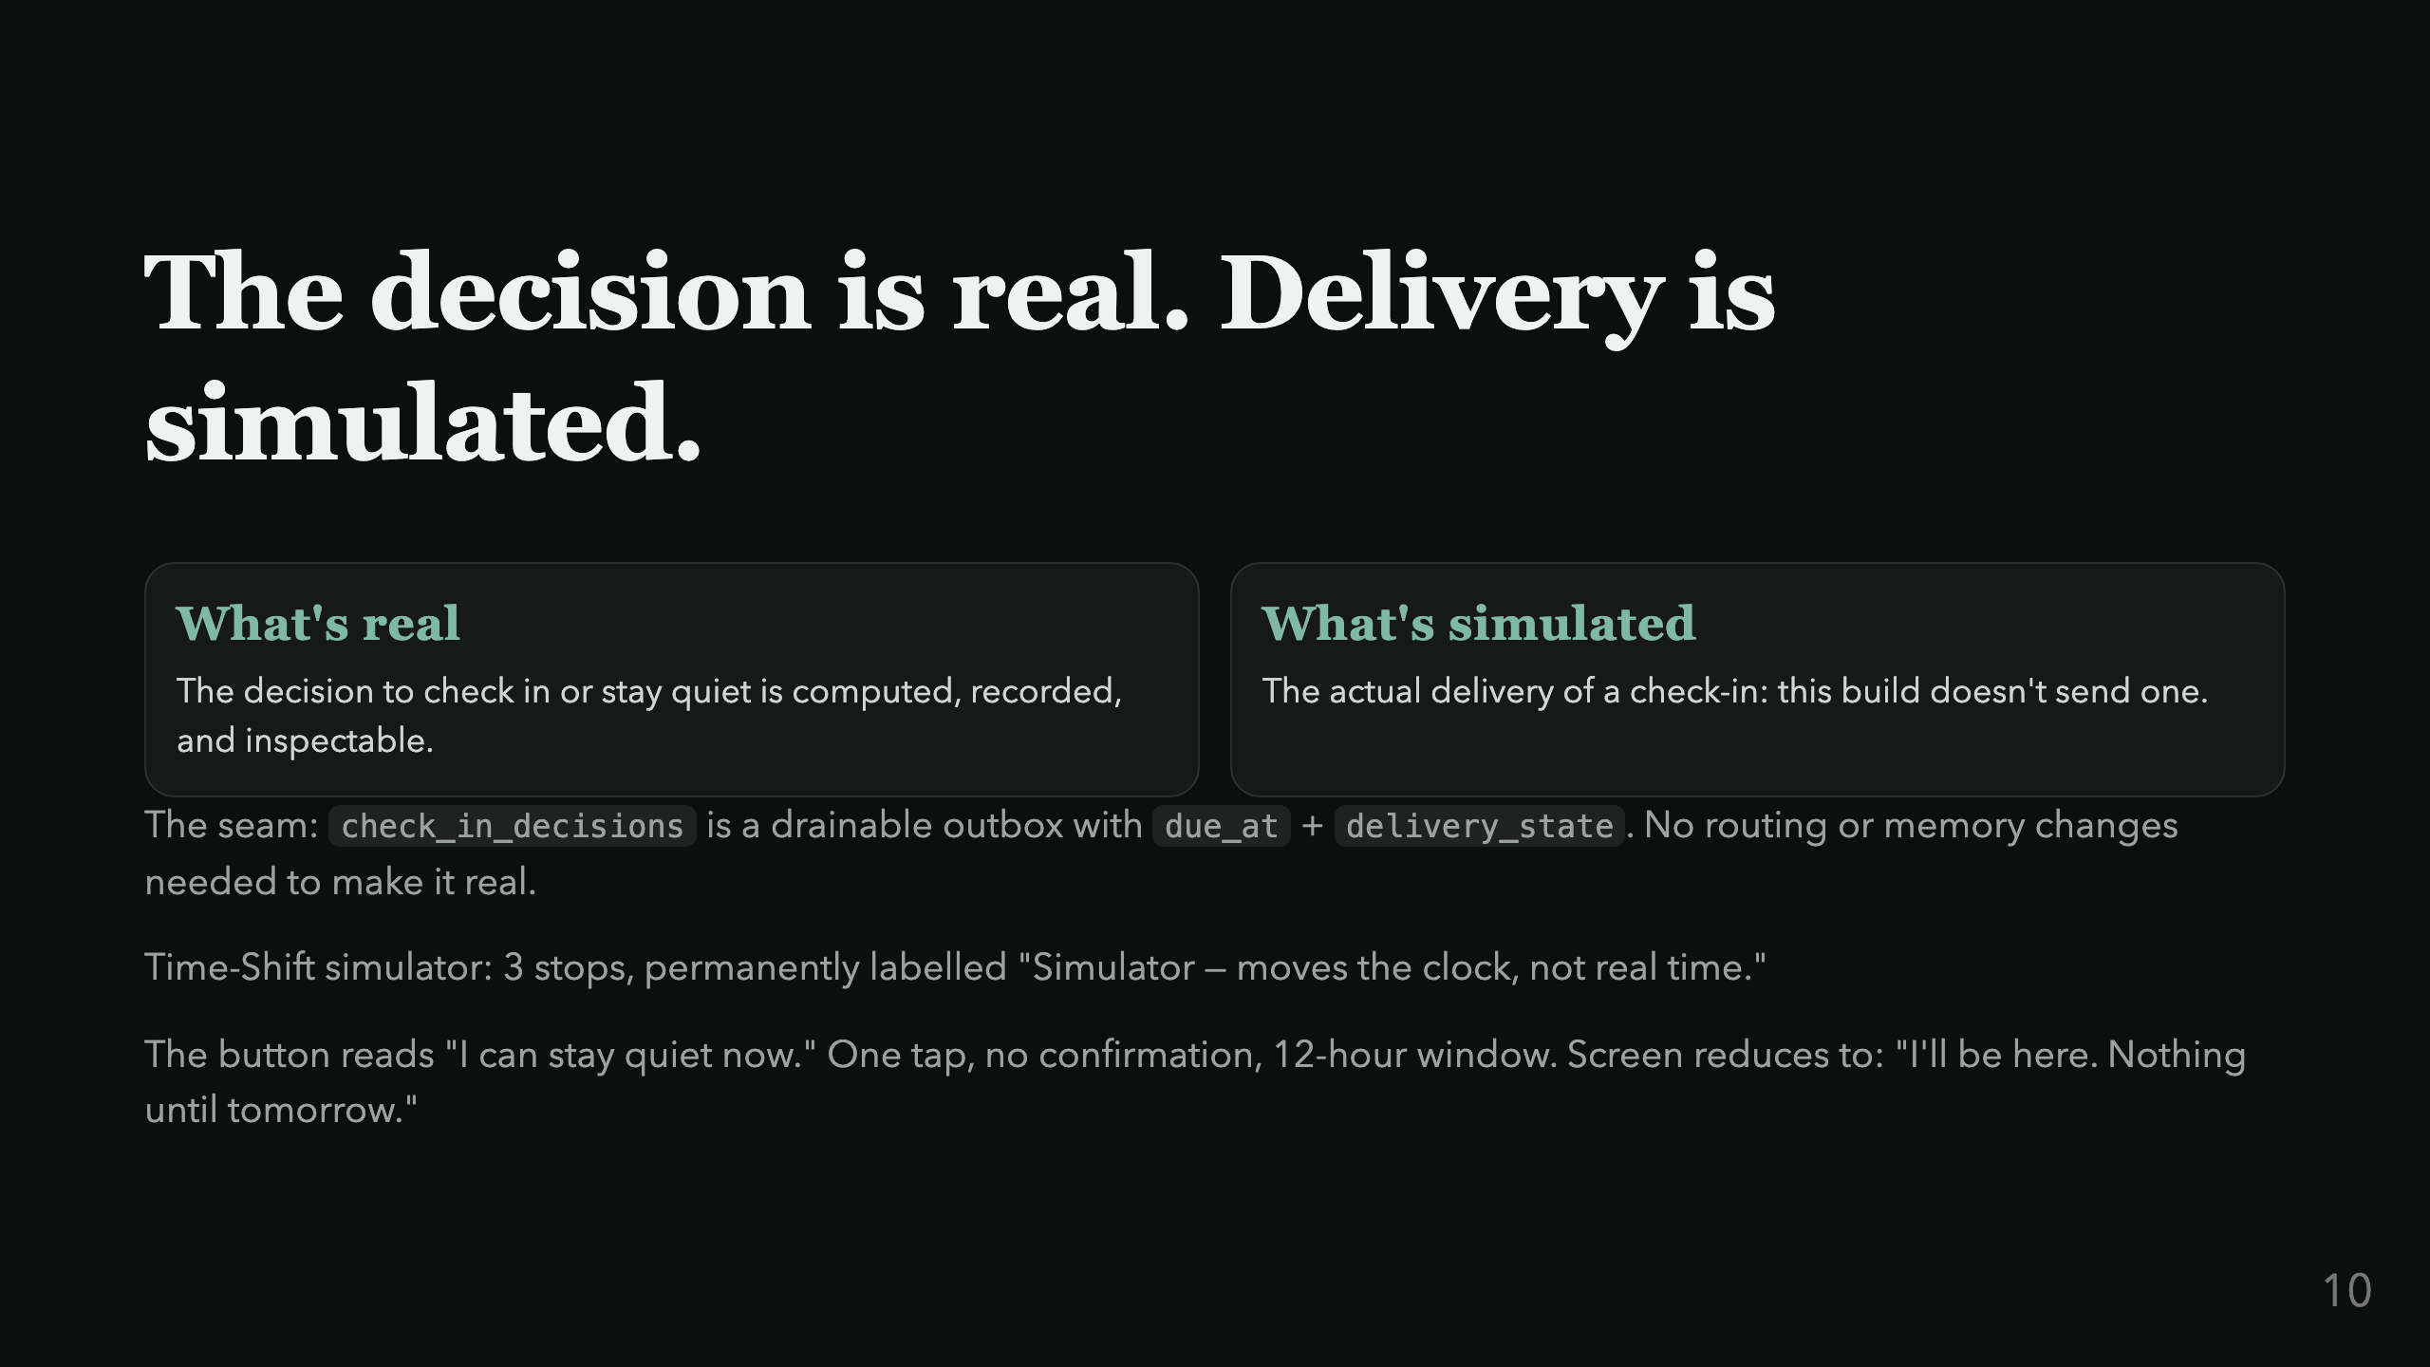
Notes:
A judge WILL ask "so it never actually reaches out?" Say the honest answer before they ask it.

Slide 11
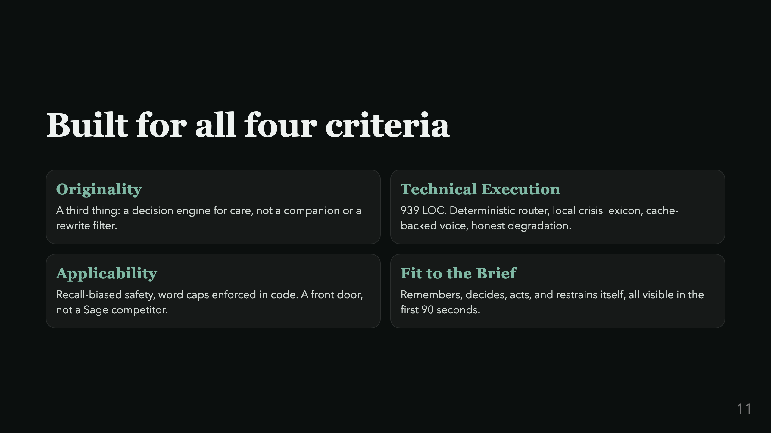
Notes:
One breath per card. Summary slide before the mic-drop. Keep pace up.

Slide 12
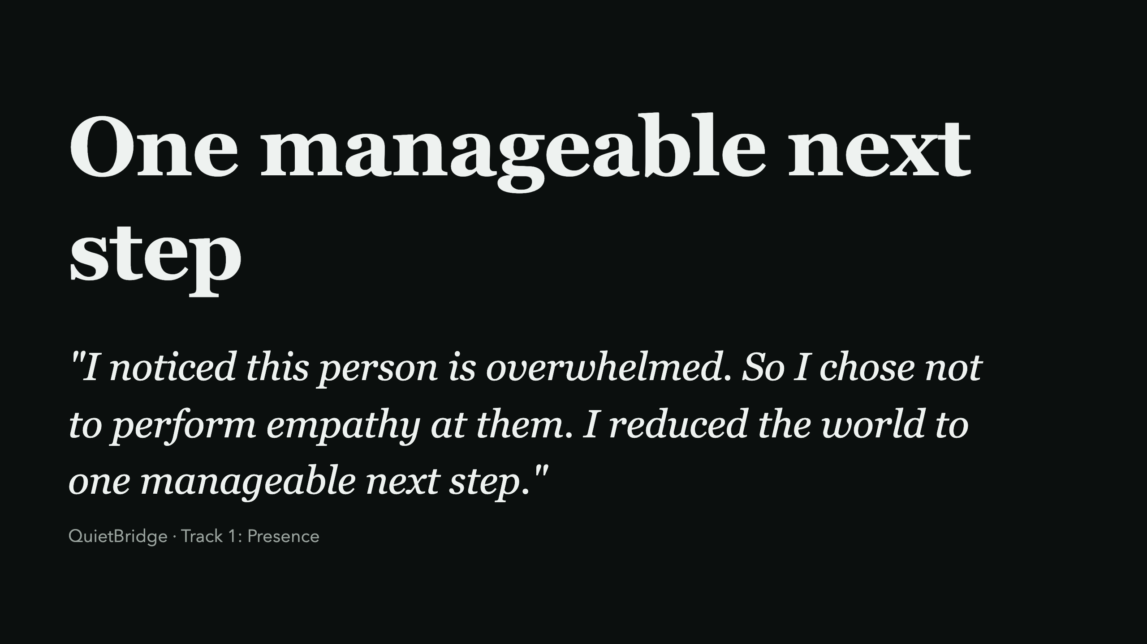
Notes:
Land on silence. Don't talk over the last line. Let it sit for two seconds before Q&A.

