Slide 1

PL/SQL Oracle Database Project
Name: Ntarindwa Mugisha Elvin
ID:26437
Group: Tuesday(B)
Lost & Found Item
Management System
project
(University)

Slide 2
Problem Statement & Objectives
Problem Definition
Objectives
Universities currently struggle with manual logs or basic spreadsheets to manage lost items. These methods are prone to errors, loss of records, and delays, complicating the recovery process for students and staff.
Our system aims to provide an automated, centralized solution utilizing a PL/SQL-based Oracle database to streamline reporting, tracking, and claiming lost items. This addresses the current inefficiencies and ensures a smoother process.
The current methods are inadequate, resulting in inefficiency, misplaced items, and delays. The new system seeks to provide an efficient and secure claims process.

Slide 3
Technical Framework & Benefits
Main Entities:
‍💼 Target Users and System Roles
🎓 Student/Staff: Initiate the process by reporting a lost item or searching for it. They also submit claims when an item is found.
‍💼 Administrator: Manages item records, validates reported items and claims, and approves the return of found items.
💽 Database: Serves as the central data store where all item and claim details are securely stored and retrieved.
🔁 Claim Workflow System: Automates the process of matching found items to lost item reports and monitors the progress of claims.
🔔 Notification System: Sends real-time updates to users when their lost item is found or when a claim has been approved or rejected.
Benefits:
Faster Item Recovery:
Users receive notifications when their lost item is found, accelerating the return process.
Better Organization
Digital record-keeping minimizes item mismanagement and ensures data accuracy.
Secure Claims Process
Verifies ownership through a secure process before items are returned to their owners.
Reduced Workload
University staff can manage reports more efficiently, freeing up time for other tasks.

Slide 4
📄 Explanation of the Business Process Model
Overview
How It Supports MIS Functions
Improved Decision-Making: Administrators access accurate, up-to-date data for validating claims.
Streamlined Operations: Automated matching and notification reduce manual tasks.
Data Accuracy: The centralized database minimizes record duplication or loss.
Transparency: Real-time status updates and audit trails ensure accountability.
Organizational Importance
This process enhances efficiency by reducing delays in item return, accuracy by securely managing records, and user satisfaction by offering a faster, tech-driven resolution process. It exemplifies how MIS can digitally transform traditional, manual workflows.
This process model illustrates the flow of activities in a university’s Lost & Found Item Management System, highlighting how Management Information Systems (MIS) support key operations such as item reporting, tracking, claim validation, and notifications.
Main Components & Interactions
Student/Staff: Initiates the process by reporting a lost item or searching for it. They also submit claims when an item is found.
Administrator: Manages item records, validates reported items and claims, and approves the return of found items.
Database: Serves as the central data store where all item and claim details are securely stored and retrieved.
Claim Workflow System: Automates the process of matching found items to reports and monitors claim progress.
Notification System: Sends real-time updates to users (e.g., when their item is found or a claim is approved).

Slide 5
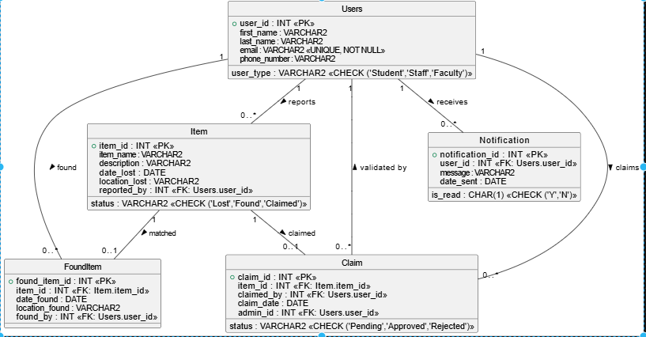
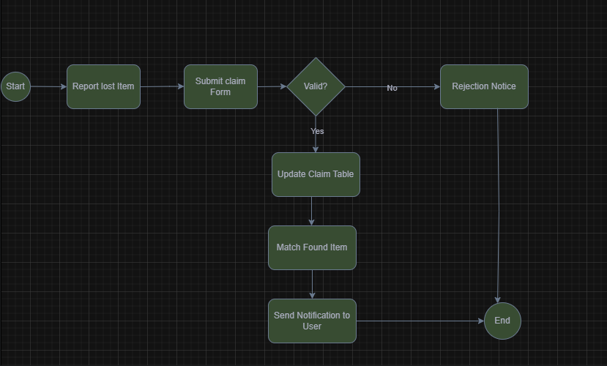
5. Ensure Logical Flow
Basic process flow:
[Student/Staff] → Report Lost Item →
[Database] → Store Item Info →
[Administrator] → Validate Report →
[Claim Workflow] → Monitor for Found Items →
[Administrator] → Approves Claim →
[Notification System] → Sends Notification →
[Student/Staff] → Receives Item → End
BPMN/UML Diagram
.
.
.
.
.
.
.
.
.
.
.
.
📘 1. Entity-Relationship (ER) Model

Slide 6
Database Architecture – PDB, OEM & SQL Operations
Pluggable Database (PDB) Deployment
The system runs inside a dedicated pluggable database, created to isolate all project components.
Ensures clean separation from other databases in a multitenant environment.
Benefits:
Better data management
Easy to open, close, and maintain
Reusable across institutional deployments
Oracle Enterprise Manager (OEM) Monitoring
OEM provided a graphical interface to:
View and manage users, sessions, storage
Confirm trigger executions and constraints
Monitor audit trails and system performance
Helped validate the correct implementation of relationships and logic.
DDL vs. DML in the System
DDL (Data Definition Language):
Used to create physical tables, triggers, and packages
Examples: CREATE TABLE, ALTER, DROP
Ensures data structure reflects the ER model
DML (Data Manipulation Language):
Used to insert, update, and delete sample data
Examples: INSERT INTO, UPDATE, DELETE
Simulates user actions and verifies business logic (e.g., lost item reports, claims)

Slide 7
PL/SQL Programming (Procedures, Functions, Packages)
To keep the logic organized, I bundled related code into PL/SQL packages. One example is the audit package, which holds the procedure that all audit triggers use. This made it easy to call a single standardized function across the entire system.
Lastly, I used cursors to fetch multiple rows — especially helpful when generating reports or reviewing multiple item statuses — and added exception handling to ensure the system remains stable, even when faced with invalid inputs or unexpected scenarios.
This level of modular programming makes the system clean, efficient, and much easier to maintain or upgrade in the future.”
“In this part of the project, I focused on building core backend logic using PL/SQL. We implemented procedures to handle common operations such as inserting and approving claims, fetching lost or found item data, and sending status updates to users. These procedures helped modularize the system and made our code reusable and maintainable.
Alongside that, I created functions to return specific values — for instance, whether a claim was valid, or what its current status is. These functions helped streamline our decision-making processes inside both triggers and packages.

Slide 8
Triggers & Restrictions
“One of the more advanced and important parts of this project is the use of database triggers for business rule enforcement — specifically, restriction rules.
I implemented a trigger that prevents any insert, update, or delete operation on the Item table during weekdays and also on public holidays.
To achieve this, I first created a Holidays table that stores dates considered non-working days. The trigger uses system functions like SYSDATE and TO_CHAR to check if the current day is Monday to Friday, and then also checks against the list of holidays.
If any condition matches, the trigger blocks the operation automatically, and returns a custom error message.
This logic ensures that sensitive modifications — such as altering item status or deleting claim records — cannot be done during off-hours or when admins are not present.
It adds an important layer of operational control and data protection, which is especially important for maintaining institutional policy and preventing mistakes or unauthorized access.”

Slide 9
Auditing & Logging
“To ensure full transparency and accountability in this system, I implemented a complete auditing mechanism.
Every time a user performs a sensitive operation — like inserting, updating, or deleting from the Claim, Users, or FoundItem tables — an audit trigger records it automatically.
All this activity is logged into an AuditLog table, which captures:
The user ID (using the current session info),
The type of operation (like INSERT, DELETE),
The table name affected,
A timestamp of the action,
And a status flag indicating if the action was allowed or denied.
To avoid repeating logging logic in every trigger, I created a PL/SQL package called pkg_audit_log. This allows every audit trigger to just call a standard procedure — keeping the code clean, consistent, and easy to manage.
This approach not only improves security, but it also aligns with MIS best practices by creating a full audit trail. This could later be used for reporting, investigation, or even legal verification of user activity.
Overall, it reinforces both the trustworthiness and accountability of the system.”

Slide 10
🏁 Slide 10: Conclusion
I developed a secure, efficient, and modular Lost & Found Management System.
It includes:
Physical & logical database design
Workflow automation (via BPMN)
Security through triggers
Auditing for accountability
This system can be scaled for use in other departments or institutions.
"This project gave me hands-on experience in real-world database development using Oracle tools, and I’m proud to present a complete solution that could be implemented and used effectively in academic environments."

