Slide 1

ProofLend
Cross-chain lending eligibility verified on Creditcoin
BUIDL CTC 2026 Fall
DeFi track / Solo project
prooflend.vercel.app
Notes:
Opening: ProofLend turns a source-chain event into lending eligibility that a Creditcoin contract verifies for itself.
Sources:
https://buidl.creditcoin.org/

Slide 2
PROBLEM
02
Cross-chain lending still depends on trusted reports
A destination contract cannot inspect Ethereum by itself. Many applications fill that gap with a private indexer or backend assertion.
Backend assertion
Proof verified on Creditcoin
“This address completed the required action.”
Transaction bytes plus Merkle and continuity proofs reach the contract.
The lending contract must trust the reporter.
Only verified source data can change eligibility.
Notes:
Explain the design choice: the off-chain component gathers public material, while the destination contract enforces trust.
Sources:
https://docs.creditcoin.org/usc/overview/usc-architecture-overview

Slide 3
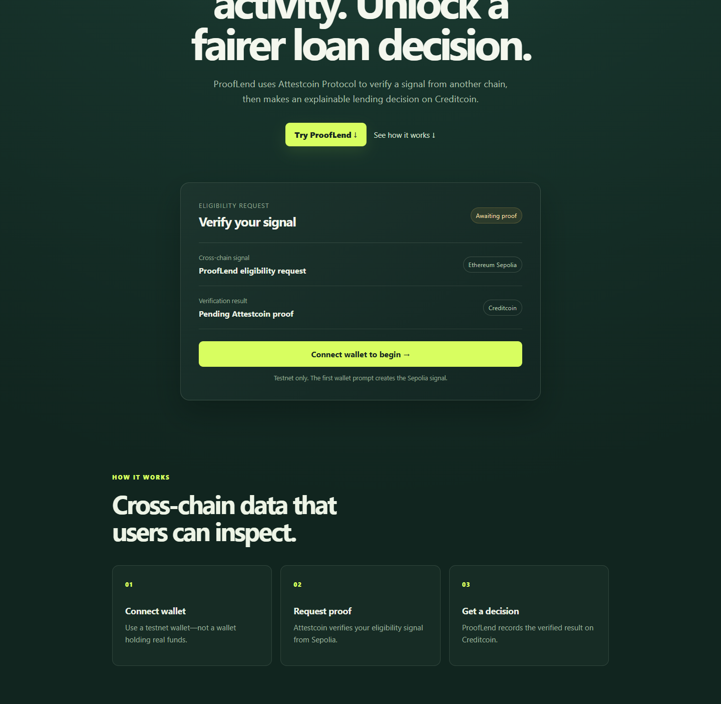
PRODUCT
03
A two-transaction path from signal to decision
01
Create the signal
The wallet emits EligibilityRequested on Sepolia.
02
Build the proof
ProofLend waits for attestation and obtains proof data.
03
Record eligibility
The wallet submits the proof to Creditcoin.
The wallet signs. ProofLend never handles private keys.
Notes:
Walk through the user flow. Mention the attestation wait, automatic retries, network switching, and public explorer links.
Sources:
Project source: https://github.com/Elvino03/prooflend

Slide 4
ARCHITECTURE
04
ProofLend verification path
User wallet
Sepolia signal
Attestcoin proof
Creditcoin contract
Signs source and destination transactions
EligibilityRequested event
Transaction bytes
Merkle + continuity
Verifies, decodes, records
Proof service
Native checks
Attestors
Checks attested height
Uses official SDK
Requests Proof Builder
Verifier 0x0FD2
Approved event source
Replay protection
Commit Sepolia block state
State changes only after proof and event validation succeed.
Notes:
Architecture: the source emits a narrow event. Attestcoin anchors source-chain state. The proof service retrieves public proof material. The Creditcoin contract verifies and interprets it.
Sources:
https://docs.creditcoin.org/usc/dapp-builder-infrastructure/dapp-design-patterns
https://docs.creditcoin.org/usc/creditcoin-oracle-subsystems/proving

Slide 5
CONTRACT LOGIC
05
The destination contract controls the decision
1
Verify inclusion
2
Validate the event
0x0FD2 checks the Merkle and continuity proofs.
The receipt must contain the expected signature from the configured source contract.
3
Decode the applicant
4
Prevent replay
EvmV1Decoder extracts the address and request ID from the proven receipt.
processedQueries rejects a second use of the same query ID.
verifiedRequestId[applicant] changes only after all four checks pass
Notes:
Highlight that Attestcoin is a required execution input. The proof builder cannot directly write eligibility. The contract enforces source validation and replay protection.
Sources:
https://docs.creditcoin.org/usc/dapp-builder-infrastructure/universal-smart-contracts
Project contract: contracts/src/ProofLendEligibility.sol

Slide 6
PUBLIC EVIDENCE
06
Public testnet execution
SEPOLIA REQUEST
CREDITCOIN EXECUTION
EligibilityRequested
EligibilityVerified
0xd5ba4fa9…ad820345
0xdec3d335…e5a13096
Request ID 1
Query ID 0x3170fd6f…4b47ba22
Applicant
0xFC99c75De3188eB27f5331E24c51F4B68F1F4286
Both deployed contract addresses
0xa91ebc1dc12aa9c43e7acc2ac4227309bdd7188f
Same address, separate bytecode on separate networks
Notes:
Open both explorer links during the demo and show successful status plus emitted events.
Sources:
https://sepolia.etherscan.io/tx/0xd5ba4fa9041a7de72bcbee6ca12ef32c8e188c4ef828564469989a69ad820345
https://creditcoin-testnet.blockscout.com/tx/0xdec3d335a1d178fa92e05af5818b607669fa8d9de0c1b4fc6d6e2626e5a13096

Slide 7
IMPLEMENTATION
07
A small stack with a clear trust boundary
Browser
React · Vite · ethers.js · EIP-6963 wallet discovery
Proof service
Vercel Function · @gluwa/usc-sdk · Proof Builder
Source contract
ProofLendSignal on Ethereum Sepolia
Execution contract
ProofLendEligibility · EvmV1Decoder · verifier precompile
2 contracts
2 public testnets
0 private keys handled by the app
Notes:
The architecture keeps source logic narrow and destination checks explicit. Wallets sign both transactions, and the application does not custody funds or credentials.
Sources:
https://github.com/Elvino03/prooflend

Slide 8
NEXT VERSION
08
ProofLend can verify real lending signals next
TODAY
NEXT
A simple eligibility event proves the complete Attestcoin path end to end.
01
Repayment and collateral events as verified inputs
02
Policy contracts that combine several proven signals
03
Relayed and batched proofs for a simpler user experience
Live demo
Source
prooflend.vercel.app
github.com/Elvino03/prooflend
Testnet prototype. Eligibility is not a real credit score or loan offer.
Notes:
Close with the concrete next product step and direct judges to the live application, repository, and public evidence.
Sources:
https://prooflend.vercel.app/
https://github.com/Elvino03/prooflend

