Slide 1
Generative adversarial network
-- SX

Slide 2
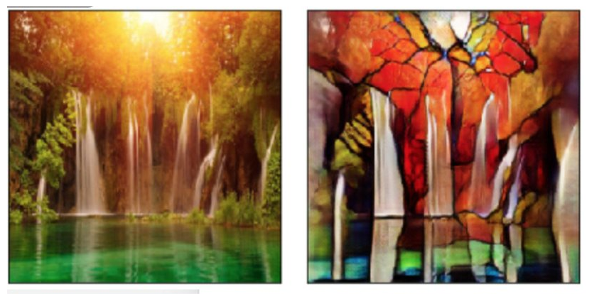
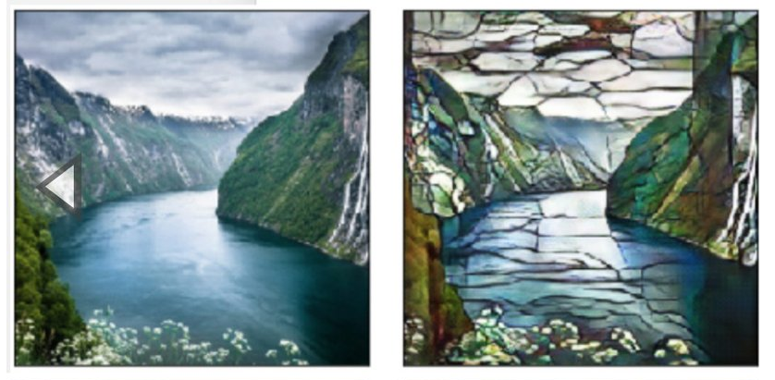

Slide 3
Classifications & Usage
Vanllia GAN
Black-white pictures
Deep Convolutional GAN
Colored Pictures （three channals）
Semi-supervisored Learning
Technique in which both labeled and unlabeled data are used to train a classifier

Slide 4
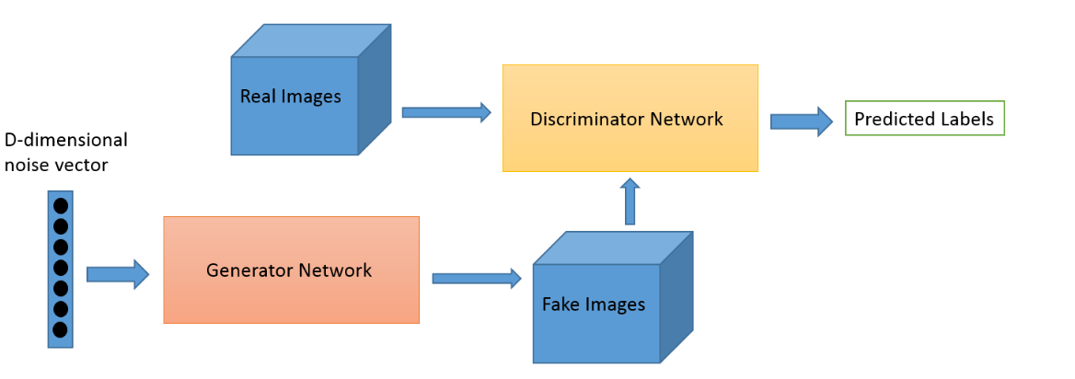
GANs are composed of two components, a generator and a discriminator.
The discriminator has the task of determining whether a given image looks natural (ie, is an image from the dataset) or looks like it has been artificially created.
The task of the generator is to create natural looking images that are similar to the original data distribution, images that look natural enough to fool the discriminator network.

Slide 5
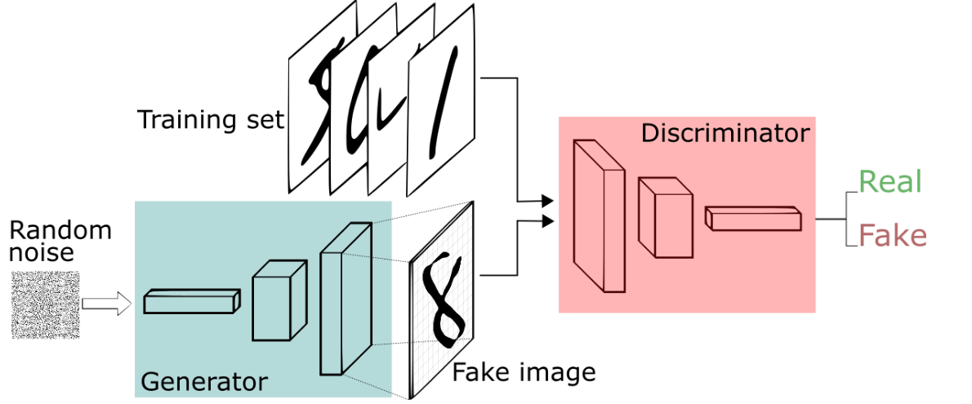

Slide 6
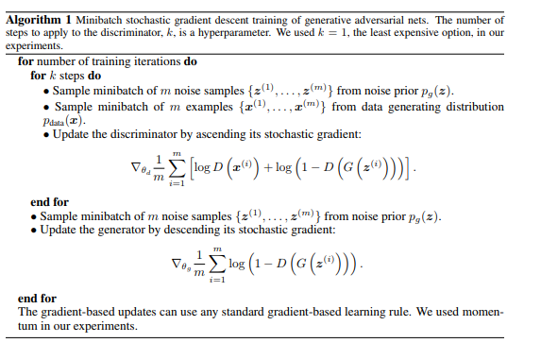
Algorithms

Slide 7
Demo

Slide 8
Reference paper：
https://papers.nips.cc/paper/5423-generative-adversarial-nets.pdf
https://github.com/uclaacmai/Generative-Adversarial-Network-Tutorial

