Slide 1

EXPLORATORY DATA ANALYSIS · MAY 2026
Cart Abandonment & Checkout Funnel Analysis
A comprehensive analysis of cart abandonment and checkout funnel drop-off behavior on TheLook, a fictitious e-commerce clothing retail platform developed by the Google Looker team. This report explores 14 analytical questions covering funnel behavior, customer segmentation, traffic channel attribution, product and pricing analysis, revenue quantification, and behavioral patterns.
Prepared by: Elvis George | Analyst · Dataset: Google BigQuery Public Dataset — TheLook E-Commerce

Slide 2
EXECUTIVE SUMMARY
Key Findings at a Glance
32.08%
$756K
Cart-to-Purchase Rate
Total Revenue Lost
67.92% drop-off at the final checkout stage
Estimated total loss from cart abandonment
97.20%
12,112
First-Time Visitor Abandonment
Abandoned Sessions in China
vs. 87.69% for returning customers — a 10-point trust gap
Dominates geographically, suggesting localization gaps
Platform-Wide Problem
Accelerating Losses
Behavioral Warning Signal
No traffic source, age group, gender, price range, or product category shows a statistically meaningful advantage — abandonment is universal across every segment.
Monthly losses grew 262× from $220 (Jan 2019) to $57,861 (Jan 2024). A 5% conversion improvement would recover over $37,000 annually.
Users who later cancelled or returned orders showed 21% higher browsing activity than those who completed purchases successfully.

Slide 3
DATASET OVERVIEW
About the Dataset & Business Problem
Dataset Structure
The Core Leadership Question
TheLook is a fictitious e-commerce platform hosted on Google BigQuery. The dataset spans multiple years across 7 interconnected tables covering customers, products, orders, web events, and logistics.
TheLook generates consistent traffic across organic search, paid advertising, email, and social media — yet a significant portion of users never complete their purchase.
Table
Rows
Are we losing customers because of a product problem, a pricing problem, a channel problem, or a checkout experience problem?
orders
125,226
14 analytical questions were explored across funnel behavior, segmentation, channel attribution, product analysis, revenue quantification, and hypothesis testing.
order_items
181,759
users
99,042
products
29,120
events
300,000 (sampled)
inventory_items
100,000 (sampled)
distribution_centers
10

Slide 4
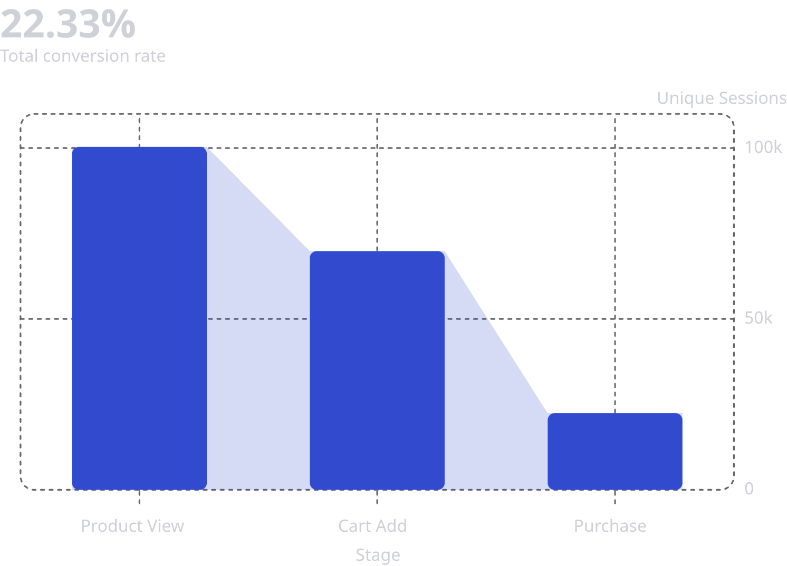
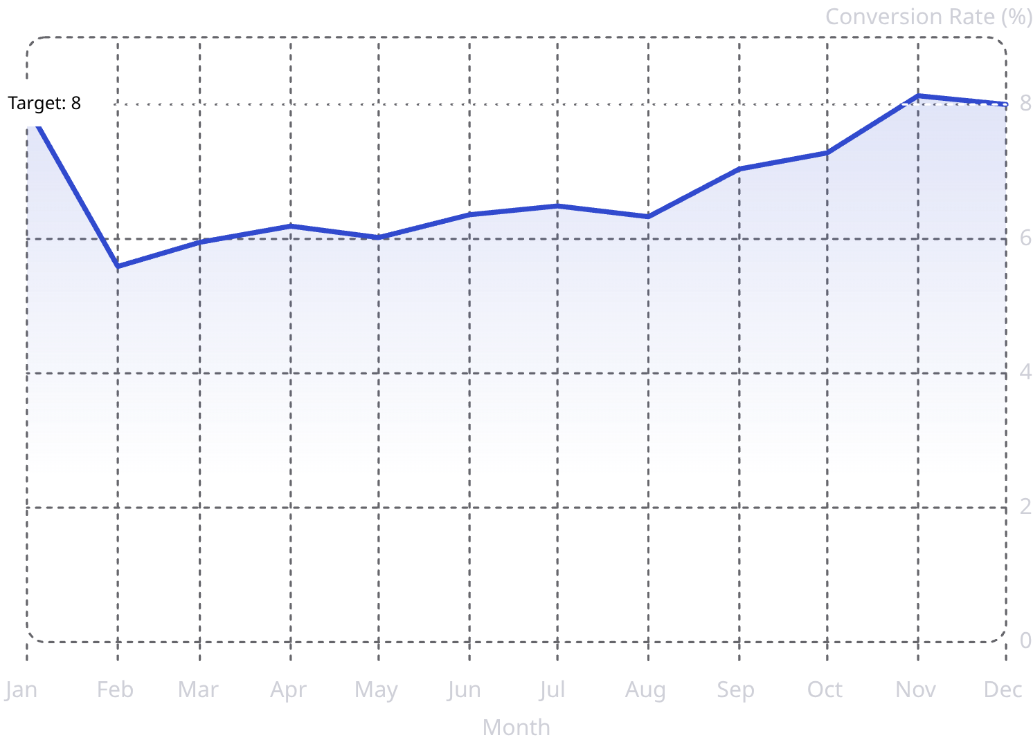
SECTION 1 — FUNNEL & CONVERSION
Overall Funnel Conversion & Monthly Trend
The funnel was defined using three event types: product view → cart add → purchase. Home and department stages were excluded as users enter directly via search or paid ads.
Funnel Drop-off Rates
Monthly Conversion Rate Trend
Biggest Drop-off: Cart → Purchase
Persistent, Year-Round Problem
67.92% drop-off rate — nearly 7 out of 10 users who add items to cart never complete the purchase. This is the primary area of concern.
Conversion fluctuates between 5.59% (February) and 8.13% (November) with no worsening trend. The year-end uptick reflects seasonal shopping intent. Abandonment is a constant, not a seasonal spike.

Slide 5
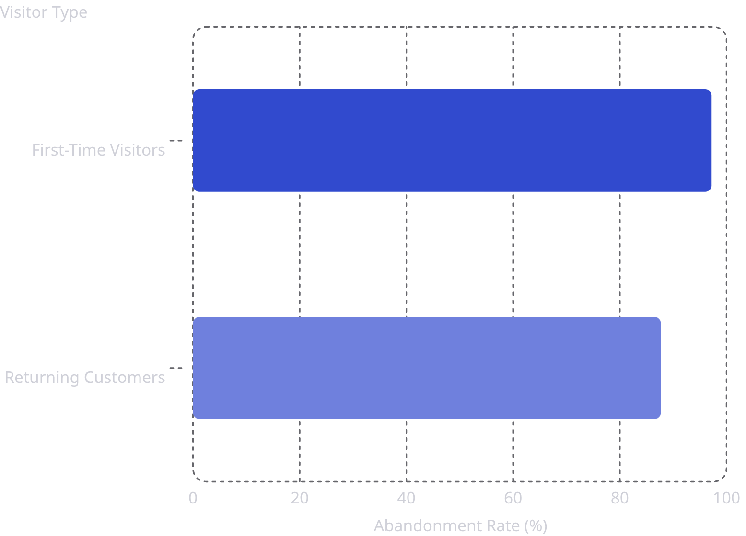
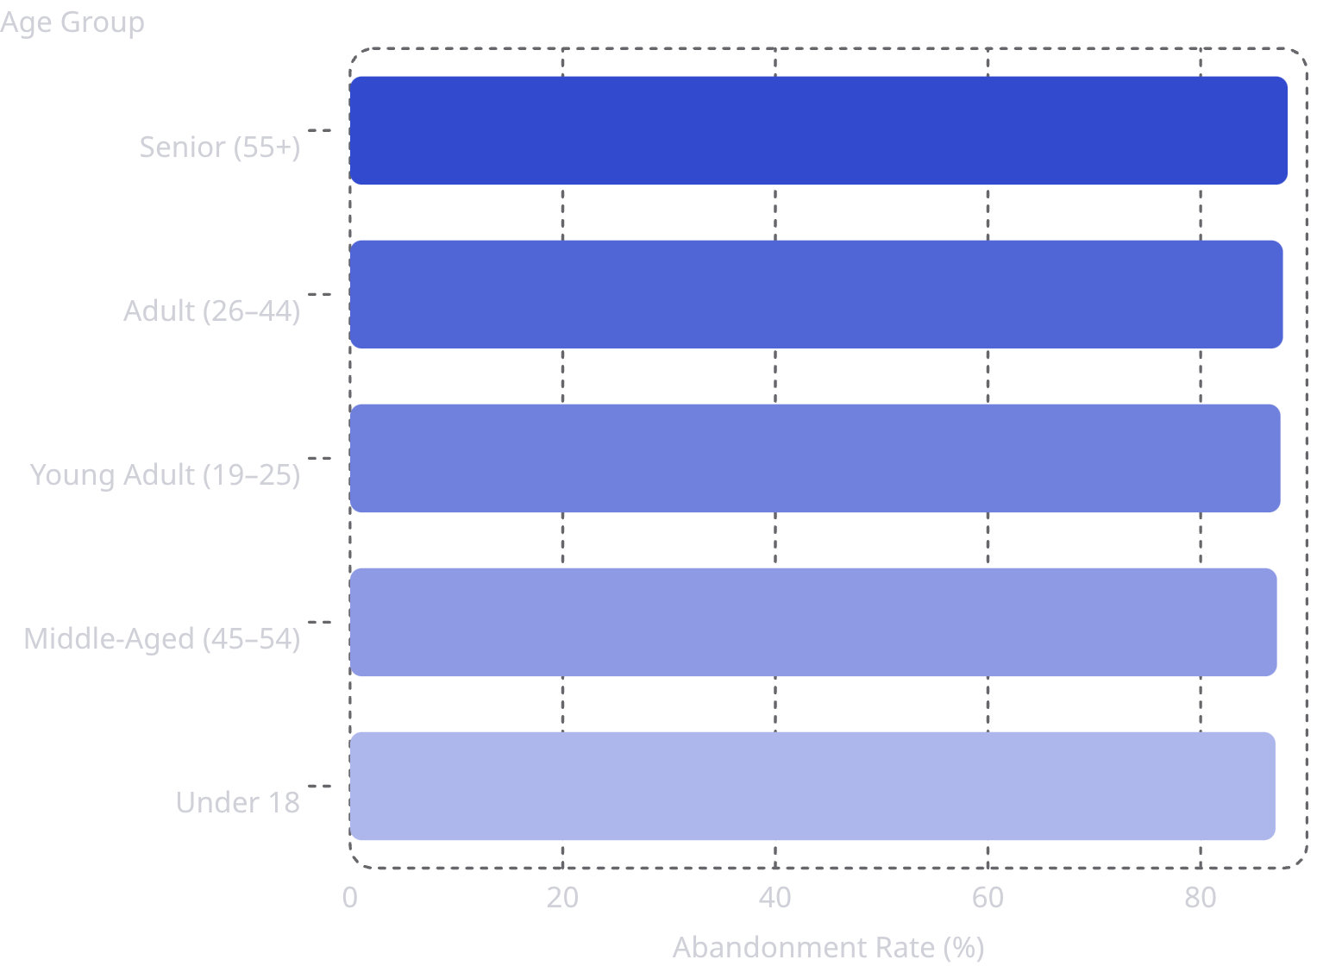

SECTION 2 — CUSTOMER SEGMENTS
Who Abandons Most? Segment Analysis
First-Time vs. Returning Visitors
Abandonment Rate by Age Group
A ~10 percentage-point gap driven by trust and platform familiarity. First-time visitor retention must be prioritized.
The ~1% spread across all age groups confirms age is not a meaningful differentiator — abandonment affects every demographic equally.
Gender Analysis (Chi-Square Test, α=0.05): With only a 0.02% difference and a p-value of 0.5525, gender has no statistically meaningful impact on abandonment behavior. Gender-specific recovery strategies would not yield differential results.

Slide 6
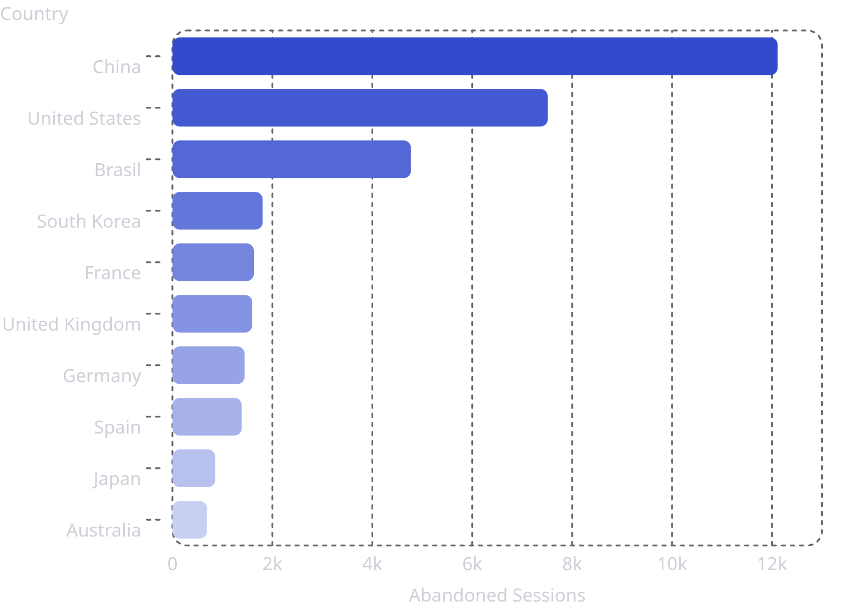
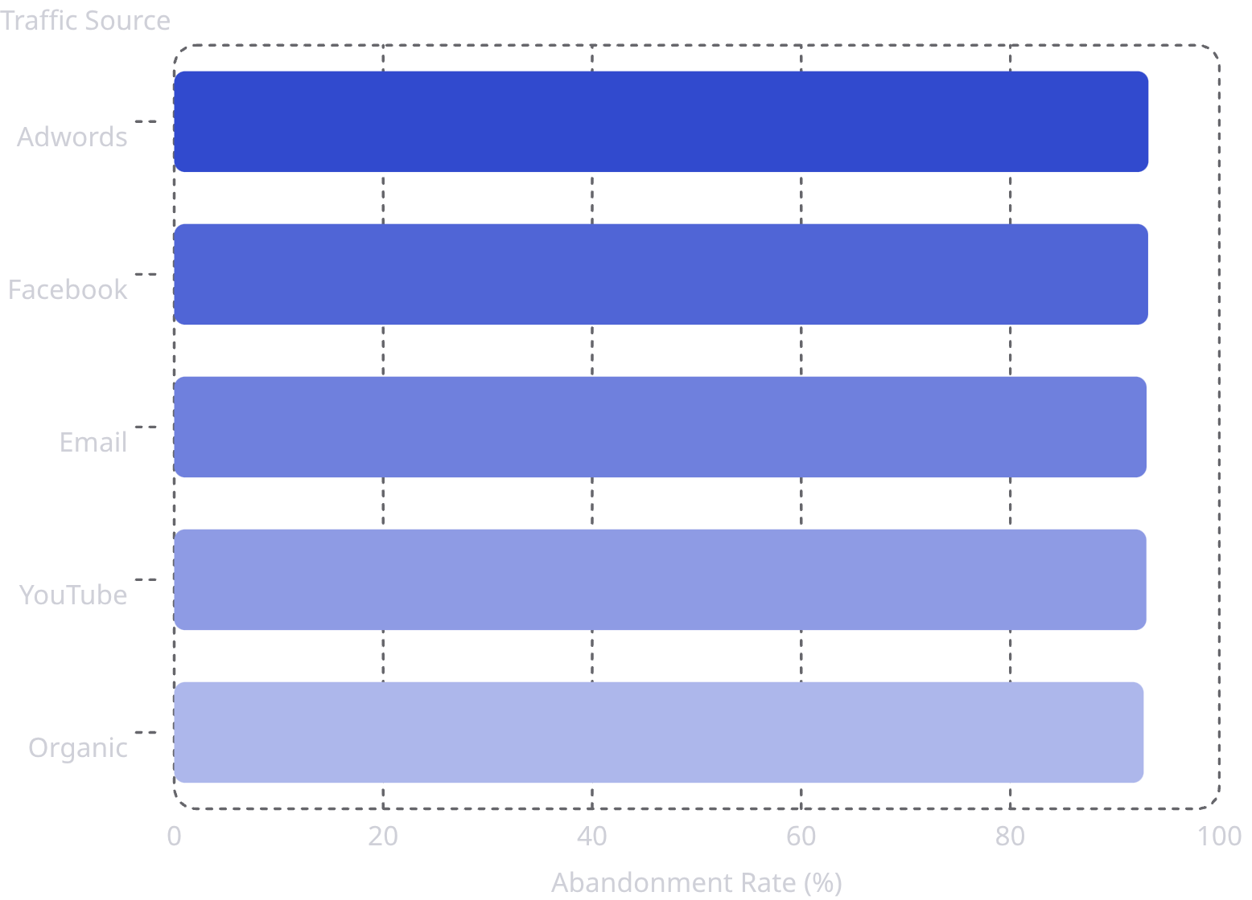
SECTION 2–3 — GEOGRAPHY & TRAFFIC
Geographic Concentration & Traffic Source Analysis
Abandoned Sessions by Country
Abandonment Rate by Traffic Source
🌏 Asian Market Gap
📢 Channel-Agnostic Problem
China dominates with 12,112 abandoned sessions — 1.6× more than the US. Eight of the top 10 cities are Asian (Shanghai, Beijing, Seoul). Critical gaps in localization, payment methods, or checkout UX for Asian markets.
Adwords leads at 93.22%, Organic performs best at 92.76% — but the spread is only ~0.5%. All 10 pairwise Z-tests yield p-values well above 0.05. The root cause lies in the checkout experience itself, not traffic quality.

Slide 7

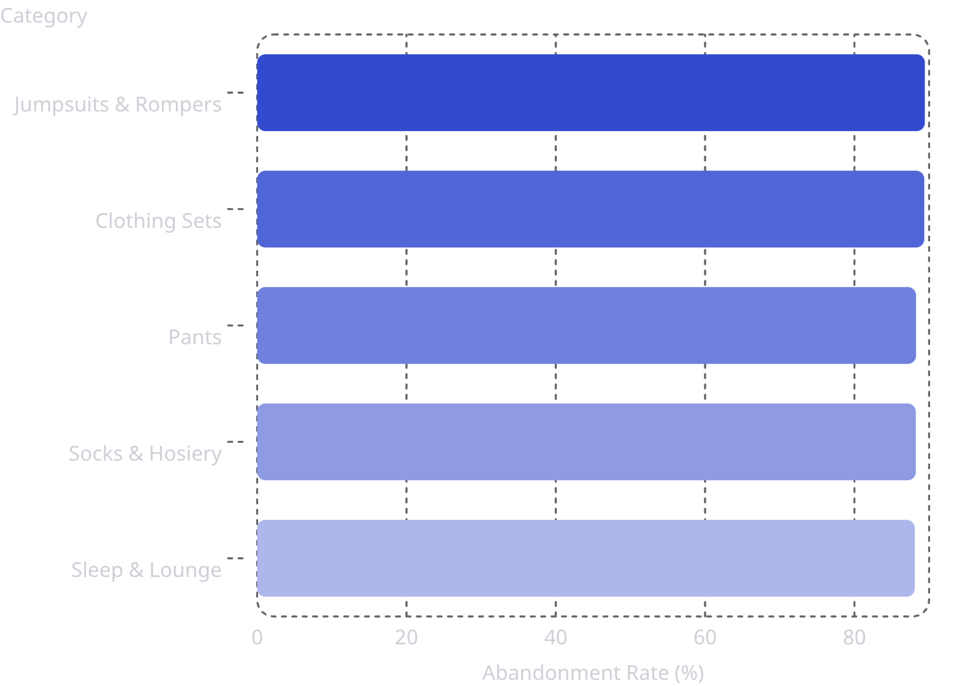

SECTION 4 — PRODUCT ANALYSIS
Product Categories, Price Ranges & Top Abandoned Items
Abandonment Rate by Price Range
Top 5 Categories by Abandonment Rate
Contrary to expectation, high-price products are NOT abandoned more. Under $20 items show the highest rate (88.07%). Price is not the primary driver.
The spread across all 26 categories is only 3.4%. High-volume categories — Intimates, Jeans, Tops & Tees — represent the largest absolute recovery opportunity.
Most Abandoned Products: Jeans appear 3 times in the top 10. Abandoned counts per product are low (20–26), indicating abandonment is spread broadly across the catalog — pointing to a platform-level checkout experience problem, not product-specific friction.

Slide 8
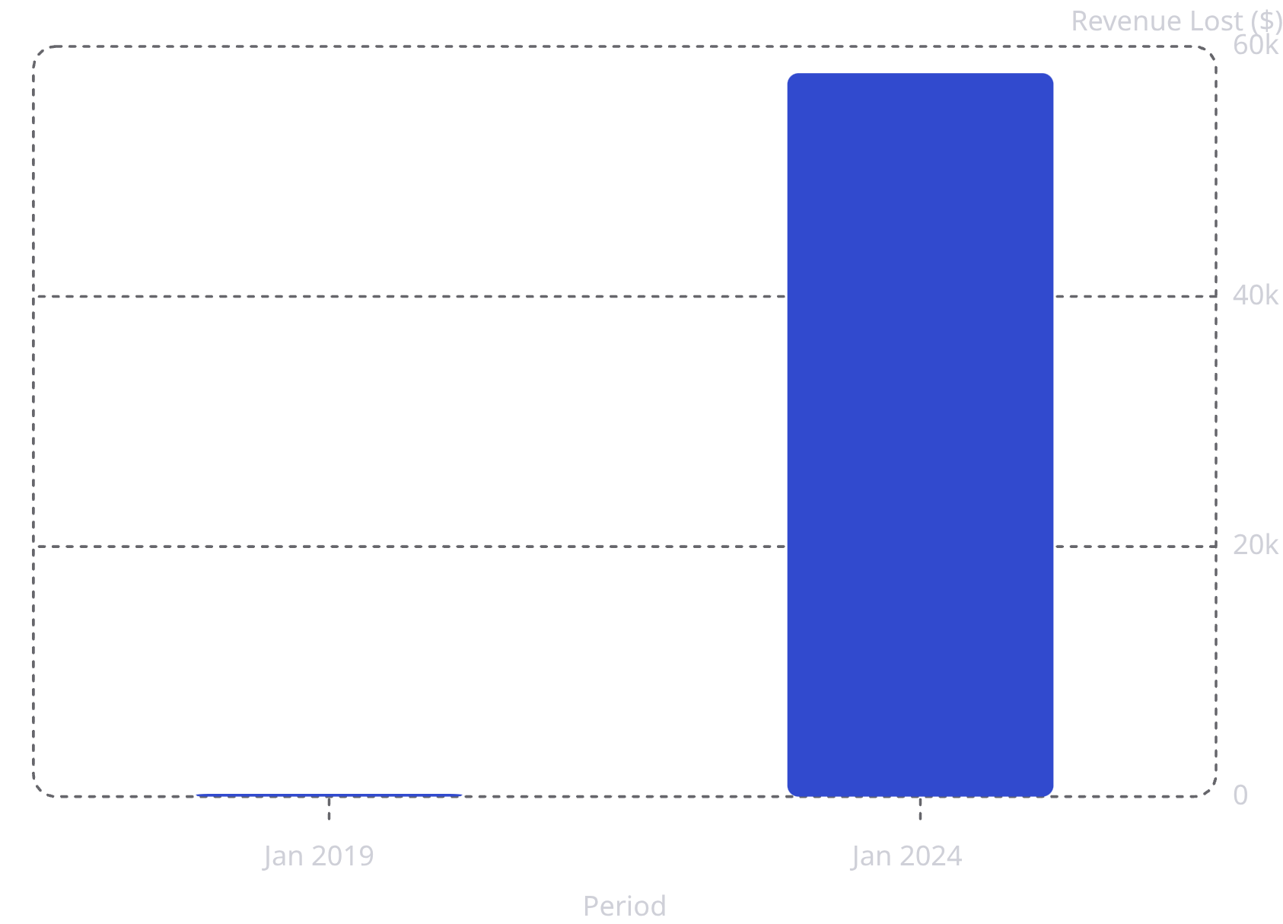

SECTION 5 — REVENUE IMPACT
Estimated Revenue Lost to Cart Abandonment
Revenue Loss Summary
Revenue lost was estimated by identifying cancelled order amounts for users who had abandoned cart sessions.
$756,855
$12,407/mo
Total all-time revenue lost
Average monthly loss
$2,922/wk
Average weekly loss
Monthly losses have grown 262× from $220 (Jan 2019) to $57,861 (Jan 2024), accelerating sharply as platform traffic increased. Peak weekly loss reached $27,850 in Week 2, 2024.
This is a compounding problem — as traffic grows without improving conversion, revenue loss scales proportionally. Even a 5% improvement in cart-to-purchase conversion would recover over $37,000 annually at current loss rates.

Slide 9
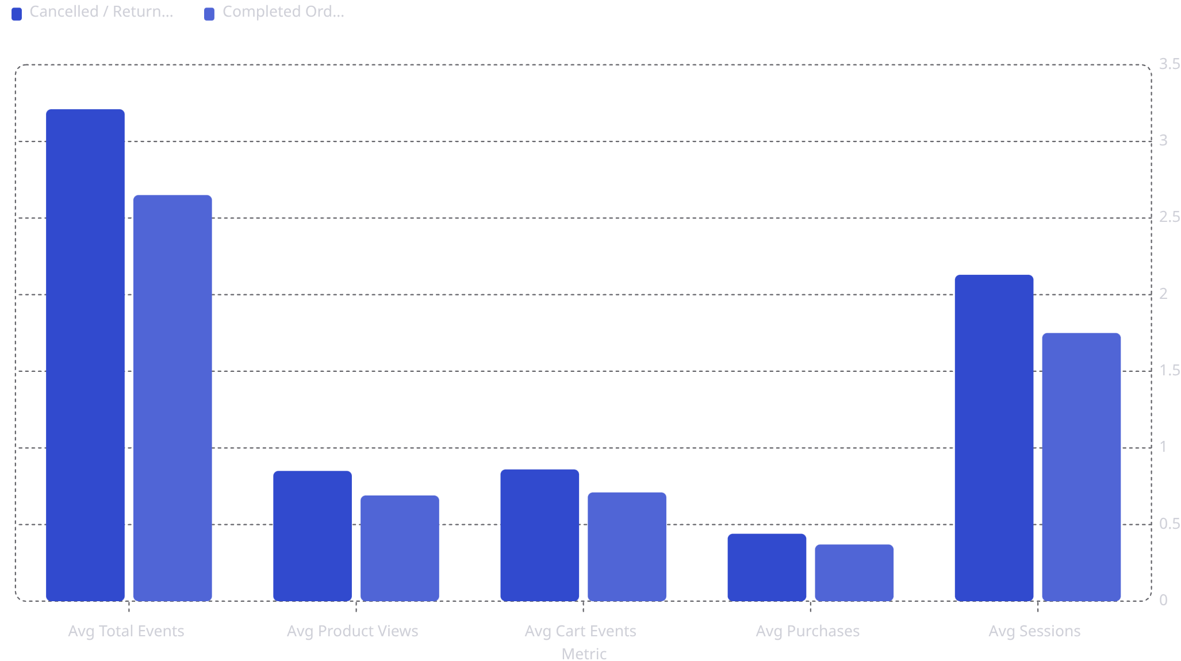
SECTION 6 — BEHAVIORAL PATTERNS
Behavioral Signals: Cancelled/Returned vs. Completed Orders
Users were classified by whether they ever had a cancelled or returned order. Session-level behavioral metrics were compared across groups to identify early-warning signals.
21% More Browsing Activity
Leading Behavioral Signal
Recommended Intervention
Users who later cancelled or returned orders were consistently more active across every behavioral metric — 21% more events, 23% more product views, and 22% more sessions than those who completed purchases successfully.
High browsing activity without clear purchase intent is a leading signal for future cancellations. Pre-purchase nudges — size guides, reviews, clear return policies — are critical interventions for this segment.
Behavioral scoring models that flag high-browse, low-intent sessions can enable targeted interventions such as live chat prompts, size recommendations, or purchase confidence messaging before checkout.

Slide 10
STRATEGIC RECOMMENDATIONS
Conclusions & Actions for Leadership
01
02
Fix the Checkout Experience — Not the Traffic
Prioritize First-Time Visitor Conversion
Every dimension shows statistically identical abandonment rates. The 67.92% cart-to-purchase drop-off demands immediate UX, trust signal, and checkout flow improvements. This is not a channel, demographic, or product problem.
The 10-point trust gap (97.20% vs. 87.69%) reveals that onboarding incentives, guest checkout, social proof, and first-purchase discounts could meaningfully improve conversion.
03
04
Address the Asian Market Gap
Refocus Email Campaigns on Conversion
China alone accounts for 12,112 abandoned sessions. A localized checkout with Alipay, WeChat Pay, local language support, and region-specific trust signals is strongly recommended.
Email drives the highest cart volume (31,225 sessions) but converts at the same low rate. Abandonment recovery sequences — personalized cart reminders, limited-time offers — represent the highest-volume recovery opportunity.
05
06
Establish Cart Conversion as a Primary KPI
Deploy Behavioral Early-Warning Models
With total losses of $756,855 and accelerating monthly trends, leadership should track cart conversion alongside total revenue. A 5% improvement recovers over $37,000 annually.
Users who cancel or return show 21% more browsing activity. Behavioral scoring can flag high-browse, low-intent sessions for targeted pre-purchase interventions like live chat or purchase confidence messaging.

