Slide 1
Dimethyl ether (DME) Production
Zezheng Li, Matr. Nr. 416038
Elvis Sim, Matr. Nr. 418012
Ilias Chair, Matr. Nr. 406149
August 2023
Computer-Aided Process Design, Chair of Process Systems Engineering

Slide 2
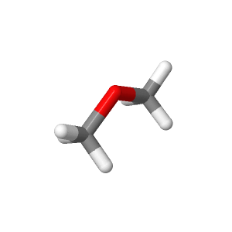








Background about DME production
Motivation
A precursor to other commodity chemicals
An aerosol propellant
Alternative or additive to diesel
Raw materials and process design
Concerns
Problem
Solutions
Natural gas, carbon dioxide and steam
Syngas
MeOH
DME
Production

Slide 3
Framework and key chemical reactions
Natural gas, CO₂ and steam
Steam methane reforming
Syngas
Steam methane reforming
MeOH
Steam methane reforming
DME
Chemical reactions:
CH₄ + H₂O
3H₂ + CO
3H₂ + CO₂
CH₃OH + H₂O
CO + H₂O
H₂ + CO₂
H₂ + CO₂
CO + H₂O
2CH₃OH
2CH₃OCH₃ + H₂O
CH₄ + 2H₂O
4H₂ + CO₂
H₂ + CO
CH₃OH
Reaction kinetic model: Langmuir-Hinshelwood-Hougen-Watson (LHHW) kinetic

Slide 4
Syngas production via steam reforming

Slide 5
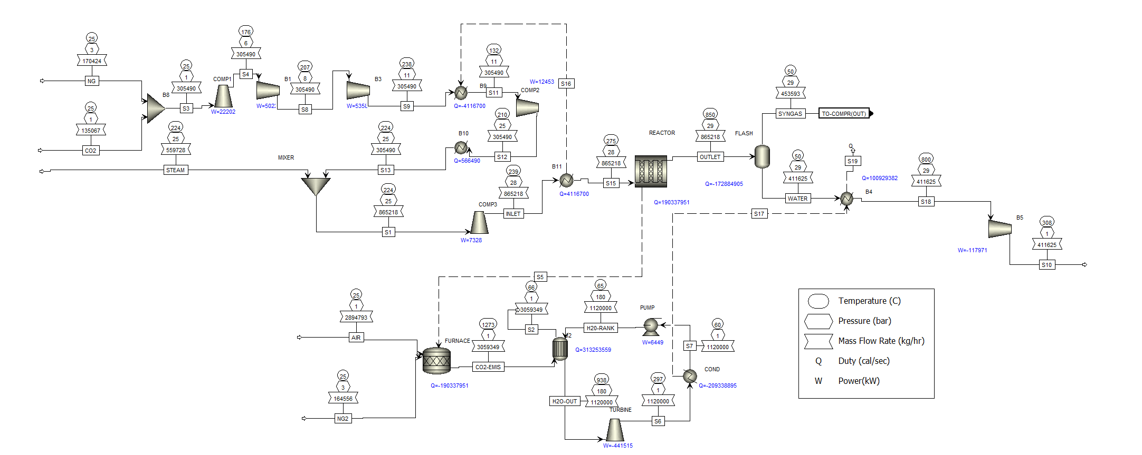
Flowsheet of syngas

Slide 6
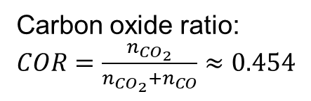
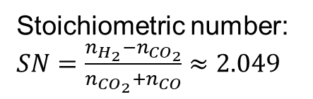
Output of the syngas production
Mole fractions:
H₂ | 0.6708
CO | 0.1464
CO₂ | 0.1216
CH₄ | 0.0540
N₂ | 0.0031
H₂O | 0.0041
Stoichiometric number: $SN=\frac{n_{H_{2}}−n_{{CO}_{2}}}{n_{{CO}_{2}}+n_{CO}}≈2.049$
Temperature | 50℃
Pressure | 29 bar
Mass flow rates | 12000 tons/day
Carbon oxide ratio: $COR=\frac{n_{{CO}_{2}}}{n_{{CO}_{2}}+n_{CO}}≈0.454$

Slide 7
Methanol synthesis

Slide 8
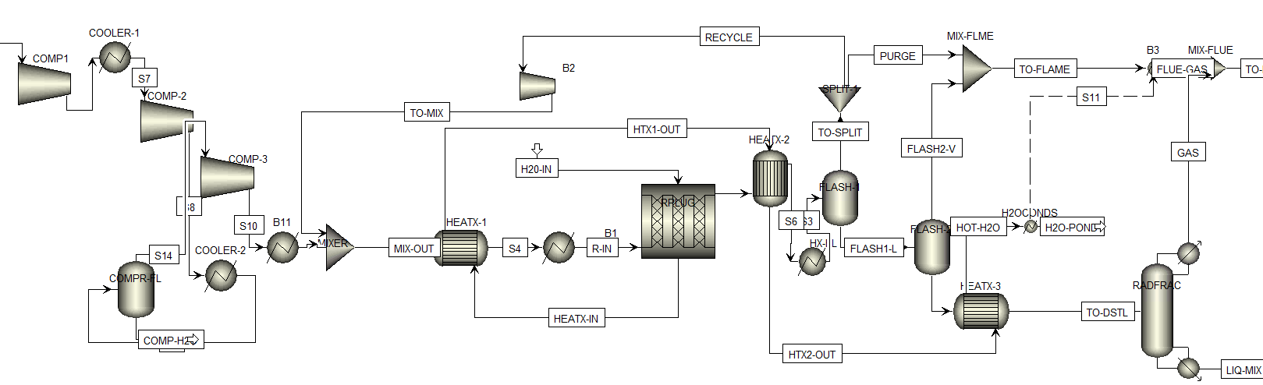
Methanol Synthesis from Synthesis Gas

Slide 9
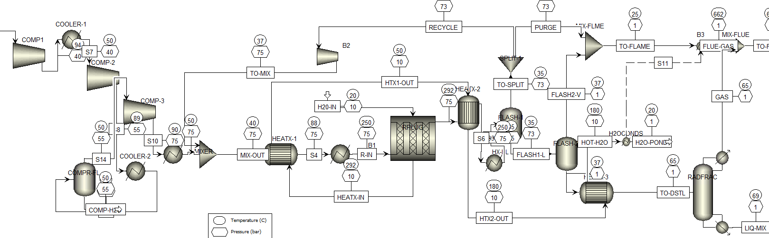

Slide 10
Feed to Dimethyl-Ether Synthesis Plant
Components | Mass Fraction
H2 | 1.5327E-20
CO | 9.3132E-19
CO2 | 7.2247E-08
CH4 | 2.0699E-15
N2 | 1.8682E-20
H2O | 0.1949
CH3OH (Methanol) | 0.8050
O2 | 0
DME (Dimethyl-Ether) | 0

Slide 11
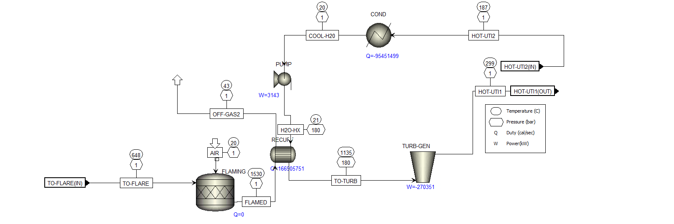
Integrated Rankine Cycle

Slide 12
DME synthesis

Slide 13
Economic analysis and results

Slide 14
Economic analysis (capital costs and utility costs)
The capital expenditure amounts to 114,399,847.8 euros. The total utility cost per year is 85,316,384.3 euros.
Name | Value | Unit
Total heating duty | 89,810,024.4 | cal/sec
Total cooling duty | 324,488,355 | cal/sec
Net duty | -234,678,330 | cal/sec
Total heating cost flow | 8,460.37372 | USD/hr
Total cooling cost flow | 2,361.08544 | USD/hr
Net cost | 10,821.4592 | USD/hr
Net cost flow of feeds | 185,247,815.8 | USD/year
Net cost flow of products | 653,621,342.6 | USD/year
Overall net cost flow | 468,373,526.7 | USD/year

Slide 15
Economic analysis (profitability and revenue from electricity sale)
The process yields an annual revenue of approximately 636,808,419 euros.
After deducting the yearly raw material cost of 503,774,022 euros and utility expenses, the resulting net profit stands at around 47,718,012.7 euros.
Given an estimated plant lifespan of 20 years, the investment ratio evaluates to 0.1836.
The pay out time is 4.795 years.
The process requires a total of 106.68 MW of electricity, while generating a substantial 829.84 MW in return. This results in a surplus of 723.16 MW of electricity.
Selling at 90% of the market rate generates approximately 285,068,651 euros in annual revenue.
The pay out time is 0.688 years.

