Slide 1
Heart Disease Prediction
Elvis Asiki 176218
Nelson Nyamweya 171258

Slide 2
Problem Statement
Heart disease is the leading cause of death globally. Early detection can improve outcomes.
We aim to develop machine learning models to predict the presence of heart disease using clinical features.

Slide 3
Dataset Overview
• Data source: https://www.kaggle.com/datasets/ritwikb3/heart-disease-cleveland University of California Irvine machine learning repository
• Target column: 'condition' (1 = disease, 0 = no disease)
• Features: age, sex, chest pain type, blood pressure, cholesterol, etc.
• Dataset split: 50% train, 50% test

Slide 4
Models Used
We applied and compared three machine learning models:
1. K-Nearest Neighbors (KNN)
2. Decision Tree Classifier
3. Multi-layer Perceptron Neural Network (MLPClassifier)
Each model was trained on the training set and evaluated using accuracy and confusion matrix.

Slide 5
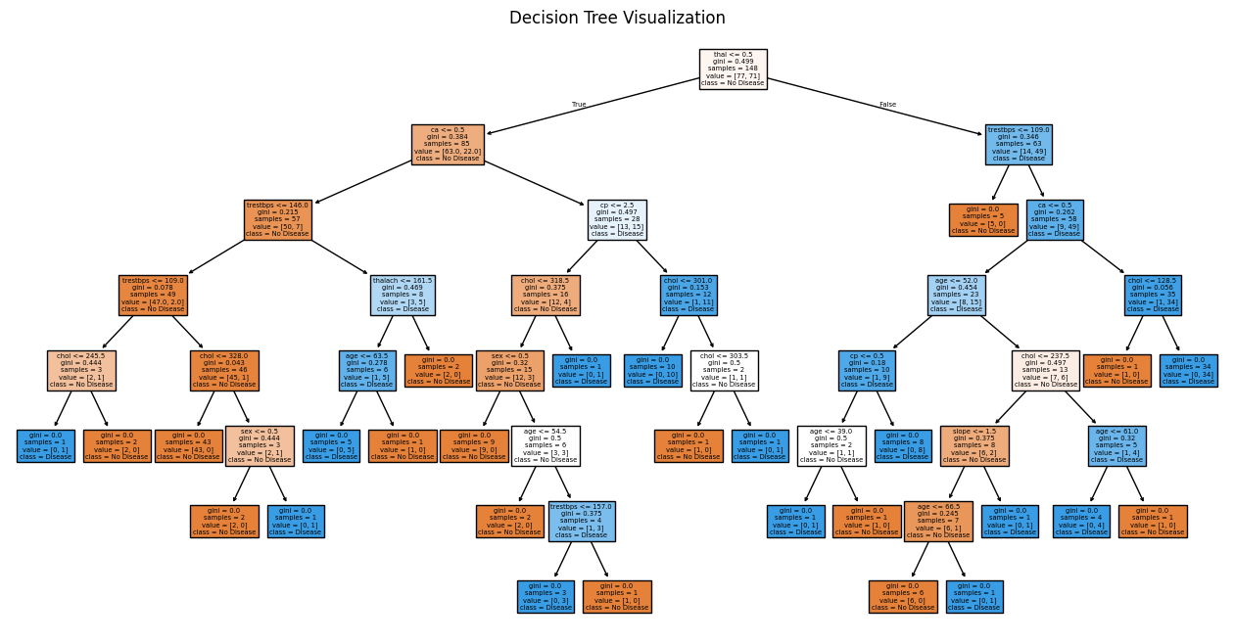
Decision Tree

Slide 6
Model Evaluation
Each model was evaluated using classification reports and confusion matrices.
i. KNN: Distance-based method
ii. Decision Tree: Rule-based and interpretable
iii. Neural Network: More complex
Evaluation metrics include precision, recall, and accuracy.

Slide 7
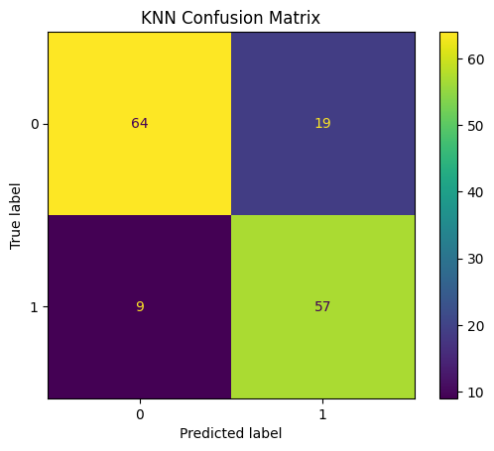
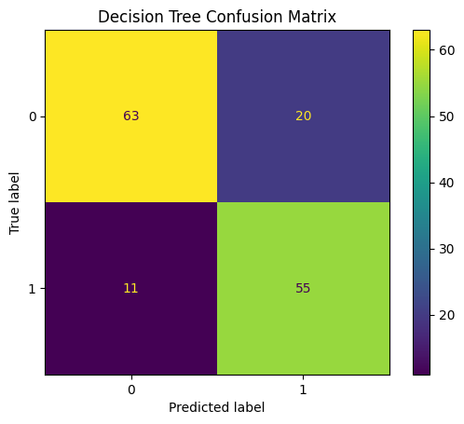

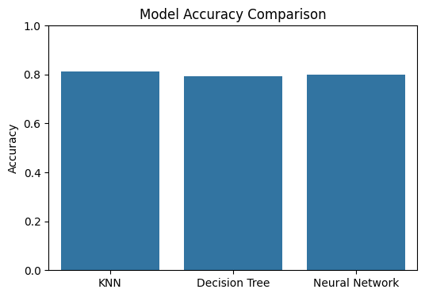
Confusion Matrices

Slide 8
Best Performing Model
Among the three models, the KNN achieved the highest accuracy.
Recommendations:
• Use as a diagnostic assistant
• Validate further with local clinical data
• Integrate into early screening tools for cardiology use

Slide 9
Conclusion & Next Steps
• Machine learning can support early detection of heart disease.
• Next steps include integrating the tool into screening processes and collecting more local data.

