Slide 1

Soybean Drought project
Processing thermal images
Martina Meira
Elvis Elli

Slide 2
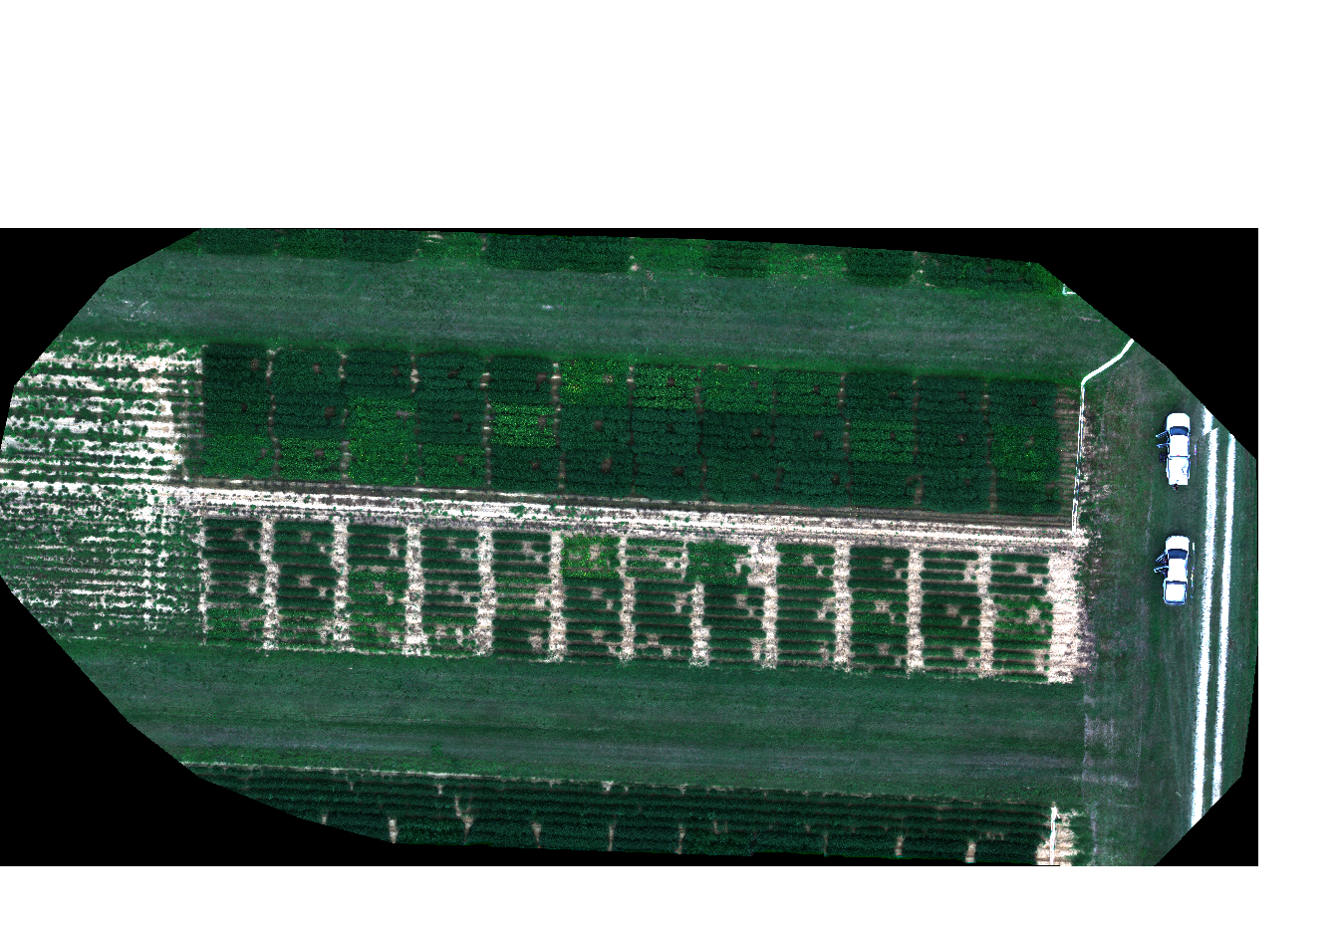
RGB (red, blue, green image) August 30

Slide 3
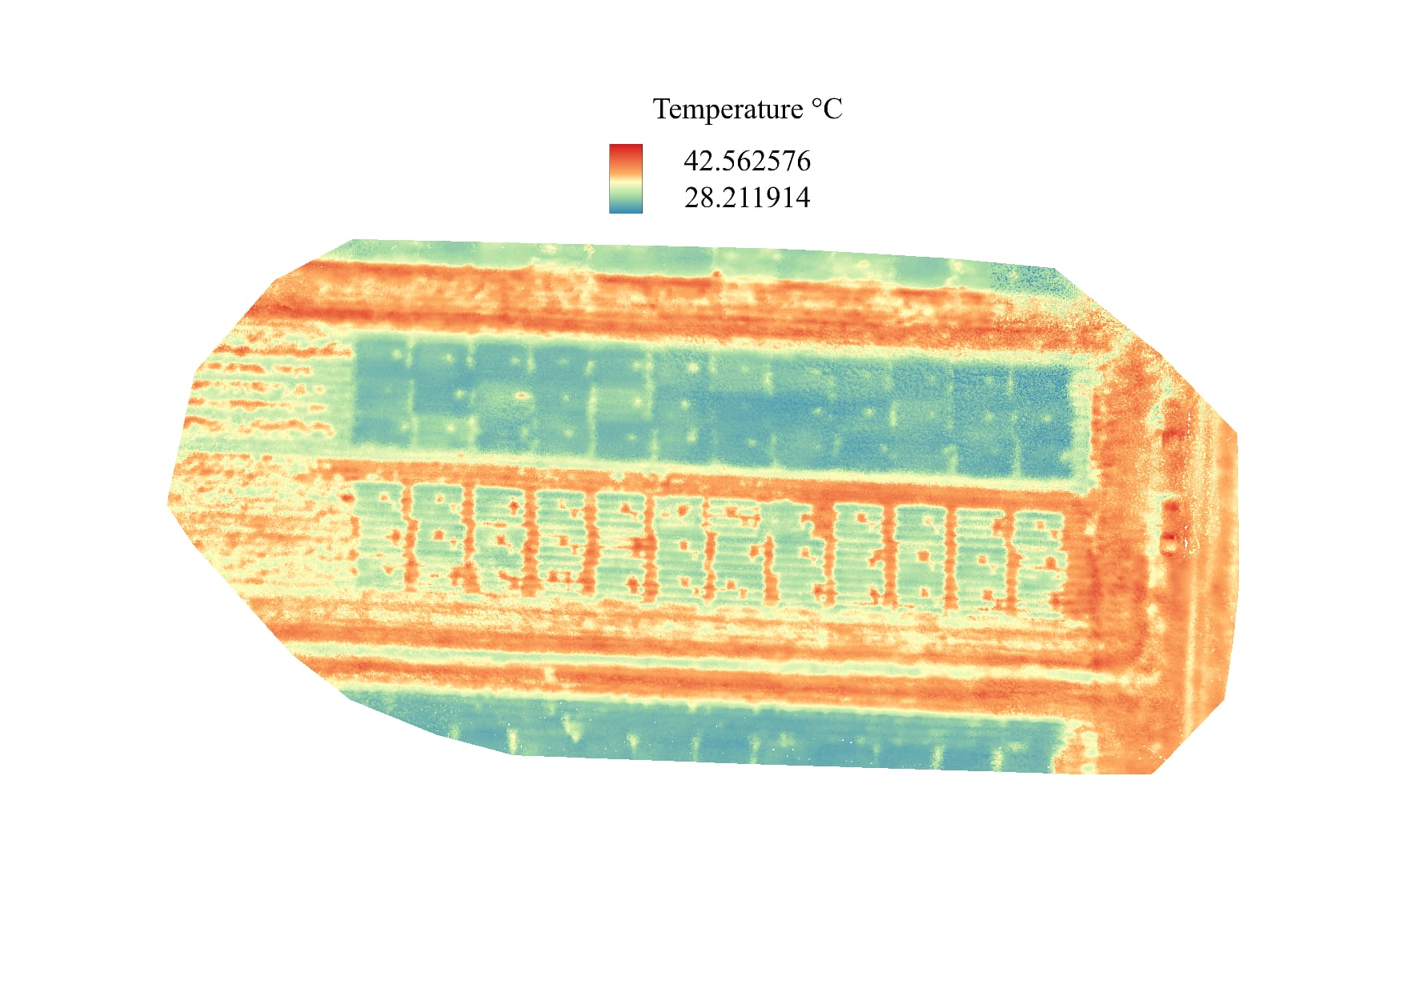
Temperature °F
108.608
82.778
Thermal Ortho mosaic 100ft August 30

Slide 4
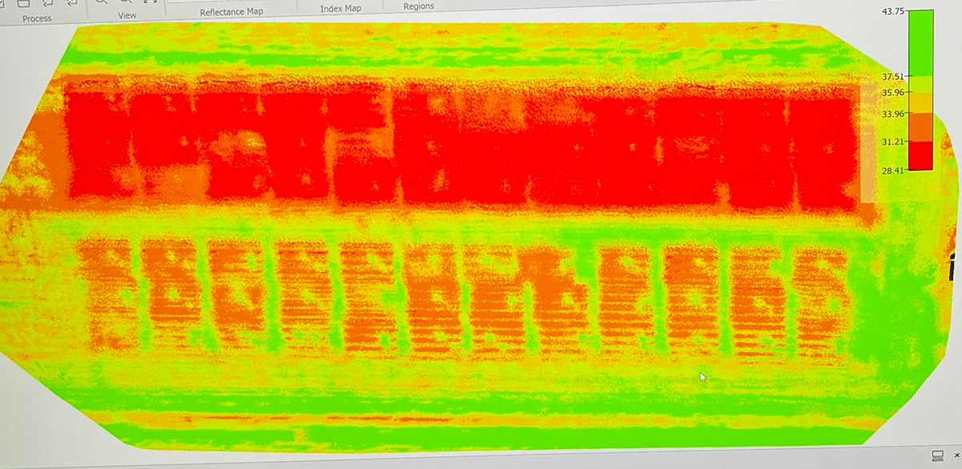
Thermal Ortho mosaic 50ft August 30

Slide 5
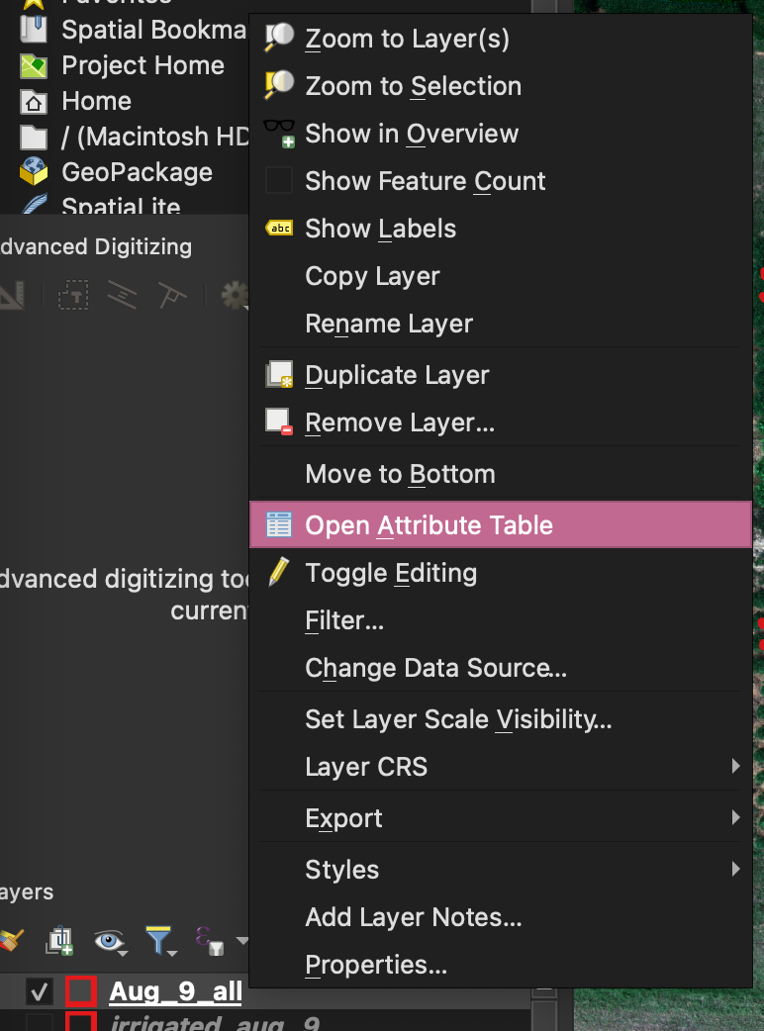
Steps in QGIS
row
columns
R package in QGIS.
FIELDimage R.
Field Shape (num rows, num cols, buffer, x and y plot size).
REMEMBER layers are temporary, you have to SAVE THEM.
Always is better to merge the layers from the same day (easier to deal with).
Give them the correct ID, matching with the field information. (right click on the layer, open Attribute Table).

Slide 6
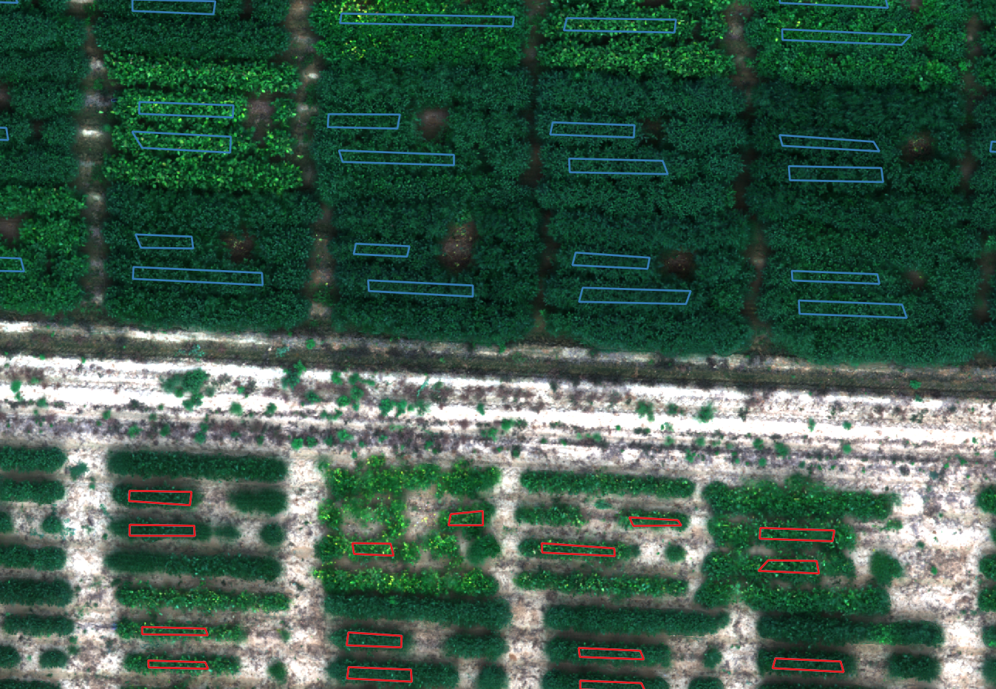
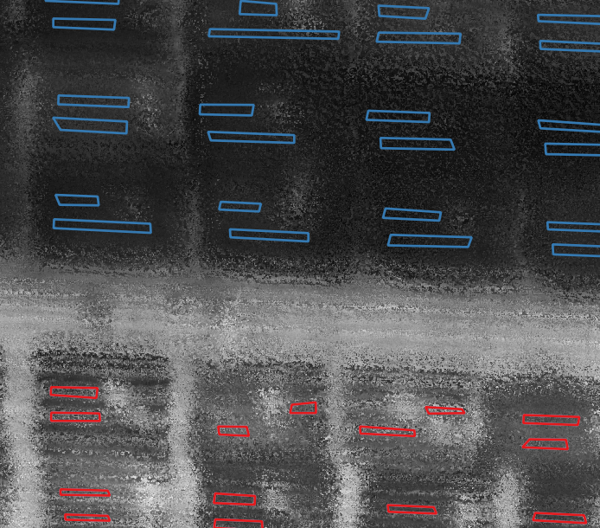
Polygon design 50ft August 30
Thermal image

Slide 7
Porometer considerations
ACTIVE GPS
LABELS FOR EACH PLOT

