Slide 1




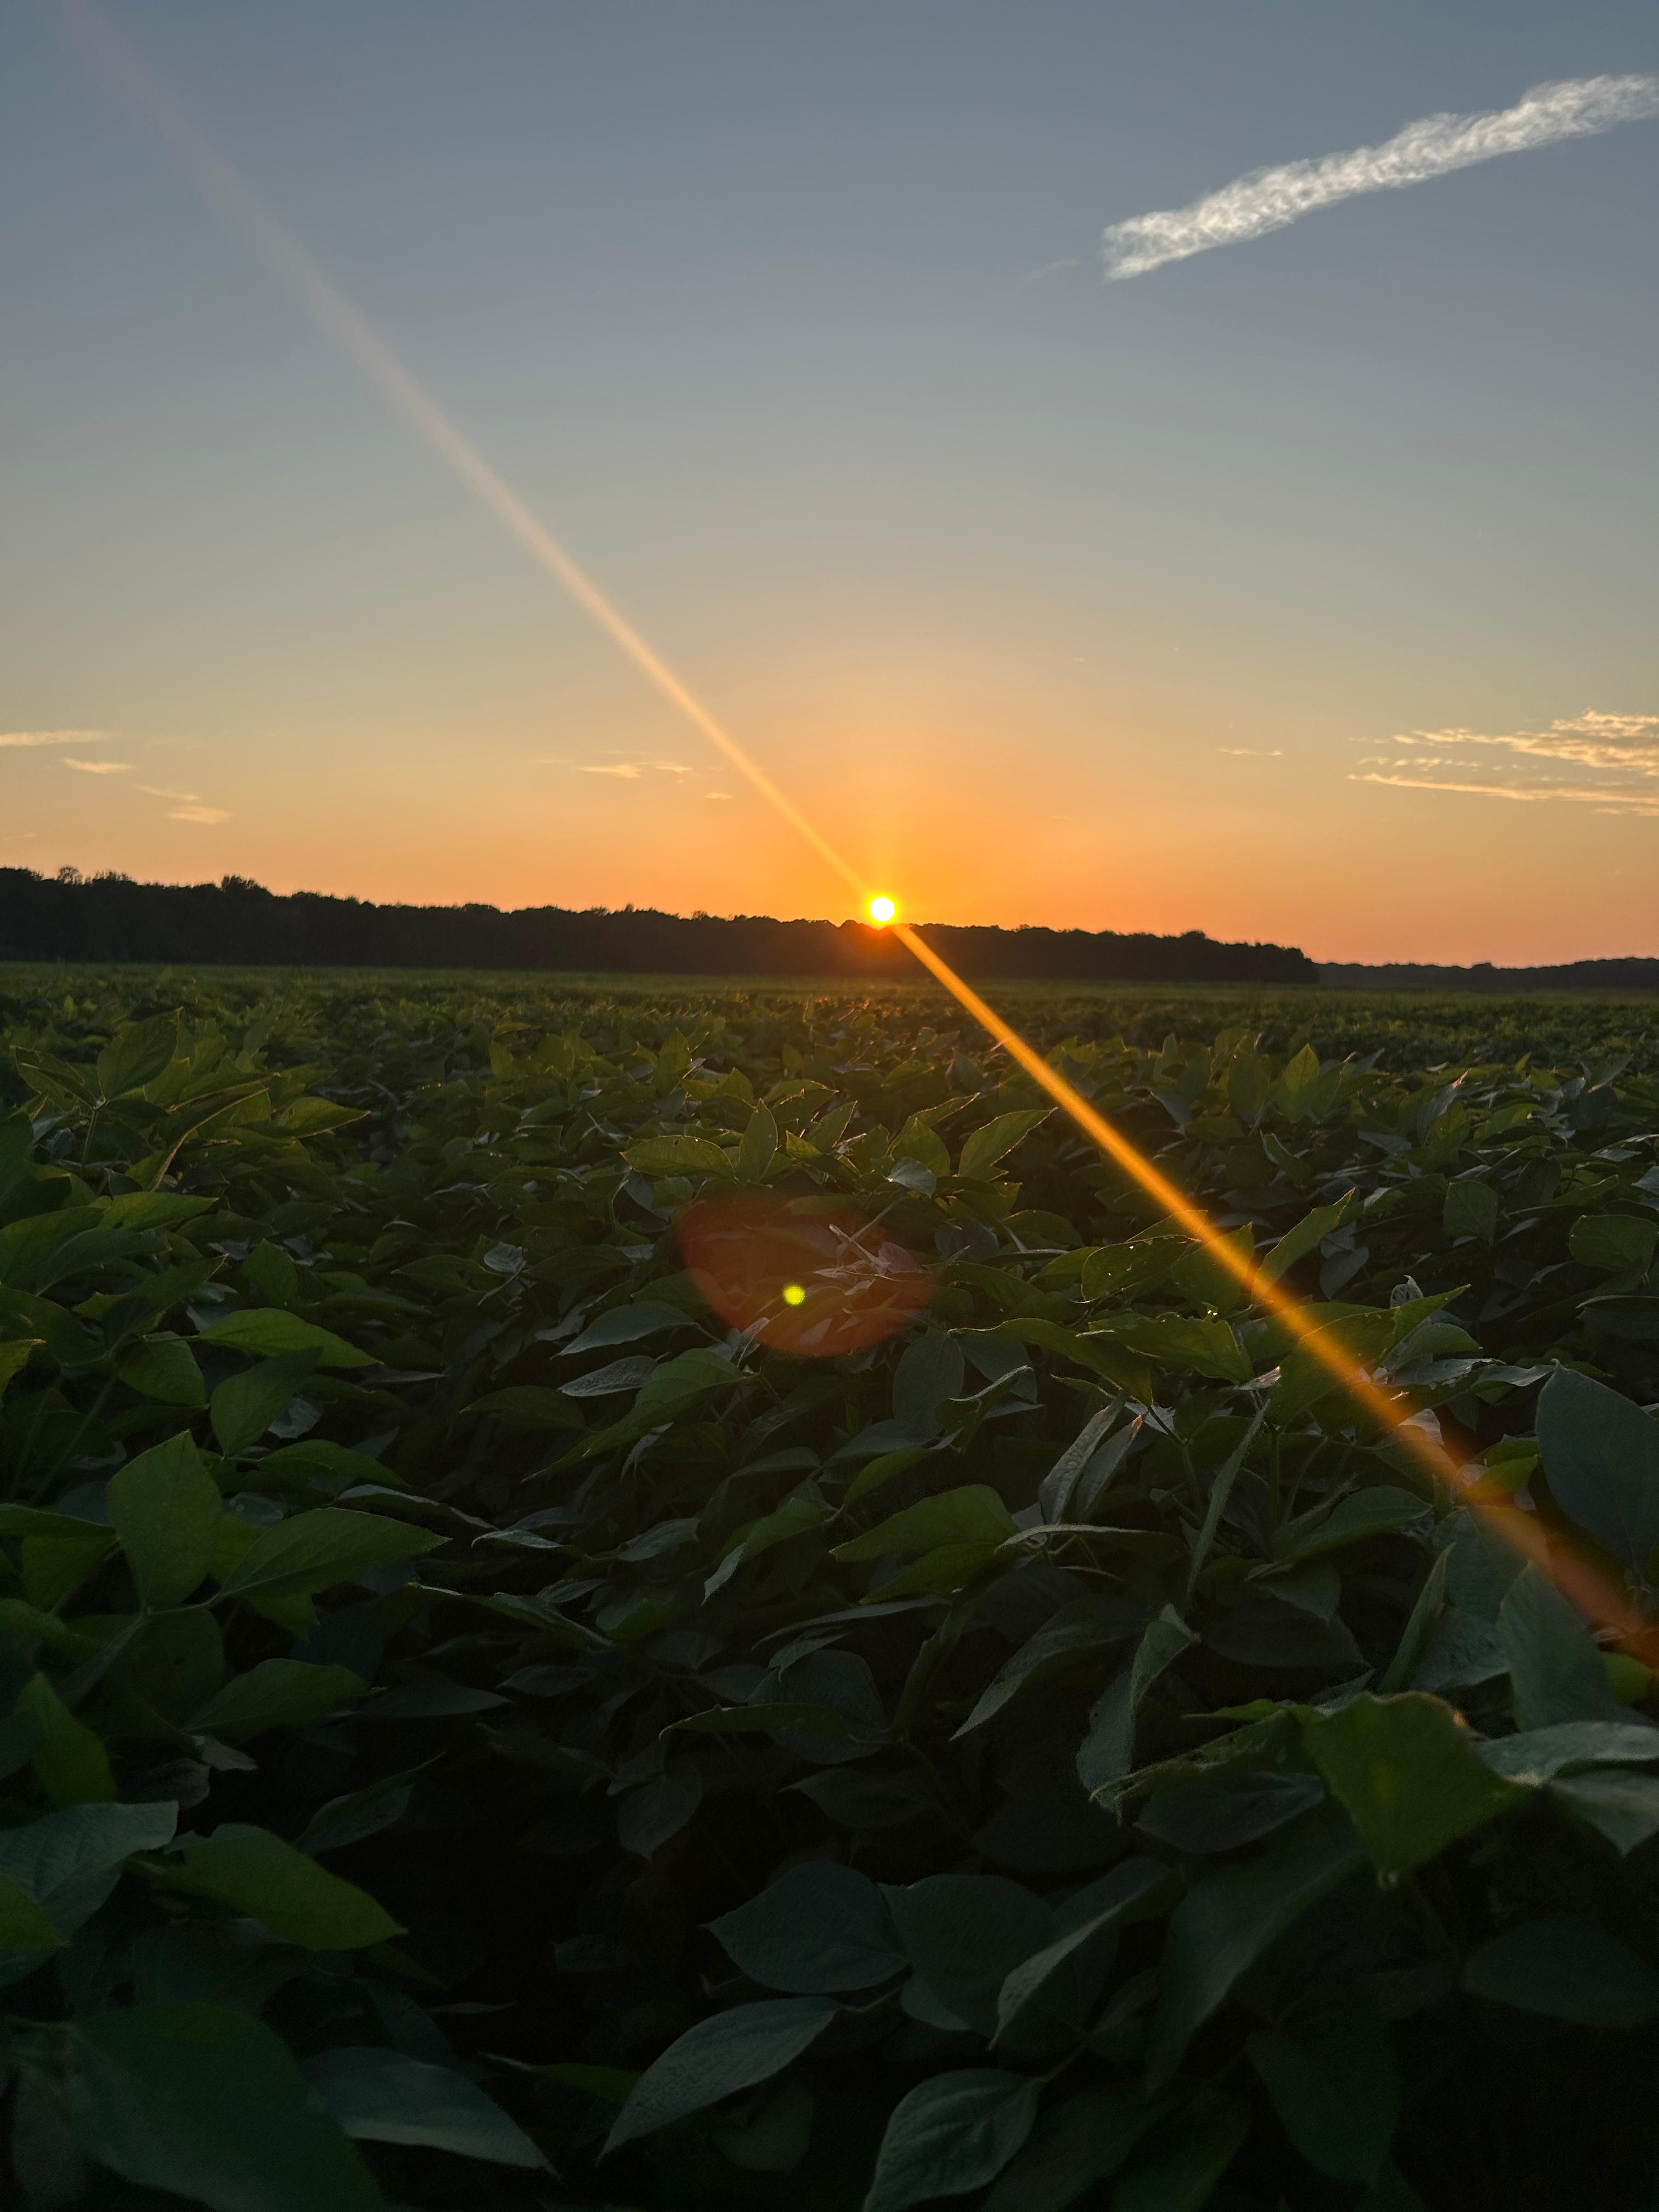
Impact of the limited transpiration trait on soybean potential and water-limited yield
Elvis Elli
Lucas Romano, Martina Meira, Felix Fritschi, Caio Canella Vieira
Assistant Professor
University of Arkansas System Division of Agriculture
Department of Crop, Soil, and Environmental Sciences
eelli@uark.edu

Slide 2
Why do we need to study plant response to VPD?
Crop season VPD trend over 1974-2023 (Lobell & Di Tommaso, 2025)
VPD drives plant transpiration and seasonal water use
VPD has increased over the past 50 years and is projected to increase at faster rates
Probably understudied compared to high temperatures
Understanding response to VPD can help identify strategies to maximize water use efficiency
Global mean vapor pressure deficit (VPD) anomalies (Yuan et al., 2019))

Slide 3
The limited transpiration (LT) trait
Plant transpiration
Vapor Pressure Deficit -VPD
Yu et al. (2024), Fletcher et al. (2007)
Notes:
Small differences can have important implications

Slide 4
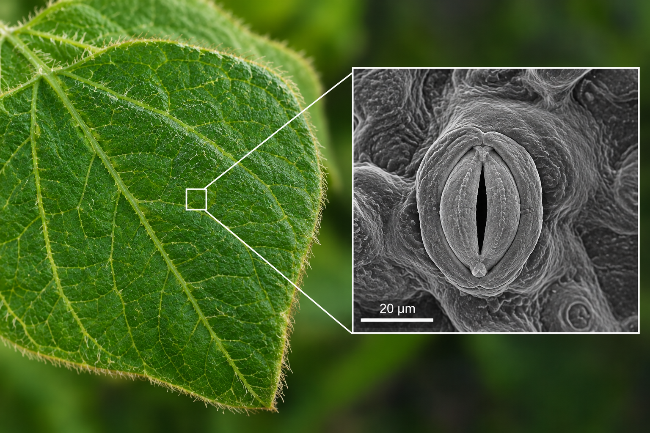
But…
CO₂
H₂O
Reduced transpiration likely decreases CO₂ uptake, thereby reducing photosynthesis

Slide 5

Objectives
Quantify transpiration responses to VPD across soybean accessions
Quantify the yield impact and trade-offs of the LT trait across the US Mid-South and Mid-West

Slide 6
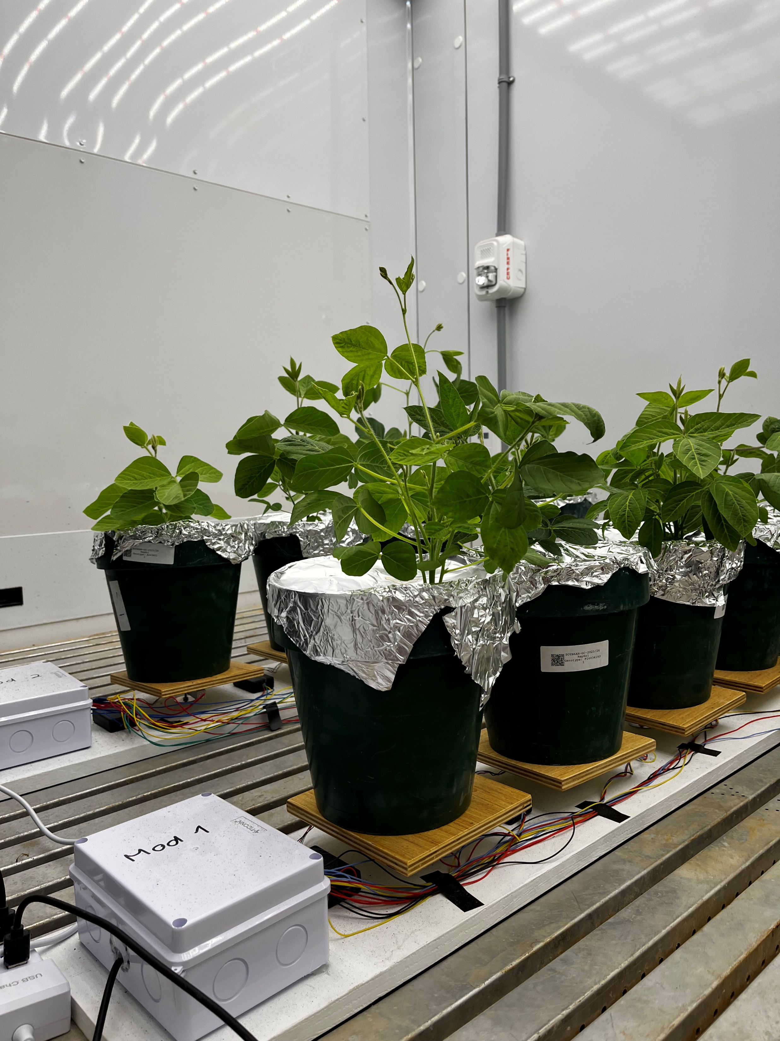
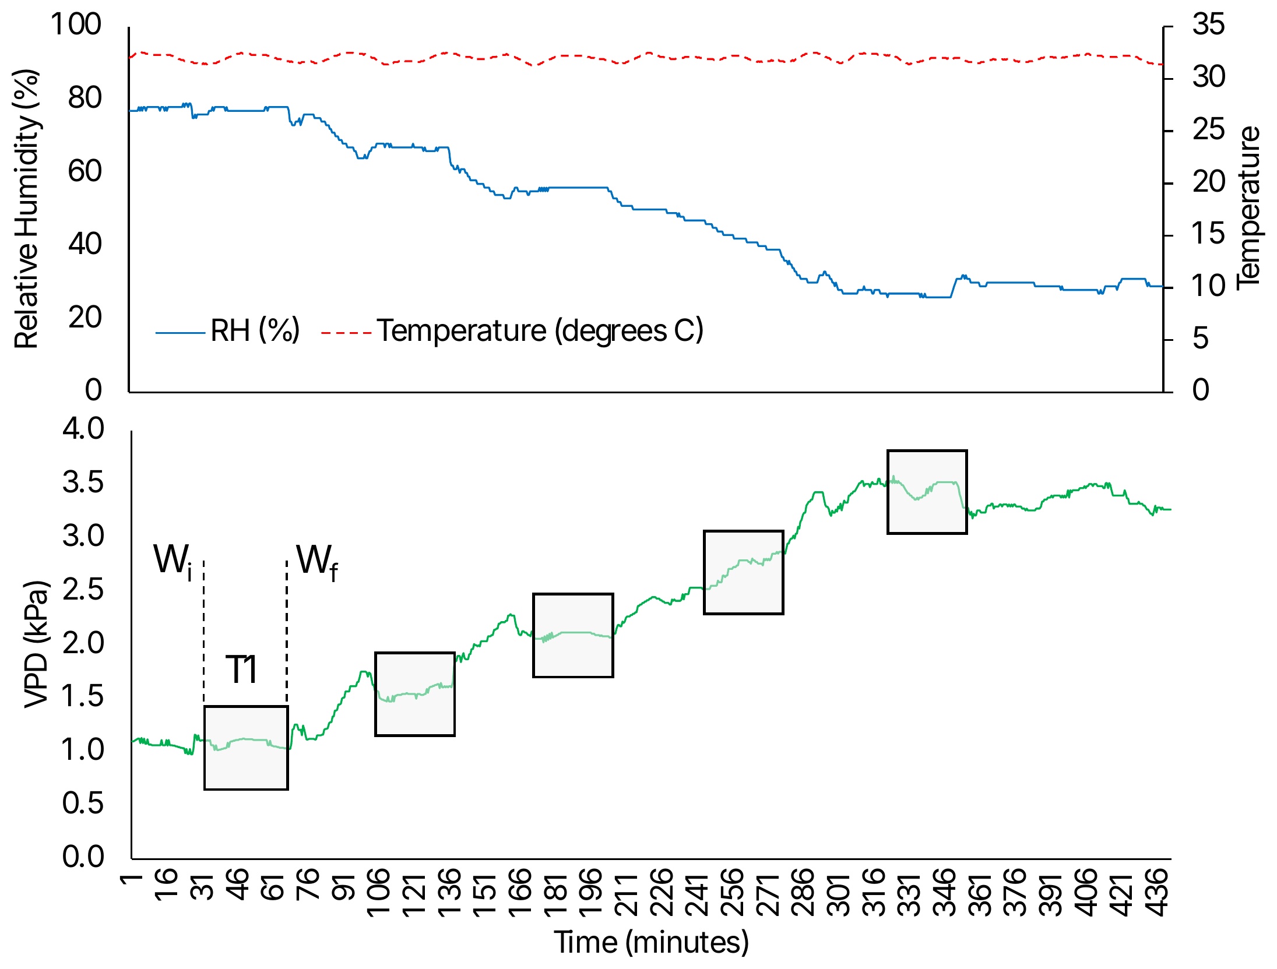
Material and Methods
Objective 1 – Controlled-environment experiment
9 soybean accessions with contrasting genetic backgrounds, incl. checks A5959 and PI416937
VPD from 1.0 to 3.6 kPa (6 steps, ~45 min each) at 32 °C, 5 replications
Weights were recorded at the beginning and end of VPD treatments
Linear, linear-plateau, and bilinear models.

Slide 7
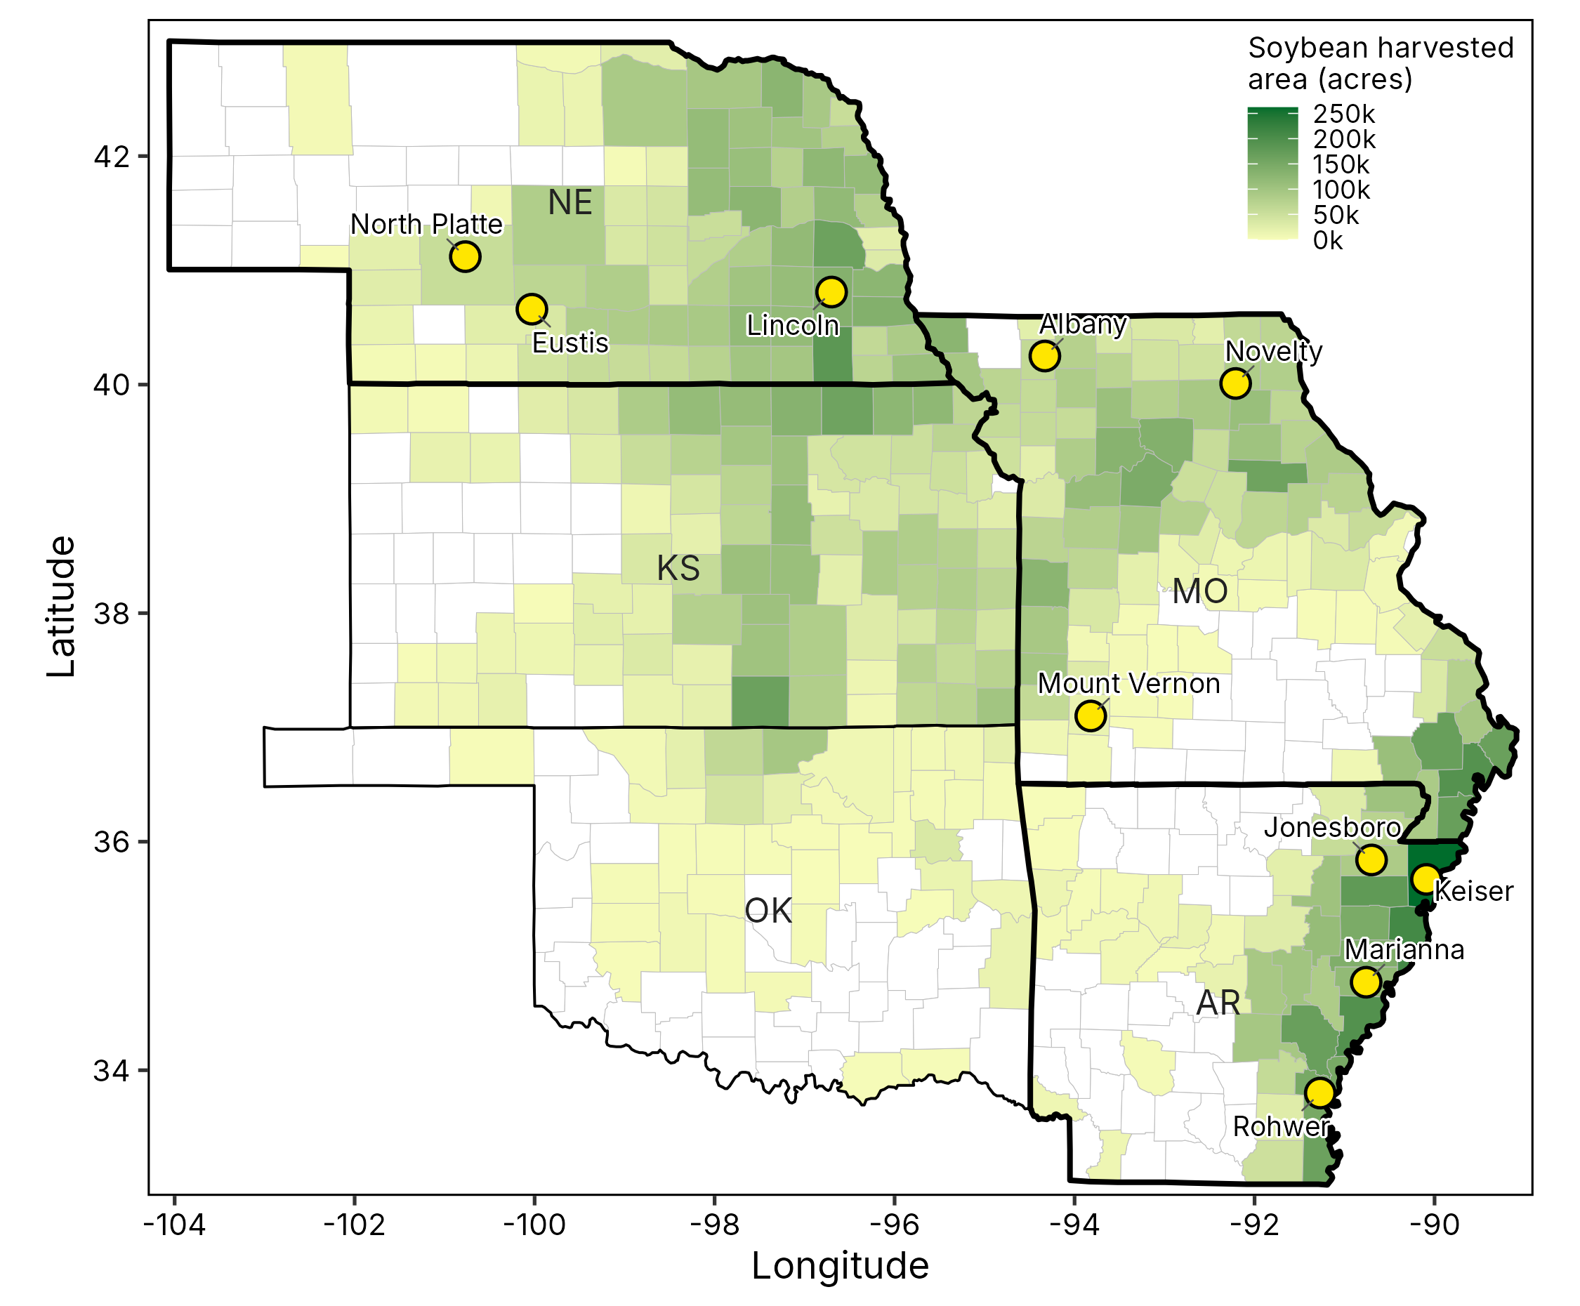
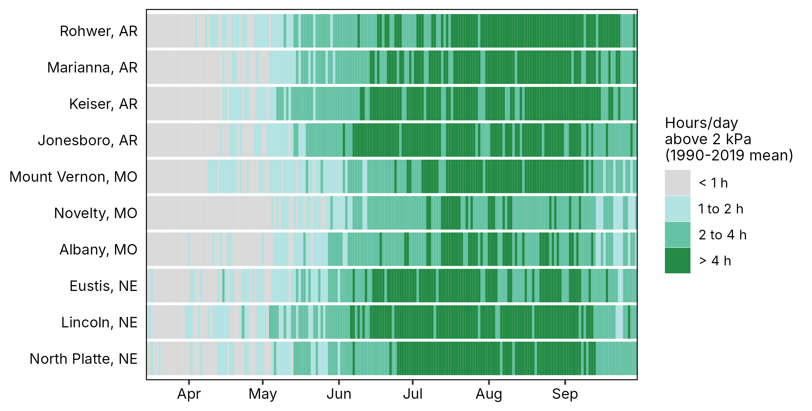
Material and Methods
Objective 2 – Crop modeling
SSM soybean model (Soltani and Sinclair, 2012)
Biomass production: RUE approach
Water use: transpiration efficiency approach
LT: transpiration capped above 1.5 kPa VPD (hourly)
LT vs non-LT genotype, rainfed vs irrigated
10 locations x 30 years (1990-2019) x 3 sowing dates
MG IV (AR, MO) and MG III (NE)

Slide 8
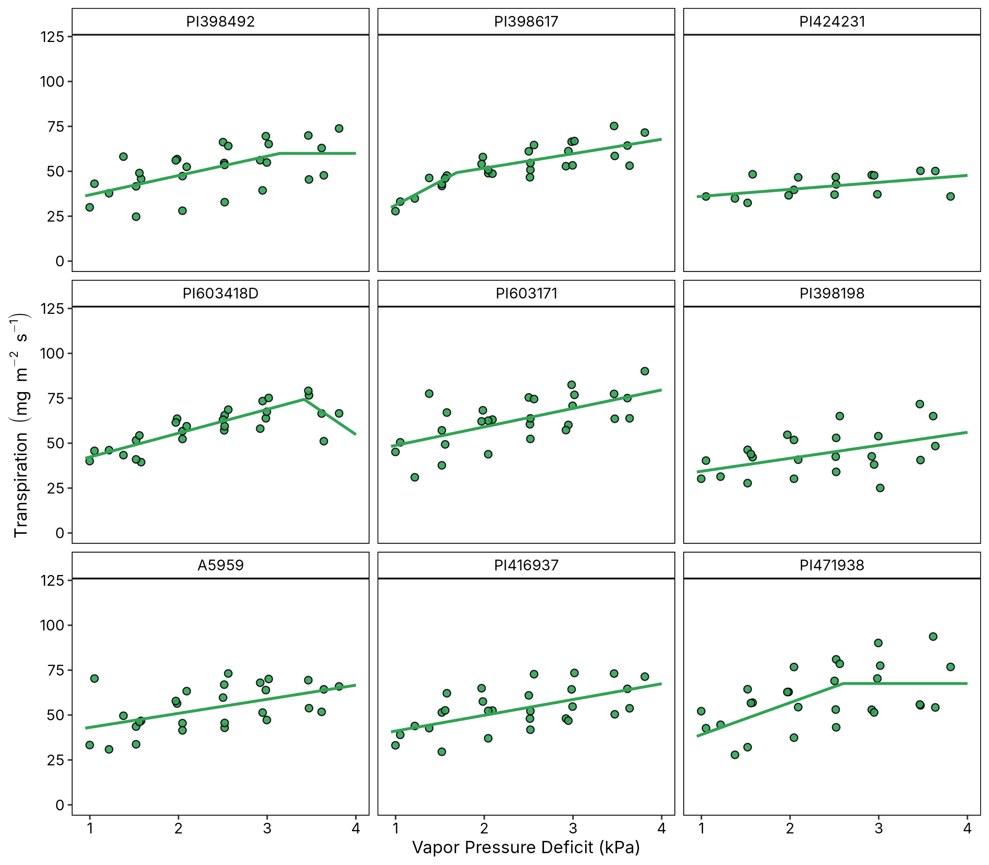
Higher than expected genotypic variability in transpiration response to VPD
4 of 9 accessions showed limited transpiration under high VPD
Breakpoint ranged from 1.7 to 3.4 kPa
Slope ranged from 3.9 to 26.2 mg m⁻² s⁻¹ kPa⁻¹
Evidence of LT associated with genotypic plasticity in water use efficiency

Slide 9
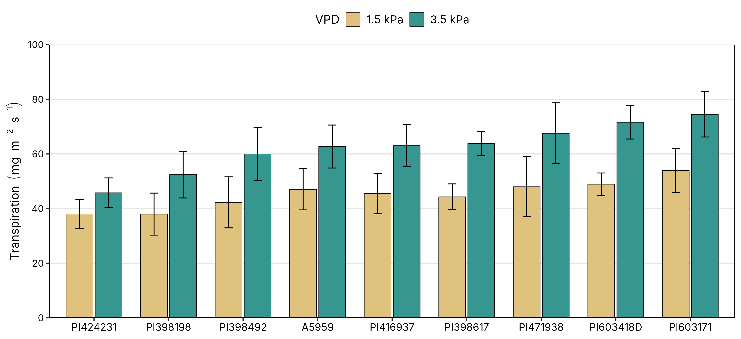
Higher than expected genotypic variability in transpiration response to VPD
Notes:
At 1.5 kPa, transpiration ranged from 38 to 54 mg m⁻² s⁻¹
At 3.5 kPa the range widened to 46 to 75 mg m⁻² s⁻¹, a 1.6-fold difference between accession

Slide 10
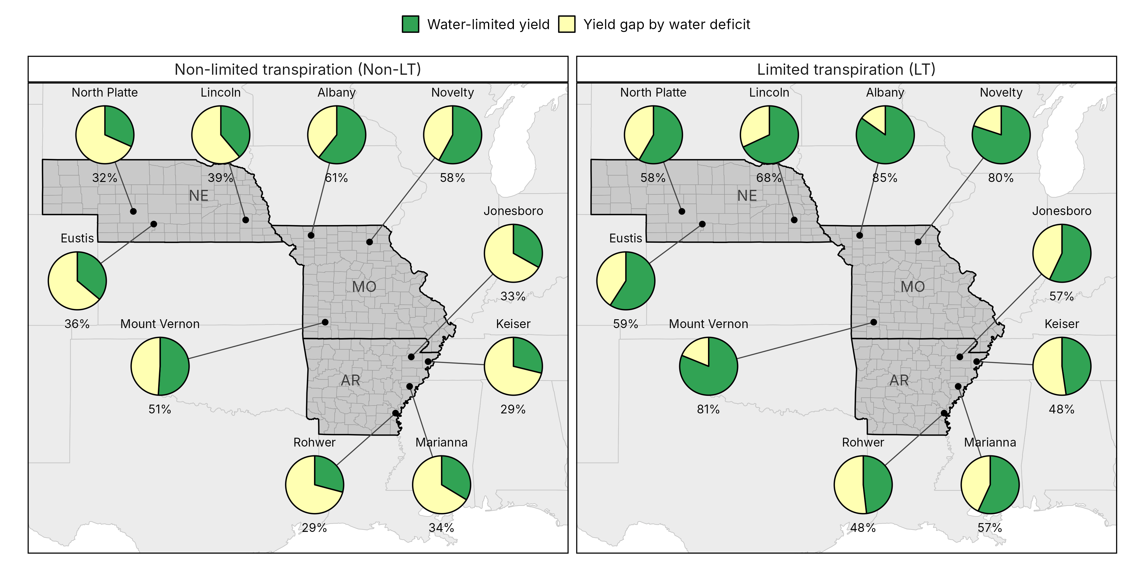
The LT trait narrows the yield gap caused by water deficit

Slide 11
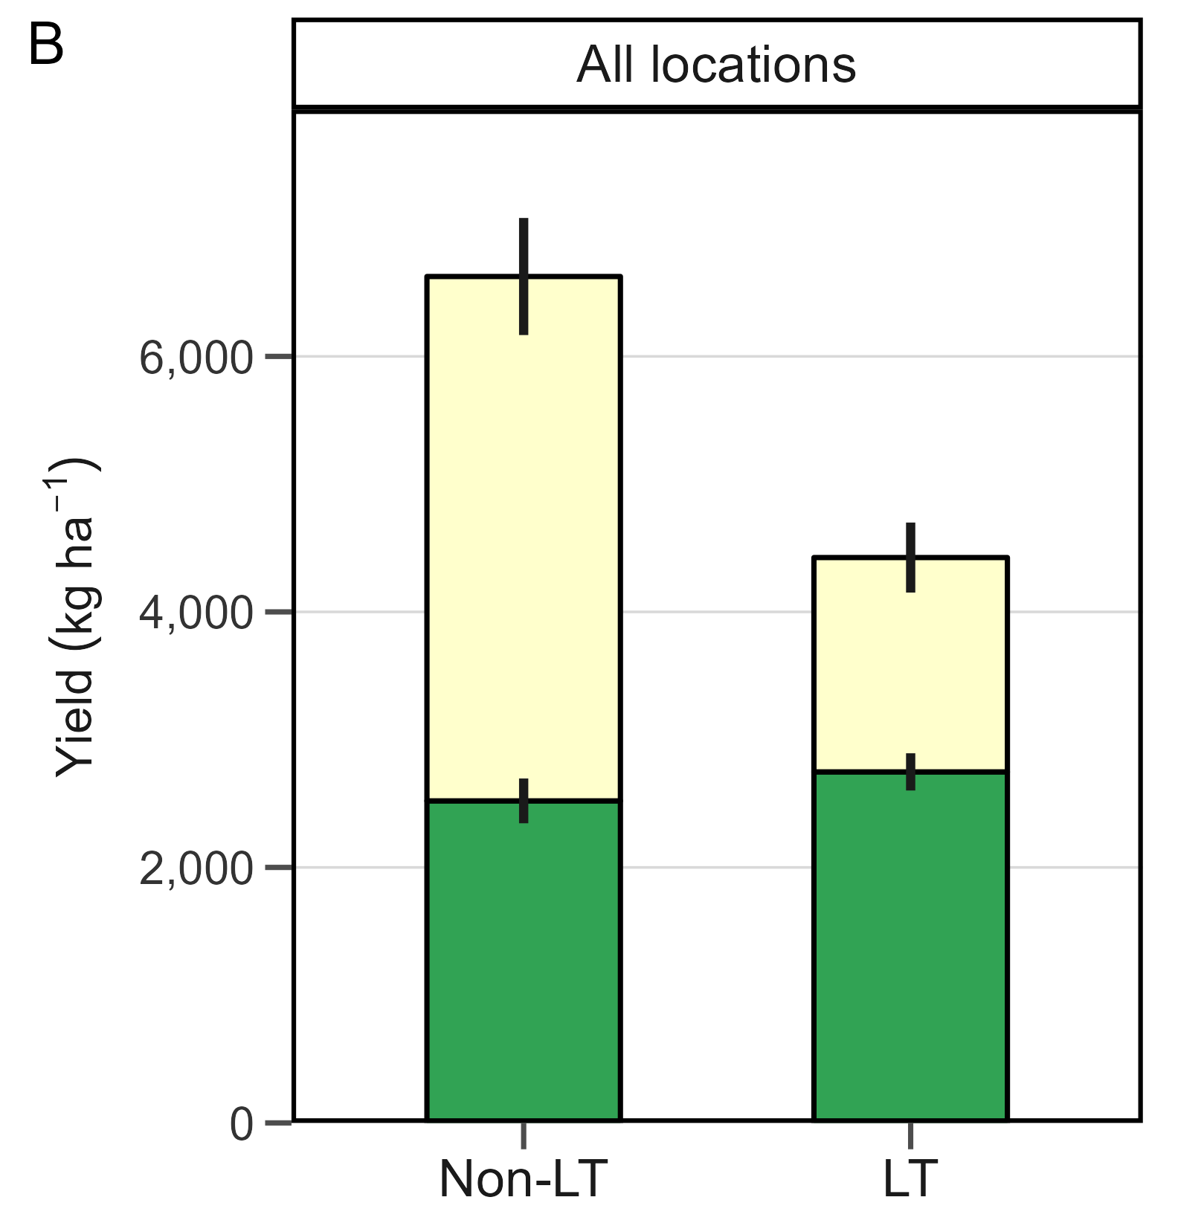
The trade-off: yield potential for water-limited yield
+8% water-limited yield with the LT trait (AR +9%, MO +5%, NE +12%)
34% lower yield potential with the LT trait (AR −35%, MO −28%, NE −36%)
In rainfed fields/dry year: the trait conserved soil water for use in late seed-fill
In irrigated or wet seasons: restricted transpiration limited carbon gain and yield potential
Mean of 10 sites x 30 years x 3 sowing dates; error bars = SE among sites

Slide 12
Conclusions
Quantify transpiration responses to VPD across soybean accessions
Large variability in transpiration responses, 4 of 9 accessions showed the LT trait. Breakpoint ranged from 1.7 to 3.4 kPa.
Quantify the yield impact and trade-offs of the LT trait across the US Mid-South and Mid-West
The LT trait (1.5 kPa threshold) trades yield potential for water-limited yield: +8% under deficit and a yield gap cut from 61% to 37%
Next steps: Field testing, explore mechanisms regulating the LT trait, use modeling to optimize transpiration response to VPD

Slide 13

Thank you!!!
Impact of the limited transpiration trait on soybean potential and water-limited yield
Elvis Elli
Assistant Professor
University of Arkansas System Division of Agriculture
Department of Crop, Soil, and Environmental Sciences
eelli@uark.edu

Slide 14
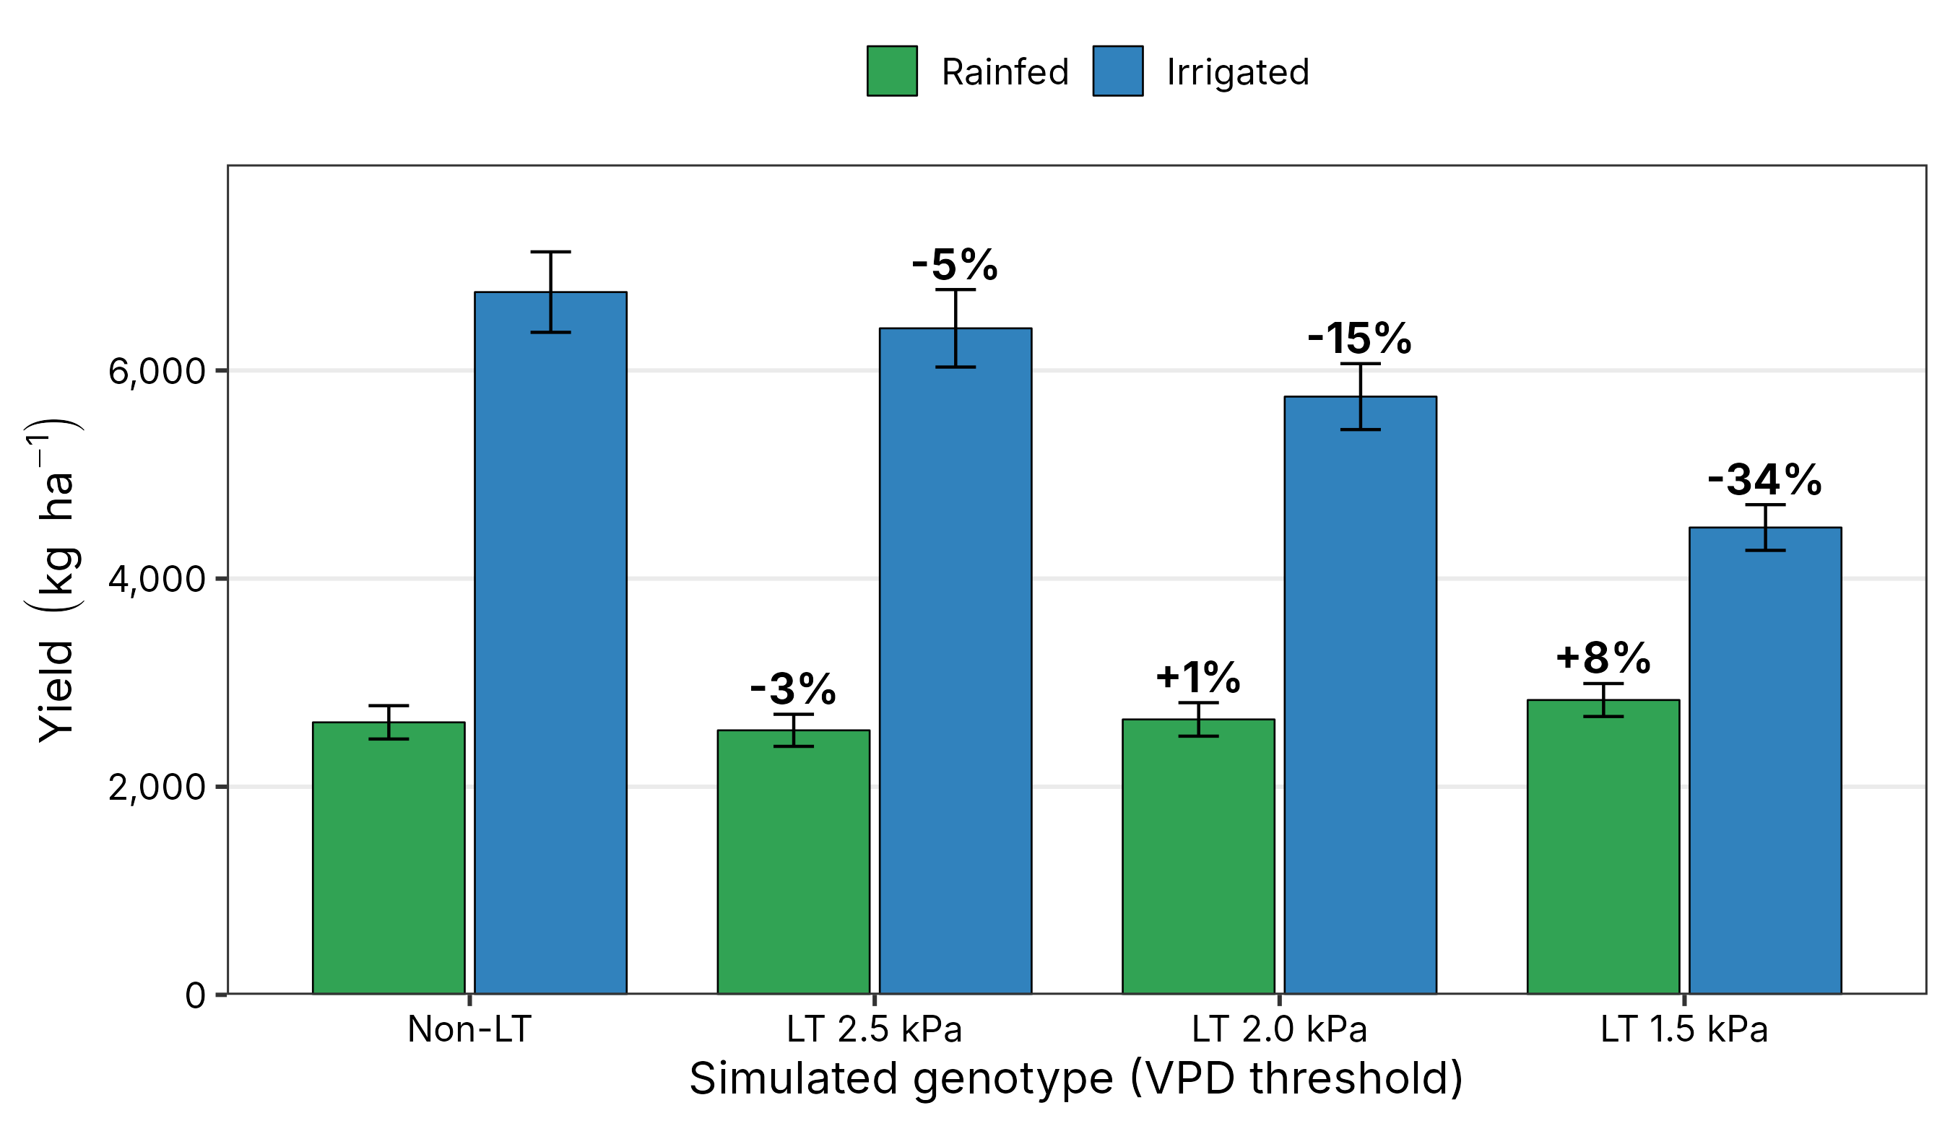
The trade-off depends on the LT threshold
BACKUP
Chamber breakpoints were 1.7-3.4 kPa; the main slides use 1.5 kPa, the most restrictive case.
Mean of 10 site means (30 years x 3 sowing dates); error bars = SE among sites; labels = change vs Non-LT.

Slide 15
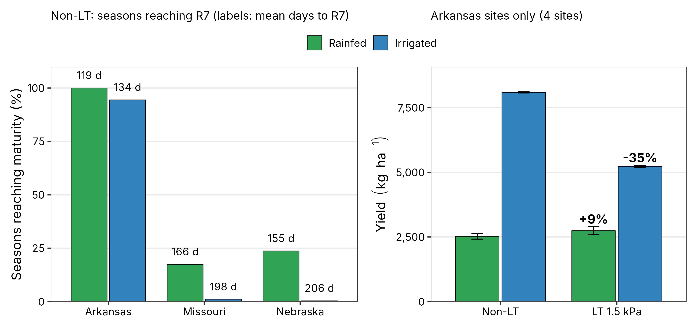
Simulated maturity: Missouri and Nebraska are provisional
BACKUP
Most MO and NE seasons hit the simulation stop day before R7, so their yields come from crops cut off early.
Arkansas, where the crop matures in 94-100% of seasons, shows the same trade-off: +9% rainfed, -35% irrigated.

