Slide 1




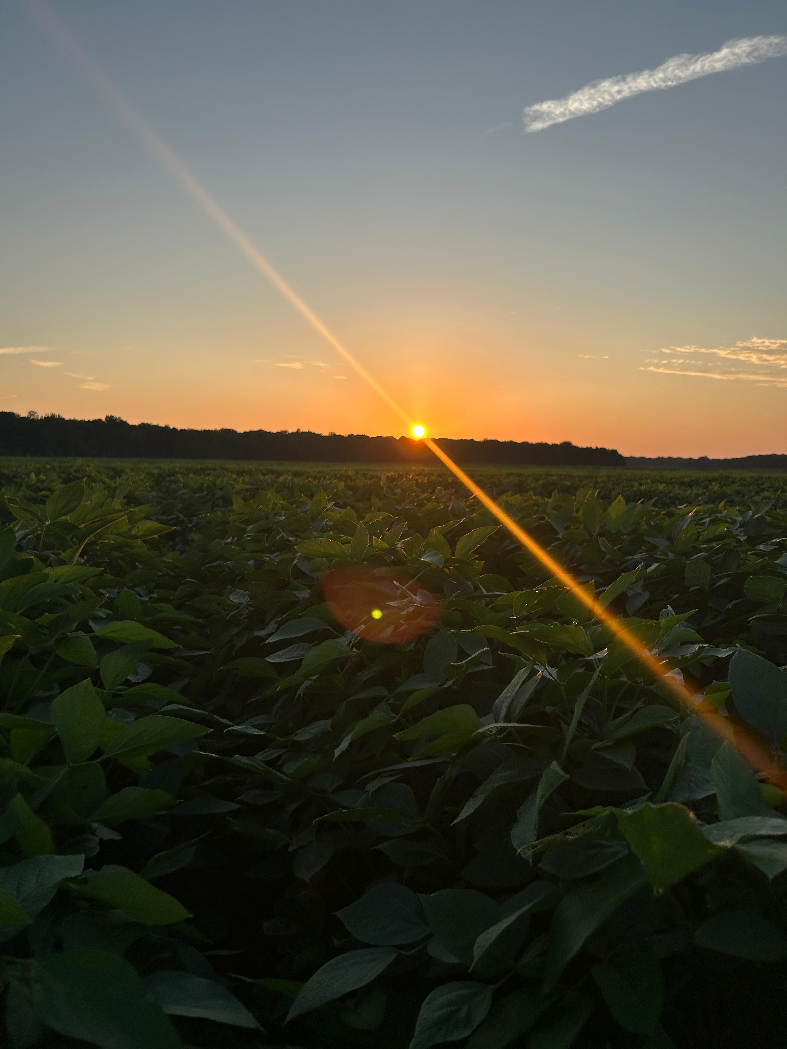
Modeling crop physiological strategies to alleviate soybean drought stress in the US-Midsouth
Elvis Elli
Assistant Professor
University of Arkansas System Division of Agriculture
Department of Crop, Soil, and Environmental Sciences
eelli@uark.edu

Slide 2
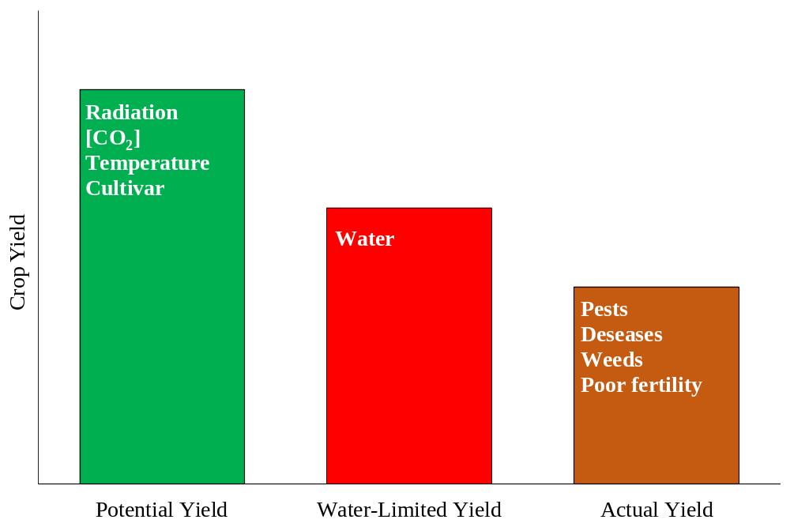
Adapting Soybeans to drought
Water use efficiency
Enhancing yield potential
Optimizing/reducing seasonal water use
Adapted from van Ittersum et al. (2013)

Slide 3
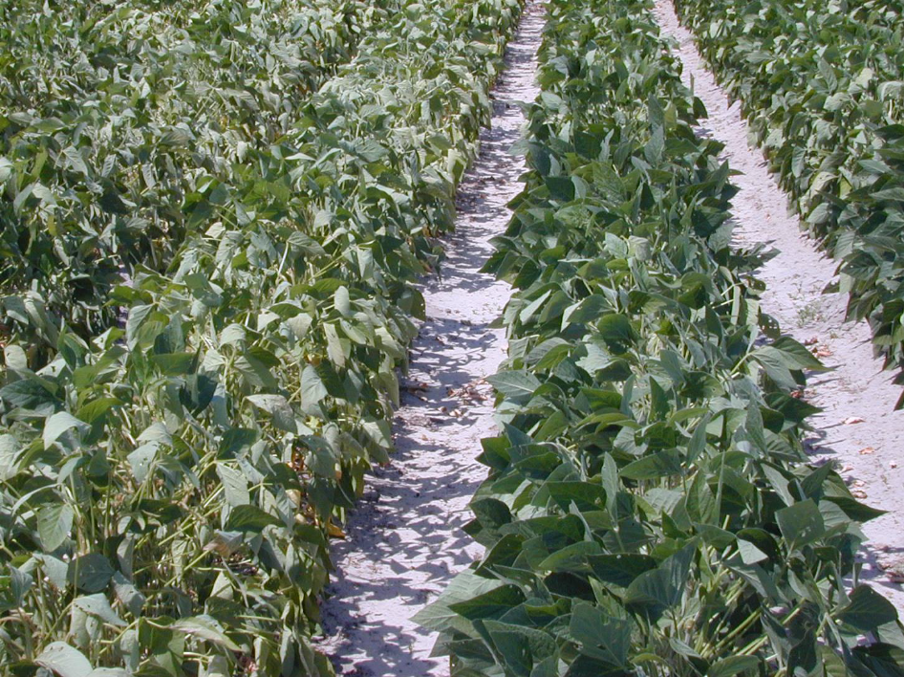
The limited transpiration (LT) trait
Plant transpiration
Vapor Pressure Deficit -VPD
Adapted from van Ittersum et al. (2013)
Yu et al. (2024), Fletcher et al. (2007)
Notes:
Small differences can have important implications

Slide 4
Non-limited transpiration trait
Limited transpiration trait
VPD
Transpiration

Slide 5

Objectives
Identify genotypes with the LT trait
Modeling the LT trait

Slide 6
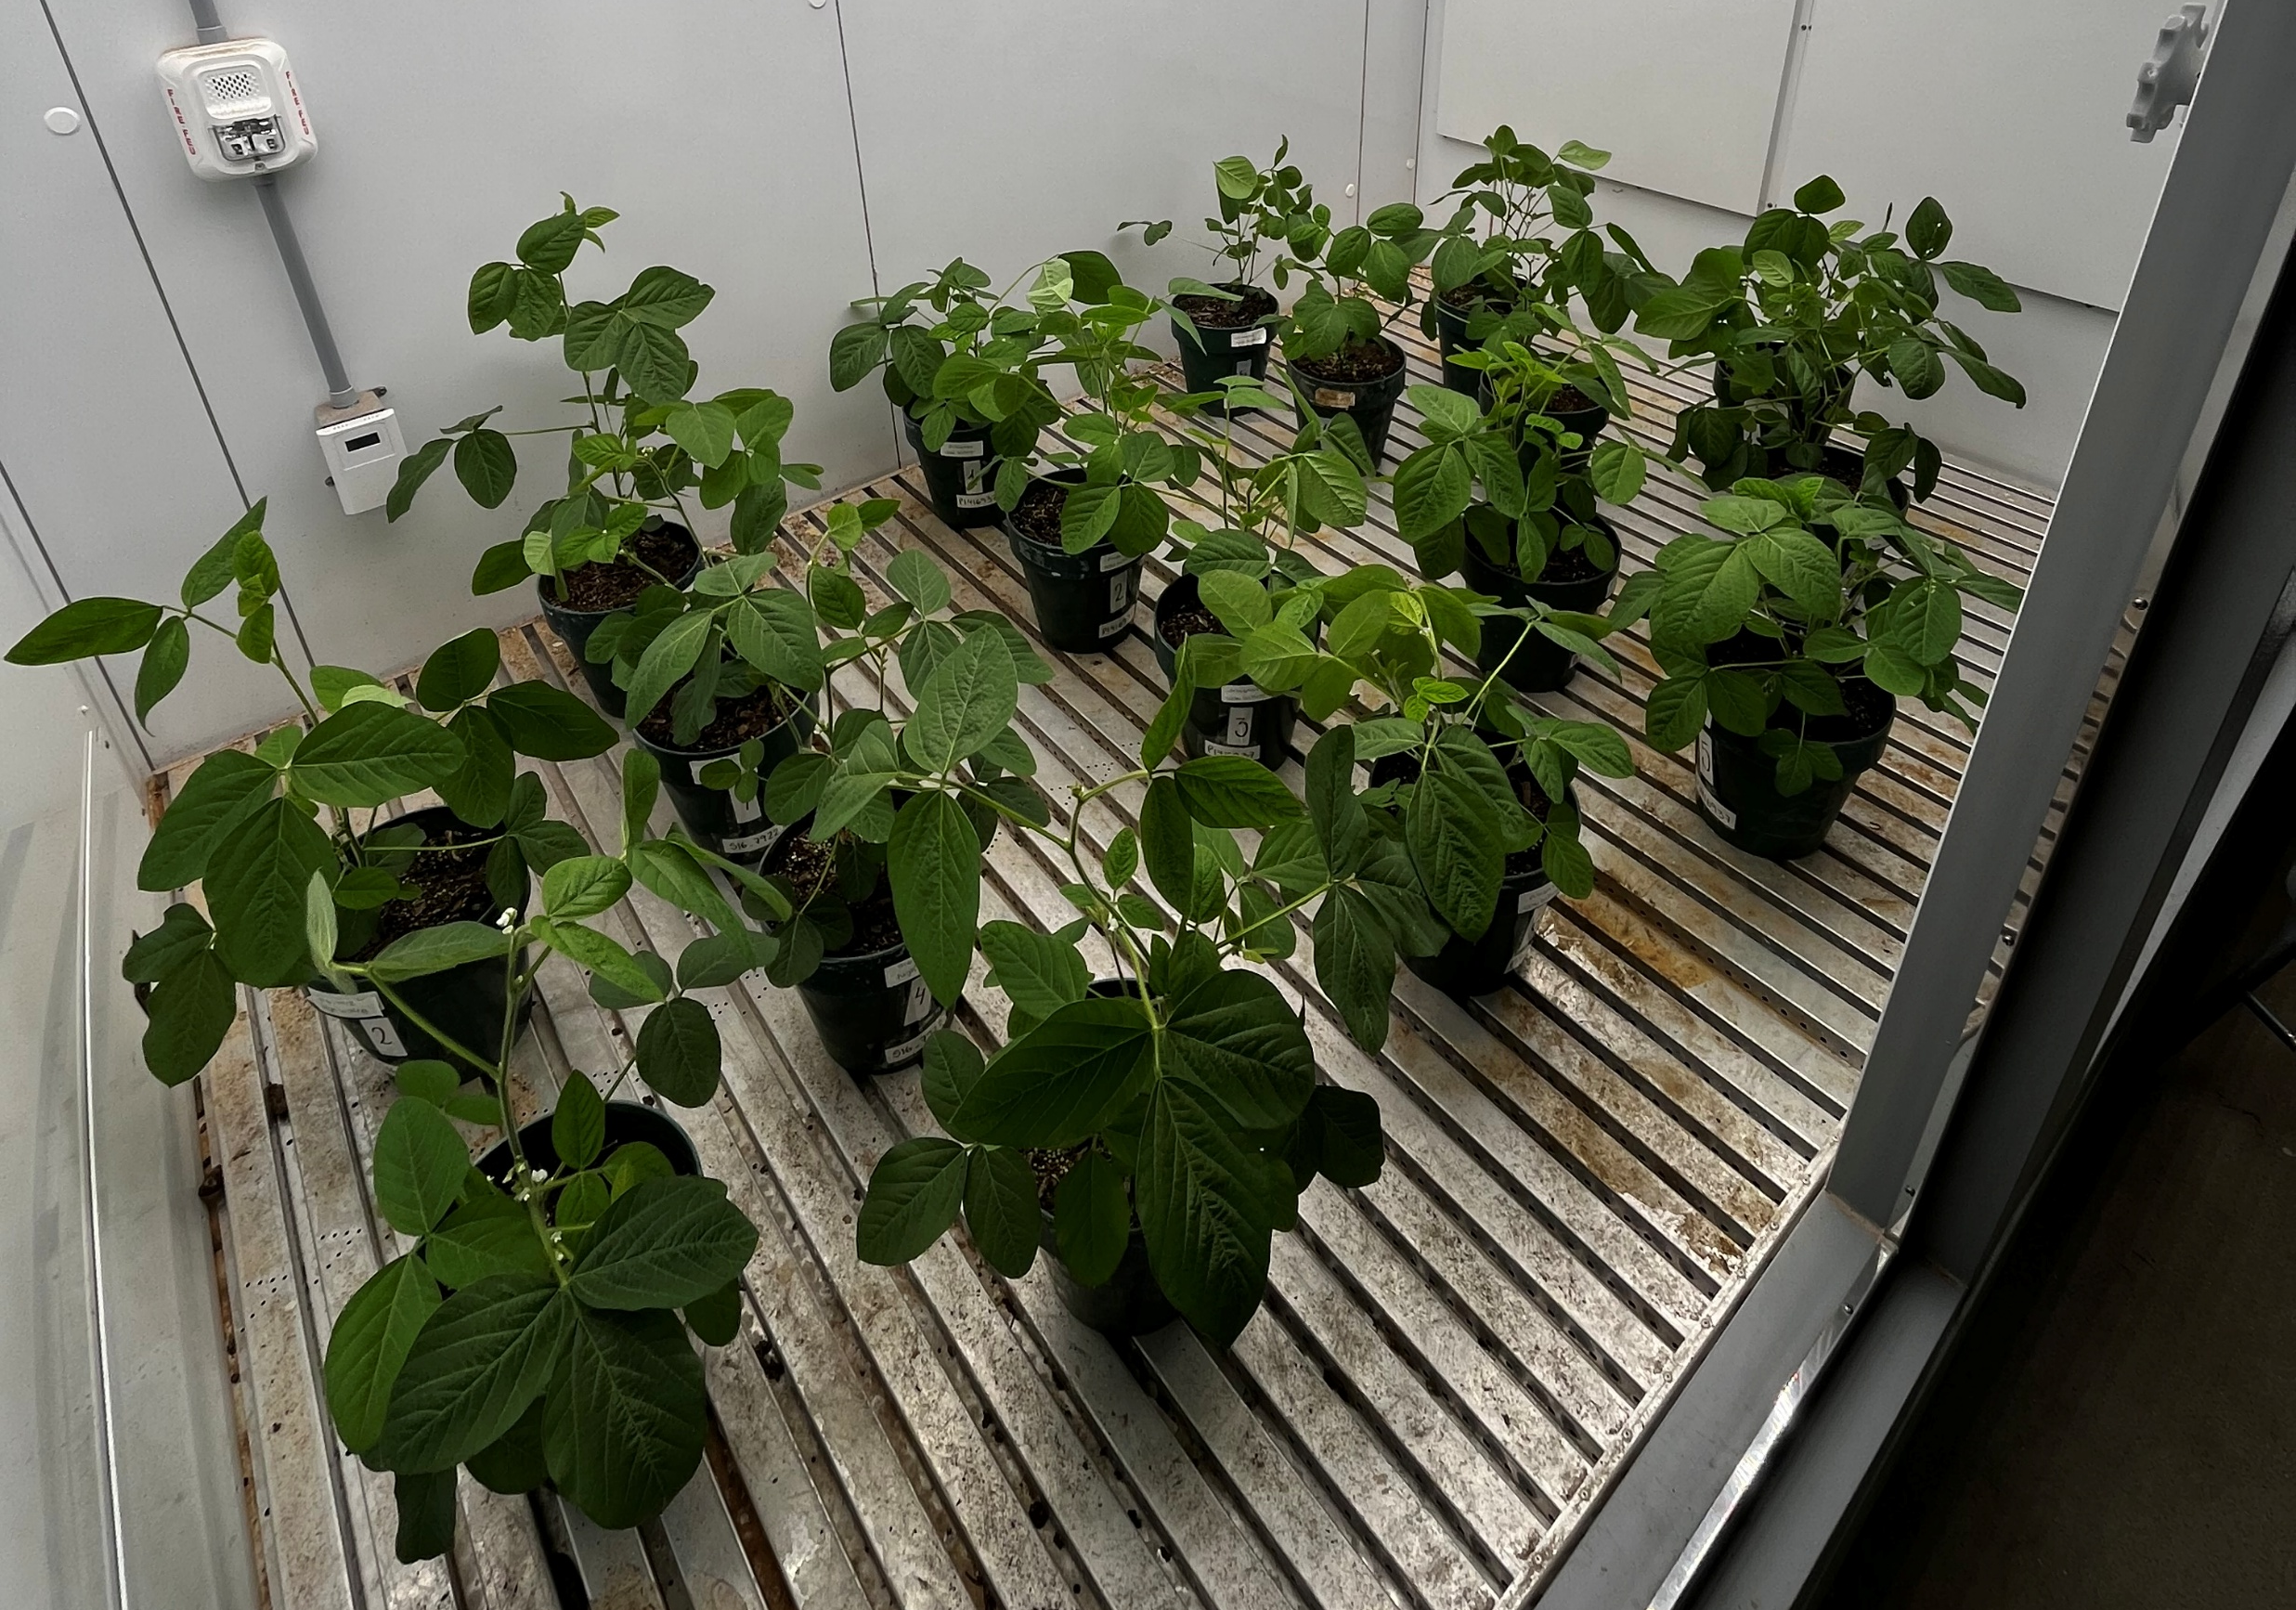
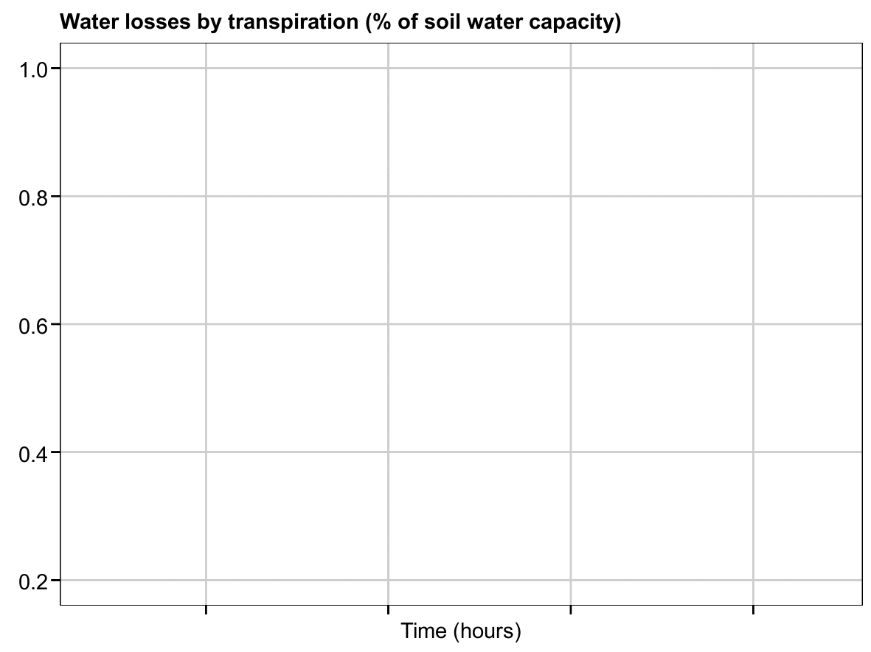
Material and Methods
Quantifying transpiration losses across VPD treatments

Slide 7
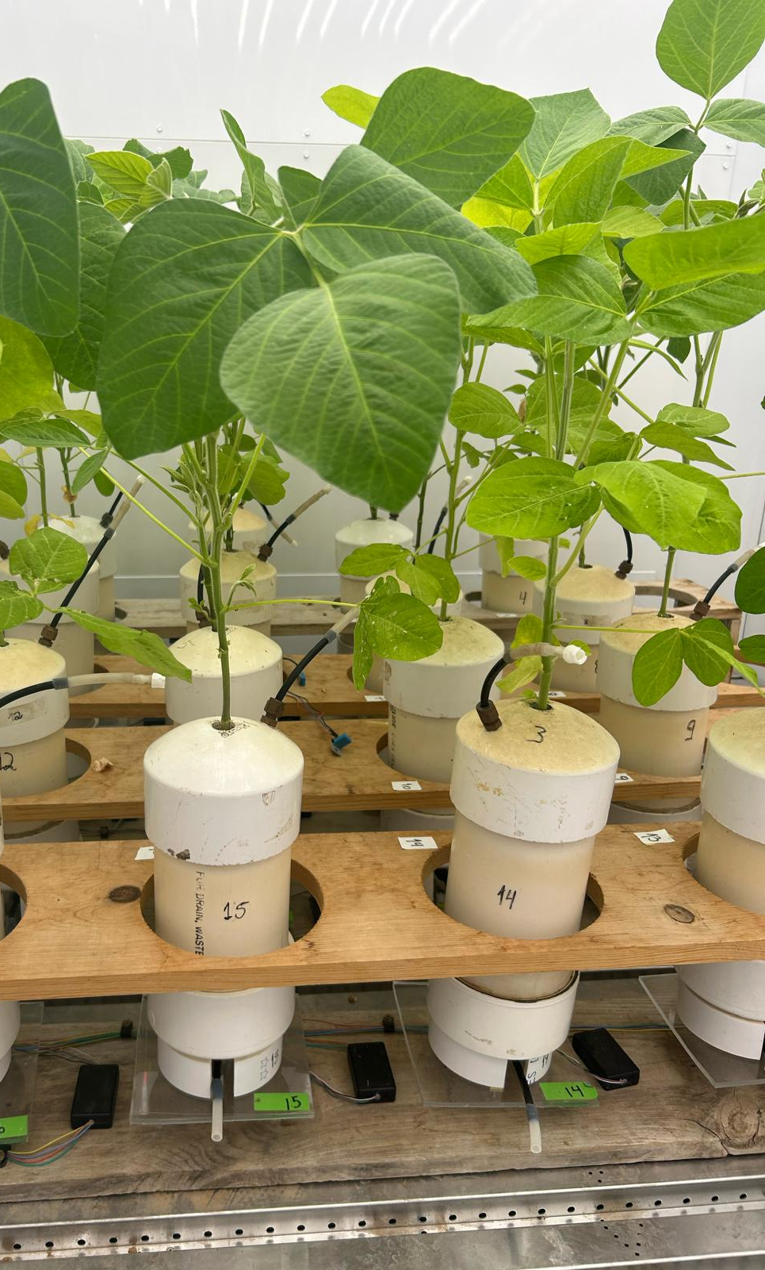
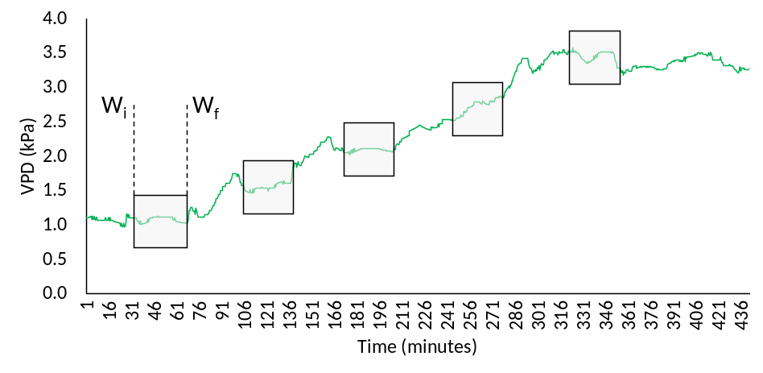
Material and Methods
VPD treatments
Objective 1
Weather
Soil
Management
Genetics/Cultivars
SSM model
(Soltani and Sinclair, 2012)
Objective 2
Carbon
Water
Nitrogen
Crop

Slide 8
Objectives
Identify genotypes with the LT trait
Modeling the LT trait

Slide 9
Diverging responses in soybean transpiration response
Preliminary results

Slide 10
Objectives
Identify genotypes with the LT trait
Modeling the LT trait

Slide 11
Yield advantage in dry years with the LT trait
+6%
+2%
+11%

Slide 12
Optimized seasonal water use with the LT trait
-4%
+ 9% (3 to 15% across sites)

Slide 13
Changing patterns in water demand with the LT trait
Slope = 29 mm/°C (1.8%/°C)
Slope = 14 mm/°C (1.3%/°C)

Slide 14
Conclusions
Identify genotypes with the LT trait
Modeling the LT trait

Slide 15
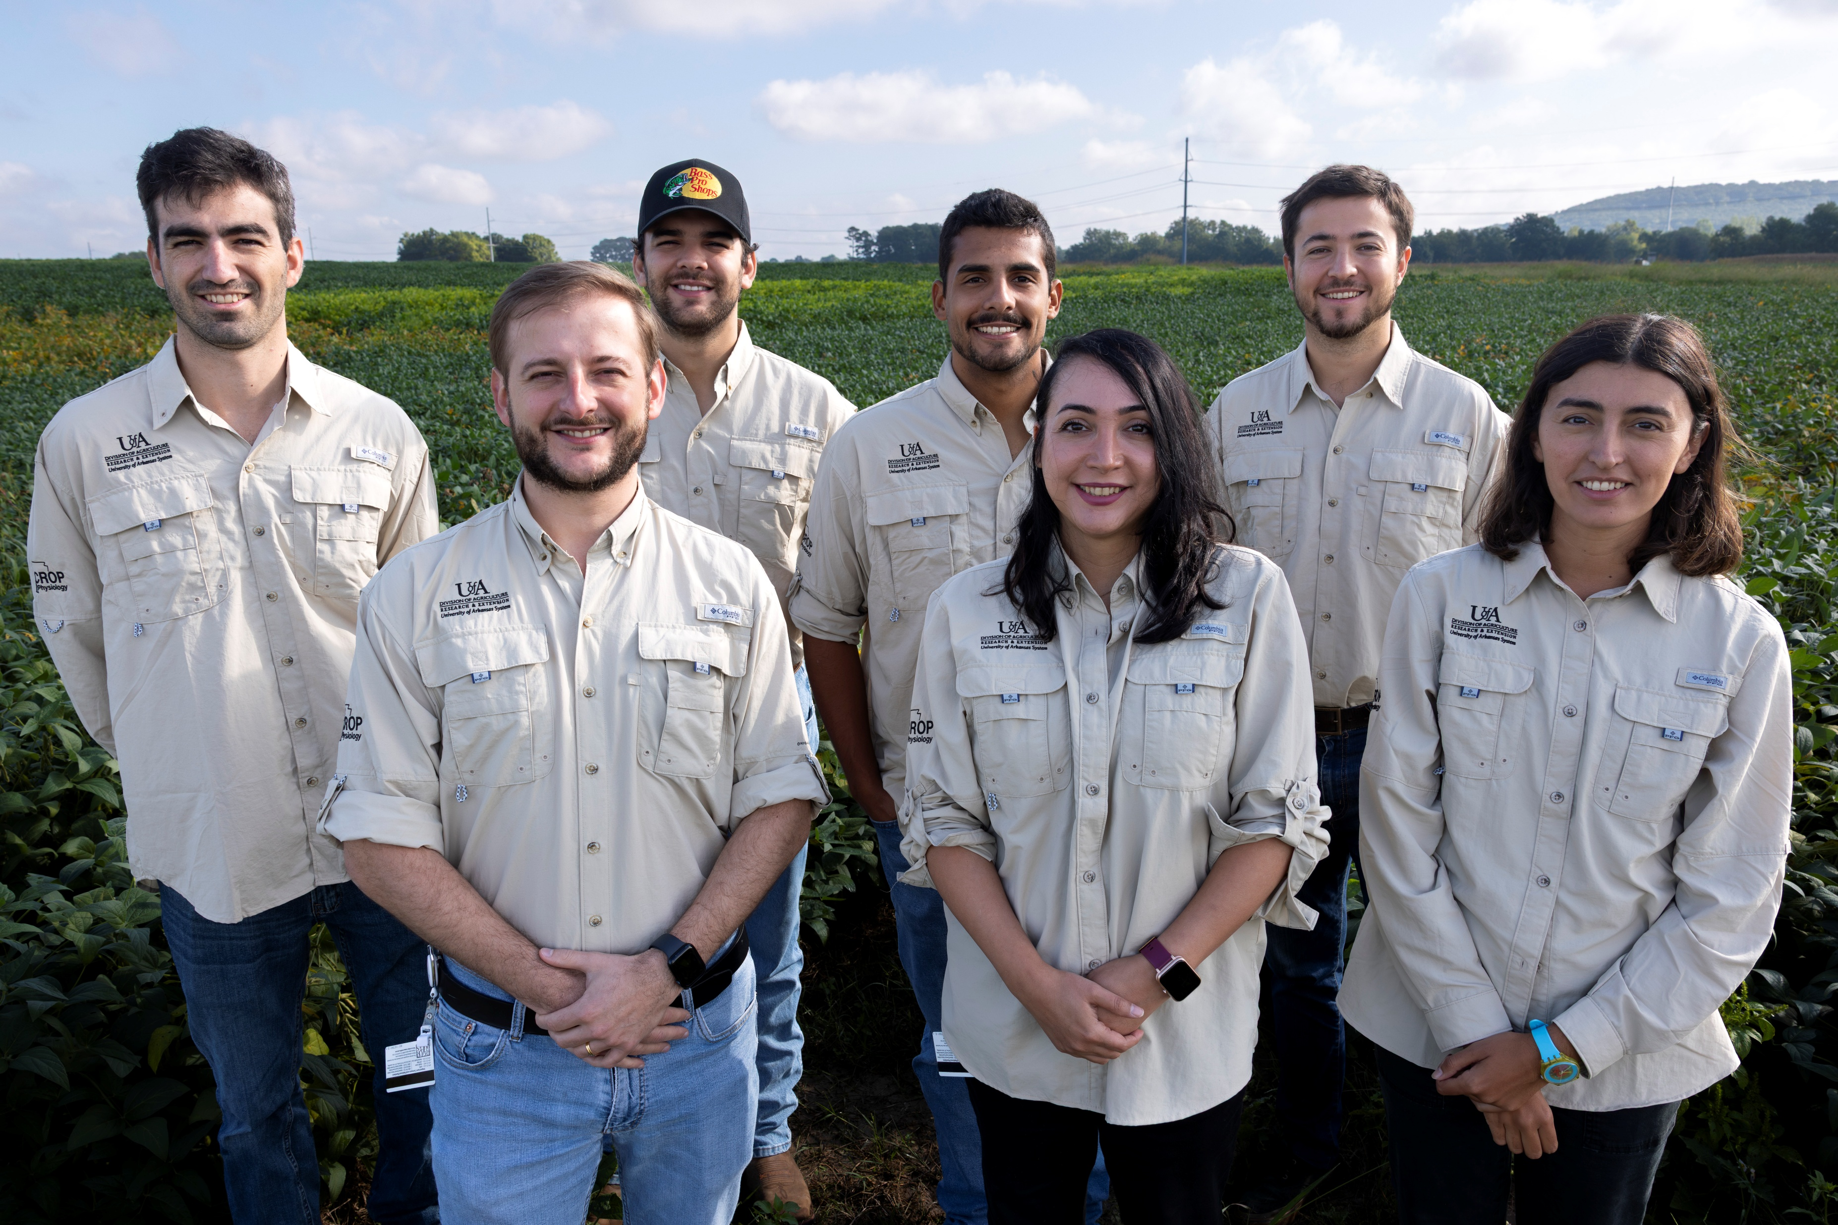


Slide 16
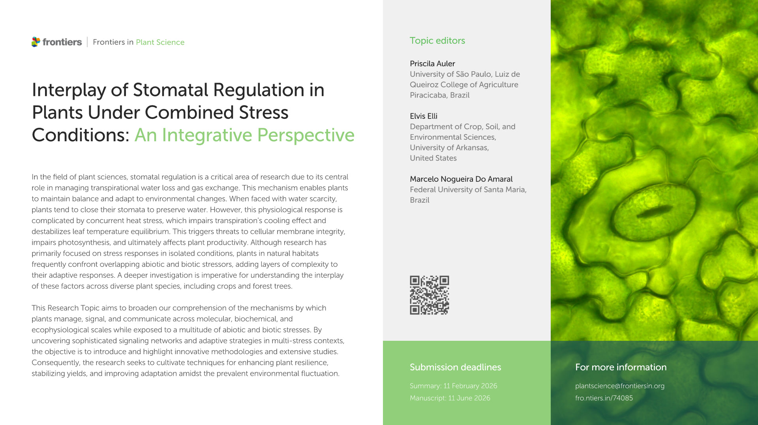

Slide 17
Thank you!!!
Modeling crop physiological strategies to alleviate soybean drought stress in the US-Midsouth
Elvis Elli
Assistant Professor
University of Arkansas System Division of Agriculture
Department of Crop, Soil, and Environmental Sciences
eelli@uark.edu

Slide 18
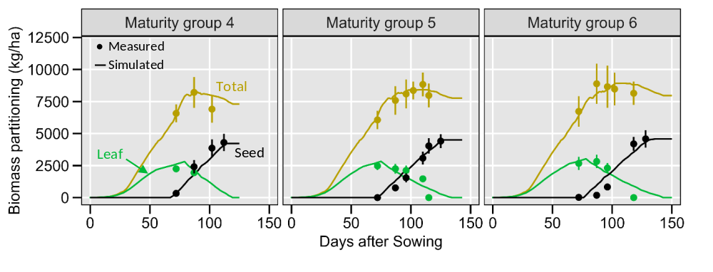
APSIM - Agricultural Production Systems Simulator
Preliminary results

Slide 19


APSIM - Agricultural Production Systems Simulator
Weather
- Daily max/min temperature, rain, solar radiation
Soil
- Soil organic carbon, hydrological parameters, initial conditions, crop residue
Management
- Planting date, plant density, tillage type/date
Genetics/Cultivars
- Phenology, RUE, seed growth, N uptake
Regional simulations
~5km resolution, 1300 fields in AR, 30 weather-years
Scenarios
- Climate Change (2°C increase), longer cycle, early sowing, longer seed-filling period, and combinations
Outputs
- Seed Yields
AR
Carbon
Water
Nitrogen
Crop

Slide 20
Case study 2 – the APSIM-Soybean model
Soybean sowing date progress in AR

Slide 21
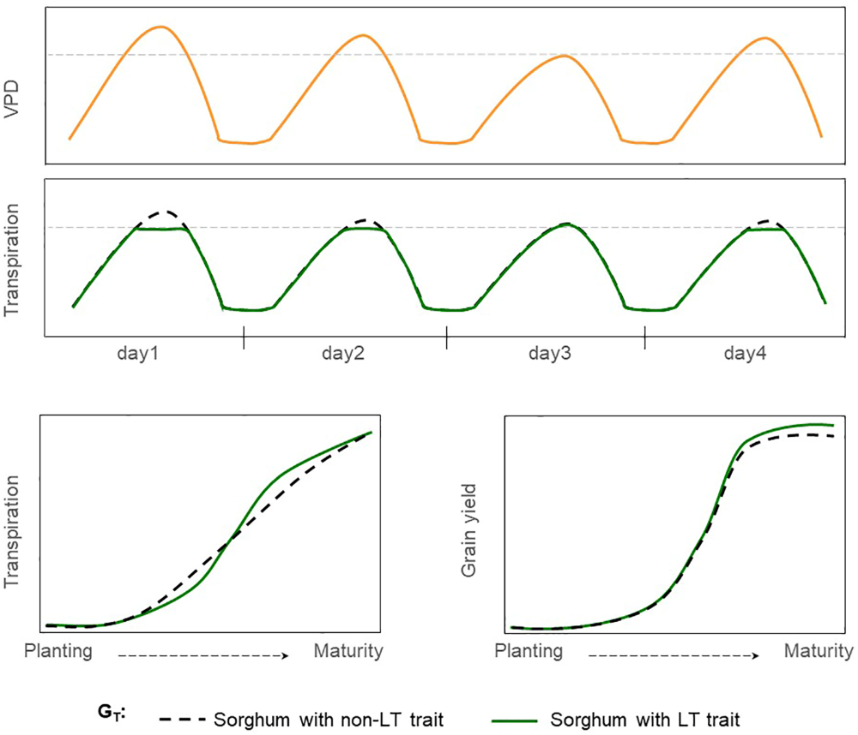
Non-limited transpiration trait
Limited transpiration trait
VPD
Transpiration

