Slide 1




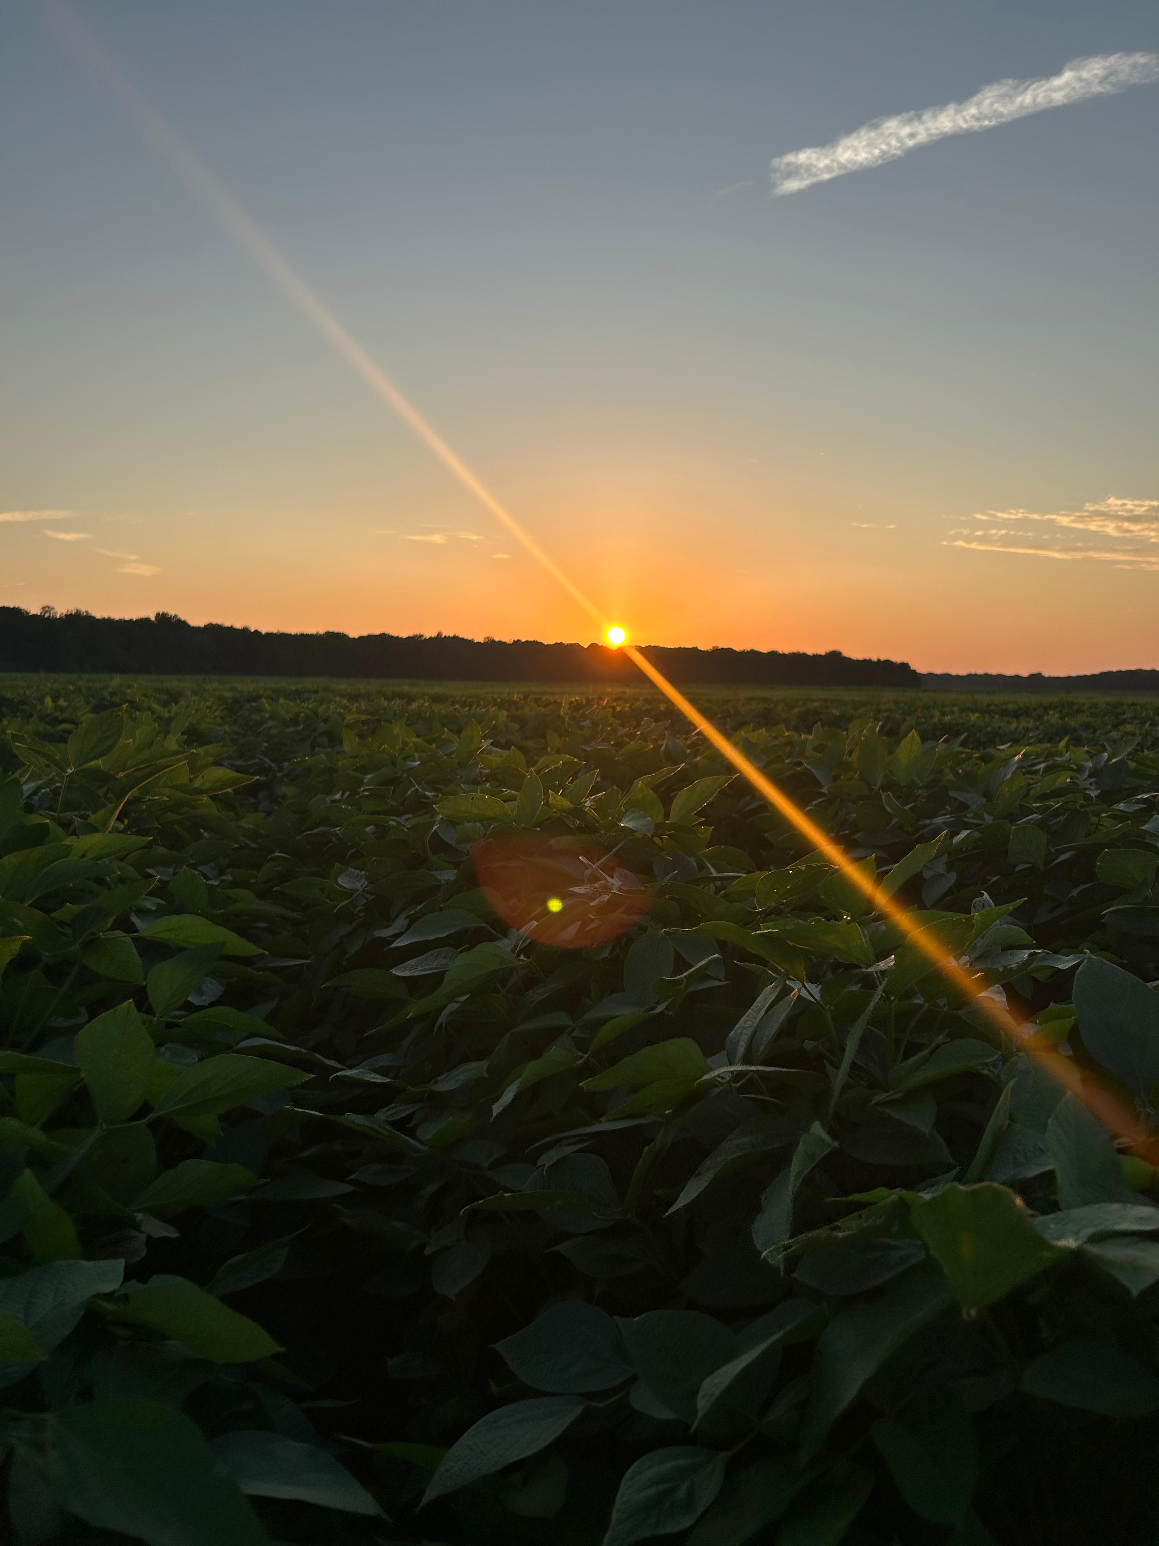
Impact of the limited transpiration trait on soybean potential and water-limited yield
Elvis Elli
Lucas Romano, Martina Meira, Felix Fritschi, Afsin Soltani, Caio Canella Vieira
Assistant Professor
University of Arkansas System Division of Agriculture
Department of Crop, Soil, and Environmental Sciences
eelli@uark.edu

Slide 2
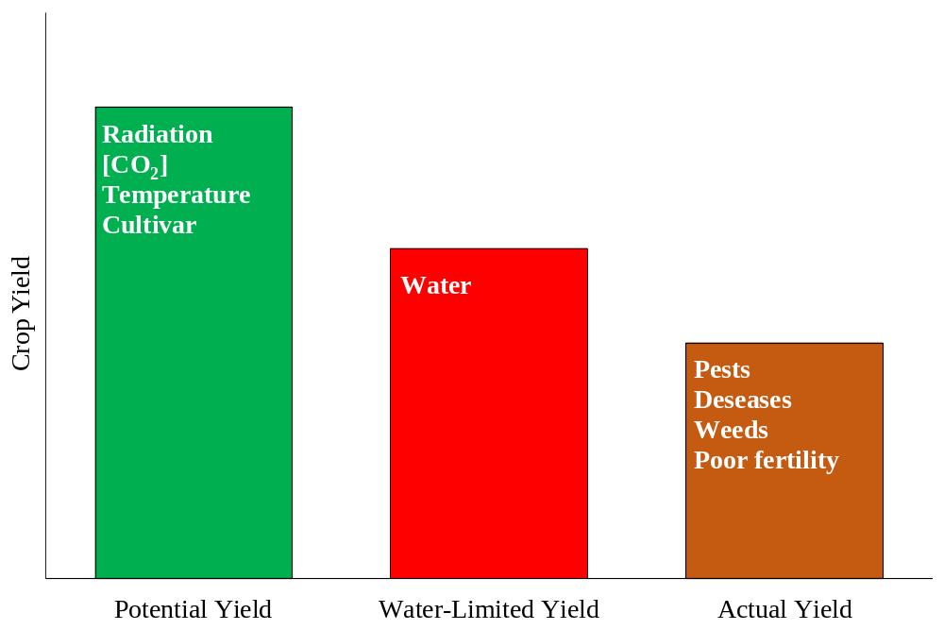
Adapting Soybeans to drought
Water use efficiency
Enhancing yield potential
Optimizing/reducing seasonal water use
Adapted from van Ittersum et al. (2013)

Slide 3
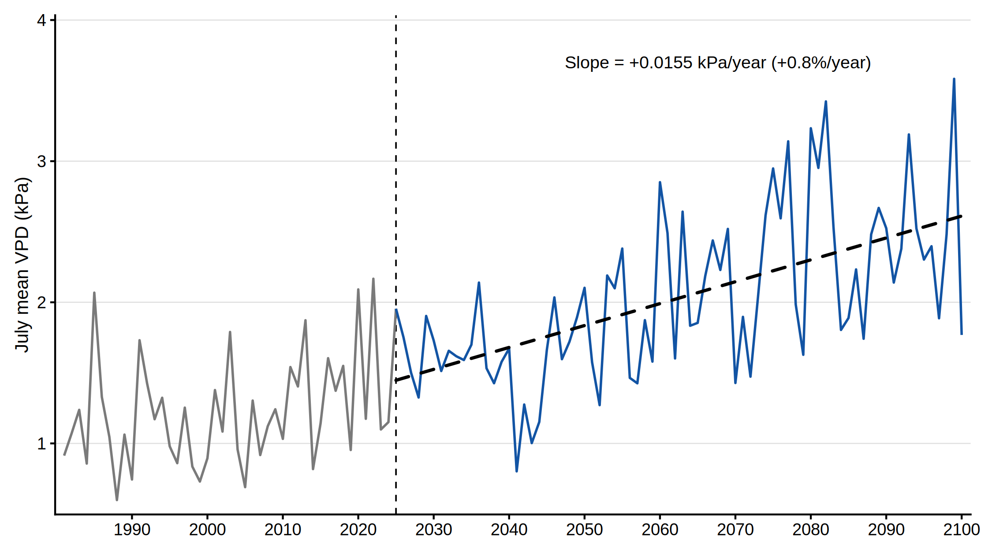
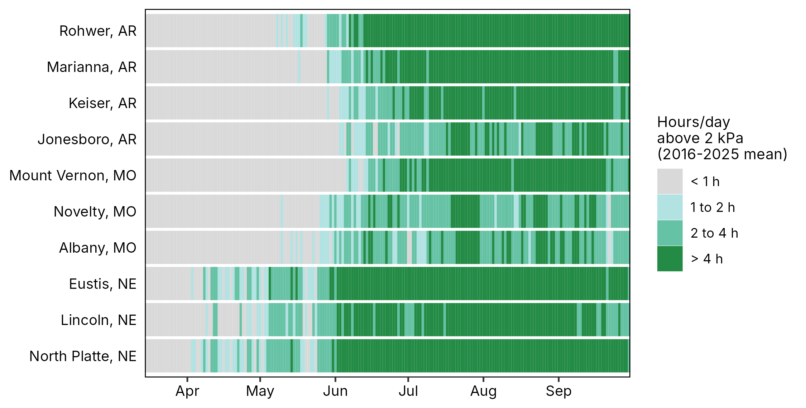
Atmospheric demand on soybean is rising
Hours per day above 2 kPa, 10 sites in Arkansas, Missouri and Nebraska
July mean VPD in Arkansas, UKESM1-0-LL model, SSP3-7.0 scenario
+0.8% per year
Projected increase in July VPD through 2100: more hours of high evaporative demand each season
Why it matters
How genotypes respond to VPD is the basis for strategies that optimize seasonal water use and raise water use efficiency (WUE)

Slide 4
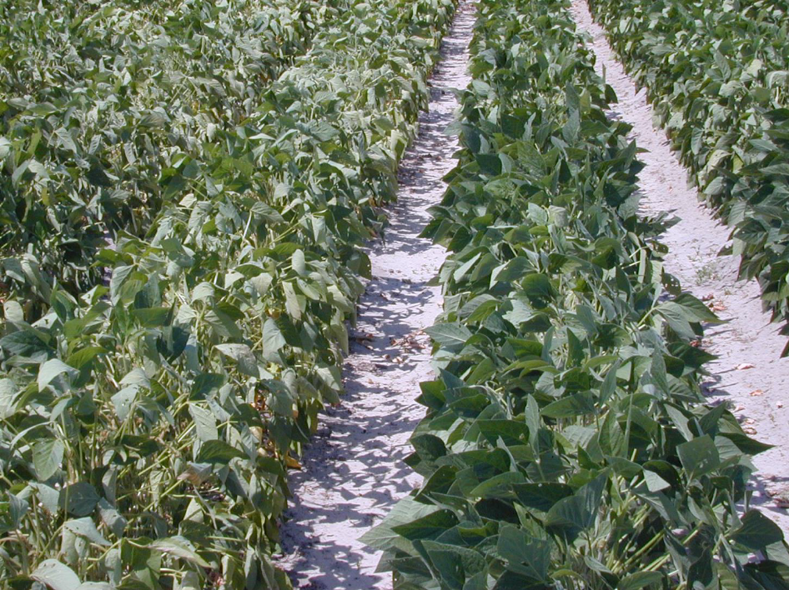
The limited transpiration (LT) trait
Plant transpiration
Vapor Pressure Deficit -VPD
Adapted from van Ittersum et al. (2013)
Yu et al. (2024), Fletcher et al. (2007)
Notes:
Small differences can have important implications

Slide 5
Non-limited transpiration trait
Limited transpiration trait
VPD
Transpiration

Slide 6
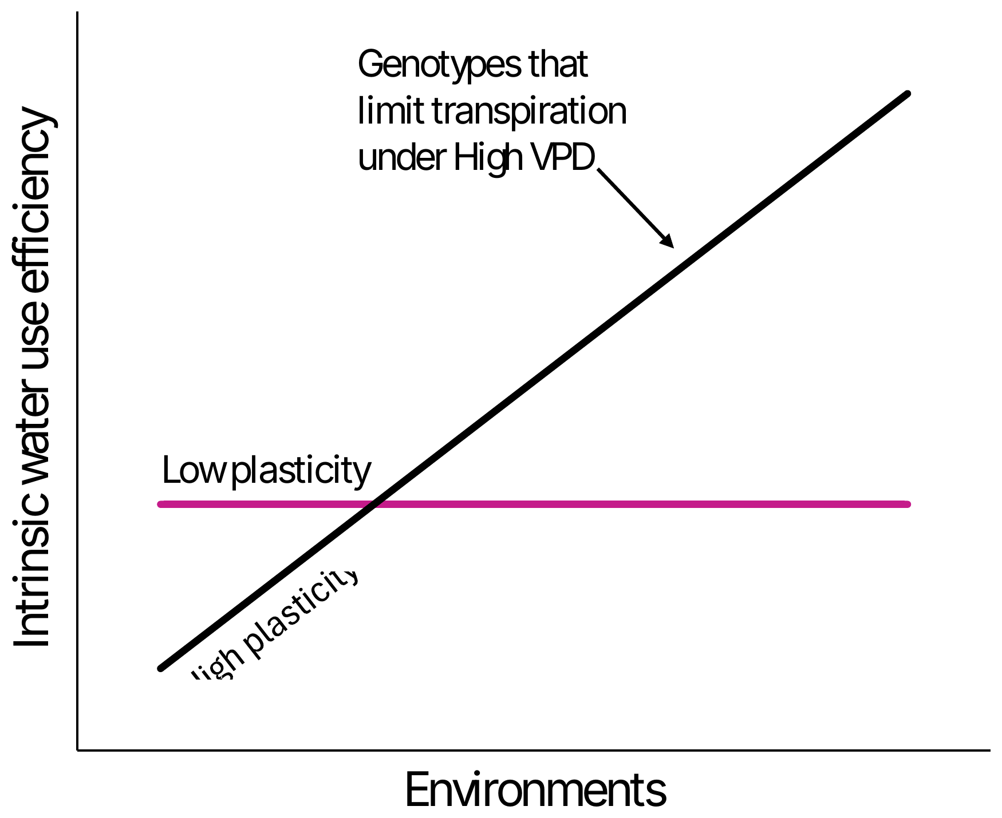
Hypothesis: WUE plasticity is a signature of the LT trait
Chamarthi et al. (2022) classified soybean accessions by the plasticity of intrinsic WUE across environments, inferred from carbon isotope discrimination
Plastic, high WUE
WUE rises with evaporative demand: expected to limit transpiration under high VPD
Nonplastic, low WUE
WUE stays flat across environments: expected to keep transpiring as VPD increases
Expected relationship between WUE plasticity and the limited transpiration (LT) response

Slide 7

Objectives
Identify genotypes with the LT trait among accessions differing in WUE plasticity
Quantify the yield impact and trade-offs of the LT trait across the US Mid-South and Mid-West

Slide 8
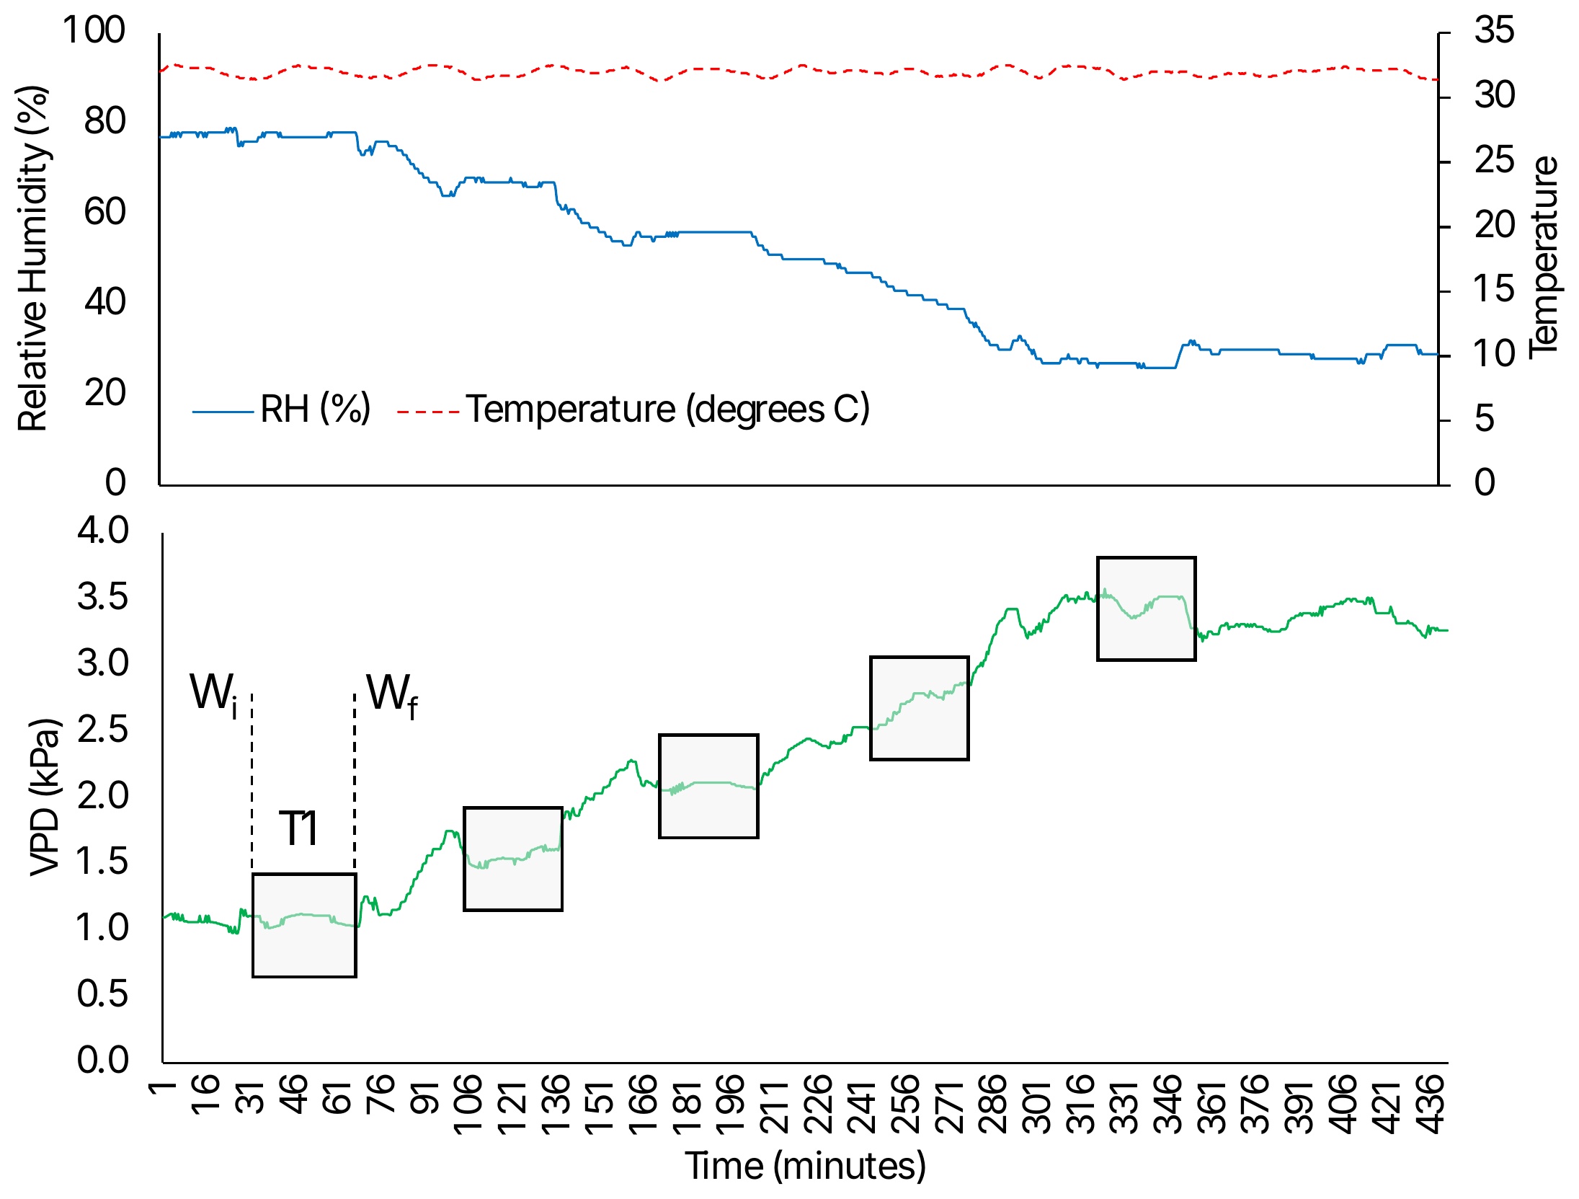
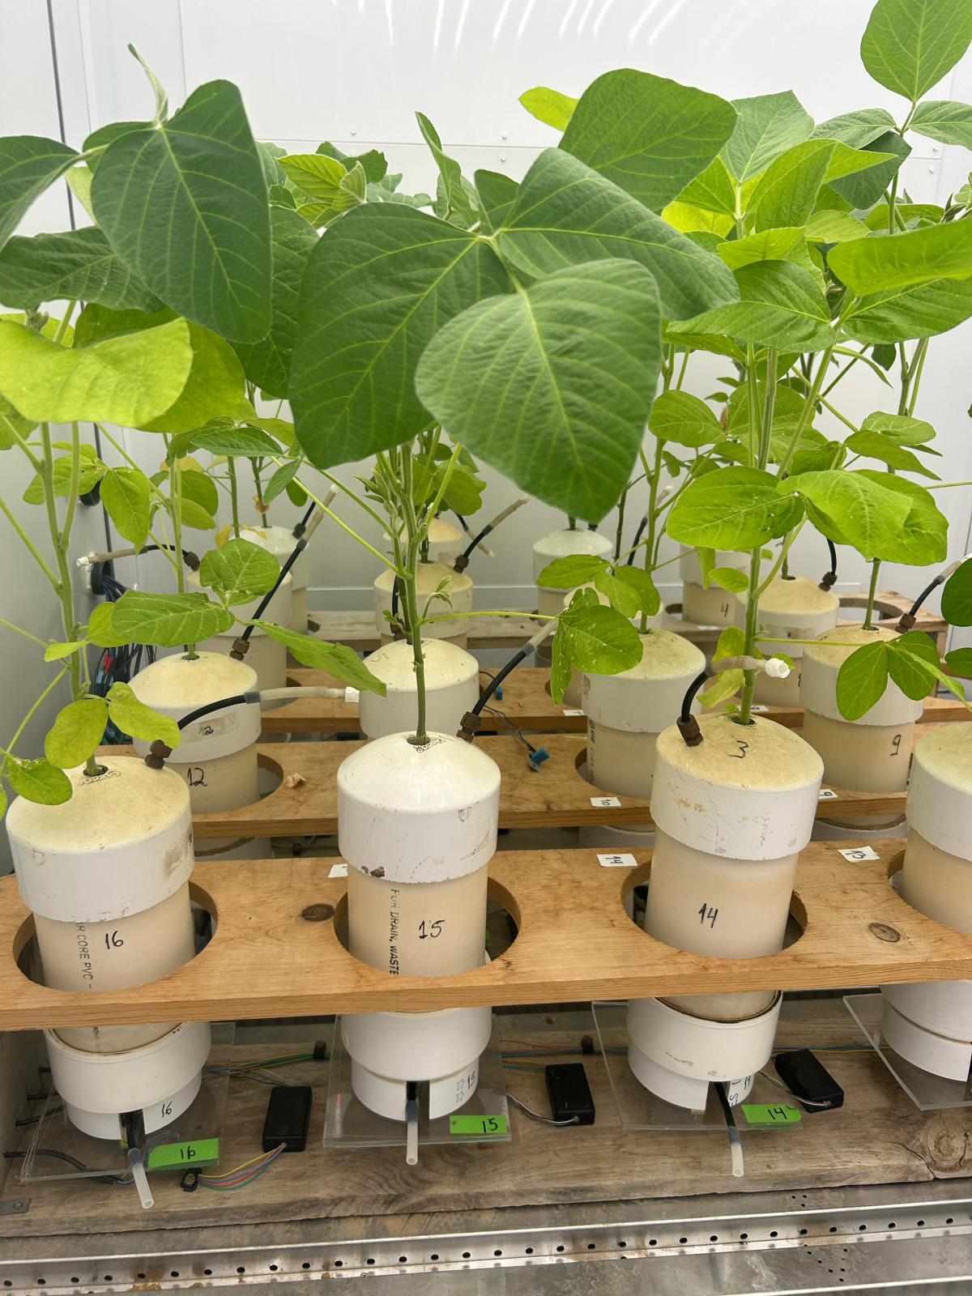
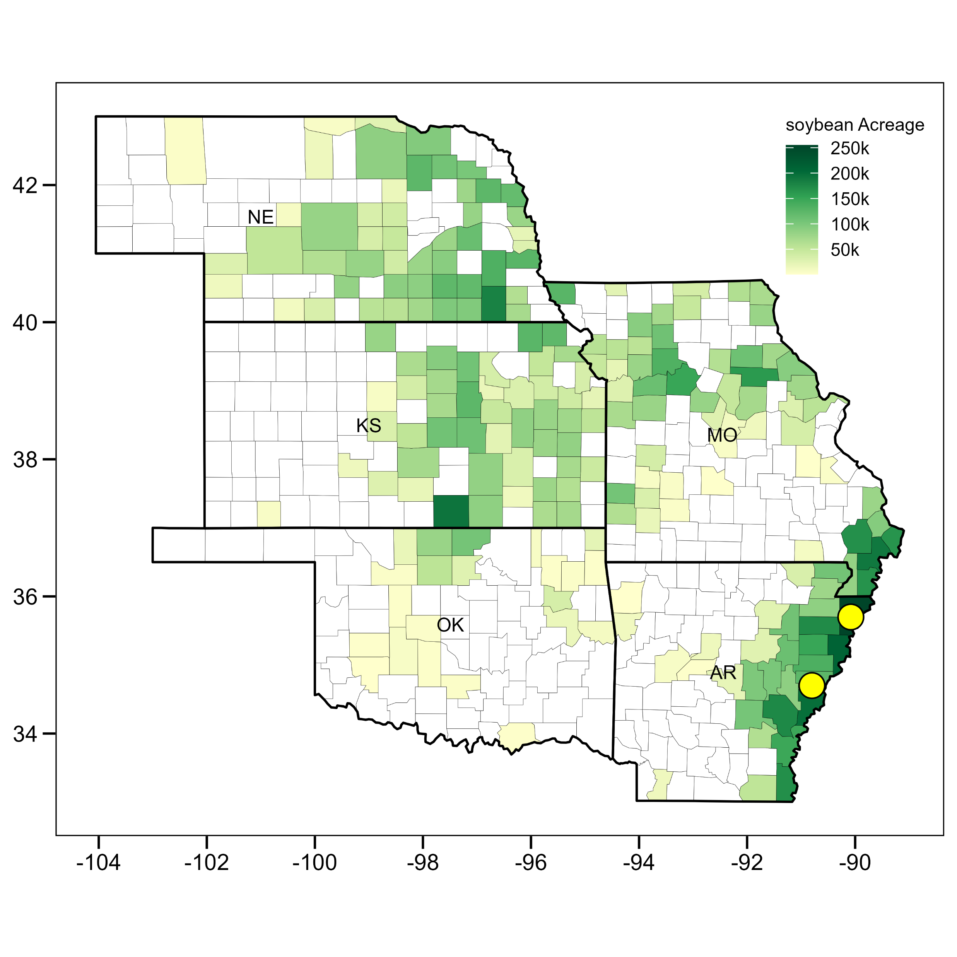
Material and Methods
Objective 1
Controlled-environment experiment
14 soybean MG IV accessions: 5 plastic / high WUE, 4 nonplastic / low WUE, slow- and high-wilting checks, 1 MAGIC parent
Stepwise VPD from 1.0 to 3.5 kPa at constant temperature, 5 replications (Dec 2025 to Aug 2026)
Gravimetric transpiration per leaf area (TR); stomatal conductance (gsw) on 13 accessions
Linear, linear-plateau and bilinear mixed models (replicate as random effect, R nlme) compared by AIC to locate VPD breakpoints
Objective 2
Systems-modeling experiment
SSM soybean model (Soltani and Sinclair, 2012)
Biomass: radiation use efficiency; water use: hourly VPD-driven transpiration efficiency
LT vs non-LT genotype, rainfed vs irrigated
10 locations (AR, MO, NE) x 30 weather-years x 3 sowing dates
Hours above 2 kPa, study sites

Slide 9
Objectives
Identify genotypes with the LT trait among accessions differing in WUE plasticity
Quantify the yield impact and trade-offs of the LT trait across the US Mid-South and Mid-West

Slide 10
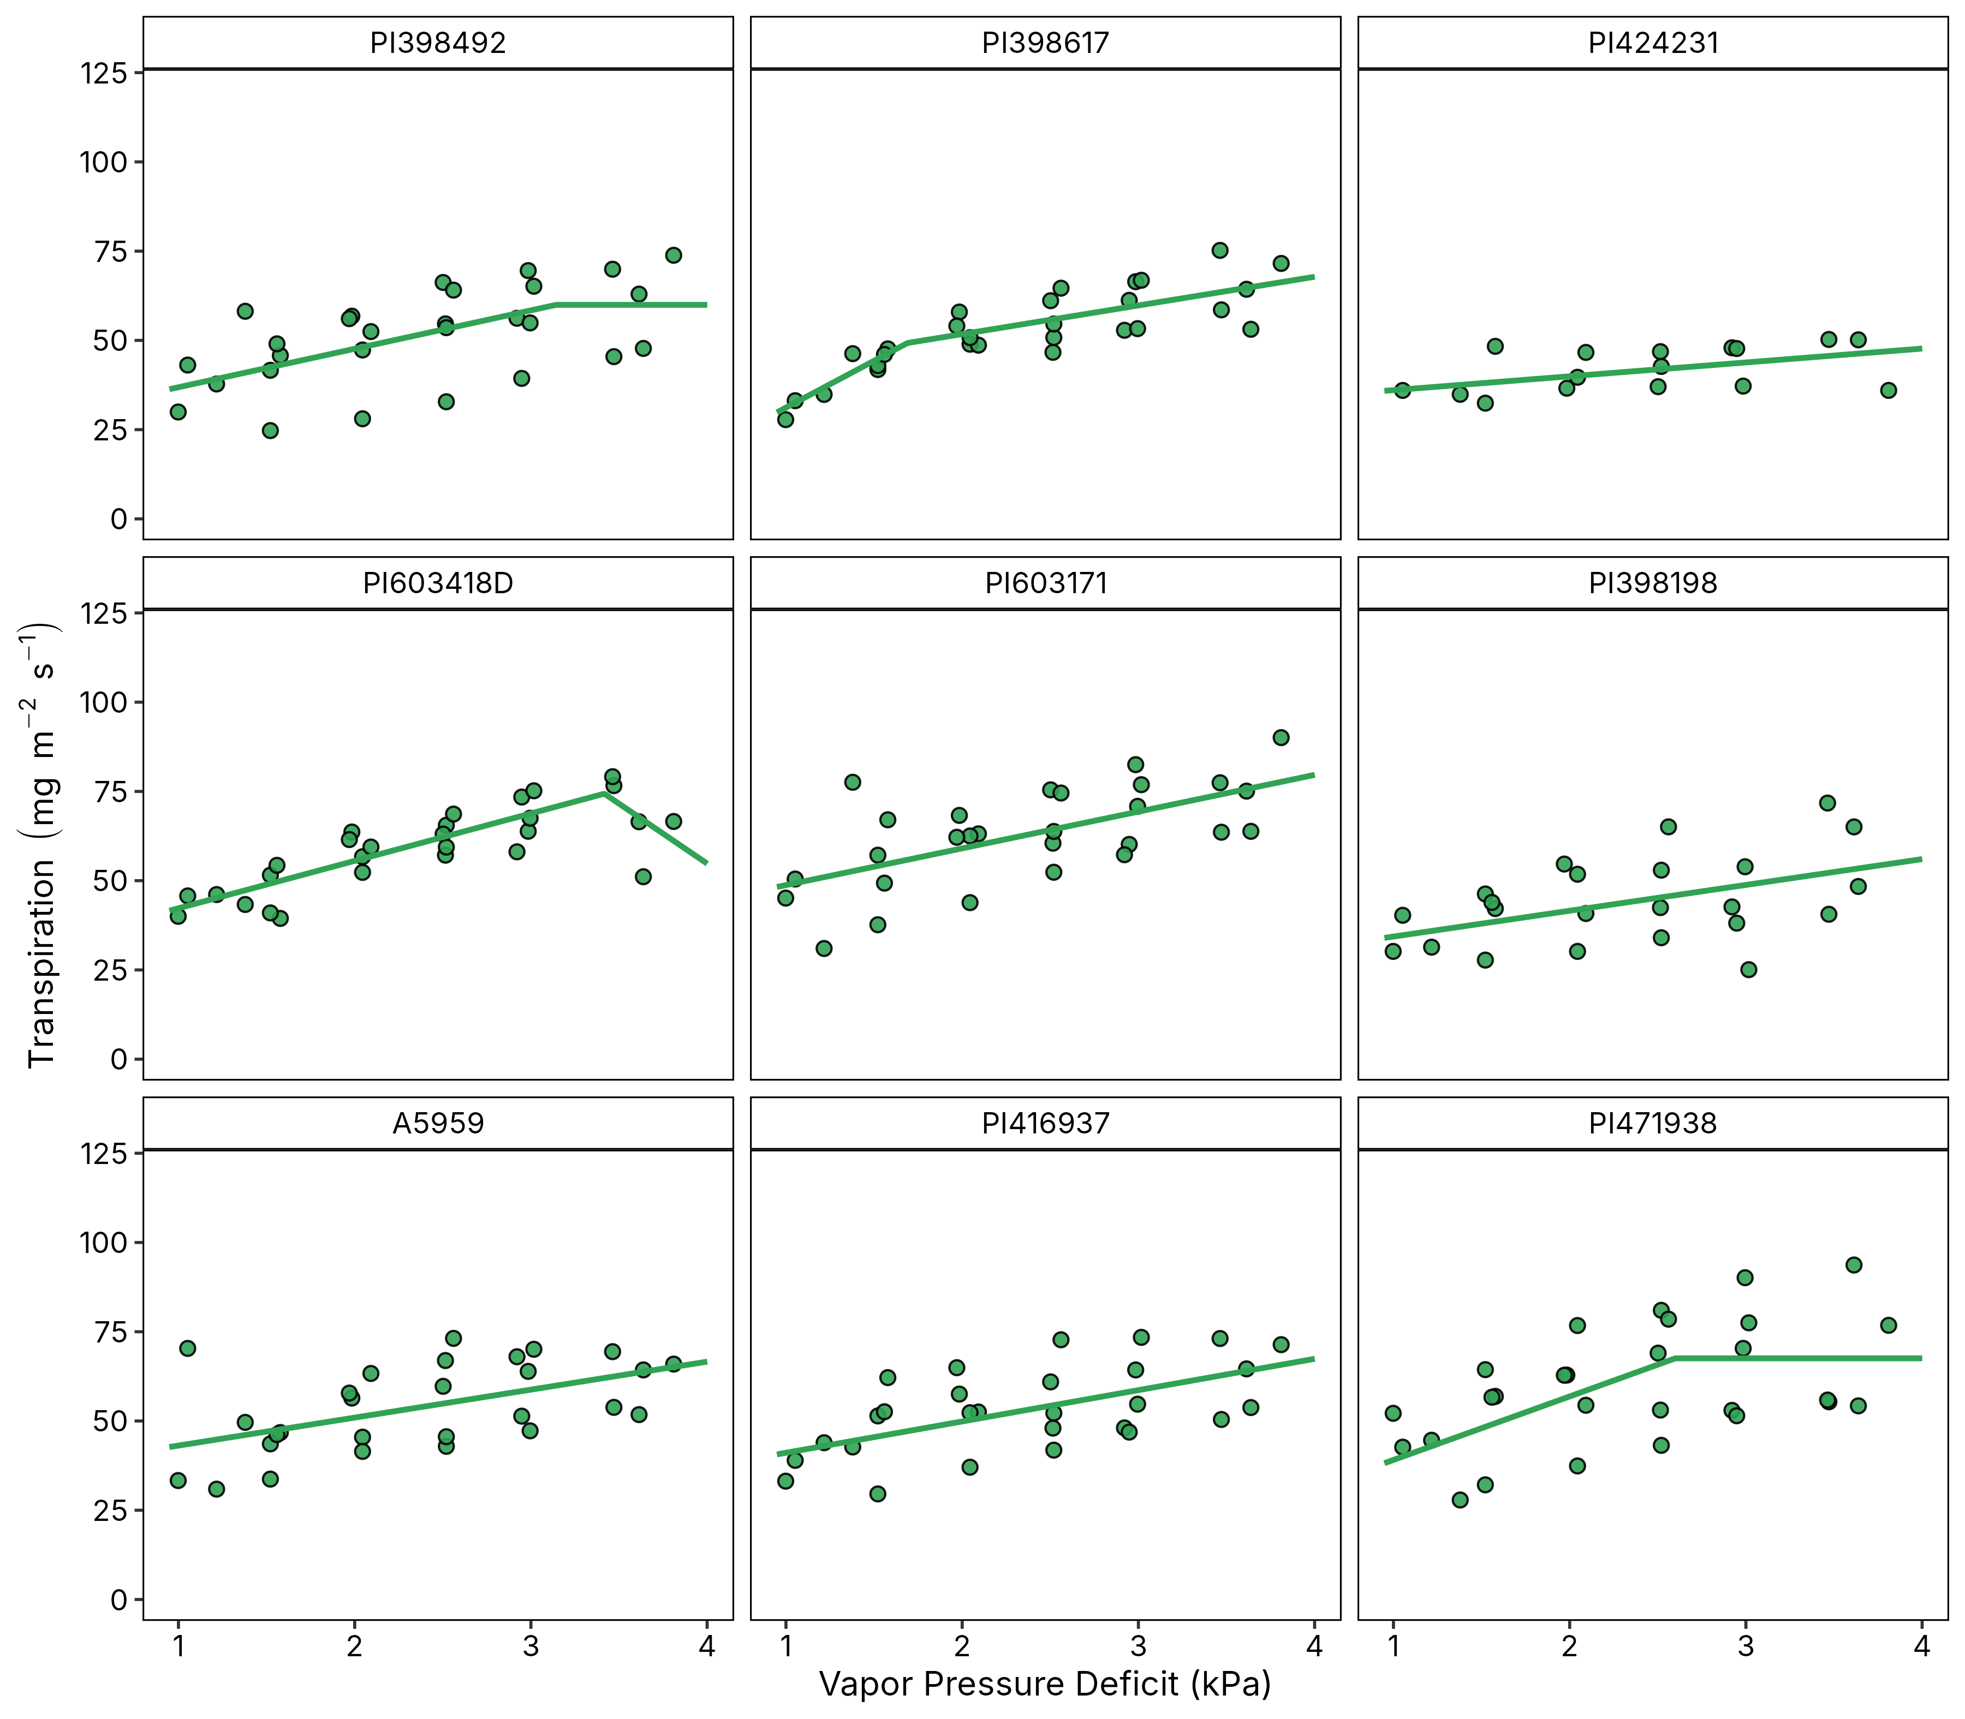
Diverging transpiration responses to VPD across accessions
4 of 9 limit transpiration
A linear-plateau or bilinear model beats the linear model above a VPD breakpoint
Checks mostly behave as expected
Slow-wilting PI471938 plateaus at 2.6 kPa; A5959 keeps increasing; PI416937 shows no breakpoint
Plasticity is an imperfect guide
3 of 4 high-plasticity accessions respond (PI398492, PI398617, PI603418D); PI424231 does not
Plant-level transpiration under increasing VPD, Day 1 of each run, accessions with at least 3 replications; lines are the AIC-selected mixed model

Slide 11
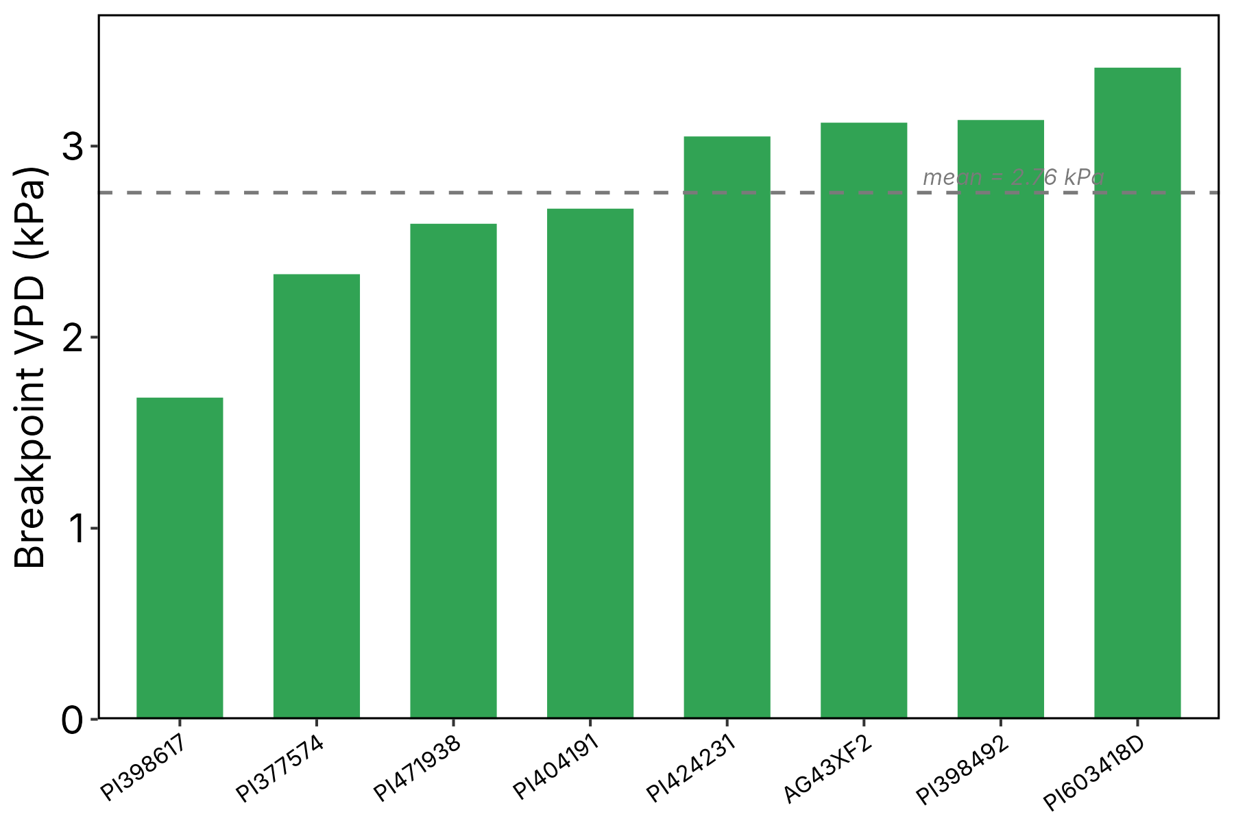
Limited transpiration emerges between 1.7 and 3.4 kPa
8 of 14
accessions showed a nonlinear TR response (57%)
4 of 5
of the plastic / high WUE accessions are among them
2.76 kPa
mean breakpoint across the eight accessions
Early closers
PI398617 (1.69 kPa) restricts transpiration before typical midday field VPD of 2.0 to 2.5 kPa; PI377574, PI471938 and PI404191 follow between 2.3 and 2.7 kPa
PI603418D only declines at the last step (3.4 kPa)
VPD breakpoint of the eight accessions with a linear-plateau or bilinear response

Slide 12
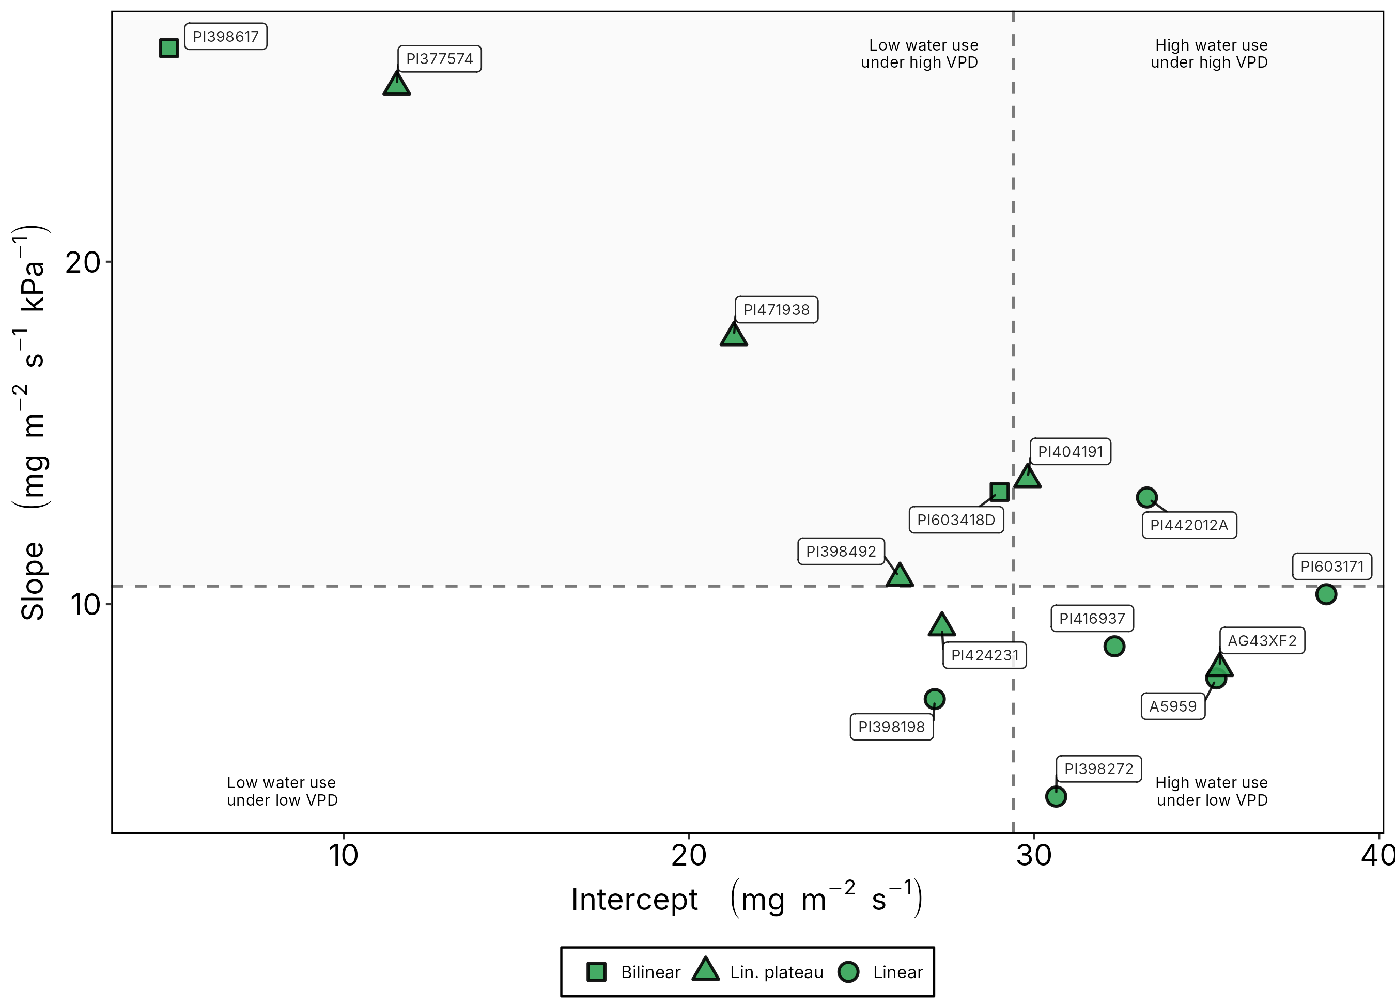
Two routes to low water use under high VPD
Low baseline, strong response
PI398617 and PI377574: intercept below 12 and slope above 25 mg m⁻² s⁻¹ kPa⁻¹, with early breakpoints
Slow-wilting check PI471938
Sits in the low-intercept / high-sensitivity quadrant and plateaus at 2.6 kPa
Plasticity class is not enough
The five plastic / high WUE accessions spread across three quadrants
Initial slope vs intercept of the TR response; dashed lines are the medians

Slide 13
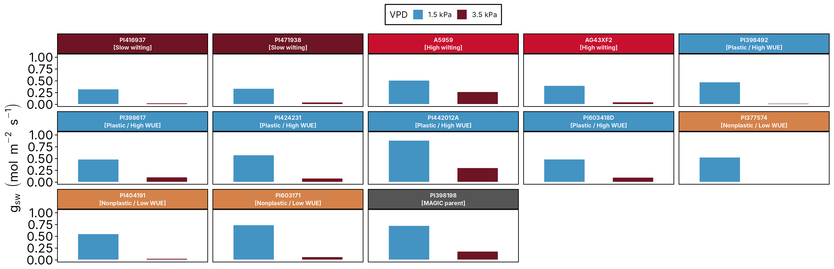
Stomata close in every genotype, but transpiration does not
Predicted stomatal conductance (gsw) at 1.5 and 3.5 kPa for the 13 accessions measured with a porometer
−47% to −100%
decline in gsw from 1.5 to 3.5 kPa, in all 13 accessions
6 of 14
accessions still increased transpiration linearly up to 3.5 kPa
Beyond the stomata
At high demand, transpiration follows the vapor pressure gradient and boundary layer, not aperture alone

Slide 14
Candidate LT accessions identified
Accession | WUE class (Chamarthi et al., 2022) | Breakpoint (kPa) | Response
PI398617 | Plastic / high WUE | 1.69 | Bilinear
PI377574 | Nonplastic / low WUE | 2.34 | Plateau
PI471938 | Slow-wilting check | 2.60 | Plateau
PI404191 | Nonplastic / low WUE | 2.68 | Plateau
PI424231 | Plastic / high WUE | 3.06 | Plateau
AG43XF2 | High-wilting check | 3.13 | Plateau
PI398492 | Plastic / high WUE | 3.14 | Plateau
PI603418D | Plastic / high WUE | 3.42 | Decline at 3.4 kPa
8 of 14
accessions limit transpiration under high VPD
4 of 5
plastic / high WUE accessions carry the LT response
1.7 to 3.4 kPa
breakpoint range: a tunable trait, not a switch
Linear up to 3.5 kPa: A5959, PI398198, PI398272, PI416937, PI442012A, PI603171
Take-home
WUE plasticity flags LT candidates, but phenotyping the VPD response is needed to confirm the trait and its threshold

Slide 15
Objectives
Identify genotypes with the LT trait among accessions differing in WUE plasticity
Quantify the yield impact and trade-offs of the LT trait across the US Mid-South and Mid-West

Slide 16
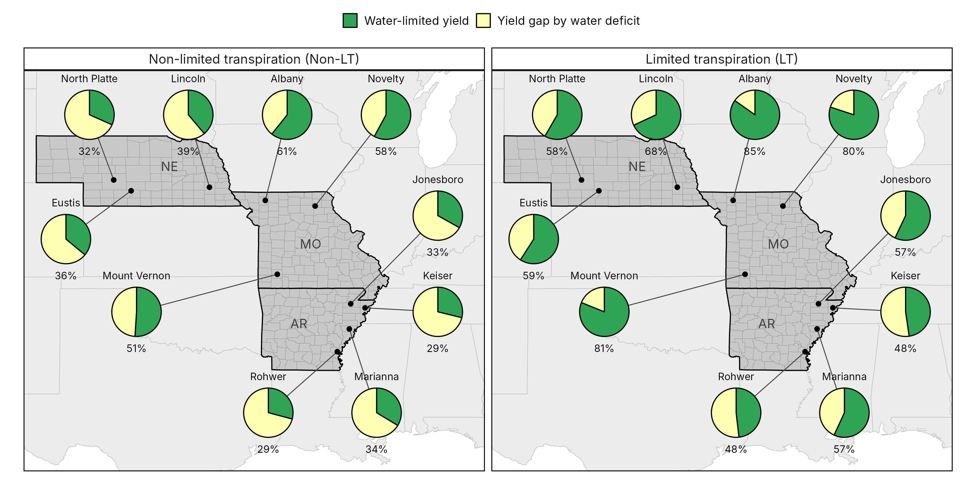
The LT trait narrows the yield gap caused by water deficit
61%
of potential yield lost to water deficit without the LT trait
37%
lost with the LT trait
Largest gains in Missouri and Nebraska; Arkansas sites keep the widest gap even with the LT trait
Water-limited yield (green) and yield gap by water deficit (yellow) as shares of potential yield at 10 sites, 30 weather-years x 3 sowing dates each; labels give the water-limited share

Slide 17
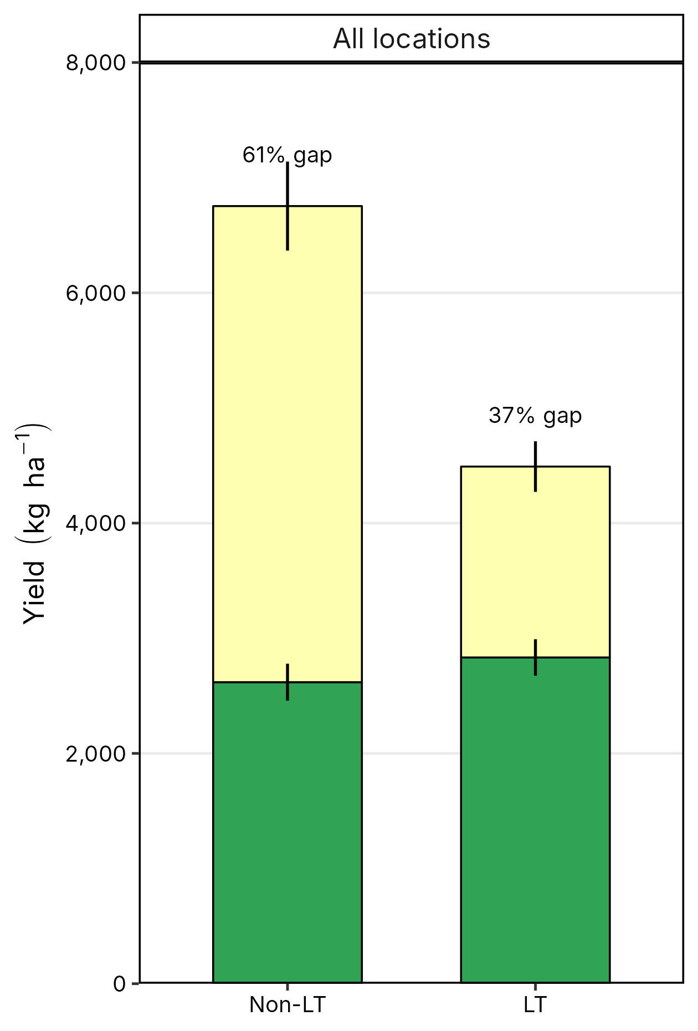
The trade-off: yield potential for water-limited yield
+8%
water-limited yield with the LT trait
+50%
potential yield without the LT trait
Where it pays
Rainfed fields and dry years: conserved soil water carries the crop through seed filling
Where it costs
Irrigated or wet seasons: restricted transpiration caps carbon gain and yield potential
Mean attainable yield (green) plus yield gap by water deficit (yellow) across 10 locations; error bars are SE among sites

Slide 18
Conclusions
Transpiration restriction under high VPD partly explains the WUE plasticity inferred from carbon isotopes (Chamarthi et al., 2022)
Most high-plasticity accessions limited transpiration, with breakpoints from 1.7 to 3.4 kPa
Not all plastic accessions showed the response: other water-conservation mechanisms also shape WUE plasticity
The LT trait trades yield potential for water-limited yield: +8% under deficit and a yield gap cut from 61% to 37% across 10 sites

Slide 19
Next steps
Field testing
Diurnal stomatal conductance of LT candidates under field temperature and humidity, Arkansas 2026-2027
Breeding donors
PI398617 and PI377574 as sources of an early, strong LT response for MG IV backgrounds
Model the threshold
Genotype-specific breakpoints in SSM to map where, and in which seasons, the LT trait pays off

Slide 20
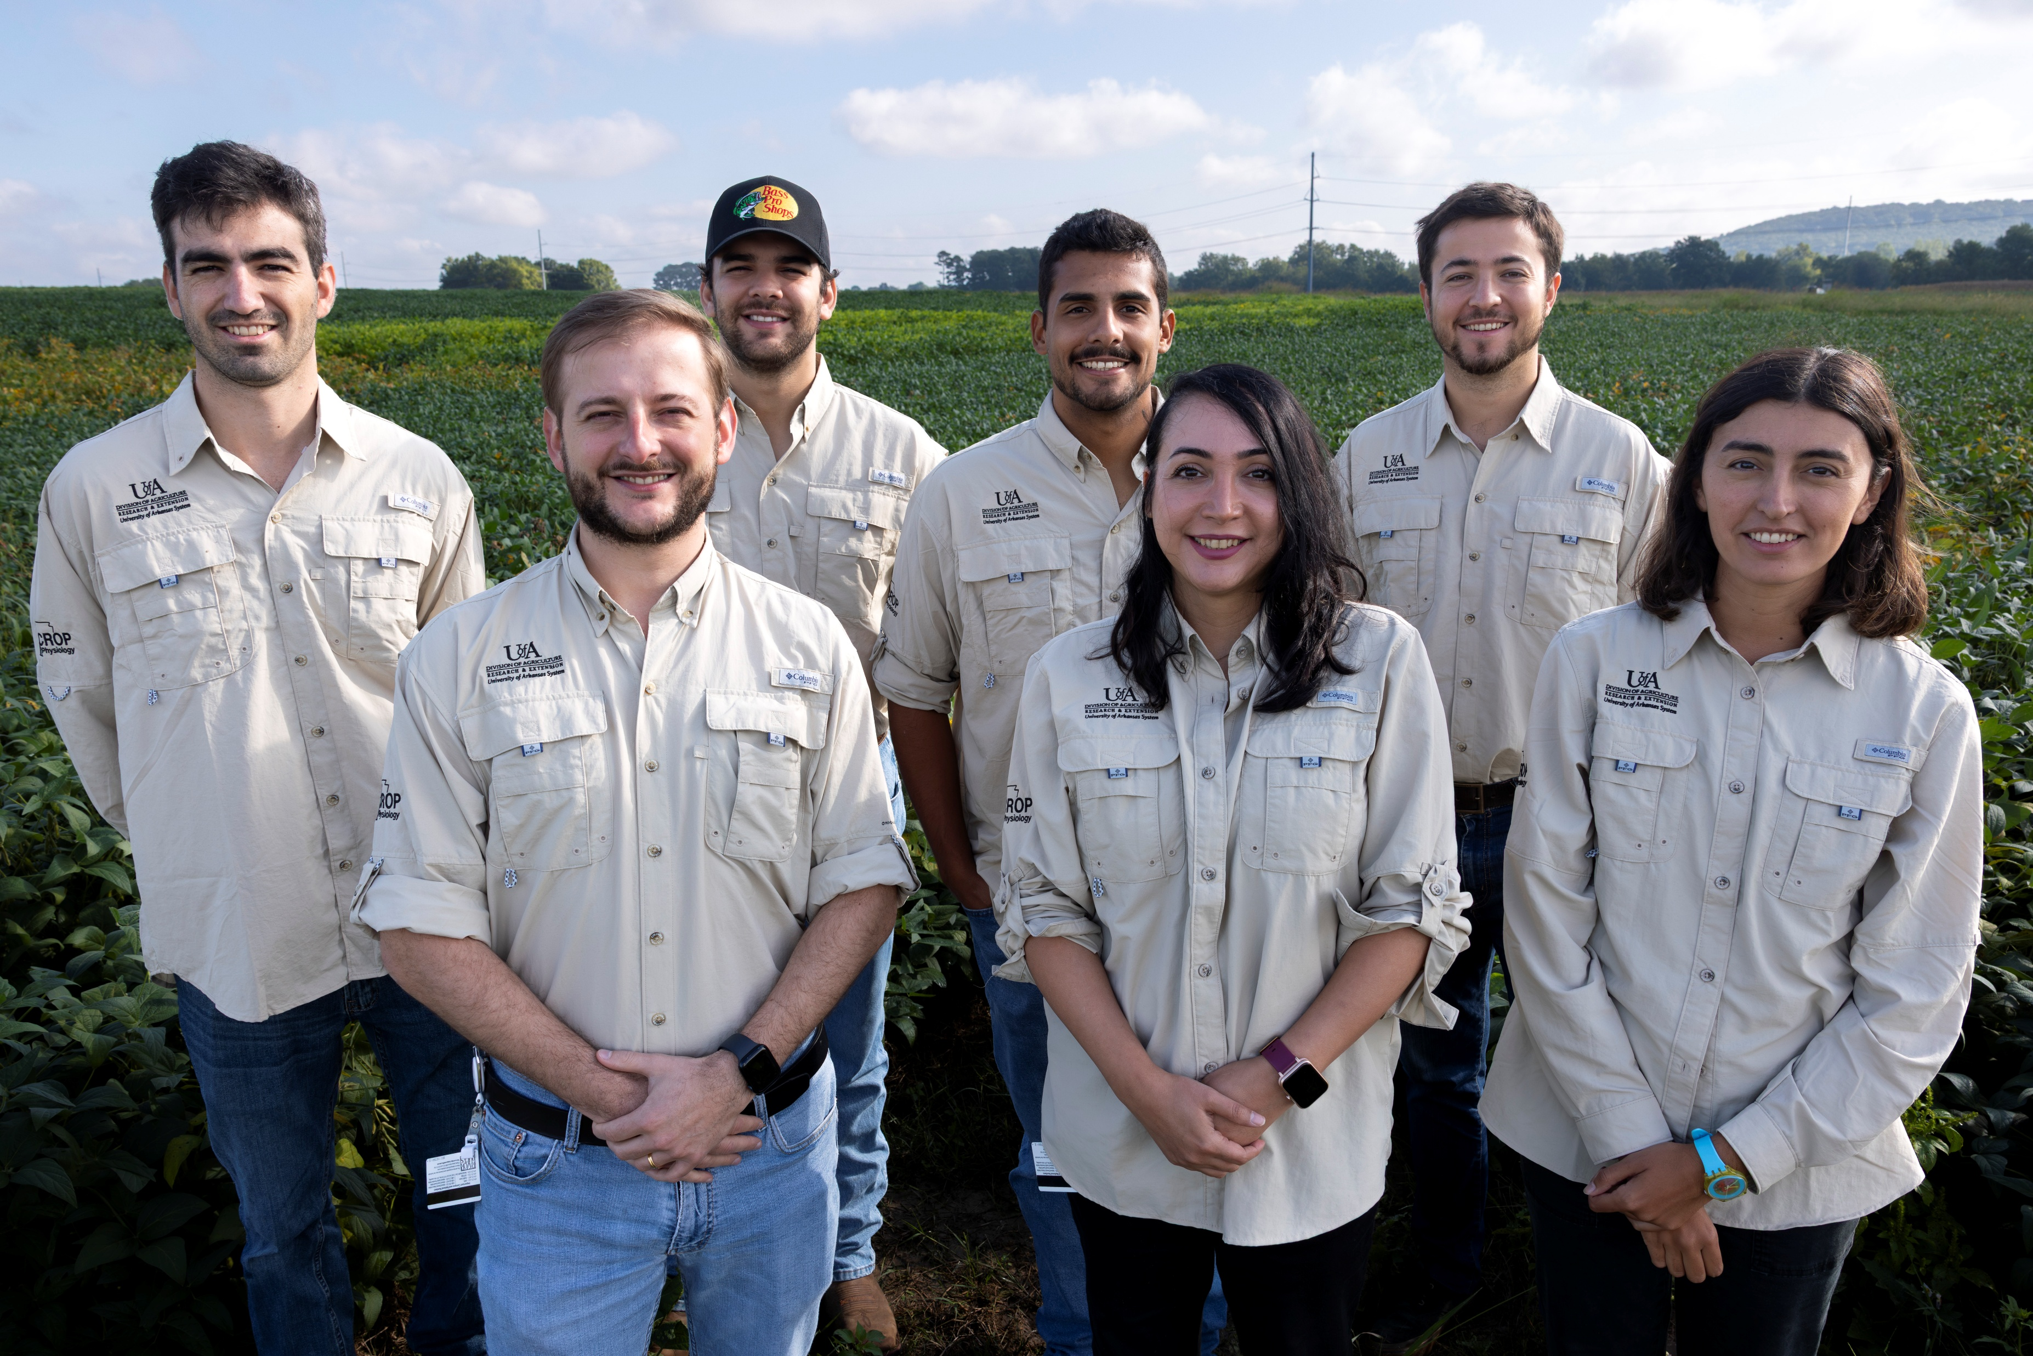


Slide 21
Thank you!!!
Impact of the limited transpiration trait on soybean potential and water-limited yield
Elvis Elli
Assistant Professor
University of Arkansas System Division of Agriculture
Department of Crop, Soil, and Environmental Sciences
eelli@uark.edu

