Slide 1
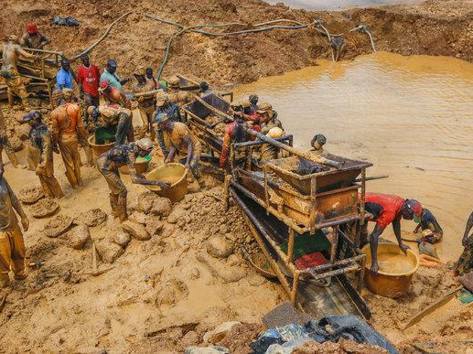
GALAMSEY IMPACT ON WATER POLLUTION
Using Data to Expose Environmental Damage and Inform Action

Slide 2
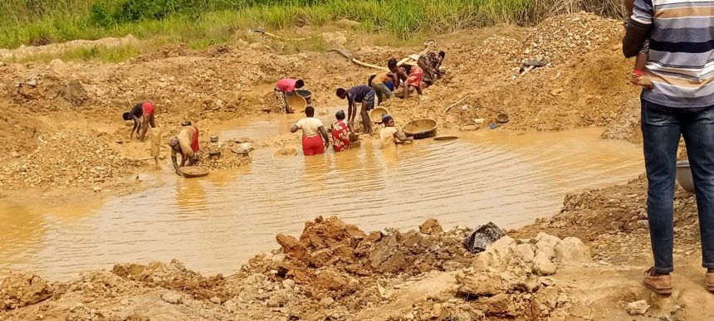
Introduction
This project investigates the impact of illegal mining (galamsey) on water bodies in Ghana.
By analyzing river water samples from galamsey-affected regions, the project uncovers serious health and environmental risks caused by heavy metal contamination and poor water quality.

Slide 3

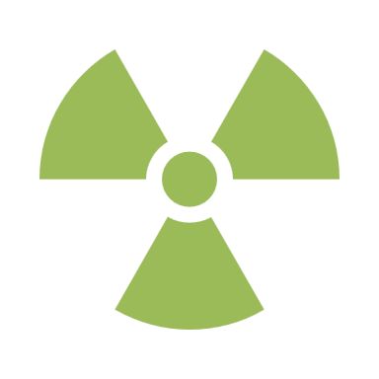



Key Water Quality Indicators
pH: Indicates water acidity (ideal range: 6.5–8.5)
Heavy Metals: Arsenic (As), Cadmium (Cd), Chromium (Cr), Lead (Pb)
TDS (Total Dissolved Solids): Measures mineral content
Conductivity: Indicates ionic concentration
Water Hardness: Levels of Calcium and Magnesium

Slide 4
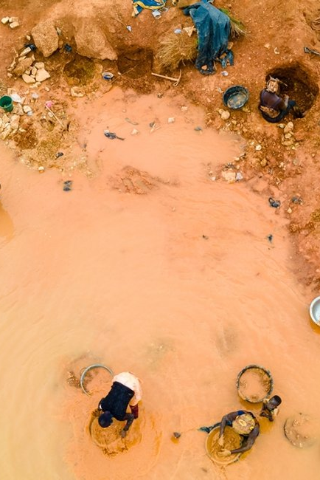
Dashboard Walk Through
Software Used: Microsoft Power BI
Dashboard breakdown
WATER POLLUTANTS DASHBOARD
STANDARDS COMPARISON DASHBOARD
WATER QUALITY DASHBOARD
GALAMSEY IMPACT DASHBOARD

Slide 5




Findings: Galamsey Pit Sample
Extremely low pH (3.21), highly acidic and unsafe
Arsenic: 3.56 mg/L | Chromium: 3.35 mg/L | Lead: 1.15 mg/L | Cadmium: 0.01 mg/L
All values exceed WHO safe limits for drinking water
Indicates severe chemical leaching from illegal mining

Slide 6




Widespread Pollution Across Rivers
Multiple rivers downstream from galamsey zones show:
Acidic pH values (as low as 5.25)
High TDS and conductivity levels
Unsafe concentrations of heavy metals
Indicates large-scale environmental impact

Slide 7
Call to Action
This visualization is more than data—it is a call to action:
Empower communities to monitor their water
Advocate for enforcement of mining regulations
Promote ecological restoration of damaged river systems
Support sustainable alternatives to illegal mining

Slide 8
Acknowledgments
Prepared by: Elvis Kwabena Asare Nkrumah
For: Galamsey Data Visualization Hackathon 2025
Organized by: Open Data Bank Ghana

