Slide 2


Slide 3


Slide 4

Fearless has two souls working together

Slide 5
Fearless has two souls working together
Object oriented
Functional
You need to understand both mindsets to
be effective in fearless.

Slide 6
How to teach Fearless?
To a modern Java expert?
Four hours of details
and you are ready to go.
There is more old stuff to forget than new stuff to learn.
To someone new to programming?
No idea, just to write basic things you need to connect all the features at the same time!

Slide 7
booleans slide here

Slide 8
Embedded DSL
A library define terms and how to combine them. It is a language nested inside the programming language.
An Embedded Domain Specific Language is a library embracing this idea.
Code using this library looks like is using a different language, with different rules and conventions.
Example: Java streams
Languages with minimal / flexible syntax are great for EDSLs

Slide 9

Find the tallest!
TallestPerson:Comparator[Person]{p1,p2->
NumComparator.compare(p1.height, p2.height)
}
//Declarative
Find-The-TallestPerson-In-myList
//Declarative/Relational
Query.findThe TallestPerson .in myList
//Functional/Declarative
myList.flow.max TallestPerson .get
//Imperative
Block#
.var res = {myList.get(0)}
.for i = {myList.range}
.do{ res.set(TallestPerson.greater(res#,myList.get(i))) }
.return {res}

Slide 10

Find the tallest!
TallestPerson:Comparator[Person]{p1,p2->
NumComparator.compare(p1.height, p2.height)
}
//Declarative
Find-The-TallestPerson-In-myList
//Declarative/Relational
Query.findThe TallestPerson .in myList
//Functional/Declarative
myList.flow.max TallestPerson .get
//Imperative
Block#
.var res = {myList.get(0)}
.for i = {myList.range}
.do{ res.set(TallestPerson.greater(res#,myList.get(i))) }
.return {res}

Slide 11
Find the tallest!
TallestPerson:Comparator[Person]{p1,p2->
NumComparator.compare(p1.height, p2.height)
}
//Declarative
Find-The-TallestPerson-In-myList
//Declarative/Relational
Query.findThe TallestPerson .in myList
//Functional/Declarative
myList.flow.max TallestPerson .get
//Imperative
Block#
.var res = {myList.get(0)}
.var i={1}
.loop {Block#
.if {i#>myList.size} .break
.do {res.set(TallestPerson.greater(res#,myList.get(i#)))}
.continue}
.return {res}

Slide 12
Embedded DSL in Fearless
flows
block
tests
guis/forms/IQL
regexes
parsing
webAPI <->

Slide 13
Example, some code to test
Fractions: F[Int,Int,Fraction]{num,den -> Fraction: {
.numerator: Int -> num,
.denominator: Int -> den,
.divide: Float -> num.float / (den.float),
.str:Str-> "Fraction["+num+", "+den+"]",
}}

Slide 14
Fluent tests
TestMyApp: TestMain{sys,runner->runner
.withReporter(runner.stdOutPrinter(sys.io))
.test TestStaysPositive: Test{Block#
.do {Assert!(Fractions#(+5, +4).divide > 0.0)}
.do {Assert!(Fractions#(+1, +2).divide > 0.0)}
.done
}
.testLog TestGetsNegative: Test{log->Block#
.let expected= {0.0}
.do {log#{Assert!(Fractions#(+5, -4).divide < expected)}}
.do {log#{Assert!(Fractions#(+1, -2).divide < expected)}}
.done
}
.test TestStrRepr: Test{Block#
.do{"Fraction[+5,+4]".assertEq(Fractions#(+5, +4).str)}
.done
}
.testSuite MoreTestFractions
}

Slide 15
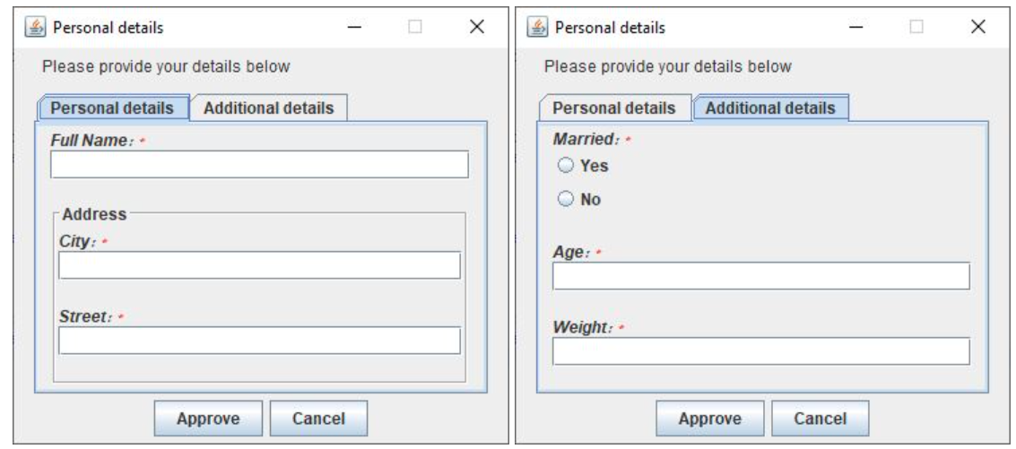
Fluent API Forms
Iql
.title "Personal details"
.single "Please provide your details below"
.tab("Personal details",
Iql.entry("name", "Full Name:", "String"),
Iql.group("Address",
Iql.entry("city", "City:", "String"),
Iql.entry("street", "Street:", "String")
)
)
.tab("Additional details",
Iql.entry("married", "Married:", "Boolean"),
Iql.entry("age", "Age:", "Integer"),
Iql.entry("weight", "Weight:", "Decimal")
)
.queryUser(system)//--> gives a flow of Map[String,Data]

Slide 16
Fluent API Forms
Iql
.title "Personal details"
.single "Please provide your details below"
.tab "Personal details"
.entry("name", "Full Name:", "String")
.group "Address"
.entry("city", "City:", "String"),
.entry("street", "Street:", "String")
!
!
.tab "Additional details"
.entry("married", "Married:", "Boolean")
.entry("age", "Age:", "Integer")
.entry("weight", "Weight:", "Decimal")
!
.queryUser(system)//--> gives a flow of Map[String,Data]

Slide 17
Fluent API Forms
Iql
.title "Personal details"
.single "Please provide your details below"
.tab{::#"Personal details"
.entry("name", "Full Name:", "String")
.group{::#"Address"
.entry("city", "City:", "String"),
.entry("street", "Street:", "String")
}
}
.tab{::#"Additional details"
.entry("married", "Married:", "Boolean")
.entry("age", "Age:", "Integer")
.entry("weight", "Weight:", "Decimal")
}
.queryUser(system)//--> gives a flow of Map[String,Data]

Slide 18
Readable API for regexes
.let r = Regex
.let stringLit = r.sequence(
r.chars"\"",
r.any( //.any is *, .many is +, .optional is ?
r.alternative(
r.anyCharExcept("\"", "\\"),
r.sequence(
r.chars"\\",
r.alternativeStrings("\"", "\\", "n", "t")
)
)
),
r.chars"\""
)
equivalent to the unreadable "(?:[^"\\]|\\["\\nt])*"

Slide 19

A good API is a wall separating simplicity from thorny complexity

Slide 20
Parsing with Flows
App:Main{ sys -> Block#
.let io = {sys.io}
.let ns = {"123\n678\n"}
.let parsed = {Tokenize#(ns)}
.return {io.println(parsed.flow#(Flow.str "; "))}
} //prints 123; 678
Tokenize:{#(str: Str): List[Str] -> str.flow
.actor[mut Str, Str](iso"", {downstream, state, current -> Block#
.if {current != "\n"}
.return {Block#( state.add(current), ActorRes.continue)}
.do {downstream#(state.str)}
.do {state.clear}
.return {ActorRes.continue}
})
.list
}

