Slide 1


Slide 2
Marco Servetto
Victoria University of Wellington
New Zealand
My Teaching Journey.
How I tech challenging concepts

Slide 3
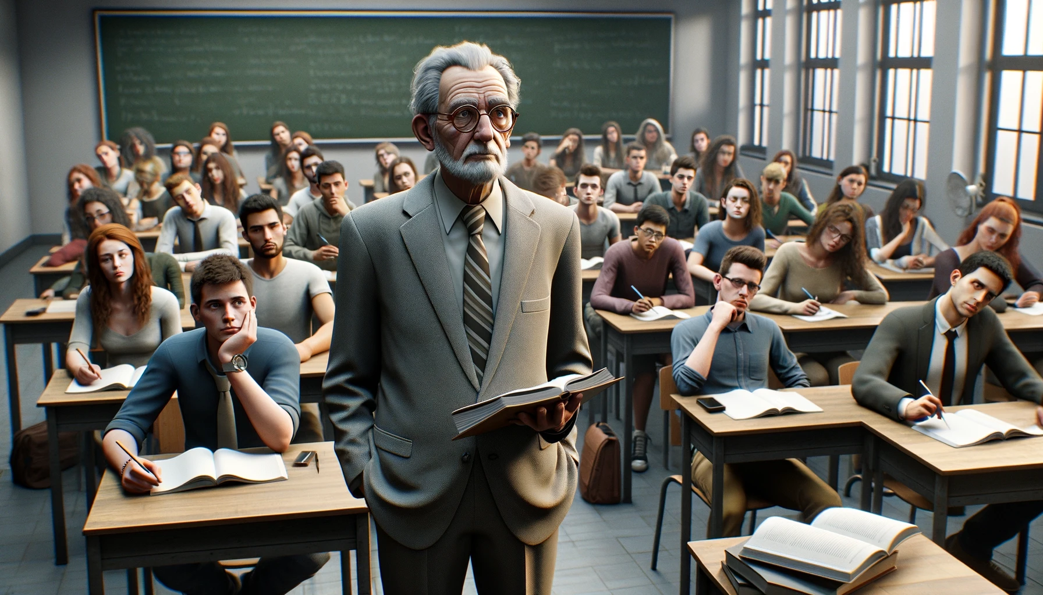
When I started teaching my lectures
were boring and near standard…
Then I learned to use images
(Examples coming soon)

Slide 4
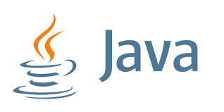

Slide 5
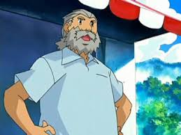
Java is now an old language(1996)

Slide 6
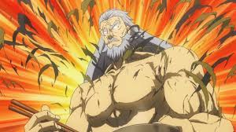
But, recently…..
(after training in secret for 20 years)

Slide 7
Java: now a modern language!
Now with
  Records,
  Interfaces with default methods
  Lambdas
We will use those features very intensively in this course!
We will use ‘class’ more rarely.

Slide 8
Hint!
When searching for Java examples, Java documentation or Java help
  Never search for “Java”
  you will get the old stuff.
  Search for “Java 21”, “Java 22”
  or “Java 2024” to get good stuff!

Slide 9
Hint!
When searching for Java examples, Java documentation or Java help
  Never search for “Java”
  you will get the old stuff.
  Search for “Java 21”, “Java 22”
  or “Java 2024” to get good stuff!
I tried to introduce memorable images
and to reuse them to recall a concept.
But I was limited by the images I could
find online. This has now changed..

Slide 10
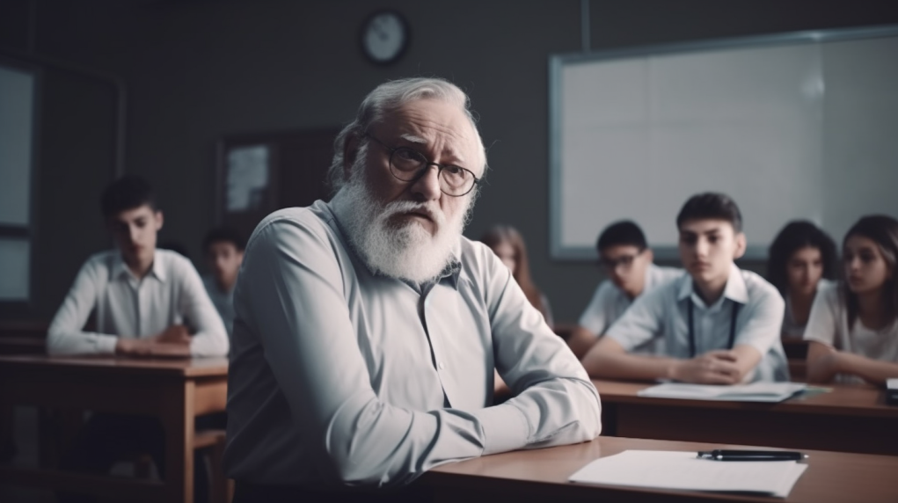
This made my slides a little more fun,
but I was still talking about technical concepts
in complete precision and dept.
That is, boring and difficoult.

Slide 11

I have tried to use images
that capture attention in a
humorous yet accurate way,
ideally featuring famous and
memorable characters…
Unfortunately, I am an old
Italian teaching in New Zealand

Slide 12
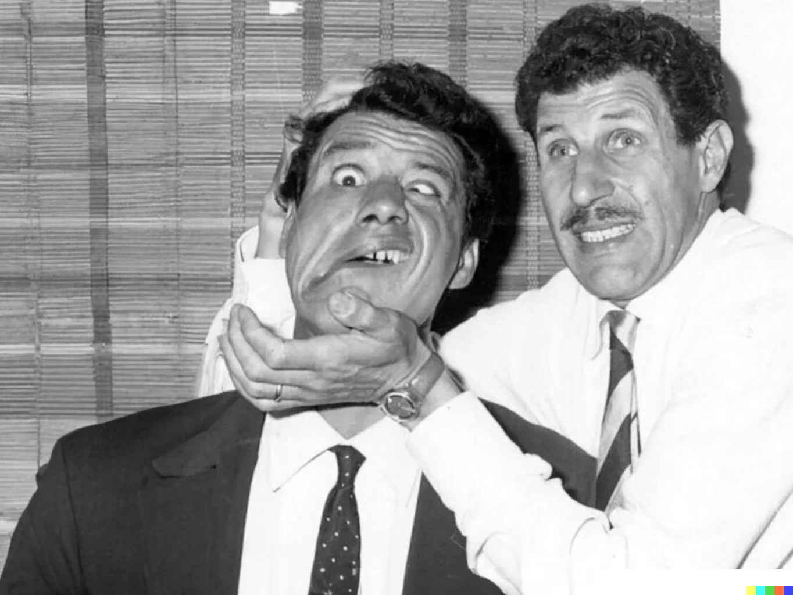
Overloading
Overriding
The two brothers

Slide 13
Overloading
Overriding
It is a good member of society.
Can do professional work.
People want to work with him.
It gets often confused with his brother.

Slide 14
Overloading
Very eager to act and take up some work.
Sadly the results are often unpredictable.
You have to convince him to desist in order to access the better brother.
Overriding
It is a good member of society.
Can do professional work.
People want to work with him.
It gets often confused with his brother.

Slide 15
Overloading
It is easy to accidentally assign work to the wrong brother
Very eager to act and take up some work.
Sadly the results are often unpredictable.
You have to convince him to desist in order to access the better brother.
Overriding
It is a good member of society.
Can do professional work.
People want to work with him.
It gets often confused with his brother.

Slide 16
Java exceptions and
Norse mythology
Sometimes my metaphors
are of great success

Slide 17
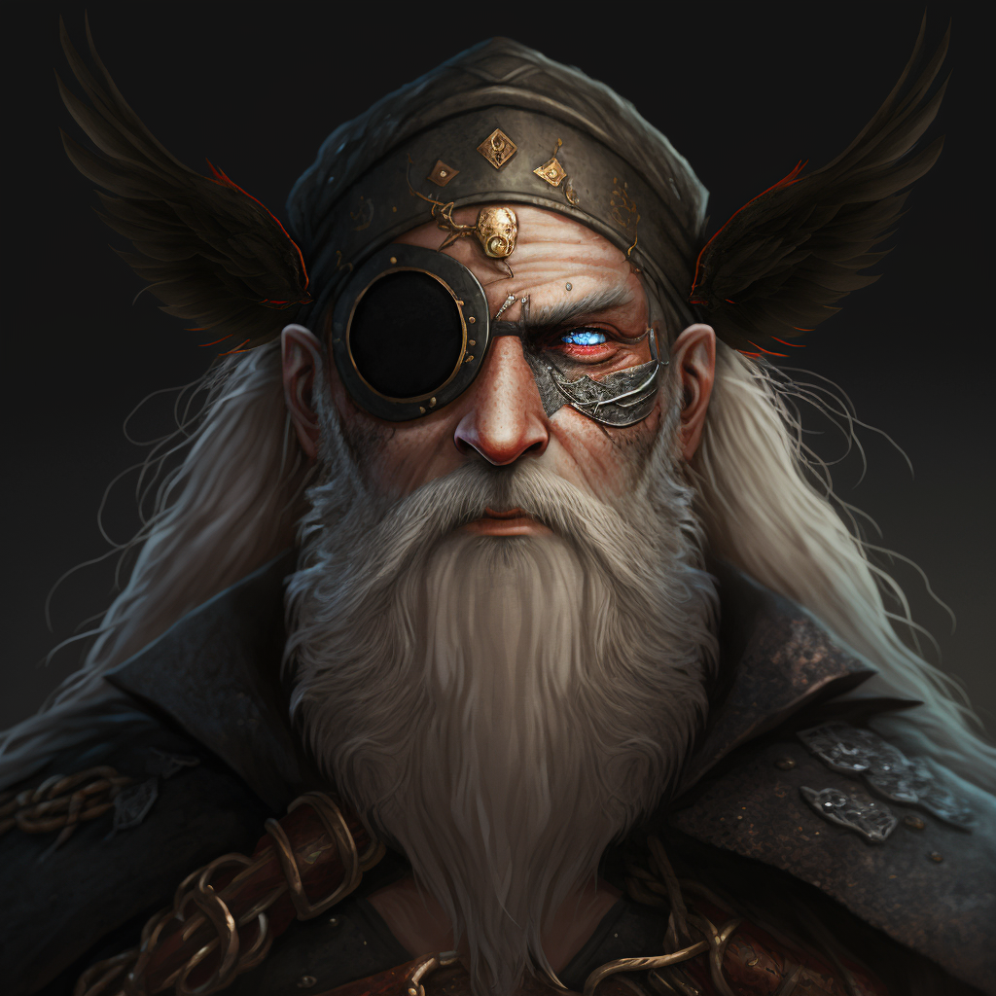
Java exceptions and
Norse mythology
Odin.
The father of all gods.
Throwable
The father of all kinds of exceptions.
It is very rare to do
new Throwable(..).
Sometime used as a type.
Quite rare to do catch(Throwable t){..}

Slide 18
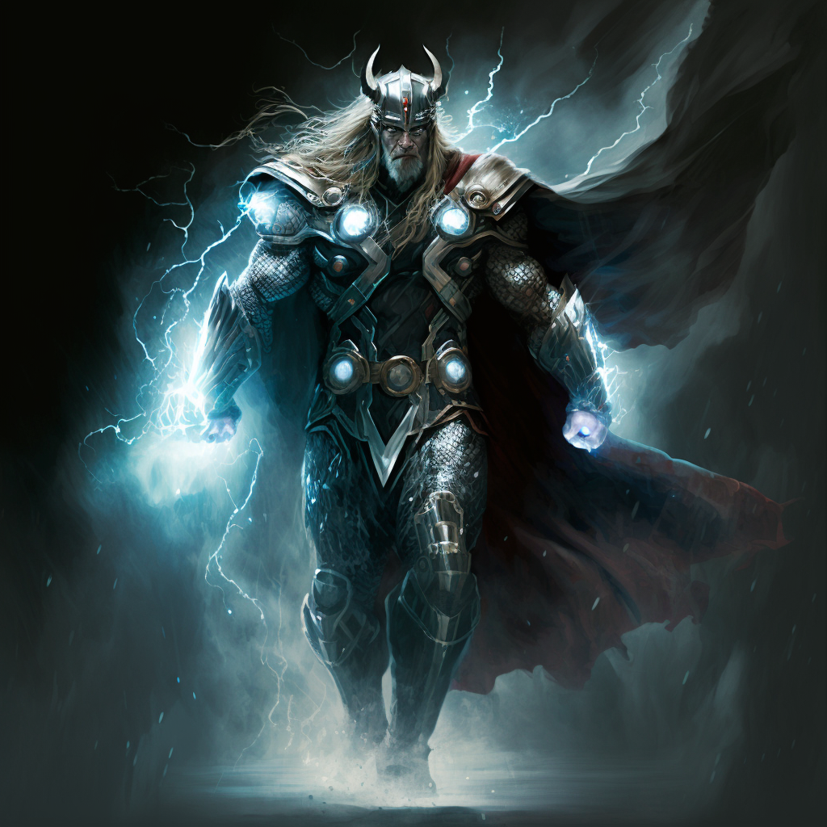
Java exceptions and
Norse mythology
Thor.
The most iconic.
Exception
The most iconic kind of Exception, the first that comes to mind.
Rare to do
new Exception(…)
catch(Exception e){..}
is often overkill

Slide 19
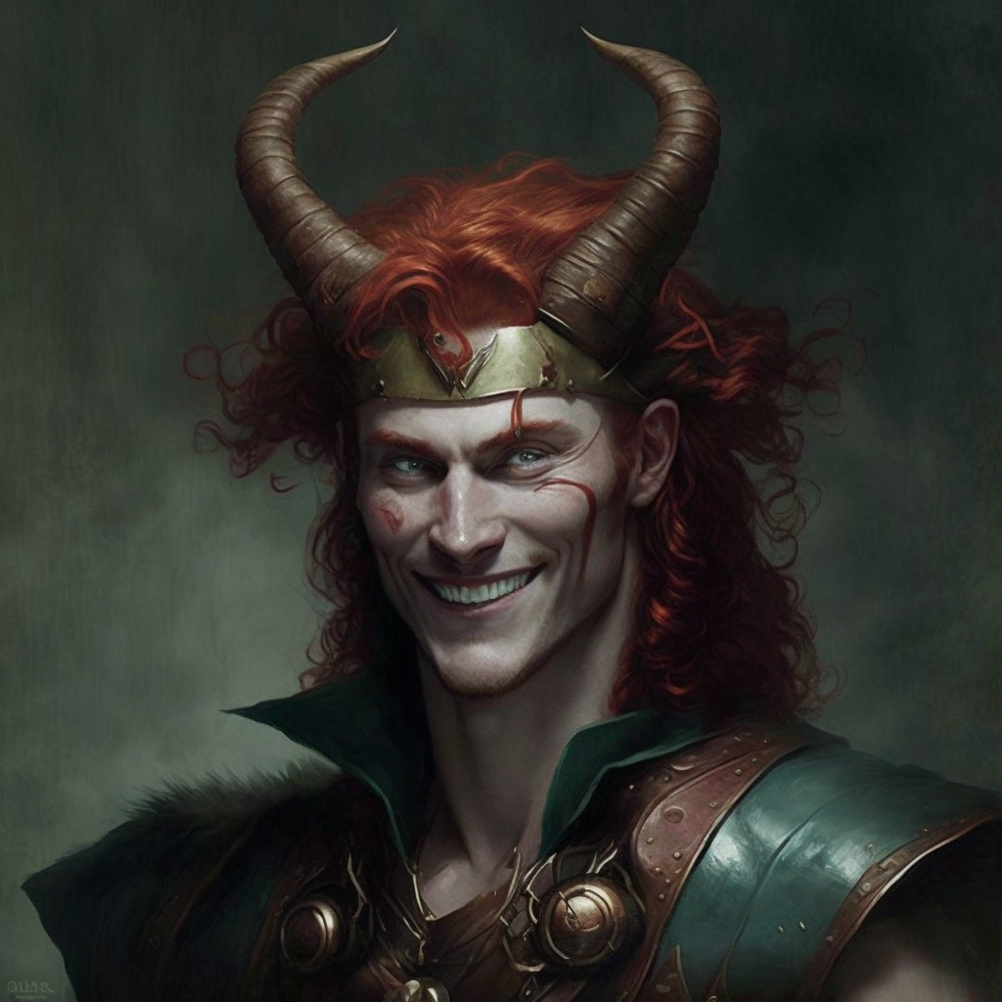
Java exceptions and
Norse mythology
Loki.
The sneaky guy
Error
The one whose name causes the most dread.
Common to do
new Error(e)
catch(Error e){..}
is common in library code

Slide 20

Java exceptions and
Norse mythology
Hoðr.
The good sneaky guy with a tragic past: tricked by Loki to kill Baldr, the god of light.
RuntimeException
Helps us to solve limitations of Java by tunneling errors around the type system.
Common to do
new RuntimeException(e)
catch(RuntimeException e){..}
is common in library code

Slide 21
Throwable
Exception
RuntimeException
Family relationships:
Throwable(Odin) is the father (supertype) of
  Error (Loki) and
  Exception (Thor). Exception is the father of
      RuntimeException (Hoðr)
They all spawn their minions
Error

Slide 22
Throwable
Exception
RuntimeException
Checked
Checked
Unchecked
Checked
Error
Unchecked
Unchecked
Unchecked

Slide 23
Throwable
Exception
RuntimeException
Error
An Error is a subclass of Throwable
that indicates serious problems that a reasonable application should not try to catch. Most such errors are abnormal conditions.
AssertionError, AWTError, CoderMalfunctionError, IOError,
LinkageError, ThreadDeath, VirtualMachineError, ...

Slide 24
Throwable
Exception
RuntimeException
The class Exception and its subclasses are a form of Throwable that indicates conditions that a reasonable application might want to catch.
The class Exception and any subclasses that are not also subclasses of RuntimeException are checked exceptions. Checked exceptions need to be declared in a method or constructor's throws clause if they can be thrown by the execution of the method or constructor and propagate outside the boundary.
Tons of kids:
ExecutionException, FontFormatException, GeneralSecurityException,
InterruptedException, IOException, MarshalException,
MidiUnavailableException, MimeTypeParseException, ParseException,
ReflectiveOperationException, SQLException, TimeoutException,
TooManyListenersException, XMLParseException, ...
Error

Slide 25
Throwable
Exception
RuntimeException
RuntimeException is the superclass of those exceptions that can be thrown during the normal operation of the Java Virtual Machine.
RuntimeException and its subclasses are unchecked exceptions. Unchecked exceptions do not need to be declared in a method or constructor's throws clause
Tons of kids. Those are actually useful/relevant
ArithmeticException, ArrayStoreException,ClassCastException,
CompletionException, ConcurrentModificationException,
EnumConstantNotPresentException,
IllegalArgumentException, IndexOutOfBoundsException,
NegativeArraySizeException, NoSuchElementException, NullPointerException,
SecurityException, UnmodifiableSetException, UnsupportedOperationException,
Error

Slide 26
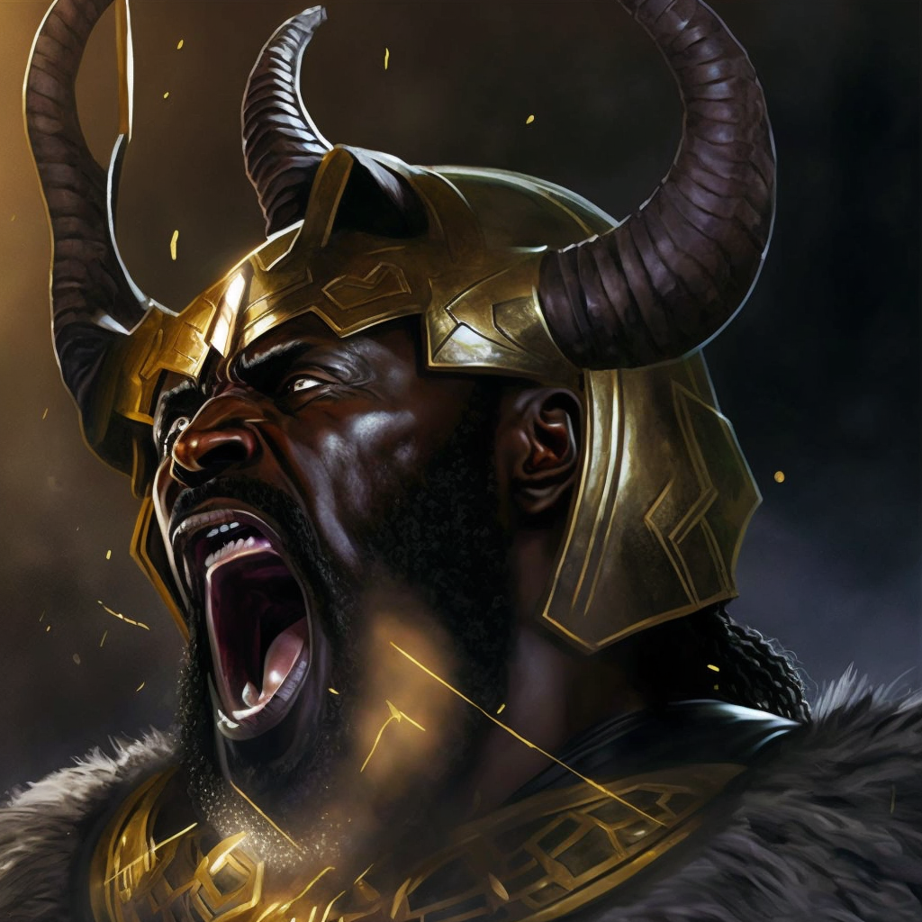
More metaphors: catch something
If the hero is too weak, the monster will win and the hero will be defeated.
However, with the ‘finally’ block, the hero can say their last words!
No matter if they win or lose, they will say those words before the stack unwinds away from them, sending them back into oblivion.
Defend the
main loop!

Slide 27
I started to even add
some music and performance

Slide 28
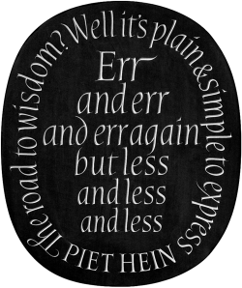
Automated testing -- Why is good
Don Knuth: this is the story of my life
[...]
Birds don't just fly
They fall down and get up
Nobody learns without getting it won
[...]
I wanna try everything
I wanna try even though I could fail
I'll keep on making those new mistakes
I'll keep on making them every day
Those new mistakes
Oh oh, try everything
Shakira - Try Everything
https://www.youtube.com/watch?v=c6rP-YP4c5I

Slide 29
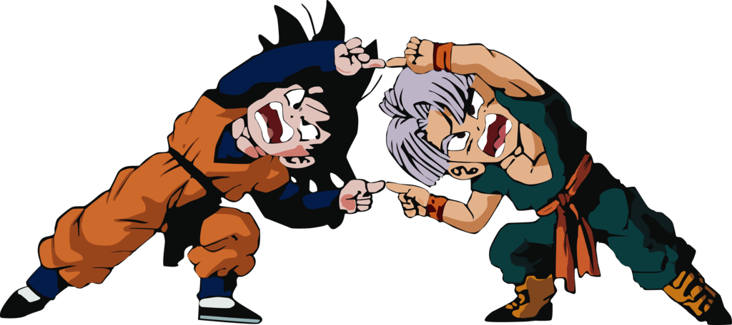
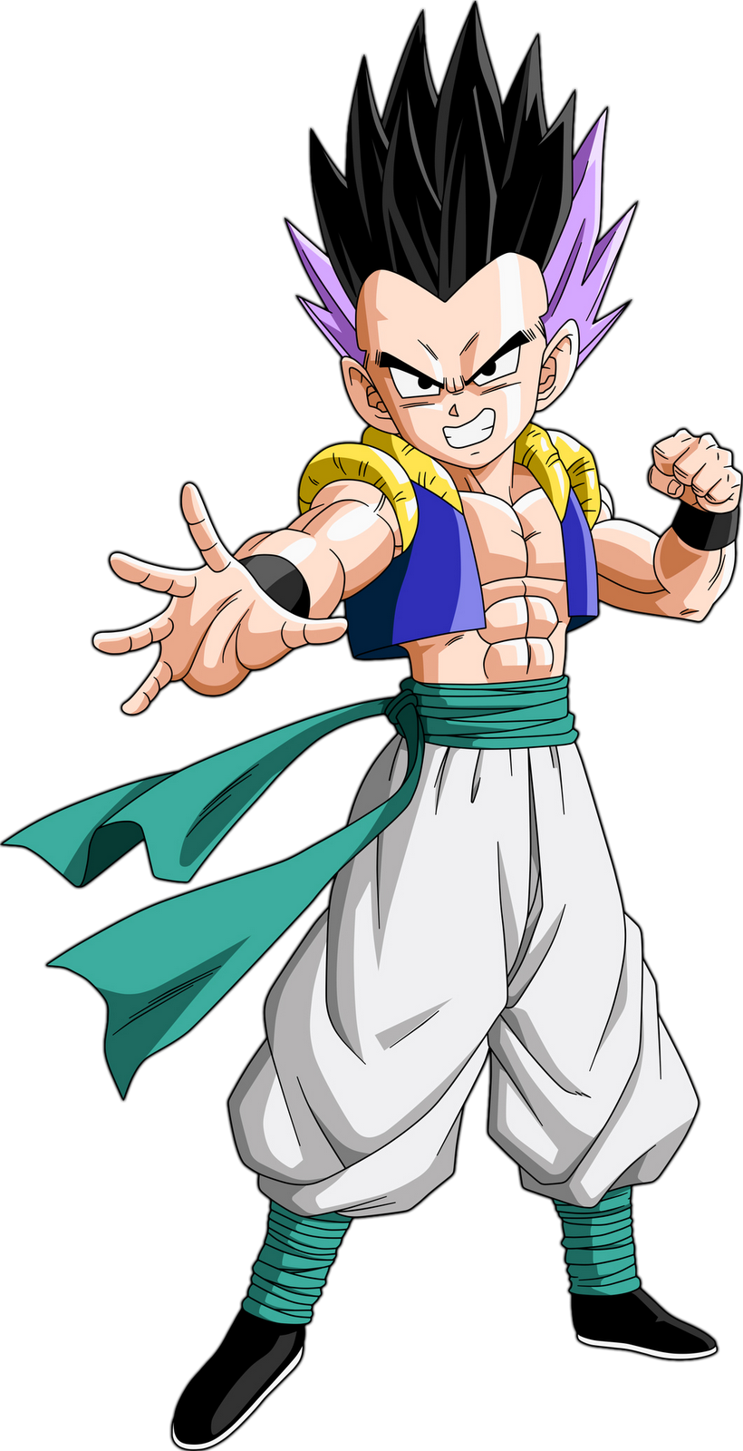
Multiple inheritance https://www.youtube.com/watch?v=8cpyejx506o
Gohan
Trunks
Goten
From Java8, this is now possible!
  A class cannot have more than one superclass
    Other languages (e.g. C++) support this
  But, a class can implement more than one interface
  Interfaces can now have reusable implementation!
class Goten extends Gohan, Trunks { … }
class Goten implements Gohan, Trunks { … }

Slide 30
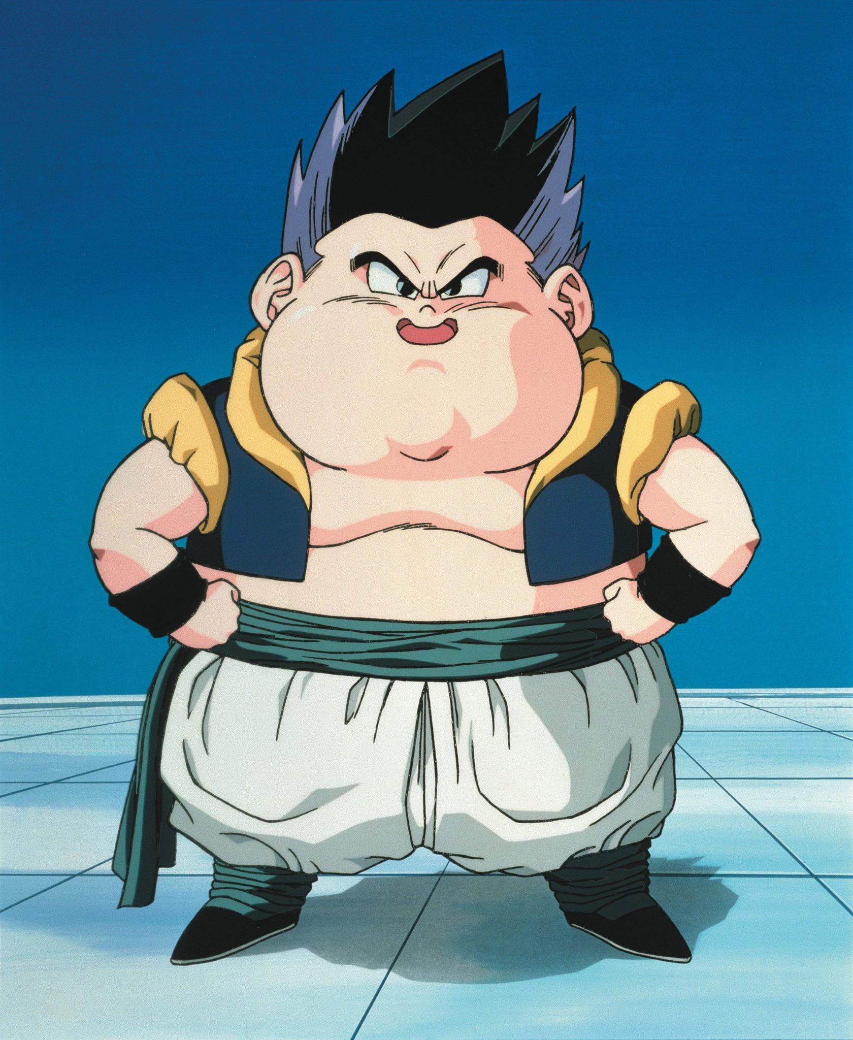
Risk of multiple inheritance: we may end up with too much stuff,
A class that is too fat.
(violating the single
responsibility principle)
To avoid this, we need to make the interfaces used to modularize our behaviour as slim as possible

Slide 31
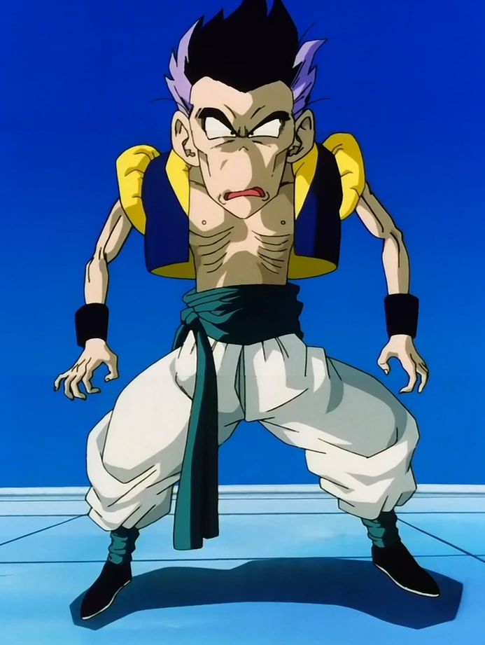
To avoid this, we need to make the interfaces used to modularize our behaviour as slim as possible
We can have many different interfaces, sometimes with just a single default method (and the private methods that it uses internally)
The other methods will be abstract and defined in other interfaces.

Slide 32
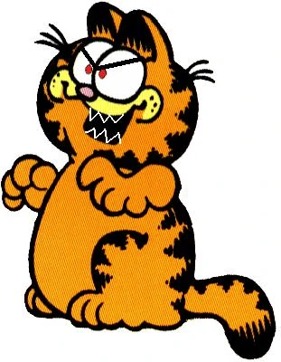
Property testing
Too many images can be distracting,
Sometimes a single small image
can have a better impact
Instead of just testing that an operation on a specific input does exactly what we expect, we can generate some input and check for general properties, for example with minIndex we could generate random sequences of numbers and test that the number at the resulting input is indeed smaller than all the other ones.
Watch: https://www.youtube.com/watch?v=IYzDFHx6QPY
“The lazy programmer's guide to writing thousands of tests”
- Scott Wlaschin
This talk is also known as “The enterprise developer from hell”

Slide 33
At this point, my lectures are no longer boring!
However, I still discuss technical concepts in
a serious, comprehensive manner...
That is: challenging and often
beyond my students' immediate reach

Slide 34
Zone of Proximal Development (ZPD) and Constructivism
In VUW, we attend teaching seminars.
Research result:
The most effective learning is often facilitated by more experienced peers, those just 'beyond the limit'. Much of our learning occurs through social interaction, where students interact with peers who are engaged in the same or slightly more advanced stages of learning. These classmates can offer unique insights and explanations, particularly accessible to other students.
Hearing these theories, and recognizing them as true based on my experience, I felt redundant as a teacher. If students learn better from other students, what is my role?

Slide 35
Idea! I pretend to be another student when I teach!
“These classmates can offer unique insights and explanations, particularly accessible to other students”
Why are they more accessible? Because they are FALSE! These explanations contain enough truth to allow students to complete exercises and activities, but they are not always perfectly correct. They are simplified, and often full of misunderstandings that, in the long run, might prove counterproductive. However, in the short term, these ‘imperfect’ explanations work.
If one is willing to refine and correct their knowledge as they go along, then learning the reality through successive approximations might not be a bad idea. Perhaps?

Slide 36

I just.. can not do it.
I can not lie.
I will not lie.
No matter the cost
I will not lie!

Slide 37
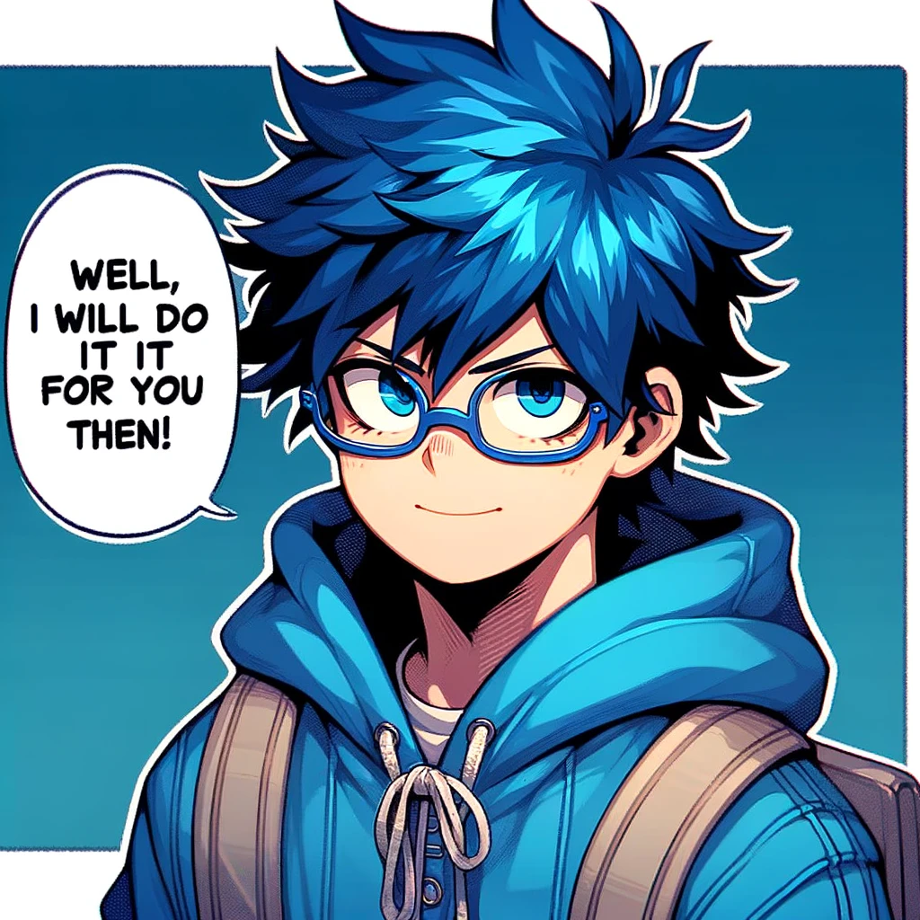

Ultimate Programming University

Slide 38
So, I stated writing a comicbook!
When something is easy, I explain it directly.
When it’s difficult, I use the comic book.
The story evolves so that the concept becomes relevant.
My characters discover the concept and don’t fully understand it. They help each other, discuss, do exercises, take tests, etc.
My characters don’t lie either; they simply say things that are reasonable and ‘in character’ according to the level of competence they have at that point in the story.
This way, I can use imperfect explanations without lying.

