Slide 1
Absurd difficulty
I try to teach extremely hard concepts starting from mundane things and building on top of them.
Example: Generics at the docs
  In the comic-book we see the lecture about generics from far away, without showing the lecture in the details.
  Our protagonists go to the docks to each fish and chips and to study Java generics.
  We now see a Pepsi Truck.

Slide 2




Ah, food!
Nothing beats food.
Let’s keep our eyes open, …
we may find some
good inspiration
to understand
generics better!

Slide 3


Slide 4
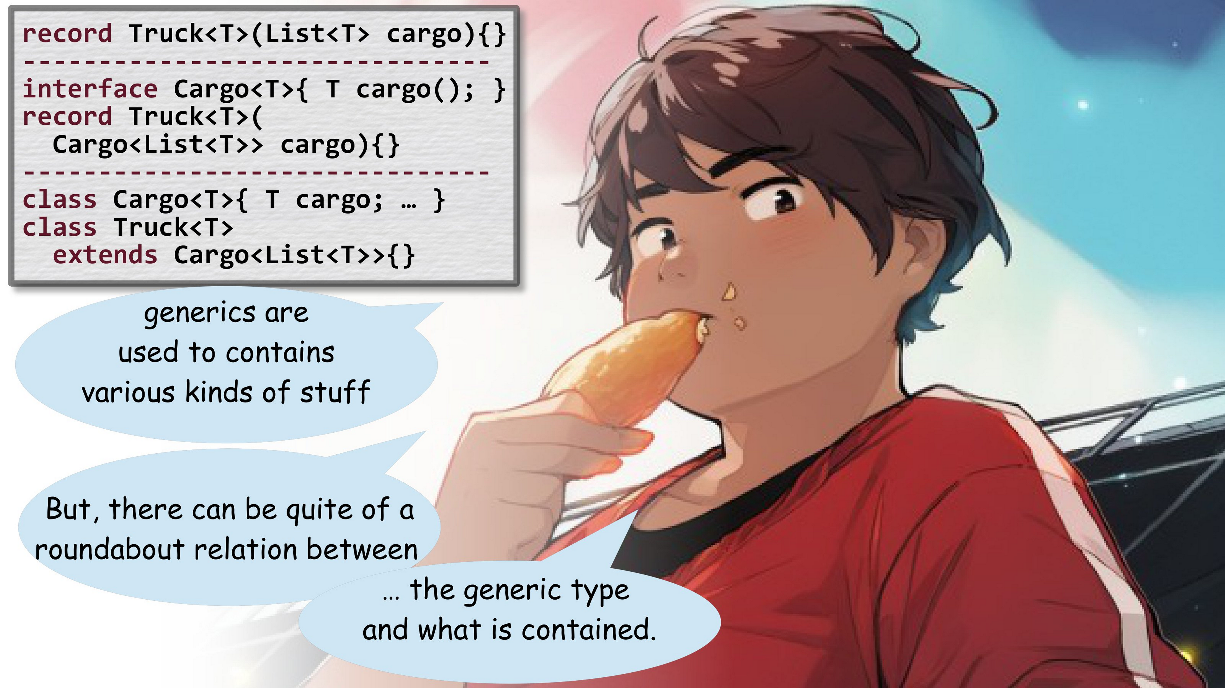
Different ways to
encode the truck

Slide 5
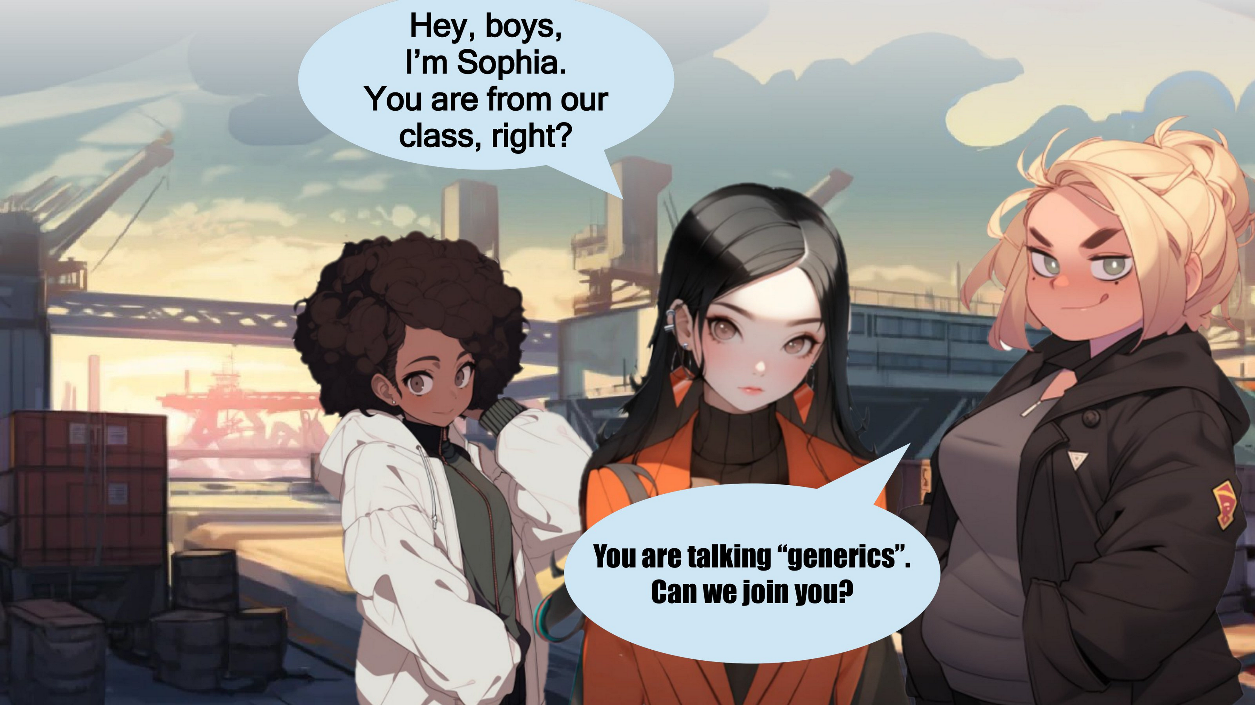
More students are
joining the discussion

Slide 6
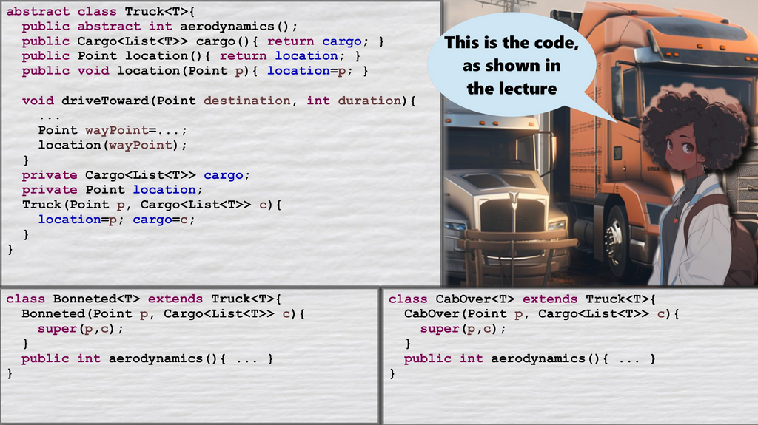

Slide 7
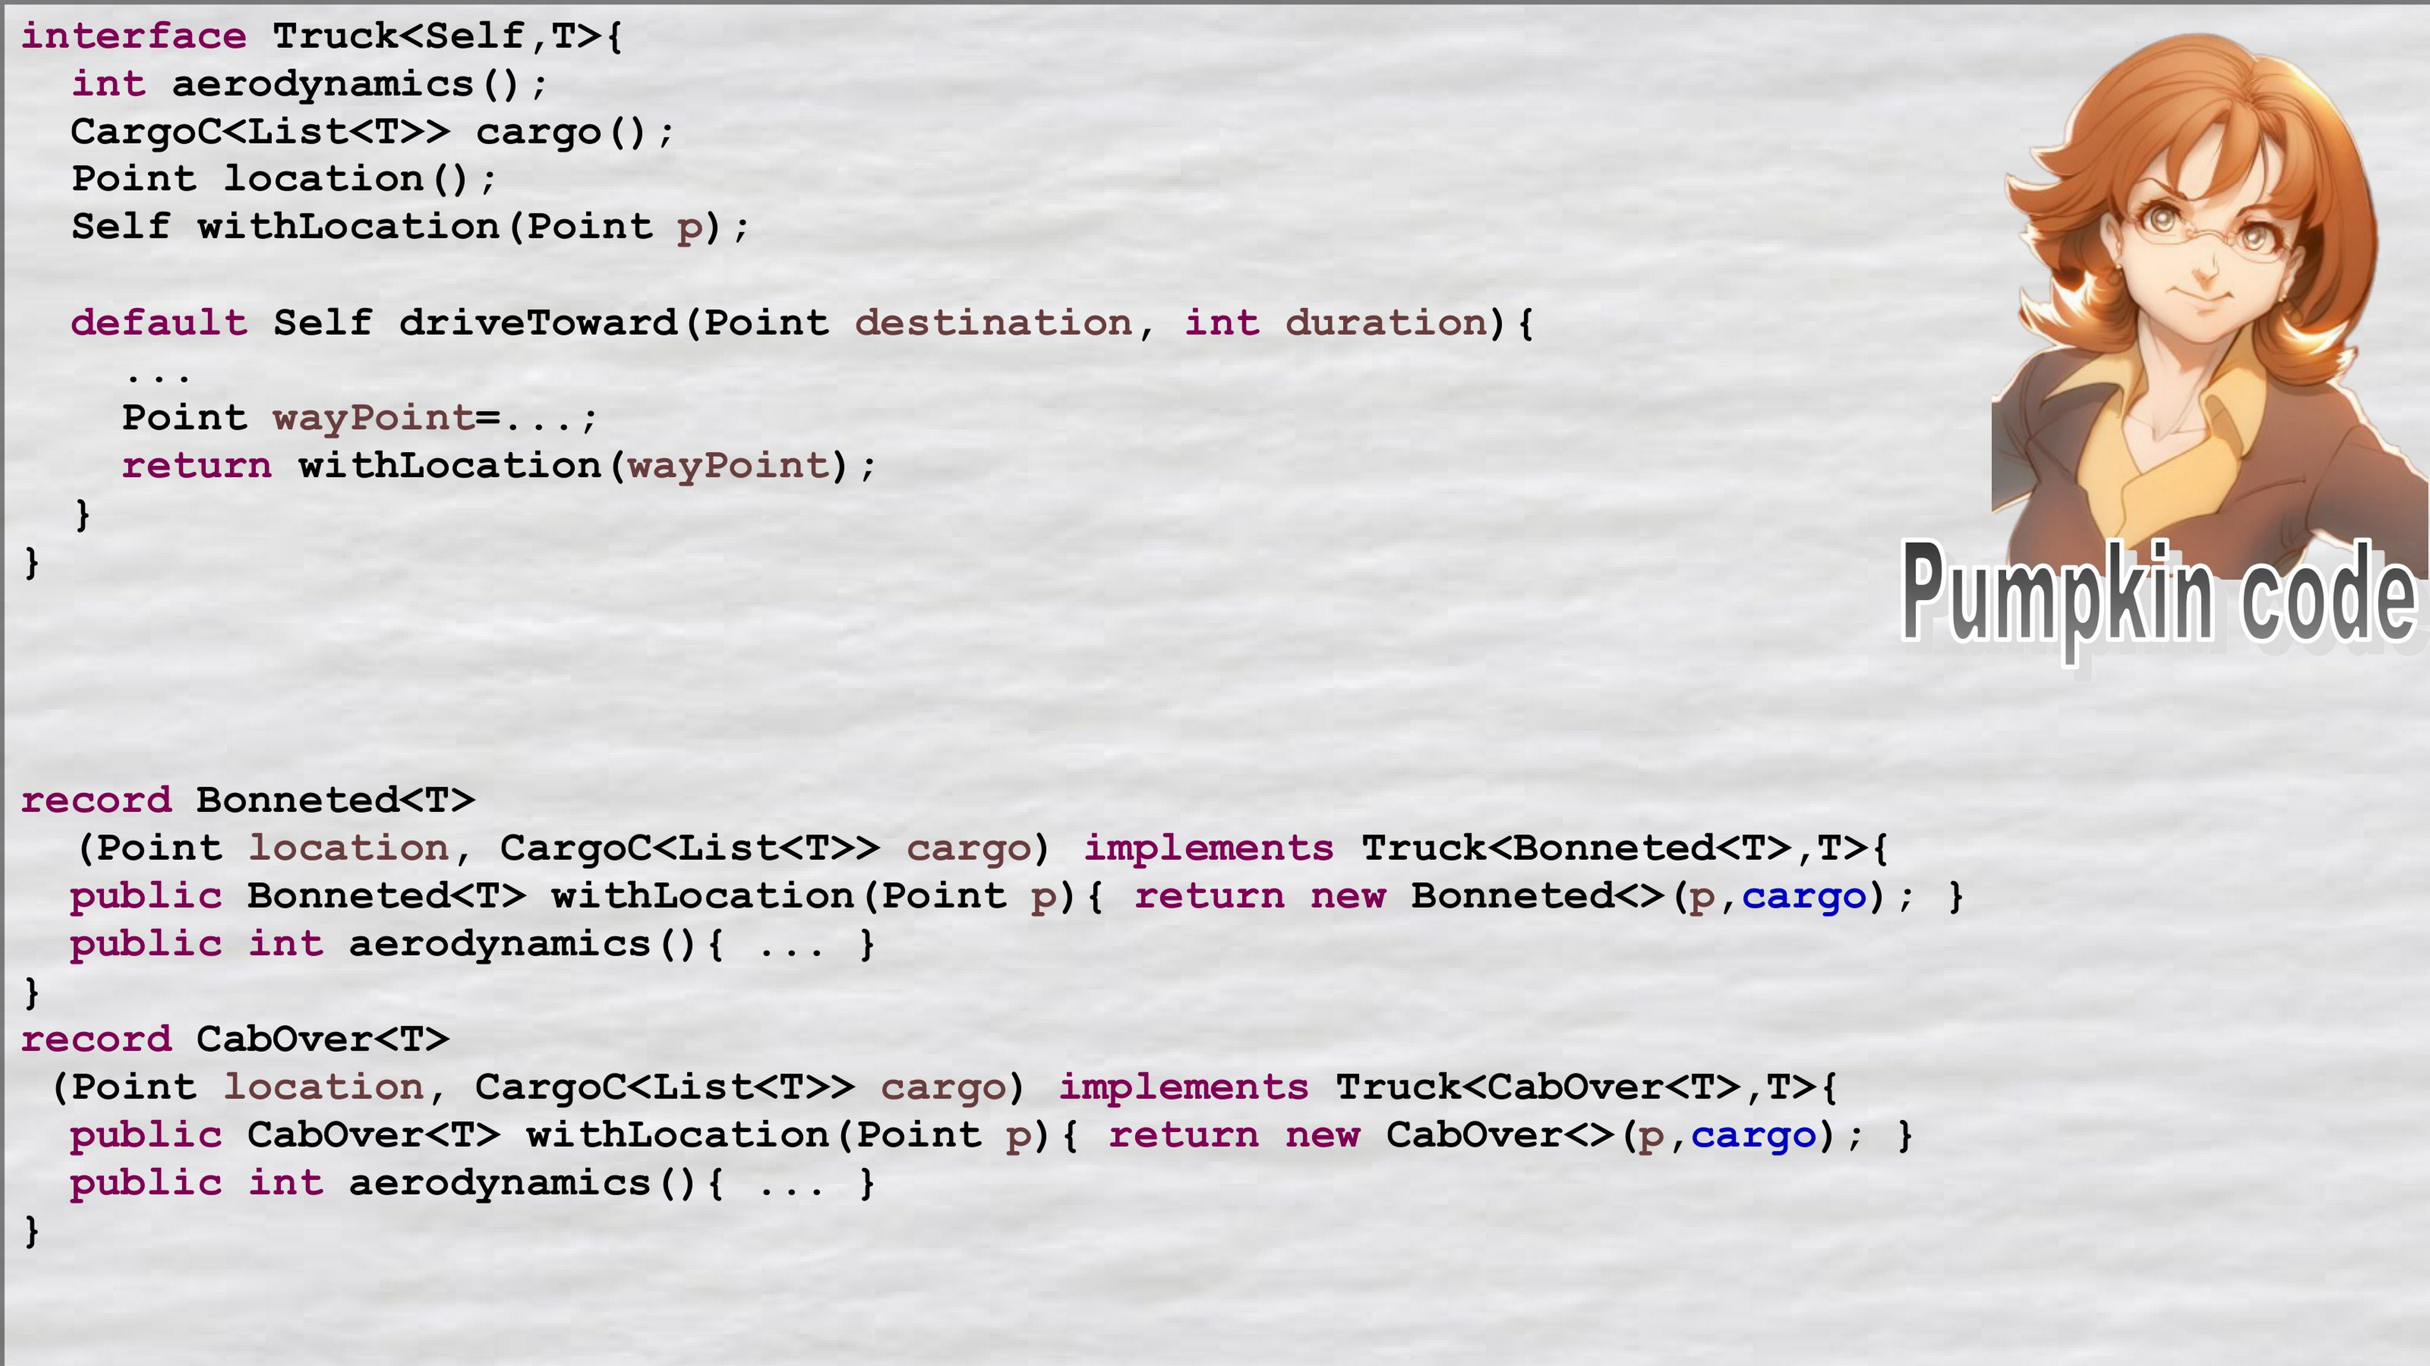
Again, we show
another way to solve it

Slide 8
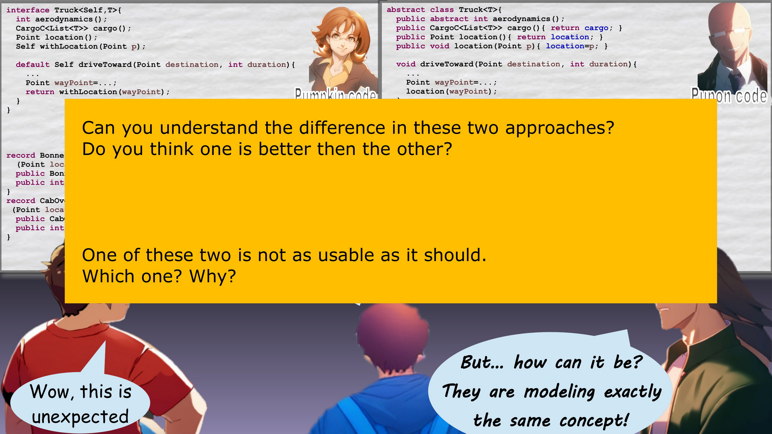

Slide 9
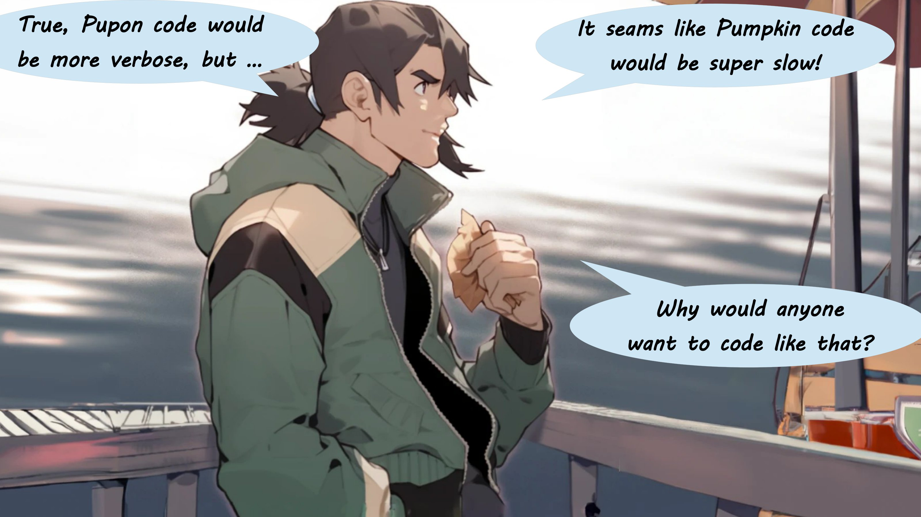
Students discuss
pro/cons of the two solutions.
They usually reach desirable
conclusions, but they can say
many reasonable but imprecise
statements during the discussion

Slide 10
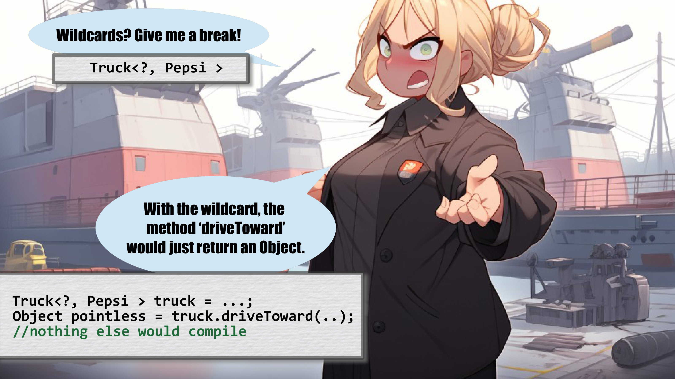
Students can get angry
and have intense discussions

Slide 11
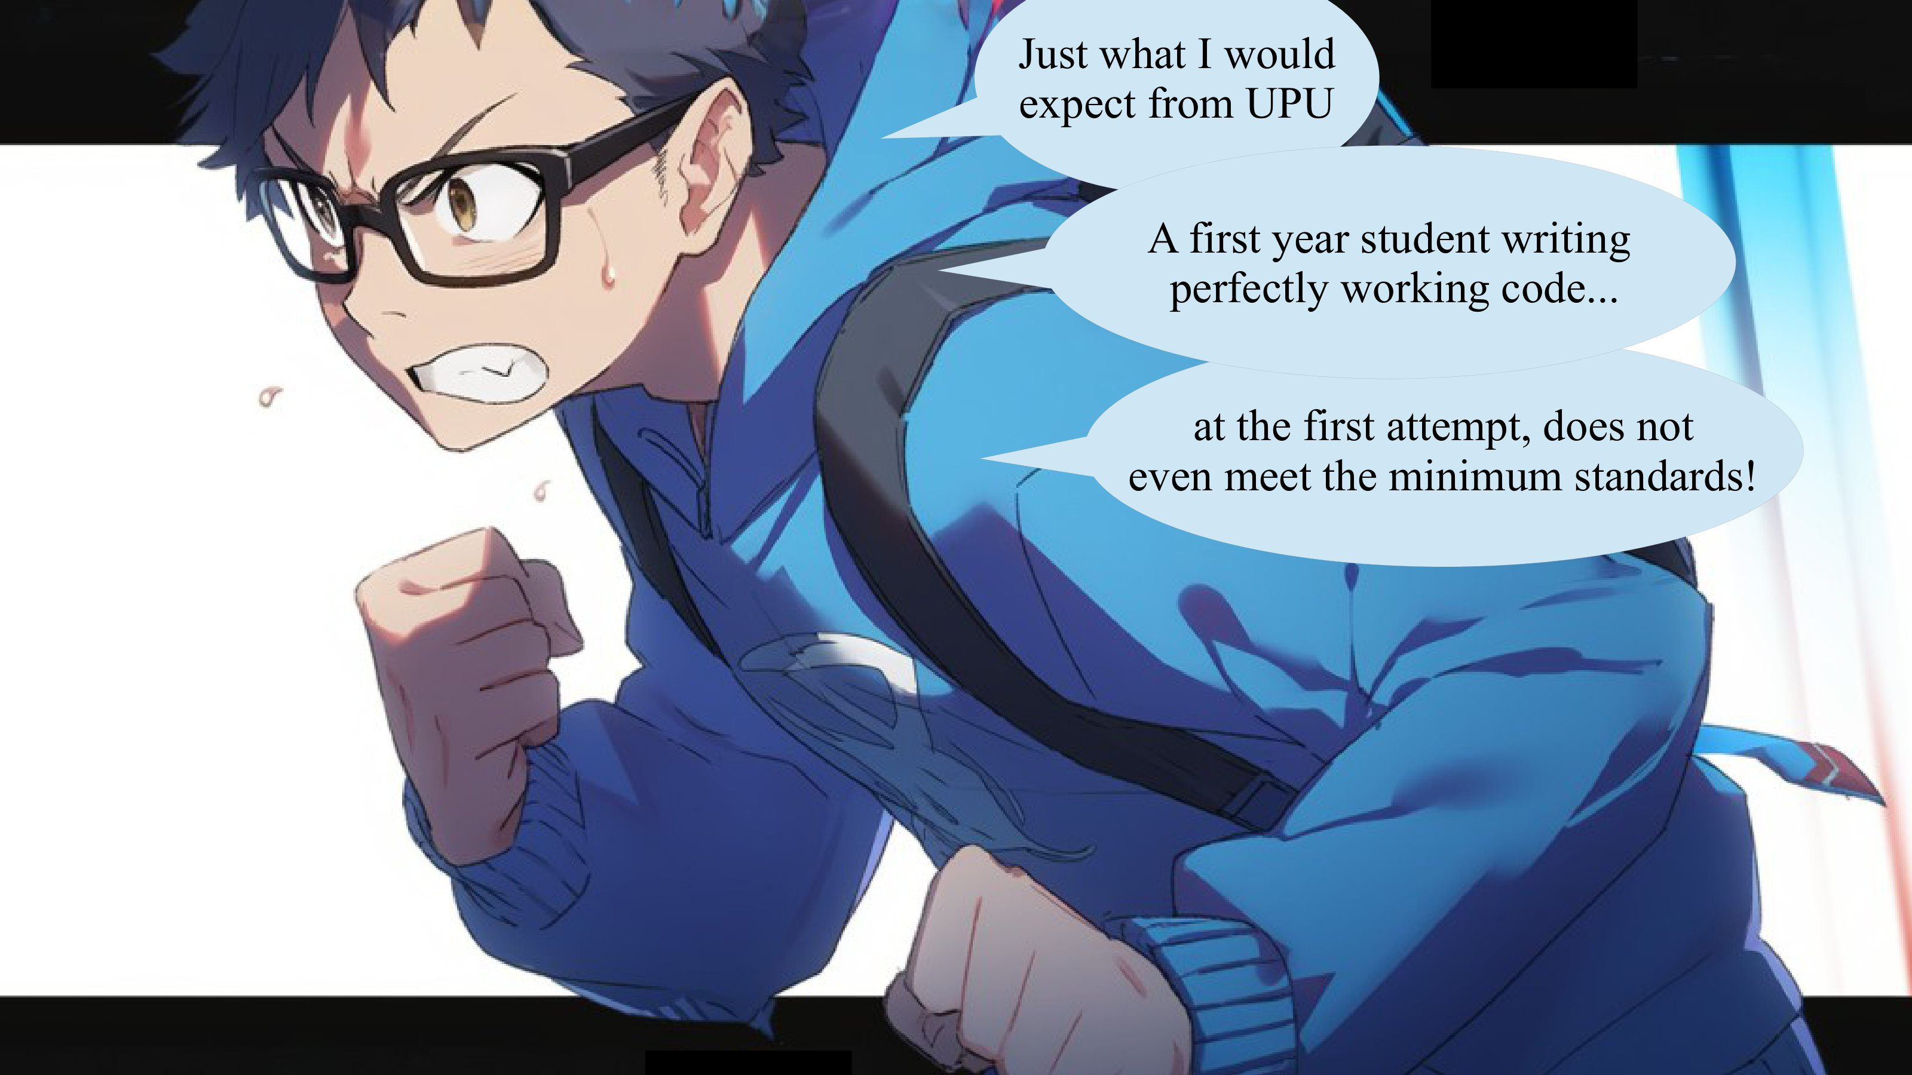
I can represent stressful
situations, showing failure.

Slide 12
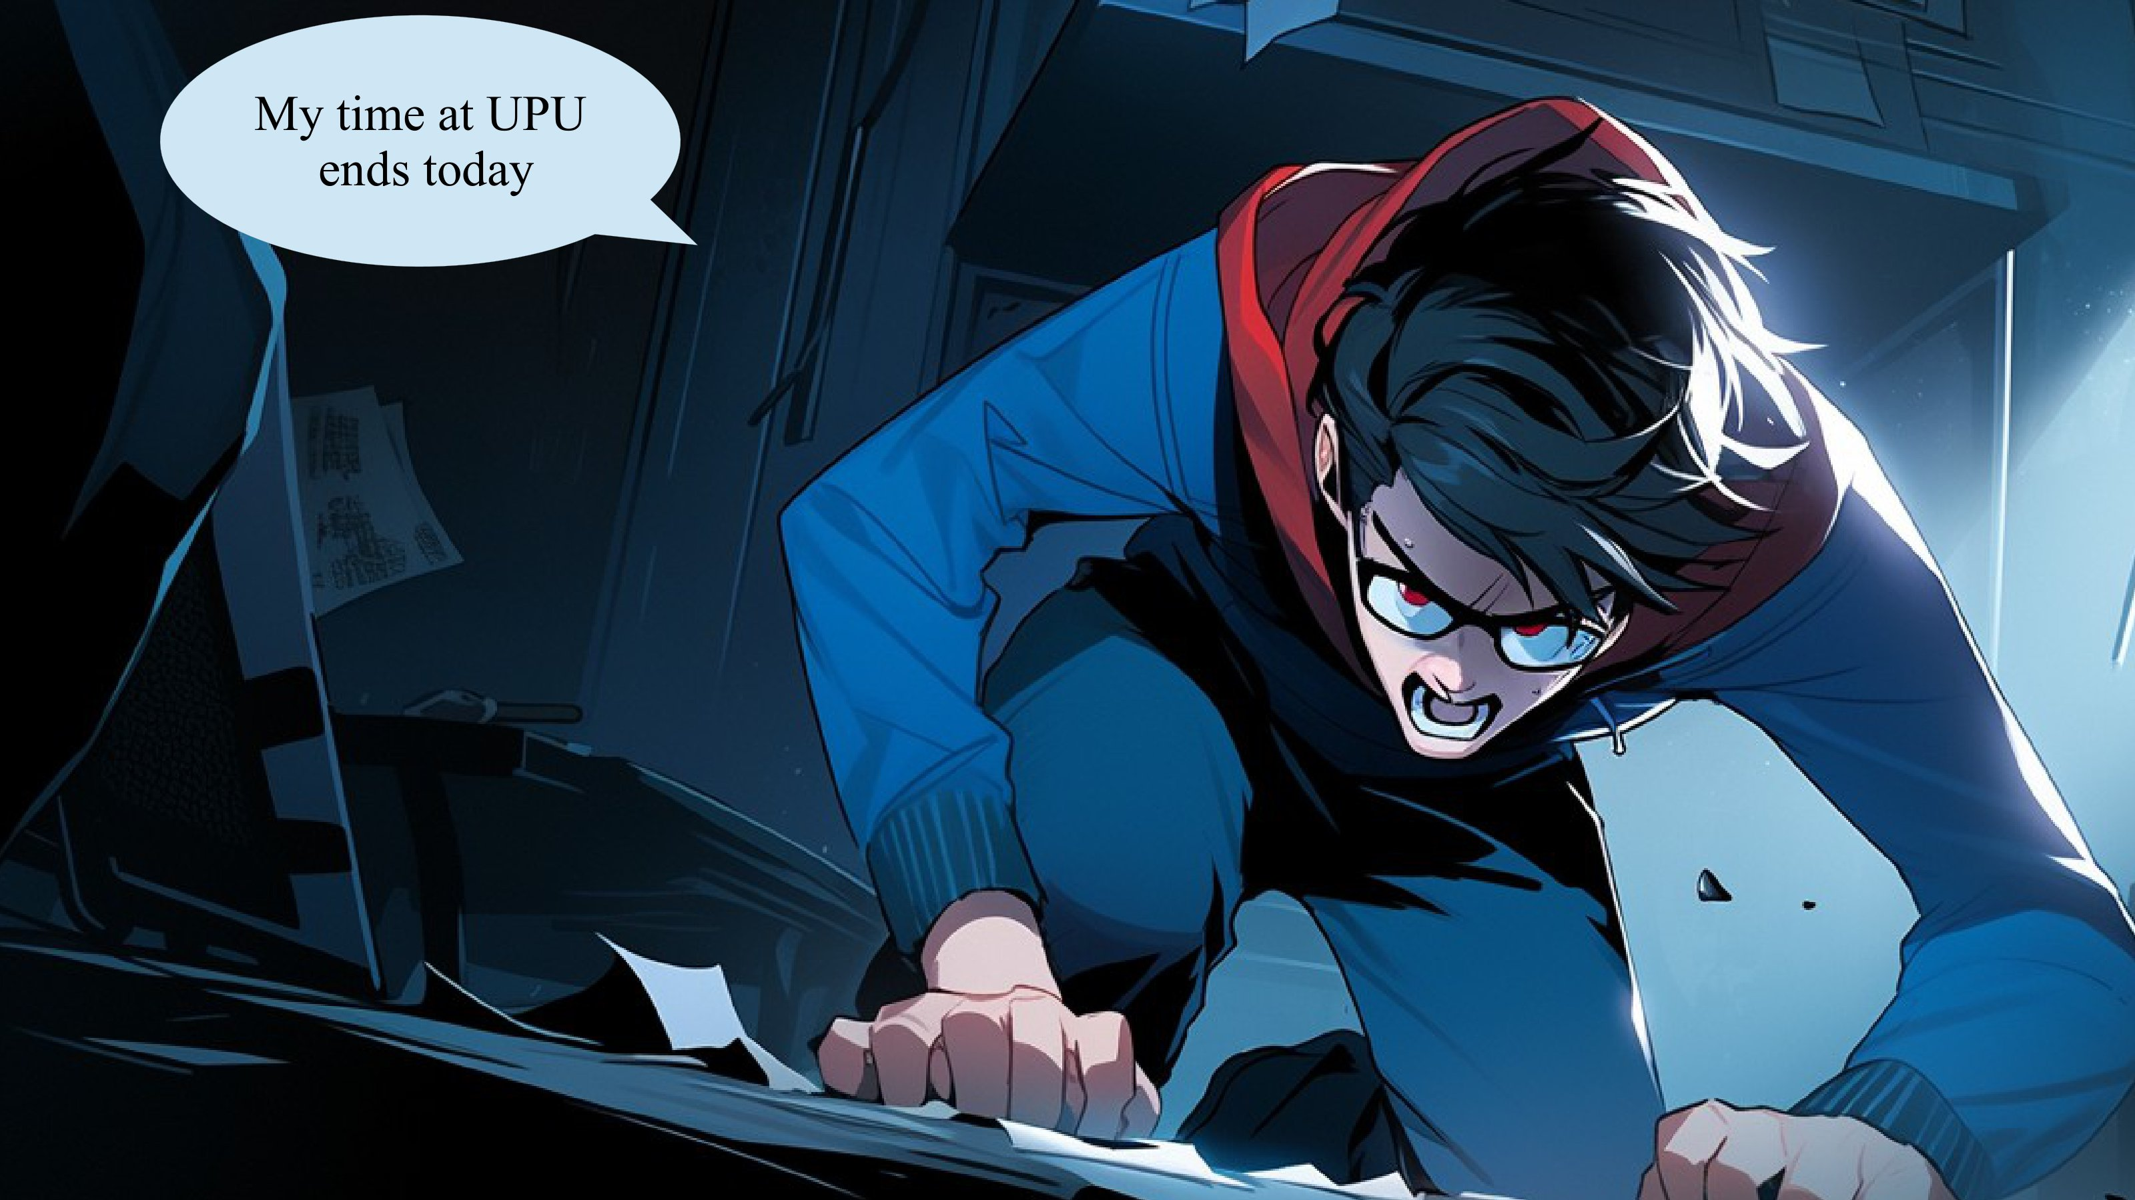
This can actually help
Students in difficulty
to feel less alone.

Slide 13
Questions and Quizzes
Both in my comicbook and in my lectures,
I insert questions and discuss answers

Slide 14


.map(s -> s.name())
record Student(String name, double height){}
String tallestStudent(List<Student> ss){
????;
}
.get()
Pause the video. Can you solve this one?
Note: not all snippets are needed.
Yes, you can not drag and drop code on a paused
youtube video, but you can imagine doing it.
Similar visualization exercises have
been shown to be very effective
at improving programming.
This message will disappear shortly; you can pause after that.
return ss.stream()
.max(Comparator.comparingDouble(s -> s.height()))
GO !
.forEach(s -> System.out.println(s.name()))
.findFirst()
.reduce((s1, s2) -> s1.height() < s2.height() ? s1 : s2)
.filter(s -> s.height() > 6)
.orElseThrow(()->new Error("Empty student list provided"))

Slide 15
.map(s -> s.name())
record Student(String name, double height){}
String tallestStudent(List<Student> ss){
????;
}
.get()
return ss.stream()
.max(Comparator.comparingDouble(s -> s.height()))
GO !
.forEach(s -> System.out.println(s.name()))
.findFirst()
.reduce((s1, s2) -> s1.height() < s2.height() ? s1 : s2)
.filter(s -> s.height() > 6)
.orElseThrow(()->new Error("Empty student list provided"))

Slide 16
.toList();
record Student(String name, int grade){}
List<String> best(List<Student> ss){
????
}
.findFirst();
Pause the video. Can you solve this one?
Note: not all snippets are needed.
The method returns the list of the student names
with grades of 80 or more.
Their grade must also be good enough that it could place
them in the best 10% of the class.
The class is composed of all the students in the list.
This message will disappear shortly; you can pause after that.
return ss.stream()
.limit(indexAt10pc)
.map(s -> s.name())
GO !
.skip(indexAt10pc)
.filter(s -> s.grade()>=80)
int indexAt10pc = (ss.size()-1)/10;
Optional<Student> threshold = ss.stream()
.filter(s -> s.grade()>=threshold.get().grade())
.sorted(Comparator.comparingInt(s -> -s.grade()))

Slide 17
.toList();
record Student(String name, int grade){}
List<String> best(List<Student> ss){
????
}
.findFirst();
return ss.stream()
.limit(indexAt10pc)
.map(s -> s.name())
GO !
.skip(indexAt10pc)
.filter(s -> s.grade()>=80)
int indexAt10pc = (ss.size()-1)/10;
Optional<Student> threshold = ss.stream()
.filter(s -> s.grade()>=threshold.get().grade())
.sorted(Comparator.comparingInt(s -> -s.grade()))

Slide 18

Still, no matter my effort,
I’m powerless alone.
If you do not show up to lecture,
you will not learn.

Slide 19


We are evolved animals.
Paying attention and learning
consumes a lot of brain juice,
thus our instinct is to avoid it.
But we are also
*tribal social animals*
In the class we can feel the whole
tribe trying to pay attention.
Our tribal instincts awaken and we
are actually able to pay attention
to difficult content, up to a level
impossible at home
watching a recording.

Slide 20

Yes, the classroom serves a
real role. It is needed to trick
our primitive brains into focus.
To convince it that
programming is good for its
own sake.

Slide 21

“I have no time to come to classes,
I will be working full time”
Some students think they can manage to
work full time AND to study full time.
It does not work.
You will fail and just lose
a lot of time and money.

Slide 22


