Slide 1
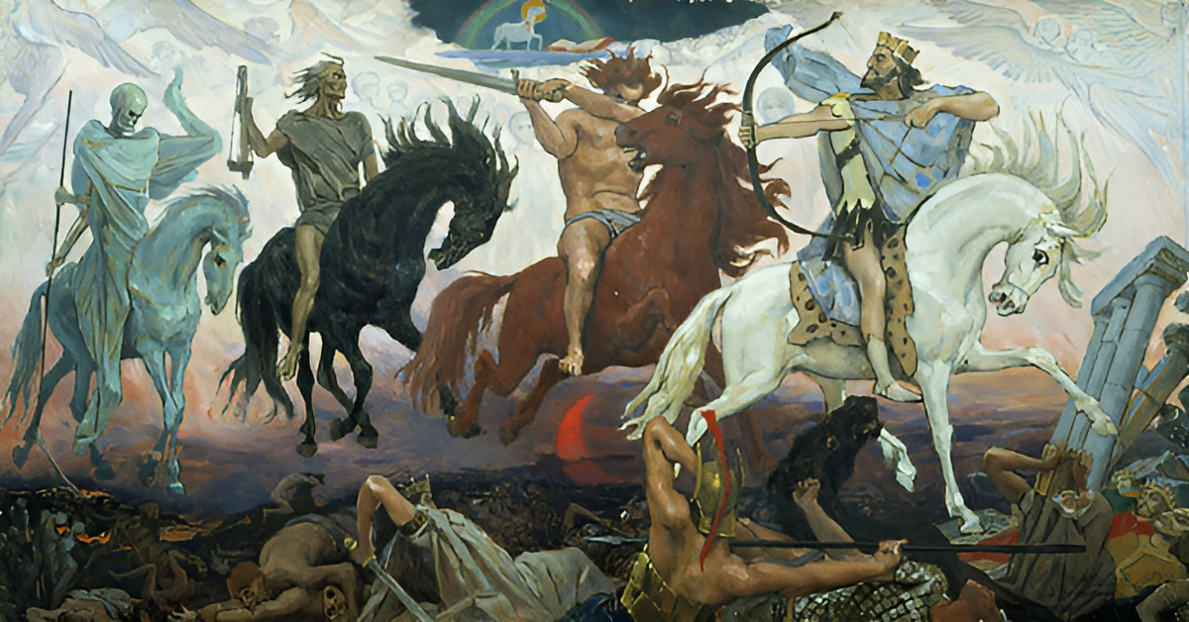
Unsound
The four horsemen of OO verification
Is OO verification completely doomed?
Marco Servetto, VUW ECS

Slide 2
First, my conjecture.
Then, supporting evidence
Coq / Agda / Lean | - First class functions - Positivity checker | CoC sound here
Java / Haskell / C# / Typescript / OCaml / Rust / ... | - First class functions - or dynamic dispatch (emulates each other anyway) | No sound proof logic exists here (conjecture). This is where MOST real programming happens
Simplified C (a sound subset of C without function pointers) | - No first class functions - No dynamic dispatch | Hoare logic extensions sound here

Slide 3
History
Hoare logic / Hoare triple
{P} C {Q} //P = precondition, C = command, Q = postcondition
Commands are expressed in a minimal ‘while’ language,
with if / while / variable-update / sequence. (Turing complete)
Those variables sit in a ‘global memory’ and they are integers or boolean.
Primitive types only: Crucially the semantic of integers and booleans is fixed and is not dependent on the commands.

Slide 4
History
Hoare logic extensions
More primitive data types, for example arrays of integers
Recursion: multiple functions and function calls.
  Partial correctness: For every function, we prove that its {P}C{Q} holds assuming all the other functions are correct
  Total correctness: prove that all recursions and iterations are terminating
Not OO yet:
  No subtyping
  No user defined types
Many attempts to support full OO.
  but it is still unobvious how to do it (see the rest of the talk)

Slide 5
The current narrative
In the current narrative, the two big issues are:
  Aliasing / mutation (often with separation logic to support reasoning)
  Violations of the LSP (Liskov substitution principle)
So most researchers in OO verification focus their time and attentions on those two points.
While those two points are important, I argue that there more fundamental open issues.
NOTE: all of the 4 points I’m making are well known (by some)
but the presentation is novel and compelling.
Many novices are unaware of these difficulties!

Slide 6
Anticipating some questions
Q: But COQ seems sound, why is it so different in OO?
  Functional type-based verification languages
  ( COQ / AGDA / ISABELLE / LEAN )
  solve these 4 challenges with positivity checking.
Q: Can’t we just do what they do but in OO?
  I will show later that positivity checking imposes restrictions
  that are unsuitable for OO programming.
  Many Haskell programmers recognize that not enforcing positivity checking contributes to the language's versatility and practical usability.

Slide 7

OO termination analysis can not be modular

Slide 8
OO termination analysis can not be modular
Objective 1: in the surface verification language
methods are annotated with Total/NonTotal
Objective 2: independent pieces of code should
be independently verifiable, and putting together verified code
produces verified code.
I will now show you that those two objectives are incompatible

Slide 9
3 companies working independently
//company0 does I
interface I{
/*Total*/int a(I i);
/*Total*/int b(I i);
}
//I verifies: there is nothing to verify
//company1 uses I and does C1
class C1 implements I{
/*Total*/public int a(I i){ return 5; }
/*Total*/public int b(I i){ return i.a(new C1()); }
}
//should C1 verify?
// method C1.a(i) clearly terminates.
// method C1.b(i) simply calls a terminating method

Slide 10
3 companies working independently
interface I{ /*Total*/int a(I i); /*Total*/int b(I i); }
class C1 implements I{
/*Total*/public int a(I i){ return 5; }
/*Total*/public int b(I i){ return i.a(new C1()); }
}
//company2 uses I and does C2
class C2 implements I{
/*Total*/public int a(I i){ return i.b(new C2()); }
/*Total*/public int b(I i){ return 5; }
}
//Should C2 verify? it is symmetric to C1… however
new C1().b(new C2()); //this goes in loop!

Slide 11
When it is safe to do a call?
How does new C1().b(new C2()); loop?
There is no while / for.
Is there recursion?
Where?
“I” has no recursion
“C1” does not look recursive,
just method b calls method a.
“C2” is the same…
However...
interface I{ int a(I i); int b(I i); }
class C1 implements I{
int a(I i){ return 5; }
int b(I i){ return i.a(new C1()); }
}
class C2 implements I{
int a(I i){ return i.b(new C2()); }
public int b(I i){ return 5; }
}

Slide 12
Solution?
I have no idea, probably we would need a richer annotation.
My example shows that just ‘Total/NotTotal’ is not sufficient.
We may need to expose ‘termination layers’
or something like that to the user.
If an OO verification language supports just ‘Total/NotTotal’
then it is NOT doing sound modular verification.
Adding apparently unrelated code could break termination of already verified code.

Slide 13

Ghost + partial correctness
= unsound

Slide 14
Ghost + partial correctness
= unsound
interface Nope{
/*ensures false*/int whoops();
}
class Omega{ // (\x. x x)
Nope omega(Omega o){ return o.omega(o); }
}
...
Omega o=new Omega();
/*ghost*/ int nope = o.omega(o).whoops();// (\x. x x)(\x. x x)
//now 'false' holds
assert 1==2;//verifies!

Slide 15
Ghost + partial correctness
= unsound
Takes a little more effort to convince Dafny,
but the concept is the same.
trait Nope { function method whoops(): () ensures false }
class Omega {
const omega: Omega -> Nope
constructor(){ omega := (o: Omega) => o.omega(o); }
}
method test() ensures false {
var o := new Omega();
ghost var _ := o.omega(o).whoops();
//false holds here!
assert 1==2;
}
.

Slide 16
Ghosts
If a verifier has ghost state and offers only partial correctness,
or it has a bug in the termination checker, then it is unsound.
Conventionally ghost statements are NOT considered part of the actual program and are not executed at run time.
If the ghost statement was to actually run as part of the actual program (as in Ada/Spark) then it would not reach the ‘false’ state, it would instead go in loop at run time.

Slide 17

Well founded contracts?

Slide 18
Well founded contracts?
The simplest OO program? The empty program!
Ok, after that?
An interface with a single abstract method!
Ok, after that?
Well, the method could take an argument!
interface C{ bool comm(C c); }
Ok, so... what is the simplest contract that I could write for this method? Return a constant!
Ok, after that? The method is commutative!
interface C{/*ensures this.comm(c)==c.comm(this)*/bool comm(C c); }
Can we try to verify a simple implementation?

Slide 19
Well founded contracts?
interface C{/*ensures this.comm(c)==c.comm(this)*/bool comm(C c); }
class CTrue implements C{
bool comm(C c){ return true; }
//proof of this.comm(c)==c.comm(this)
//how to do it? we would need to know what c.comm(this) would do.
//Standard solution: we use the contract of C.comm!
//step1: we know that c.comm(this) respects the postcondition
//step2: we rewrite the equality so that c.comm(this)
// gets rewritten into this.comm(c)
//step3: reflexivity over this.comm(c)==this.comm(c) QED
//Unconvincing: we did not even needed to look inside the body!
}

Slide 20
Well founded contracts?
interface C{/*ensures this.comm(c)==c.comm(this)*/bool comm(C c); }
class CTrue implements C{ bool comm(C c){ return true; } }
class CFalse implements C{ bool comm(C c){ return false; } }
…
new CTrue().comm(new CFalse()) != new CFalse().comm(new CTrue());
Broken again!
But here, the code does not go in loop!
Is the contract going in ‘loop’?
It depends of what you mean by ‘loop’
In static verification the contracts can even be specified in a logical metalanguage that could not be executed, even in principle.
So, what does it even mean for a contract to go in ‘loop’?

Slide 21
Well founded contracts
These kinds of contracts are often called ‘ill founded’
However, it is not fully clear what it takes
for a contract to be well/ill founded.
I suspect that modular well foundedness checking is impossible.
Similar to the impossible modular termination checking.
We may have to further annotate our contracts in some way.
Or, it may be a fundamentally impossible problem.

Slide 22
Well founded contracts
It may be a fundamentally impossible problem.
Consider the following variant:
interface CA{
/*ensures this.comm(cb)==cb.m(this)*/bool comm(CB cb); }
interface CB{
/*ensures ..something..*/ bool m(CA ca); }
Does CA.comm have a well founded contract?
Does it just depends on what ‘..something..’ is?
What if a class implementing CB was to use CA inside?
What uses would be ok? What uses would not? Why?

Slide 23

Inevitable reduction to primitive operations

Slide 24

Inevitable reduction to primitive operations
Is most OO verification just an ‘extra layer’ over verification on primitive types? If not, what can we verify in a basic OO system that does not have int/bool? For example, Featherweight Java.
How would a contract even look if we did not have == or any int/bool operation?
What can we ‘observe’?
In pure OO, objects have methods, methods return other objects… that have other methods.
How do we express that the method did the right thing?

Slide 25
Inevitable reduction to primitive operations
Idea: allows for == just in the specification. For example
class B{}
class A{
B b; A(B b){this.b=b;}
/*ensures this.getB()==new B()*/ //structural equality
B getB(){return b;}
}
Bad Idea! OO design encourages returning objects that behave like a certain object but they are a wrapper doing some twists.
This fundamental pattern could not be verified in this system.

Slide 26
Inevitable reduction to primitive operations
Objective: we should have a modular and sound verification system for some functional variation of FJ before we can hope to get a sound verification system that works with aliasing and mutation.
In such a language we should be able to express and verify
  Pure OO encoding of Booleans and Peano numbers
  Generic Linked lists and stream-like operations on those lists
  Most of the OO patterns that can be expressed in a functional setting: Decorator, visitor, proxy, chain of responsibility, etc.
Until we have that, I think that it is unwise to focus
on the imperative aspects.

Slide 27

Potential solutions

Slide 28
Positive type dependencies are everywhere in OO programming
The root of all the problems is that in OO we can encode fixpoints.
But.. all the good about OO is about open fixpoints!
(co-)recursive functions on open data structures
But with those we can go in loop in hard to predict ways, where there is no while/for and no explicit recursion.
But with those we can make contracts that become ill founded in hard to predict ways.

Slide 29
Positive type dependencies are everywhere in OO programming
OO patterns are all about inserting interfaces
  to split the graph of static types in layers that can be compiled in separate libraries,
  while allowing the graph of actual type dependencies to be circular.

Slide 30
Positive type dependencies are everywhere in OO programming
But the problem is more fundamental.
Any method that takes a non primitive/non final type can sneak non termination or ill founded contracts in. Consider the following:
  is this well founded?
  is it feasible to check termination since IntList is not final?
class IntList{
/*ensures this.size()+other.size()==this.concat(other).size()*/
IntList concat(IntList other){ /*..*/ }
int size(){ /*..*/ }
}

Slide 31
Positive type dependencies
Can we simply be safe and prevent Positive type occurrences as Coq does?
Coq, Agda and Lean all restrict the shape of inductively defined data types to avoid positive occurrences of the inductively defined type.
Valid Example:
1 Inductive nat : Type :=
2 | O : nat
3 | S : nat → nat. //Given a nat, S produces a nat.
Invalid example:
1 Inductive nat : Type :=
2 | O : nat
3 | Err : (nat → nat) → nat.
//Given a function from nat to nat, Err produces a nat.

Slide 32
Positive type dependencies
Invalid example:
1 Inductive nat : Type :=
2 | O : nat
3 | Err : (nat → nat) → nat.
If this was allowed in Coq, we could use it to
encode fixpoints and break the termination checker
Consider the list before interface List{ .. List concat(List other); ..}
The Coq encoding of this list datatype would be blocked by the positivity checker for the same reason:
1 Inductive list : Type :=
2 | List : (list → list) → list.
//Given an implementation for `method concat’, produces a list.

Slide 33
Positive type dependencies
What about
class List{ List concat(NotAList other){ /*..*/ } }
What if ‘NotAList’ has a List field?
What if ‘Evil extends NotAList’ has a List field?
What if ‘Evil’ simply makes a ‘new MyList()’
inside a method call?
Would this be usable to encode fixpoints/omega?

Slide 34
So, no positivity checker for OO
Other solutions?
…

Slide 35
So, no positivity checker for OO
Other solutions?
…
…

Slide 36
So, no positivity checker for OO
Other solutions?
…
…
...

Slide 37
So, no positivity checker for OO
Other solutions?
What if we get rid of the general pre/post condition mindset?

Slide 38
Any Question?

