Slide 1

Group discussion agenda
our UNSOUND future
  would someone in the
  audience want to be the
  organizer next year?
  every year? every 2 years?

Slide 2

Group discussion agenda
What is soundest
UNSOUND venue?
Reach:
  how should we reach out to the
  OO verification community
  how should we reach out to the
    verified compilers community?
    verified tool chains community?
    deep verification community?
    ...community?

Slide 3

General implications for safety in computing
How do we convince anyone here in person to board their airplane home?
No problem: even safety of nuclear power plants is modeled in eclipse-generated C++ monte-carlo simulations running without any formal proof,
so you unsoundness might be your least concern when no-one is even trying to be formal in practice.

Slide 4
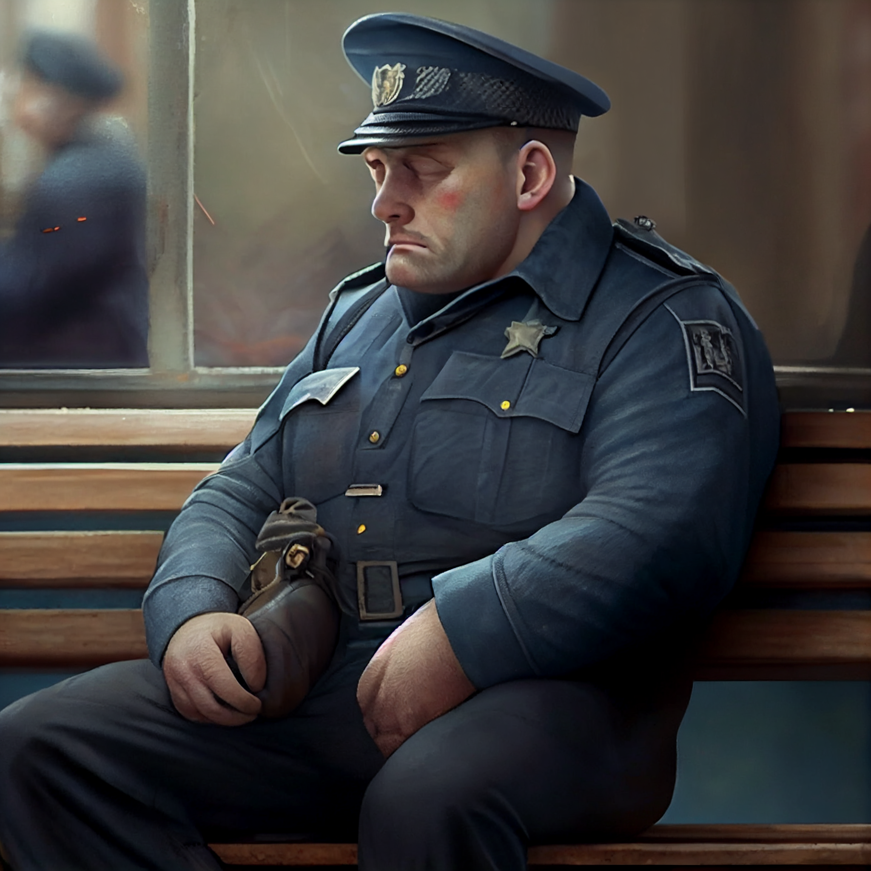
Perverse incentives in a world with unsound software verification
Perverse incentives in a world
with unsound software verification:
  what if having “verified” code
  makes us relax the “testing/auditing”
  process of coding?
  Implications for hackers submitting
  “verified” code.
  Comparison with model checking

